Slide 1

SMART INDIA HACKATHON 2026
TITLE PAGE
Problem Statement ID – SIH26264
Problem Statement Title – Integrated Monitoring of Institution-Related Complaint Cases Across AICTE Bureaus/Cells
Theme – Smart Automation
PS Category – Software
Team ID –
Team Name (Registered on portal) – Bugs
PROJECT: EKATRA (एकत्र, “gathered in one place”)
Every AICTE unit’s work on a college, in one place, checked before anyone acts.
Prototype · all data synthetic · not an official AICTE system
Notes:
Ekatra: one place where every AICTE unit sees the others' work on a college, before acting.

Slide 2
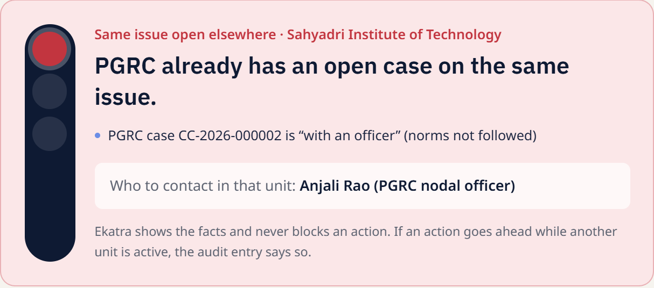
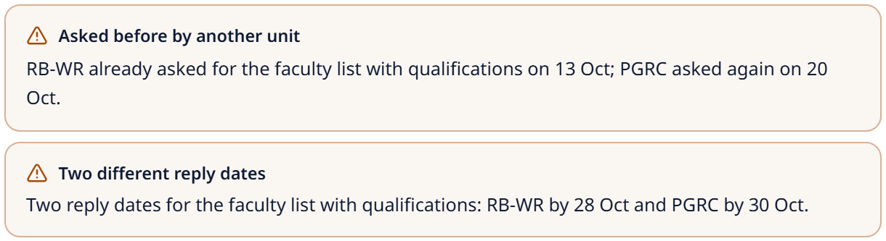
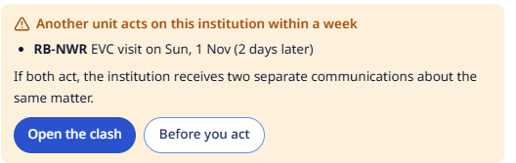
IDEA TITLE: EKATRA
Bugs
Units write to the same college without seeing each other. Ekatra shows them first.
THE PROBLEM
PGRC, the Regulation Bureau and Regional Offices act on one college from separate files, so letters clash and deadlines slip.
OUR SOLUTION
Ekatra joins every unit’s cases and letters by the college’s AICTE Permanent ID and warns before a clash.
WHAT IS NEW
Drop a letter, the form fills itself.
Already asked? Ekatra says who asked, and when.
Red light before a clashing notice or closure.
Who else is on it: every officer sees it.
Live screens from Ekatra. Synthetic data.
Notes:
Problem: separate files. Solution: join by Permanent ID and warn. Show the red light and the 'asked before' warning.

Slide 3
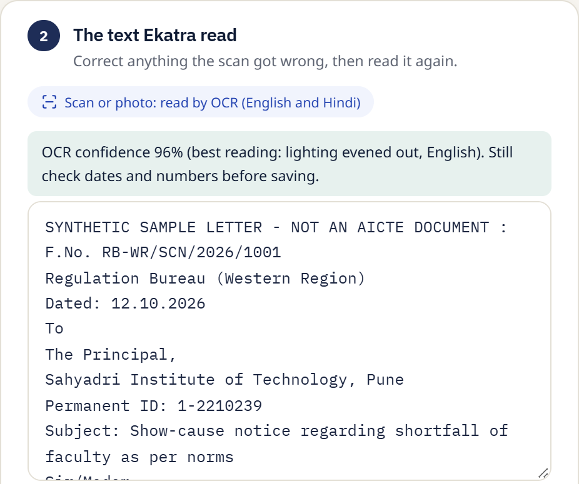
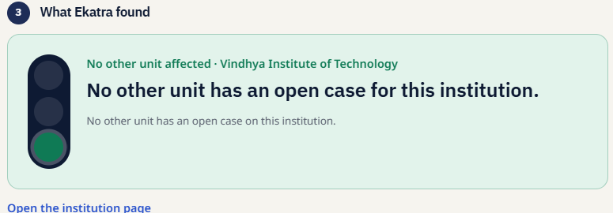
TECHNICAL APPROACH
Bugs
Letter → Read → Match → Check → Decide → Watch → Record
Read: PDF text exactly; scans by OCR in English and Hindi, never uploaded.
Match: an AICTE ID links the college; a name alone is only a suggestion.
Check: fixed rules catch two units on one college, a document asked twice, a reply due near a hearing.
Decide: the officer chooses; Ekatra never closes, merges or transfers a case.
Watch: every deadline checked hourly; late work goes up to the nodal officer.
Record: each action in a hash-chained log the database will not let anyone edit.
A scanned letter read in the browser: 96% confidence on our sample.
Built with React · FastAPI · PostgreSQL (Neon) · Tesseract OCR · Vercel — all on free tiers.
Notes:
Walk the six steps. The letter never leaves the computer; names never auto-link; the log cannot be edited.

Slide 4
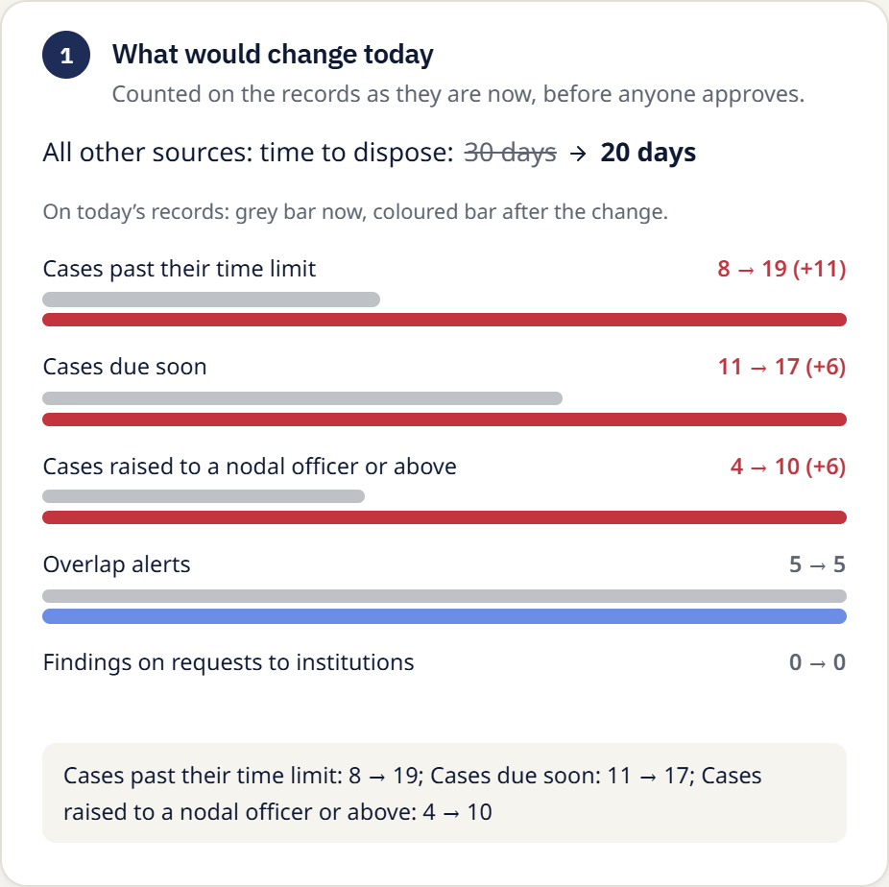
FEASIBILITY AND VIABILITY
Bugs
It runs today, costs nothing, and asks units to change nothing.
WHY IT IS FEASIBLE
Working: real database, sign-in, seven roles, 300 automated tests passing.
Free: Vercel, Neon and GitHub free tiers; no paid service.
Fast: a page loads in about 0.6 s even with 10,000 cases.
Beside, not instead: units keep CPGRAMS and e-Office; Ekatra reads their files.
RISKS AND OUR ANSWER
Wrong college linked → a name only suggests; a person confirms.
A bad rule change → it shows its effect first and needs a second approver.
Private details leak → complainant names stay with the owning unit.
A poor scan → every fact shows its source words; the officer corrects it.
A rule change, before approval: its effect on today’s cases.
Notes:
It already runs on free tiers with tests; each risk has a built-in answer.

Slide 5
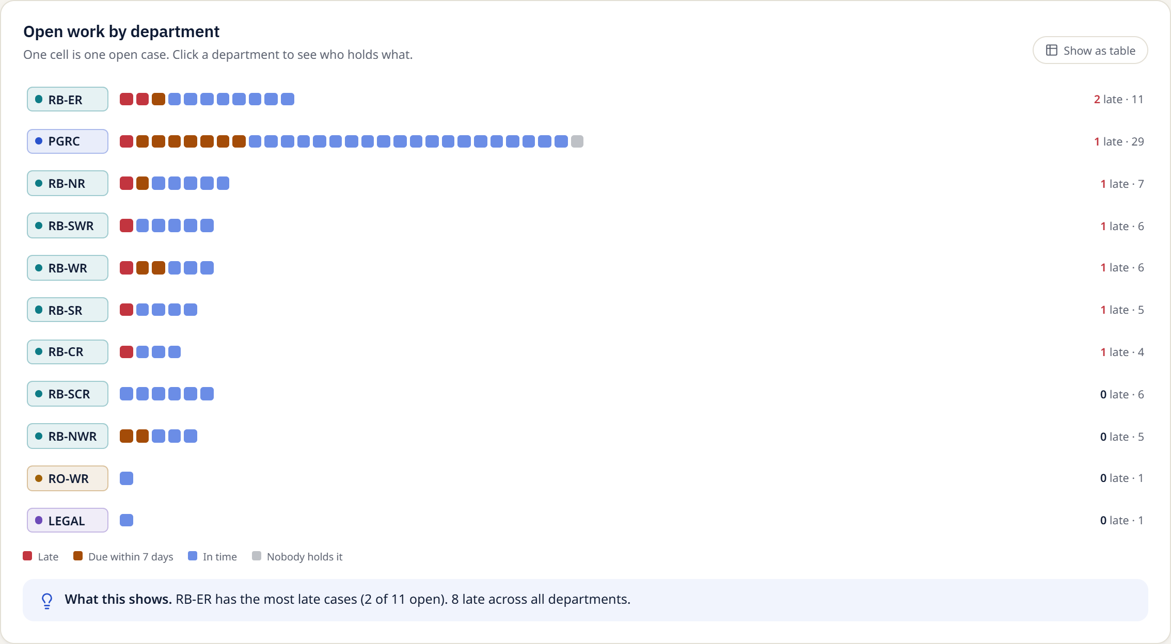
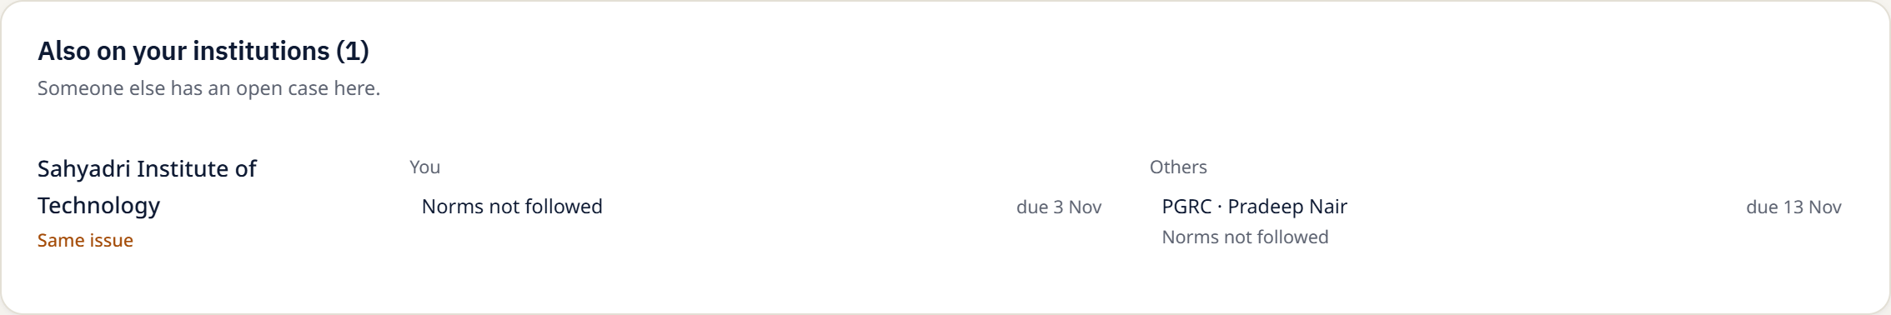
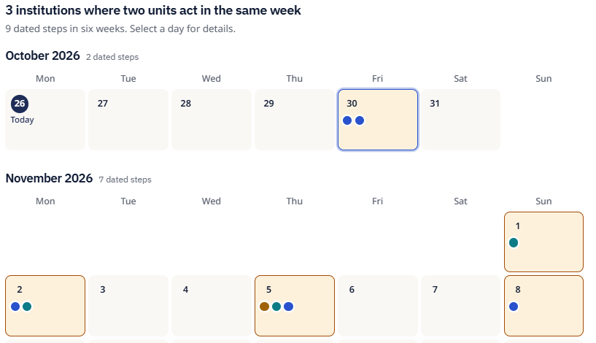
IMPACT AND BENEFITS
Bugs
Everyone sees the same picture, so the college gets one clear message.
WHO GAINS
Dealing officer: sees who else is on the college before writing.
Nodal officer: hands out work by load and spots late replies.
Coordinator: one list of clashes to settle.
Senior management: true counts; rule changes need their approval.
The college: one request, one date, not five letters.
All figures in Ekatra come from records; transfers are counted apart from closures.
Live: open work by department, and who else is on your college. Synthetic data.
Notes:
Each role gains one thing; the college stops receiving clashing letters.

Slide 6
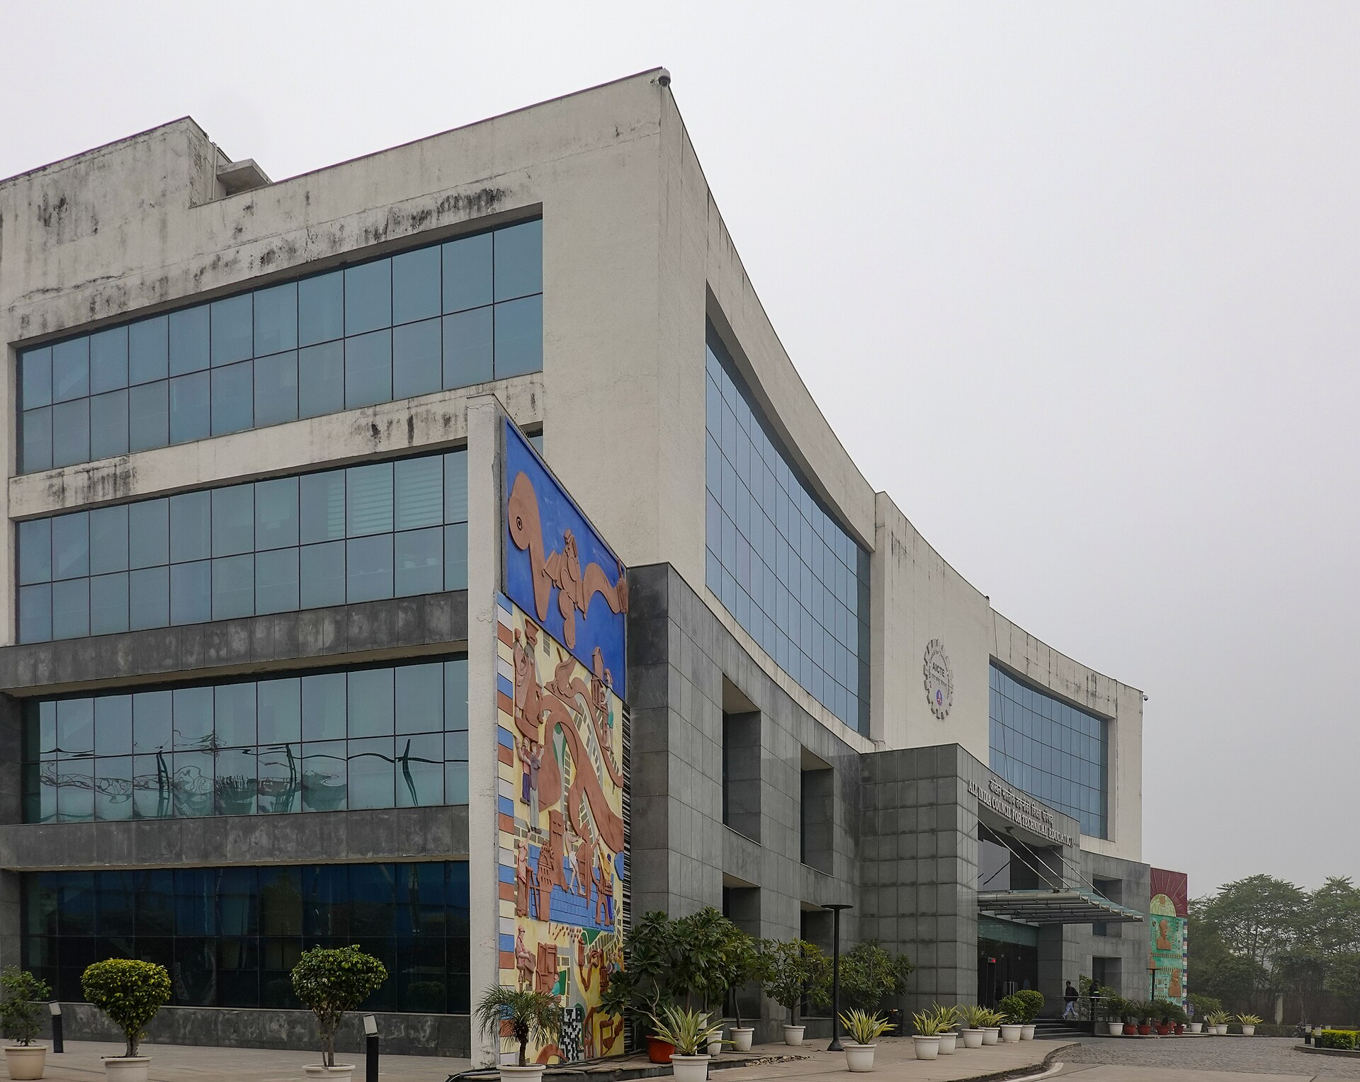
RESEARCH AND REFERENCES
Bugs
SOURCES
[1] DARPG (2024). Guidelines for handling public grievances: 21-day limit, interim reply, appeal.
[2] AICTE. Approval Process Handbook 2024–27: complaint and penal-action route.
[3] AICTE. PGRC roles; SHC/SAC hearing schedules listing institutions by Permanent ID.
[4] Parliamentary Standing Committee. Strengthening grievance redressal (via PRS India): closures without valid reasons.
[5] Fellegi & Sunter (1969). A theory for record linkage. JASA 64(328).
[6] Smith, R. (2007). An overview of the Tesseract OCR engine. ICDAR.
[7] Sauvola & Pietikäinen (2000). Adaptive document image binarization. Pattern Recognition 33(2).
[8] Govt. of India. Digital Personal Data Protection Act 2023 and Rules 2025.
AICTE head office, New Delhi. Photo: Timothy A. Gonsalves, CC BY-SA 4.0, Wikimedia Commons.
WHAT IS REAL
All cases are synthetic; no public case data exists.
Only the CPGRAMS 21 days is verified; other limits are prototype settings.
Ekatra advises; people decide.
Prototype ekatra-nzsvx7asi-hakimk438.vercel.app
Code github.com/HakimK438/Ekatra
Notes:
Sources are public; data is synthetic; only the 21-day CPGRAMS limit is verified.

