Slide 1
How does the
web works?

Slide 2
How the web works provides a simplified view of what happens when you view a webpage in a web browser on your computer or phone.
Computers connected to the web are called clients and servers. A simplified diagram of how they interact might look like this:
REQUEST
CLIENT
SERVER
RESPONSE
Clients are the typical web user's internet-connected devices (for example, your computer connected to your Wi-Fi, or your phone connected to your mobile network) and web-accessing software available on those devices (usually a web browser like Firefox or Chrome).

Slide 3
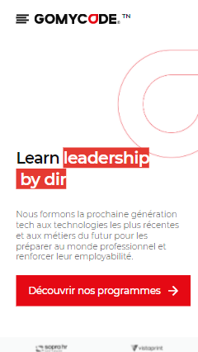
Servers are computers that store webpages, sites, or apps. When a client device wants to access a webpage, a copy of the webpage is downloaded from the server onto the client machine to be displayed in the user's web browser.
In addition to the client and the server, we also need to say hello to:
Your internet connection: Allows you to send and receive data on the web.
TCP/IP: Transmission Control Protocol and Internet Protocol are communication protocols that define how data should travel across the internet.
DNS: Domain Name Servers are like an address book for websites. When you type a web address in your browser, the browser looks at the DNS to find the website's real address before it can retrieve the website.
HTTP: Hypertext Transfer Protocol is an application protocol that defines a language for clients and servers to speak to each other.
CLIENT
BROWSER
Expect to see
Enters a url
https://gomycode.com/
REQUEST
Translate domain to IP
DNS SERVER
RESPONSE
SERVER

Slide 4
What do you need to be a web developer?
Good communication skills
Love of learning
Patience
Web developers must work with multiple members of an organization to ensure everyone’s goals are being met through the website. It’s important to maintain open lines of communication and be able to translate technical jargon into layman’s terms for other team members.
To make it as a web developer, you’ll need to have a natural curiosity. If you’re the type to scour YouTube and web developer blogs for tutorials and inspiration, and just can’t wait to jump in and start learning new techniques, you’re on the right track.
A website is never fully complete. Often, client work will go back and forth and the smallest details will require tedious nurturing

Slide 5
What’s the role of a web developer?
01
02
03
Web developers typically construct the layout of a website, creating a visually interesting home page and user-friendly design, and may sometimes write content for the website. After a website is up and running, developers make sure that the site is functional on all web browsers, testing and updating as needed.
Types of Web Developers:
A front-end developer is a web developer that codes the front end of a website. While web design is the way a website looks, front end development is how that design actually gets implemented on the web.
Front-End Developer
A back-end developer is someone who builds and maintains the technology needed to power the components which enable the user-facing side of a website to exist. Their back end code adds utility to everything the front-end designer creates.
Back-End Developer
Full stack developers understand how every part of the web development process takes place. They are knowledgeable with the server side as well as the client side’s user experience.
Full Stack Developer

