Slide 1
SqueezeSegV2: Improved Model Structure and Unsupervised Domain Adaptation for Road-Object Segmentation from a LiDAR Point Cloud
Shi Qianjing
shiqj@shanghaitech.edu.cn
[1] F. Moosmann, O. Pink, and C. Stiller, “Segmentation of 3d lidar data in non-flflat urban environments using a local convexity criterion,” in IV, 2009, pp. 215–220.
[2] B. Wu, A. Wan, X. Yue, and K. Keutzer, “Squeezeseg: Convolutional neural nets with recurrent crf for real-time road-object segmentation from 3d lidar point cloud,” in ICRA, 2018.
[3] A. Torralba and A. A. Efros, “Unbiased look at dataset bias,” in CVPR, 2011, pp. 1521–1528.
[4] T.-Y. Lin, P. Goyal, R. Girshick, K. He, and P. Dollar, “Focal loss for ´ dense object detection,” IEEE TPAMI, 2018.
[5] S. Ioffe and C. Szegedy, “Batch normalization: Accelerating deep network training by reducing internal covariate shift,” in ICML, 2015, pp. 448–456.
[6] P. Morerio, J. Cavazza, and V. Murino, “Minimal-entropy correlation alignment for unsupervised deep domain adaptation,” in ICLR, 2018.
[7] B. Douillard, J. Underwood, N. Kuntz, V. Vlaskine, A. Quadros, P. Morton, and A. Frenkel, “On the segmentation of 3d lidar point clouds,” in ICRA, 2011, pp. 2798–2805.
[8] D. Zermas, I. Izzat, and N. Papanikolopoulos, “Fast segmentation of 3d point clouds: A paradigm on lidar data for autonomous vehicle applications,” in ICRA, 2017, pp. 5067–5073.
[9] F. Piewak, P. Pinggera, M. Schafer, D. Peter, B. Schwarz, N. Schneider, ¨ D. Pfeiffer, M. Enzweiler, and M. Zollner, “Boosting lidar-based ¨ semantic labeling by cross-modal training data generation,” arXiv preprint arXiv:1804.09915, 2018.
[10] C. R. Qi, H. Su, K. Mo, and L. J. Guibas, “Pointnet: Deep learning on point sets for 3d classifification and segmentation,” in CVPR, 2017, pp. 77–85.
[11] C. R. Qi, L. Yi, H. Su, and L. J. Guibas, “Pointnet++: Deep hierarchical feature learning on point sets in a metric space,” in NIPS, 2017, pp. 5099–5108.
[12] C. R. Qi, W. Liu, C. Wu, H. Su, and L. J. Guibas, “Frustum pointnets for 3d object detection from rgb-d data,” arXiv preprint arXiv:1711.08488, 2017.
[13] V. M. Patel, R. Gopalan, R. Li, and R. Chellappa, “Visual domain adaptation: A survey of recent advances,” IEEE SPM, vol. 32, no. 3, pp. 53–69, 2015.
[14] G. Csurka, “Domain adaptation for visual applications: A comprehen_x0002_sive survey,” arXiv:1702.05374, 2017.
[15] M. Long, Y. Cao, J. Wang, and M. Jordan, “Learning transferable features with deep adaptation networks,” in ICML, 2015, pp. 97–105.
[16] B. Sun, J. Feng, and K. Saenko, “Correlation alignment for unsuper_x0002_vised domain adaptation,” in Domain Adaptation in Computer Vision Applications, 2017, pp. 153–171. [17] J. Zhuo, S. Wang, W. Zhang, and Q. Huang, “Deep unsupervised convolutional domain adaptation,” in ACM MM, 2017, pp. 261–269.
[18] Y. Zhang, P. David, and B. Gong, “Curriculum domain adaptation for semantic segmentation of urban scenes,” in ICCV, 2017, pp. 2039– 2049.
[19] M.-Y. Liu and O. Tuzel, “Coupled generative adversarial networks,” in NIPS, 2016, pp. 469–477.
[20] Y. Ganin, E. Ustinova, H. Ajakan, P. Germain, H. Larochelle, F. Lavi_x0002_olette, M. Marchand, and V. Lempitsky, “Domain-adversarial training of neural networks,” JMLR, vol. 17, no. 1, pp. 2096–2030, 2016.
[21] E. Tzeng, J. Hoffman, K. Saenko, and T. Darrell, “Adversarial dis_x0002_criminative domain adaptation,” in CVPR, 2017, pp. 2962–2971.
[22] A. Shrivastava, T. Pfifister, O. Tuzel, J. Susskind, W. Wang, and R. Webb, “Learning from simulated and unsupervised images through adversarial training,” in CVPR, 2017, pp. 2242–2251.
[23] K. Bousmalis, N. Silberman, D. Dohan, D. Erhan, and D. Krishnan, “Unsupervised pixel-level domain adaptation with generative adver_x0002_sarial networks,” in CVPR, 2017, pp. 3722–3731.
[24] J. Hoffman, E. Tzeng, T. Park, J.-Y. Zhu, P. Isola, K. Saenko, A. A. Efros, and T. Darrell, “Cycada: Cycle-consistent adversarial domain adaptation,” in ICML, 2018.
[25] M. Ghifary, W. Bastiaan Kleijn, M. Zhang, and D. Balduzzi, “Domain generalization for object recognition with multi-task autoencoders,” in ICCV, 2015, pp. 2551–2559.
[26] M. Ghifary, W. B. Kleijn, M. Zhang, D. Balduzzi, and W. Li, “Deep reconstruction-classifification networks for unsupervised domain adaptation,” in ECCV, 2016, pp. 597–613.
[27] S. R. Richter, V. Vineet, S. Roth, and V. Koltun, “Playing for data: Ground truth from computer games,” in ECCV, 2016, pp. 102–118.
[28] M. Johnson-Roberson, C. Barto, R. Mehta, S. N. Sridhar, K. Rosaen, and R. Vasudevan, “Driving in the matrix: Can virtual worlds replace human-generated annotations for real world tasks?” in ICRA, 2017, pp. 746–753.
[29] X. Yue, B. Wu, S. A. Seshia, K. Keutzer, and A. L. Sangiovanni_x0002_Vincentelli, “A lidar point cloud generator: from a virtual world to autonomous driving,” in ICMR, 2018, pp. 458–464.
[30] S. R. Richter, Z. Hayder, and V. Koltun, “Playing for benchmarks,” in ICCV, 2017, pp. 2232–2241.
[31] P. Krahenb ¨ uhl, “Free supervision from video games,” in ¨ CVPR, 2018, pp. 2955–2964.
[32] J. Hu, L. Shen, and G. Sun, “Squeeze-and-excitation networks,” in CVPR, 2018, pp. 7132–7141.
[33] A. Geiger, P. Lenz, and R. Urtasun, “Are we ready for autonomous driving? the kitti vision benchmark suite,” in CVPR, 2012, pp. 3354– 3361.
[34] Y. Li, N. Wang, J. Shi, X. Hou, and J. Liu, “Adaptive batch normal_x0002_ization for practical domain adaptation,” PR, vol. 80, pp. 109–117, 2018.
[35] Y. Wang, T. Shi, P. Yun, L. Tai, and M. Liu, “Pointseg: Real-time semantic segmentation based on 3d lidar point cloud,” arXiv preprint arXiv:1807.06288, 2018.

Slide 2
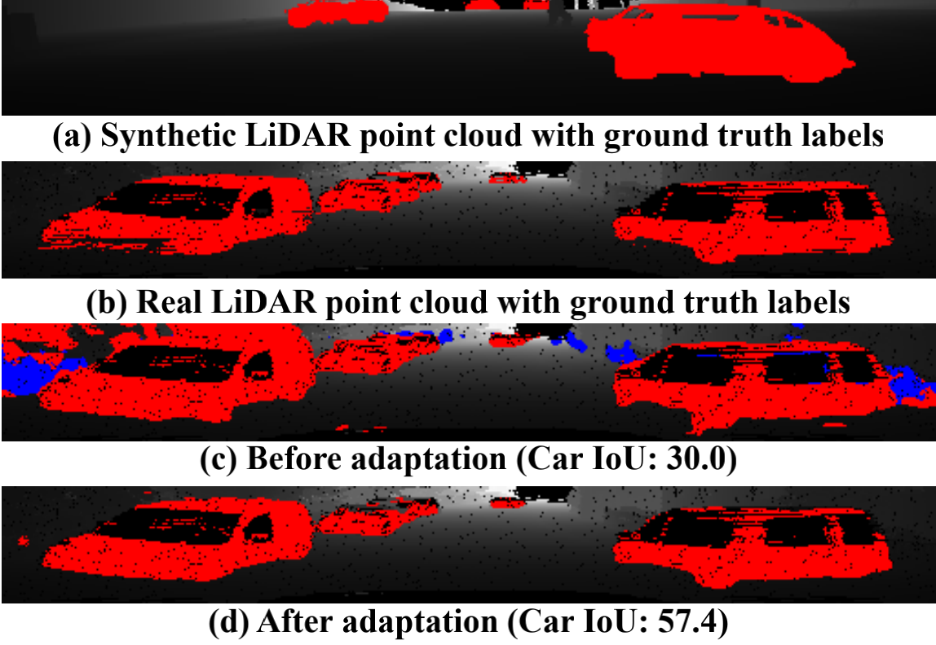
Introduction
Limitations:
1.Accuracy is not enough (dropout noise)
2.Training deep learning models is expensive and time-consuming
With an improved model structure, SqueezeSetV2 is more robust against dropout noises in LiDAR point cloud and therefore achieves significant accuracy improvement.
Contribution:
1.Mitigate the impact of dropout noise
2.Propose a domain adaptation training pipeline

Slide 3
Related work
3D LiDAR Point Cloud Segmentation( recognize objects from point clouds by predicting point-wise labels)
Unsupervised Domain Adaptation (UDA) ( adapt the models from one labeled source domain to another unlabeled target domain.)
Simulation( for creating large-scale ground truth data for training purposes.)

Slide 4
Improving the model structure A. Context Aggregation Module
Dropout noise is mainly caused by :
1) limited sensor range
2)mirror reflection (instead of diffusion reflection of sensing lasers on smooth surfaces
3) jitter of the incident angle.
To solve this problem, we propose a novel Context Aggregation Module (CAM) to reduce the sensitivity to dropout noise.

Slide 5
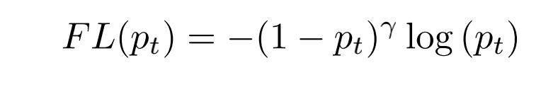
Improving the model structure B.Focal Loss
LiDAR point clouds have a very imbalanced distribution of point categories– there are many more background points than there are foreground objects such as cars, pedestrians, etc.
The focal loss for that pixel is thus

Slide 6
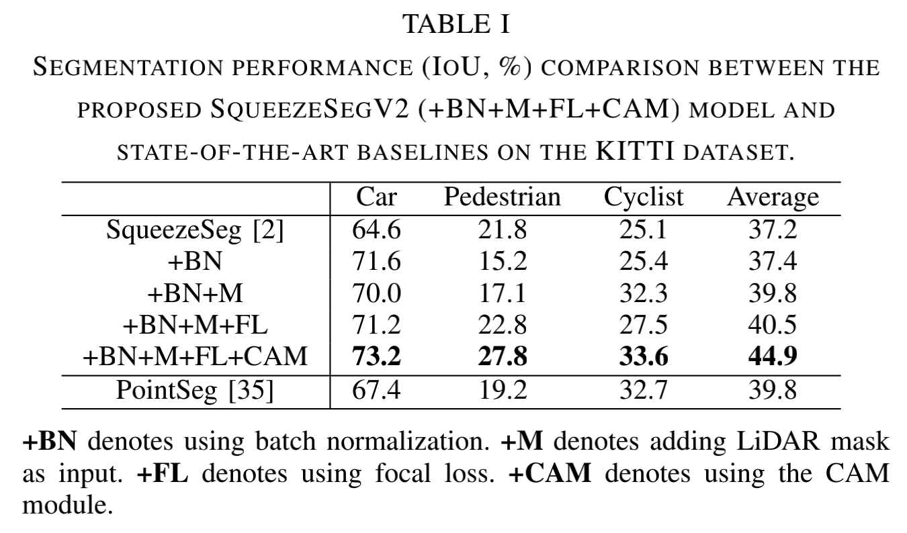
Improving the model structure C.Other improvements
LiDAR Mask: Besides the original (x, y, z, intensity,depth) channels, we add one more channel – a binary maskindicating if each pixel is missing or existing.
Batch Normalization: Unlike SqueezeSeg , we also add batch normalization after every convolution layer.

Slide 7
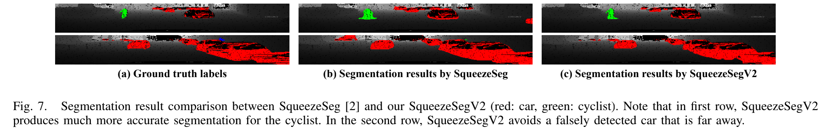
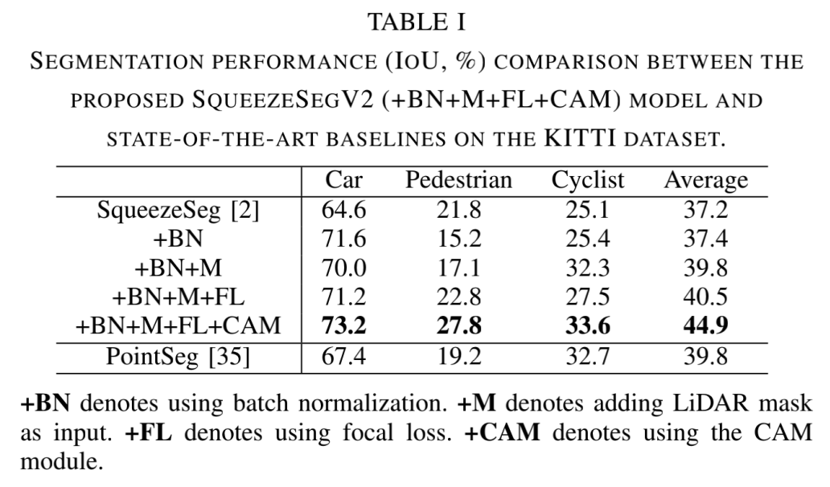
Experiments
Improved Model Structure

Slide 8
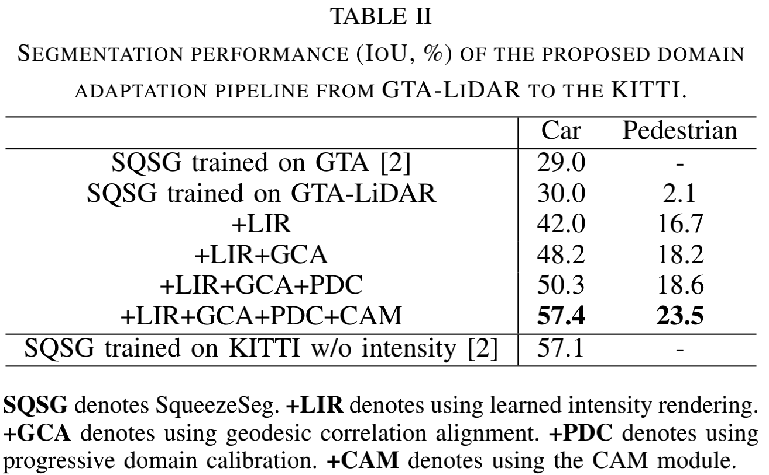
Experiments
Domain Adaptation Pipeline

Slide 9
Conclusion
1.Proposed SqueezeSegV2 with better seg_x0002_mentation performance.
2.Designed a context aggregation module to mitigate the impact of dropout noise.
3.Proposed a domain adaptation pipeline

Slide 10
How this paper is relevant to your project.
Squeezeseg
Projection-based
Accuracy improvements

