Slide 1
RangeNet ++: Fast and Accurate LiDAR Semantic Segmentation
Delin Feng
fengdl@shanghaitech.edu.cn
A. Milioto, I. Vizzo, J. Behley and C. Stachniss, "RangeNet ++: Fast and Accurate LiDAR Semantic Segmentation," 2019 IEEE/RSJ International Conference on Intelligent Robots and Systems (IROS), Macau, China, 2019, pp. 4213-4220, doi: 10.1109/IROS40897.2019.8967762.

Slide 2
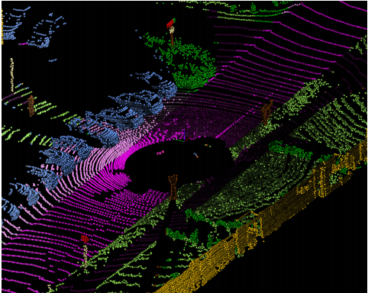

Background
Notes:
Semantic Segmentation's significance.

Slide 3
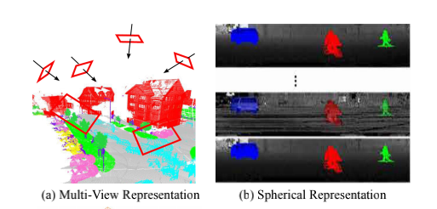
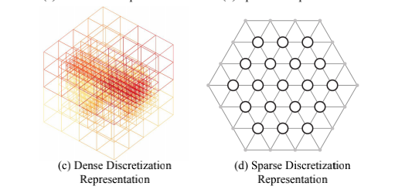
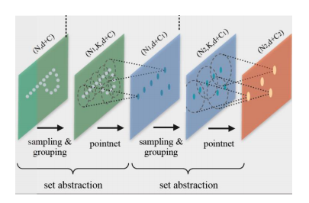
Related Work
Projection-based Methods
SqueezeSeg
Projection-based Methods
SPLATNet
point-based
Discretization-based Methods
PointNet++

Slide 4
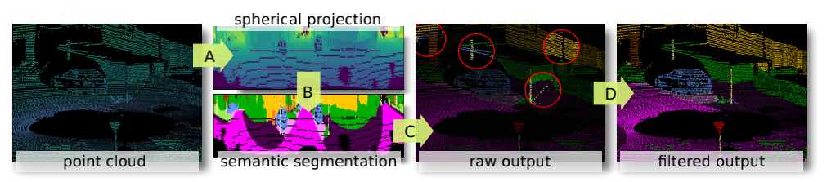
Main Work

Slide 5
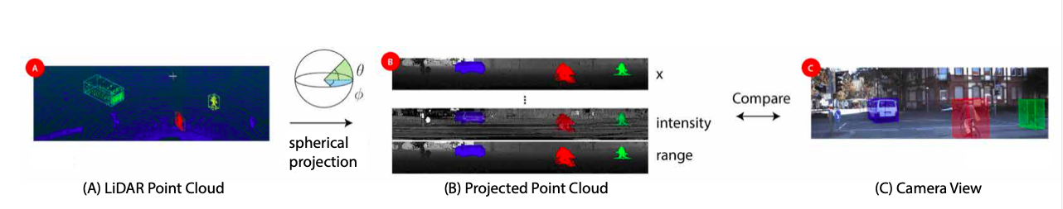
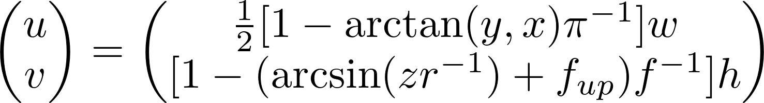
Range Image Point Cloud Proxy Representation

Slide 6
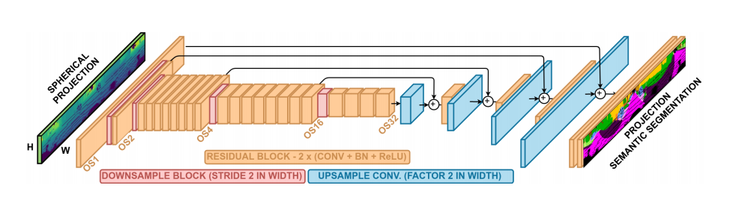
Fully Convolutional Semantic Segmentation

Slide 7
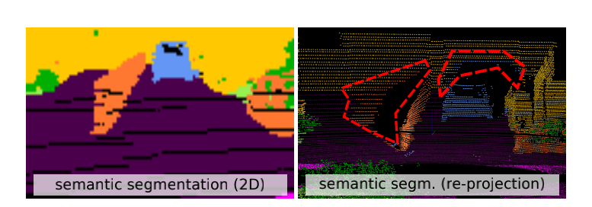
Point Cloud Reconstruction from Range Image

Slide 8
Efficient Point Cloud Post-processing

Slide 9
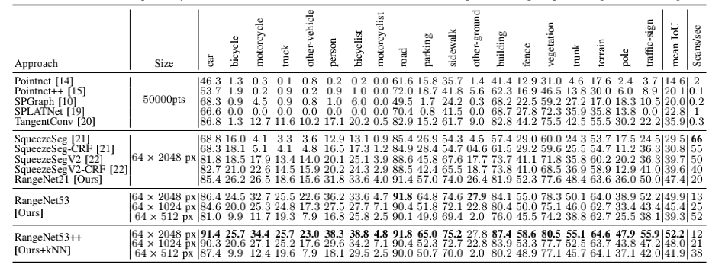
Experiment Evaluation

Slide 10
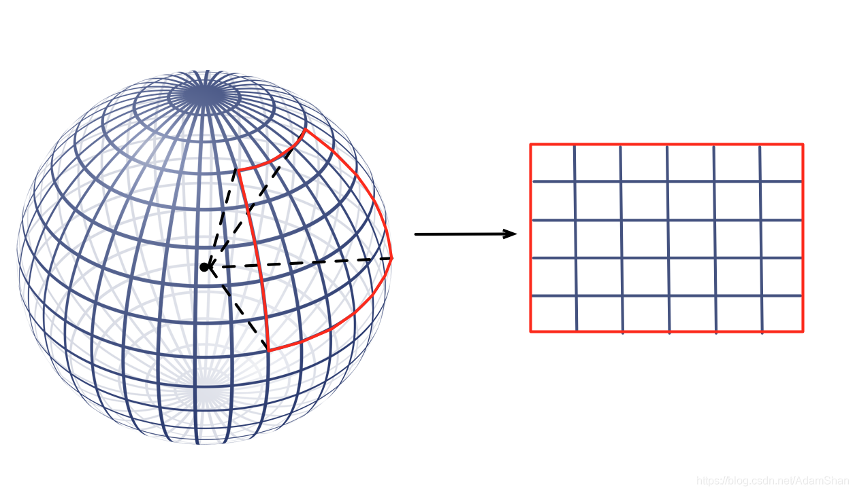
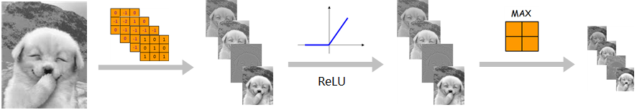
Association with Our Project
Data loss from projection
Optimization
CNNs provide blurry outputs
Conv
Pooling
Position information loss

