Slide 1

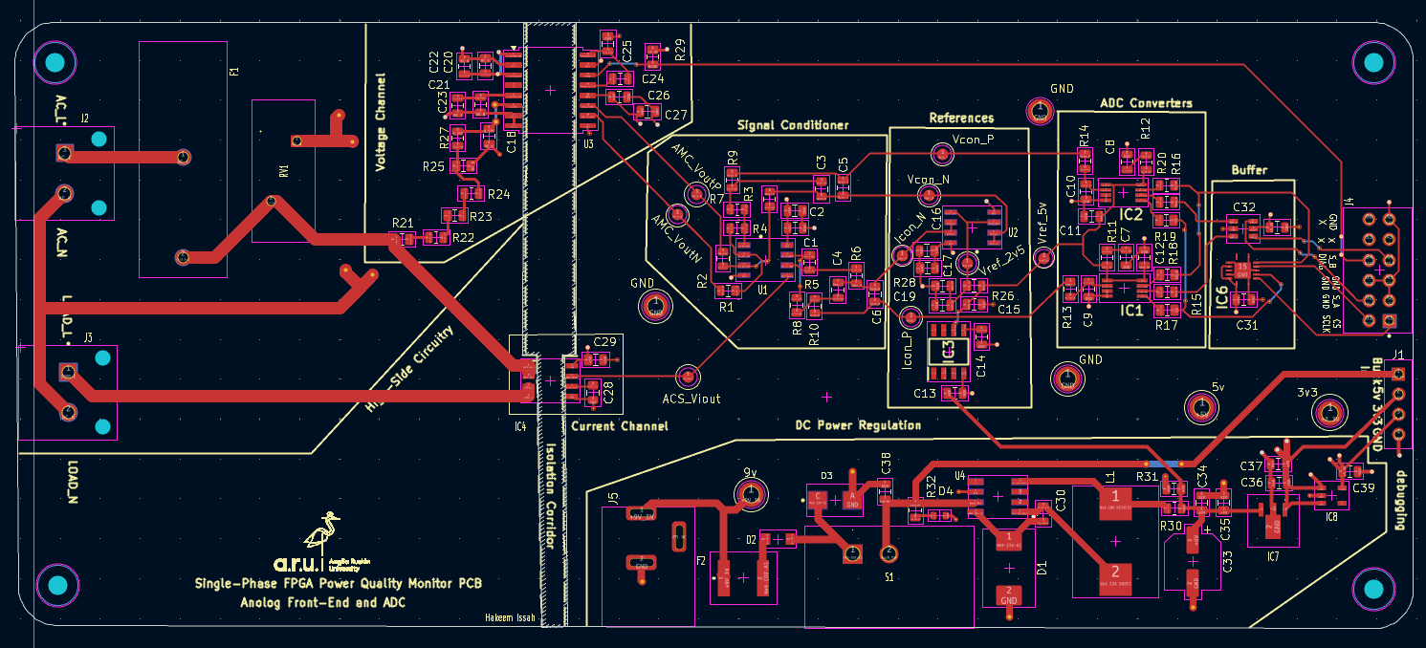
ENGINEERING MAJOR PROJECT
FPGA-Based Power Quality
Monitoring
with Measurement Uncertainty Analysis
Hakeem Issah (2452525)
MSc Electronic/Electrical Engineering
Anglia Ruskin University · September 2026
Supervisor: Dr. Sufian Yousef
Custom 4-layer sensing PCB + Nexys A7 FPGA + Python GUI
10-minute presentation
Notes:
Good morning. My project is an FPGA-based single-phase power quality monitoring system with a particular focus on measurement uncertainty. The system combines a custom analogue sensing PCB, two 16-bit ADS8320 ADCs, a Nexys A7 FPGA and a Python GUI. Rather than only showing that the algorithms work, I also evaluated how well the complete measurement chain represents the applied input and where the available reference instruments limit the conclusions.

Slide 2
MOTIVATION
Problem and project aim
The engineering problem
Sensing
Conditioning
16-bit ADC
FPGA
GUI
Correct FPGA maths does not guarantee correct measurement.
Sensor offset, analogue gain, noise, ADC reference and channel timing can all alter the samples before processing.
measurement uncertainty enters before the digital result
A prototype must therefore be tested as a complete measurement chain.
Project aim
Design and implement a single-phase FPGA-based power quality monitor, then evaluate its measurement-chain performance using calibration, reference comparisons and uncertainty analysis.
50 Hz nominal
10 kS/s / ch
Single phase
16-bit ADC
Notes:
The central problem is that an FPGA can calculate RMS or THD correctly and the displayed answer can still be inaccurate because the samples may already contain gain error, offset, noise or timing error. That is why my aim was not only to build the monitor, but to evaluate the measurement chain itself. The design targets a 50 hertz single-phase system, samples both channels at 10 kilosamples per second, and uses 16-bit ADCs.

Slide 3
LITERATURE REVIEW
Selected literature and research gap
Adapted from dissertation Table 2.1
Study | Relevant evidence | Limit on transfer
Yildirim et al. (2018) | FPGA-based online power-quality monitoring using continuously acquired voltage and current signals. | Different sensing hardware, network conditions and communication architecture.
De Oro Arenas et al. (2021) | FPGA smart-energy meter with analogue acquisition, power-quantity calculation, Goertzel harmonics and calibration. | Three-phase system with different sensors and ADC arrangement.
Maśnicki et al. (2025) | Review stressing modelling, development and validation of the complete measuring channel for power-quality assessment. | General measuring-channel framework; not the exact AMC3330 / ACS724 / ADS8320 chain.
Research gap addressed: complete measurement-chain validation and uncertainty, not only FPGA algorithm demonstration.
FPGA-Based Power Quality Monitoring Hakeem Issah · MSc Electronic/Electrical Engineering · 3
Notes:
This literature-review slide is a short version of the table in Chapter 2. I would explain that previous work supports FPGA use for deterministic and parallel power-quality processing. Yildirim et al. show online FPGA monitoring, and De Oro Arenas et al. show an FPGA smart-energy meter with Goertzel harmonics and calibration. Maśnicki et al. is important because it stresses that the whole measuring channel must be validated. My gap is therefore not simply implementing another algorithm. It is integrating the sensing PCB, ADCs, FPGA and GUI, then checking what the measurements and uncertainty actually support.

Slide 4
WHAT I BUILT
System architecture
Separate physical test sources feed a common hardware–FPGA–GUI chain.
Signal generator
Voltage sensing
Conditioning
ADS8320 V
voltage test
divider + AMC3330
OPA2188 + filter
16-bit SAR
Nexys A7
Python GUI
PQ processing
UART 115200
DC supply + load
Current sensing
Conditioning
ADS8320 I
current test
ACS724 Hall sensor
OPA2188 + filter
16-bit SAR
AMC3330
ACS724
2 × ADS8320
10 kS/s / ch
Goertzel 1–25
voltage isolation
current sensor
conversion
sampling
harmonics
Shared ADC control gives a common sampling schedule; exact analogue phase alignment was not physically established.
Notes:
This is the overall architecture. The voltage path uses a divider, AMC3330 isolation and OPA2188 conditioning before a dedicated ADS8320. The current path uses an ACS724 Hall sensor, OPA2188 conditioning and a second ADS8320. Both converters are controlled by the Nexys A7 at 10 kilosamples per second. The FPGA calculates the power-quality quantities and sends results to a Python GUI over UART. The two ADCs share control timing, but because the analogue paths are different, that does not by itself prove exact phase alignment.

Slide 5
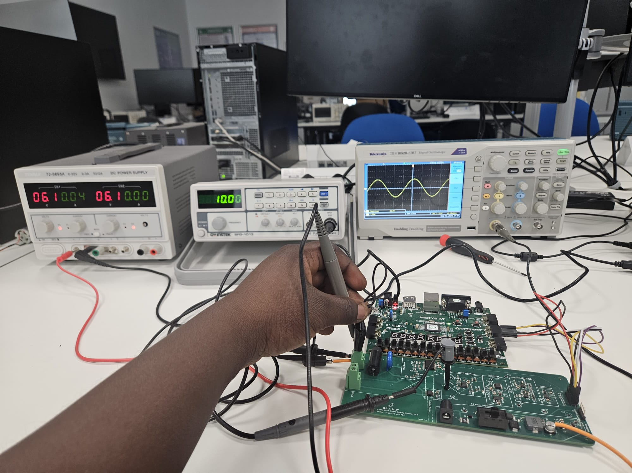
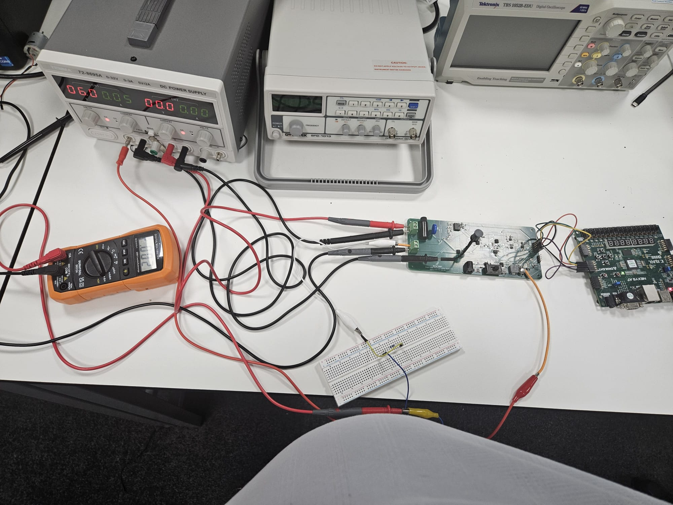
PHYSICAL IMPLEMENTATION
Hardware prototype and commissioning
As-built revisions
• External 6 V applied at C33
• Original 9 V path disconnected
• AMC3330 LDO_OUT–DCDC_IN jumper
• Results refer to this modified configuration
4-layer custom PCB
REF5050 5 V reference
Vcon_P / Vcon_N
Icon_P / Icon_N
Left: voltage-channel lab setup. Top-right: final PCB layout. Bottom-right: DC current test setup.
Notes:
The hardware was implemented on a custom four-layer PCB. The board includes isolation and conditioning for voltage, Hall-effect current sensing, a precision five-volt reference and two ADCs. Commissioning also revealed real prototype issues. The original buck-supply section was bypassed, so the final tests used an external six-volt supply at C33, and the AMC3330 required a jumper between LDO_OUT and DCDC_IN. I report those changes explicitly because the results apply to the actual as-tested hardware, not only to the original schematic.

Slide 6
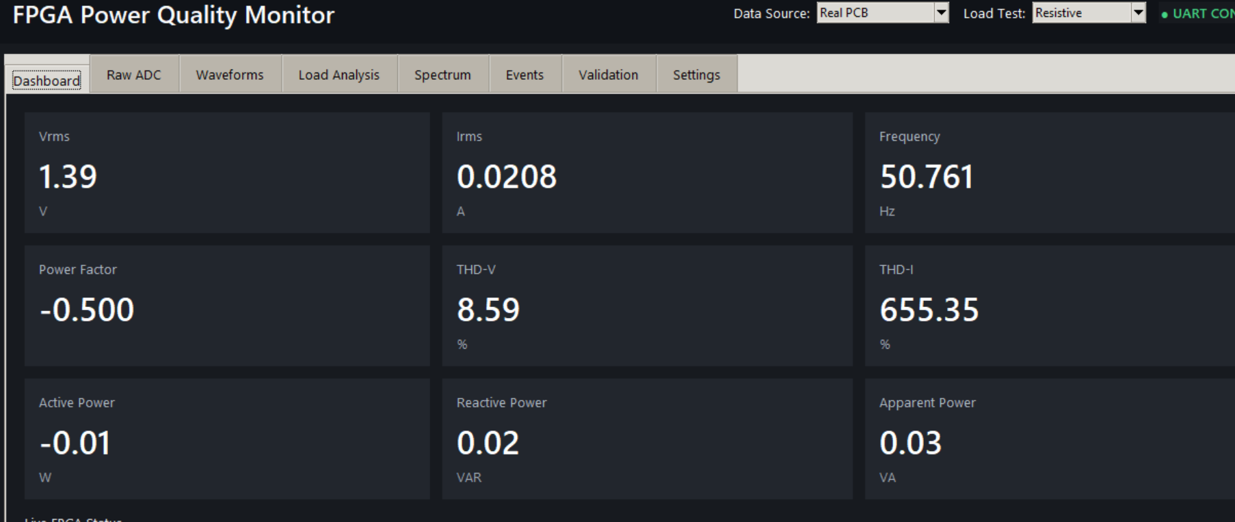
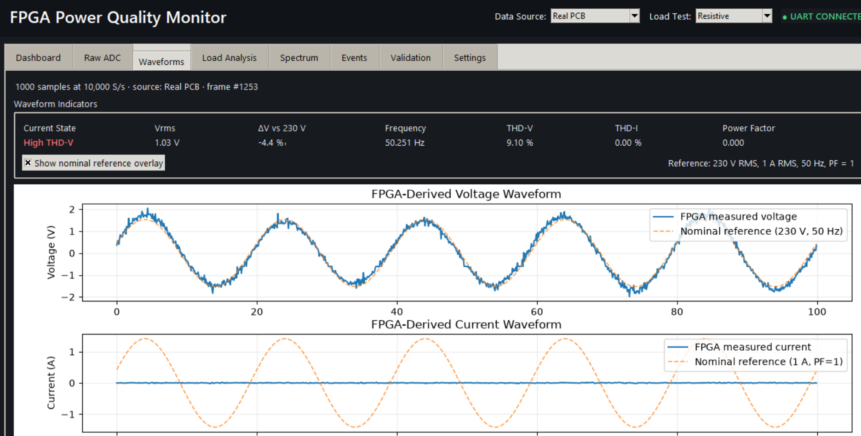
DIGITAL IMPLEMENTATION
FPGA processing and software interface
ADC pair
16-bit
Offset removal
+ scaling
Parallel
processing
AA55 / AA56
packetisation
UART
115200
RMS | frequency | active / apparent power | PF | sag/swell | adaptive Goertzel THD
Implementation choices
• TEST_MODE = false for final physical tests
• 1000-sample waveform frames = 0.1 s of data
• Frequency-adaptive Goertzel targets harmonics 1–25
• Fixed-width / integer arithmetic to control FPGA cost
• Raw ADC data can be exported to CSV
100 MHz
100 µs
1000 samples
AA56 v2
115200 baud
FPGA clock
sample period
frame size
packet build
host link
Notes:
Inside the FPGA, each 16-bit ADC sample is offset-corrected, scaled and fed to several processing blocks in parallel. The implemented functions include RMS, frequency, power, power factor, sag and swell detection, and adaptive Goertzel harmonic processing up to the twenty-fifth harmonic. The final physical tests used TEST_MODE false, so the system processed real ADC samples. Scalar metrics and waveform data are packetised separately and sent to the Python GUI, which also records raw ADC data for offline analysis.

Slide 7
HOW I TESTED IT
Experimental method
Voltage channel
Current channel
Input / reference
Input / reference
Signal generator + Tektronix TBS1052B-EDU with P2200 probe at 10×
DC bench supply + resistive load + Duratool D03124 multimeter on 10 A range
What it supports
What it supports
• RMS validation at 3 low-voltage levels
• Frequency operation
• Physical sag/swell detection
• THD behaviour, but no matched independent THD reference
• Zero-input offset and static sensitivity
• DC calibration over 0–0.46 A
• Linearity and repeatability
• Not AC current, phase or harmonic validation
Important scope decision: the channels were tested separately because no suitable isolated variable AC source was available. These were not simultaneous AC-load measurements.
Notes:
Because there was no suitable isolated variable AC source, I deliberately used two separate experiments. For voltage, I used a signal generator and measured the actual test-point amplitude with a Tektronix TBS1052B-EDU and P2200 probe at ten-times attenuation. This supports low-voltage RMS comparisons, frequency operation and physical sag and swell tests. For current, I used a DC supply, resistor and Duratool D03124 on its ten-amp range, covering zero to about 0.46 amps. That supports static calibration and linearity, but not AC phase, current harmonics or live-load power-factor accuracy.

Slide 8
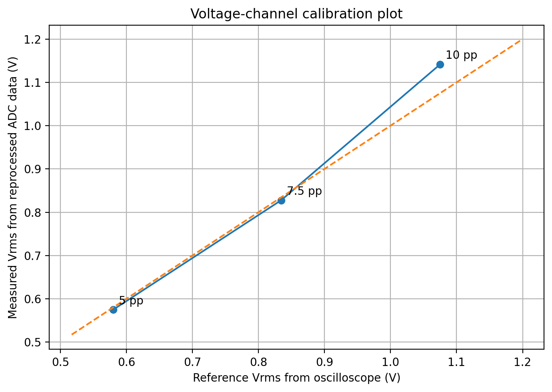
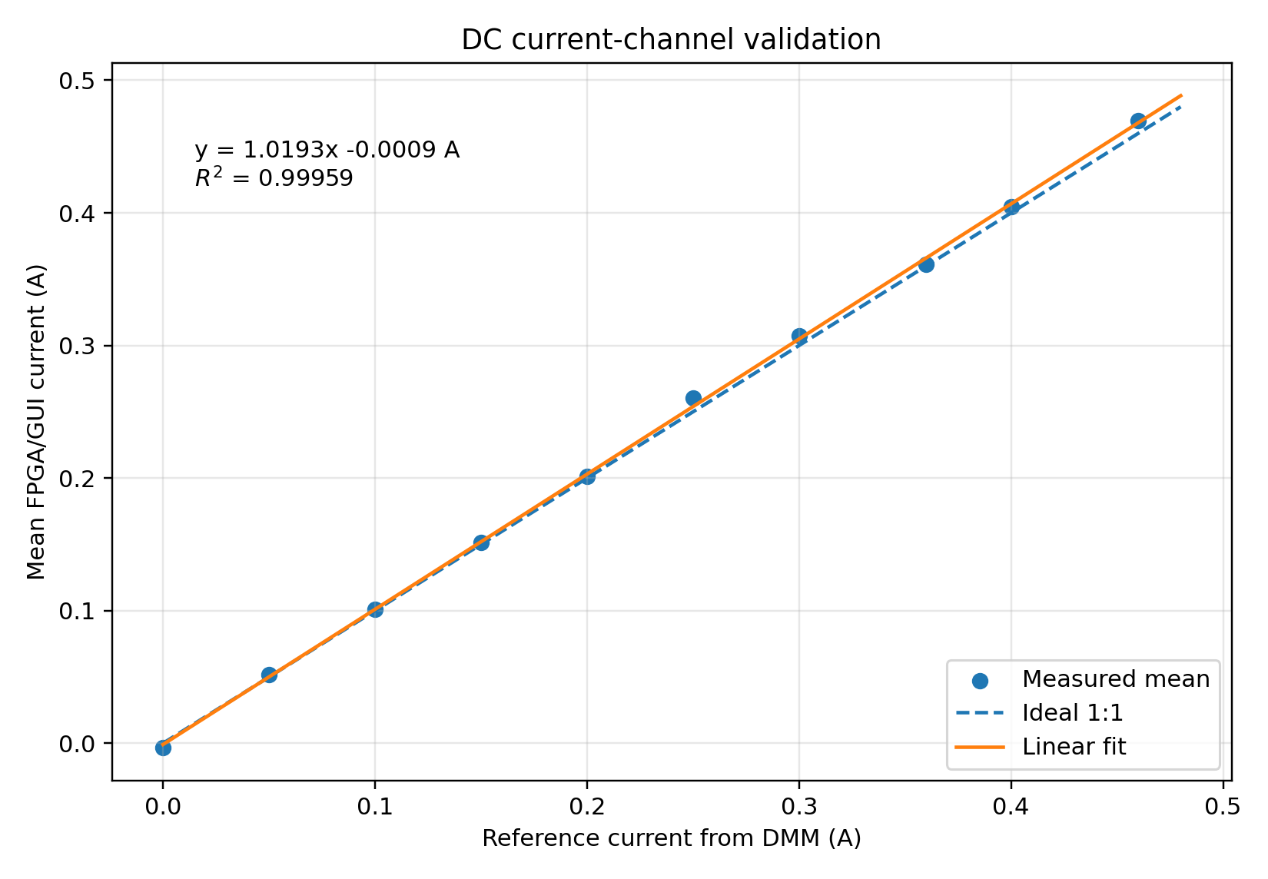
WHAT THE DATA SHOWED
Key results
Voltage RMS validation
DC current-channel validation
−0.90%
−0.81%
+6.18%
0–0.46 A
R² 0.99959
1.0193×
5 Vpp nominal
7.5 Vpp nominal
10 Vpp nominal
tested range
linearity
gain fit
Three-point fit: R² = 0.994 · MAPE = 2.63%
Observed comparison differences were small, but the reference DMM was too coarse for mA-level accuracy claims.
CS = 10.00 kHz
WNS +0.327 ns
LUT 10.43%
DSP 25.0%
Sag/swell functional
physical sample cadence
timing closure
resource use
resource use
events
Notes:
These are the key quantitative results. For voltage RMS, the first two test levels agreed with the oscilloscope to within about one percent, while the highest level showed a positive error of 6.18 percent. The three-point response was still strongly linear, with an R-squared of 0.994. For the current channel, the response from zero to 0.46 amps was extremely linear, with R-squared approximately 0.9996. On the FPGA side, the measured conversion cadence was 10 kilohertz, the final build met timing with positive worst setup slack, and resource utilisation remained modest. Physical sag and swell changes were also detected successfully.

Slide 9
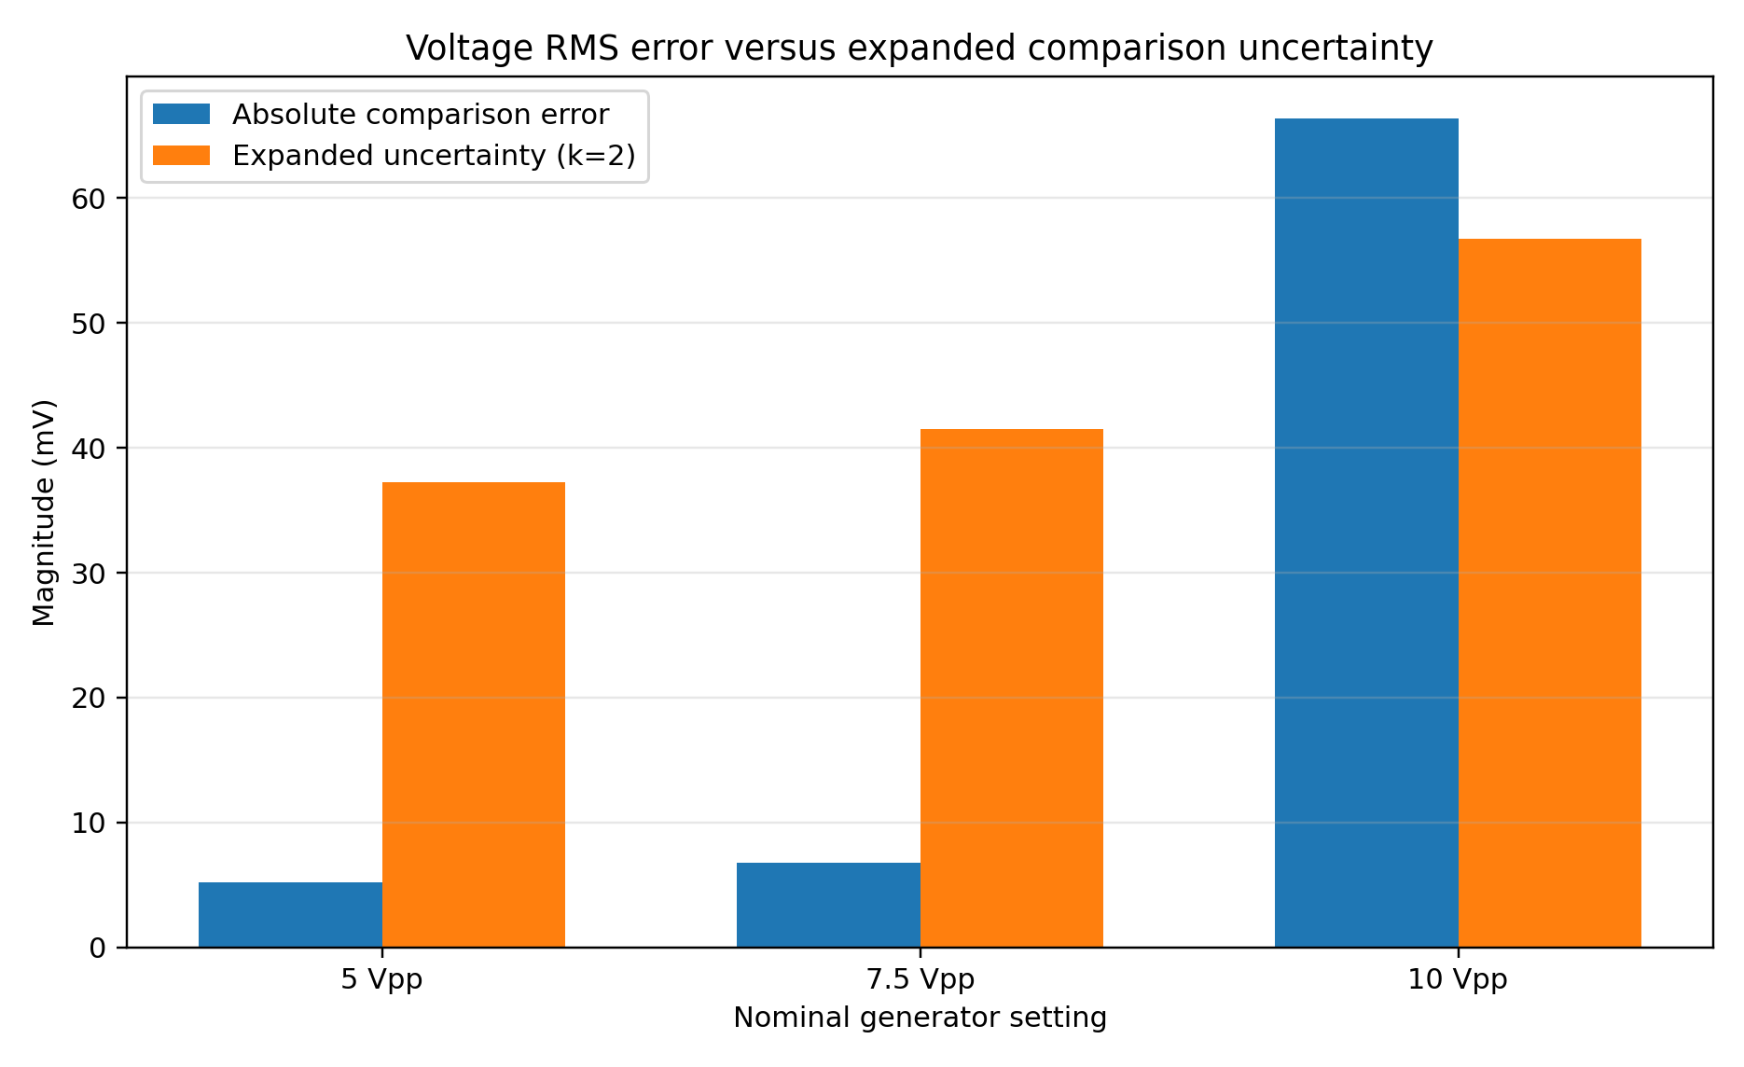
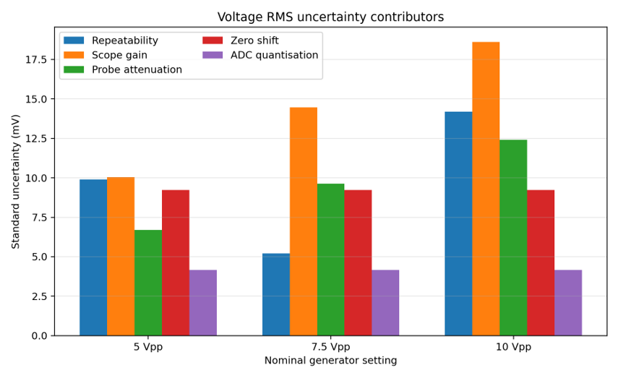
WHAT CAN BE CLAIMED
Voltage uncertainty and limitations
Voltage RMS error vs U(k=2)
Voltage RMS uncertainty contributors
U(k=2): ±37.2 mV · ±41.5 mV · ±56.7 mV
Main contributors: scope gain, probe attenuation, repeatability and zero shift.
Interpretation
The 5 Vpp and 7.5 Vpp RMS errors are inside the estimated k=2 comparison intervals.
The 10 Vpp residual is still outside the interval, so an additional systematic effect or missing term is likely.
Therefore, the voltage channel is functional and roughly linear, but not justified as uniformly accurate across the range.
Notes:
This slide explains how the results should be interpreted. For voltage, the expanded comparison uncertainties were about plus or minus 37, 42 and 57 millivolts. The first two errors fall inside those intervals, but the 10 Vpp residual of about 66 millivolts remains outside, suggesting an additional systematic effect or a missing uncertainty contribution. For current, the DMM ten-amp range dominates the uncertainty, so the experiment demonstrates linear response but not milliampere-level absolute accuracy. The key point is that the prototype works, but the evidence does not justify unsupported claims about simultaneous AC power, power factor or independently validated THD accuracy.

Slide 10
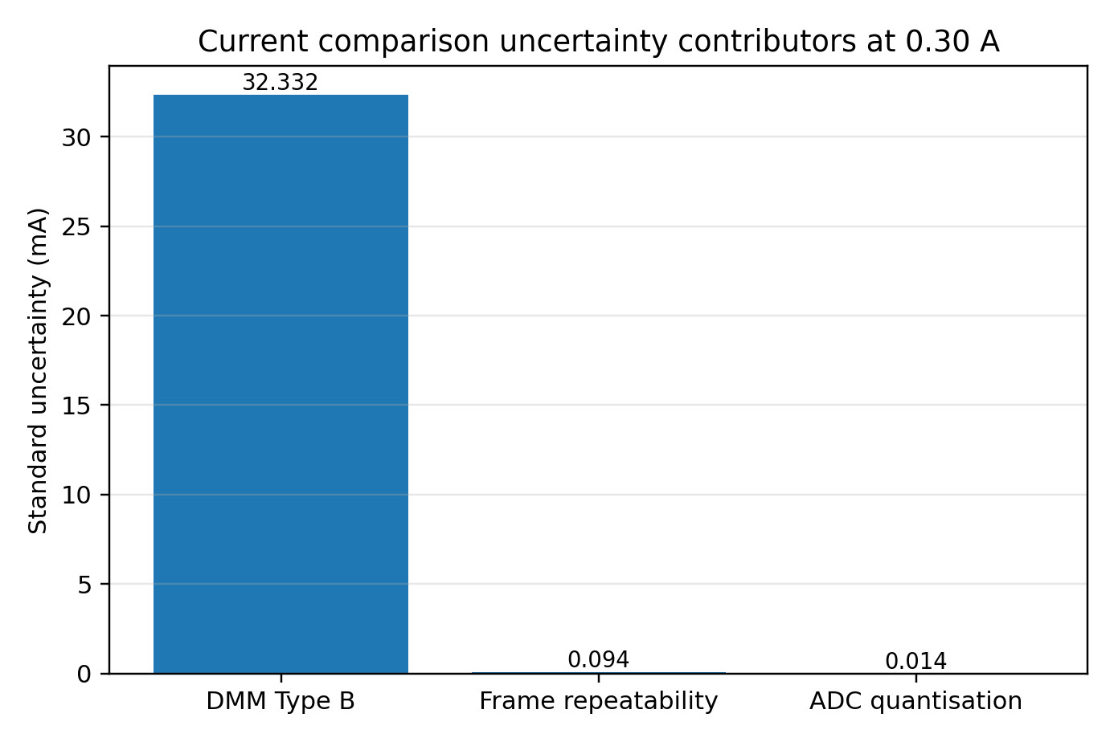
WHAT CAN BE CLAIMED
Current uncertainty and limitations
Current uncertainty at 0.30 A
Interpretation
The current channel response is highly linear over 0–0.46 A: R² ≈ 0.9996.
However, the Duratool D03124 was used on its 10 A range, so the reference uncertainty dominates.
Frame repeatability and ADC quantisation are very small compared with the DMM term.
The test supports DC calibration and response shape, but not milliampere-level absolute accuracy.
Main limit
Need a calibrated low-current reference before high-accuracy claims.
DMM Type-B term ≈ 32.3 mA standard uncertainty
Boundary: DC current calibration was completed; AC current, phase, power and power-factor accuracy were not physically validated.

Slide 11
TAKEAWAY
Conclusion and future work
Final result
Next steps
Working FPGA power-quality prototype achieved.
1
Improve reference instruments
Use calibrated voltage and lower-current references.
2
Investigate 10 Vpp residual
Integrated platform
Repeat with a documented reference chain and additional amplitude points.
Custom sensing PCB, two ADS8320 ADCs, Nexys A7 FPGA, UART and Python GUI.
3
Complete AC validation
Validated evidence
Use an isolated AC source for phase, power and power-factor testing.
Voltage RMS at three levels, DC current calibration, physical sag/swell and FPGA timing/resource results.
4
Validate THD independently
Apply known harmonic content and compare with a calibrated reference.
Key judgement
Functionality was claimed only where real test evidence and uncertainty support it.
5
Revise hardware
Correct the power section and integrate the AMC3330 link on PCB.
Overall: the prototype is a functioning platform; the strongest future step is improved metrology, then full AC validation.
FPGA-Based Power Quality Monitoring
Hakeem Issah · MSc Electronic/Electrical Engineering

Slide 12
THANK YOU

