Slide 1

Explainable Artificial Intelligence framework for Robust Object Detection in Tactical Unmanned Vehicles (XAI-UAV)
Review - 1
Under the Guidance of
Dr. Deepasikha Mishra

Slide 2
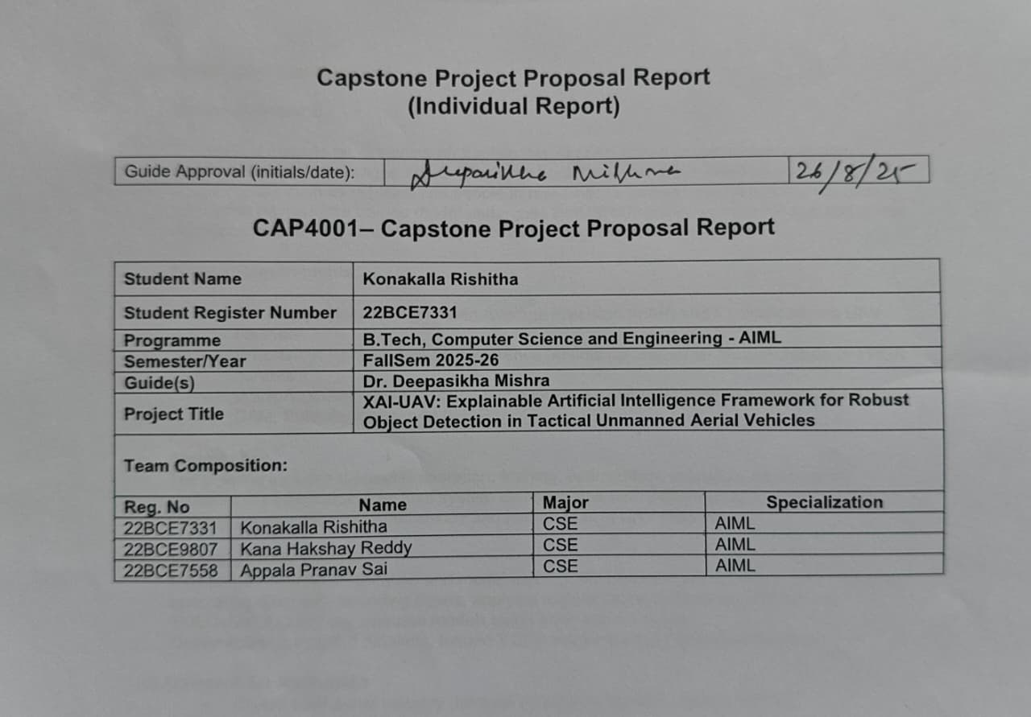
Proposal Report

Slide 3
Motivation
In high-stakes UAV applications like surveillance & defense, AI must not only be fast, it must be explainable
Current object detection models used in drones (e.g., YOLO) are accurate, but behave like black boxes
Lack of transparency reduces trust, limits adoption, and poses risks in human-AI decision-making
We are motivated to bridge this gap by building a real-time, interpretable AI system for UAVs
Our solution merges model optimization (DetDSHAP) with visual explanations (Grad-CAM, SHAP) — ensuring both performance and accountability

Slide 4
Objectives
Identify and address the lack of explainability in UAV-based object detection systems
Optimize deep learning models (YOLOv5/YOLOv8) for real-time inference on edge devices (e.g., Jetson, FPGA)
Apply DetDSHAP pruning to reduce model size while preserving performance and interpretability
Integrate explainability tools (Grad-CAM, SHAP, Saliency Maps) into the UAV inference pipeline
Build a ground station interface that visualizes detections alongside their explanations
Evaluate both detection accuracy (mAP, F1) and explanation quality (fidelity, stability)

Slide 5
Hypothesis
We hypothesize that DetDSHAP-guided pruning can produce a lightweight YOLO model that is both accurate and interpretable
We propose that integrating XAI methods (Grad-CAM, SHAP, Saliency Maps) with the deployed model will enable real-time visual explanations onboard UAVs
We believe this combination will allow UAV operators to understand and trust AI decisions without compromising performance
Our pipeline will maintain detection accuracy while also delivering explanation fidelity and stability, bridging the gap between efficiency and transparency

Slide 6
Problem Survey
State of the Art
UAV object detection: VisDrone, UAVDT benchmarks; YOLOv5/YOLOv8 widely adopted for aerial vision.
Edge AI deployments: Jetson Nano/Orin enable onboard inference but limited by resource constraints.
XAI methods (Grad-CAM, SHAP, Saliency Maps) are established in medical and NLP domains, rarely extended to UAV detection.
Limitations Identified
Existing UAV research optimizes models for speed but overlooks interpretability.
No standardized inclusion of fidelity/stability metrics alongside accuracy.
Edge pruning is often magnitude-based, risks accuracy drop and ignores explainability.
Premise of Proposal
Introduce DetDSHAP-guided pruning: interpretable model compression.
Integrate real-time explainability engine in UAV object detection pipeline.
Deliver trustworthy, operator-validated UAV AI that balances accuracy, efficiency, and transparency.

Slide 7
Subject Knowledge
Object Detection Models
YOLO family: single-shot, real-time detection
Trained on UAV-specific datasets (VisDrone, UAVDT)
Balancing accuracy (mAP) vs. efficiency (FPS, latency) is critical for UAV hardware
Optimization
DetDSHAP Pruning:
Uses Shapley values to rank neuron importance
Retains interpretability while reducing parameters
Deployment Workflow:
PyTorch (training) → ONNX (intermediate format) → TensorRT (.engine model)
Runs efficiently on Jetson/FPGA hardware

Slide 8
Subject Knowledge
Evaluation Framework
Accuracy: mAP, F1-score
Efficiency: Latency per frame, FPS, GPU/Memory utilization
Interpretability:
Fidelity: explanation truly reflects model’s reasoning
Stability: explanations consistent for similar UAV inputs
Explainability Methods
Grad-CAM: Highlights which regions in feature maps drive detections
Saliency Maps: Pixel-level sensitivity showing why detection confidence changes
SHAP: Quantifies numerical importance of image regions to predictions

Slide 9
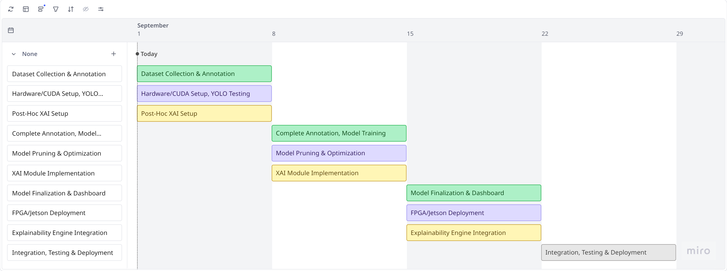
Time Plan

Slide 10
Thank you!
Team members:
Konakalla Rishitha 22BCE7331
Kana Hakshay Reddy 22BCE9807
Appala Pranav Sai 22BCE7558

