Slide 1
SALARY ANALYSIS USING EXCEL
STUDENT NAME: AKSHAYA.A
REGISTER NO: 312208909 asunm135122/c/17
DEPARTMENT: BACHELOR OF COMMERCE
COLLEGE: CHEVALIER T.THOMAS ELIZABETH COLLEGE FOR WOMEN

Slide 2
PROJECT TITLE
Salary analysis using excel

Slide 3


AGENDA
Problem Statement
Project Overview
End Users
Our Solution and Proposition
Dataset Description
Modelling Approach
Results and Discussion
Conclusion
3/21/2024 Annual Review

Slide 4

PROBLEM STATEMENT
The primary objective of this project is to analyze the salary data of employees at XYZ Corporation using Excel. The goal is to gain insights into the company's compensation structure, identify any discrepancies or trends, and provide actionable recommendations to ensure equitable and competitive pay across the organization.

Slide 5

PROJECT OVERVIEW
A salary analysis project using Excel involves collecting, processing, and analyzing salary data to draw insights and make data-driven decisions. Here's an overview of how you might approach such a project:
Project ObjectivesUnderstand the distribution of salaries within an organization or industry.Identify factors influencing salary levels (e.g., experience, education, job role, department).
Data CollectionGather data from internal sources (HR databases) or external sources (industry reports, job postings).
Data AnalysisDescriptive Analysis:Use summary statistics (mean, median, mode) to understand salary distributions.

Slide 6
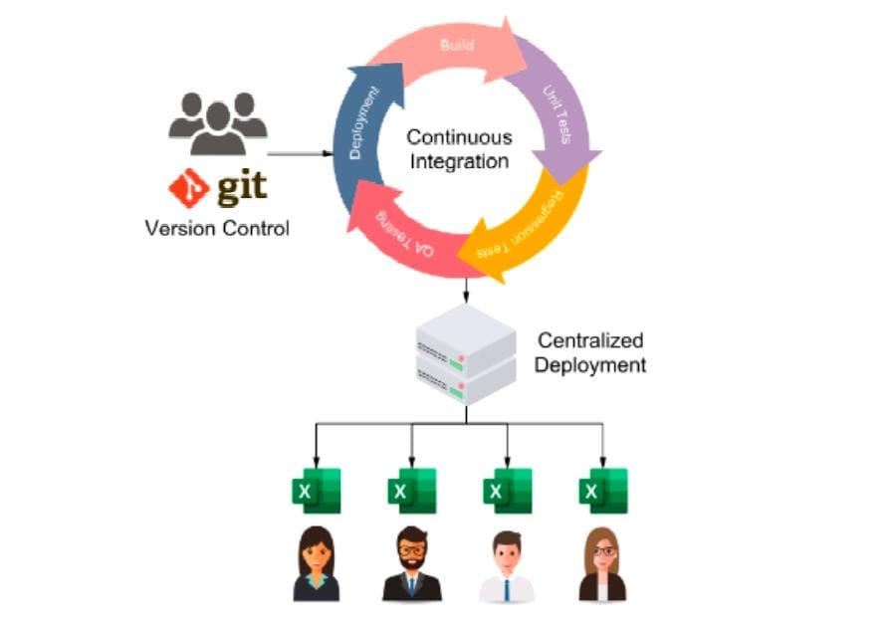


WHO ARE THE END USERS?

Slide 7

OUR SOLUTION AND ITS VALUE PROPOSITION
Data AnalysisDescriptive Analysis:Use summary statistics (mean, median, mode) to understand salary distributions.Your solution provides comprehensive salary analysis, offering insights into compensation trends, benchmarking against industry standards, and identifying pay gaps or inconsistencies. It could include features like data visualization, predictive analytics, and custom reporting tailored to different organizational needs.

Slide 8
Dataset Description
Data AnalysisDescriptive Analysis:Use summary statistics (mean, median, mode) to understand salary distributions.Your solution provides comprehensive salary analysis, offering insights into compensation trends, benchmarking against industry standards, and identifying pay gaps or inconsistencies. It could include features like data visualization, predictive analytics, and custom reporting tailored to different organizational needs.
To conduct a salary analysis using Excel, you typically need a dataset containing relevant information about employees and their salaries. Here's an outline of a typical dataset description and some key points for analyzing salaries in Excel

Slide 9

THE "WOW" IN OUR SOLUTION
Our Excel-based salary analysis solution stands out by delivering powerful, actionable insights with a user-friendly approach. Here’s what makes our solution impressive and why it’s a game-changer for organizations:
Accessibility and Ease of Use:
Wow Factor: We utilize Excel, a tool that is already widely available and familiar to most business professionals. No need for expensive, complex software or extensive training—our solution is accessible to everyone, from HR managers to executives.Impact: This accessibility allows teams to quickly adopt the solution and start generating insights without a steep learning curve.
Dynamic Dashboards and Visualizations:
Wow Factor: Our solution includes dynamic, interactive dashboards that present data in visually compelling ways. From heat maps showing pay discrepancies to trend lines forecasting future salary shifts, the visual tools turn raw data into a story that’s easy to understand and act upon.Impact: These visualizations make it simple for stakeholders to grasp key insights at a glance, enhancing communication and decision-making processes.
3/21/2024 Annual Review
9

Slide 10
MODELLING
Modeling in salary analysis involves using statistical and analytical techniques to understand the factors that influence salaries and predict salary outcomes. Below are key modeling approaches you can implement using Excel to enhance your salary analysis
Descriptive Modeling:
Objective: To summarize and describe the main features of the salary data.
Techniques Used:
Summary Statistics: Calculate mean, median, standard deviation, minimum, and maximum salaries across various dimensions (e.g., departments, job titles, gender).
Pivot Tables: Summarize data to compare salary distributions across multiple categories, such as experience levels or education qualifications
10

Slide 11
RESULTS
11

Slide 12
conclusion
By using Excel for salary analysis, you can gain valuable insights and make informed decisions to optimize your organization's compensation practices.

