Slide 1
Figure 1: The Sytem of iMedBot
iMedBot
Window 1
Prediction
Deep Feedforward Neural Network Model
Model Training
Window 2
Knowledge-base (questions and answers)
…
…
…
Front end
Backend
Functions

Slide 2
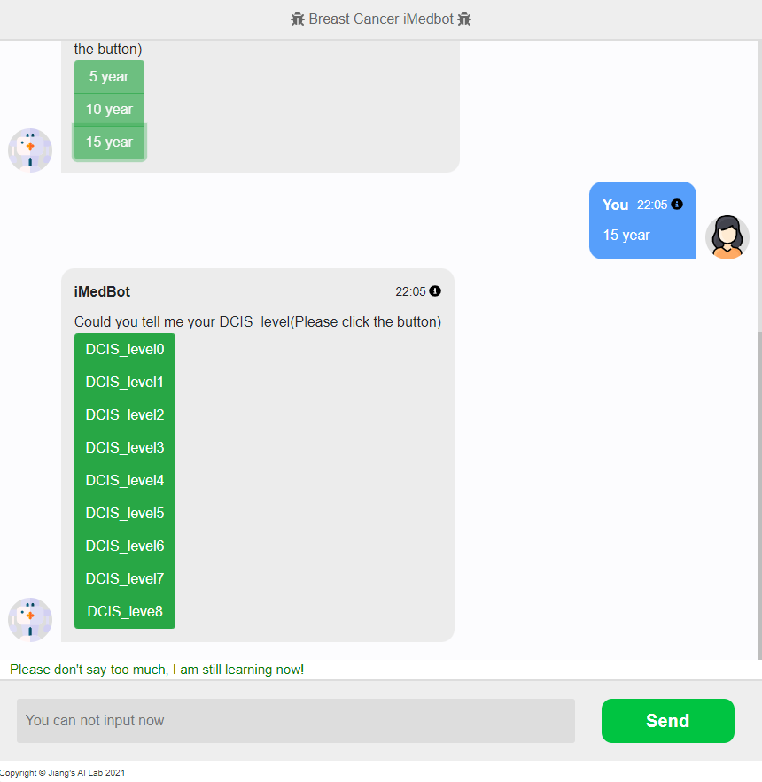
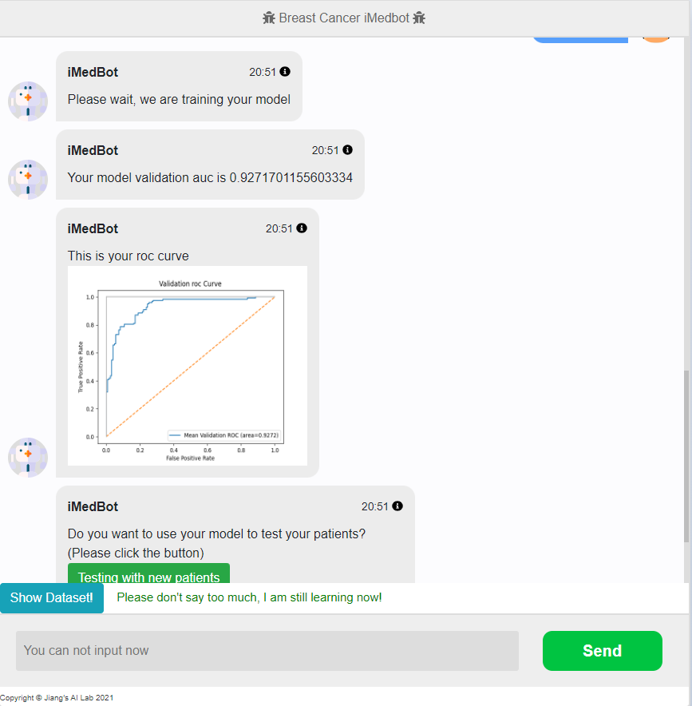
Original one

Slide 3
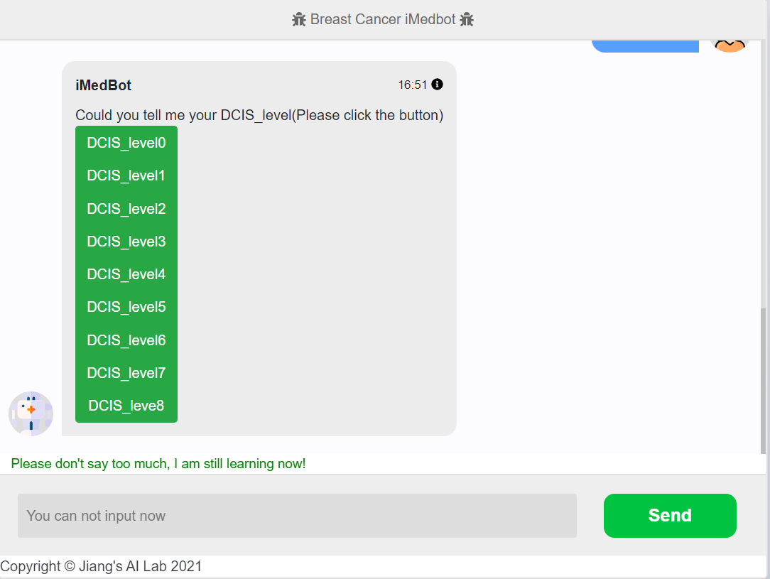
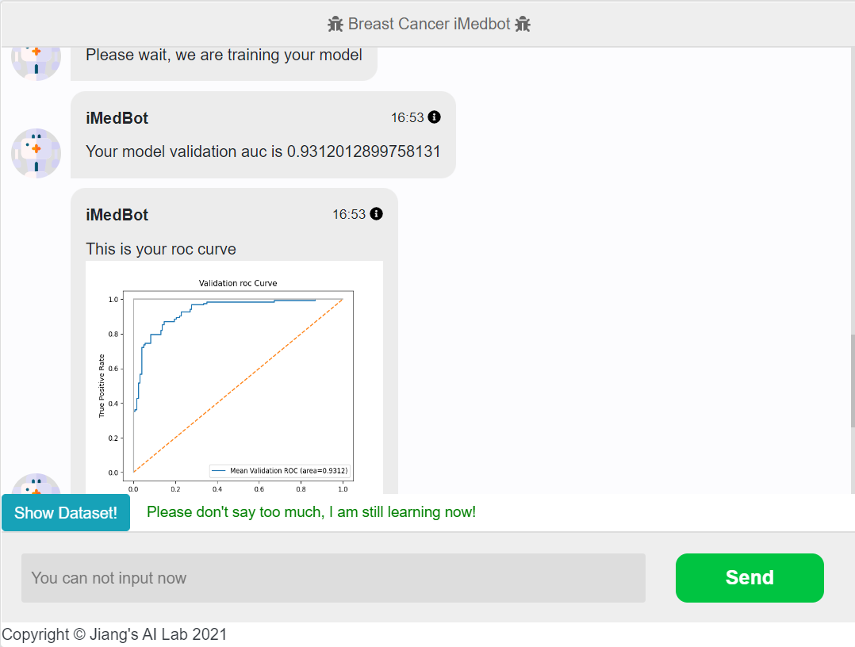
New one with high resolution

Slide 4
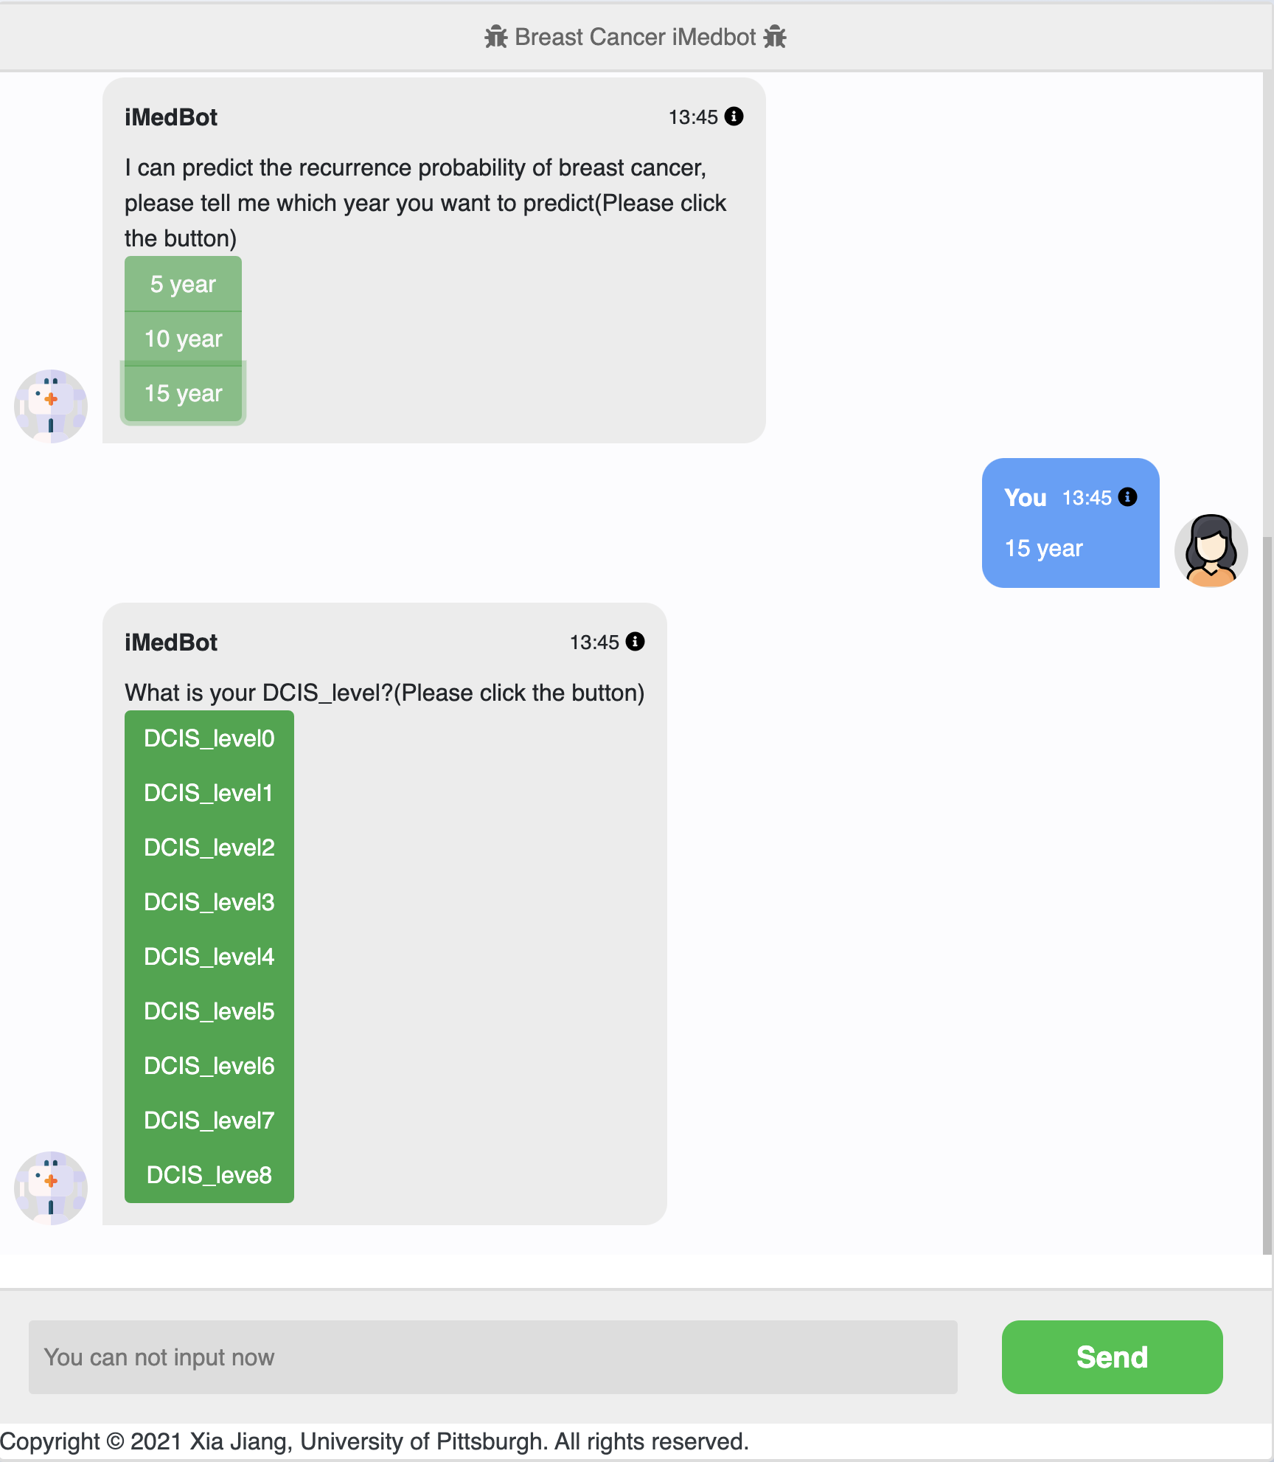

Slide 5
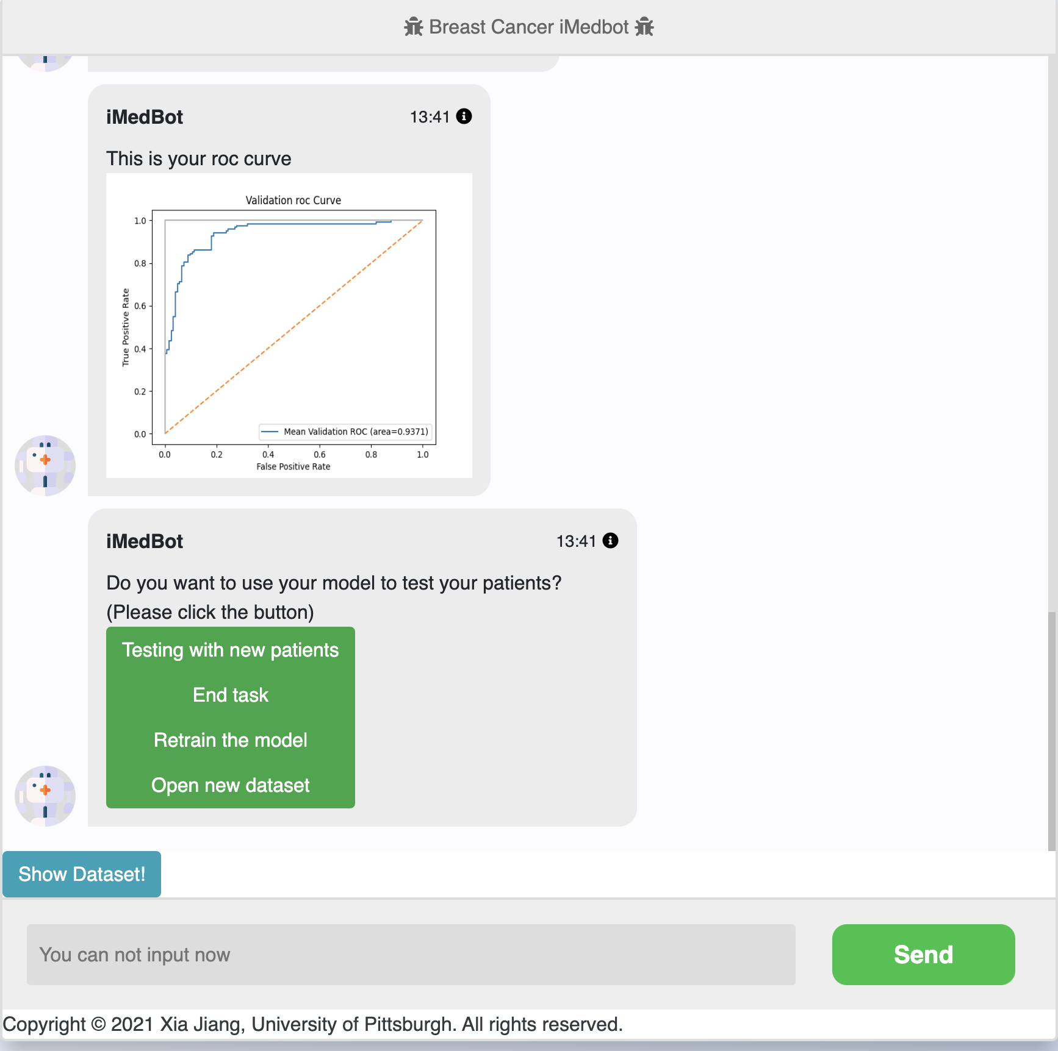

Slide 6

The System Structure of iMedBot
Serialized Model Object (AWS S3)
FrontEnd
BackEnd
DNS
(AWS route53)
Model Training Service
Client
Load Balancer
(AWS ELB)
Web Server
(AWS EC2)
Model Prediction Service
KerasClassifier Module
(AWS S3)

Slide 7
iMedBot
Model Prediction
Model Training
Acquire patient medical index: DCIS_Level; Tumor_Size; Grade and so on
If use default dataset
NO
YES
Upload your own dataset
Return patient recurrence probability
If use default parameter setting
NO
YES
Set your own parameter setting
Collect feedback
Return validation AUC and roc curve plot
Retrain the model
End Task
End Task
Upload new dataset
Test patient

