Slide 1
Introduction to Machine Learning

Slide 2
Today’s lecture
Review syllabus and course schedule
Introduce Machine Learning (slides here)
Project selection and discussion
Set up your environments (Project 0)

Slide 3
ML uses algorithms to learn
What does this mean?
Algorithms identify patterns in the data
Patterns are refined (learned) by adding additional data
The trained algorithm can make predictions on new data
Ideally,
A pattern actually exists in the data
The pattern is learned by the algorithm
The pattern generalizes to new, unseen data

Slide 4
Example
Could we build model to predict someone’s favorite color from their social security number?
Probably not…
What about from their clothing purchases?
What about from the color of their car?
This isn’t just a toy example;
Ad-tech would love to be able to customize user experiences…

Slide 5
What is Machine Learning used for?

Slide 6
Selling you things
Customizing user experiences
Product recommendations
Email marketing campaigns
Ad-tech

Slide 7
Predicting or optimizing costs
Stock market prediction
Dynamic pricing on travel sites

Slide 8
Natural Language Processing
Machine translation
Autocomplete
Voice recognition
Question-answering

Slide 9
Process optimization
Vehicle routing (ride share)
Vehicle routing (parcel delivery)
Scheduling
Logistics and inventory

Slide 10
Biology and Natural Sciences
Drug discovery
Analysis of academic research articles
Disease detection/segmentation from medical images (X-ray, fMRI, etc.)
Disease prediction from vitals (i.e. sepsis detection)
Cell counting and/or classification
Scientific instrument processing

Slide 11
Automation
Detecting fractures during manufacturing
Counting and sorting
Robotics (decision-making)

Slide 12
Fraud Detection
Spam filtering
Credit card fraud
Detecting malware

Slide 13
Object recognition
Facial recognition
Vehicle detection and counting
Robotics (sensing)

Slide 14
What kind of data can be analyzed?
Imagery/photos
Text
Sound
Videos
Sensor data
Tabular data/records
DNA
What else?

Slide 15
What is covered in a Machine Learning course?
Depends on who is teaching it!
This course
Theory: some math is necessary to have a good foundation and understanding of these algorithms
Implementation
Shallow learning
Deep learning
Evaluation

Slide 16
What will we be doing this semester?
Talking about various ML algorithms/approaches
How do they work, including theory (math)
What data do they work well on
What are their limitations
How to implement them
How to evaluate them
What this course is NOT:
A survey on various ML approaches
A python/PyTorch tutorial
A jupyter notebook tutorial
A math/stats course
A deep learning course

Slide 17
Goals
By the end of the course, you will be able to:
Identify if a problem is amenable to a ML solution
Decide which ML approaches would work best
Implement the ML approach
Evaluate your solution

Slide 18
Training algorithms from data
What is supervised vs unsupervised learning?
Aren’t the both “learning” from data?
Supervised learning uses a set of labels/targets from the training dataset
Unsupervised learning does not have these labels; perhaps they are discovered?

Slide 19
Consider the problem space of:
Looking at images of blood cells
Unsupervised learning would be discovering the different blood cell types from unlabelled images
Supervised learning would be using labelled images to train a model to label images
The supervision is knowing what label the training data has
Both approaches can be used on unseen images to generate a predicted label
Which one is better?

Slide 20

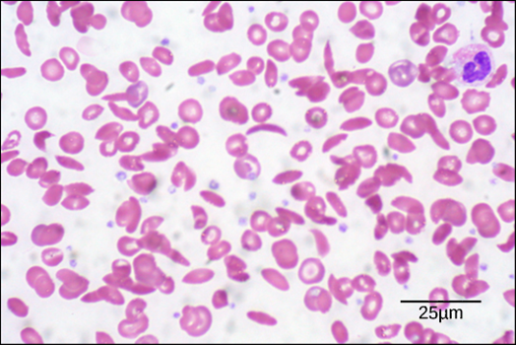
Unsupervised Learning
How many blood cell types are there?

Slide 21
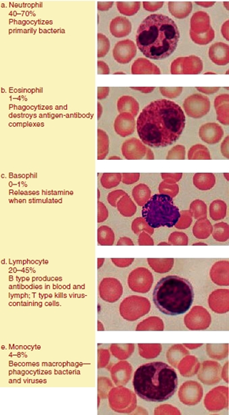
Supervised Learning
Learn a representation for blood cell types using labelled images

Slide 22
Inductive Bias
A poorly-planned model just memorizes its training data…this will not be useful (doesn’t generalize)
There are also multiple potential models that could be learned from a training dataset
Inductive bias allows us to choose the model that would best generalize
Defined as what the model assumes about unseen data
For example, there is a linear relationship between the features and the target
Different types of models have different inductive biases

Slide 23
Inductive Bias, continued
Allows you to choose one algorithm over another, in terms of generalization for unseen data
Also referred to as bias in bias-variance tradeoff (later this semester)
Examples of inductive biases:
Linear regression: model assumes linear relationship between the data (you can fit a line to the points)
Occam’s razor: the simplest model is the best one
Shallow decision trees in a Random Forest
Support Vector Machines – choose the one that maximizes the margin between classes
K-Nearest Neighbors: the class belongs to the nearest neighbor’s class
Minimum cross validation error
Minimum number of features
Neural network with low validation error and minimal weights
Assume in a neural net that Y can be modeled as some non-linear function of X
Anything that imposes constraints on the learning

Slide 24
Student question: is Inductive Bias quantitative or qualitative?
Choosing the right model with respect to inductive bias is currently a manual process
But researchers are looking into automating this process
Quantitative: what can we measure?
You can train different models and see which one worked best on your holdout set
But this isn’t the true distribution
Models will work to find parameters that will minimize their error/loss
But this isn’t the true distribution
The errors observed will be some combination of bias and variance of the model (more later this semester)
Variance here refers to how stable the model is on different training data
Qualitative:
Choosing which model to try a priori is qualitative
Requires heuristics and domain knowledge

Slide 25
Course topics
Foundations of supervised learning
Classification
Decision trees
Logistic Regression
Perceptron
Nearest Neighbors
Regression
Linear regression
Advanced supervised learning
Ensemble trees
Kernels and SVMs
Neural Nets and deep learning

Slide 26
Course topics continued
Unsupervised learning
Clustering
Natural Language Processing
Advanced topics (tentative)
Generative Adversarial Networks (GANs)
Hidden Markov Models
Reinforcement Learning
Testing for ML

Slide 27
Rest of class
Decide if you want to work on a group project, or individually
Find a group, and draft your group project proposal
If you want to work on the pre-assigned projects, go to the next item
Finish Project 0: environment setup
Nothing to submit
Post to Ed (you can do it anonymously so only I can see your name)
Why you’re taking this course
What topics in Machine Learning interest you (if you know)
Any datasets/domains you are particularly interested in

