Slide 1
Classification: Decision Trees and Ensembles

Slide 2
Reminder
HW1 due on Monday
Grading rubric under Assignments tab on course homepage
Work with your group
Only one group member submit on BB
Please list the names of your group at the top of your file
Please copy the grading rubric bullets into MarkDown
Please let me know (email) ASAP if you are having any issues with your group members; all group members are expected to contribute equally to the homework assignments. We reserve the right to modify group assignments as needed.

Slide 3
Quick Jupyter Notebook tutorial
Run from the command line; will open up a browser window
Demo

Slide 4
Review from last time: decision trees and classification
You can train a decision tree (like a flowchart) to classify numeric features
Each inner leaf of the tree is a decision
The tree will choose to split on a feature that does a good job of dividing the classes first
Each leaf node of the tree is a class
But we have yet to explain how a decision tree is built via learning from the training data

Slide 5
Review from last time: decision trees and classification
You can train a decision tree (like a flowchart) to classify numeric features
Each inner leaf of the tree is a decision
The tree will choose to split on a feature that does a good job of dividing the classes first
Each leaf node of the tree is a class
But we have yet to explain how a decision tree is built via learning from the training data

Slide 6
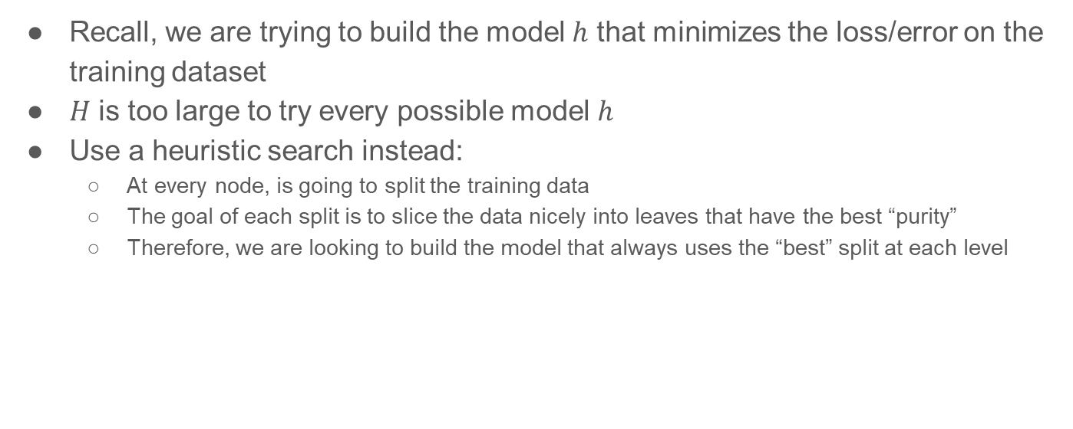
Training a Decision Tree
Recall, we are trying to build the model $h$ that minimizes the loss/error on the training dataset
$H$ is too large to try every possible model $h$
Use a heuristic search instead:
At every node, is going to split the training data
The goal of each split is to slice the data nicely into leaves that have the best “purity”
Therefore, we are looking to build the model that always uses the “best” split at each level

Slide 7
Algorithm for training a Decision Tree
TreeNodeProcessing(currentNodeSamples, currentNodeAvailableFeatures):
If currentNodeSamples are all of the same class, stop [leaf node].
Find F in currentNodeAvailableFeatures that gives the “best” split of currentNodeSamples
For each possible value in F, create new child nodes
Sort currentNodeSamples into the new child nodes created in (2), based on the split
Recursively call TreeNodeProcessing( ) on all the leaf nodes from (4)
Call the TreeNodeProcessing( ) function on the root (all samples)
Stop at the smallest acceptable tree

Slide 8
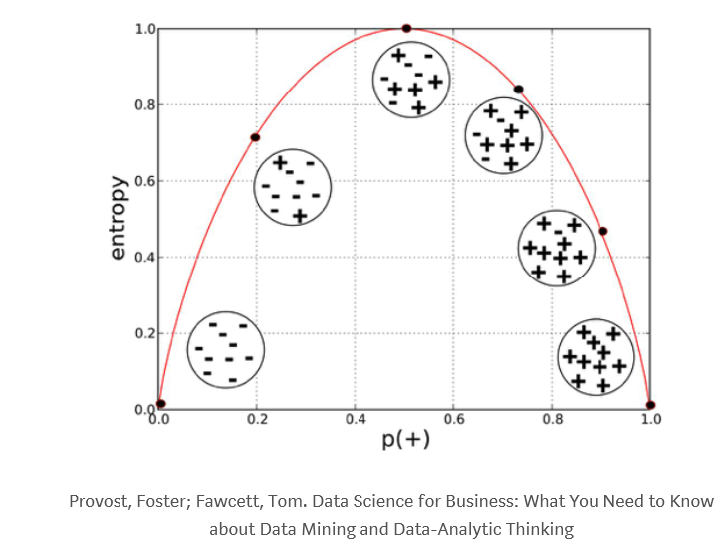
Entropy: how much can I rearrange the set?
What is the “best” split at each level?
Recall, we want to choose a feature that would result in the most “pure” split of the samples at that node
Because, ideally, a leaf would be made up of a large group of samples all from the same class
We can measure the impurity of the split using entropy
Entropy is a term used in information theory to measure the [most efficient] expected number of bits needed to encode a random variable X
The more possible values X has, the more bits you need
High entropy scores are bad for our purposes
Notes:
j is all possible values for random variable X

Slide 9
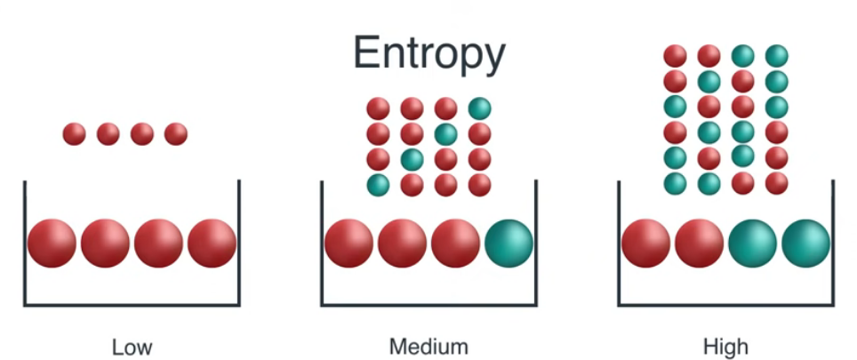
Image from https://www.youtube.com/watch?v=9r7FIXEAGvs
Entropy illustration
Notes:
j is all possible values for random variable X

Slide 10
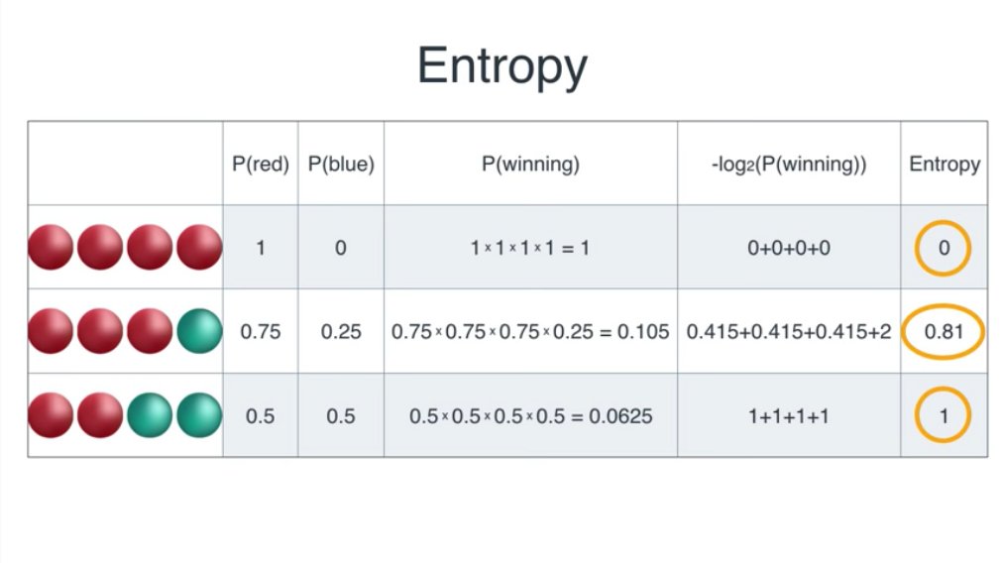
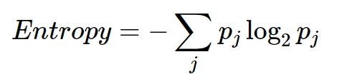
Here “winning” means pulling the desired order [with replacement] shown from the balls in the bucket (previous slide)
Image from https://www.youtube.com/watch?v=9r7FIXEAGvs

Slide 11
Image from https://www.youtube.com/watch?v=9r7FIXEAGvs
Entropy illustration
Notes:
j is all possible values for random variable X

Slide 12
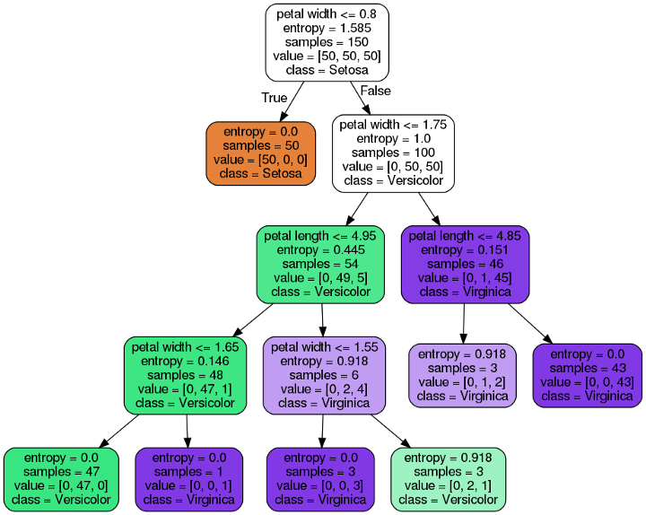

Example entropy
This is a decision tree from the famous iris dataset, where there are three classes of plant {Setosa, Versicolor, Virginia} with features of petal width and petal length
Note the purity of the different nodes
Note some very small leaf nodes

Slide 13
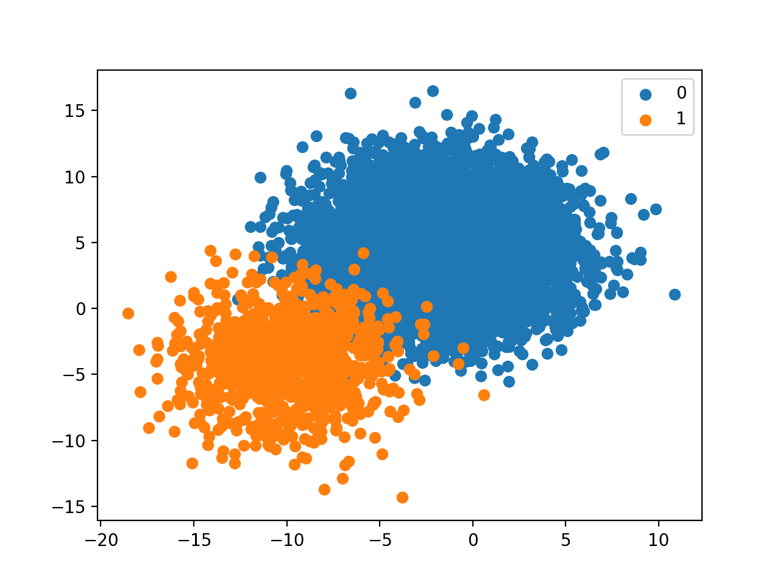
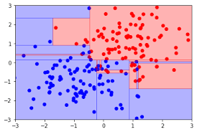
Decision Trees and splitting the samples
Decision trees split the data “into boxes”
Not great for linearly separable data
Decision trees are prone to overfitting!
Especially with a large number of features; we’ll talk about feature reduction later

Slide 14
Options for improving the performance of Decision Trees
A nice summary here: https://scikit-learn.org/stable/modules/generated/sklearn.tree.DecisionTreeClassifier.html#sklearn.tree.DecisionTreeClassifier
You don’t have to memorize these arguments by name, but make sure you conceptually understand why these are provided as options for decision trees in general
Tips on practical use: https://scikit-learn.org/stable/modules/tree.html#tips-on-practical-use
Again, don’t memorize scikit-learn; focus on the conceptual implications and utility of the suggestions found here

Slide 15
Advantages and Disadvantages of Decision Trees
Let’s take a look at the scikit-learn manual and user guide: https://scikit-learn.org/stable/modules/tree.html#tree

Slide 16
Big disadvantage of Decision Trees: overfitting
We can minimize loss/error by allowing our leaves to have a single sample during training: this is unlikely to generalize
Pruning can help, but doesn’t always solve our problems
really hard problems
The problem of learning an optimal decision tree is known to be NP-complete under several aspects of optimality and even for simple concepts. Consequently, practical decision-tree learning algorithms are based on heuristic algorithms such as the greedy algorithm where locally optimal decisions are made at each node. Such algorithms cannot guarantee to return the globally optimal decision tree. This can be mitigated by training multiple trees in an ensemble learner, where the features and samples are randomly sampled with replacement.

Slide 17
Ensemble learning
Train multiple models on the same dataset, and “aggregate” their results
Could average the results or vote across models
Could build models sequentially and learn from the mistakes of earlier models
Either the models are different methodologically [harder], or they involve some randomness in how they are created [easier]
Randomness could be in feature selection, or in sub-sampling the training dataset, or both
Using ensembles minimizes the risk of any individual model overfitting to the data
Often through the randomness in how they are constructed
Often combining several weak models into one strong one
Two main types of ensemble learning:
Averaging: reduce variance by averaging results of models
Boosting: build models sequentially to reduce the bias

Slide 18
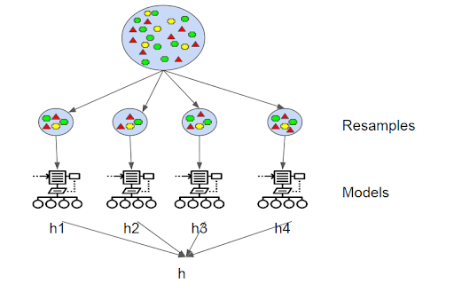
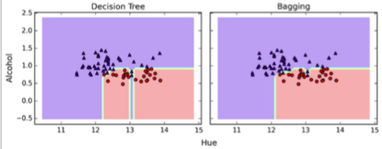
Examples of ensemble learning for decision trees
Bagging: use random subsets of the original training dataset to train multiple models, then average their results

Slide 19
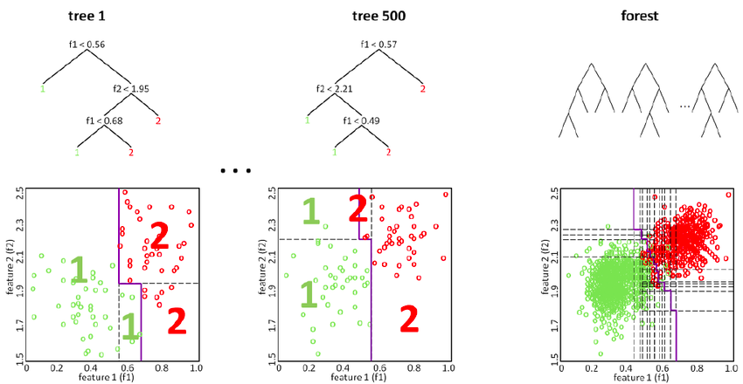
Examples of ensemble learning for decision trees
Random Forests: use random samples drawn with replacement from the training dataset, and use a random subset of features to split at each node
Works well using weak models
Image from Hanselmann et al, “Towards Digital Staining using Imaging Mass Spectrometry and Random Forests-Technical Report”

Slide 20
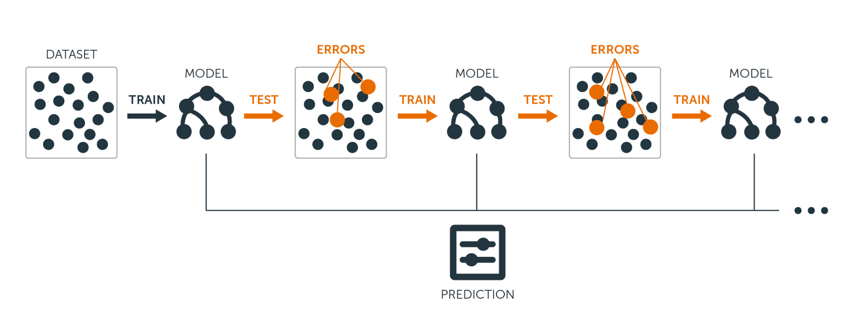
Examples of ensemble learning for decision trees
Boosting: train a series of weak models; at each step, reweight the training samples to give more weight to the incorrect predictions from the previous step.
A weighted majority vote across all models is used for the final prediction.
Image from https://www.datacamp.com/community/tutorials/decision-trees-R

Slide 21
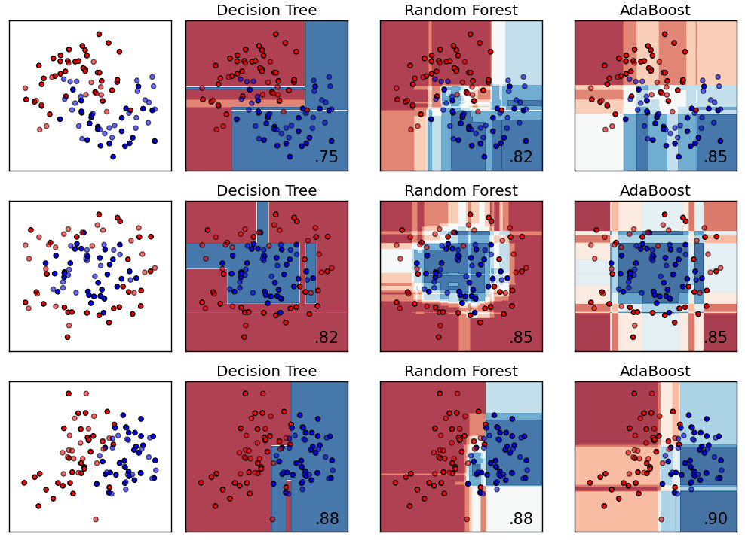
Visualization of decision boundaries
Examples are on small datasets
Note the shapes of the distribution
Decision trees are an example of a non-parametric model: they do not make any assumptions about the shape of the distribution
Unlike linear models, for example
Image from https://martin-thoma.com/comparing-classifiers/

Slide 22
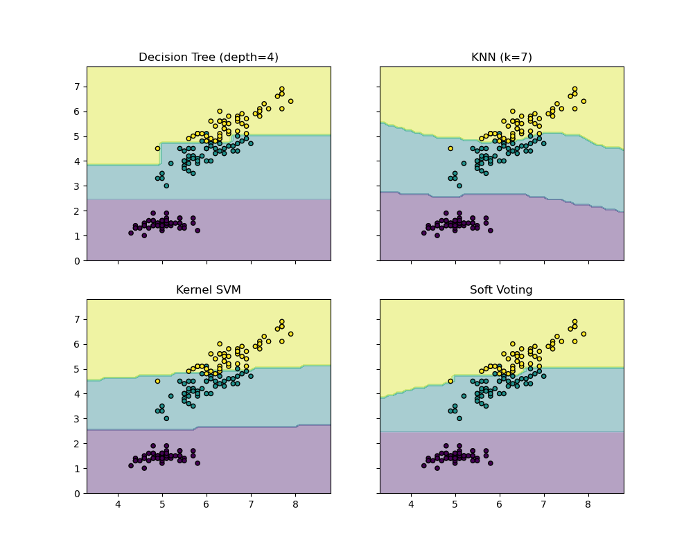
Voting ensemble models
Voting: combine several strong classifiers that use different methodologies into a single classifier
The weaknesses of each individual model hopefully cancel each other out
You can use any type of models you want for these voting ensembles
Image from https://scikit-learn.org/stable/modules/ensemble.html#voting-classifier

Slide 23
Practical advice: training and tuning Decision Trees
You can make use of categorical features by converting them to numeric
If they represent a range, you can assign them to consecutive integers
If they are non-ordered, one-hot encoding is conceptually more correct
One-hot encoding takes a single categorical feature, and converts it into several binary features representing the same information
You’ll want to limit your features, however, to the smallest number that makes sense
This helps prevent overfitting
When tuning model parameters, automated methods such as GridSearch can help -- we’ll cover this in a few weeks

Slide 24
Homework 2: In-class exercise in groups of 2-3 students
Change all the features of the student dataset to be numeric, using the apply( ) method in pandas.
Think about which can be a range, and which should be one-hot encoded
Modify your homework problem to [in a copy of your Homework 1 file] split your training dataset from earlier into a train and validation set.
Train a RandomForest with the default settings on your training dataset, and run it on the holdout. Report the accuracy of this baseline model.
Choose five parameter+value combinations, retrain the model on your training set for each one, and test it on your validation set. Report which parameters+values resulted in the best performing model.
Now, using your best model, test it on the holdout dataset. Did your results generalize? Write a short paragraph explaining your results.

Slide 25
Homework 2 continued: due in a week
Submit one Jupyter Notebook per group to BB
Begin working on your first project:
If you are working on a semester-long project, the professor will email you by Friday with an approval of your proposal, and edits. In the meantime, you can download and explore your dataset.
If you are completing the shorter projects this semester, begin Project 1 [tabular dataset using RandomForests]

Slide 26
In this lecture we:
Decision Trees
Understand how a decision tree is trained (constructed)
Understand the advantages and limitations of decision trees
Ensembling
Understand how ensembling can be used to build more robust models
Understand some of the options for improving model performance
Understand how forests, boosting, and voting models work
In-class coding examples:
Train a RandomForestClassifier
Tune a RandomForestClassifier

