Slide 1
Classification: Practical issues -- Dataset Engineering

Slide 2
Review from last time
We saw how we can improve performance by ensembling models
We saw how we can improve models through some parameter tuning
Maybe…
But we have yet to see details about how our dataset selection and curation can affect model performance
Often more important than the tuning of the model!

Slide 3
In this lecture you will:
Dataset selection
Understand how to choose the right amount of data for your model
Understand how to manage situations where you have very little data
Understand how to perform feature reduction (and why)
Feature engineering
Understand how adding new information to your dataset can improve performance

Slide 4
Not all data is created equal
Recall, models are trying to learn patterns in the data
If the pattern is easily observed in a small amount of samples, you probably don’t need machine learning and you can just invent your own rules
If the pattern is more subtle or weaker, you’ll need more data
Problems that are hard for humans are typically even harder for machines
Deciding whether this is a photo of a cat or a dog? Easy for humans.
Deciding if this mammogram has a cancerous tumor? Harder for humans.
Humans aren’t great at processing tabular data though, so you might luck out here
The more data you have, the better
But not all data is high quality!

Slide 5
Dataset issues
Noisy labels [example: disease diagnosis codes in health records]
Noisy data [example: errors or variance in reading blood pressure]
Limited number of samples [example: x-rays of COVID19 lungs in 2020]
Limited generalizability of samples [example: thousands of photos of blood cells, but only from three patients]
More features than samples
Your model will be prone to overfitting
Useless features
Your model may learn spurious correlations and therefore not generalize
Missing feature values for some samples

Slide 6
Handling noisy labels and noisy data
Noisy means here the values are not exactly what they should [theoretically] be
The model will learn the wrong pattern
Simplify your data to reduce noise (where possible) -- recall how decision trees work:
Turn an ordinal feature into a binary one [when the distinction is not really important]
Reduce the number of categories by including “Other” or cutting off long tails
Have multiple human labelers vote on labels to reduce variance
Discard samples you have low confidence in

Slide 7
Handling limited number/generalization of samples
Obtain more data…
Train a model on a related, larger dataset and transfer those learnings to your current model
More on this later this semester
If you have multiple samples from the same patient, make sure no patient data is split across training-holdout
Feature engineering: bring in new knowledge from an outside source that is useful
Example on next slide
Be mindful of how you weight your data
Semi-supervised learning and other techniques we’ll mention later

Slide 8
Example of Feature Engineering: Titanic Dataset
https://www.kaggle.com/c/titanic/data
If gender was the most important feature for survival, and we didn’t have that information from the dataset itself, could we derive it from the name column?
This is bringing outside knowledge (about the relationships between name and gender) to our problem
Another example: interaction terms for height and weight when modeling heart disease risk from electronic health records
Why would a decision tree (and other models like linear regression) not do a great job handling these types of relationships?
Some models “don’t need feature engineering” -- neural nets

Slide 9
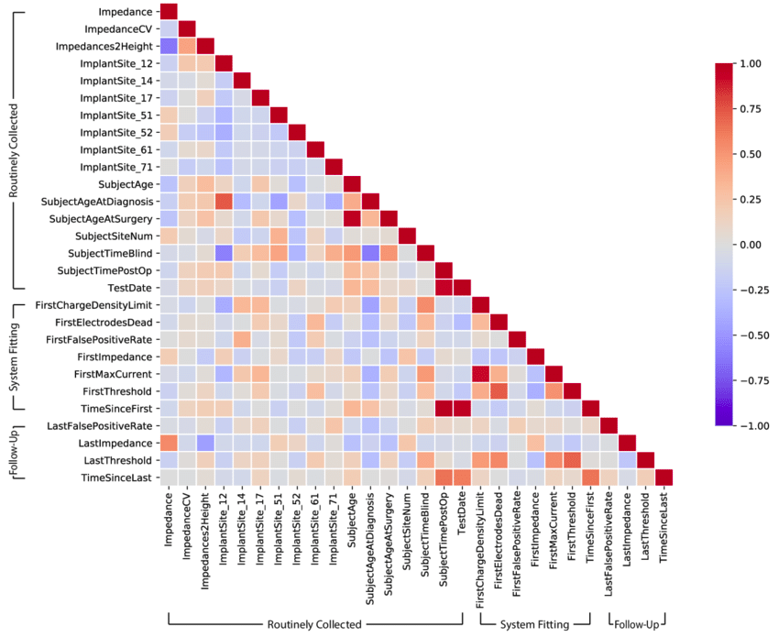
Handling too many features
If you have more features than samples, how many of those features are really meaningful?
Recall, decision trees don’t do well with lots and lots of features
If you have to one-hot encode a very large categorical variable, you’ll end up with a lot of features
Check for features that are highly correlated and drop one of them
Perform dimensionality reduction via a Principal Component Analysis (PCA)
Image above from Hu et al “Explainable AI for Retinal Prostheses: Predicting Electrode Deactivation from Routine Clinical Measures”

Slide 10
Handling incomplete data with missing values
Real world data often has missing values for various reasons
Models such as decision trees implemented in scikit-learn cannot handle missing values (NaN)
If you have a large dataset and few records with missing values, you can probably drop those records
If you need to keep the records, you have a few options:
Impute the missing data (use average value or something more fancy)
Convert the column into a binary column (has price or not) if that makes intuitive sense to add value
Convert the missing value to be zero; this can be dangerous

Slide 11
Data Scientists spend most of their time cleaning and curating data
This class is about Machine Learning (more theory) versus Data Science (more applied)
Many data scientist positions have “coding homeworks” that are assigned as part of the interview process
Can take anywhere from 6 - 48 hours
Are usually pretty simple (don’t expect you to use a GPU)
You’ll spend most of your time cleaning and curating the dataset they gave you, not tuning the model you’re training
Machine Learning researchers will often encounter real-world data (hopefully!) where you’ll also have to deal with these kinds of issues
A good dataset will typically get you further than exhaustive model tuning
You can’t learn what isn’t there...

Slide 12
Input Representations
We discussed how models need numeric representations of the data for training
You can convert categories to integers, for example, etc.
Many models also benefit from feature scaling/normalization (or even require it!):
Imagine you have features in different units (kg, mm) -- a small absolute change means different things for these different columns! Takes long to learn the right weights…and hard to interpret
Use feature scaling to put all the features on the same scale and/or normalization to put features on a 0-1 scale
Options, explained in python: https://python-data-science.readthedocs.io/en/latest/normalisation.html
Be careful about scaling your train vs test data
Your model should “not be aware” of the distribution in the test data in order to meaningfully try to measure generalization
Notes:
KNN and distance algs require same scale

Slide 13
Homework 3: In-class exercise in groups of 2-3 students [until last 10 minutes of class]
Download the Open Source Mental Health in Tech Survey: https://www.kaggle.com/osmi/mental-health-in-tech-2016
Clean the dataset to:
Handle the missing values. Write a short paragraph explaining your reasoning (did you drop them? Impute them? Other).
Reduce the number of features. Write a short paragraph explaining your rationale for which features you dropped, combined, or other techniques you may have used.
Reduce the cardinality of one feature. [This is for practice; there aren’t really any high cardinality features here]
Scale/normalize at least one feature. [This is for practice, our RF doesn’t really care too much]
Are there any features you would want to one-hot encode? Why or why not?
If you had the time (and assume you could implement), what features would you engineer?
One team member submit your code and writeup on BB by next class

Slide 14
Handling class imbalances
Classifiers are easiest to train/evaluate when the number of samples in each class is the same
Often, this is not the case
Credit card fraud, cancer diagnosis, and other “rare events”
You could train an almost-perfect model if it always returned “no cancer”
Choosing the right evaluation metrics will help put your model performance into perspective; next class
There are also options for reweighting the samples during training to help counter the class imbalance, including:
Downsampling: subselect from the more common class to match the size of the rare one
Upsampling: “make copies” or use other heuristics to generate synthetic samples of the rare class
Which you can use depends on the size of your dataset

