Slide 1
Regression, Linear models

Slide 2
Review from last time: Exam 1
We’ve discussed classification, using Decision Trees as an example
Decision Trees are non-parametric: make no assumptions about the shape of the data
We’ve discussed model selection, tuning, and evaluation on classification problems
Part of model tuning is to prevent the model from overfitting

Slide 3
In this lecture we will:
Understand classification with a linear model
This type of model trains weights that create a line
Understand loss functions
Introduce the regression class of problems
Understand how a linear model can be used for regression
Understand how a decision tree can be used for regression
Understand regularization of linear models

Slide 4
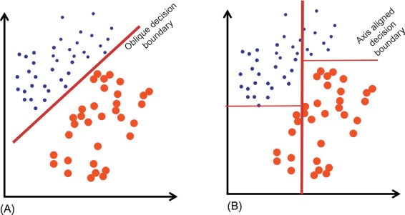
Recall decision boundaries with decision trees
The boundary on the left better captures this relationship
But a decision tree can’t generate this type of boundary effectively; its boundaries look like the graph on the right
Image from https://www.sciencedirect.com/topics/engineering/decision-boundary

Slide 5
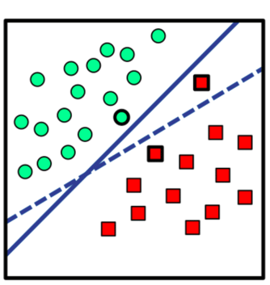
Example of binary classification with a linear model
The two classes can be effectively split using a hyperplane
Recall the formula for a line is
We are trying to find the best-fit line
Modify the slope m
Modify the intercept b
Once you have trained such a model, you can predict new points by checking what side of the hyperplane they fall on
y = mx + b
Image from Pischedda, “Rule-guided behaviour: how and where rules are represented and processed in human brain.”

Slide 6
Linear models and weights
Training a linear model means finding the best slope and intercept for the formula y = wx + b
Here, we consider w and b the trained weights of the model
x is a feature
If we have more than one feature, our formula will look like
We would train the model to find all of the best weights for all the features
Finding the best weights for this model is another optimization problem, just like finding the best decision tree for a given sample set
y = w⁰x⁰ + w¹x¹ + … + w^{n}x^{n} + b

Slide 7
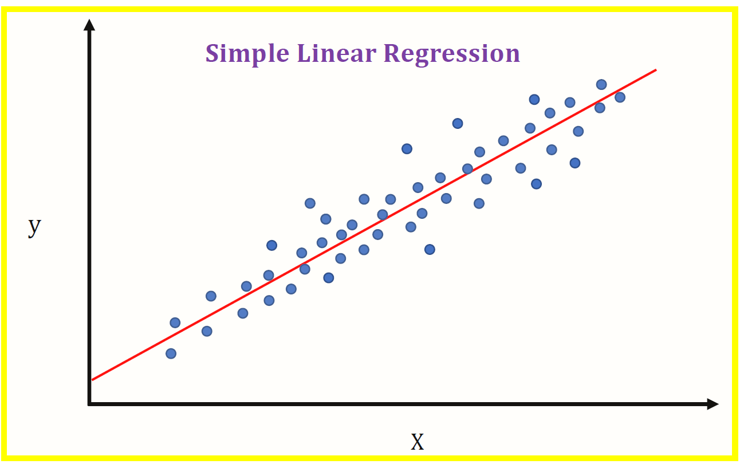
Using linear formulas for machine learning
A linear model y = m⁰x⁰ + m¹x¹ + … + m^{n}x^{n} + b can only be used for binary classification, as it splits the input space
What is above the line, vs what is below the line
In the real world, problems are rarely linearly separable
Linear regression (and regression in general) is a type of model that predicts a value, rather than a class
We are fitting a line to the data, like with classification
However, the line predicts a value, rather than splitting classes
Same formula as above
Image from https://medium.datadriveninvestor.com/machine-learning-101-part-1-24835333d38a

Slide 8
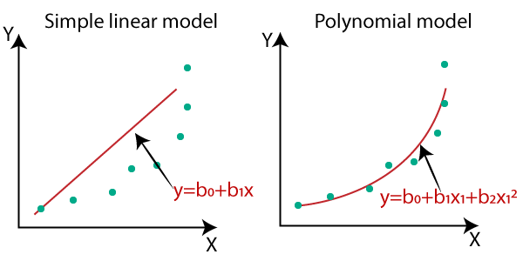
Linear Regression
Adding higher-order polynomial features (i.e. x², x³, etc.) allows you to draw curved lines
Image from https://medium.datadriveninvestor.com/complete-guide-on-linear-regression-vs-polynomial-regression-with-implementation-in-python-964c64c28aa8

Slide 9
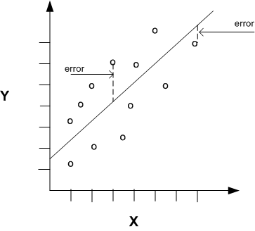
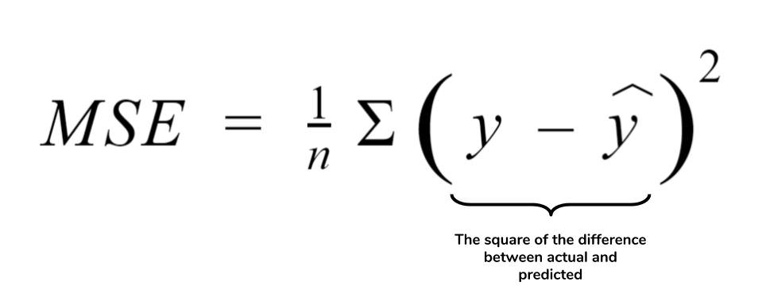
Loss functions for training regression models
We’re no longer answering the binary question, “is this the right class or not?”
Instead, we want to see how close our prediction was to the correct value
Mean Squared Error (MSE) loss
Averages the loss across all samples
We want to minimize MSE
Other loss functions also exist for regression, with various tradeoffs around sensitivity to noise/outliers, etc.
Image from https://educationalresearchtechniques.com/2015/11/30/simple-regression-in-r/

Slide 10
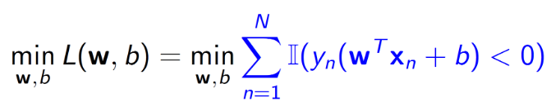
Linear models and loss functions
Recall, we are trying, in general, to minimize loss functions in machine learning
This is how we train our models; loss functions not only tell the model what it predicted incorrectly during training, but, via a penalty, inform the model of how to improve itself
For linear classification models, we are trying to minimize the loss:
The indicator function I assigns 0 or 1 depending on which side of the hyperplane the prediction falls on; this is called 0-1 loss
Finding the best weights to minimize 0-1 loss is also NP-hard (like optimization for decision trees); let’s see how we can approximate this loss function
NP-hard means “non-tractable”

Slide 11
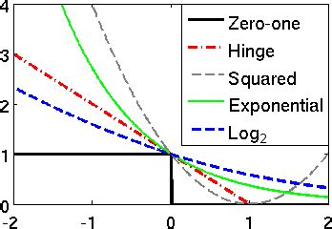
Zero-one loss
Image from https://www.researchgate.net/figure/Convex-surrogates-for-the-zero-one-loss_fig1_283782155
“step function”
Non-convex
Non-smooth

Slide 12
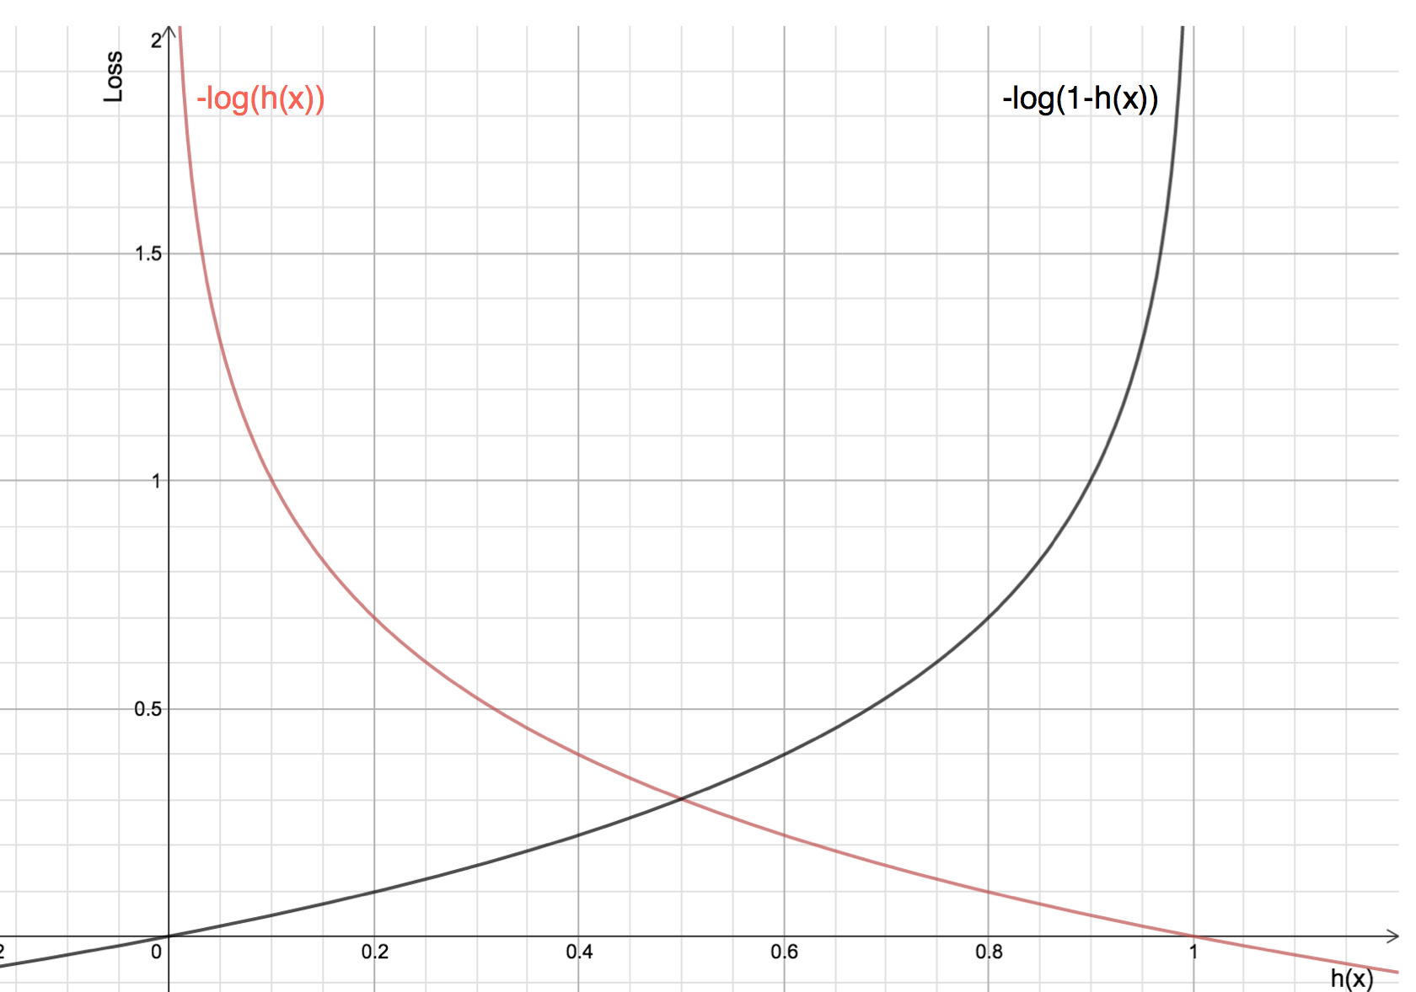
Approximating 0-1 loss for binary linear classification
0-1 loss is non-convex, non-smooth; small changes in the weights can lead to large changes in the loss
This is bad; hard to learn best weights
Convex upper bounds on 0-1 loss exist:
Log loss (binary, at right) aka cross-entropy loss (for multi-class, difference between probability distributions)
Several others
It’s much easier to optimize a loss function that is smooth and convex, than 0-1 loss
For example, using gradient descent (next lecture)
Image from https://www.analyticsvidhya.com/blog/2020/11/binary-cross-entropy-aka-log-loss-the-cost-function-used-in-logistic-regression/

Slide 13
How can we create a linear binary classifier?
Want to maintain a “line” shape (as opposed to decision trees)
Want to also, for example, use log loss to be able to more effectively find the best weights
Minimize this loss via optimization (next class)
Have a more meaningful loss?
Let’s take a look at Logistic Regression

Slide 14
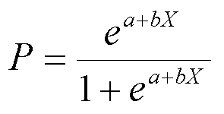
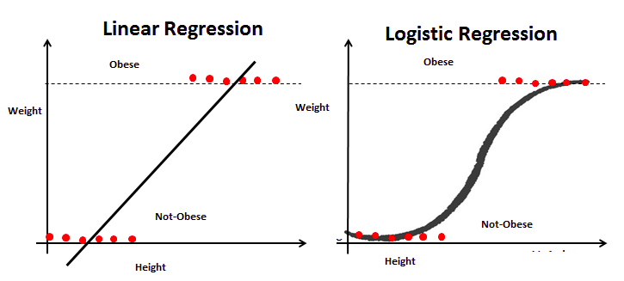
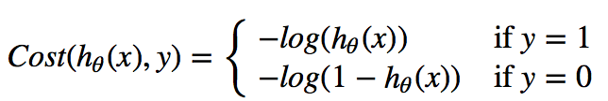
Logistic Regression as a classifier
Logistic Regression (a binary classifier) is a very common model that uses log loss to learn optimal weights
Logistic Regression is a way we can “split” our data -- we are trying to fit the Sigmoid curve (logistic curve) using log loss (next slide) on the predictions of the logit formula
Predictions must range between 0 and 1 (unlike linear regression)
Log loss punishes a wrong 0 or 1 prediction more severely than minimizing MSE
Logit formula
1
Image from https://www.analyticsvidhya.com/blog/2020/12/beginners-take-how-logistic-regression-is-related-to-linear-regression/

Slide 15
Log loss for binary classification, again
Image from https://www.analyticsvidhya.com/blog/2020/11/binary-cross-entropy-aka-log-loss-the-cost-function-used-in-logistic-regression/

Slide 16
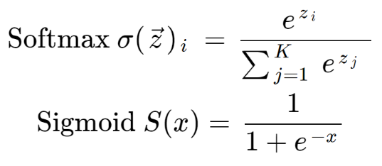
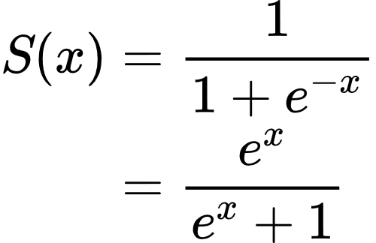
Multi-class classification using the sigmoid function
The sigmoid function (not to be confused with the loss function) we just saw is a special case of another function called the softmax function
The sigmoid we used for binary classification
We can use the same shape for multi-class classification
Softmax takes a vector of values and transforms them to all be between 0 and 1, and also sum to 1
Each class prediction is therefore is represented with some probability
With neural nets, converts the outputs of neurons (per class) into a normalized probability distribution
Easily digestible further reading: https://deepai.org/machine-learning-glossary-and-terms/softmax-layer (image from this link)
Slide 14
Above, softmax takes a vector, while sigmoid takes a single value
Both return a probability (or probabilities) for each class

Slide 17
What are some other optimizations for linear models?
That is, what other constraints can be imposed on how weights are learned for these types of models?

Slide 18
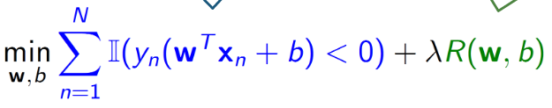
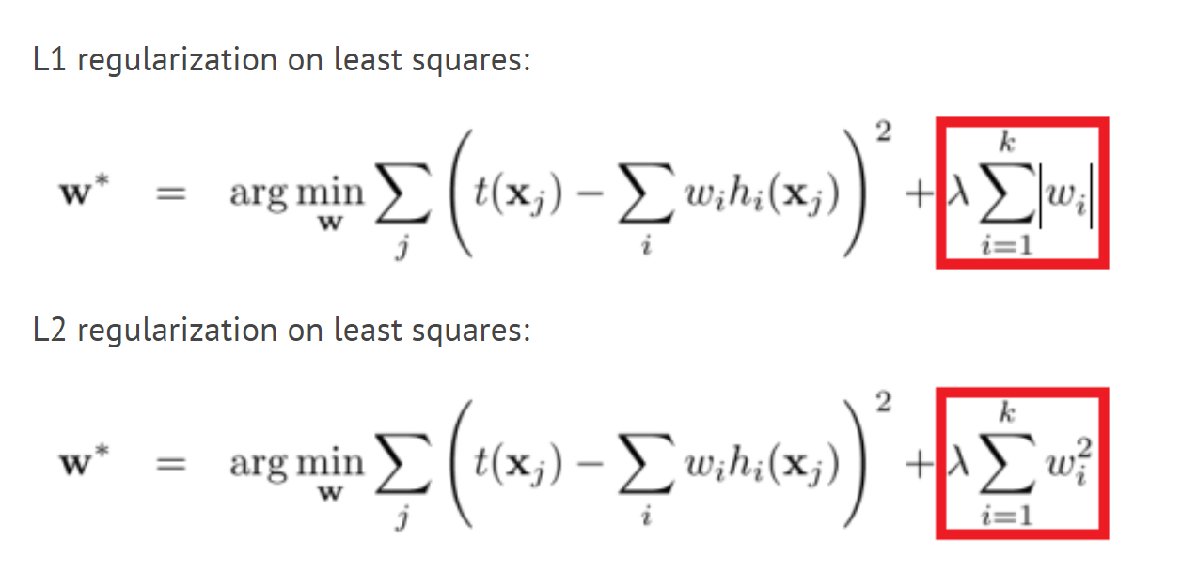
Regularization
Recall, it is generally desirable to have our models use as few features as necessary
Simple solutions generalize better
In an effort to train our models to have as many weights be pushed to zero as possible, we can introduce regularization
Add a parameter to our formula for minimizing loss that punishes non-zero weights (green)
Many regularization options for linear models:
L1: encourages zero coefficients (feature reduction if you have many features); implemented in Lasso linear model
L2: encourages zero coefficients for less predictive features by penalizing coefficient size; implemented in Ridge linear model
ElasticNet: combines L1 and L2 regularization
Implemented with alpha parameter to control the amount of regularization: https://scikit-learn.org/stable/modules/linear_model.html

Slide 19
What is the benefit of reducing our active features?
The model can fit a good line using all the features, so why bother?
Simpler models (with fewer features) are less likely to:
Find patterns in the data that aren’t really there (i.e. spurious correlations that don’t generalize)
Even when the correlation isn’t spurious (imagine two features: height in inches and height in centimeters), while the model could generate a good fit using these correlated features, it makes the results hard to interpret if we care to know which features are important
In a different type of model, such as decision trees, we reduced our features:
Manually, or,
We “regularized” the model by pruning the trees and controlling the size of the forest, etc.

Slide 20
How to we minimize our loss functions?
Recall, this is an optimization problem
Gradient descent is a general solution to our optimization problem for
We will cover gradient descent in the next lecture

Slide 21
In-class exercise in groups of 2-3 students [5 mins]
Returning to our student dataset
Replace your target values to be one of the grades (G1, G2, G3), with the remaining numeric features as X
Train a Linear Regression model using https://scikit-learn.org/stable/modules/generated/sklearn.linear_model.LinearRegression.html
Score your model using the LinearRegression’s score( ) method -- note that this is not the loss function, but is spiritually similar in what it is calculating
No need to submit on BB

