Slide 1
Gradient Descent

Slide 2
In this lecture we will:
Gradient descent
Understand at a high level why gradient descent works for this optimization problem
Understand when gradient descent works well
Understand how situations are handled when gradient descent doesn’t work well out-of-the-box
Understand how choosing a good step size is important

Slide 3
Review from last time
Discussed how linear models train a set of weights
Examples: logistic regression, linear regression
Discussed how loss functions evaluate the model performance during training
Including a regularization parameter in the loss function
Goal is to minimize the loss
Nice review of logistic regression and log loss by Andrew Ng: https://www.youtube.com/watch?v=HIQlmHxI6-0
But we still haven’t discussed HOW the loss is minimized during training

Slide 4
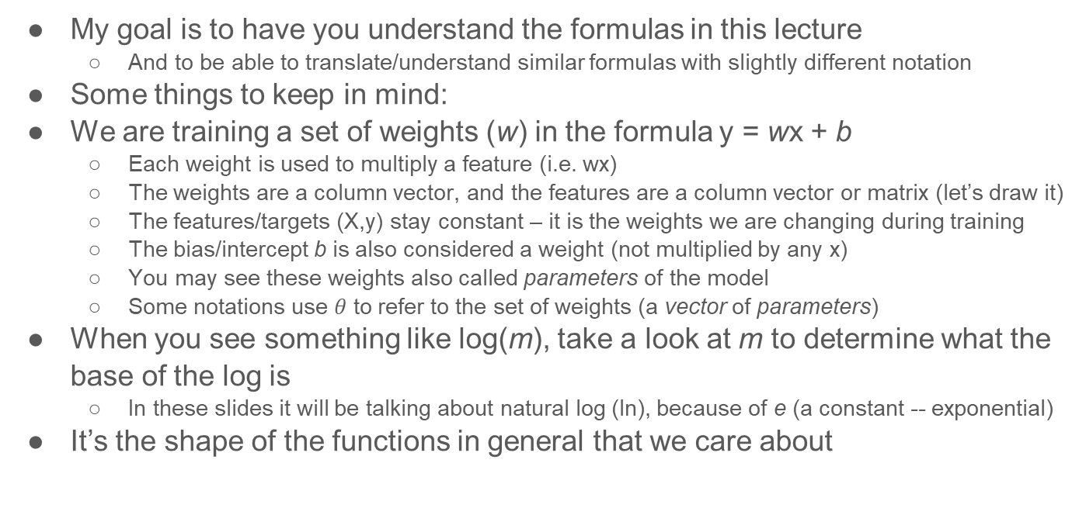
A word on mathematical notations
My goal is to have you understand the formulas in this lecture
And to be able to translate/understand similar formulas with slightly different notation
Some things to keep in mind:
We are training a set of weights (w) in the formula y = wx + b
Each weight is used to multiply a feature (i.e. wx)
The weights are a column vector, and the features are a column vector or matrix (let’s draw it)
The features/targets (X,y) stay constant – it is the weights we are changing during training
The bias/intercept b is also considered a weight (not multiplied by any x)
You may see these weights also called parameters of the model
Some notations use $θ$ to refer to the set of weights (a vector of parameters)
When you see something like log(m), take a look at m to determine what the base of the log is
In these slides it will be talking about natural log (ln), because of e (a constant -- exponential)
It’s the shape of the functions in general that we care about

Slide 5
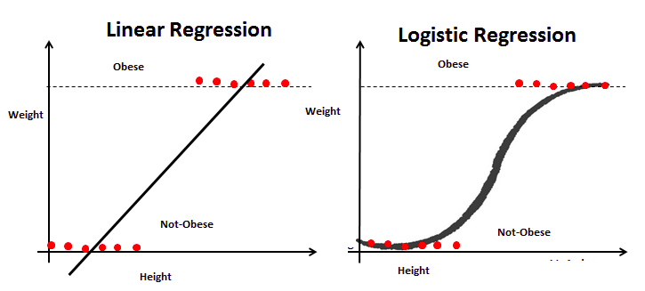
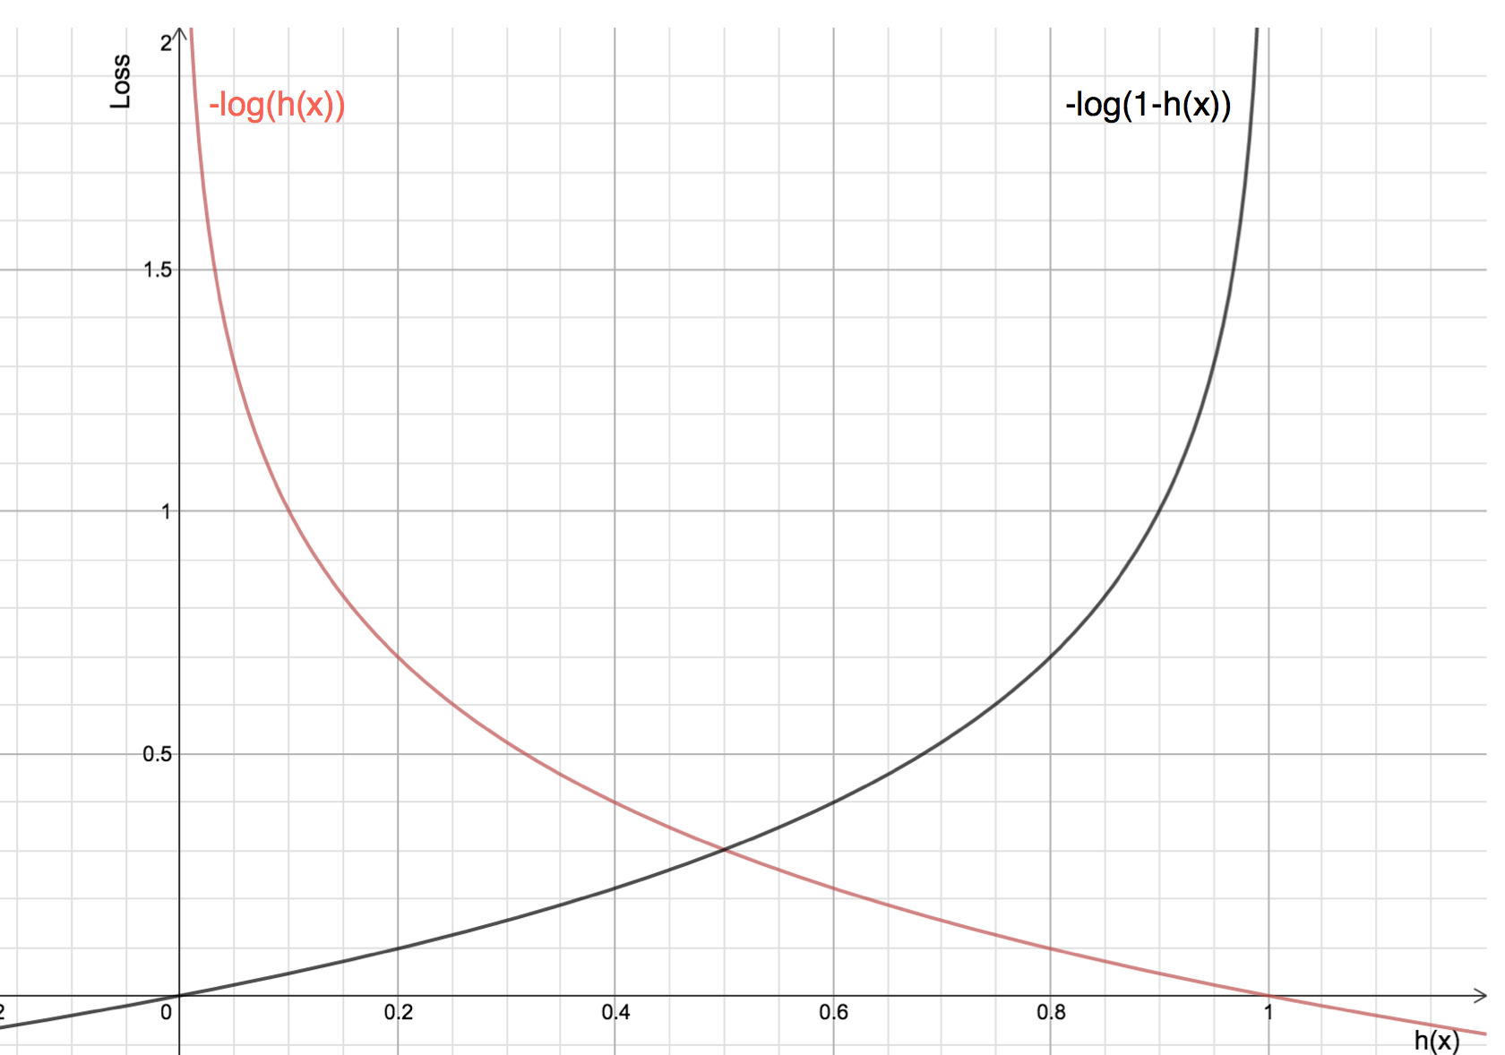

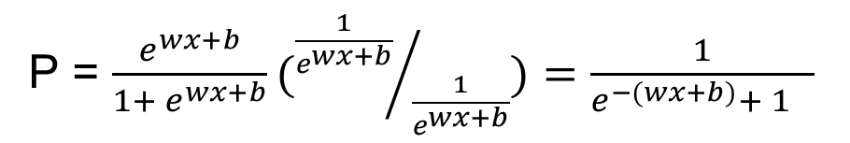

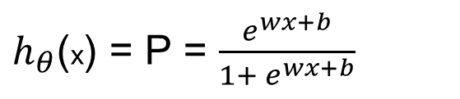
Review of logistic regression and log loss
The linear formula wx+b appears in the logit formula
This function makes predictions in the range of 0 to 1
Let’s try it out with some values
These correspond to probabilities of it being one class or the other
We use log loss as our loss function
To approximate 0-1 loss. Why?
The log loss give a penalty of 0 for a hit, and +$∞$ for a miss
Logit formula(s)
$h_{θ}$(x) = P = $\frac{e^{wx+b}}{1+ e^{wx+b}}$
Loss formula
P = $\frac{e^{wx+b}}{1+ e^{wx+b}}({\frac{1}{e^{wx+b}}}/{\frac{1}{e^{wx+b}}})=\frac{1}{{e^{−(wx+b)}+ 1}^{}}$
Another notation you may see for logit formula

Slide 6
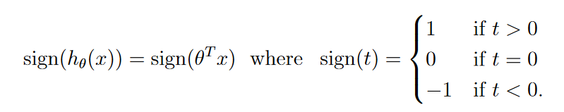
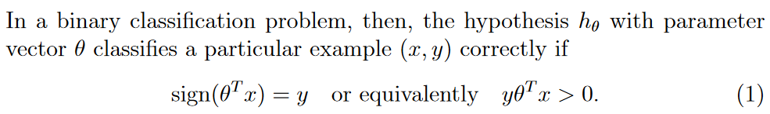

Another way to look at binary classification
Images from https://cs229.stanford.edu/extra-notes/loss-functions.pdf
Another way you may see binary classification defined as defining the two class’ labels as either -1 or 1 (rather than 0 or 1), and then having a function make predictions in the range of –$∞$ to +$∞$
We then only pay attention to the sign of the prediction:
We can evaluate such a predictor looking at if the sign of the prediction matches the sign of our target:
We call the expression ${yx}^{T}θ$ the margin (this is how we will talk about our models now)

Slide 7
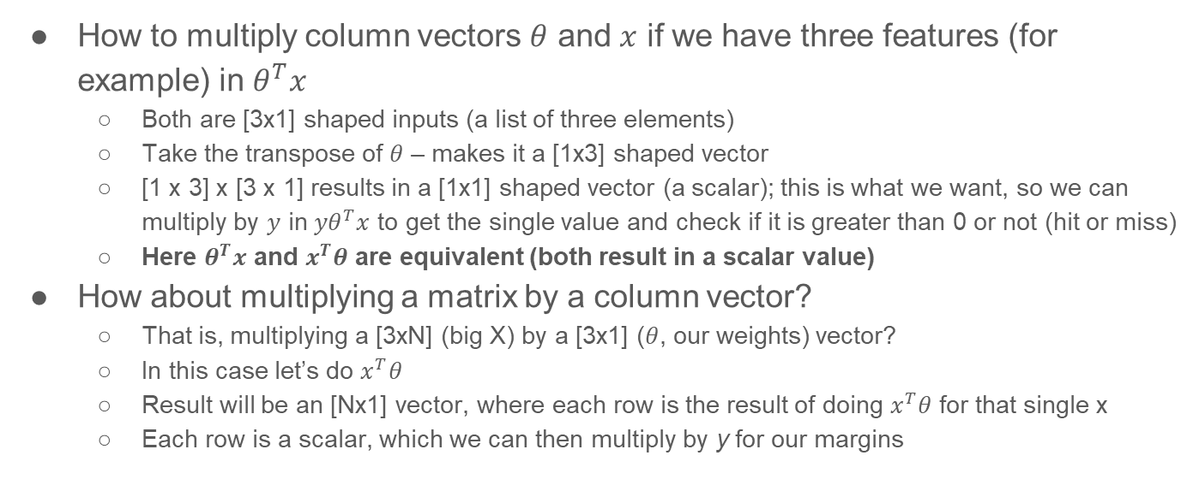
A reminder on matrix multiplication
How to multiply column vectors $θ$ and $x$ if we have three features (for example) in $θ^{T}x$
Both are [3x1] shaped inputs (a list of three elements)
Take the transpose of $θ$ – makes it a [1x3] shaped vector
[1 x 3] x [3 x 1] results in a [1x1] shaped vector (a scalar); this is what we want, so we can multiply by $y$ in ${yθ}^{T}x$ to get the single value and check if it is greater than 0 or not (hit or miss)
Here $θ^{T}x$ and $x^{T}θ$ are equivalent (both result in a scalar value)
How about multiplying a matrix by a column vector?
That is, multiplying a [3xN] (big X) by a [3x1] ($θ$, our weights) vector?
In this case let’s do $x^{T}θ$
Result will be an [Nx1] vector, where each row is the result of doing $x^{T}θ$ for that single x
Each row is a scalar, which we can then multiply by y for our margins

Slide 8
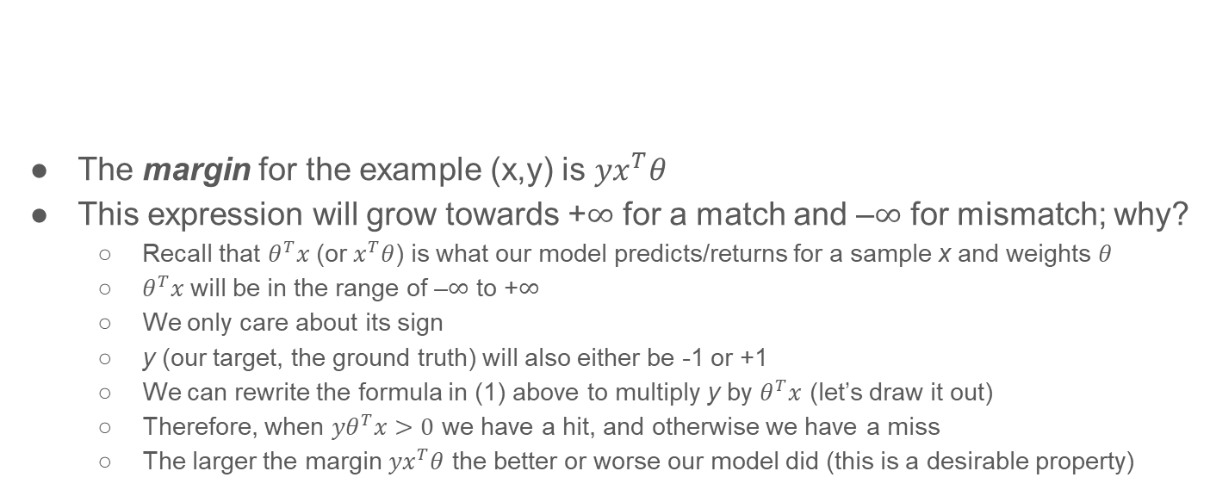
How did we get that expression for the margin?
The margin for the example (x,y) is ${yx}^{T}θ$
This expression will grow towards +$∞$ for a match and –$∞$ for mismatch; why?
Recall that $θ^{T}x$(or $x^{T}θ$) is what our model predicts/returns for a sample x and weights $θ$
$θ^{T}x$will be in the range of –$∞$ to +$∞$
We only care about its sign
y (our target, the ground truth) will also either be -1 or +1
We can rewrite the formula in (1) above to multiply y by $θ^{T}x$ (let’s draw it out)
Therefore, when ${yθ}^{T}x>0$ we have a hit, and otherwise we have a miss
The larger the margin ${yx}^{T}θ$ the better or worse our model did (this is a desirable property)

Slide 9
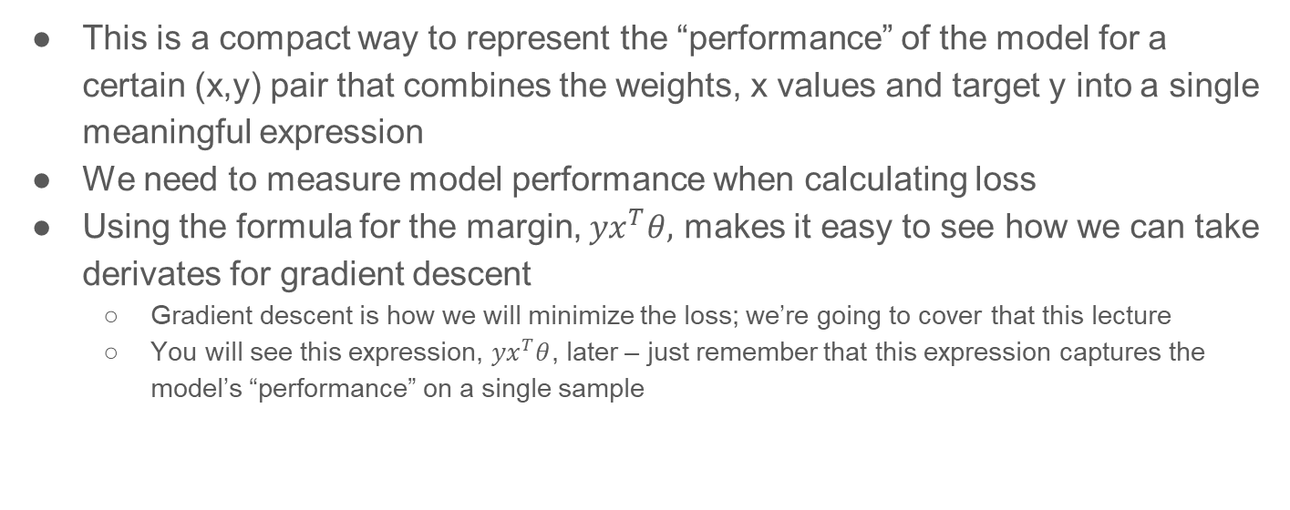
Why do we care about the margin?
This is a compact way to represent the “performance” of the model for a certain (x,y) pair that combines the weights, x values and target y into a single meaningful expression
We need to measure model performance when calculating loss
Using the formula for the margin, ${yx}^{T}θ,$ makes it easy to see how we can take derivates for gradient descent
Gradient descent is how we will minimize the loss; we’re going to cover that this lecture
You will see this expression, ${yx}^{T}θ$, later – just remember that this expression captures the model’s “performance” on a single sample

Slide 10
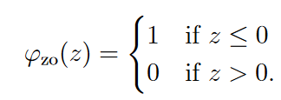
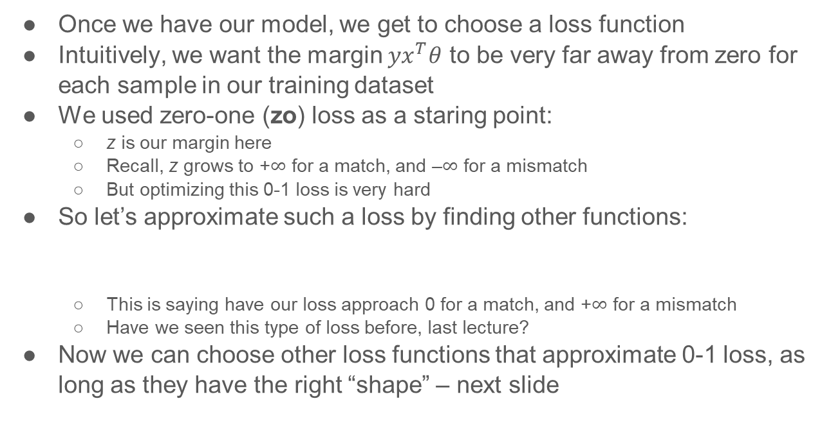
Review of loss functions
Images from https://cs229.stanford.edu/extra-notes/loss-functions.pdf
Once we have our model, we get to choose a loss function
Intuitively, we want the margin ${yx}^{T}θ$ to be very far away from zero for each sample in our training dataset
We used zero-one (zo) loss as a staring point:
z is our margin here
Recall, z grows to +$∞$ for a match, and –$∞$ for a mismatch
But optimizing this 0-1 loss is very hard
So let’s approximate such a loss by finding other functions:
This is saying have our loss approach 0 for a match, and +$∞$ for a mismatch
Have we seen this type of loss before, last lecture?
Now we can choose other loss functions that approximate 0-1 loss, as long as they have the right “shape” – next slide

Slide 11



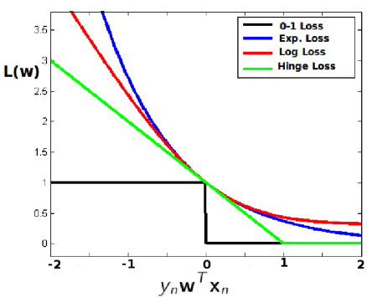

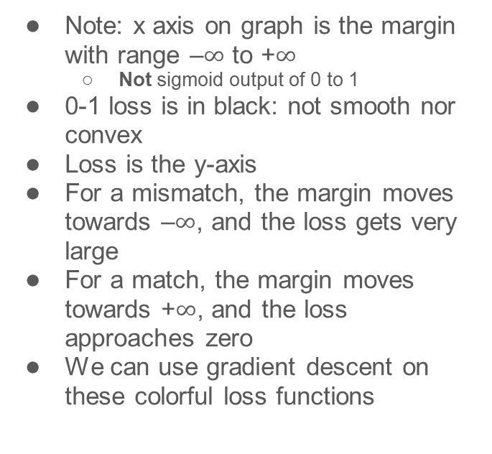
Shape of loss functions revisited
Image from https://www.cs.umd.edu/class/spring2018/cmsc422-0101/slides0101/lecture13.pdf
Loss defined on margin, not prediction
Note: x axis on graph is the margin with range –$∞$ to +$∞$
Not sigmoid output of 0 to 1
0-1 loss is in black: not smooth nor convex
Loss is the y-axis
For a mismatch, the margin moves towards –$∞$, and the loss gets very large
For a match, the margin moves towards +$∞$, and the loss approaches zero
We can use gradient descent on these colorful loss functions
== ${yx}^{T}θ==z$

Slide 12

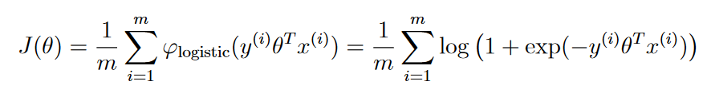

How does this connect to logistic regression last class?
If we define our target labels as -1 or 1 (rather than 0 or 1), you can rewrite the logistic regression loss formula :
Which we then want to minimize:
The more positive the margin , the better! (means it was a match)
Why are we bothering with this alternate formulation? Easier to see how to do gradient descent calculation, when we involve the margin, and some models do not output predictions on a 0 to 1 range (more on this later)

Slide 13
Loss functions and margins
Rewriting the problem to make predictions for targets that are -1 or +1 allows us to rewrite our loss functions to take the margin as their argument
These loss functions can then be used to approximate zero-one loss more easily
Now, we can minimize the loss by finding the best weights for all features

Slide 14
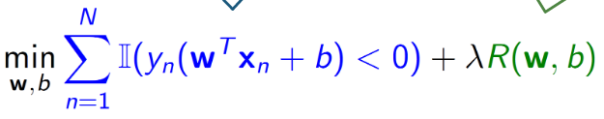
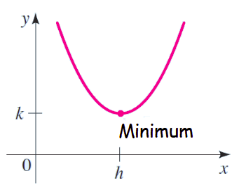
How to minimize the loss function
Recall, we are trying to minimize the function at right -- what does this mean?
Find the weights (w, b) that, when applied to all of our samples, return the smallest value overall for the equation above
Each weight w corresponds to a feature x in a single sample; b is the intercept (allows you to move the decision boundary up/down)
Not only finds the best raw fit (in blue), but regularizes the weights (in green)
If we can graph the loss function performance on the data, our goal is to find the x-axis value(s) [weights] that yield the smallest y-axis value [loss] for your particular samples
loss
margin/
model performance

Slide 15
Graphing the loss function performance, simplified
This it NOT the loss function! This is graphing the performance of different models
Imagine we’re trying to build a classifier
Each possible model has a loss value associated with it
Using some set of chosen weights, measured on all training data points
A perfect classification will have a loss value of 0
If you change the weights, the loss value for that particular model also changes
The further you move from the optimal model, the progressively worse your loss scores get
We can graph the relationship between the candidate models/weights, and their losses
Ideally, this is a continuous function in the shape similar to a parabola
Has a minimum value representing the best-fit model
With this type of graph (a convex shape), we can use gradient descent to find the best model with smallest loss
loss
model/weights

Slide 16
Conceptual pieces in minimizing the loss
Your function to generate predictions should [ideally] be continuous and differentiable (calculate the slope at all points)
For example, like the sigmoid function (as opposed to a decision tree -- stepwise)
Your loss function should also be continuous, differentiable, and [ideally] convex
For example, like log loss (as opposed to 0-1 loss)
You then can minimize the loss overall by combining these two functions (your predictions feed into your loss function), and taking the derivative of that for some specific weights on the training dataset (X,y)
The gradient will tell you in which direction to adjust the weights, and by how much

Slide 17
Intuition for minimizing loss: how to find the minimum of y = x²
We want the x value that yields the smallest y
In the graph to the right, when x == h, y is at its lowest value, k
Start by randomly picking an x value
Let’s say x = 3
What is the slope of the function at x = 3?
It’s positive…
We want it to be flat…
So we know we need to make x smaller…
Reduce x by some amount
How steep the slope is tells us how much to change x by…
And repeat the previous bullet
If the slope is negative, we went too far and want to increase x’s value
Stop when slope is 0 (or close or out of time) – this is when x == h
3
Now let’s see how this applies to minimizing the loss!

Slide 18
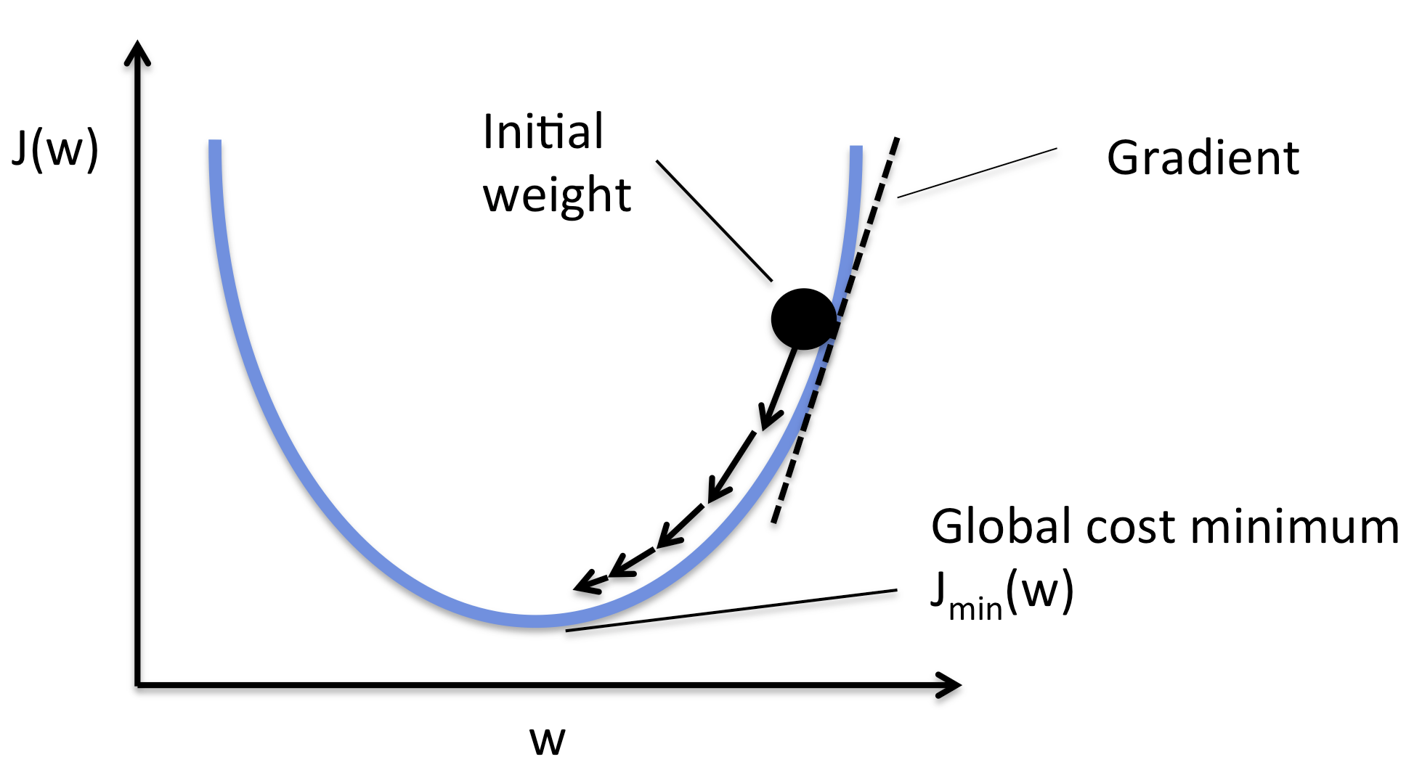
How do you find the slope of a function at a point?
That is, how do you find the gradient?
We can calculate the derivative of a function (in many cases) with respect to a variable;
d/dx x² = 2x
d/dx x² + x³ = 2x + 3x²
d/dx x^{n} = nx^{n-1}
d/dx e^{kx} = ke^{kx}
The derivative gives us the gradient
Why do we care about the gradient again?
That slope tells us in which direction to pick a new value for x to minimize y
And when discussing minimizing a loss, recall, the feature values are static; it’s the weights that we are going to change

Slide 19
How to calculate the gradient?
Recall, a gradient is used to measure the slope of a line
Derivative is a rate of change, the slope of the function at a point (used for intercept b)
Gradient: a vector that points to the steepest ascent (used for vector of weights)
You can take a gradient/derivative of your loss function for all the weights and the bias to know how to update the weights
Partial derivates allow you to calculate/adjust the individual weights
We will work through an example on the next few slides using exponential loss (easy to take derivative)
Not guaranteed to find the global minimum
May get stuck in local minimum depending on initialization and step size
Not all functions are differentiable everywhere
Example: hinge loss
Also, not all loss functions need gradient descent
Some can be solved using closed-form (i.e. MSE for linear regression: https://sebastianraschka.com/faq/docs/closed-form-vs-gd.html)

Slide 20
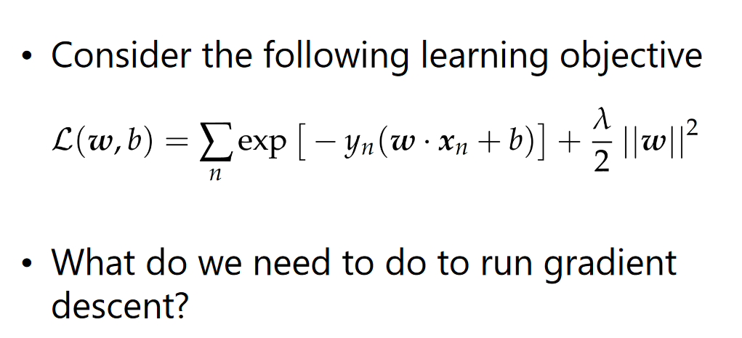
From https://www.cs.umd.edu/class/spring2018/cmsc422-0101/slides0101/lecture13.pdf
Exponential loss; an example of a loss function
We need to handle b (bias/intercept) as well as w (our vector of weights)
Recall, our goal is to know how much to adjust all the weights and b by, and what direction
loss
regularization (optional)

Slide 21
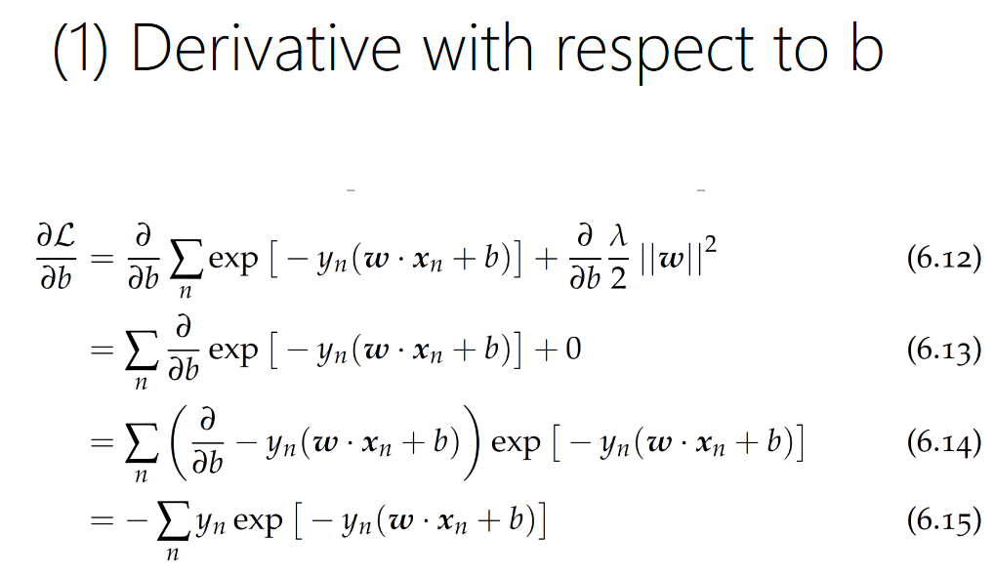
From https://www.cs.umd.edu/class/spring2018/cmsc422-0101/slides0101/lecture13.pdf
d/dx e^{kx} = ke^{kx}
Taking the derivative results in an expression that yields a scalar when we plug in our current weights and b on all the samples in our training dataset
This scalar tells us in what direction, and by how much, to adjust b by (this is how we learn the best value for b)
old target
old prediction

Slide 22
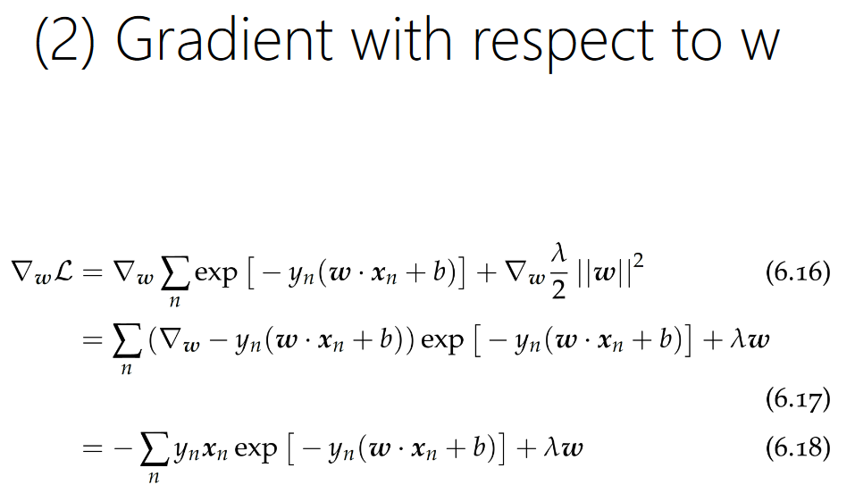
From https://www.cs.umd.edu/class/spring2018/cmsc422-0101/slides0101/lecture13.pdf
d/dx e^{kx} = ke^{kx}
w is a vector of weights, and we want to know how much to adjust each one of them, individually
We take the gradient with respect to w, which yields a bunch of partial derivatives
Looks similar to last slide, just that we’re now multiplying by one weight’s corresponding x feature in our expression (plus regularization)
old target
old prediction

Slide 23
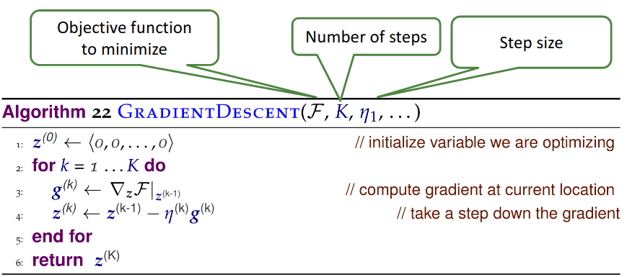
Finding the minimum of a function: gradient descent
Start with random initialization of the model weights
Will place you somewhere on this curve
Take a look at the slope of the gradient at that point
Will tell you in which direction you should adjust the weights to get closer to the minimum
Adjust the weights of your model, and repeat step 2
Until you find the minimum/stop
The step size controls the stride
Images from http://www.cs.umd.edu/class/spring2018/cmsc422-0101//slides0101/lecture13.pdf,
http://rasbt.github.io/mlxtend/user_guide/general_concepts/gradient-optimization/

Slide 24
Gradient descent in python
def gradient_descent(loss_function, X, y, weights, n_iter=50, step_sizes):
for i in range(n_iter):
weights = weights - step_sizes[i] * gradient(loss_function(weights, X, y))
return weights

Slide 25
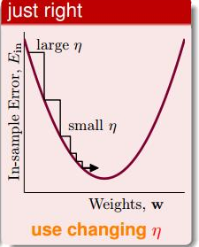
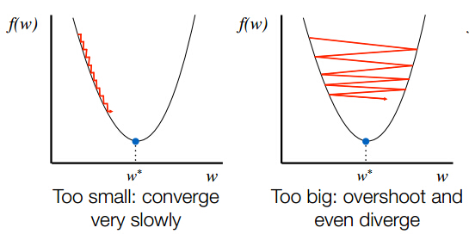
Choosing the right step size
Step size influences both the speed of training, and the ability to find the global minimum
It’s a good idea to start with larger steps, and then go to smaller ones
Image from https://www.programmersought.com/article/84323842168/
Image from https://stackoverflow.com/questions/46569899/gradient-descendent-coust-increass-by-each-iteraction-in-linear-regression-with

Slide 26
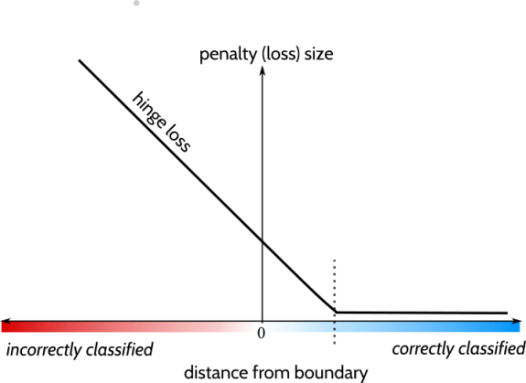

Handling a non-differentiable loss function
Hinge loss function does not have a slope at that one point
We can take the gradient of the loss function for w
But this will be conditional, depending on whether the margin, -y_{n}(wx_{n} + b), is greater than 1 or not, according to the formula above; if it isn’t, our gradient is zero and not -y_{n}x_{n}
We can take the derivative of the loss function for b
This will also be conditional on the margin -y_{n}(wx_{n} + b); our derivative will either be 0 or y_{n}
We can modify our formula for gradient descent calculation to handle these two options
In this case, we use an if statement to decide what value to update the weight gradient and the bias (either zero, or the values above) for every single sample in X when we calculate the gradient for the current step
Image from https://towardsdatascience.com/a-definitive-explanation-to-hinge-loss-for-support-vector-machines-ab6d8d3178f1

Slide 27
Other optimizations: Stochastic Gradient Descent
Stochastic, i.e. introduce randomness, into the gradient descent calculation
Achieved by taking a random subsample of the training data for gradient descent calculation, rather than all the samples
Faster for problems where you have a large number of samples
However, does not perform as well as GD on a convex function to find the global minimum
But, the randomness can help get out of local minima if you are trying to do GD on a non-convex function (think squiggly line)

Slide 28
Linear models and Gradient Descent: Practical issues
Gradient descent is not just used for calculating the model weights; you’ll also see it used for regularization (i.e. L2 regularization with Ridge Regression)
Recall, it’s a general-purpose way to optimize many things!
Library implementations of various linear models often use their own solvers to calculate a step size based on the data
You can’t set it yourself, unless you use a model like sklearn.linear_model.SGDClassifier
Models that are doing SGD are sensitive to feature scaling
Feature scaling also makes the results (learned weights) easier to interpret, even if your model implementation doesn’t require it

Slide 29
Supplemental reading
Slide deck from UMD (we borrowed a lot from here): https://www.cs.umd.edu/class/spring2018/cmsc422-0101/slides0101/lecture13.pdf
Textbook-style notes from Stanford: https://cs229.stanford.edu/extra-notes/loss-functions.pdf
Gradient descent for logistic regression: https://www.internalpointers.com/post/cost-function-logistic-regression

