Slide 1
SVM, Kernels, and KNN classification

Slide 2
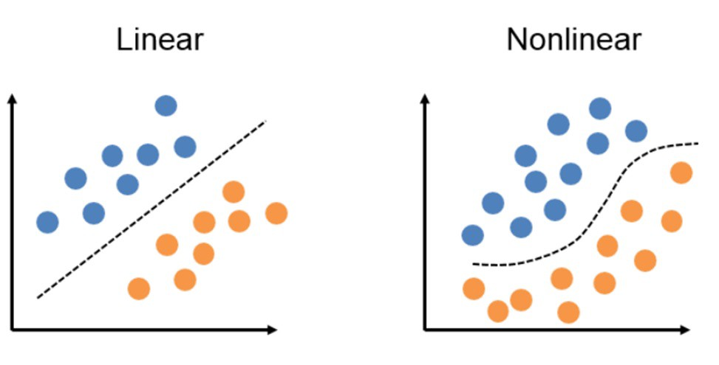
Tradeoffs using NNs
Image from https://towardsdatascience.com/6-steps-to-write-any-machine-learning-algorithm-from-scratch-perceptron-case-study-335f638a70f3
Far more expressive than linear models
Able to learn complex, non-linear patterns in the data
Relatively plug-and-play: no feature engineering
Expensive, expensive, expensive
Typically needs a GPU...carbon footprints!
Can’t always be deployed
Take a very long time to train, data hungry, etc.
What other options do we have for learning non-linear patterns in our data?
SVMs (Support Vector Machines) where data has been transformed in dimensions so that it is linearly seperable in a high dimension
KNN: uses neighbors of points in a class to learn how to classify a new point

Slide 3
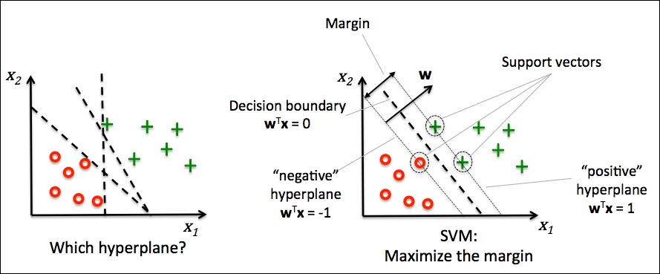
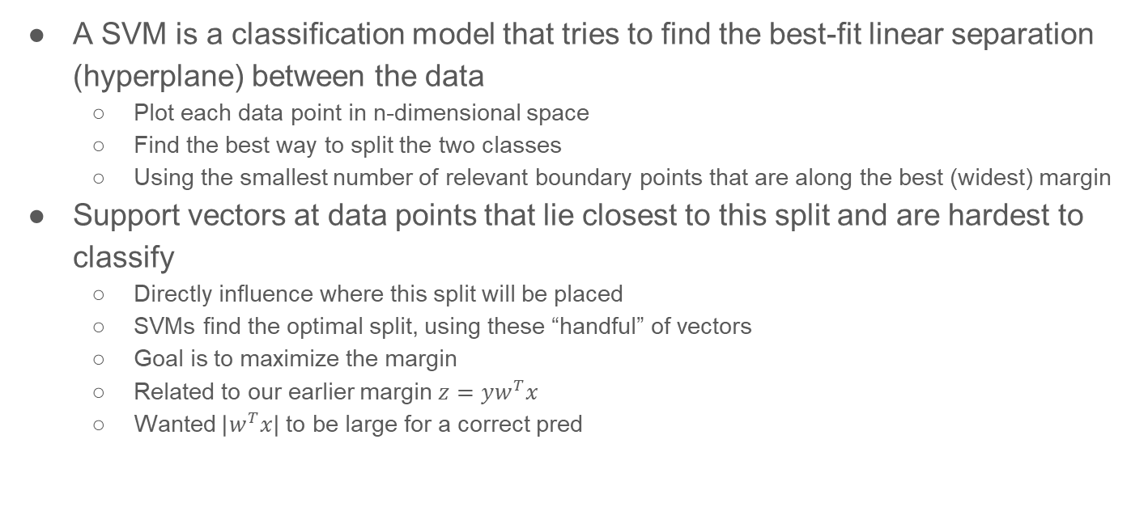
Support Vector Machines (SVMs)
Image from https://www.oreilly.com/library/view/python-machine-learning/9781783555130/graphics/3547_03_07.jpg
A SVM is a classification model that tries to find the best-fit linear separation (hyperplane) between the data
Plot each data point in n-dimensional space
Find the best way to split the two classes
Using the smallest number of relevant boundary points that are along the best (widest) margin
Support vectors at data points that lie closest to this split and are hardest to classify
Directly influence where this split will be placed
SVMs find the optimal split, using these “handful” of vectors
Goal is to maximize the margin
Related to our earlier margin $z=yw^{T}x$
Wanted $\left|w^{T}x\right|$to be large for a correct pred

Slide 4
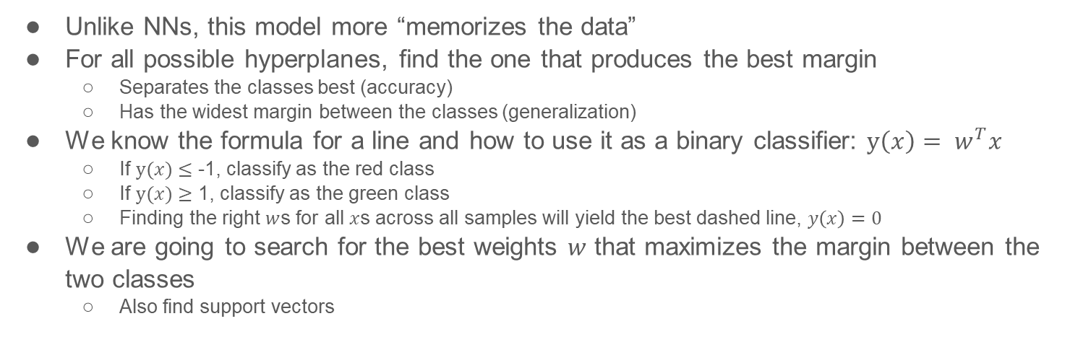
Generating a SVM classifier
Image from https://www.oreilly.com/library/view/python-machine-learning/9781783555130/graphics/3547_03_07.jpg
Unlike NNs, this model more “memorizes the data”
For all possible hyperplanes, find the one that produces the best margin
Separates the classes best (accuracy)
Has the widest margin between the classes (generalization)
We know the formula for a line and how to use it as a binary classifier: $y\left(x\right)= w^{T}x$
If $y(x)$ $≤$ -1, classify as the red class
If $y(x)$ $≥$ 1, classify as the green class
Finding the right $w$s for all $x$s across all samples will yield the best dashed line, $y\left(x\right)=0$
We are going to search for the best weights $w$ that maximizes the margin between the two classes
Also find support vectors

Slide 5
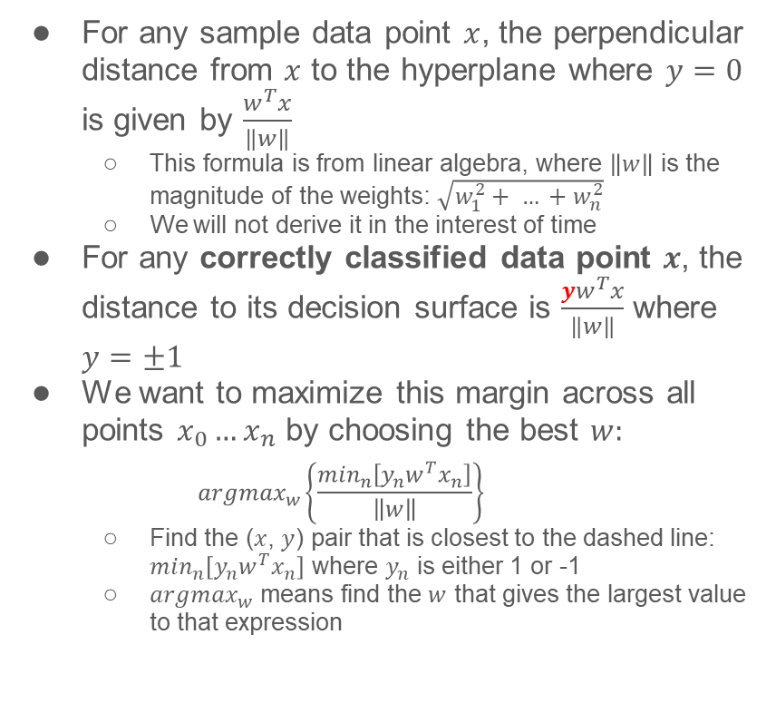
Maximizing the margin
Image from https://www.oreilly.com/library/view/python-machine-learning/9781783555130/graphics/3547_03_07.jpg
For any sample data point $x$, the perpendicular distance from $x$ to the hyperplane where $y=0$ is given by $\frac{w^{T}x}{\left\|w\right\|}$
This formula is from linear algebra, where $\left\|w\right\|$ is the magnitude of the weights: $\sqrt{w_{1}^{2}+ … +w_{n}^{2}}$
We will not derive it in the interest of time
For any correctly classified data point $x$, the distance to its decision surface is $\frac{{yw}^{T}x}{\left\|w\right\|}$ where $y=±1$
We want to maximize this margin across all points $x_{0}…x_{n}$ by choosing the best $w:$
$${argmax}_{w}\left\{\frac{\min_{n}\left[y_{n}w^{T}x_{n}\right]}{\left\|w\right\|}\right\}$$
Find the ($x$, $y$) pair that is closest to the dashed line: $\min_{n}\left[y_{n}w^{T}x_{n}\right]$ where $y_{n}$ is either 1 or -1
${argmax}_{w}$ means find the $w$ that gives the largest value to that expression

Slide 6
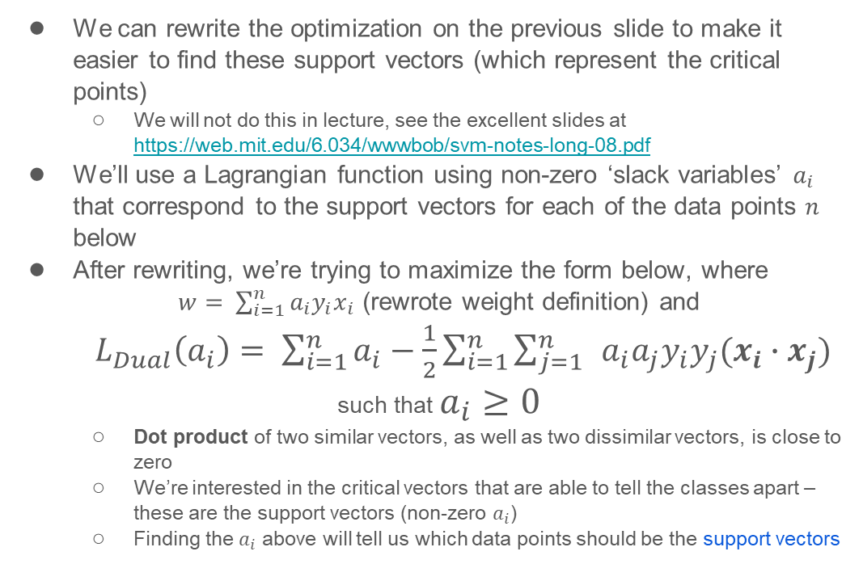
Maximize the margin by finding the support vectors
We can rewrite the optimization on the previous slide to make it easier to find these support vectors (which represent the critical points)
We will not do this in lecture, see the excellent slides at https://web.mit.edu/6.034/wwwbob/svm-notes-long-08.pdf
We’ll use a Lagrangian function using non-zero ‘slack variables’ $a_{i}$ that correspond to the support vectors for each of the data points $n$ below
After rewriting, we’re trying to maximize the form below, where
$w= \sum_{i=1}^{n}{a_{i}y_{i}x_{i}}$ (rewrote weight definition) and
$L_{Dual}\left(a_{i}\right)= \sum_{i=1}^{n}{a_{i}−\frac{1}{2}\sum_{i=1}^{n}{\sum_{j=1}^{n}{ }a_{i}a_{j}y_{i}y_{j}(x_{i}∙x_{j})}}$
such that $a_{i}≥0$
Dot product of two similar vectors, as well as two dissimilar vectors, is close to zero
We’re interested in the critical vectors that are able to tell the classes apart – these are the support vectors (non-zero $a_{i}$)
Finding the $a_{i}$ above will tell us which data points should be the support vectors

Slide 7
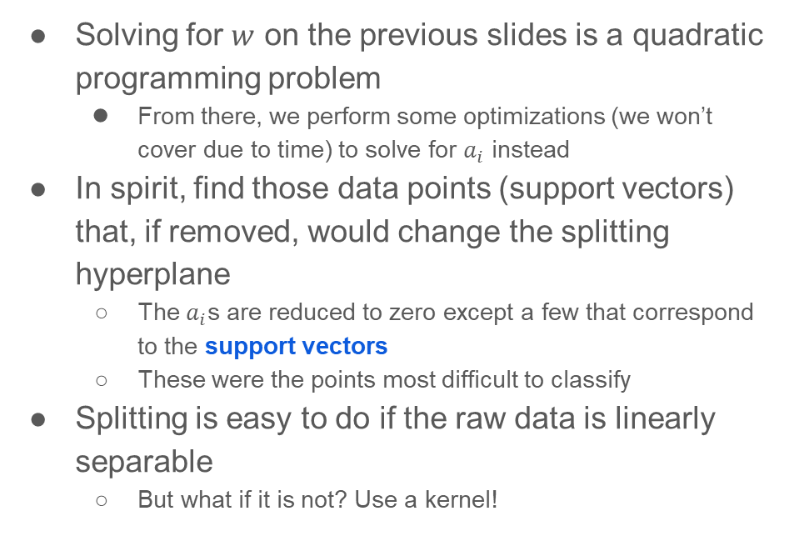
TLDR: solve for the $w$ that maximizes the margin for all $x$s
Solving for $w$ on the previous slides is a quadratic programming problem
From there, we perform some optimizations (we won’t cover due to time) to solve for $a_{i}$ instead
In spirit, find those data points (support vectors) that, if removed, would change the splitting hyperplane
The $a_{i}$s are reduced to zero except a few that correspond to the support vectors
These were the points most difficult to classify
Splitting is easy to do if the raw data is linearly separable
But what if it is not? Use a kernel!

Slide 8
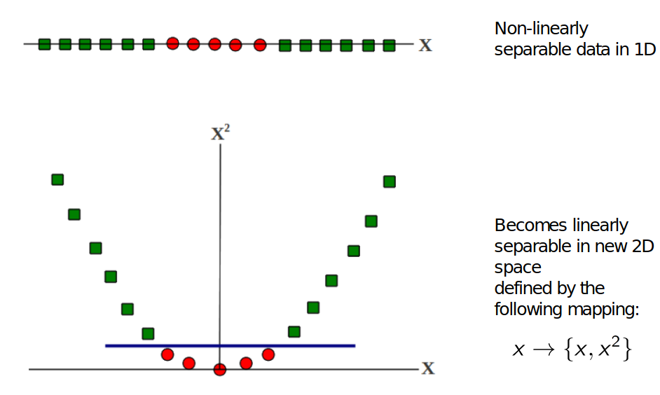
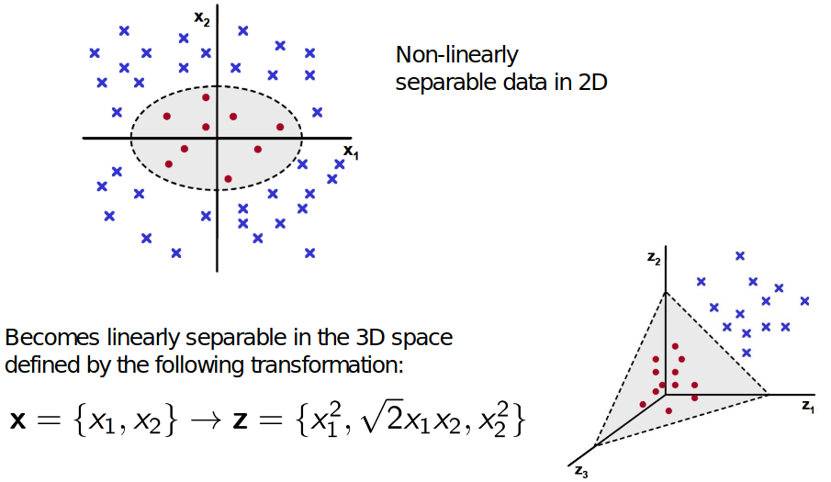
Kernel intuition
Map raw data into higher dimension
The mapped data can then be linearly separated
Images from http://www.cs.umd.edu/class/spring2018/cmsc422-0101//slides0101/lecture21.pdf
Notes:
Example is quadratic feature mapping

Slide 9
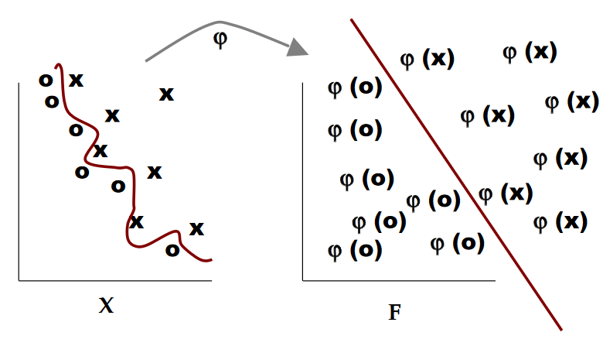
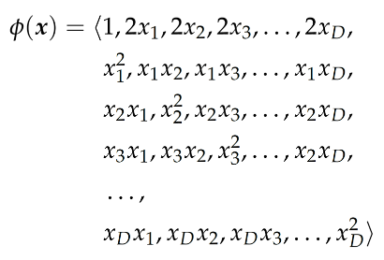
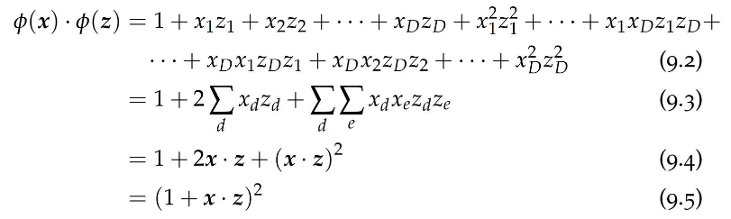

But...now we just have even MORE features!
Image from https://web.mit.edu/6.034/wwwbob/svm-notes-long-08.pdf
We already could see this sort of thing when moving from LinearRegression to PolynomialRegression in scikit-learn; took forever to train, if you ran it
We want to avoid explicitly computing these values
We’ll rewrite the linear models to avoid computing all these new features
The kernel trick: get the dot product easily by choosing a friendly ‘conversoin function’ (we need dot product for SVs)
This is just one example, many others possible
= ...
Images from http://www.cs.umd.edu/class/spring2018/cmsc422-0101//slides0101/lecture21.pdf

Slide 10
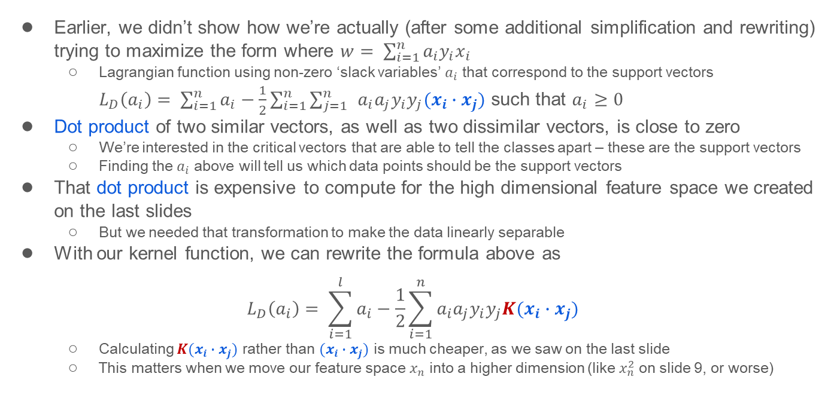
Why do we care about the dot product between two points for SVMs?
Earlier, we didn’t show how we’re actually (after some additional simplification and rewriting) trying to maximize the form where $w= \sum_{i=1}^{n}{a_{i}y_{i}x_{i}}$
Lagrangian function using non-zero ‘slack variables’ $a_{i}$ that correspond to the support vectors
$L_{D}\left(a_{i}\right)= \sum_{i=1}^{n}{a_{i}−\frac{1}{2}\sum_{i=1}^{n}{\sum_{j=1}^{n}{ }a_{i}a_{j}y_{i}y_{j}(x_{i}∙x_{j})}}$ such that $a_{i}≥0$
Dot product of two similar vectors, as well as two dissimilar vectors, is close to zero
We’re interested in the critical vectors that are able to tell the classes apart – these are the support vectors
Finding the $a_{i}$ above will tell us which data points should be the support vectors
That dot product is expensive to compute for the high dimensional feature space we created on the last slides
But we needed that transformation to make the data linearly separable
With our kernel function, we can rewrite the formula above as
$$L_{D}\left(a_{i}\right)= \sum_{i=1}^{l}{a_{i}−\frac{1}{2}\sum_{i=1}^{n}{a_{i}a_{j}y_{i}y_{j}K(x_{i}∙x_{j})}}$$
Calculating $K(x_{i}∙x_{j})$ rather than $(x_{i}∙x_{j})$ is much cheaper, as we saw on the last slide
This matters when we move our feature space $x_{n}$ into a higher dimension (like $x_{n}^{2}$ on slide 9, or worse)

Slide 11
When to use SVMs vs NNs
SVMs were the “most powerful model” for many tasks before Neural Nets became practical and popular
They’re much less popular now (and not really winning any competitions – replaced by NNs)
Finding the right kernel function must be done manually
Unlike NNs, which basically engineer the features themselves
Not all functions can be kernels: must satisfy Mercer’s condition (won’t cover here)
You can look up common kernel functions on your own if interested
But, there may be instances where you don’t want to use a NN because you don’t have the resources to train/deploy one

Slide 12
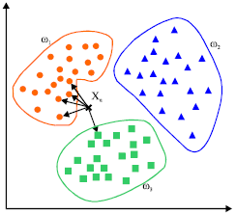
...and one more classification model: KNN
K-Nearest Neighbors (KNN) is a classification algorithm
It uses the distance between data points to determine class membership
Distance can be Euclidian distance between two points
Therefore, important to scale your features!
It’s a non-parametric method, and “memorizes” the data
But can be surprisingly useful in practice, despite its simplicity
The value K stands for how many neighbors it considers before labelling a point
Typically chosen via tuning (try a bunch of K and measure error)
To predict a class value for new data:
Find its distance from all points, sort these distances in increasing order, examine the top K points/distances and use their labels to inform the label of the new point
Image from https://www.mathworks.com/matlabcentral/fileexchange/63621-knn-classifier

Slide 13
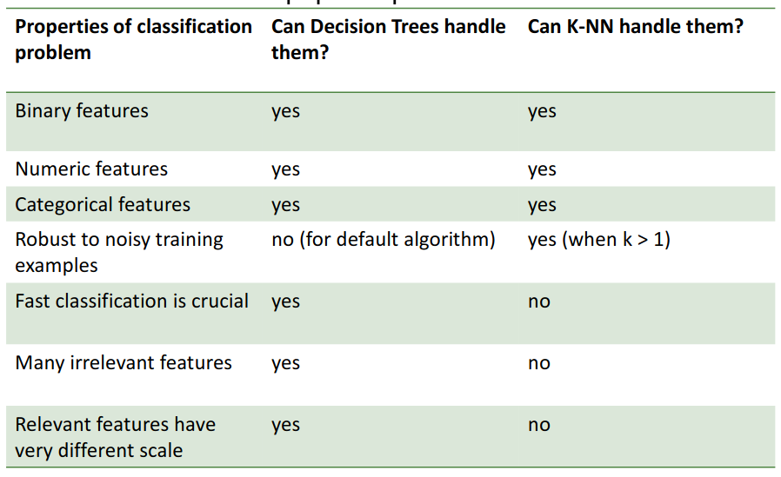
Decision Tree Classification vs KNNs
*
Image from http://www.cs.umd.edu/class/spring2018/cmsc422-0101//slides0101/lecture05.pdf

Slide 14
Rest of class
Work on Project 2: CNNs, or
Work on group project

