Slide 1
Recommendation Systems
Extra Lecture: a high level overview

Slide 2
What are some example recommendation systems you’ve seen?
Related products on Amazon
Movies on Netflix
What else?

Slide 3
How would you create a recommendation system if you didn’t know anything about ML?
Related products on Amazon
Movies on Netflix
What else?

Slide 4
Recommendation outputs
A sorted list of potential recommendations
Display the top five?
Would you rather have movies similar to the movie you just watched?
Or, would you rather want to know what movies other people like you found to be entertaining?

Slide 5
Two types of recommendation engines
Content-based filtering
Determines the similarity between two items
Based on the features of the items only
Developer must engineer the features
Good for “cold start” problems
Collaborative-based filtering
Determines how similar two users are (rather than just how similar two items are) to make recommendations
If you and I are similar users, and you liked this T-shirt, the system can recommend the same T-shirt to me
Even though I haven’t bought T-shirts before
Which is better?

Slide 6
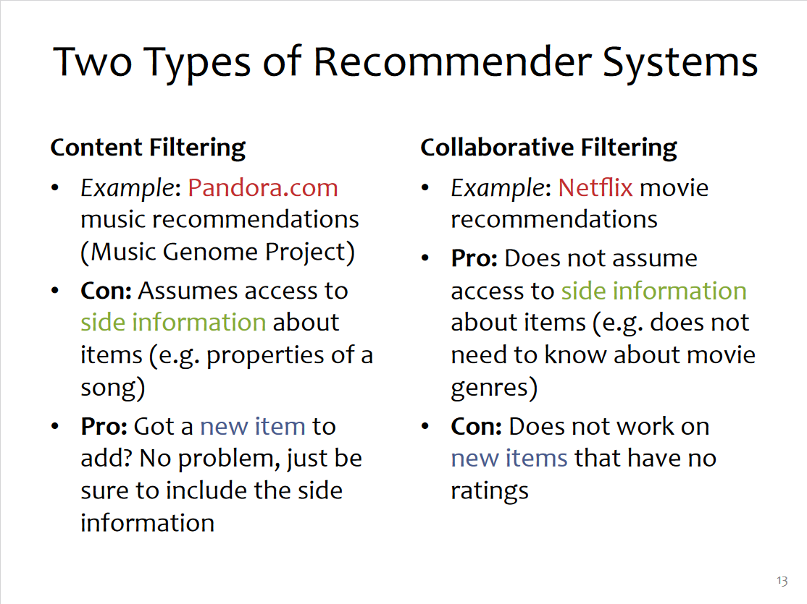
Slide from https://www.cs.cmu.edu/~mgormley/courses/10601b-f16/lectureSlides/lecture26-mf.pdf

Slide 7
How does this filtering work?
We need to represent each item or query as a set of features
Perhaps a matrix for Netflix movies:
The columns are the Netflix movie titles
Each row is what a user rated each of the movies
Perhaps a movie that they haven’t watched gets a default value
Perhaps a matrix for Amazon products:
The columns are the price, size, color, and other features of the product
Each row is one Amazon product
Now, with these embeddings (matricies) you can compare how similar two users or two products are
More on this in a minute

Slide 8
Let’s pick up at slide 15-18 from
https://www.cs.cmu.edu/~mgormley/courses/10601b-f16/lectureSlides/lecture26-mf.pdf

Slide 9
Options for similarity metrics
Can we draw an example of what two similar vs dissimilar products on Amazon might look like?
Can we draw an example of what similar vs dissimilar users on Netflix might look like?
We LOVE these types of embeddings for certain kinds of similarity metrics:
Cosine similarity (we will cover late this semester a bit)
Euclidian distance
Once you have the matricies, you can get a prediction
See slide 21-22 at https://www.cs.cmu.edu/~mgormley/courses/10601b-f16/lectureSlides/lecture26-mf.pdf

Slide 10
Rankings with Embeddings
Once you have your embeddings, you can query these for recommendations
For example, to get a movie similar to some other movie, this could be done by looking for its nearest neighbors (KNN model) in the embedding

