Slide 1
Natural Language Processing

Slide 2
What is Natural Language Processing (NLP)
NLP deals with computational processing of human languages
Can be as simple as looking at word frequencies
Can be as hard as “understanding” the language
NLP is hard!
Natural language is ambiguous and messy
Is it a verb or a noun?
“The bat flew across the field.”
Often uses statistics to learn about relationships between words and other words, or words and documents
Syntax versus semantics
Synatx; easy
Semantics -- harder

Slide 3
Some basic NLP terms
tokens: you can think of these as words (or word-parts)
sentences: what we think they are…
documents: made up of one or more sentences
corpus/corpora: your collection of documents
stopwords: common words that you may remove from your analysis (because they don’t provide a lot of interesting information)
Parts of Speech: is a token a verb, noun, etc.
N-gram: treat two or more words as a single word/concept

Slide 4
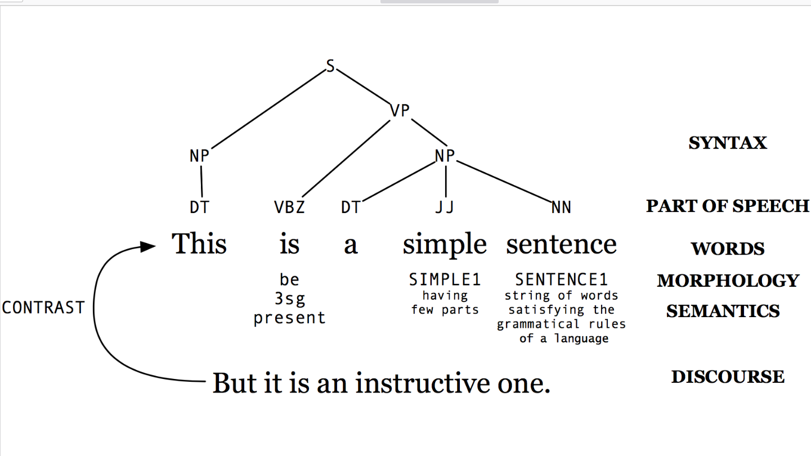
How can a sentence be analyzed?
Image from http://www.cs.umd.edu/class/fall2019/cmsc470/slides/slides_01.pdf

Slide 5
Review of NLP use cases
Machine translation
Autocomplete
Voice recognition
Question-answering
Topic modeling
Summarization
Information Extraction
Text generation (GPT)
Autocorrect
“Understanding”
Spam detection
Chatbots
Urgency detection
Parts of Speech tagging
Named Entity Recognition
Entailment
Knowledge extraction
Confidence/tone analysis
Document Similarity
Claim matching
Plagiarism detection

Slide 6
Review of NLP approaches (so far)
Text pre-processing
Topic modeling with LDA

Slide 7
How do we represent natural language for ML?
Recall, we are typically going to pass in a representation of the data for a model that is numeric
Straightforward for images (pixel color) and other types of data
How do we represent the natural language in the format our models understand and can work with?
Typically, we will pre-process the text:
Break up the document into sentences
Break up each sentence into words (tokenization)
Get the root of the words via stemming/lemmatization
These word-pieces are then transformed into a numeric embedding

Slide 8
Pre-processing natural language: Tokenization
At a minimum, break up the sentences into words
Could break up words as well
Split on non-alphanumeric characters (I’m, student’s, door-frame)
Languages other than English may pose additional challenges
Do you break up some words or not?

Slide 9
Pre-processing natural language: Lemmatization and stemming
Lemmatization converts variations to base form
student, students, student’s, and students’ all become student
am, is, and are all become be
Stemming chops off the ends of words to the same “stem”
Amuse, amused, amusement, amusements, amusing, and amusation (not a word!) would all become amus (not a typo)

Slide 10
Options for word embeddings: bag of words (BOW)
Simplest approach
Sentences are represented as vectors of numbers
No memory of where the words were in the sentence
All the words in your text corpus are thrown into a bag (a set of words)
Imagine there is now a column for each possible unique word in your corpus
See next slide
Next, you can create a vector for each sentence in your corpus
Put a 1 in each column where the word appears, a 0 otherwise
You end up with a sparse matrix for your dataset
Disadvantages:
Hard to infer any temporal connection between the words in the same sentence
Hard to infer the “meaning” of words, unless same words keep appearing together?

Slide 11
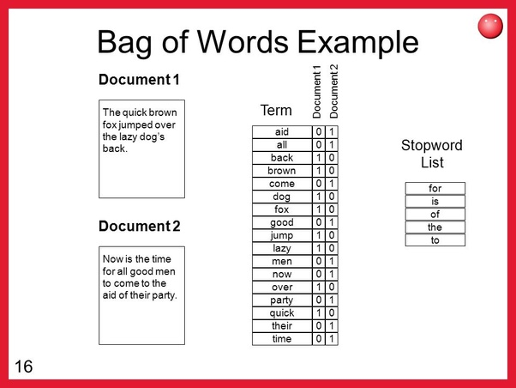

Slide 12
Options for word embeddings: tf-idf
Stands for Term Frequency - Inverse Document Frequency
Trying to find “important words” in your corpus based on how frequently words appear in different documents
A word that appears a lot in a document is important
Each sentence is also made into a vector in this case; we calculate the score for each word
Term Frequency:
How often does the word appear in the document?
TF_{Word} = (Number of times word appears in document) / (length of document)
Inverse Document Frequency:
IDF_{Word} = (Number of documents) / (number of documents which have the word)
TF-IDF = TF * IDF
Will be a very small number for common words (presumably we don’t care about them as they don’t tell us much “interesting”)?
Like BOW there isn’t much semantic understanding of what the words mean
Useful for document classification and search engines

Slide 13
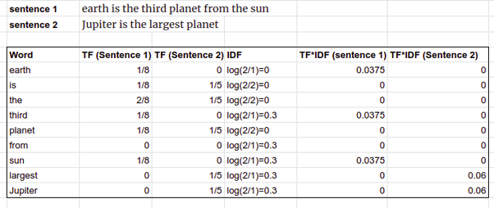
tf-idf example

Slide 14
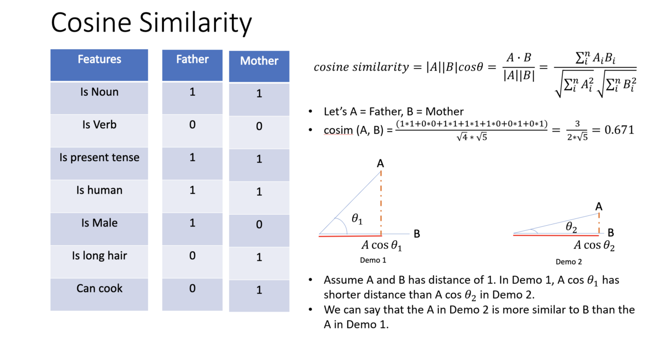
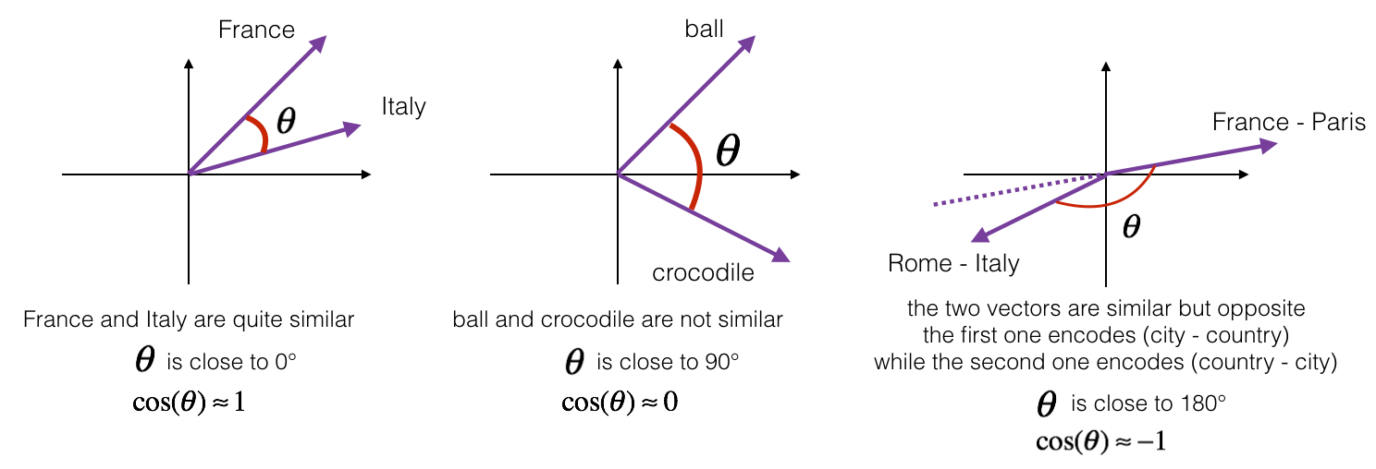
Using tf-idf for measuring document similarity
Image from https://olestourko.github.io/notes/sequence-models-nlp
Cosine similarity is often used to compare two documents (or sentences!)
Given two documents represented by their tf-idf vectors, measure the cosine of the two vectors of each document
Similar documents have high cosine similarity
Unrelated documents have low cosine similarity

Slide 15
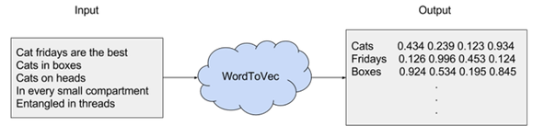
Options for word embeddings: Word2vec [2013]
Image from https://medium.com/@zafaralibagh6/a-simple-word2vec-tutorial-61e64e38a6a1
Previous models generated sparse matrices with an entry for each possible word
If you have a big corpus, you’ll end up with a huge, sparse matrix as input to your model, which means leaning a lot of weights for each of those features: this isn’t great
Goal is to capture both meaning and contextual relationships between words in a sentence
Failed to do this so far with BOW and TF-IDF
Uses an embedding to represent words that places words that are similar to one another closer in that embedding
Start with a one-hot encoding for each word (created a vector for each word)
Uses a neural network to learn the embedding for each word

Slide 16
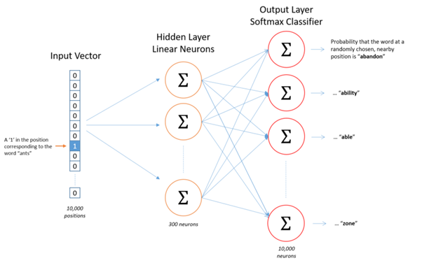
Word2Vec model (high level)
Image from https://medium.com/@zafaralibagh6/a-simple-word2vec-tutorial-61e64e38a6a1
Each word in our corpus has a slot in the input vector
The output of the model predicts the probability that the input word is near any of the other words in our corpus
Goal is to learn the weights of the hidden layer (300 neurons)

Slide 17
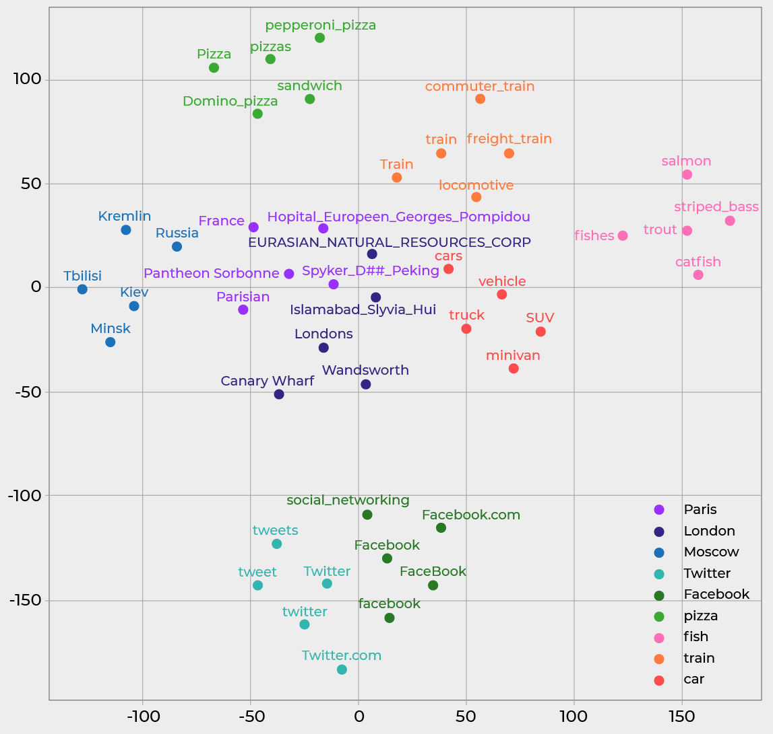
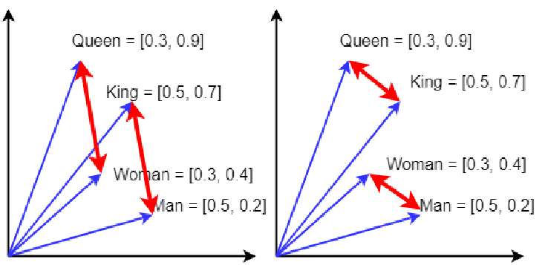
Word2vec insight
Images from https://openclassrooms.com/en/courses/6532301-introduction-to-natural-language-processing/6980911-discover-the-power-of-word-embeddings, https://www.researchgate.net/publication/332679657_Metaconcepts_Isolating_Context_in_Word_Embeddings
Embeddings (vector representations) of related words are “closer” to one another than unrelated words

Slide 18
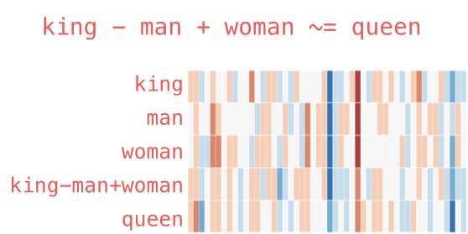
Options for word embeddings: GloVe [2014]
Similar concept to word2vec: get good word embeddings
Learns similar relationships between words like word2vec (king-queen example)
Glove uses global word occurrences, whereas word2vec looks at nearby words
Unlike word2vec, we don’t train a NN model with Glove
GloVe is based on matrix factorization, so more about statistics
Image from https://jalammar.github.io/illustrated-word2vec/
More information: https://nlp.stanford.edu/projects/glove/

Slide 19
Modeling Natural Language Processing via deep learning
We saw how convolutions can mimic the human visual cortex for identifying objects in a Convolutional NN (CNN)
What about using deep learning for Natural Language Processing (NLP)?
What is “special” about written language (we’re going to be working with text)?
Natural language imposes an order on the words
The meaning of a word can depend on the context (surrounding words) around it
We can probabilistically analyze text:
It’s cold outside, the sky is cloudy, and there is a moderate chance of __________ today
Can you fill in the blank? Other options? How did you know? Can we train a model on sentences so it too can make these types of predictions?

Slide 20
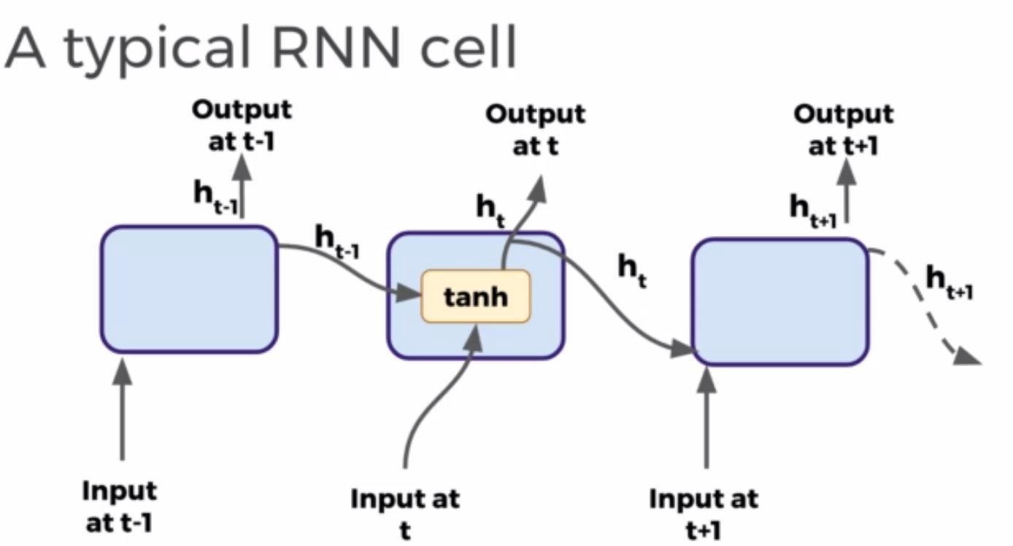
Recurrent Neural Networks (RNNs)
See video starting at 3:45 for visualization plus code for RNN: https://www.youtube.com/watch?v=LHXXI4-IEns
The NNs we’ve seen so far don’t have long-term memory
Maybe they “remember” the adjacent pixels in a patch
But we need something that can handle “longer” distances between the input features
Recurrent Neural Networks: create a chain of nodes/units
Each node takes as input one of a sequence of inputs (..., i_{t-1}, i_{t}, i_{t+1}, …) -- think of a word in a sentence as each i_{t}
And, each node also takes as input the output from the previous node in the chain
Final node output is fed to feed-forward layer
Therefore, can use the past to predict the future
It’s cold outside, the sky is cloudy, and there is a moderate chance of __________ today
Image from https://medium.com/@zeeshanmulla/lstm-gru-rnn-let-me-tell-what-to-understand-in-this-neural-network-deep-learning-5c8f78815b71

Slide 21
Challenges of vanilla RNNs
It’s cold outside, the sky is cloudy, and there is a moderate chance of __________ today
The longer your RNN, the harder it is to “remember” what you saw at the start [of a sentence]
And sometimes the context is “very far” away from the current cells
Think of vanishing gradient problem
Long Short-Term Memory (LSTM): adds additional gating to the cells to model the ability to learn when to read, write, and store information in a cell
Can now remember much longer sequences
Bi-directional LSTM: information can flow in both directions
BERT: a very popular extension of bi-LSTM that generates a rich word embedding (encoding) of incoming sentences for various tasks
A very large model that also comes pre-trained like ImageNet

Slide 22
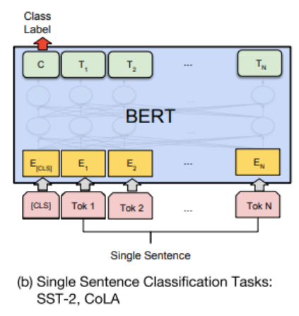
Options for word embeddings: BERT [2019]
Another word embedding using neural networks
BERT converts a sentence into an embedding
Can actually be two (or more) short-ish sentences
Sentences can be from two different languages
Sentences can be a question and answer
Sentences can be...anything, except long!
Trained on multiple tasks
At the same time!
Image from https://jalammar.github.io/illustrated-bert/

Slide 23
How is BERT used?
Transfer learning
People download one of many pre-trained models (similar to ImageNet)
Fine-tune such a model on your own dataset
Pre-trained models were trained on a large dataset of natural language text to do tasks like word prediction
You don’t need to start from scratch to train BERT on your own dataset
Instead, if you have a few thousand labelled sentences, this may already be quite helpful
Many different model tasks available
For example, BertForSequenceClassification

Slide 24
How do you evaluate NLP model performance?
It’s not always just predicting the correct label or not or a regression
However, for classification, we can use the standard precision, recall, etc.
Models often return ranked results for queries
BLEU score for machine translation
What percent of n-gram appear in the translation
Some other measurements, such as brevity factor

Slide 25
Example of BERT for sentence classification
Install HuggingFace Transformers library
Provides a Pytorch interface for BERT
Tokenize your text using BERT’s tokenizer
BERT has special tokenization that isn’t just cutting at spaces
from transformers import BertTokenizer
Add special tokens to the start and end of each sentence, such as [SEP] and [CLS]
Choose a max sentence length
Download the pre-trained model and set the number of classes
Perform the training as you normally would
Excellent tutorial on using BERT as a classifier for a dataset: https://mccormickml.com/2019/07/22/BERT-fine-tuning/

