Slide 1
Software Testing in the age of Machine Learning

Slide 2
Machine Learning Failures
Facial recognition in China tagged an ad on a bus as a jaywalker
Amazon’s AI-powered recruiting tool not rating candidates in a gender-neutral way
A mobile app to detect melanoma incorrectly labels photos of moles as benign
Many, many others
Famous ones: self-driving cars
Failures we don’t even realize are happening (until it’s too late)

Slide 3
How do we traditionally test software?
The inputs and expected outputs are known
We can characterize the valid ranges of these inputs in a meaningful way
Unit tests are often written to evaluate the logic of the code
This logic corresponds to a set of “rules”
Example: write unit tests to check that the website is correctly calculating and displaying the student GPA when they view their transcript

Slide 4
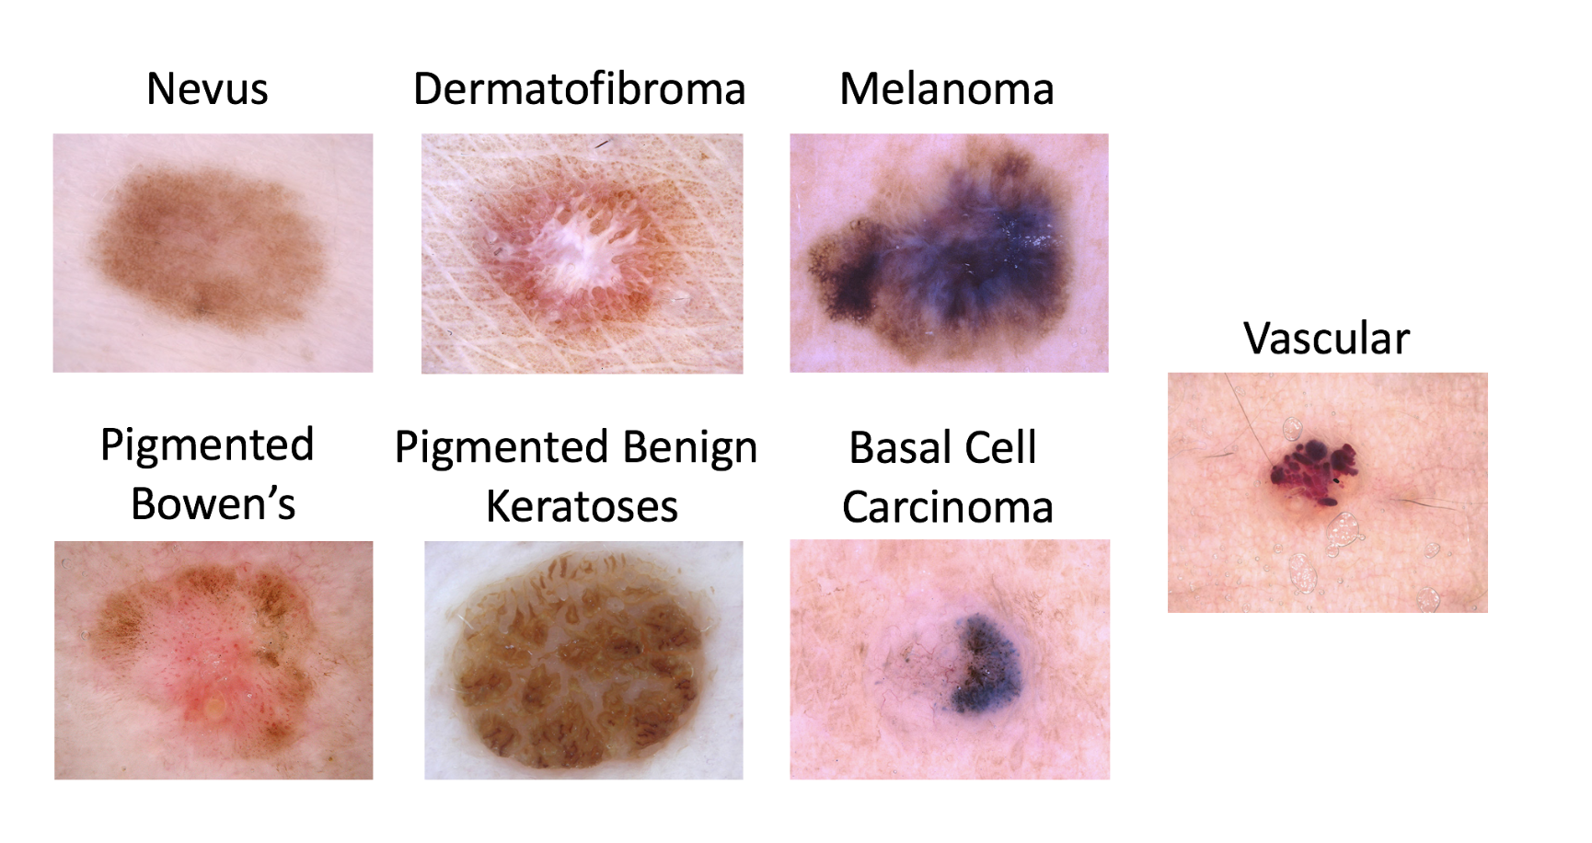
Testing Machine Learning models
We’re not really talking about testing the logic of the code used to build the algorithm
We’re actually “testing” the data the model is trained on
Example: write test cases that ensure your model can correctly distinguish between melanoma and benign skin conditions
Image from https://medium.com/hackernoon/transfer-learning-in-the-cloud-for-the-isic-cancer-classification-challenge-e0898bffcc52

Slide 5
Example: testing a melanoma binary classifier
How many photos of melanoma would you need?
Are there potential biases?
Blue marker the doctor uses to circle suspicious moles?
Skin tone of images is limited?
Magnification of certain lesion types versus others?
Many others
What metrics would you want to use to measure model performance here?
Image from https://medium.com/hackernoon/transfer-learning-in-the-cloud-for-the-isic-cancer-classification-challenge-e0898bffcc52

Slide 6
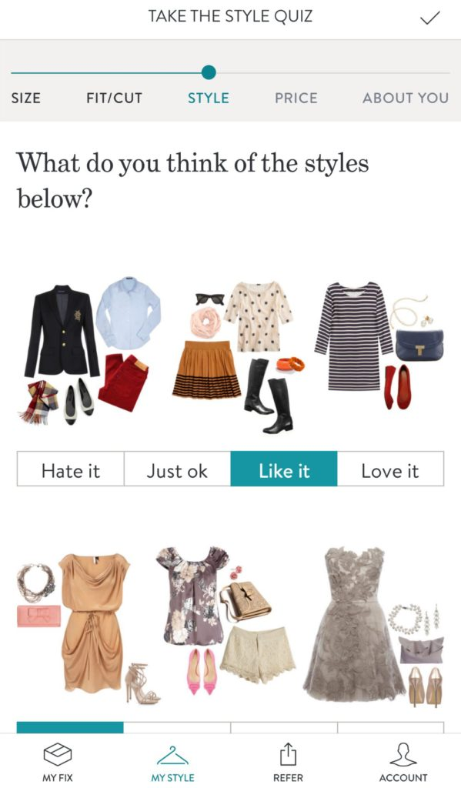
Example: predicting clothing items (Stitchfix.com)
How can you tell if your outfit prediction was correct for a new person, if your algorithm has never seen those inputs before?
What if orange was a trendy color the year the training data was collected, but it’s fallen out of style three years later?
Image from https://www.sweetpurpletulips.com/finding-style-with-stitch-fix/

Slide 7
Motivation: Machine Learning Testing is hard
You can unit test the ML libraries, but how do you test the model?
Traditional SWE testing techniques aren’t really set up to do this...
ML testing suffers from the Oracle Problem: there isn’t an easy way to tell if your results are correct or not
Example: predicting what product an Amazon customer will buy next (if we knew this using a rule-based system, we wouldn’t need ML…)
Example: how many pixels can I change in an image of a cat before it is no longer a cat? (Humans may not even agree on the answer...)
Many ML algorithms aren’t even stable: they learn over time
Yesterday’s “correct” answer is no longer valid
The real-world correctness of your model depends on the training data
Bias, bias, bias!
How do you normally test your models?
Cross validation, some error bars...but this doesn’t capture all possible failures
These metrics are really about model evaluation, which is different than the model testing we’ll talk about today

Slide 8
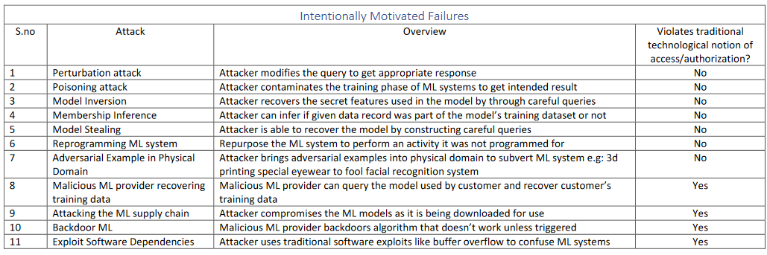
Failure Modes in Machine Learning
From Kumar (Microsoft) et al. “Failure Modes in Machine Learning”
There are a lot of research on intentionally motivated failures:

Slide 9
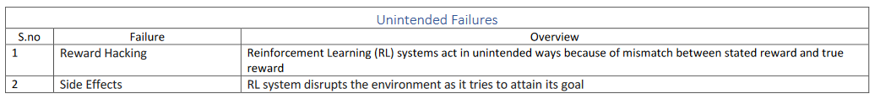
Failure Modes in Machine Learning
From Kumar (Microsoft) et al. “Failure Modes in Machine Learning”
This talk focuses on unintended failures
Much less research here so far in bullet 6 below, except for bias

Slide 10
Testing for ML isn’t a mature field
Not really on people’s landscapes: https://venturebeat.com/2021/10/16/the-2021-machine-learning-ai-and-data-landscape/
We’ll share a few industry tools over the next few slides
Also an immature field in the research landscape as well
We’ll share a few research tools in this talk also
Automatically generating tests for ML models has not been attempted much by startups or ML researchers
Next up: some examples from industry

Slide 11
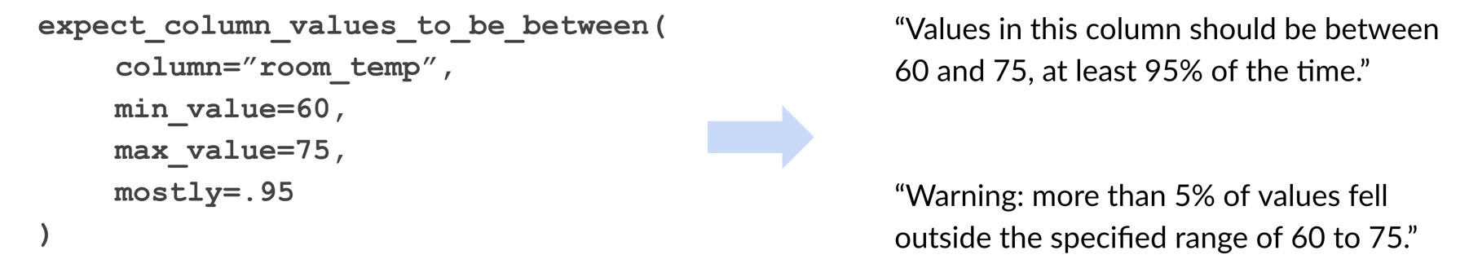
ML Testing and model assertions
We often don’t know what the exact correct output might be
For example, when predicting the price of a home
But we can often specify assertions about the range of the valid outputs
Home price should never be negative
Home price for an N-bedroom home should be between X and Y
Home price should never be more than 20% different than the price last month
These are rules than a human, subject-matter expert can often specify for us
Great Expectations tool: https://github.com/great-expectations/great_expectations

Slide 12
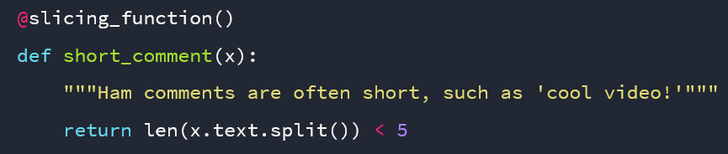
ML Testing and dataset slicing
Slicing functions: allow you to select a subset of the data that meets certain criteria
For example, sentences that are shorter than a certain length
You have to specify the function
These can be used for minimum functionality tests of your data
Snorkel AI: https://www.snorkel.org/use-cases/03-spam-data-slicing-tutorial

Slide 13
ML testing and dataset profiling
Measure model performance over time
Detect differences in train and deployment data distributions
Is there “drift”?
Detect bias in model predictions for certain subsets of the input
Fiddler AI
Dataset shift:
https://blog.fiddler.ai/2021/03/introducing-ml-model-performance-management/
Bias detection: https://blog.fiddler.ai/2021/06/introducing-bias-detector-a-new-methodology-to-assess-machine-learning-fairness/

Slide 14
ML Testing in Academia
The previous examples are very useful approaches, but they tend to be missing some desirable features:
Automatic generation of test cases
Handling of more complex data types, such as imagery, audio, etc.
There is a lot of room for improvement in this field!
Recall, one of the issues we face is the Oracle Problem, where we may not know exactly what output is correct for a certain set of inputs

Slide 15
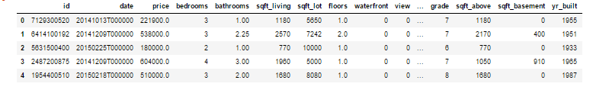
Proposed solutions to the Oracle Problem
Pseudo-oracles, where multiple ML models (classifiers) are trained and their results compared for consistency
Metamorphic testing, where relations between input modifications and expected output changes are asserted
Even if you don’t know what the correct output is, you know that if you change the input in a certain direction, you expect the output to change in a certain direction
Example: if I am modeling house prices for Zillow, and increase the number of bedrooms, would I expect my predicted price to rise or not?

Slide 16
What is metamorphic testing for ML (classifiers)?
Define a set of metamorphic relations
A known change to the input of the model has an expected known direction of change in the output
Generate source test cases
Assumes an existing classifier has been trained
Pair each source test case with one or more follow-up test cases
The metamorphic relation is used to define the follow-up test case
In some cases, it is just the original test input that needs to be modified
In other cases, the original model is re-trained according to the metamorphic relation
Check that each (source, follow-up pair) exhibits the expected behavior according to the metamorphic relation

Slide 17
Selected metamorphic relations for ML classifiers
Consistence with directional transformation
Addition of uninformative attributes
There are many more, but we won’t cover all of them in this talk due to time; see Fault Detection Effectiveness of Metamorphic Relations Developed for Testing Supervised Classifiers by Sata et al, 2019

Slide 18
Consistence with directional transformation
Change one of the inputs in a direction to force a known change in the output
Non-ML example: calculating the mean of a list of integers:
Source test case: mean([1, 2, 3, 4, 5, 6, 7, 8]) == 4.5
Follow-up test case: mean([1, 2, 3, 4, 5, 9, 7, 8]) > 4.5
ML classification example 1: Sentiment analysis on movie reviews
Source test case: polarity(“This movie was fine, I didn’t really care.” == -0.1
Follow-up test case: polarity(“This movie was bad, I didn’t really care.” <= -0.1
ML classification example 2: predicting skin cancer from images
Source test case: == a benign mole
Follow-up test case: == a melanoma

Slide 19


Consistence with directional transformation
ML classification example 2: Is it a forest, or is it a tank?
Blocking out the main component of an image should reduce the classification accuracy
Adding copies of existing items-of-interest in a cell segmentation/counting task

Slide 20
Selected metamorphic relations for ML classifiers
Consistence with directional transformation
Addition of uninformative attributes
There are many more, but we won’t cover all of them in this lecture due to time; see Fault Detection Effectiveness of Metamorphic Relations Developed for Testing Supervised Classifiers by Sata et al, 2019

Slide 21
2) Addition of uninformative attributes
Add a new feature that should be equally associated with all classes
Shallow learning example: adding a new feature of random noise to a Zillow house price predictor
Source test case: the original input and original output
Follow-up test case: [original input + previous sold date*] yields the original output
Deep learning: not really associated with feature engineering as much
Invariance: apply a label-preserving perturbation
NLP: switch a word with a synonym
Source test case: polarity(“This was a nice movie by John Smith.” == +0.7
Follow-up test case: polarity(“This was a nice film by John Smith.” == +0.7
Computer vision: next slide

Slide 22
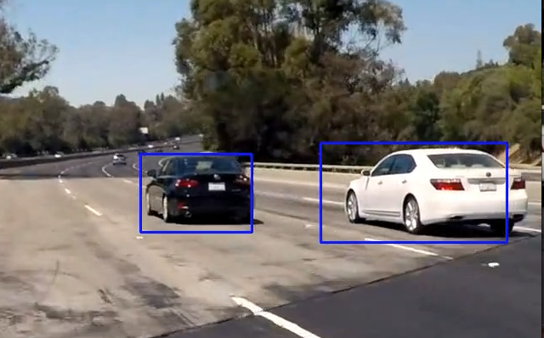
2) Addition of uninformative attributes
Can you think of a related example for computer vision?
Example answers:
adding in an object that shouldn’t matter
Changing the background? Changing the color?

Slide 23
Research Example: CheckList tool for NLP
Beyond Accuracy: Behavioral Testing of NLP models with CheckList by Ribeiro et al., 2020
Helps you automate the process of generating test cases for testing sentences
Github:
Minimal functionality tests
Invariance tests
Directional expectation tests

Slide 24
Bias in Machine Learning
Could devote an entire course to this subject: https://courses.cs.cornell.edu/cs1340/2021sp/
Lots of great papers/chapter to read at the link above

