Slide 1
VAE
Top500 dataset

Slide 2
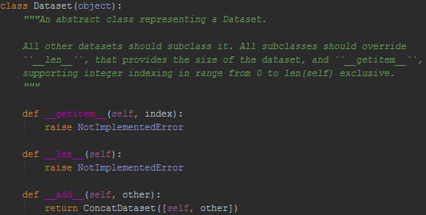
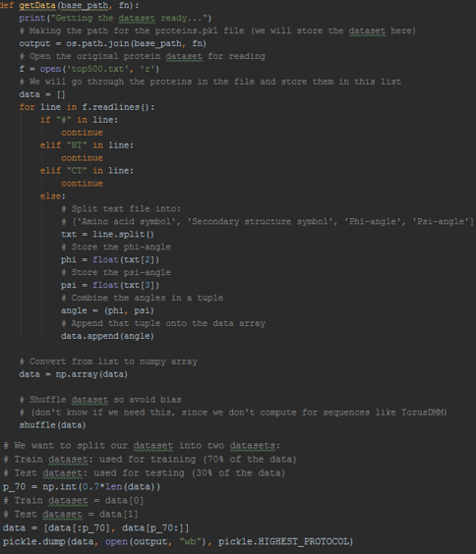
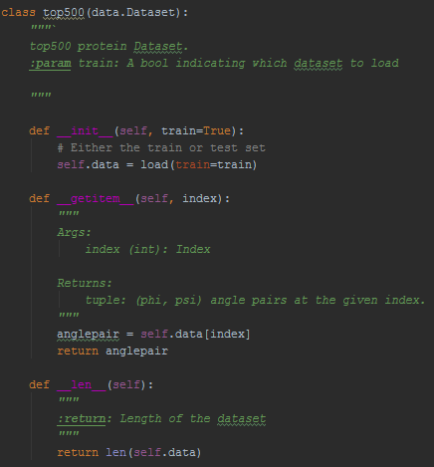
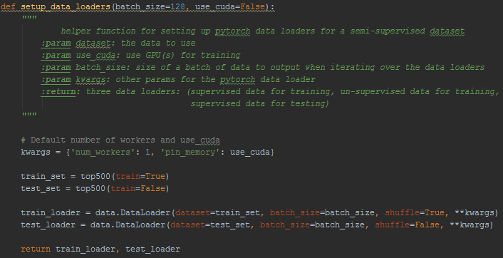
Train_loader/Test_loader
Notes:
Setup the train and testloader.
I give the top500 dataset as train_set and test_set.
Then we give the dataset to the build in class DataLoader, which combines a dataset and a sampler, and return the train and test loader.
the dataloader needs to get the dataset in the form of a class of type "dataset", and if we look at the abstract class for a "Dataset", we see that all sublasses of it should override these functions "__getitem__" and "__len__" - "getitem" returning an anglepair, and "len" just returning the size of the dataset.
The way we load our dataset is we "pickle" it - that is convert it to a byte stream so we can store and load it. Very much so inspired by Amelias, but I only split it into two parts - training and testing (they also had validation).

Slide 3
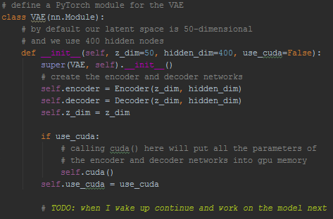

Setup VAE
Notes:
I Initialize by setting up the encoder and decoder, and the z_dim, which is the amount of nodes in the
latent space:

Slide 4
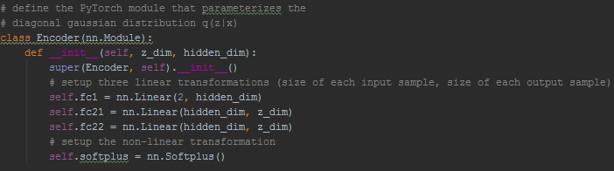
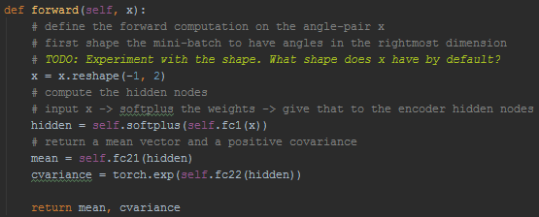
The encoder
Notes:
In the encoder, we setup the three linear transformations:
The first takes two angles (which makes up the anglepair), and they go to our hidden dimmension, which has 400 nodes.
The second is for the mean, so when we go from the hidden layer 400 nodes, to the latent space consisting of 50 nodes.
The third one is for the variance.
So with these, we can input the anglepair, encode them through the hidden layer, and end up with a latent space for the mean and one for the variance, which we can use to make a normal distribution, which we then can sample a latent variable z from.
In the forward function we input x to the encoder, we use the softplus as the activation function to calculate the input for the hidden layer - and we get a mean and a variance by going from the hidden dimension to the mean and variance layer.
We will use the mean and variance for a normal distribution, from which we will sample our latent dimension.

Slide 5
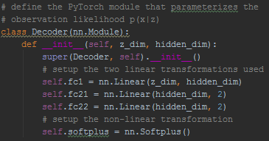
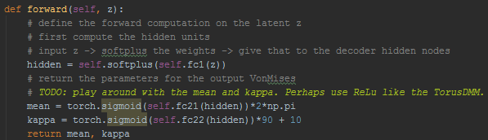
The decoder
Notes:
In the decoder, we setup the three linear transformations:
The first one takes the latent dimension and goes to the decoders hidden dimension
The second is for the mean
The third is for the kappa.
In the forward function, we input the sampled z dimension, we use the softplus as the activation function to calculate the input for the hidden layer - and we get a mean and kappa by using the sigmoid function on the output from the hidden layer going to the mean and kappa layer resprectively.

Slide 6
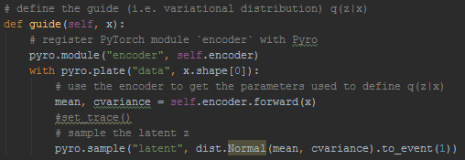
The guide
Notes:
In the guide, we use pyro.plate to declare that the batch is conditionally independant, and we get our mean and variance by encoding the batch, and we use that mean and variance for a normal distribution, from which we sample our latent z.

Slide 7
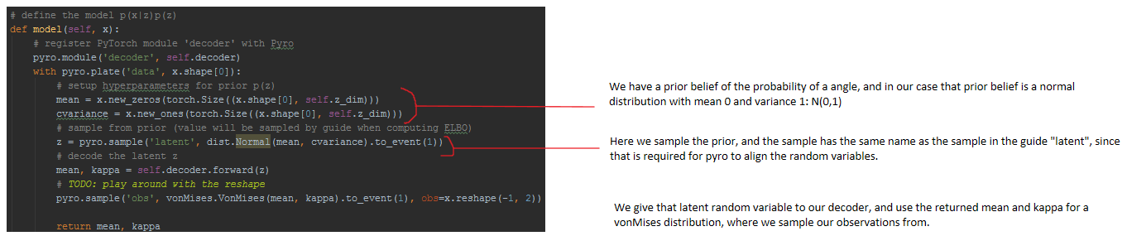
The model

Slide 8
The plot (make_plots)
I create 1000 samples from the model.
Angles
Means
Kappas
Flatten data and transform to list
Define bins and axis
Plot

Slide 9
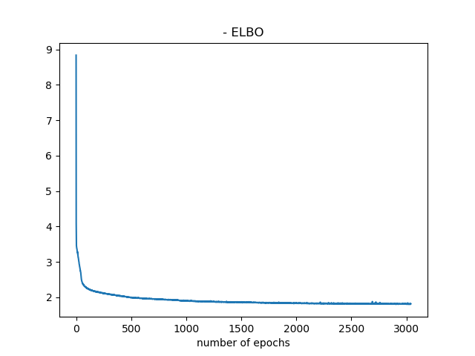
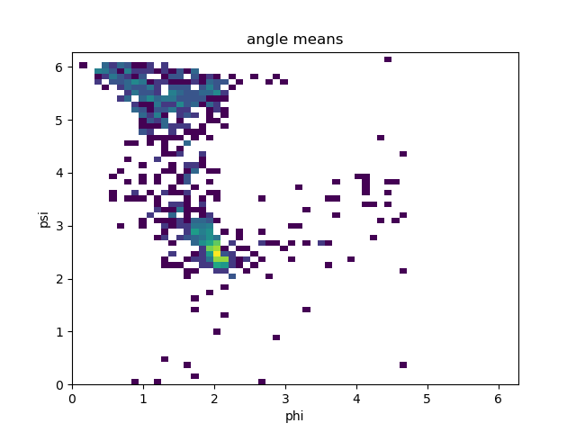
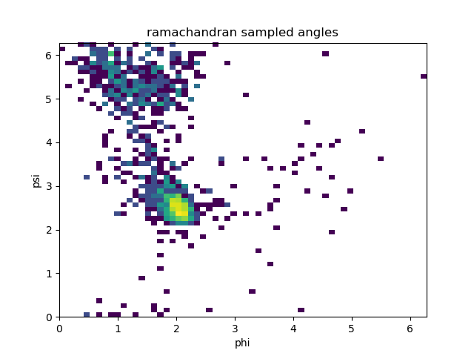
Results

Slide 10
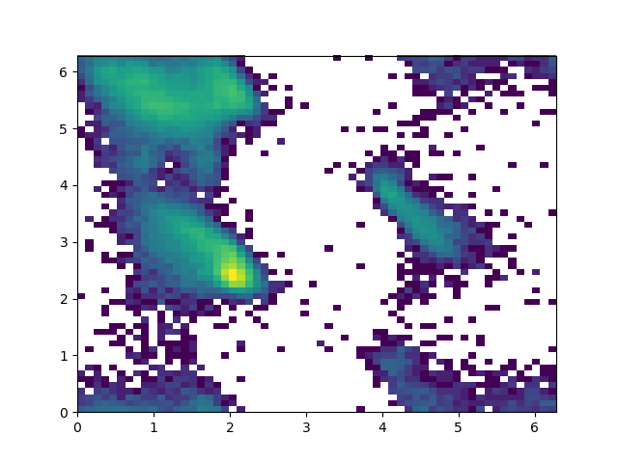
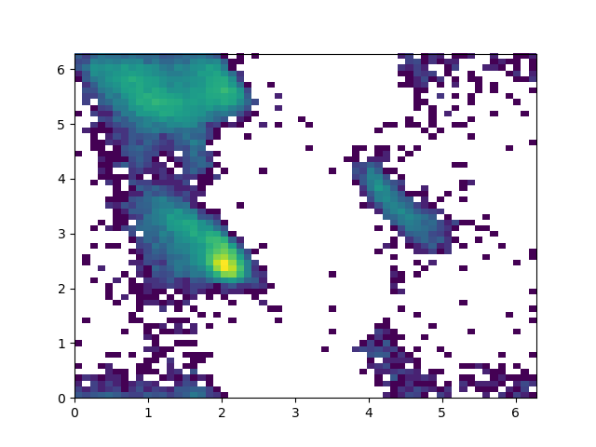
Train_loader/Test_loader

Slide 11
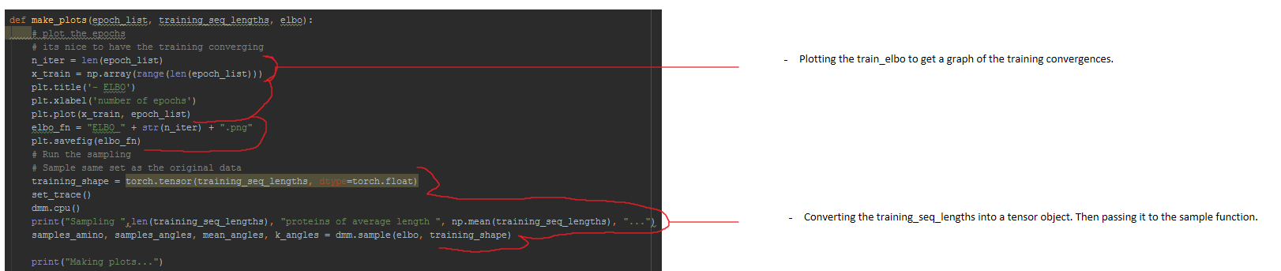
Importance sampling

Slide 12
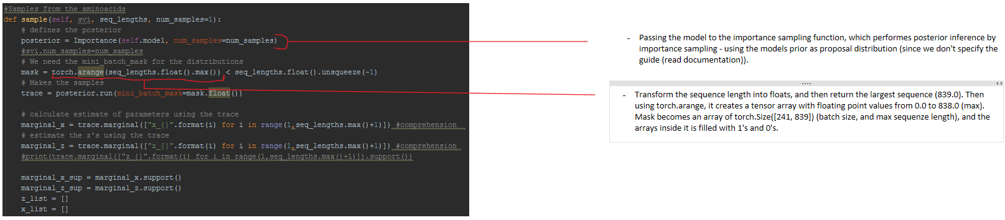
Importance sampling

