Slide 1
Classification – Model Evaluation Critiera

Slide 2
False Positive and False Negative

Slide 3
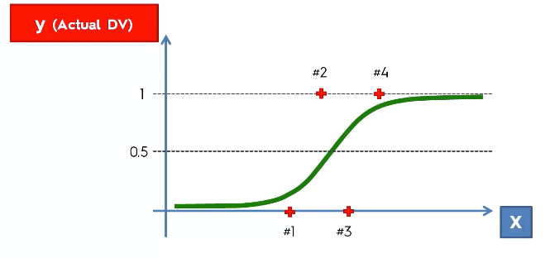
False Positive and False Negative

Slide 4
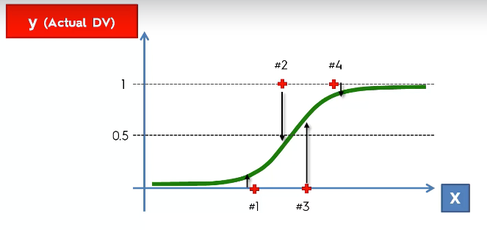
False Positive and False Negative

Slide 5
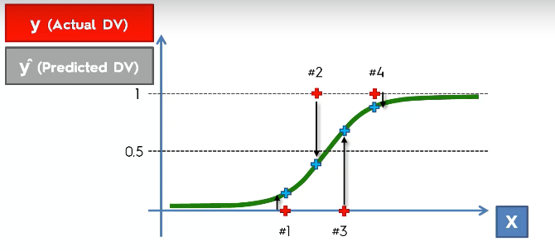
False Positive and False Negative

Slide 6
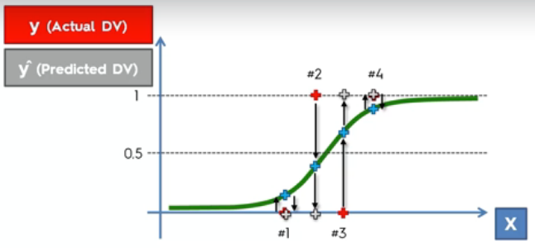
False Positive and False Negative

Slide 7
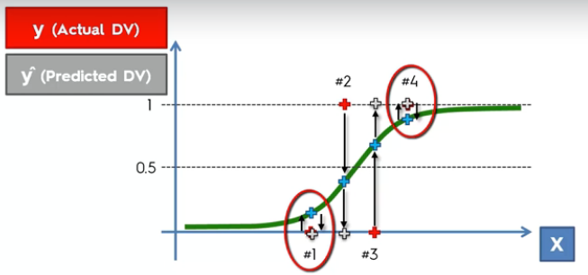
False Positive and False Negative

Slide 8
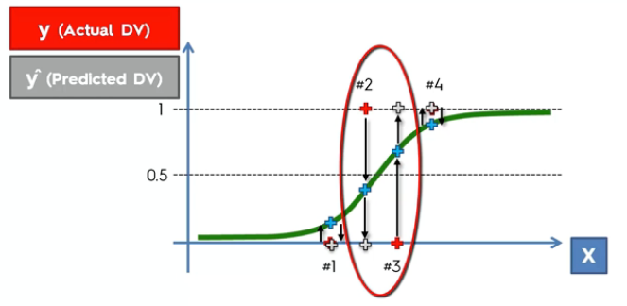
False Positive and False Negative

Slide 9
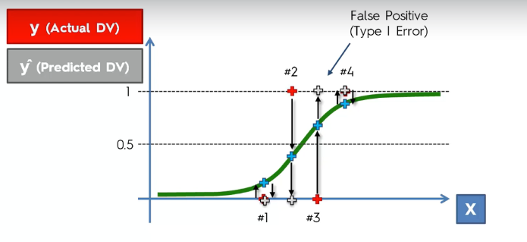
False Positive and False Negative

Slide 10
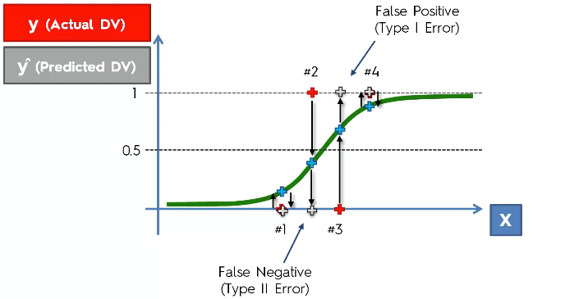
False Positive and False Negative

Slide 11
Confusion Matrix

Slide 12
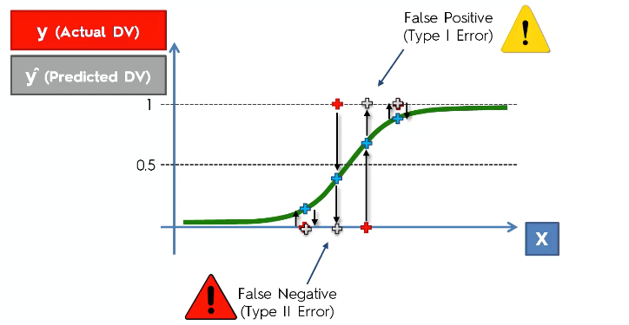
Confusion Matrix

Slide 13
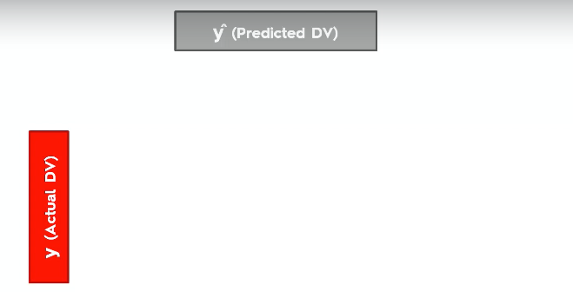
Confusion Matrix

Slide 14
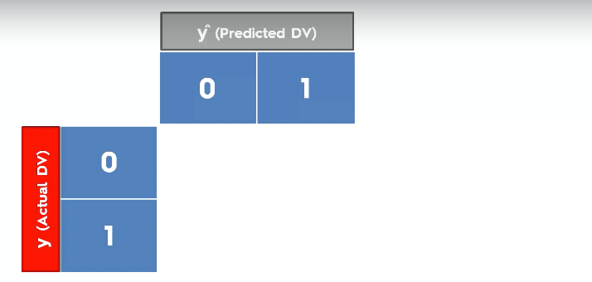
Confusion Matrix

Slide 15
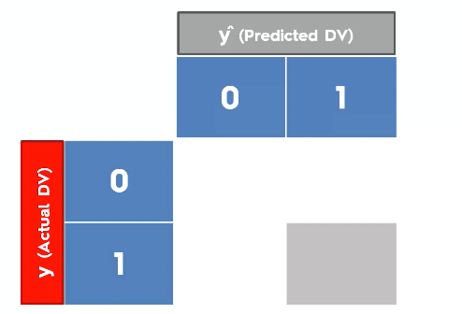
Confusion Matrix

Slide 16
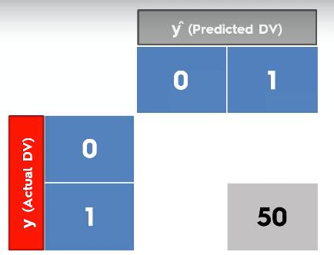
Confusion Matrix

Slide 17
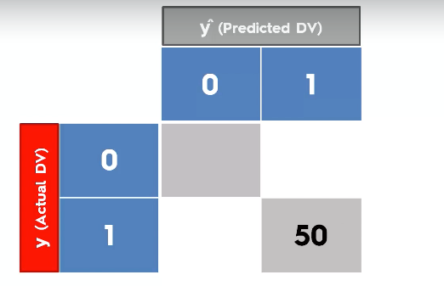
Confusion Matrix

Slide 18
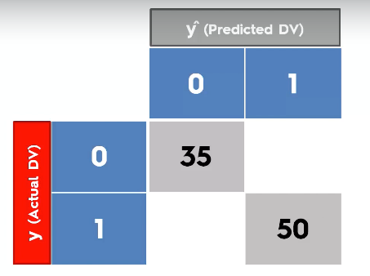
Confusion Matrix

Slide 19
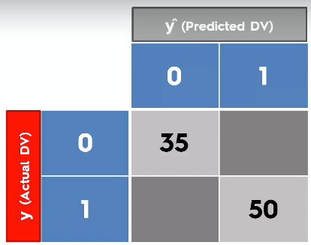
Confusion Matrix

Slide 20
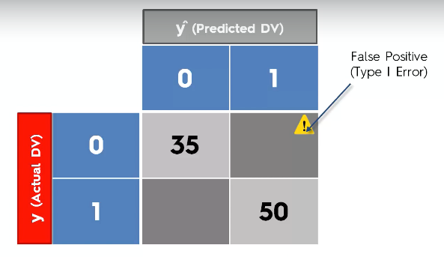
Confusion Matrix

Slide 21
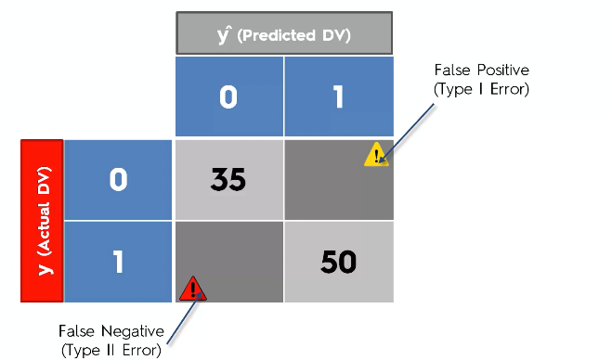
Confusion Matrix

Slide 22
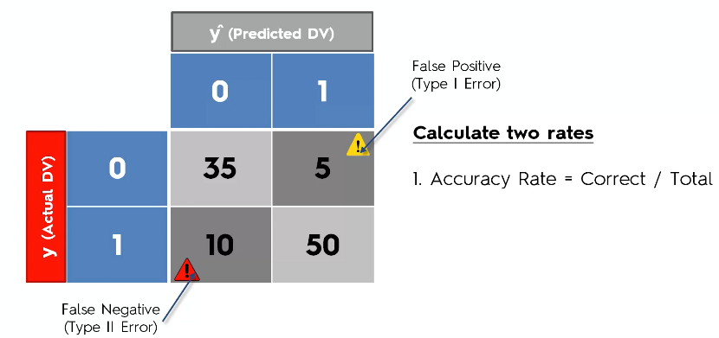
Confusion Matrix

Slide 23
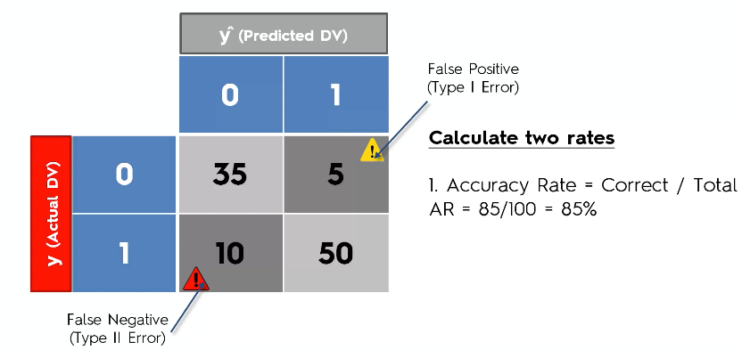
Confusion Matrix

Slide 24
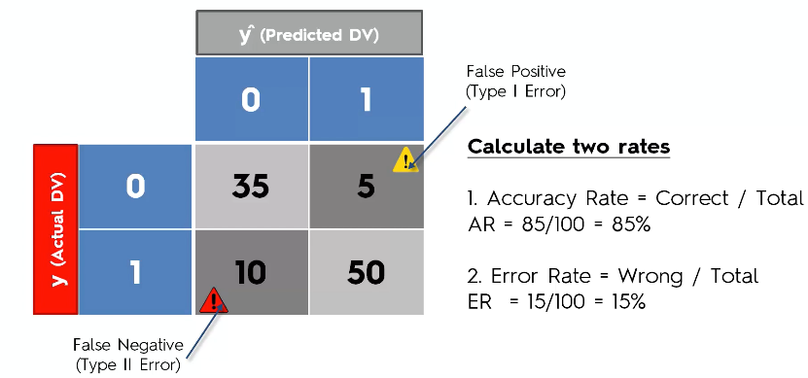
Confusion Matrix

Slide 25
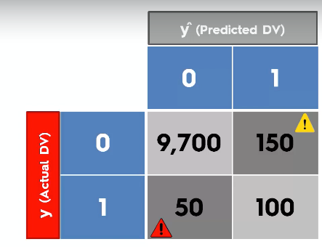
Accuracy Paradox

Slide 26
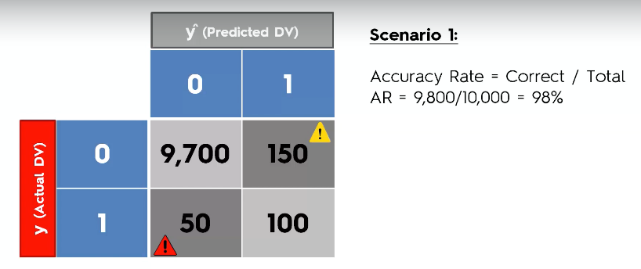
Accuracy Paradox

Slide 27
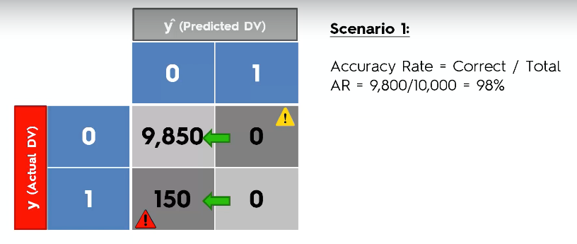
Accuracy Paradox

Slide 28
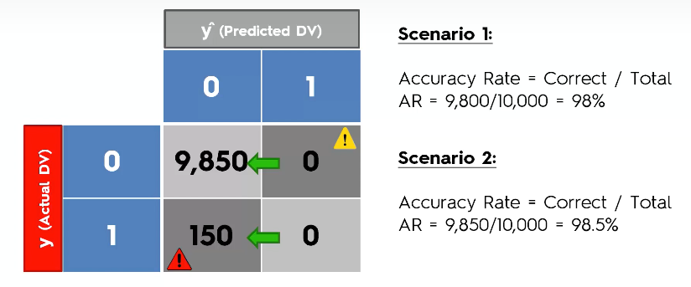
Accuracy Paradox

Slide 29
Confusion Matrix – Other Measure

Slide 30
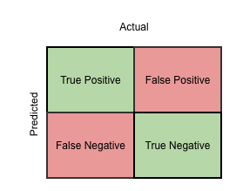
Confusion Matrix – Other Measure

Slide 31

Confusion Matrix – Other Measure

Slide 32
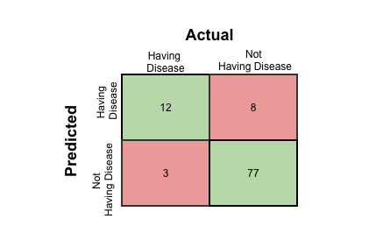
Confusion Matrix – Other Measure
Let us calculate the value:

Slide 33
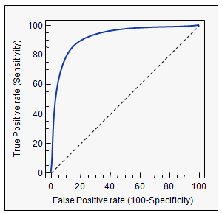
Receiver Operating Characteristics – ROC Curve
ROC is the ratio of True Positive Rate (TPR) and False Positive Rate (FPR)

Slide 34
Area Under Curve – AUC
The are between the ROC Curve and the dotted line are called AUC – Area Under the Curve.

Slide 35

F1 - Score
In statistical analysis of binary classification, the F1 score (also F-score or F-measure) is a measure of a test’s accuracy.
It considers both the Precision and the Recall of the test to compute the score:
Precision is the number of correct positive results divided by the number of all positive results
Recall is the number of correct positive results divided by the number of positive results that should have been returned.
The F1 score can be interpreted as a weighted average of the precision and recall, where an F1 score reaches its best value at 1 and worst at 0.
The traditional F-measure or balanced F-score (F1 score) is the harmonic mean of precision and recall:

Slide 36
Article – Why F1 Score is considered
https://adamyedidia.files.wordpress.com/2014/11/f_score.pdf

Slide 37
Cumulative Accuracy Profile CAP Curve

Slide 38
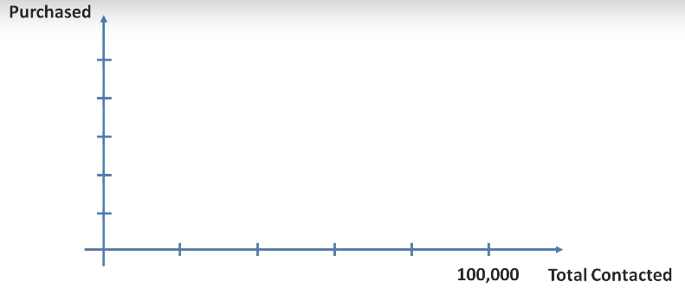
Cumulative Accuracy Profile

Slide 39
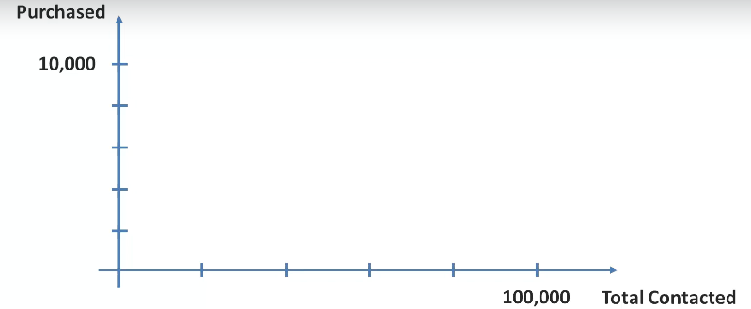
Cumulative Accuracy Profile

Slide 40
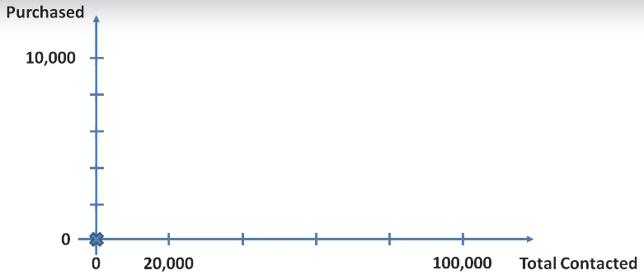
Cumulative Accuracy Profile

Slide 41
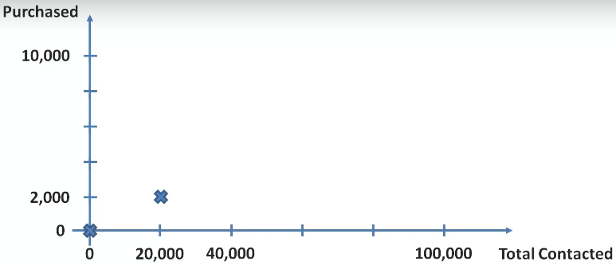
Cumulative Accuracy Profile

Slide 42
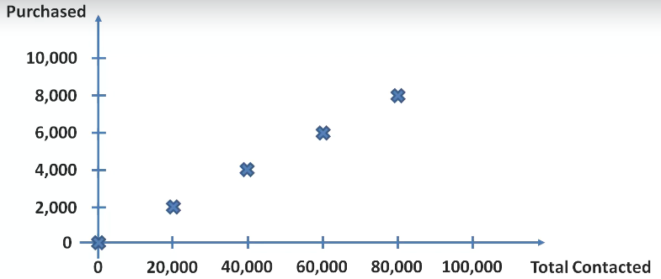
Cumulative Accuracy Profile

Slide 43
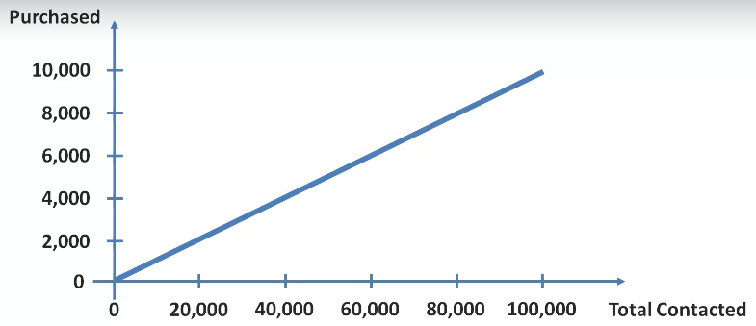
Cumulative Accuracy Profile

Slide 44
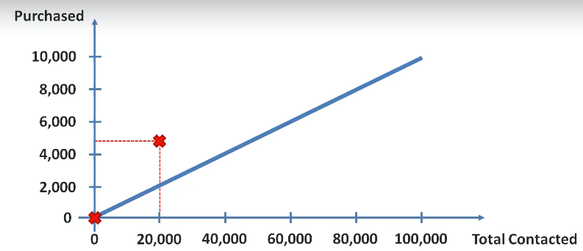
Cumulative Accuracy Profile

Slide 45
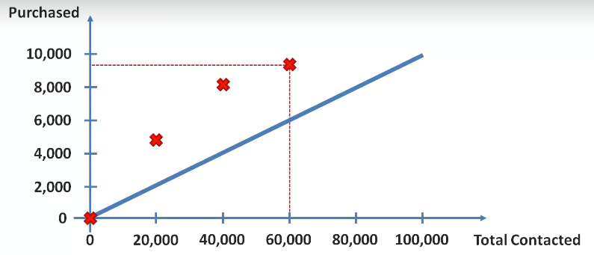
Cumulative Accuracy Profile

Slide 46
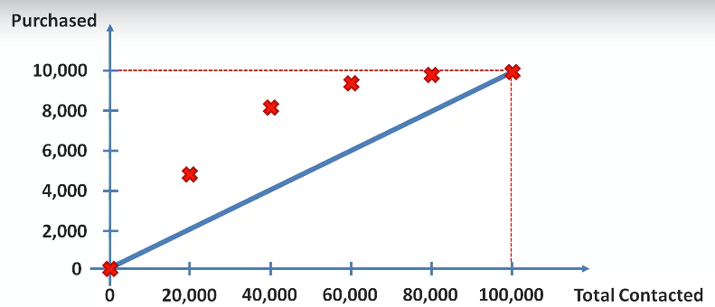
Cumulative Accuracy Profile

Slide 47
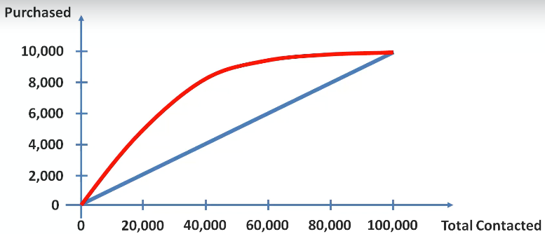
Cumulative Accuracy Profile

Slide 48
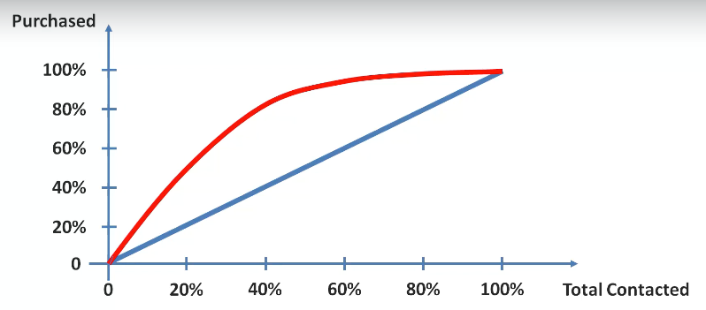
Cumulative Accuracy Profile

Slide 49
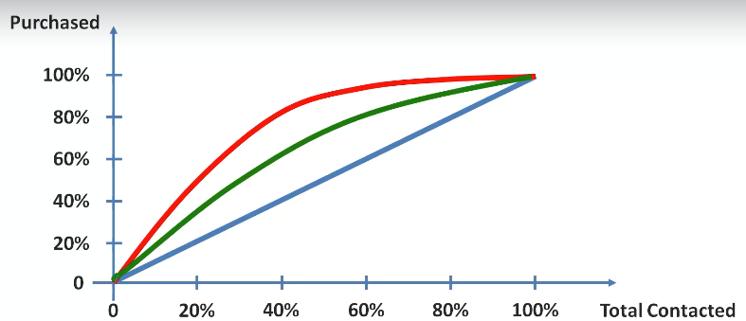
Cumulative Accuracy Profile
Green curve is a model whose CAP curve is worst. So we can actually compare the new model with different data to understand the performance

Slide 50
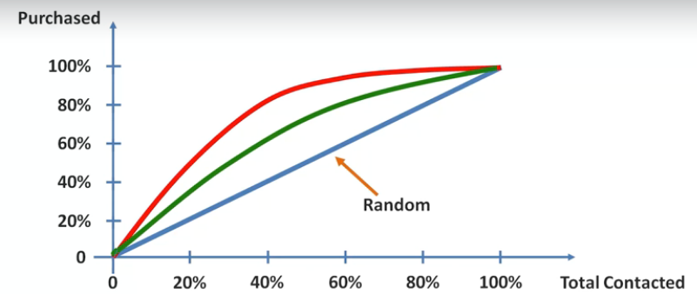
Cumulative Accuracy Profile

Slide 51
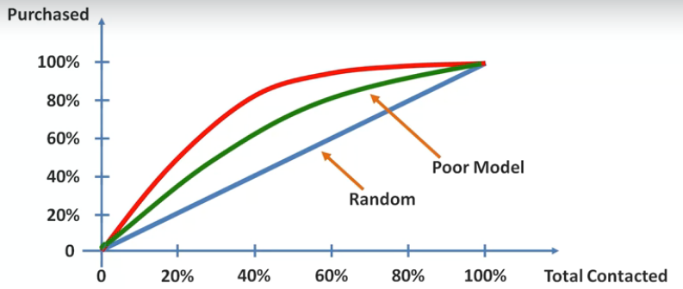
Cumulative Accuracy Profile

Slide 52
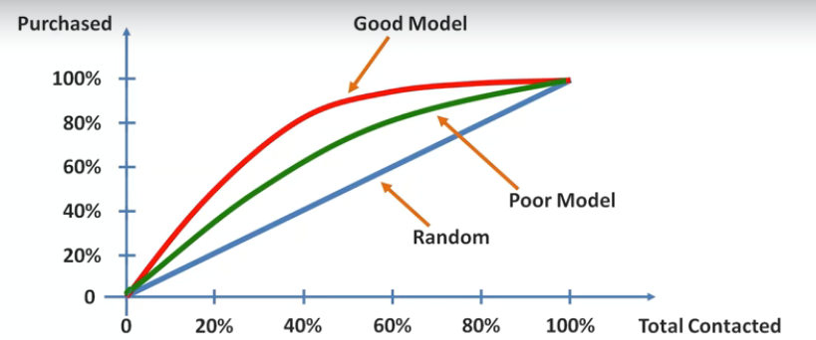
CAP - Curve

Slide 53
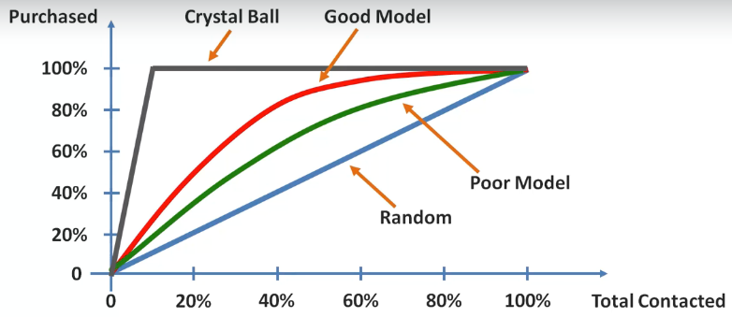
CAP - Curve

Slide 54
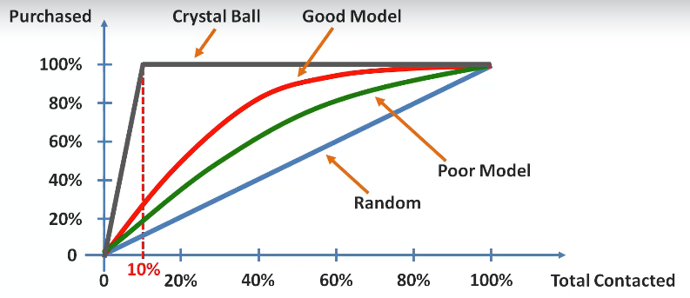
CAP - Curve

Slide 55
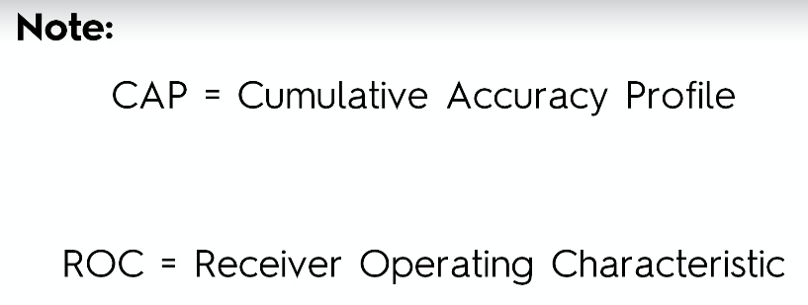
CAP - Curve

Slide 56
CAP - Analysis

Slide 57
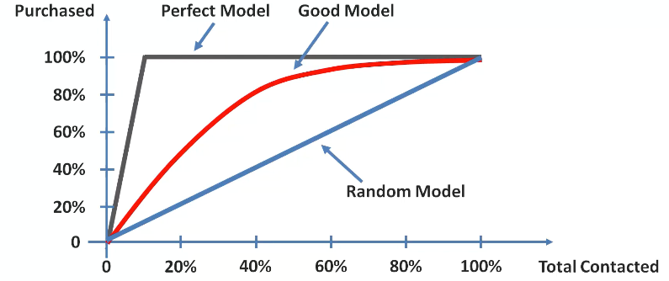
CAP - Analysis
Closer the Red line is to Grey Line – Model is Better.
Closer the Red line is to Blue Line - Model is Worse.

Slide 58
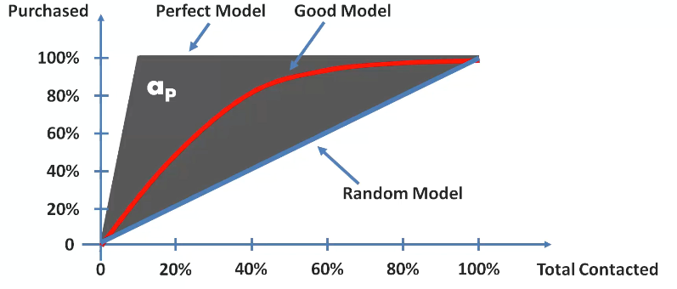
CAP - Analysis

Slide 59
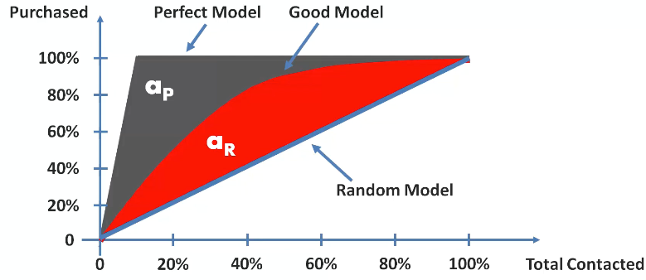
CAP - Analysis

Slide 60
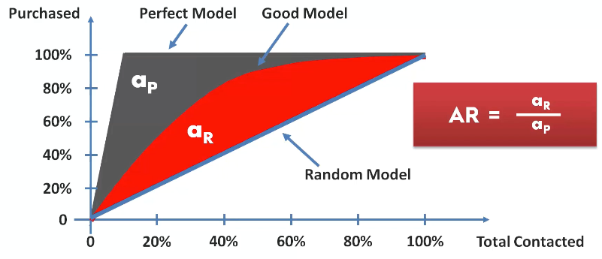
CAP - Analysis
The Ratio will always be between 0 and 1.
Closer the Ratio is to 1, it is better.

Slide 61

CAP - Analysis

Slide 62

CAP - Analysis

Slide 63

CAP - Analysis

Slide 64

CAP - Analysis

Slide 65

CAP - Analysis

Slide 66

CAP - Analysis

Slide 67

CAP - Analysis
Too Good model are subjected to Over-Fitting.

Slide 68
To double check the Accuracy
Cross Validation Technique
K-Fold Cross Validation ?
HoldOut Cross Validation – Train/Test dataset.

