Slide 1
Classification

Slide 2
Classification
Classification is used to predict a category.
Following are the Classification models:
Logistic Regression
K-Nearest Neighbors (K-NN)
Support Vector Machine (SVM)
Kernel SVM
Naive Bayes
Decision Tree Classification
Random Forest Classification

Slide 3
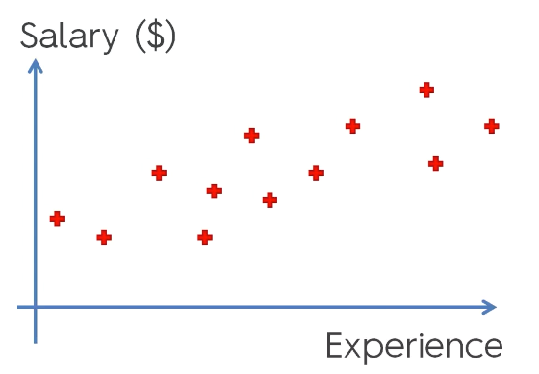
We know how to handle Linear Regression problem
Y = b + aX

Slide 4
New Problem Statement
Problem Statement:
Company has send marketing advertisement to individuals of different age.
They have data whether those individual have purchased their product or not.

Slide 5
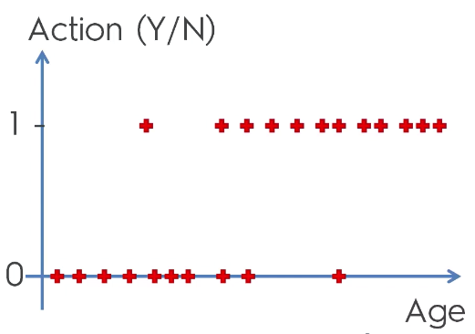
Logistic Regression - Explanation
Notes:
Predict the probability of someone taking action i.e. 0 and 1.

Slide 6
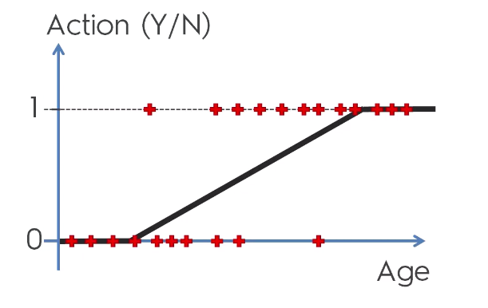
Logistic Regression - Explanation

Slide 7
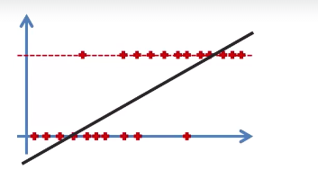

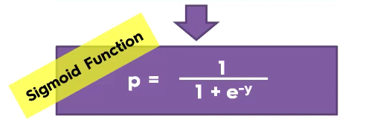
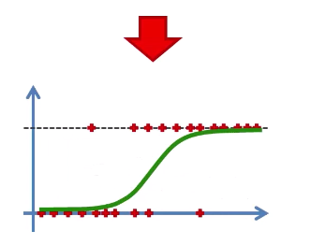
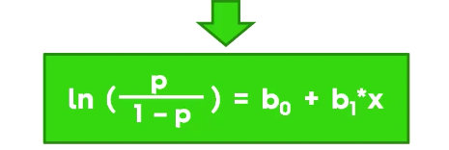
Logistic Regression - Explanation

Slide 8
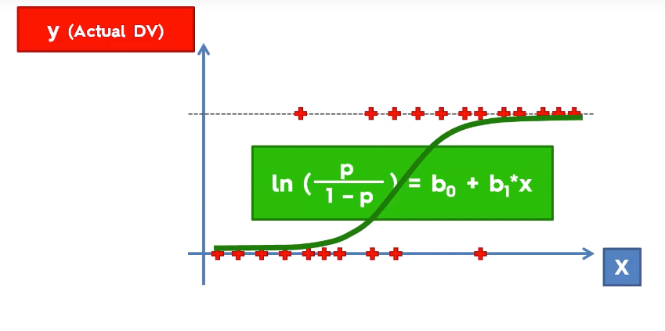
Logistic Regression - Explanation

Slide 9
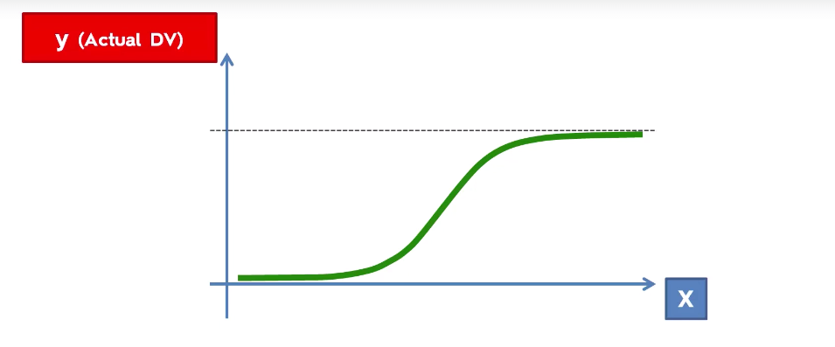
Logistic Regression - Explanation

Slide 10
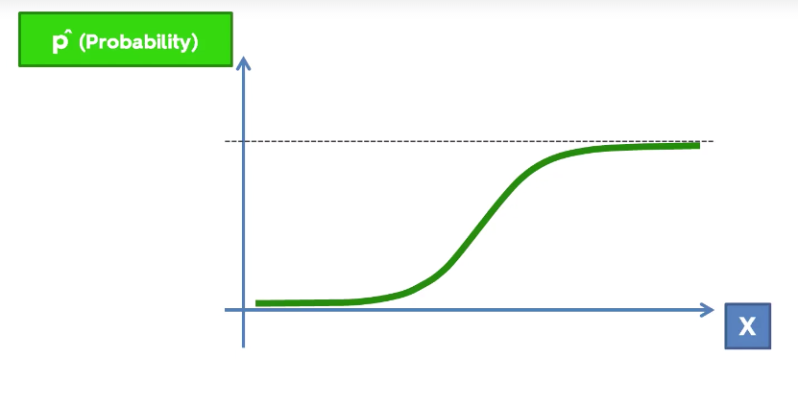
Logistic Regression - Explanation

Slide 11
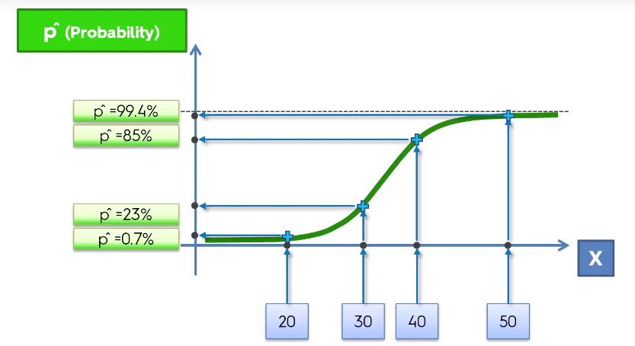
Logistic Regression - Explanation

Slide 12
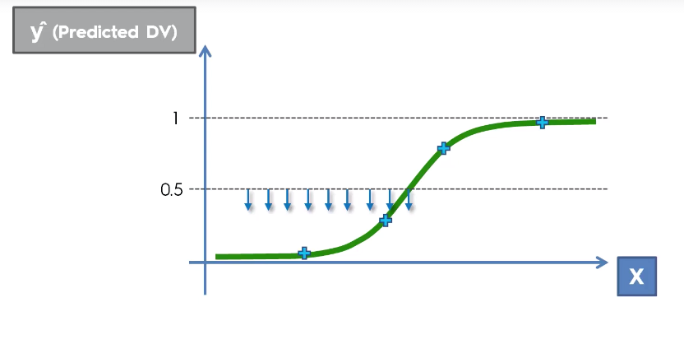
Logistic Regression - Explanation

