Slide 1
Naïve Bayes
~ Pankaj

Slide 2

Bayes Theorem

Slide 3
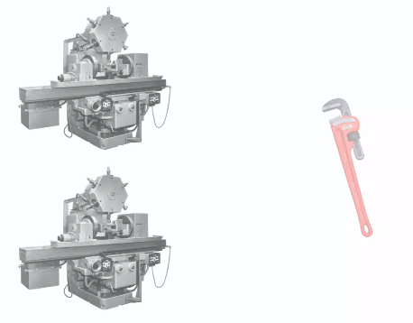
Bayes Theorem

Slide 4
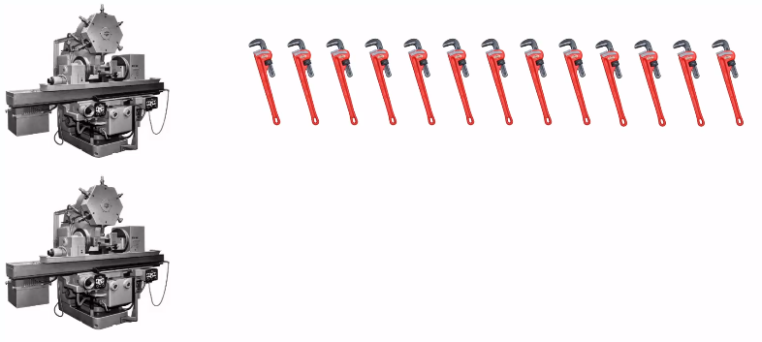
Bayes Theorem

Slide 5

Bayes Theorem

Slide 6
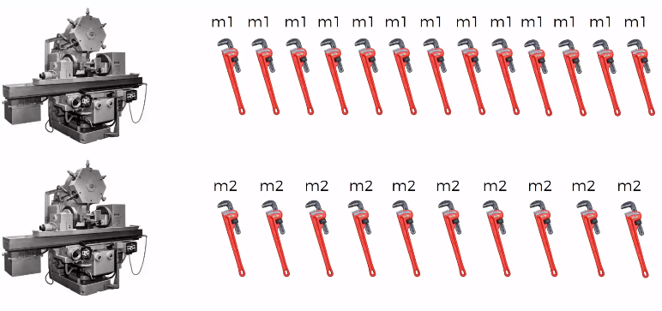
Bayes Theorem

Slide 7
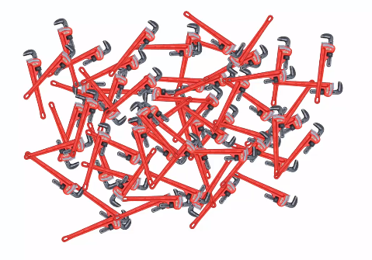
Bayes Theorem
Goal – Is to pick out the defective spanners ..

Slide 8
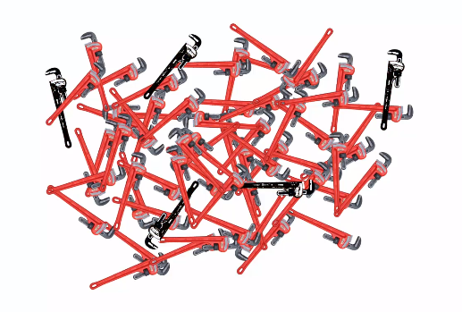
Bayes Theorem
Goal – Is to pick out the defective spanners hidden inside the pile of Spanners
i.e. what is the probability of picking the defective spanners

Slide 9
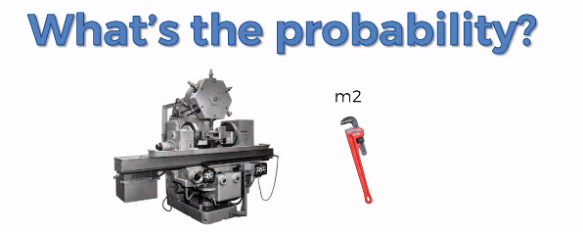
Bayes Theorem
What is the probability of machine 2 producing the defective spanner ?

Slide 10
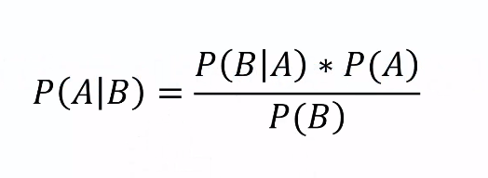
Bayes Theorem
Bayes Theorem
What information do we have to find that ?

Slide 11

Bayes Theorem

Slide 12

Bayes Theorem

Slide 13

Bayes Theorem

Slide 14

Bayes Theorem

Slide 15
Bayes Theorem

Slide 16

Bayes Theorem

Slide 17

Bayes Theorem

Slide 18

Bayes Theorem

Slide 19
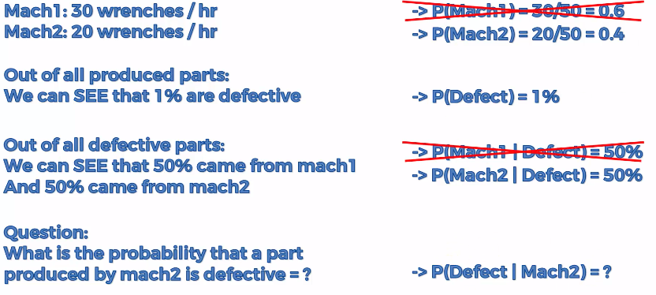

Bayes Theorem

Slide 20
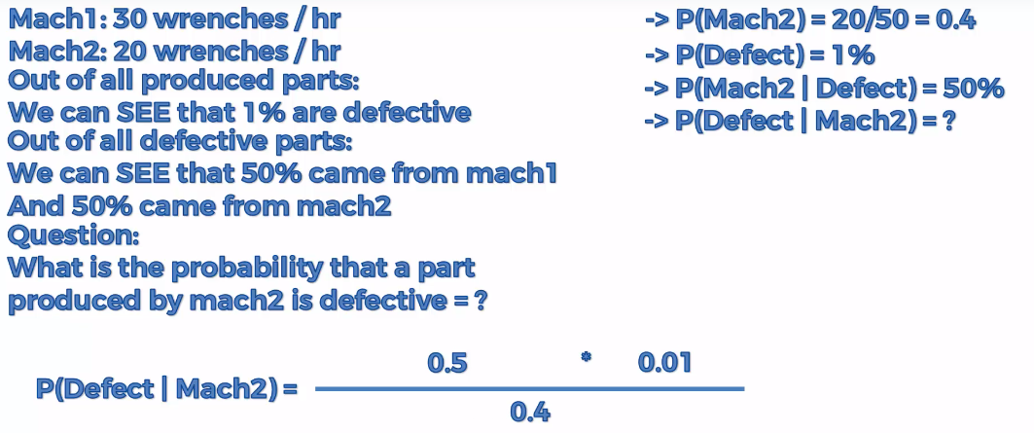
Bayes Theorem

Slide 21

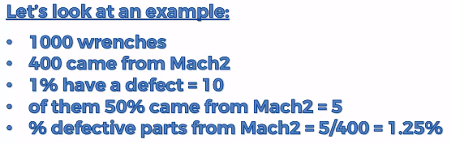
Bayes Theorem

Slide 22
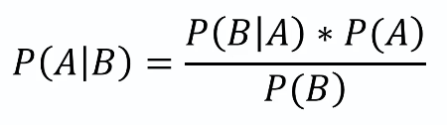
Naïve Bayes

Slide 23
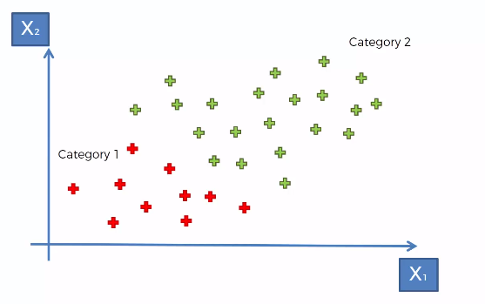
Naïve Bayes

Slide 24
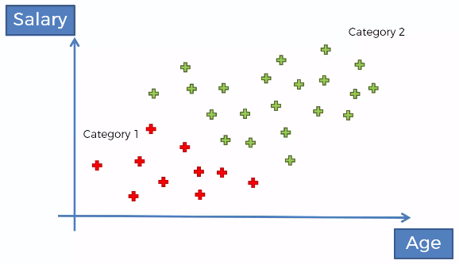
Naïve Bayes

Slide 25
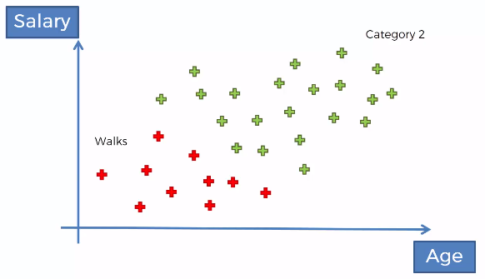
Naïve Bayes

Slide 26
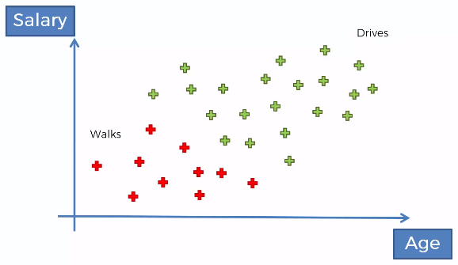
Naïve Bayes

Slide 27
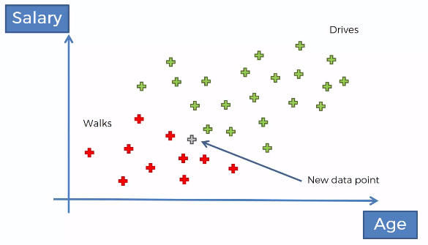
Naïve Bayes

Slide 28
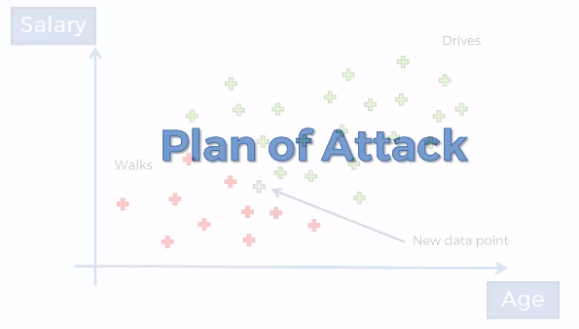
Naïve Bayes

Slide 29
P(y|X) = P(X|y) * P(y)
-------------
P(X)
----------------------------------------------------------------------
X = X1 ( age), X2(Salary), ....... , Xn
---------------------------------------------------------------------------
P(y|X) = P(X1|y) * P(y) P(X2|y) * P(y)
------------- * -------------
P(X1) P(X2)
----------------------------------------------------------------------
Y = Categorical Column = 1 and 0
1 is Walk
0 is Drive
---------------------------------------------------------------------------
P(Walk|X) = P(X1|Walk) * P(Walk) P(X2|y) * P(Walk)
------------- * ------------- = 0.?
P(X1) P(X2)
---------------------------------------------------------------------------
P(Drive|X) = P(X1|Drive) * P(Drive) P(X2|Drive) * P(Drive)
------------- * ------------- = 0.?
P(X1) P(X2)

Slide 30
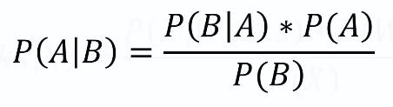
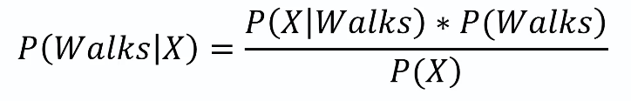
Naïve Bayes

Slide 31
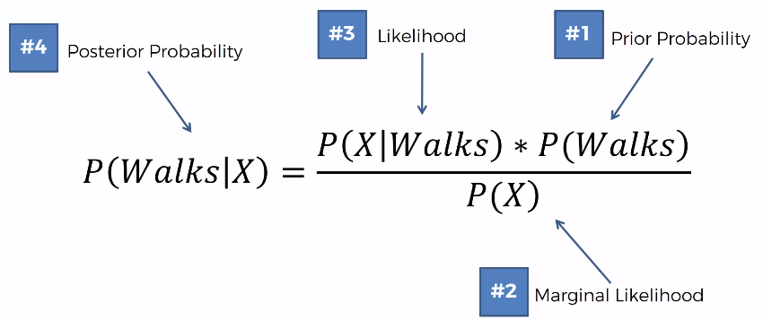
Naïve Bayes
Step 1

Slide 32
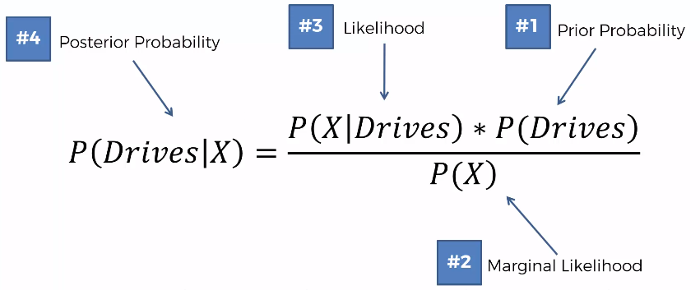
Naïve Bayes
Step 2

Slide 33


Naïve Bayes

Slide 34
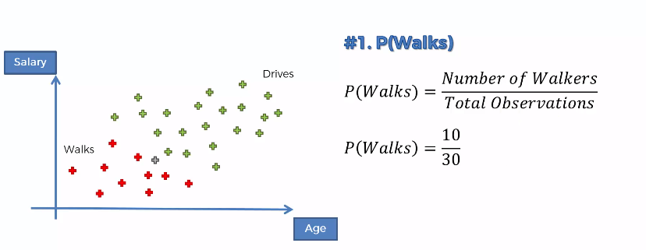
Naïve Bayes
Step 1

Slide 35
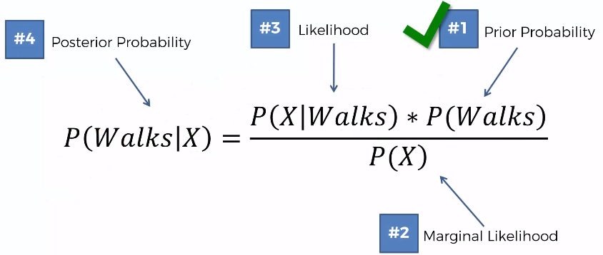
Naïve Bayes
Step 1

Slide 36
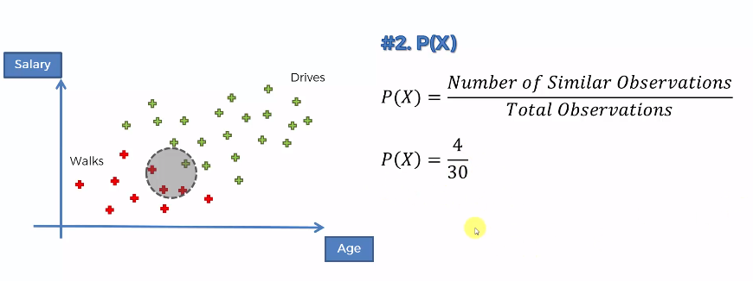
Naïve Bayes
Step 1

Slide 37
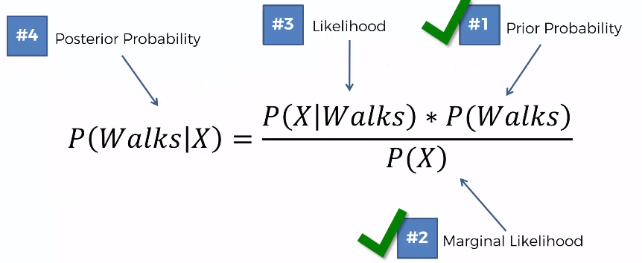
Naïve Bayes
Step 1

Slide 38
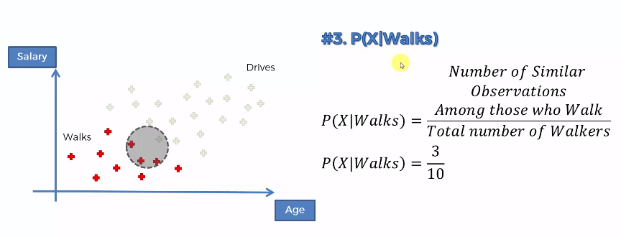
Naïve Bayes
Step 1

Slide 39
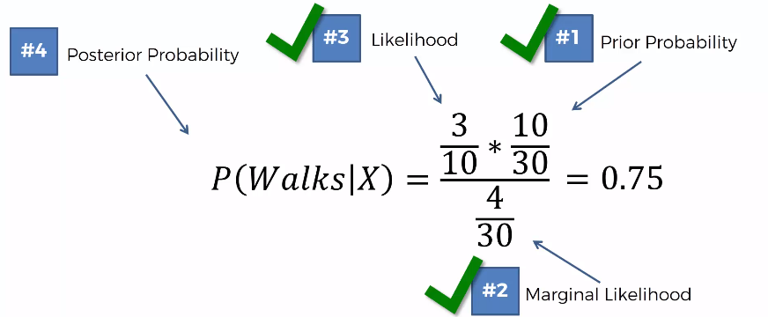
Naïve Bayes
Step 1

Slide 40
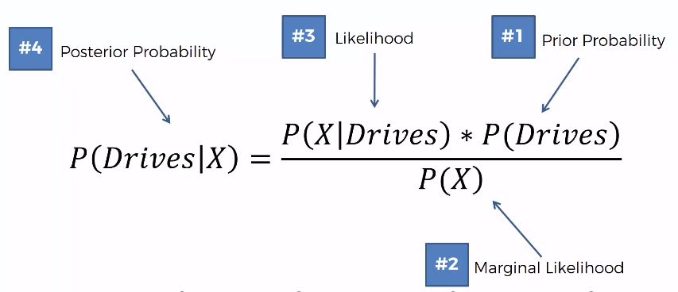
Naïve Bayes
Step 2

Slide 41
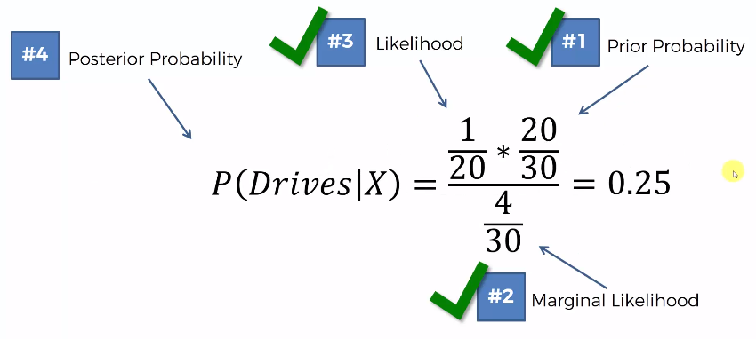
Naïve Bayes
Step 2

Slide 42



Naïve Bayes

Slide 43
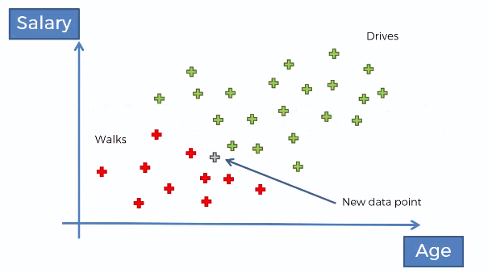
Naïve Bayes

Slide 44
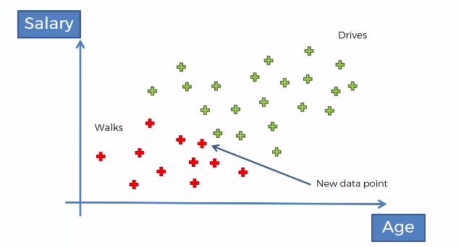
Naïve Bayes

Slide 45

Naïve Bayes

Slide 46

Naïve Bayes

Slide 47

Naïve Bayes

Slide 48
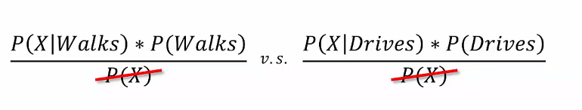
Naïve Bayes
When we are comparing we do not have to calculate the P(X) as it will always remain the same

Slide 49

Naïve Bayes

Slide 50
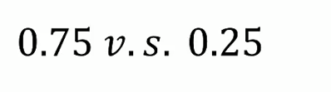
Naïve Bayes

