Slide 1


AI
BY HALA
PAGE
01/15

Slide 2

Let’s start by knowing the aspects of AI?
Artificial intelligence (AI) is a set of technologies that enable devices to make a variety of advanced functions
whether making a decision or approach.
The key elements of AI include:
•Machine Learning (ML)
•Deep Learning (DL)
•Natural Language Processing (NLP)
•Computer Vision
•Expert Systems
•Robotics
Describe the fundamental aspects of Artificial Intelligence
PAGE
02/15

Slide 3



Now that we know the aspect let's dig into the fundamentals ?
The main purpose of the fundamental of AI is to create machines that can intelligently stimulate human cognition
to solve real-world problems by acquiring knowledge and awareness of some of the tasks that can include learning,
problem-solving, decision-making, identifying trends and patterns, recommendations and predictions, etc.
PAGE
03/15

Slide 4
Describing types and areas of application to solve current real-world problems
PAGE
03/15

Slide 5


TYPES OF AI
ARTIFICIAL NARROW INTELLIGENCE (ANI).
ARTIFICIAL GENERAL INTELLIGENCE (AGI)
ARTIFICIAL SUPER-INTELLIGENCE (ASI)
Known also as weak AI, artificial intelligence systems developed to do a specific task and operate under limited constraints such as playing chess and manufacturing robots.
AI systems can perform any intellectual task that a human can. Such as self-driving cars,
theoretical concept of AI that combines human intelligence and cognitive abilities in all areas, including creativity, understanding, and social problems.
PAGE
04/15

Slide 6

  AI-powered Diagnosis: assisting healthcare in diagnosing and treating diseases more accurately and quickly by analyzing medical images.
  Predictive Analytics: assisting healthcare in predicting ,disease outbreaks, personalize treatment plans, and more all of these done by leaverging data driven insights.
Healthcare
& Medical Diagnosis
AREA OF APPLICATION
  AI Coaching & Strategy Optimization: analyze player overall performance to suggest various strategies to overcome the weakness
  Matchmaking Systems: machine learning to balance teams based on their skill level, gameplay history, etc.
Esports & Competitive Gaming
Cybersecurity & Fraud Prevention
Phishing Attack Prevention: NLP models are used to analyze large numbers of emails and messages to block phishing attempts keeping it data secure.
Fraud detection: it will detect any anomalies in real time by analyzing pattern
PAGE
05/15

Slide 7


CHALLENGES
Esports & Competitive Gaming:
  Player Frustration: If AI makes incorrect decisions (e.g., false cheat bans), it can harm the gaming experience.
  High Processing Costs: AI in gaming requires strong computational power (GPUs,CPUs) and more for real-time data analysis and strategy optimization for the players.
6AGE
06/15

Slide 8

CHALLENGES
Cybersecurity & Fraud :
  High Implementation Costs: Developing and maintaining AI security systems is expensive.
  False Positives & Negatives: AI may mistakenly flag legitimate actions as threats or miss advanced attacks.
6AGE
06/15

Slide 9


Bias in AI Models
High Implementation Costs
It is crucial to identify and mitigate any biases that might occur by having strict ethical rules, good bias algorithm implementation to prevent unfair outcomes for patients .
To train the data we need vast diverse data to be entered also since the data should be kept confidential and secure this needs strong encryption and large hardware with cloud backup also maintenance plan this is cost-effective in the long term
Data Privacy Risks
Large amounts of patient data are needed in healthcare including medical histories and personal details making it a prime target for hackers
Challenges in Healthcare & Medical Diagnosis

Slide 10

Security Issues:
  Data Privacy: the system might have a vast amount of data some of them might be personal data this will cause more concerns to the user that an intruder break into apply data regulations like GDPR and CCPA
Robust encryption methods and secure data storage solutions
  Cyberattacks: the AI systems can be vulnerable to cypher threats such as hacking, Ransomware, etc. AI system should be updated to any cypher threat and manipulation protecting the system malicious actors intentionally manipulate or deceive the system by introducing subtle changes to input data.
SECURITY
AND ETHICAL ISSUES
Ethical Issues:
  Bias and Fairness :if our data is baised the and its trained on algorithms might cause the algorithms to inhertite, leading to ethical dilemmas related to fairness and discrimination.
  Job Displacement and Economic Impacts:
due to the ai automation this will result to human displacment for the jobs because it will be cost effective over time since ai improve job quality by reducing mundane tasks
6AGE
07/15

Slide 11


5. TECHNICAL CHALLENGES IN MANAGING AND MAINTAINING INTELLIGENT SYSTEMS
STUDIO SHODWE
Having a high-quality of data is the core stage in building any system even obtaining reliable and accurate data with labels is very difficult to obtain.
As data and user demands grow, maintaining system performance becomes challenging for example might need Computational Resources, storage, etc.
Integrating AI systems with existing infrastructure (can be complex and costly for example the AI system infrastructure will need an upgrade schedule and ongoing maintenance.
Data Quality
Scalability
Integration
6AGE
08/15

Slide 12
6. REVIEW THE LEGAL IMPLICATIONS AND SECURITY RISKS TO BOTH USERS AND ORGANIZATIONS
User Privacy
Liability
Data Security:
Organizational Risks:
include data protection laws like GDPR and HIPAA is essential to protect sensitive data and information of patients on the medical system and the system must apply a robust privacy policy to assure transparency in data usage between the company and user keeping them updated on all the processes of their data.
for example, in automated surgery, if there is a problem occurs in the surgery it would be difficult to know where the problem is, whether it is the AI or the doctor used AI wrong or any other factor we need to require new regulations and guidelines to address these scenarios effectively.
Applying end-to-end encryption and strengthening storage protocol will lower any risk of unauthorized parties that might access the sensitive data, Also having frequent security updates and audits will improve the system security
To protect the organization's reputation we need to prevent any security breach and any unethical use of AI that might occur to do this we need to implement proactive risk management measures such as having well-defined incident response plans that will reduce the risks and protect the organization's standing
6AGE
11/15

Slide 13
EVALUATE THE TECHNICAL AND ETHICAL CHALLENGES AND OPPORTUNITIES
6AGE
12/15

Slide 14


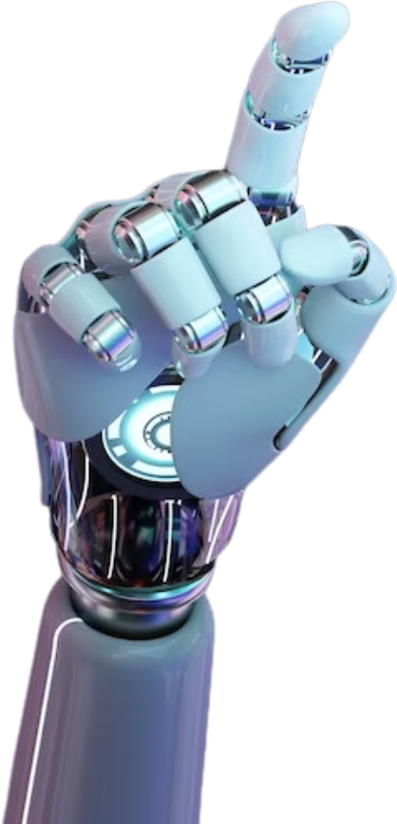
Technical
Challenges
Data Quality and Availability:
system might face a challenge with having high quality data, reliable, accurate, labeled data is difficult, biased, incomplete, or noisy data, all of these will impact the quality of AI outcome.
Scalability:
As the data grows as the user needs grows more data inputted into the system the more we need extra computational resources and storage having more data some of them might be sensitive this means that we should make our infrastructure more robust
to maintain the performance of an intelligent system.

Slide 15



Ethical
Challenges
AI systems hold large amounts of data and some of the data might include sensitive data that needs to be protected and secured efficiently this will be done by applying laws such as GDPR and HIPAA to ensure privacy and security also including biases in the data will result in unfair results leading to unfair outcomes. Moreover, having in increase of AI automation capabilities will replace human jobs which will lead to a shift in the economics that will require careful management. these issues are crucial to ensure responsible and equitable AI deployment.
page 13

Slide 16


STUDIO SHODWE
Innovation
AI can think out of the box and things can't be imagined by humans providing incredible solutions in a short time based on stats and more such as personalized medicine like drugs or treatment.
Opportunities
Enhanced Decision-Making
AI help us to have a more accurate and timely decision making especially in medicine and this will be done by identifying patterns and making predictions these will provide more enhanced decision making. Also, AI solve the timely decision tasks (patient data entry) instead of doctor this will save up time for doctor to work on other stuff(e.g diagnosing ) making it very productive to use

Slide 17

STUDIO SHODWE
THANK YOU!
Hala Nazzal
PAGE
15/15

