Slide 1

Churn
Prediction

Slide 2




Business Problem
Why Churn Prediction?
Competitives in the market & need to predict the likelyhood of a customer to churn
Early solutions for customer retention e.g. Discounts, Personalized services, Marketing Efforts

Slide 3


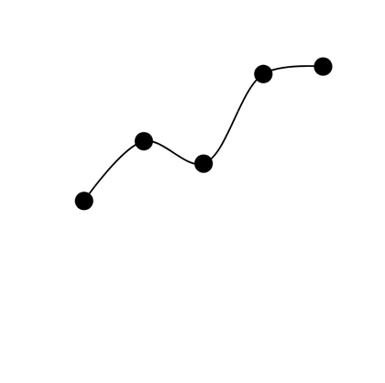
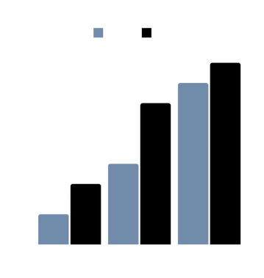
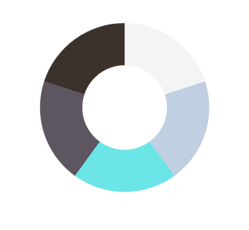
Data Visualization
Exploring the data

Slide 4
Missing Values
Data
Artifacts
High Cardinality
Duplicates
Outliers

Slide 5

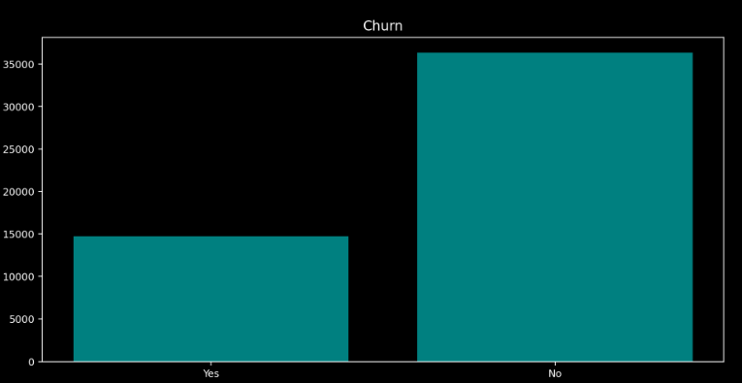
Univariate Analysis
The Churn (target variable) is imbalanced

Slide 6
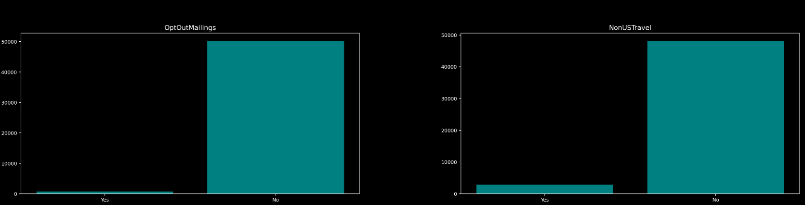
Univariate Analysis
Some categoricals convey nearly no information due to imbalance

Slide 7
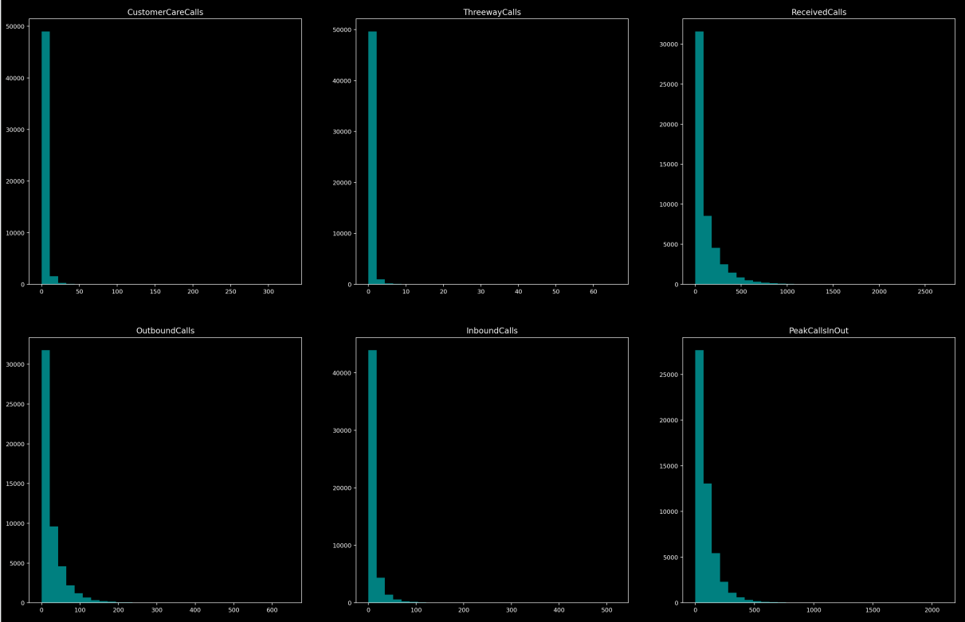
Univariate Analysis
Most of the numericals are right skewed

Slide 8
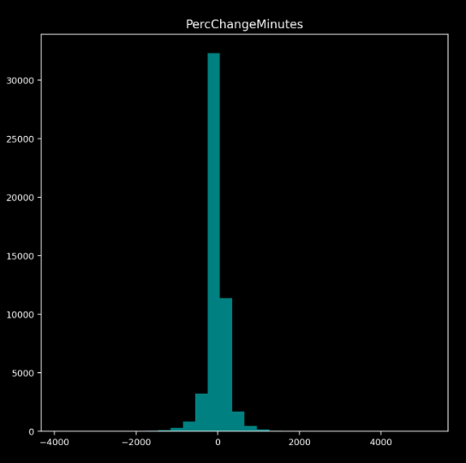
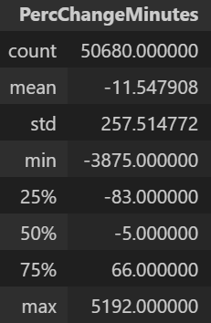
Univariate Analysis
Slightly balanced effect of customers tendency to inc/dec their use of this service

Slide 9
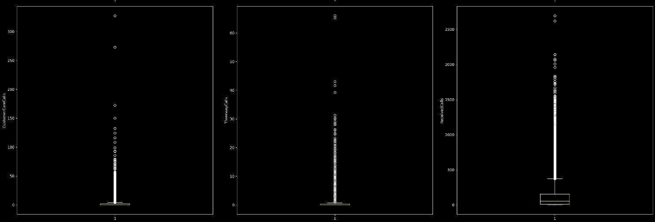
Univariate Analysis
Outliers Seems to exist alot in this data & needs special attention

Slide 10
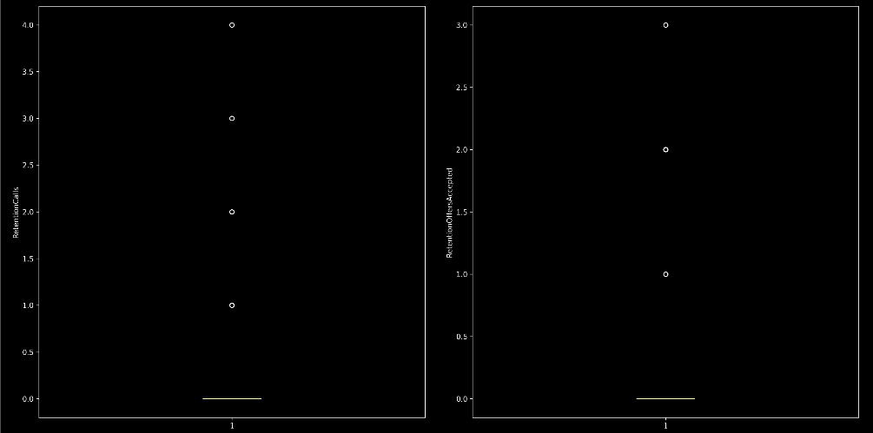
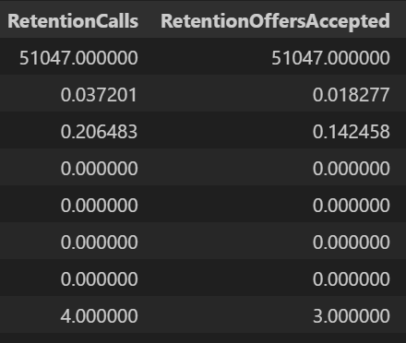
Univariate Analysis
Except for these two which seems to have meaning

Slide 11

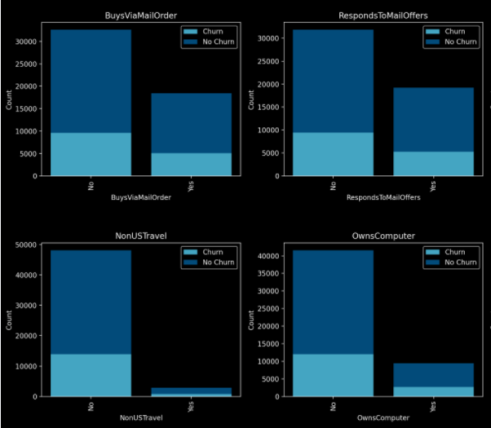
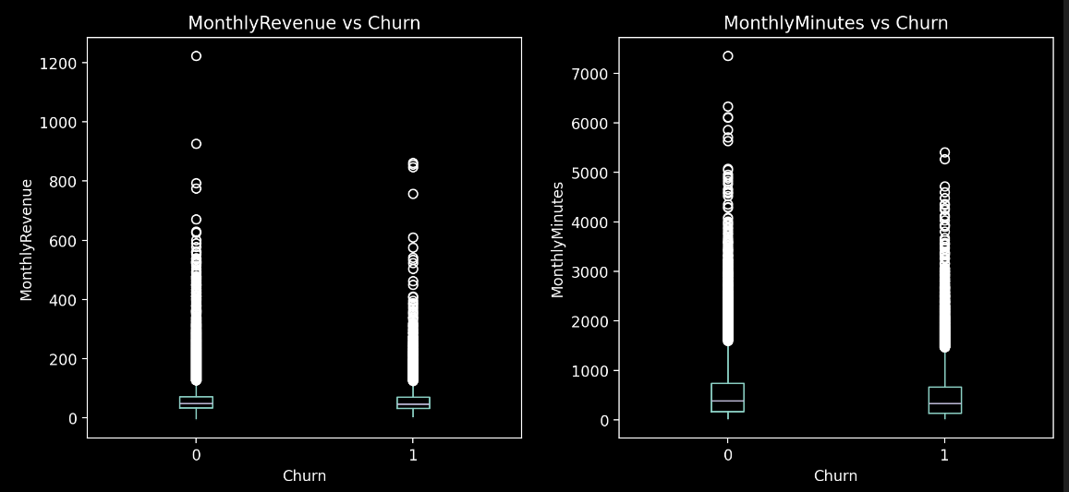
Bivariate Analysis
Relations with target feature seems not interesting

Slide 12
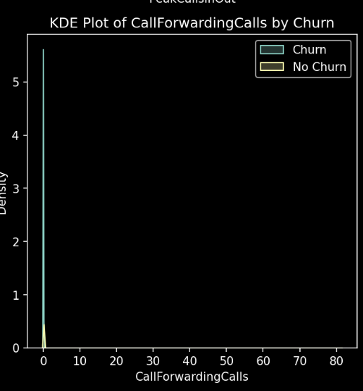
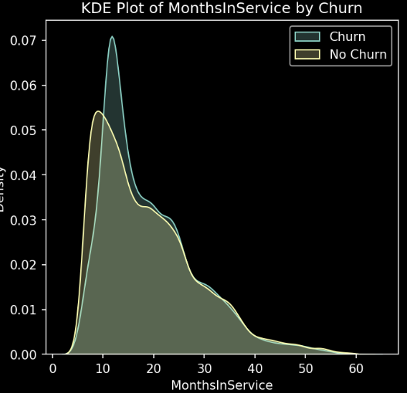
Bivariate Analysis
Some KPIS have slighly higher distributions for Churn category

Slide 13
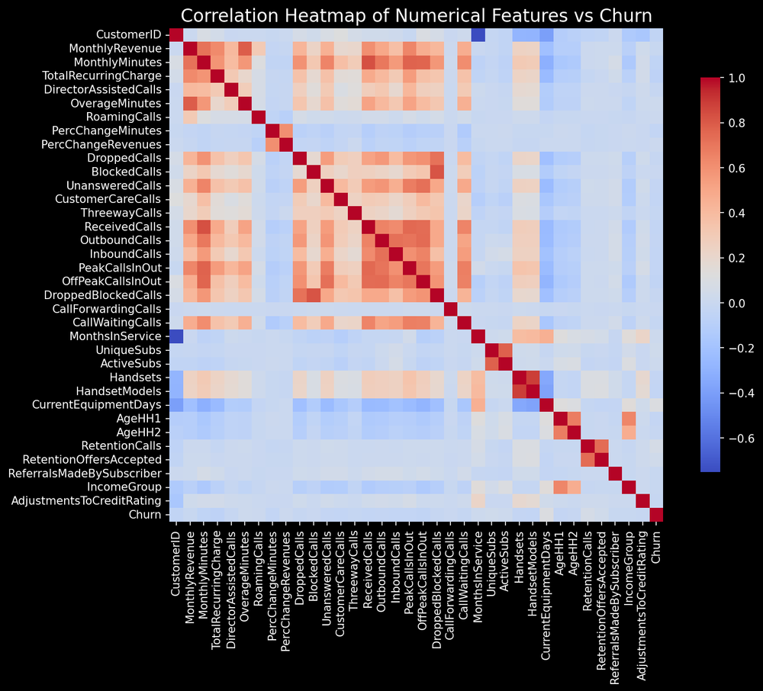
Bivariate Analysis
Some features are highly correlated together but not with Churn

Slide 14
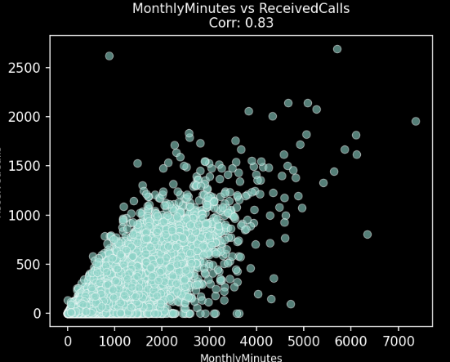
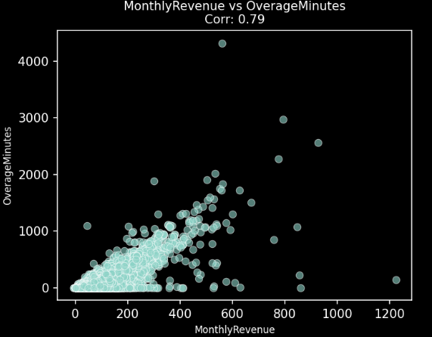
Bivariate Analysis
SomeFeatures are highly correlated so PCA could be worth

Slide 15
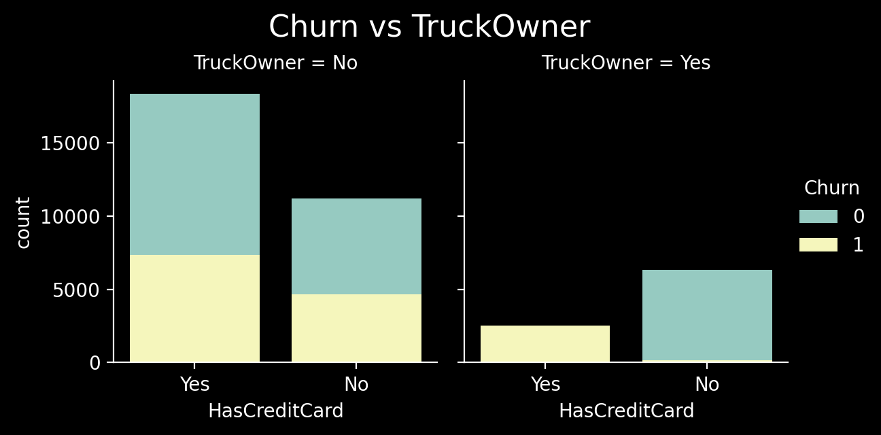
Mulivariate Analysis
In a higher dimensional.. More interesting patterns

Slide 16
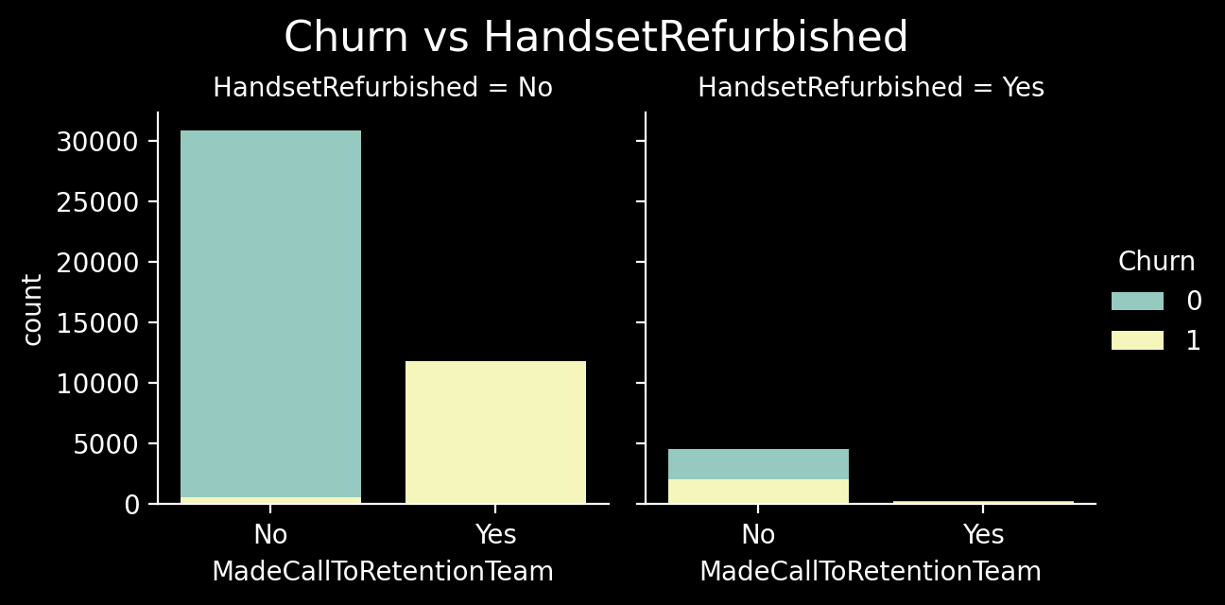
Mulivariate Analysis
In a higher dimensional.. More interesting patterns

Slide 17
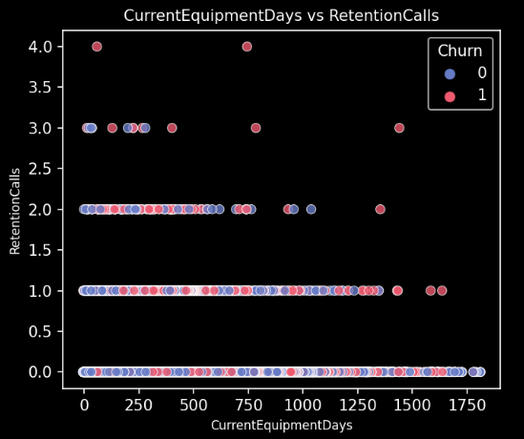
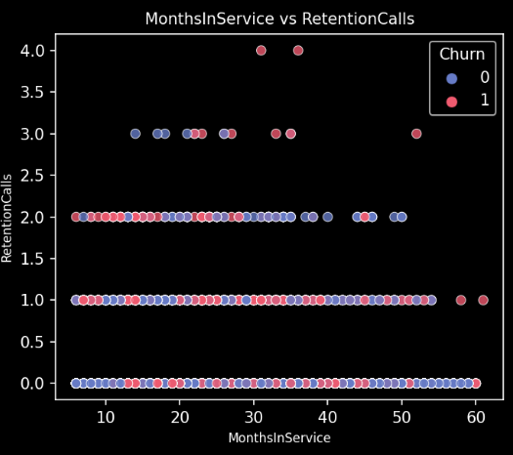
Multivariate Analysis
High Retention calls mostly Churn
More in the notebook

Slide 18




Nulls
Filled with median(numericals) and mode(categoricals)
In
==
Out
Outliers
Capped them.
Data Cleaning
& Processing
Categorical
High Cardinality handled. Then Binary Encoded.
Numericals
A modular approch was implemented
Standardized.
High Dimensionality
PCA

Slide 19




Modeling

Slide 20
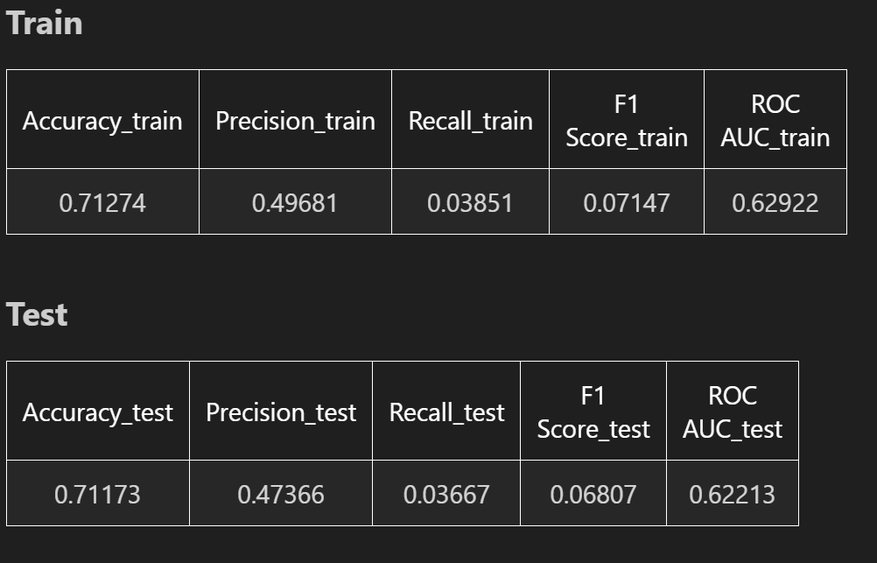
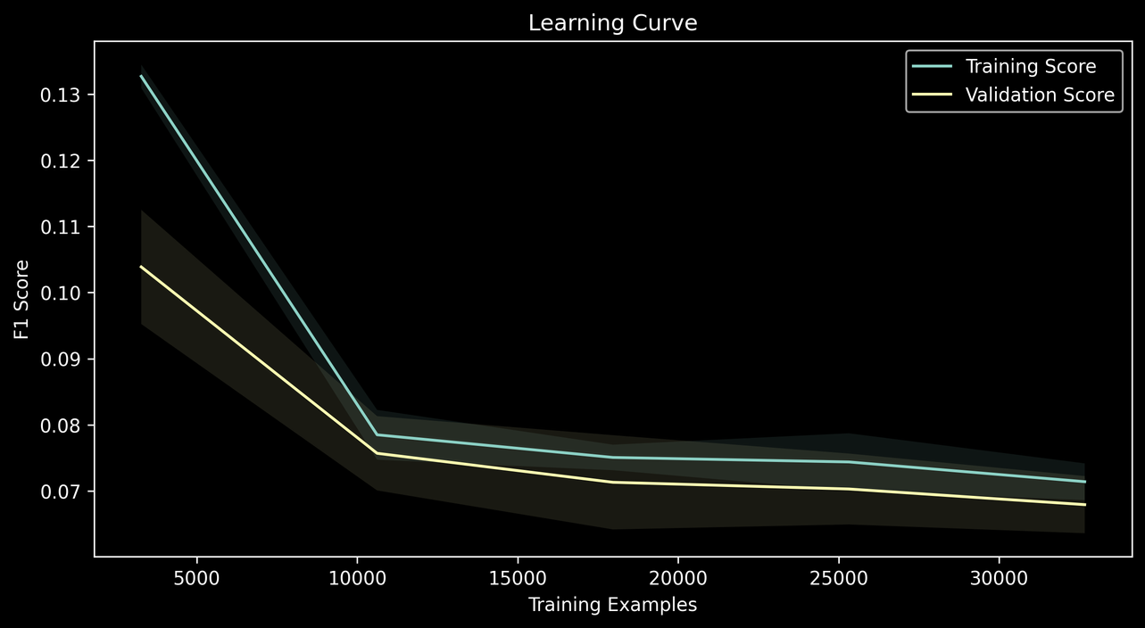
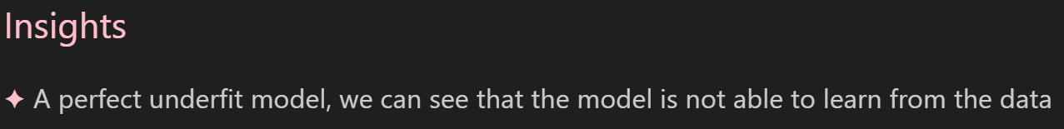
Logistic regression

Slide 21
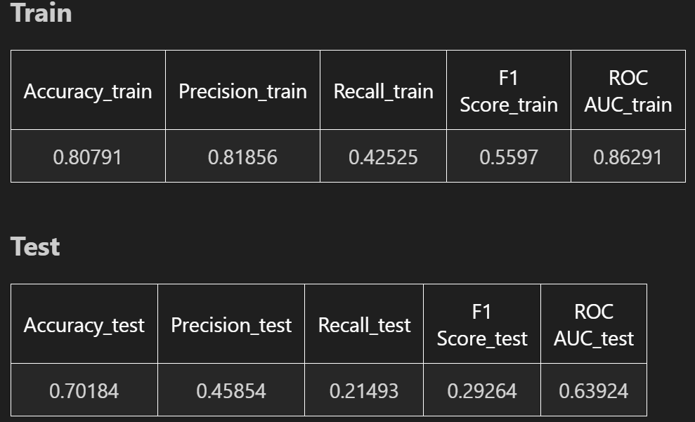
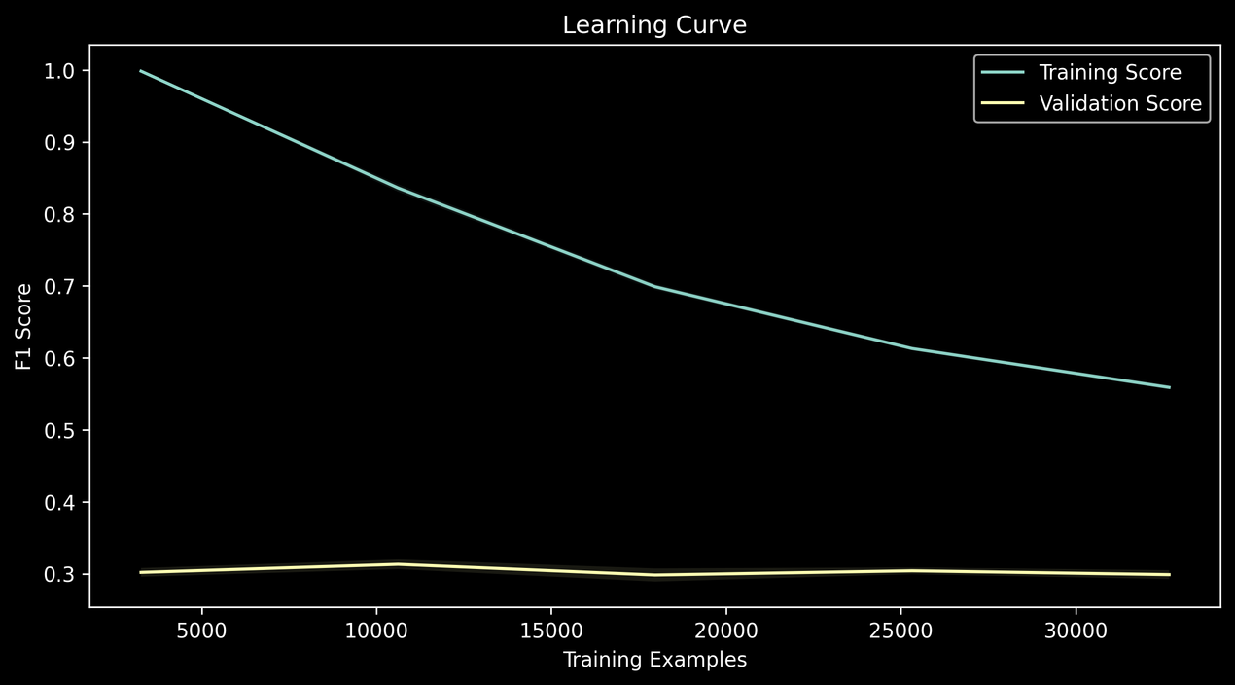
GradientBoost

Slide 22
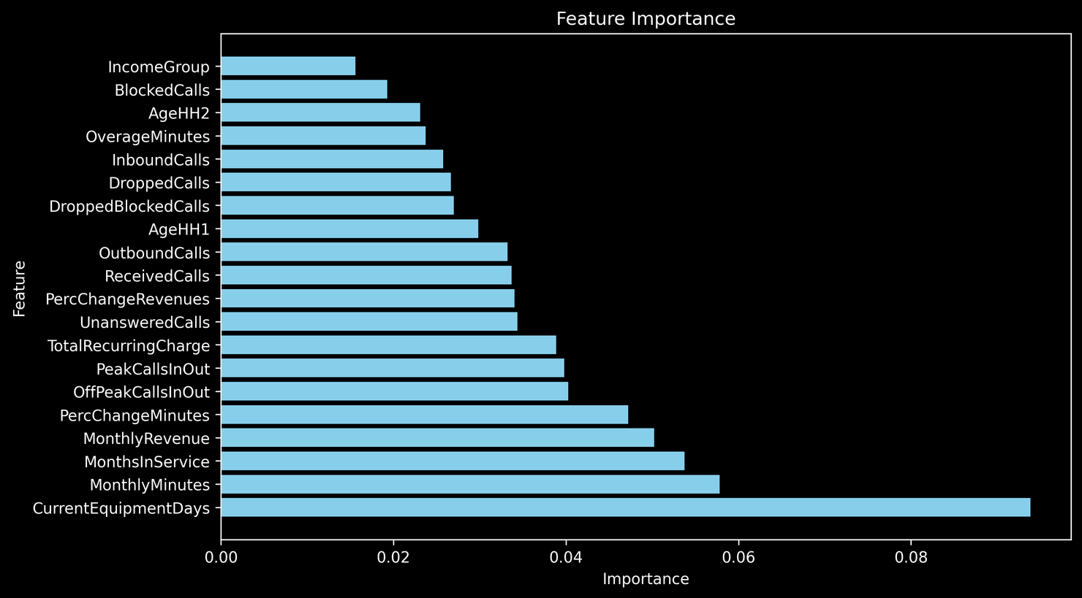
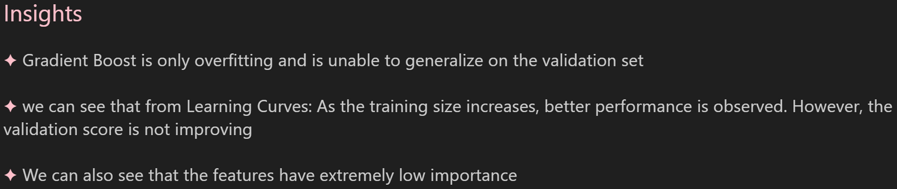
GradientBoost

Slide 23
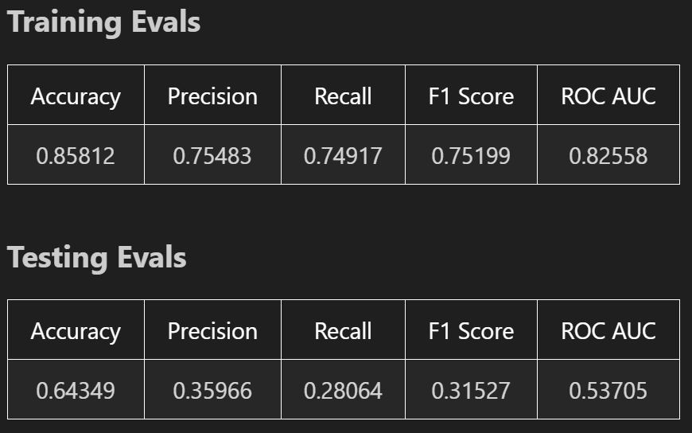
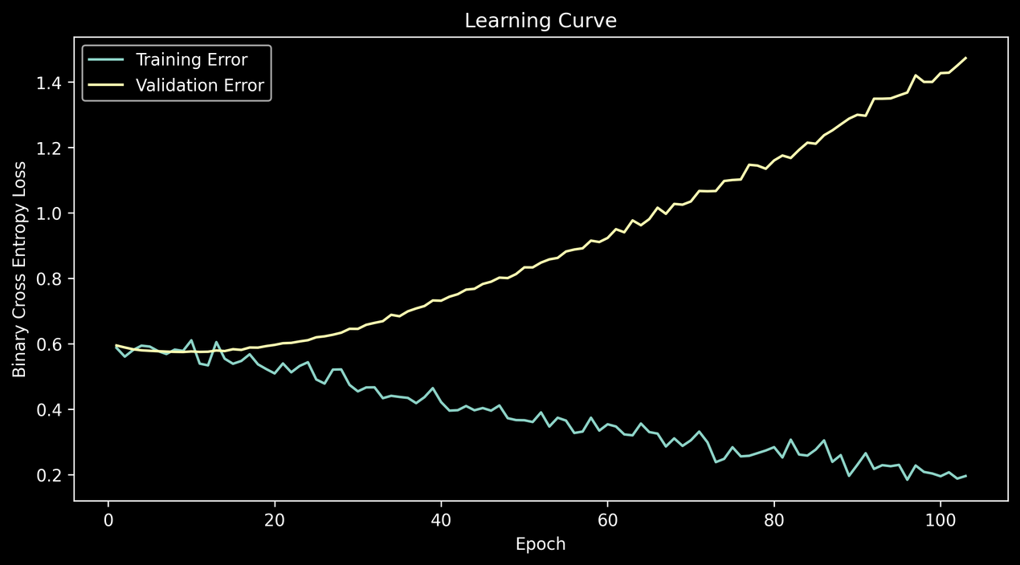
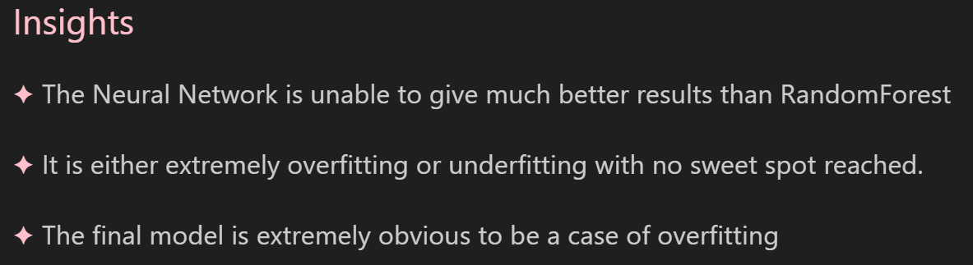
Neural Networks

Slide 24
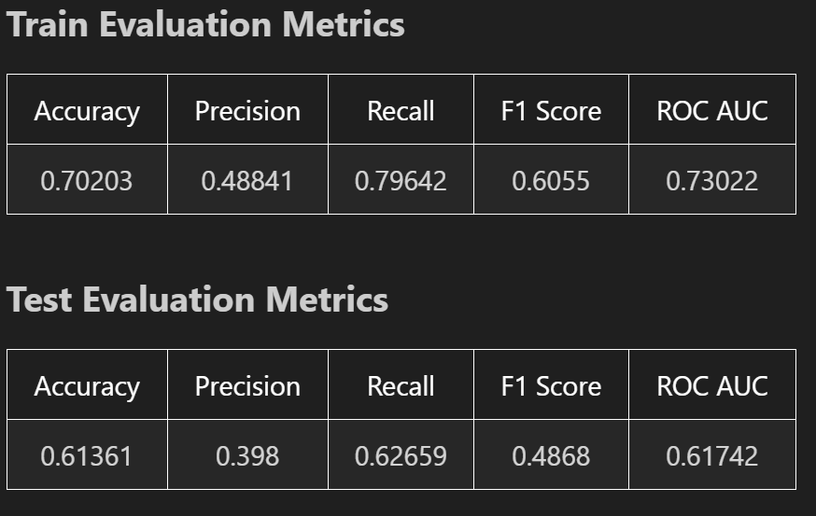
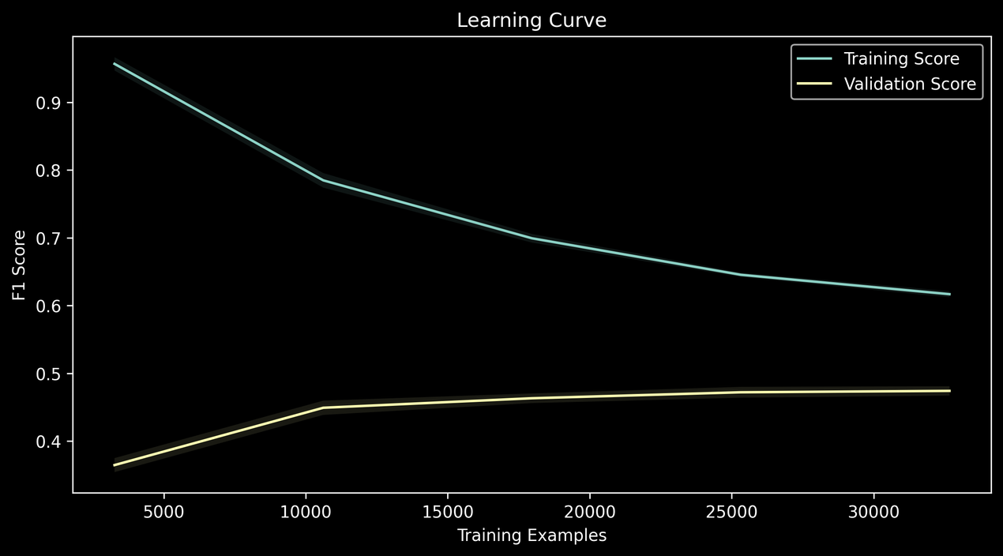
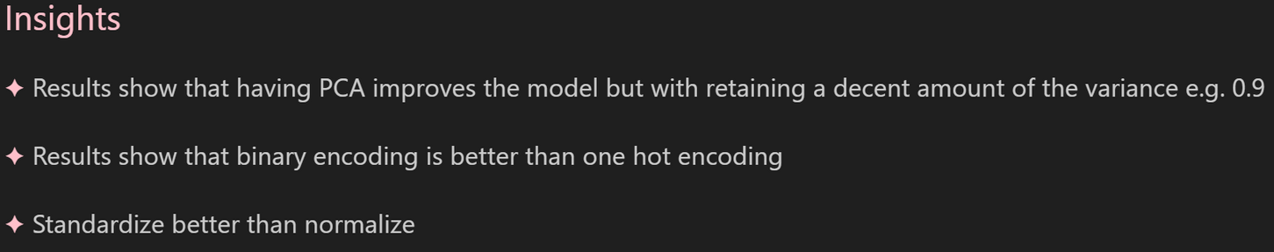
Random Forest

Slide 25
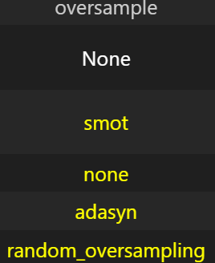
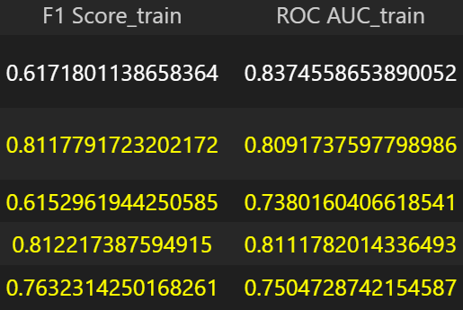
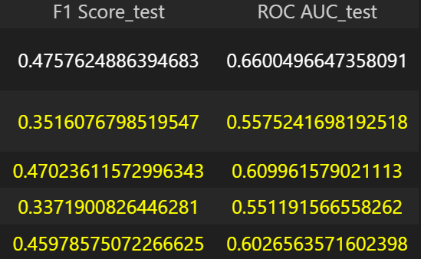
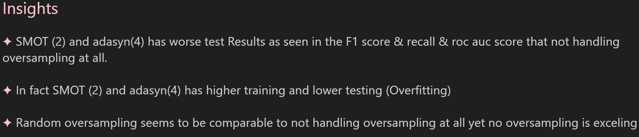
OverSampling

Slide 26
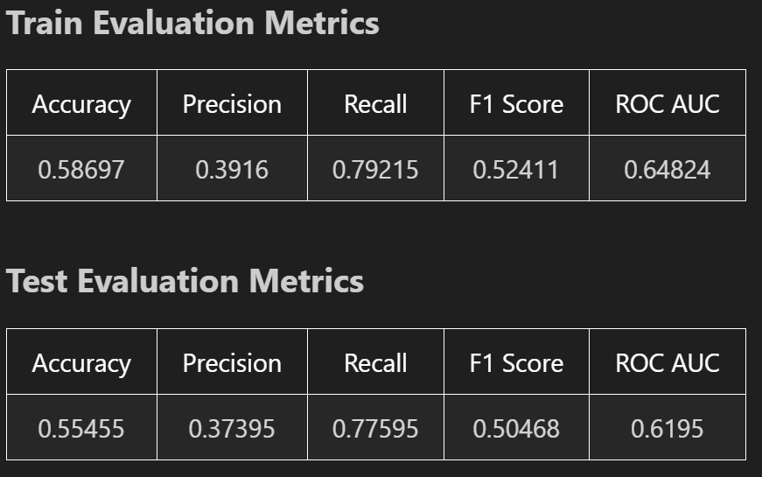
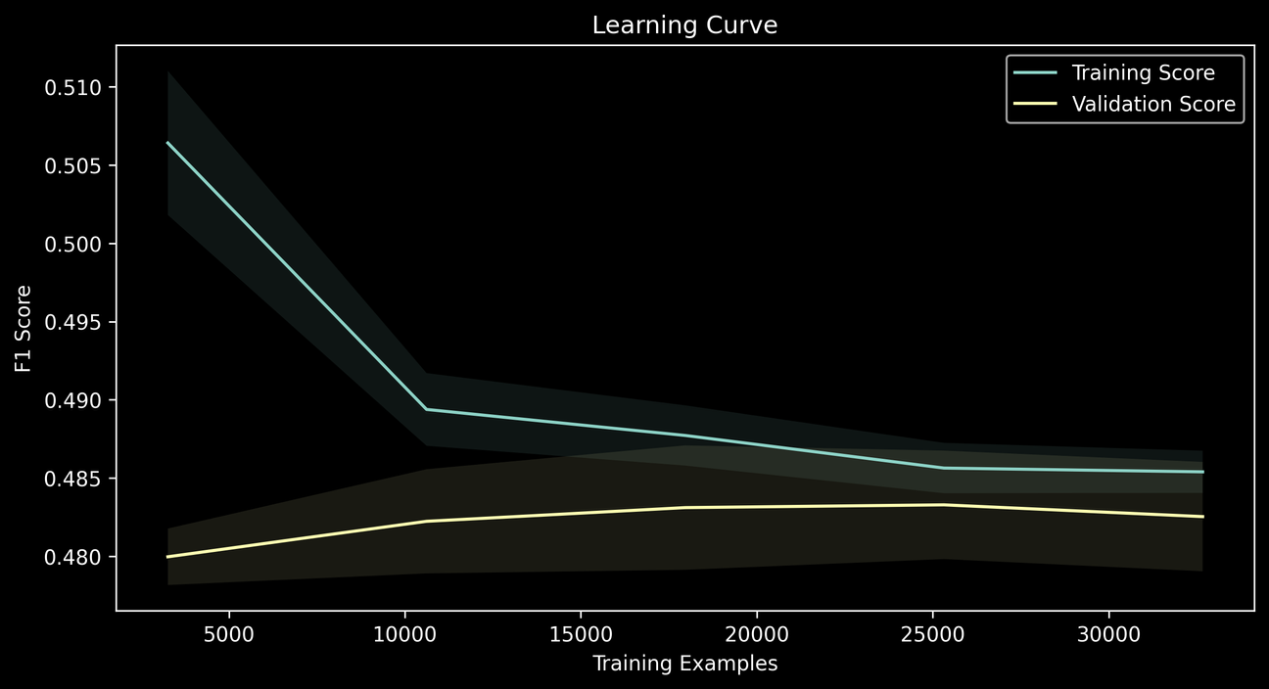
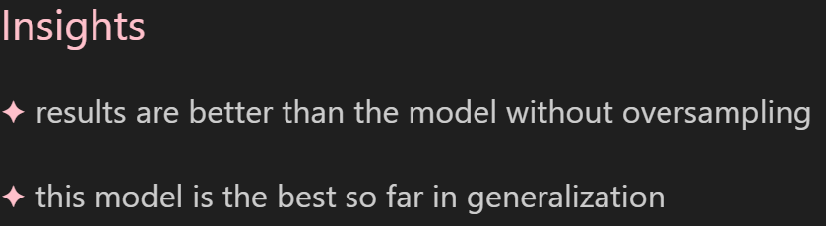
XgBoost
More in the notebook

