Slide 1

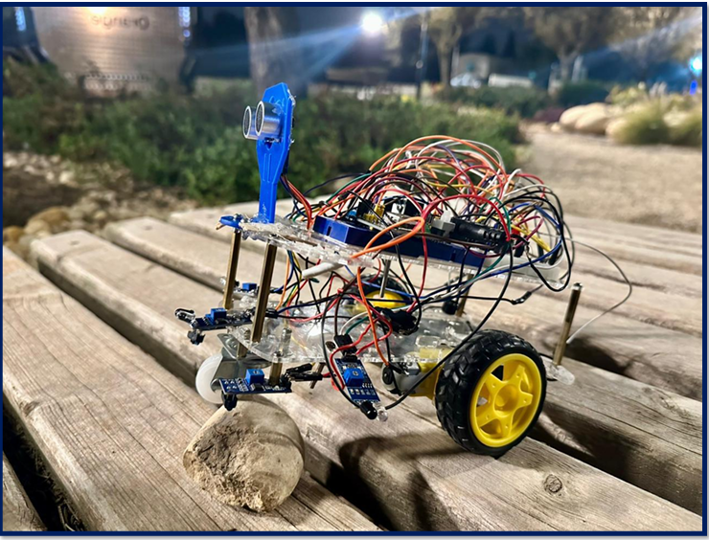
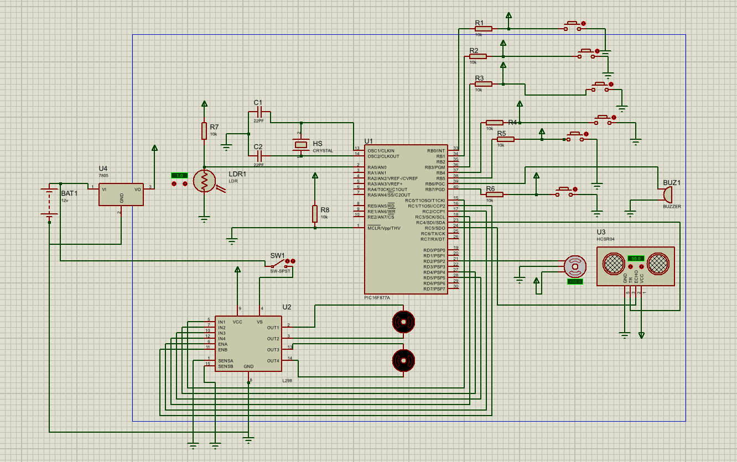
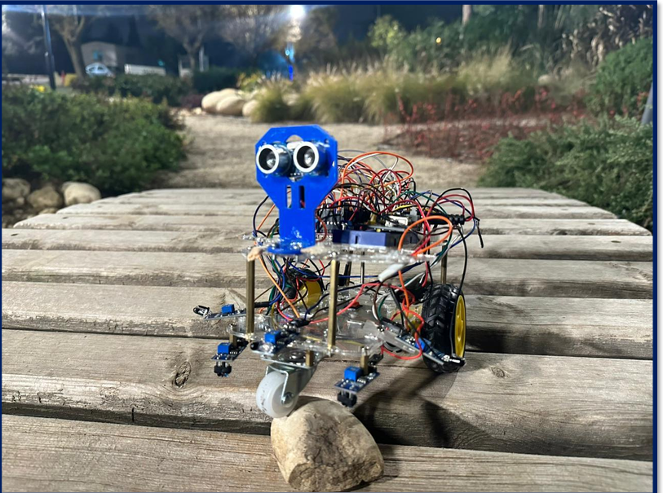
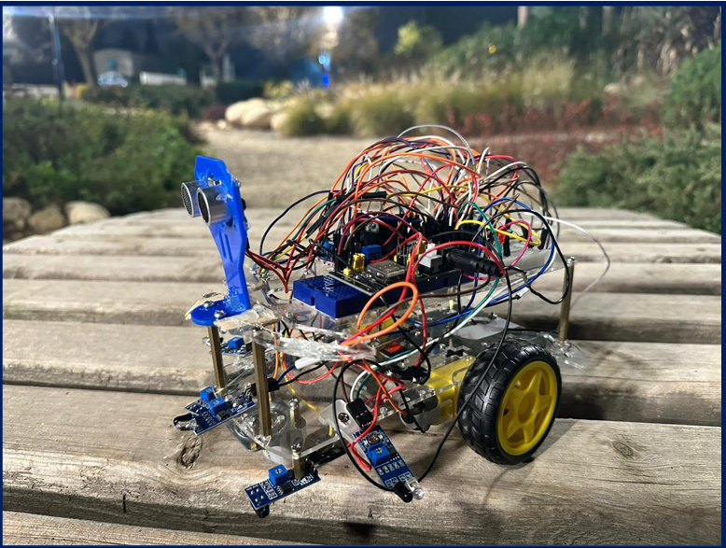
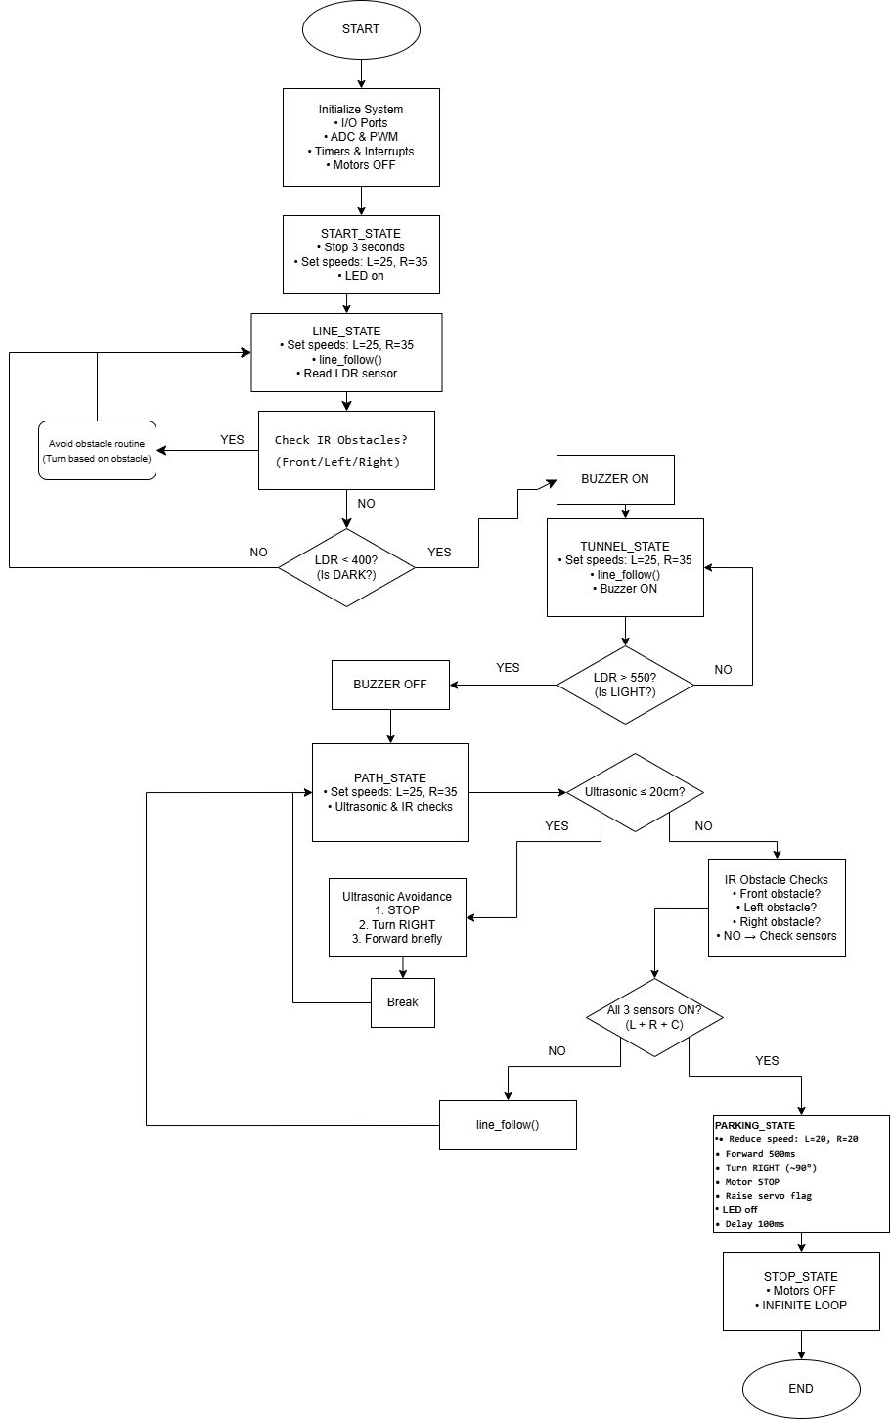
Jiritsu Two-wheel Rover
R. Al-mahadin, H. Al-zaben, and Z. Al-shweikh
Supervisor: Dr. Essam Alqaralleh
Embedded Systems Final Design Project, First semester 2025-2026
King Abdullah II School of Engineering
Princess Sumaya University for Technology
Introduction
Autonomous mobile robots move and complete tasks without human control. They rely on sensors and control logic to understand their surroundings and react in real time.
This project builds an embedded autonomous robot using the PIC16F877A microcontroller. The robot navigates a multi-zone track that includes line following, tunnel detection, obstacle avoidance, ramp climbing, and precise parking. The goal is to show how embedded programming and sensor integration can create a robot that is stable, accurate, and responsive.
Results
The robot was tested on the full challenge track: line following, tunnel, obstacle path, bump handling, and parking. It completed all zones in the correct order with no manual intervention.
It starts with a 3-second delay, LED turns on, then follows lines smoothly using IR sensors and PWM speed control. In the tunnel, the LDR detects low light and activates a buzzer, then turns it off after exiting. In the line-free path, ultrasonic + IR obstacle sensors detect obstacles and perform stable avoidance (stop, turn, continue). In the parking zone, the robot detects the surface, slows down, parks accurately, raises the flag using a servo, and then enters a stop state.
Figure 3: Two-wheel rover.
Figure 4: Two-wheel rover test views: (a) front view, (b) side view.
Key observations: Stable tracking on curves and intersections, smooth state transitions between zones, reliable tunnel detection, and consistent obstacle avoidance. Parking was completed successfully, including flag activation and final idle state.
Design
Our robot was constructed as a PIC16F877A-based, sensor-driven rover. To manage each track zone sequentially, the design incorporates a straightforward mechanical platform, a small control circuit, and a state-machine program.
Figure 1: Electrical design
PIC16F877A reads the sensors and controls outputs. Motors are driven through an H-bridge driver with PWM speed control. Integrated sensors include IR line sensors, LDR, and HC-SR04 ultrasonic + IR obstacle sensors, with a buzzer indicator.
Figure 2: Software Design
The program follows a clear state sequence: START → LINE → TUNNEL → PATH → PARK → STOP. Each state has its own sensor checks and actions to ensure smooth transitions and correct zone order.
Conclusion
This project matters because it demonstrates how a low-cost embedded controller can produce reliable autonomous behavior using real sensor feedback, not manual control. Our goal was to build a PIC16F877A-based robot that can handle a multi-stage challenge by making decisions in real time and switching behaviors correctly.
The final outcome shows that the design is not just “working,” but structured and dependable: the robot consistently transitioned between behaviors when conditions changed (light level, obstacles, surface cues) and completed the full track autonomously. This validates the value of the chosen approach: a clear state-machine architecture, stable motor control, and purposeful sensor integration. Overall, the project provides a practical foundation for future improvements such as tighter control tuning, faster obstacle handling, or adding smarter navigation methods, while keeping the system lightweight and embedded-friendly.

