Slide 1
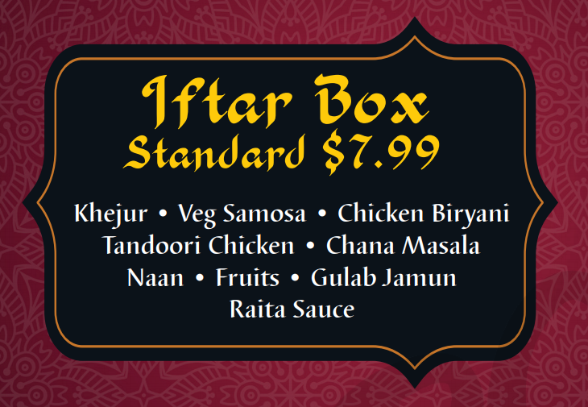
Halal Indo Cuisine
Authentic
Indian . Bangladeshi . Pakistani

Slide 2
Daily Lunch Box
Vegetarian $8.99
Samosa • Veg Biryani • Chana Masala Mix Vegetables • Daal Makhni • Naan Salad + Raita • Gulab Jamun

Slide 3
Daily Lunch Box
Non-Vegetarian $10.00
Samosa • Chicken Biryani Tandoori Chicken • Daal Makhni • Naan Salad + Raita • Gulab Jamun

Slide 4
Daily Lunch Box
Non-Vegetarian Premium $12.00
• Sheekh Kabab • Butter Chicken
Samosa • Chicken Biryani Tandoori Chicken • Daal Makhni • Naan Salad + Raita • Gulab Jamun

Slide 5

Halal Indo Cuisine

