Slide 1
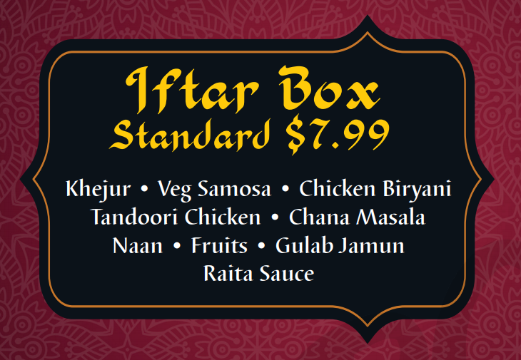
Halal Indo Cuisine
Authentic
Indian . Bangladeshi . Pakistani

Slide 2
Daily Lunch Box
Vegetarian $8.99
Samosa • Veg Biryani • Chana Masala Mix Vegetables • Daal Makhni • Naan Salad + Raita • Gulab Jamun

Slide 3
Daily Lunch Box
Non-Vegetarian $10.00
Samosa • Chicken Biryani Tandoori Chicken • Daal Makhni • Naan Salad + Raita • Gulab Jamun

Slide 4
Daily Lunch Box
Non-Vegetarian Premium $12.00
• Sheekh Kabab • Butter Chicken
Samosa • Chicken Biryani Tandoori Chicken • Daal Makhni • Naan Salad + Raita • Gulab Jamun

Slide 5
Standard
$12.00 per person
1 Veggie Appetizer (Pakora or Chat Papri)
1 Non-Veg Appetizer (Chilly Chicken or Tandoori Chicken)
1 Veggie Curry ( Any Choice )
2 Curry (Curry, Biryani, Kabab, Roast)
Pulao Naan Salad
Any Dessert

Slide 6
Gold
$14.00 per person
1 Veggie Appetizer (Pakora or Papdi Chat)
1 Non-Veg Appetizer (Chilly Chicken or Tandoori Chicken)
2 Veggie Curry ( Any Choice )
2 Curry (Chicken, Goat, Kabab, Roast)
Pulao Naan Salad
Any Dessert

Slide 7
Diamond
$16.00 per person
2 Veggie Appetizer (Pakora and Papdi Chat)
1 Non-Veg Appetizer (Chilly Chicken or Tandoori Chicken)
2 Veggie Curry ( Any Choice )
2 Curry (Chicken, Goat, Kabab, Roast)
Pulao Naan Salad
Any Dessert

Slide 8
Premium
$18.00 per person
2 Veggie Appetizer (Pakora and Papdi Chat)
1 Non-Veg Appetizer (Chilly Chicken or Tandoori Chicken)
2 Veggie Curry ( Any Choice )
Fried Fish or Shrimp
2 Curry (Chicken, Goat, Kabab, Roast)
Pulao Naan Salad
Two Desserts

