Slide 1

Virtual Classroom Final Evaluation Presentation
FYP-2
Members
Ahsaan Ullah 17I-0133
Fasih Saeed 17I-0245
M. Uzair Ibrar 17I-0300
Supervised By : Mr. Jawad Hassan

Slide 2
Project analysis slide 3
Content
Overview
Poster
FYP - 1
Iteration-1
FYP-2
Iteration-2
FYP-2
Demo / Implementation

Slide 3

Overview
Web-based platform through which students can take online classes.
Institutional mentors can check the percentage of presence of a student in an online class using eye-tracking.
Institutional mentors can analyze the engagement of the student in a certain course through his/her performance in the course.
Provide a Dashboard to mentors to visualize the result of analyses

Slide 4
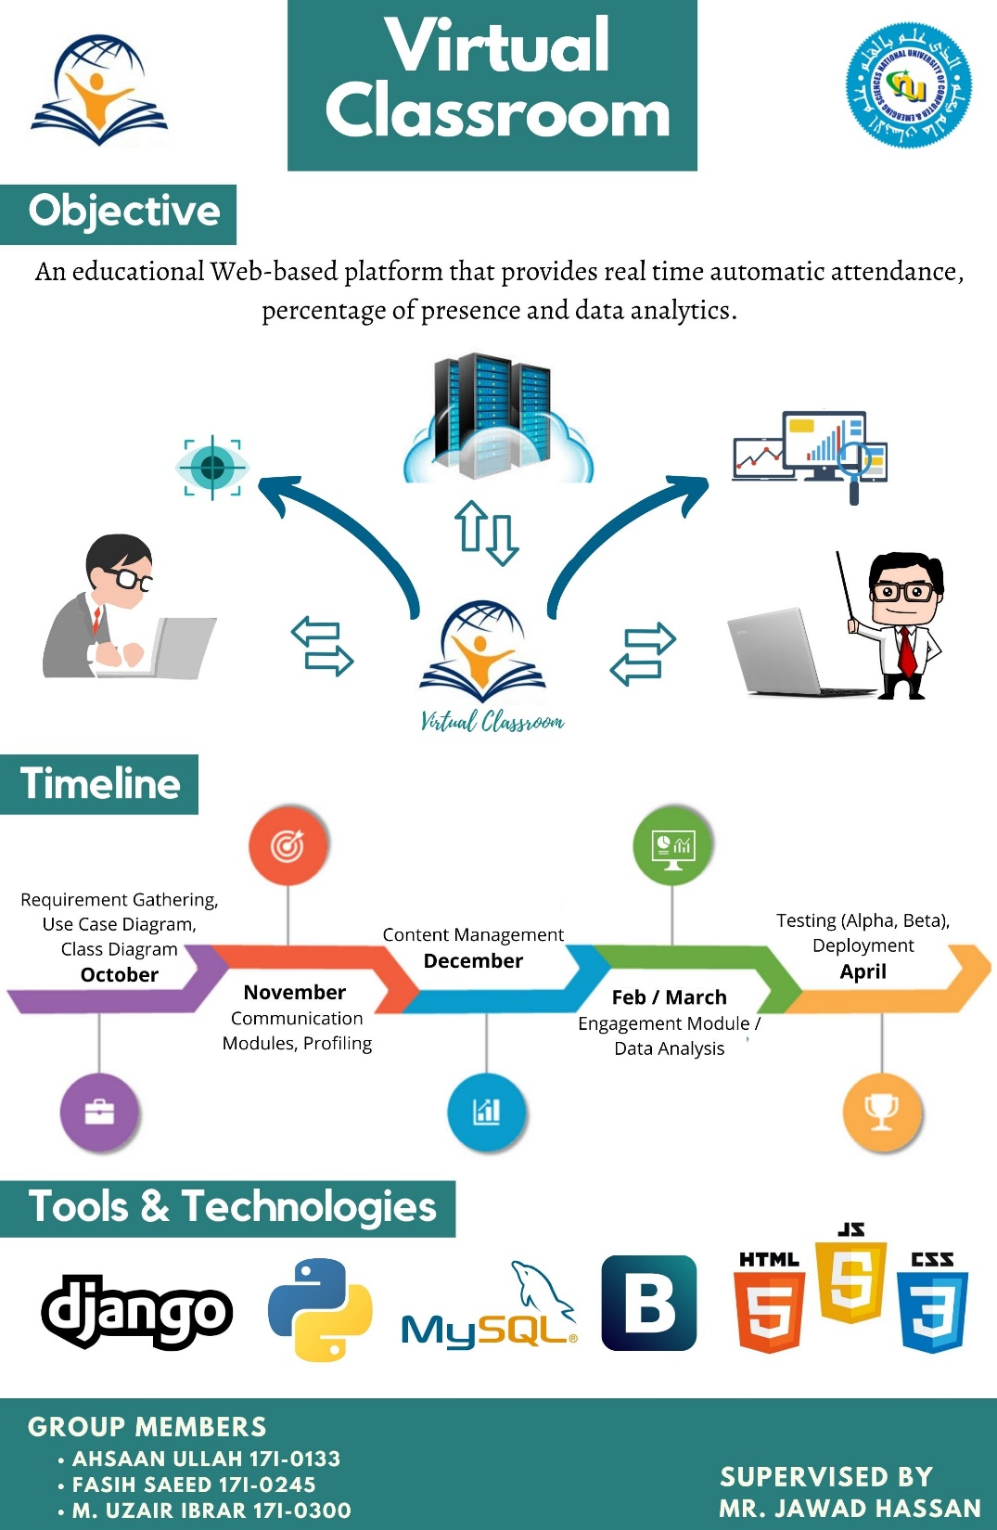
FYP POSTER

Slide 5
Project analysis slide 2
FYP-1-a
Documentation
Student Sign Up / Sign In
Teacher Sign Up / Sign In
Student Registration
DESIGNING
IMPLEMENTATION

Slide 6
Project analysis slide 2
FYP- 1-b
Group Chat
Video Call
Eye-Tracking
Student / Teacher Log out
DESIGNING
IMPLEMENTATION

Slide 7
Project analysis slide 2
FYP - 2 - a
Eye Tracking (Improved)
White Board
Facial Recognition – (Attendance)
Improvements in Display Pages
DESIGNING
IMPLEMENTATION

Slide 8
FYP - 2 - b
Eye Tracking Integration
Facial Recognition Integration
Calculating POP and marking
attendence
Assignment Posting and Submission
DESIGNING
IMPLEMENTATION

Slide 9
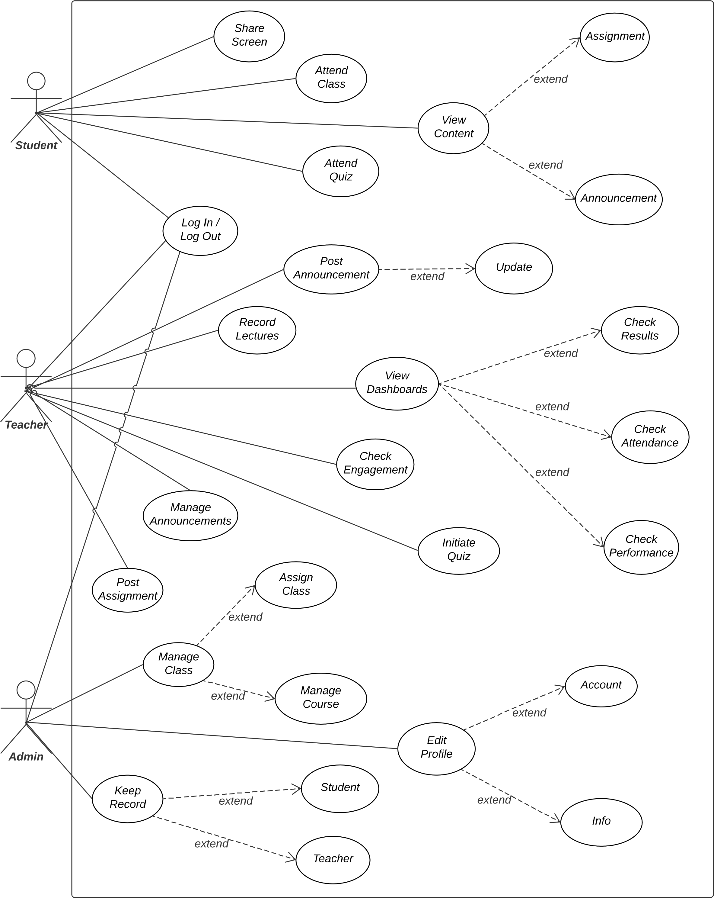
FYP
Use Case
Diagram

Slide 10
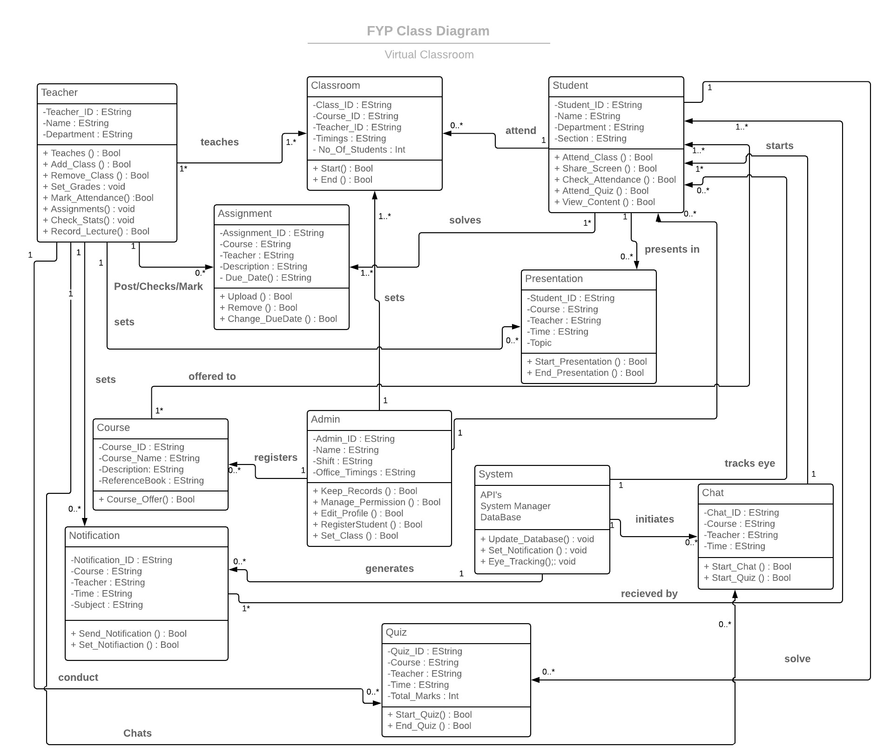

FYP
Class Diagram

Slide 11
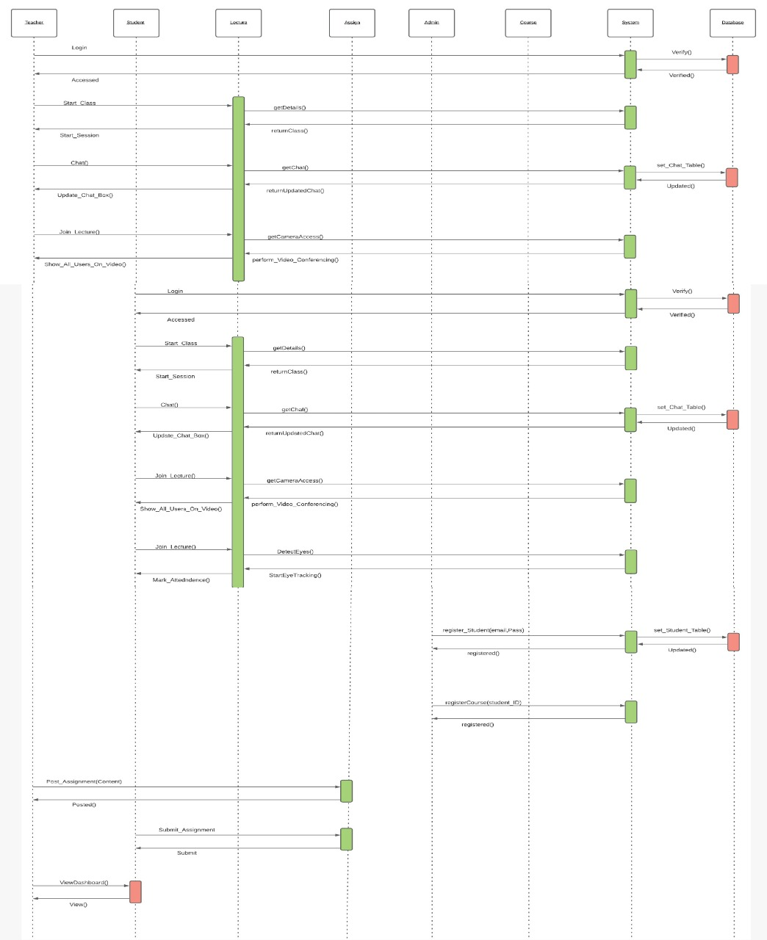
Sequence Diagram

Slide 12
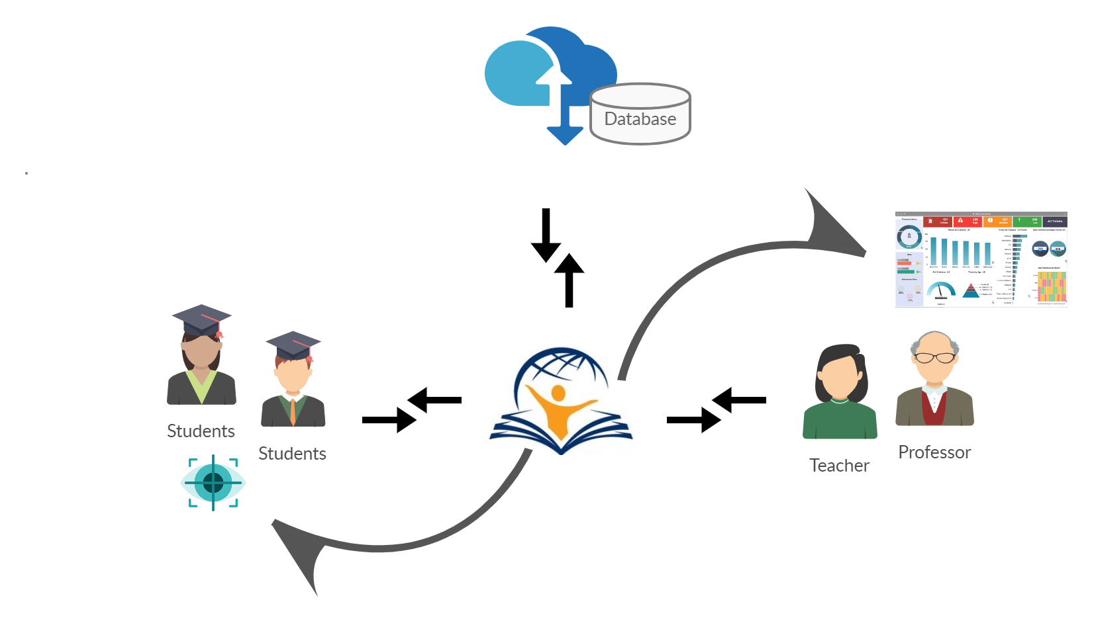
Architecture Diagram

Slide 13
Framework
Django ( Python )
Why Django?
It’s fast and simple.
It suits any web application project.
Provides dynamic CRUD (create, read, update and delete) interface.
Companies which use Django:-
Instagram, Spotify, Pinterest, Dropbox, Mozilla

Slide 14
Implementation

Slide 15
Thank You

