Slide 1
Platforming and Collision
A dab into bounding boxes and trees

Slide 2
My project!
My project involved a bit of a dabble into bounding boxes as my original idea was to make a platformer
I used the most primitive of ideas: AABB, otherwise known as Axis Aligned Bounding Boxes

Slide 3
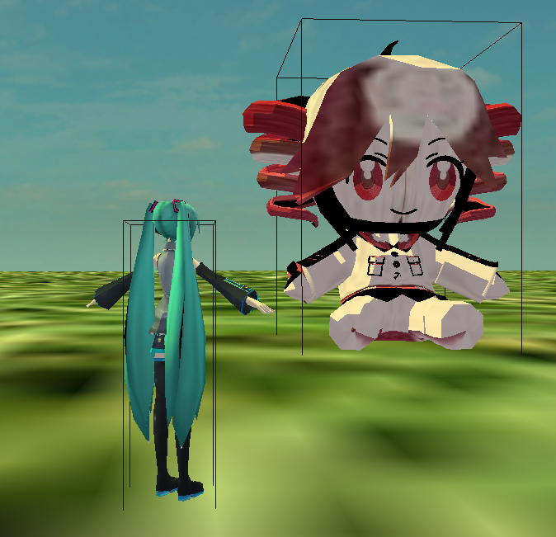
So...what IS an AABB?
An Axis Aligned Bounding Box, as the name suggests is a box-shaped entity around a model which is locked to an Axis, meaning they can not rotate or tilt.

Slide 4
What’s the point?
Well, since the box can’t actually rotate, it’s not oriented and so any kind of slope or stair would prove jittery to walk, but not impossible*.
Moreover, it’s easy to implement, so that’s good for us lazy programmers :]

Slide 5
I feel a “BUT” coming...
Well, it turns out there’s another problem. This box just bounds the ENTIRE model inside it, which would mean had we made a game with only AABB collision and wanted to put a flight of stairs in it, we would have to render each step as a different entity...as I said not impossible ╮(︶▽︶)╭

Slide 6
That’s crazy!!
I don’t wanna’ do that!
Now, now. Not all is lost, remember what was on the welcome slide “trees”. You’re probably wondering how trees come in to play when we only have ONE box, right? What would we even put in that tree?

Slide 7
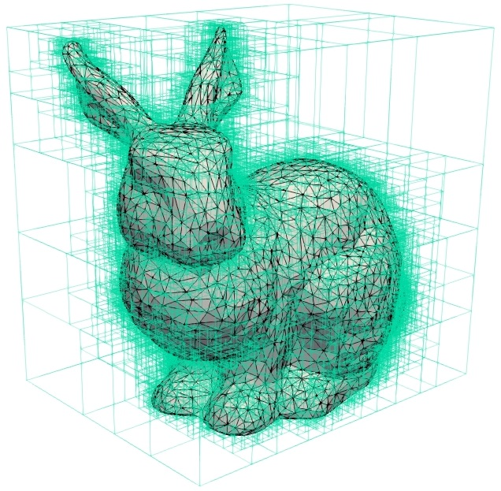
Well, the fix is easy: MORE BOXES
No, literally.

Slide 8
Introducing:
Bounding Volume Hierarchy (BVH) or “AABB Trees”
The concept is rather simple:
  We take our model
  Seperate the model’s vertexes into smaller pieces
  Calculate each piece’s bounding box seperately
  And finally link them all together in one big box

Slide 9
You’re still using a big box, what’s the difference?
Well the difference comes when we’re actually checking for collisions. You see what we’d do for a single big box is: check if either side intersects with an another box’s side; but now we will search for primitives.

Slide 10
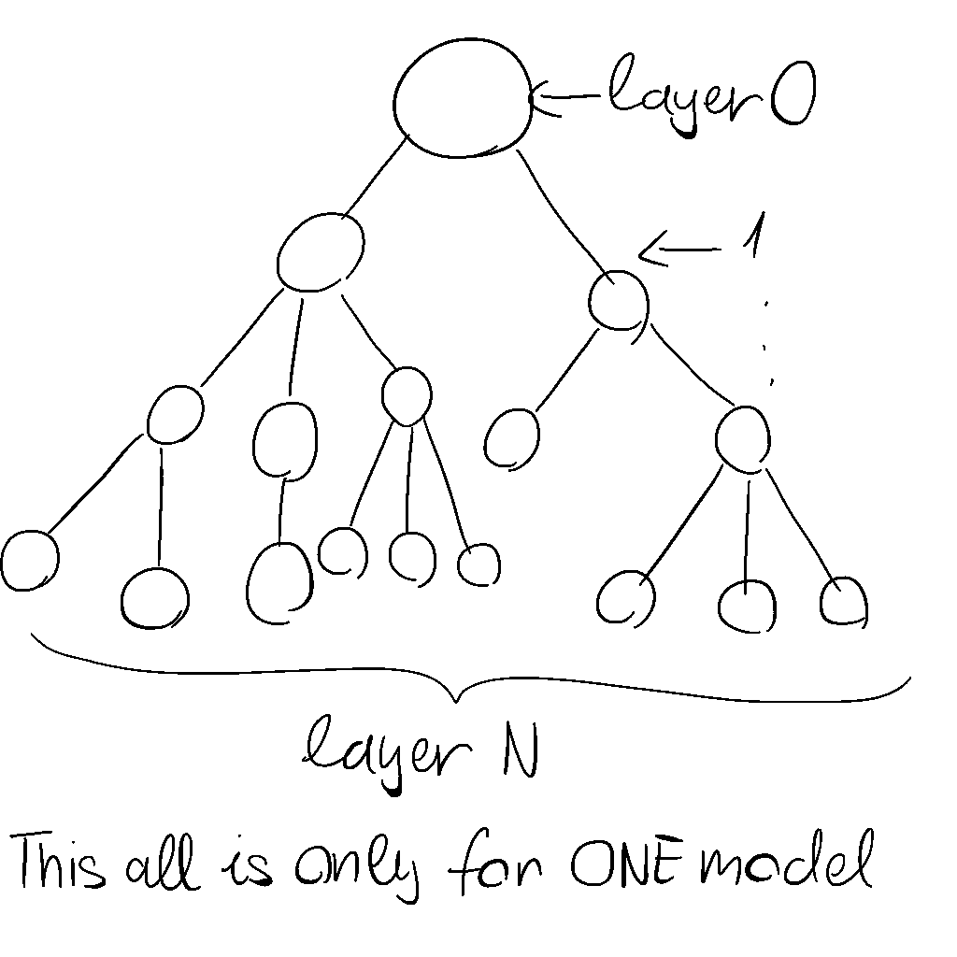
A bit of abstraction:
As we can see our tree can be as big as we want it to be, or rather as DEEP as we want it to be.
Best not to make it too deep since it’s going to make performance a lot worse

Slide 11
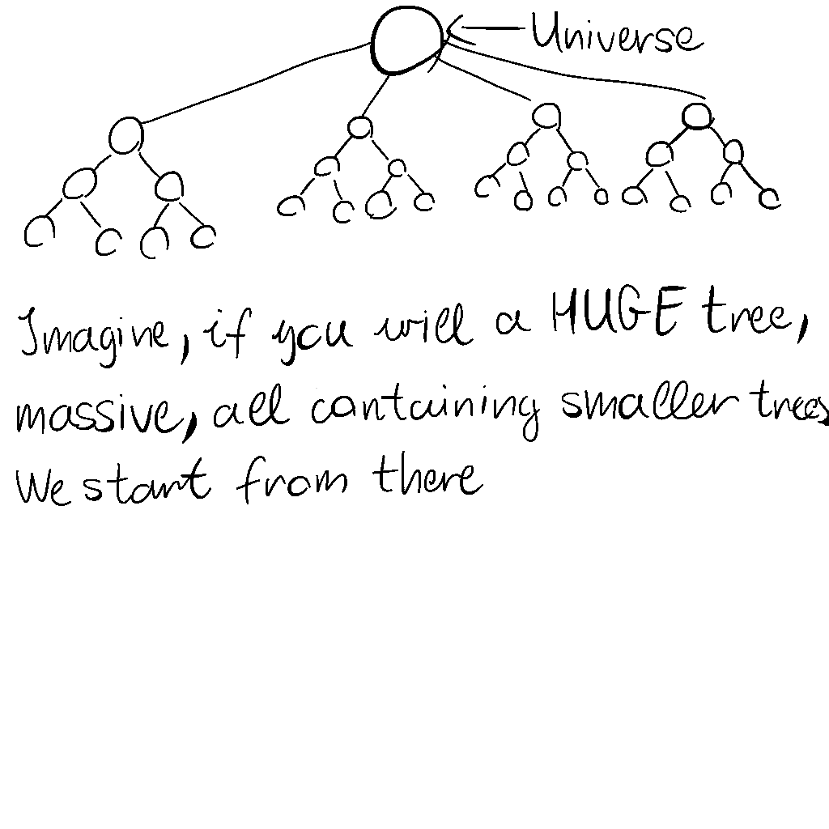
Great, we have a tree, now what?
Easy
BIGGER TREE
＼(￣▽￣)／

Slide 12
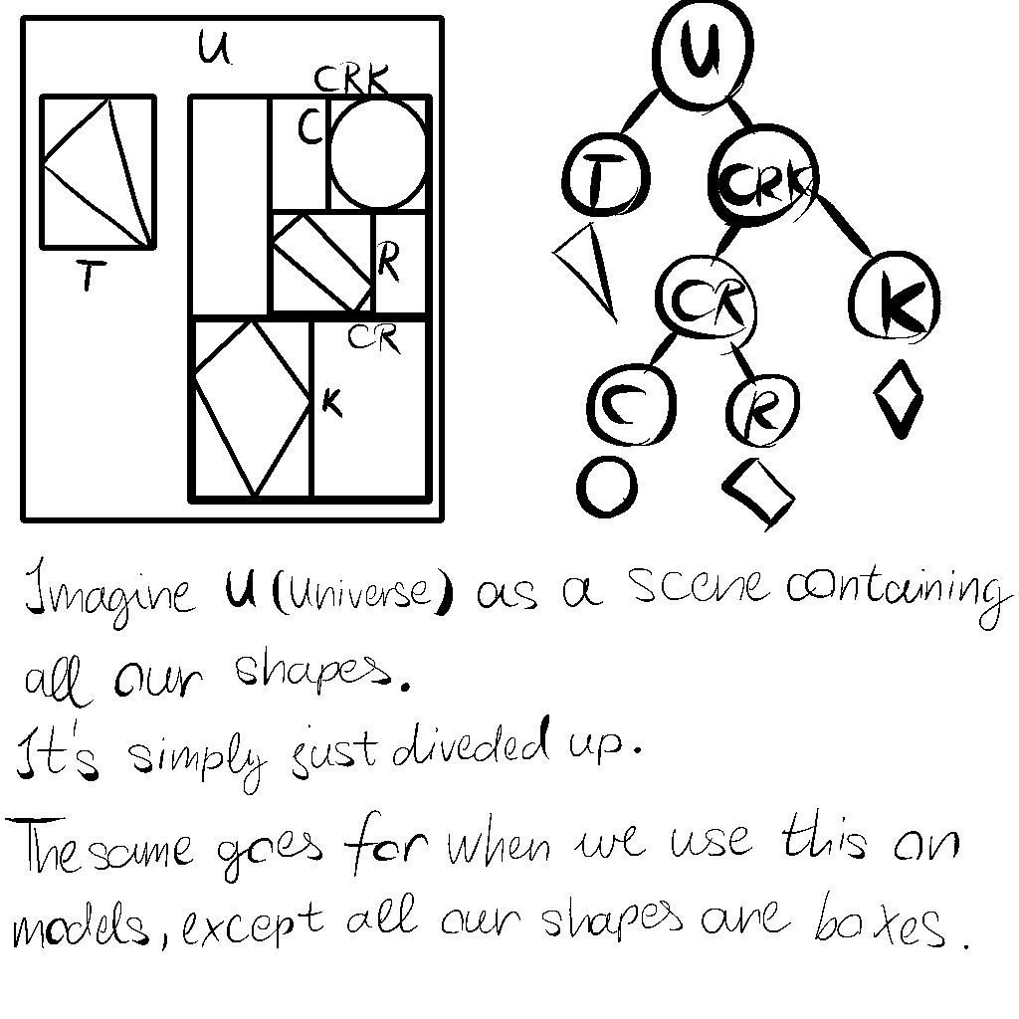
I’m completely lost
I feel you, but trust me, it’s simple (the concept at least):

Slide 13
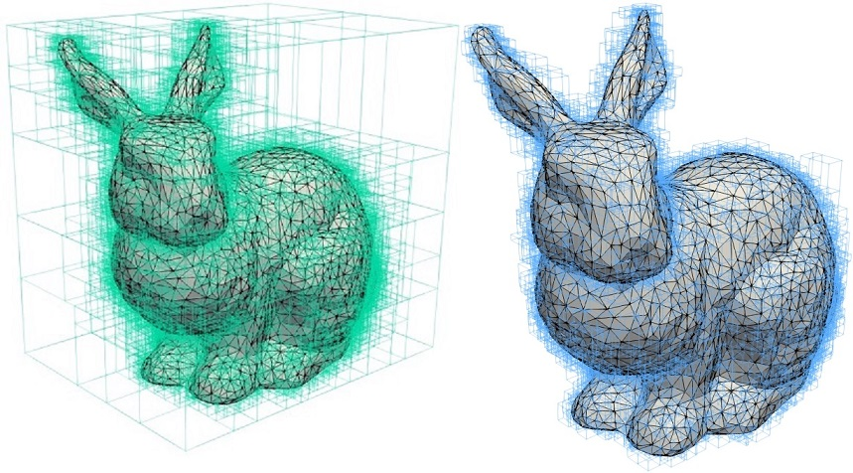
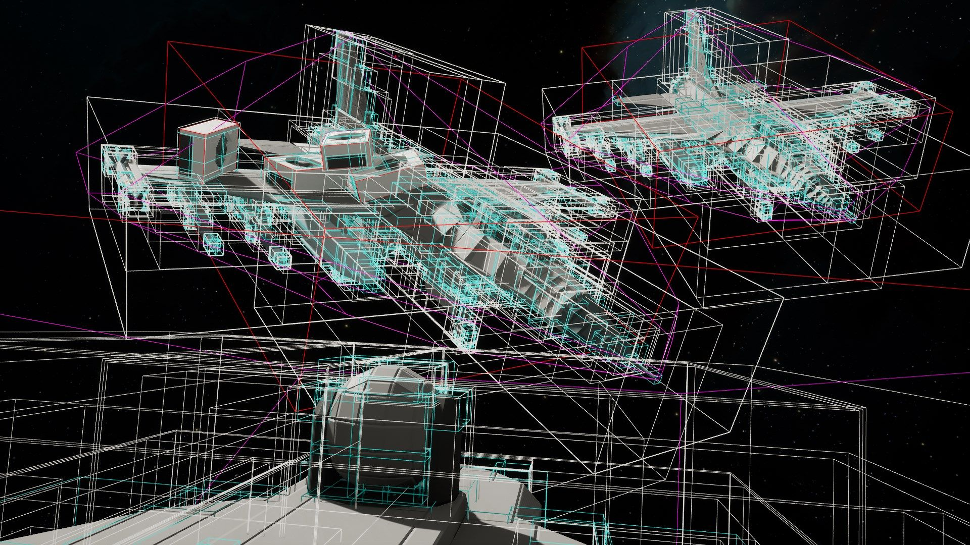

Slide 14
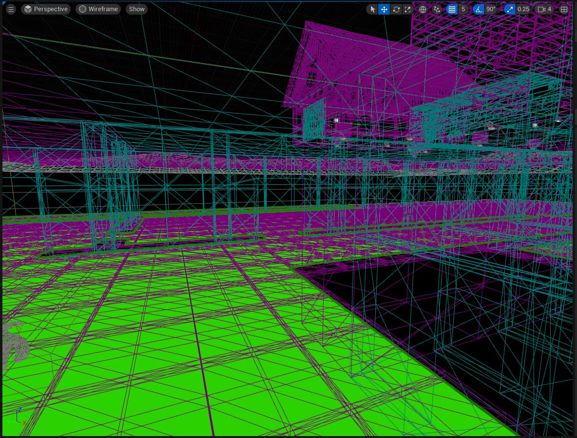
There could be a LOT of these in a map, not only in an object.
I, however will not go into accelerating algorithms today

Slide 15
Onto the program!
Thank you for your attention, I will cite my sources in the next slide, if you have any questions, please make sure you ask them now. Anything, even my favourite colour (it’s purple).
Buh-byee ヾ(*'▽'*)
Made By: Halász Máté Sándor

Slide 16
Sources:
AABB Tree by Martin Cavarga
Collision Detection with Bounding Volume Hierarchies
Dynamic Bounding Volume Hierarchies

