Slide 1
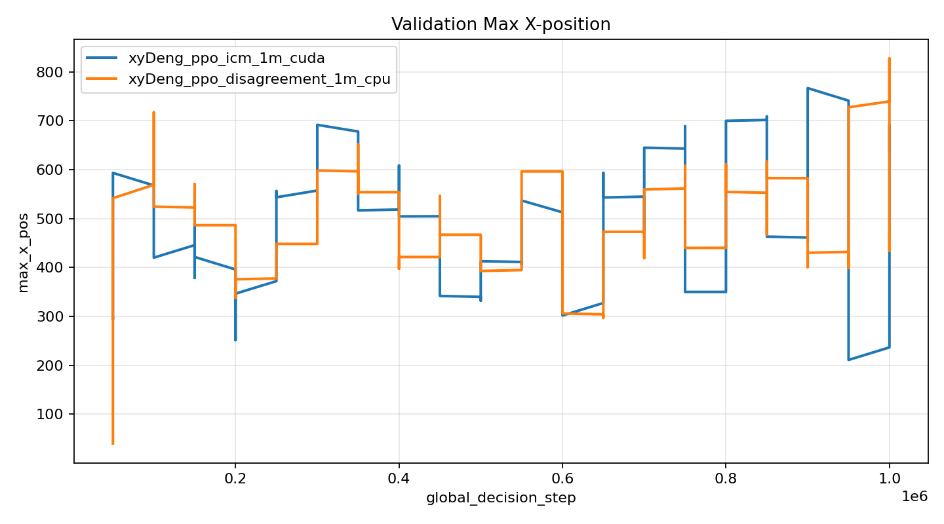
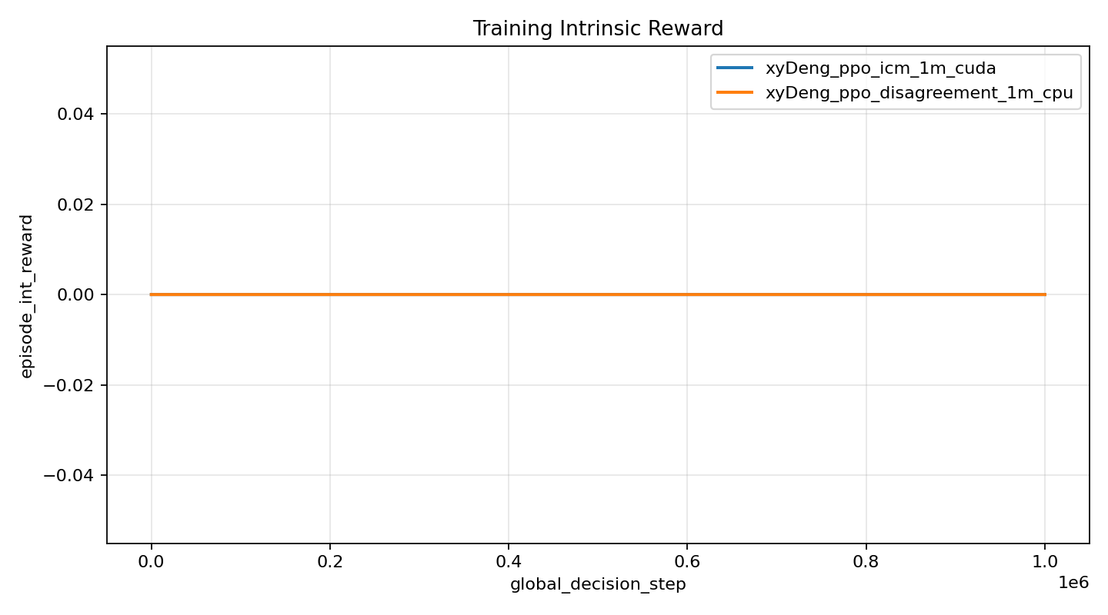
Method A
PPO + ICM
Mario RL / PPO intrinsic rewards
1M steps | seed 1 | World 1-1
Method, setup, and intrinsic reward interface
1. Role
2. Key settings
3. Protocol
Learns inverse and forward dynamics in latent space.
Intrinsic reward is forward prediction error.
PPO uses r_total = r_ext + beta*r_ICM.
Item | Value
Intrinsic type | ICM
beta | 0.001
latent_dim | 128
module lr | 0.0001
batch/update | 32 / 1.0
Item | Value
Train env | SuperMarioBros-1-1-v0
Input | 4-frame stack, 84x84
Actions | SIMPLE_MOVEMENT, 7 actions
Budget | 1,000,000 timesteps
Eval | sample / greedy; best by sample validation
Seed | 1
Shared backbone: PPO + CNN Actor-Critic. Only the intrinsic reward module changes.
Training flow
4. Signals
Observation
4x84x84
CNN
Actor-Critic
Policy / Value
PPO update
ICM
intrinsic module
r_total = r_ext
+ beta*r_int
validation
test
train terminal
device
x=1237.2
x=785.0
x=3161
GPU
best step 900k
sample mean
4 inferred terminal episodes
CUDA | 8.54 sec/1k
Evidence: selected 1M World 1-1 runs, best_summary.json, one_million_run_metrics.csv, and training_completion_audit.md.

Slide 2
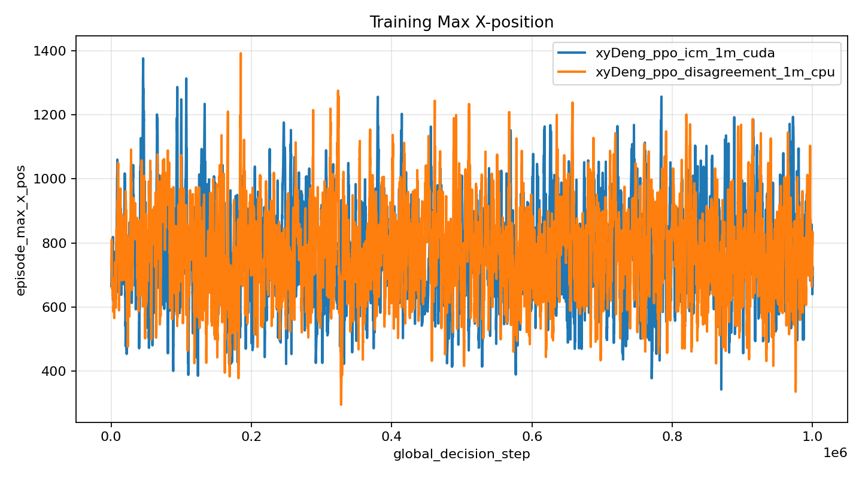
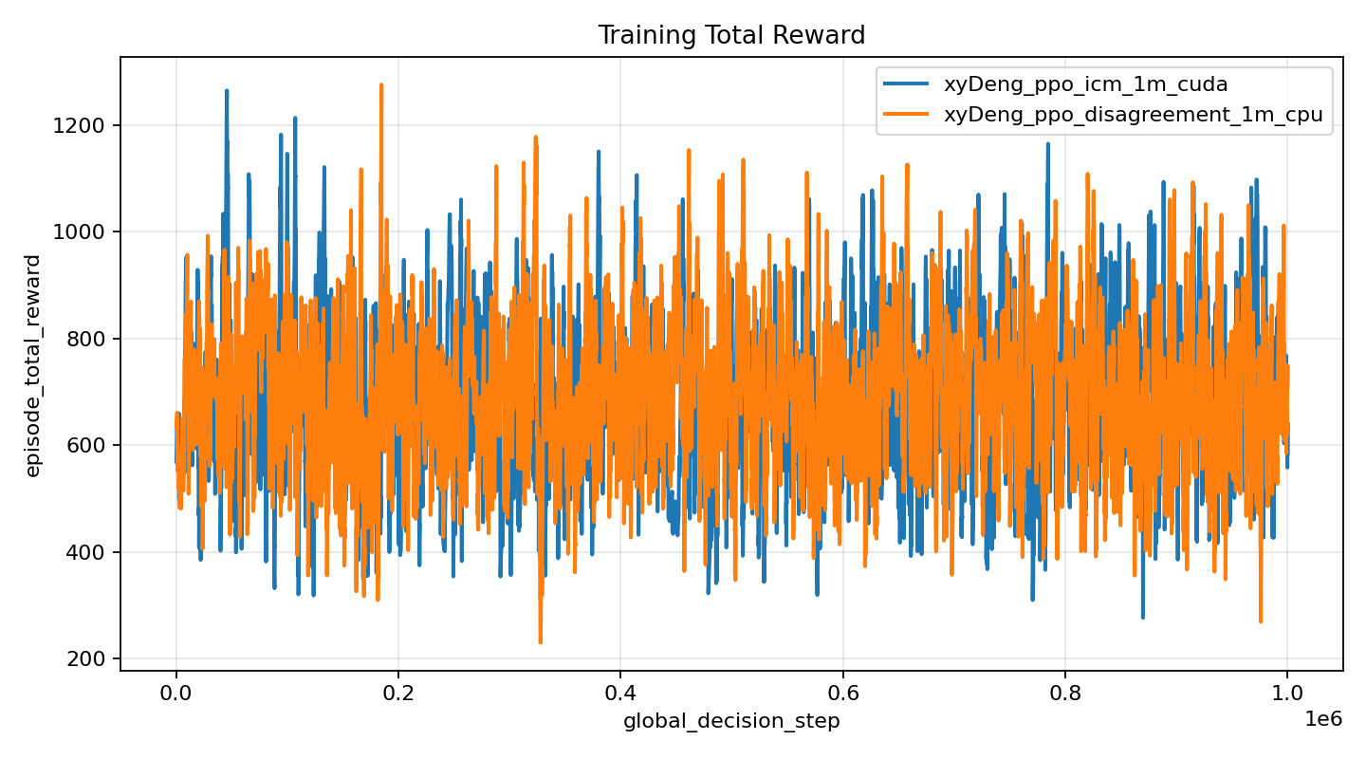
Method A
PPO + ICM: World 1-1 outcomes
Mario RL / PPO intrinsic rewards
1M steps | seed 1 | World 1-1
Progress, reward, and video evidence
Scope
Train, validation, and test are all on SuperMarioBros-1-1-v0. Best checkpoints use sample-mode validation.
1-1 training evidence
episodes
reward
max_x
reward/prog.
Reward-progress consistency
7480
3033
3161
Diff.
4 episodes reached
final_x=3161
training
best train
train max
video < train
Clear / progress
Reached x=3161
max_x = 3161 / 3161
No flag_get column in the selected run. Completion is inferred from terminal x_pos and high reward.
1M steps | mean | best | max
val max_x | 1237.2 | 2008 | 3161
test max_x | 785.0 | 1442 | 3161
best saved video
best video x=1435
xyDeng_ppo_icm_1m_cuda_seed1_1780669071_ppo_step_800000_sample20.mp4
Saved videos show rollouts, not confirmed clears. Training logs provide terminal x evidence.
ICM gives stronger mean validation progress, but its saved rollout does not show a confirmed clear.
Evidence: final_selected_runs_1_1 and xyDeng/videos. Completion claims are conservative.

Slide 3
Method B
PPO + Disagreement
Mario RL / PPO intrinsic rewards
1M steps | seed 1 | World 1-1
Method, setup, and intrinsic reward interface
1. Role
2. Key settings
3. Protocol
Trains an ensemble of forward models.
Intrinsic reward is prediction disagreement.
PPO explores states with high model uncertainty.
Item | Value
Intrinsic type | Disagreement
beta | 0.001
ensemble_size | 4
latent_dim | 128
batch/update | 32 / 1.0
Item | Value
Train env | SuperMarioBros-1-1-v0
Input | 4-frame stack, 84x84
Actions | SIMPLE_MOVEMENT, 7 actions
Budget | 1,000,000 timesteps
Eval | sample / greedy; best by sample validation
Seed | 1
Shared backbone: PPO + CNN Actor-Critic. Only the intrinsic reward module changes.
Training flow
4. Signals
Observation
4x84x84
CNN
Actor-Critic
Policy / Value
PPO update
Disagreement
intrinsic module
r_total = r_ext
+ beta*r_int
validation
test
train terminal
device
x=1140.8
x=784.6
x=3161
CPU
best step 950k
sample mean
1 inferred terminal episode
12.01 sec/1k
Evidence: selected 1M World 1-1 runs, best_summary.json, one_million_run_metrics.csv, and training_completion_audit.md.

Slide 4
Method B
PPO + Disagreement: World 1-1 outcomes
Mario RL / PPO intrinsic rewards
1M steps | seed 1 | World 1-1
Progress, reward, and video evidence
Scope
Train, validation, and test are all on SuperMarioBros-1-1-v0. Best checkpoints use sample-mode validation.
1-1 training evidence
episodes
reward
max_x
reward/prog.
Reward-progress consistency
7994
3020
3161
Diff.
1 episode reached
max_x=3161
training
best train
train max
video < train
Clear / progress
Reached x=3161
max_x = 3161 / 3161
The selected run gives inferred terminal-progress evidence. The deck uses only World 1-1 results.
1M steps | mean | best | max
val max_x | 1140.8 | 2021 | 3161
test max_x | 784.6 | 1634 | 3161
best saved video
best video x=2009
xyDeng_ppo_disagreement_1m_cpu_seed1_1780679739_last_sample20.mp4
Saved videos show rollouts, not confirmed clears. Training logs provide terminal x evidence.
Disagreement gives the farthest saved rollout, reaching x=2009 in the recorded videos.
Evidence: final_selected_runs_1_1 and xyDeng/videos. Completion claims are conservative.

Slide 5
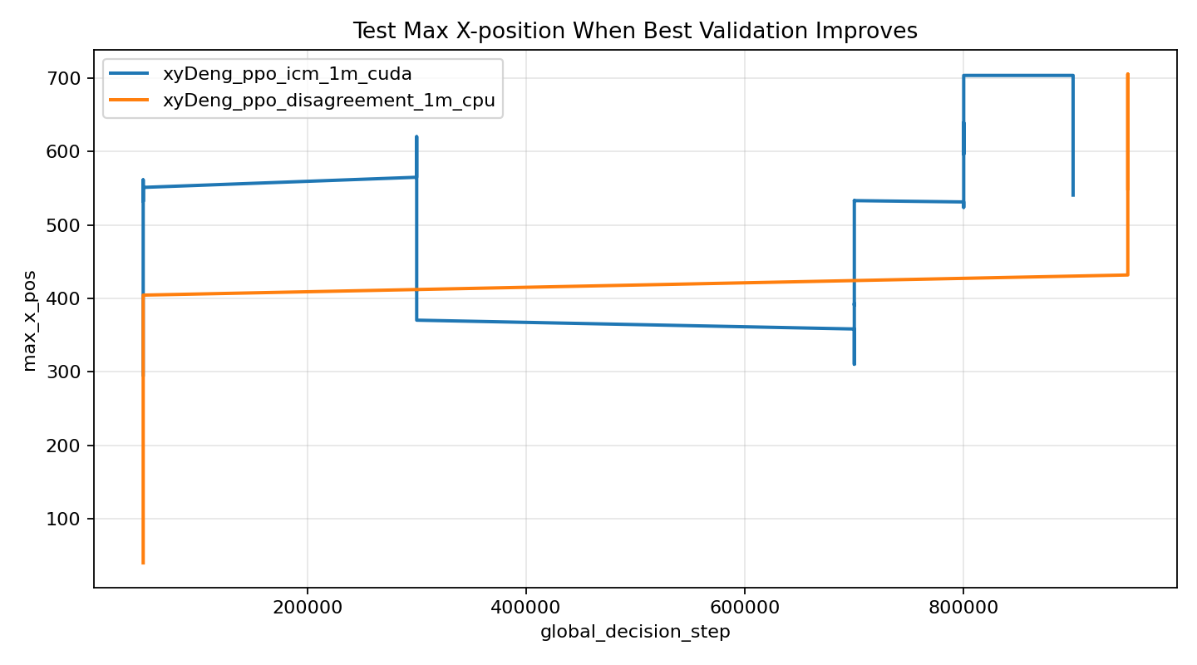
Compare
ICM vs Disagreement: World 1-1
Mario RL / PPO intrinsic rewards
1M steps | seed 1 | World 1-1
Same PPO backbone, same 1M-step budget, same environment
Key metrics
Curves
Metric | PPO+ICM | PPO+Dis.
Device | CUDA | CPU
Episodes | 7480 | 7994
Best step | 900k | 950k
Val mean max_x | 1237.2 | 1140.8
Test mean max_x | 785.0 | 784.6
Train max_x | 3161 | 3161
Best video max_x | 1435 | 2009
Speed
Fair read
Method | CPU sec/1k | CUDA sec/1k | Used
ICM | 11.88 | 8.54 | CUDA
Disagreement | 12.01 | 13.43 | CPU
ICM
ICM has slightly higher mean validation progress. Disagreement has the farther saved rollout. Both reach terminal x=3161 during training.
Forward-model error gives dense curiosity. This run shows stronger mean validation progress.
Disagreement
Device choice follows the 10k-step benchmark: CUDA for ICM, CPU for Disagreement.
Ensemble uncertainty gives the best saved rollout, reaching max_x=2009.
Evidence: run_summary.md, device_benchmark_10k.csv, one_million_run_metrics.csv, and xyDeng/videos.

Slide 6
Summary
What we can claim
Mario RL / PPO intrinsic rewards
1M steps | seed 1 | World 1-1
Claim boundary, evidence, and next steps
1. Main claim
2. Best method
3. Evidence
Both methods learn useful exploration on World 1-1 and reach terminal x_pos=3161 during training.
Use ICM for mean validation progress. Use Disagreement for the farthest saved rollout.
Use World 1-1 only:
- ICM best-sample video
- Disagreement last-sample20 video
- 1m_comparison plots
Do not present sampled videos as full-clear proof. They are policy visualizations.
Fair wording: the methods are close. One seed is not enough for a strong ranking.
4. To record a confirmed clear
Checkpoint search
Flag logging
More seeds
Longer run
Run more sample episodes on 400k, 800k, best, and last checkpoints. Save the farthest flag_get=1 video.
Log episode_flag_get in training and evaluation. Do not rely only on x_pos.
Use at least 3 seeds to report mean and variance, not one-run luck.
Continue from a strong 1-1 checkpoint, then search with greedy and sample policies.
Claim boundary: current saved videos are rollouts, not strict full-clear evidence.

