Slide 1

Manipal Hackathon 2026
Team Name: DataBaes
Track: Sustainable Cities and Communities (SDG 11)
Problem Statement: Cascading Failure - When One Failure Becomes Many
Solution Title: Ripple
Team Members: Sagnik Basu, Man Mohit Kumar, Yashaswi Mohan, Pagavath D P, Amritanshu

Slide 2
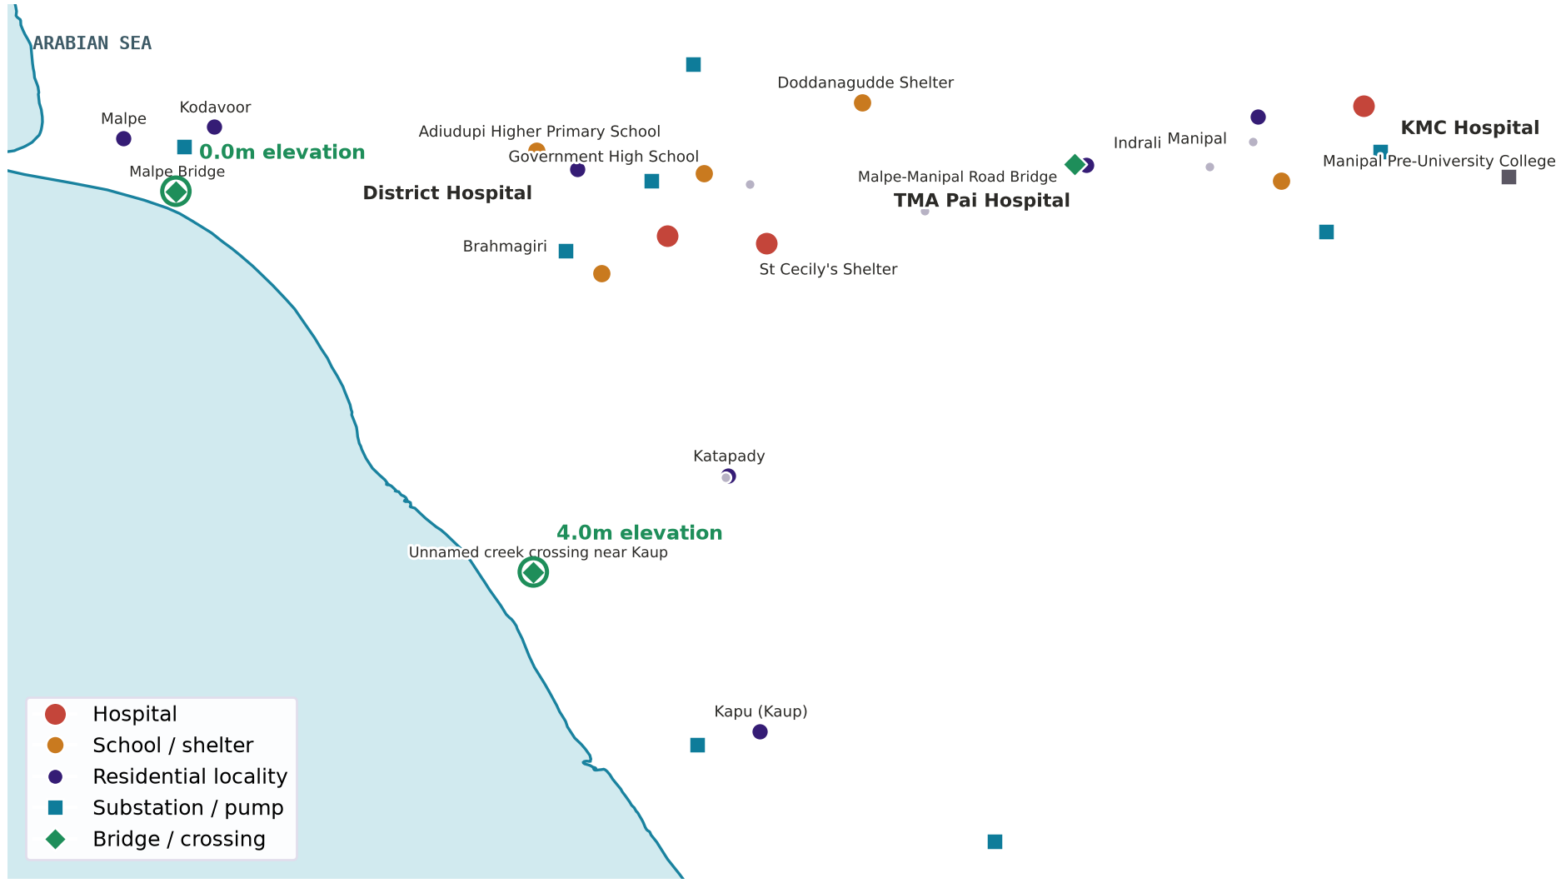
Solution
THE PROBLEM, AND OUR APPROACH
A single flooded bridge can cut off a hospital nobody thought was at risk.
R
=
%
Real, not hypothetical
Equity-weighted impact
Capacity-aware, not binary
Built on real OpenStreetMap positions and NASA / USGS SRTM elevation data.
Every failure is scored by who it affects, not just how many assets fail.
A backup tie can rescue a failed pump, but only up to its rated capacity.
WHAT THE REAL DATA REVEALED
Every hospital sits at 24 to 102 metres. The real risk is two low crossings the elevation data itself surfaced.
Malpe Bridge: 0.0m. A creek crossing near Kaup: 4.0m. Cut either one and people lose hospital access, with no building ever flooding.
The elevation data revealed this risk. We did not design it in.

Slide 3
Technical Implementation
ARCHITECTURE, ALGORITHMS AND WHAT IS NEW
Real data in, an interactive simulation out, entirely in the browser
OSM + SRTM
32-asset network
Client-side engine
Interactive UI
Live positions and real elevation, via Overpass and OpenTopoData
25 verified, 7 estimated utility placeholders, clearly marked
Cascade, routing, centrality and the optimizer run instantly
Slider, critical-asset view, routing, ranked interventions
BFS
Cascade propagation
Dijkstra
Shortest vs. safest routing
Traces power, water and road failure through the network on every change.
Compares the pre-flood route to the best surviving route today.
Brandes
Betweenness centrality
Knapsack
Budget-constrained optimizer
Ranks assets by connections lost if that one asset failed, any scenario.
Best mitigation portfolio across multiple scenarios, not just one.
The overload model, capacity-limited backup ties between substations and pumps, was built specifically for this brief.

Slide 4
Feasibility
PRACTICALITY, ROADMAP AND INCLUSIVITY
A working prototype today, a path to real deployment
NOW
NEXT 3 MO.
6 TO 12 MO.
12+ MO.
Round 1 prototype
Pilot partnership
Live, multi-hazard
Multi-city rollout
Validated on real data for one corridor: Malpe, Udupi, Manipal, Kaup.
One municipal body; real data replaces estimates.
Weather-API, sensors, automated alerts, new hazards.
Same pipeline, replicated to new coastlines.
INCLUSIVITY AND REAL-WORLD FIT
=
Equity by design
The impact score itself weights vulnerable localities higher, by construction, not as an add-on.
$
Priced for who needs it
Slider-based, usable by field disaster-response staff, not a specialist GIS tool few can afford.
i
Honest about confidence
Verified positions are marked separately from estimates, useful even where clean data does not exist.

Slide 5
Business Strategy
MARKETING, MONETISATION AND SUSTAINABILITY
Sell to who already owns this problem, on three revenue lines
TARGET AUDIENCE
OUTREACH PLAN
Primary: district and state disaster-management authorities.
Secondary: urban planning consultancies.
Tertiary: infrastructure insurers pricing flood risk.
Pilot with Udupi's own district disaster-management authority, our own map's geography.
Open-source the engine for developer adoption.
Presence at Smart Cities Mission and AMRUT 2.0 forums.
1
2
3
B2G SaaS licensing
Data onboarding and consulting
Insurer data licensing
Per-city annual licence, tiered by assets modeled.
Paid engagement to ingest a city's real dependency data.
Longer term: flood-risk scoring as a data product.
The open-core engine stays free for adoption and research credibility; onboarding a new city is largely configuration, not new development, so three independent revenue lines reduce dependence on any one source.

