Slide 1
Project Title
Analyzing Economic Indicators and Inflation Data (2010-2025)
Country | Country
USA | France
China | South Korea
Japan | Saudi Arabia
Germany | Brazil
India | Italy
UK | Bangladesh
Canada | Indonesia
Russia | Turkey
Australia | Malaysia
Pakistan
3.39%
35.53%
6.81%
Economic Growth (%)
Inflation Rate (%)
Unemployment Rate (%)

Slide 2
objective
This report provides a comprehensive analysis of key economic indicators, including GDP (in billion USD), inflation rates, unemployment rates, and economic growth across multiple countries worldwide.
Covering the period from 2010 to 2025, it highlights economic trends, patterns, and insights that shape global markets.
Dataset: Economic Indicators and Inflation Data
Source: Economic Indicators and Inflation Data : Kaggle / Adil Shamim (Owner)

Slide 3
Visualization
Average GDP Comparison Across Countries- 2010-2025 (Vbar)
Average Economic Growth Across Countries- 2010-2025 (Vbar)
Inflation Rate of Countries in 2024 (Vbar)
Average Global Inflation vs. Economic Growth Trends Across Countries- 2010 to 2025(Linebar)
Canada Inflation Rate/Unemployment Rate(%)/Economic Growth(%)- 2020-2025 (Linebar)

Slide 4
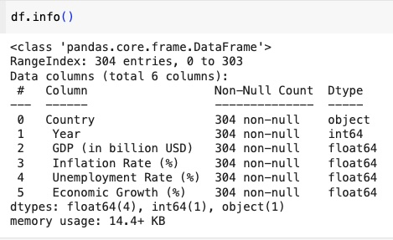

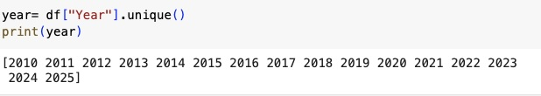
Data Preparation
Cleaning and processing raw economic data using Pandas.
Time Series

Slide 5
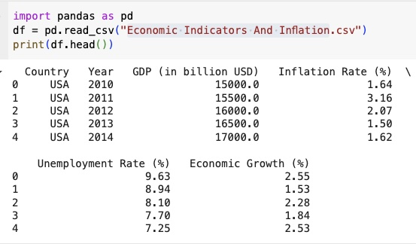
Information about Data

Slide 6
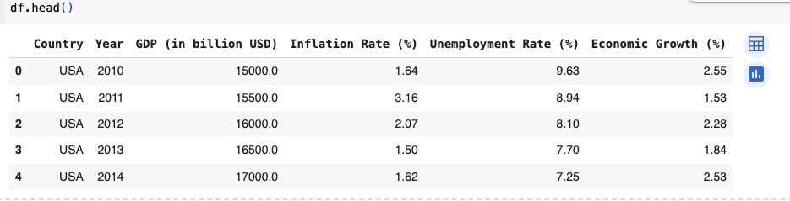
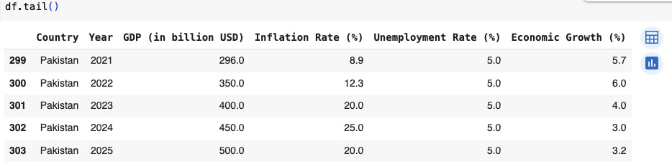
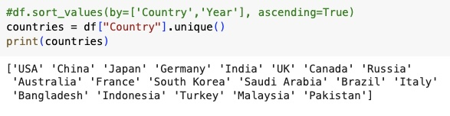
Information about Data

Slide 7
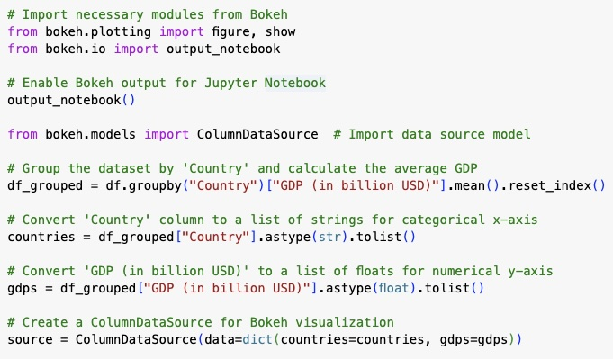
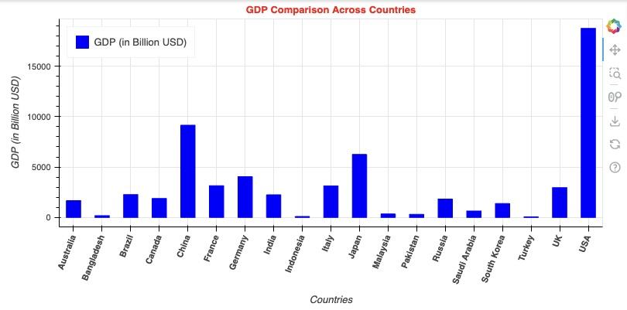
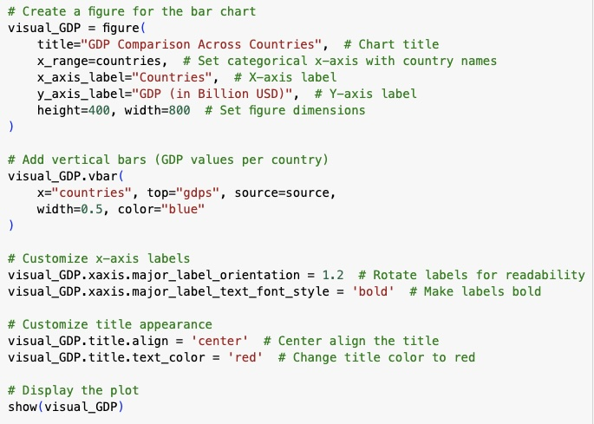
Average GDP Comparison Across Countries
2010-2025

Slide 8
Result
Average GDP Comparison Across Countries
2010-2025
Country | GDP (billion USD)
USA | 18,750.00
China | 9,150.00
Japan | 6,250.00
Key Insights
The USA has the highest GDP, keeping a strong influence on the global economy.
2-China is growing quickly but still has a long way to catch up with the US.
3-Japan remains strong but struggles with an aging population and slower growth.
What is GDP (in billion USD)?
GDP (Gross Domestic Product) is the total monetary value of all goods and services produced within a country's borders in a specific time period (usually annually).
Why Is GDP Important?
Measures economic performance → Higher GDP indicates a strong economy, while a declining GDP may signal a recession.
Used for international comparison → Helps compare economic sizes of countries (e.g., USA vs. Canada).
Influences economic policies → Governments adjust policies (interest rates, taxes) based on GDP trends.

Slide 9
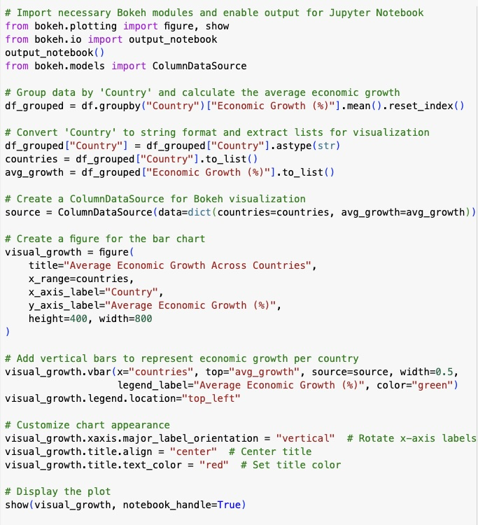
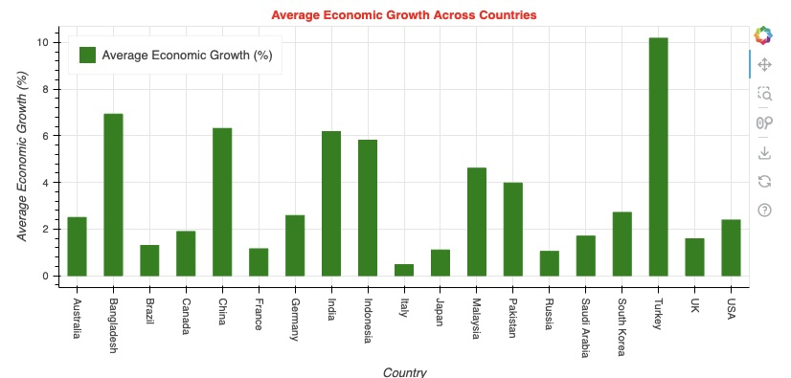
Average Economic Growth Across Countries
2010-2025

Slide 10
Result
Average Economic Growth Across Countries
2010-2025
Country | Average Economic Growth
Turkey | 10.19%
Bangladesh | 6.93%
China | 6.32%
High Growth Countries
Turkey, Bangladesh, and China show the highest average economic growth.
Their economies benefit from rapid industrialization, exports, and investments.
Moderate & Stable Growth
Countries like India, Indonesia, and Malaysia experience steady but moderate growth.
These nations maintain expansion but at a controlled pace.
Slow-Growing Economies
Developed nations (USA, UK, Japan, Germany) have lower but stable growth rates.
This is typical for mature economies with already high GDP.

Slide 11
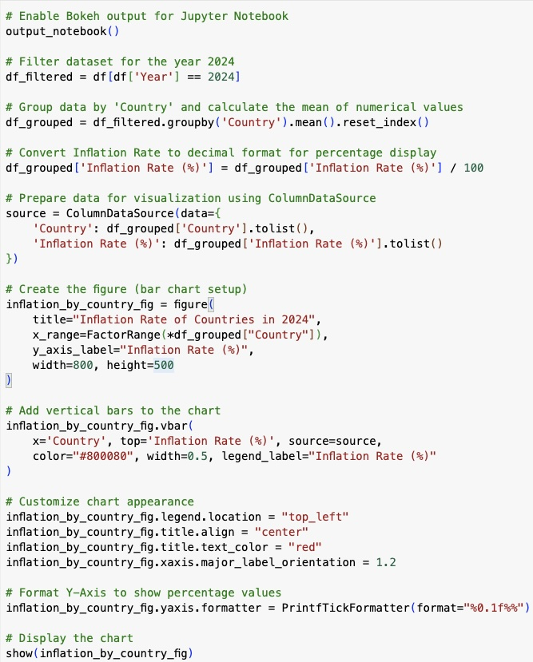
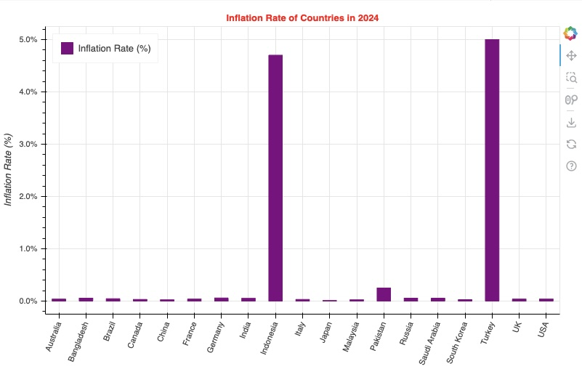
Inflation Rate of Countries in 2024

Slide 12
Result
Inflation Rate of Countries in 2024
Country | Average Economic Growth
Turkey | 5.0%
Indonesia | 4.7%
Pakistan | 0.25%
High Inflation Countries:
Turkey and Indonesia have the highest inflation rates, indicating rising costs, currency devaluation, or economic instability.
These countries may face higher living costs and reduced consumer confidence.
Moderate Inflation Nations:
Countries like Pakistan and Malaysia experience moderate inflation, balancing growth and price stability.
Low or Stable Inflation:
Developed economies (USA, Canada, UK, Japan, Germany) tend to have low and stable inflation, reflecting strong monetary policies.
Lower inflation ensures stable purchasing power and economic predictability.

Slide 13
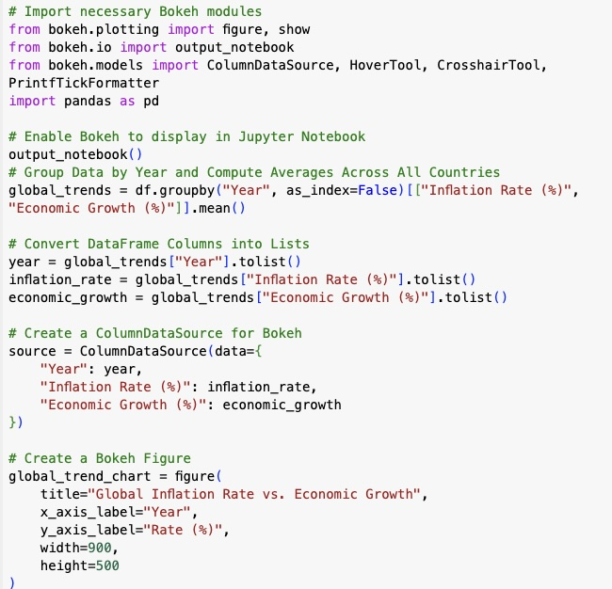
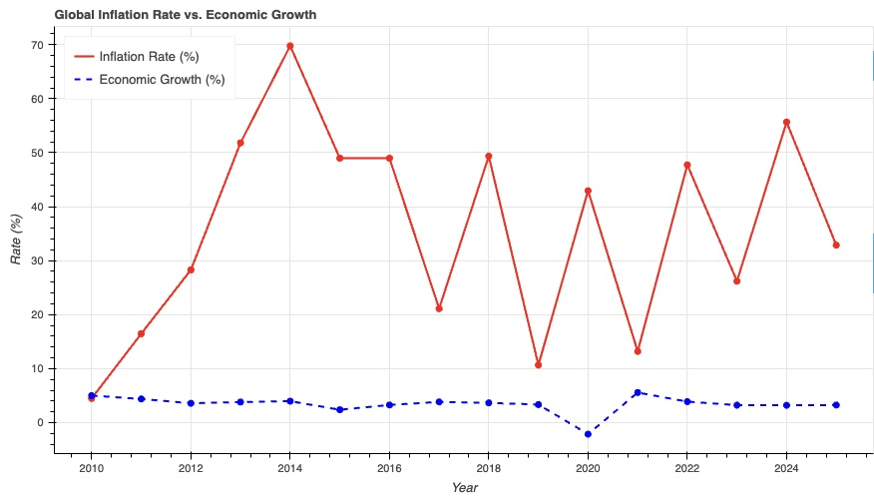
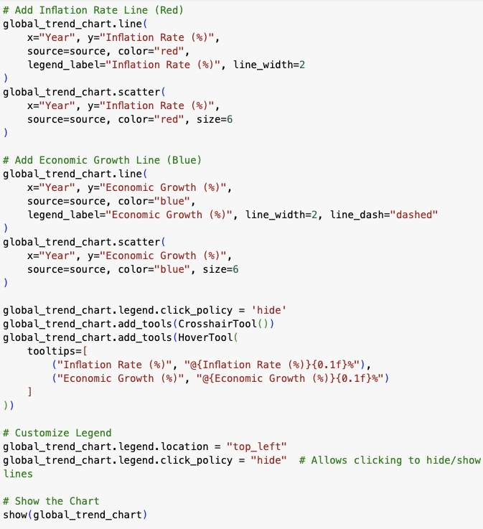
Average Global Inflation vs. Economic Growth
2010 to 2025

Slide 14
Result
Average Global Inflation vs. Economic Growth Trends Across Countries- 2010 to 2025
Stable inflation = Steady growth
High inflation = Economic risk Deflation = Growth slowdown
Inflation Trends (Red Line)
Key points
-Stable inflation supports steady growth.
-High inflation weakens economies, while moderate inflation is ideal.
-Effective policies are essential to balance inflation and growth.
1- High inflation leads to slower growth, showing a negative correlation between inflation and economic expansion.
2- Periods of controlled inflation (1-3%) align with stronger economic growth, ensuring stability.
3- Sharp inflation spikes (>6-7%) often result in economic downturns, likely due to rising costs and interest rate hikes.
4- Deflation (negative inflation) also harms growth, discouraging spending and investment.

Slide 15
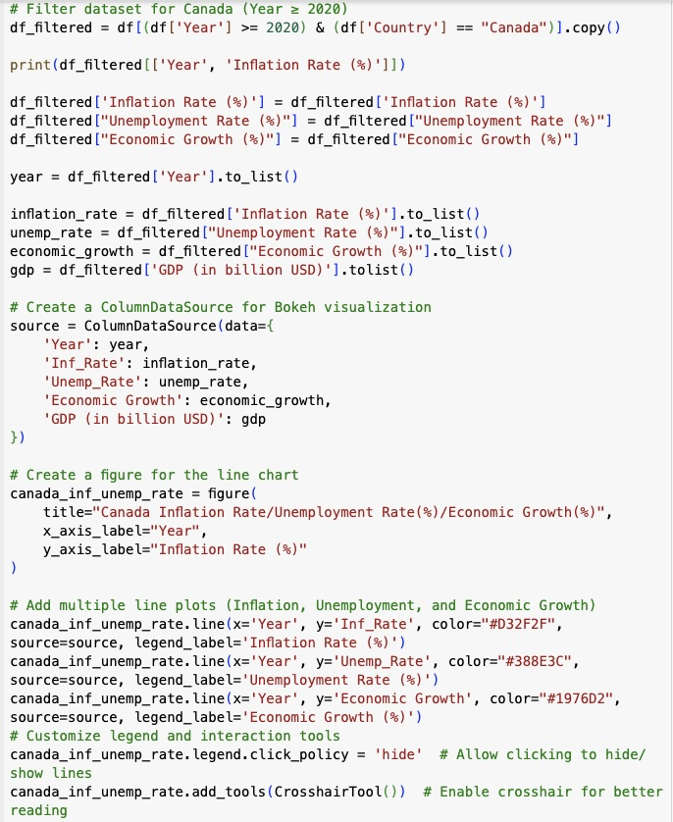
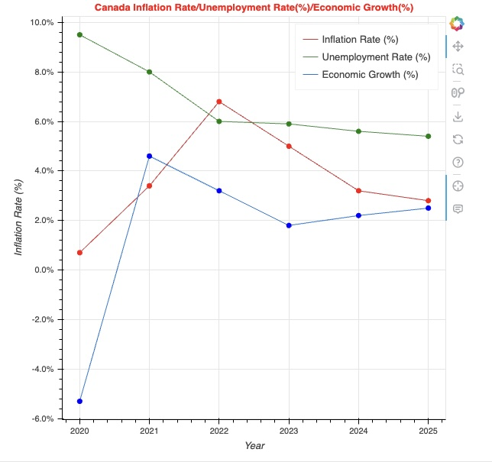
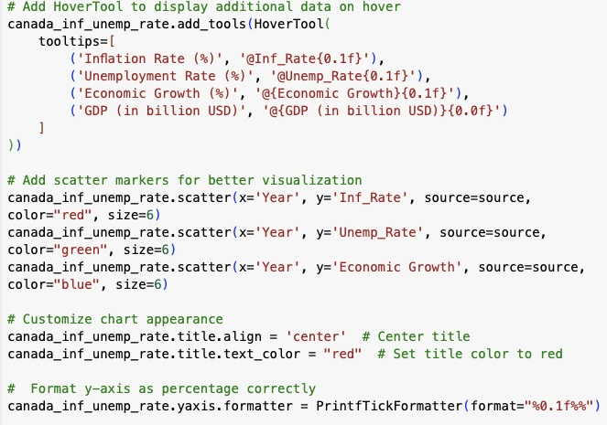
Canada Inflation Rate/Unemployment Rate(%)/Economic Growth(%)
2020-2025

Slide 16
Result
Average Global Inflation vs. Economic Growth Trends -2020 to 2025
Inflation Trends (Red Line)
2020-2022: Inflation rose sharply due to supply chain issues and post-pandemic recovery.
2022 Peak: Inflation reached its highest point.
After 2022: It gradually declined, likely due to central bank actions (interest rate hikes).
Unemployment Trends (Green Line)
The unemployment rate was high in 2020, reflecting COVID-19-related job losses.
It steadily declined after 2021, suggesting job market recovery and economic stabilization.
Economic Growth (Blue Dot-Dash Line)
2020: Sharp decline due to recession (likely from lockdowns).
2021: Strong recovery, then slower but steady growth.
Recent years: Stable but lower growth, impacted by interest rates and inflation control.

Slide 17
Conclusion
Emerging economies are growing fast, while developed nations remain stable.
High inflation weakens growth; controlled inflation is ideal.
Post-2020 job markets improved, signaling recovery.
1-GDP Trends: The USA, China, and Japan have the highest GDP, while emerging markets like India and Indonesia are growing rapidly.
2- Economic Growth: Turkey, Bangladesh, and China show the fastest growth, while developed nations grow at a slower but stable rate.
3-Inflation (2024): Turkey and Indonesia have the highest inflation, which can reduce purchasing power and economic stability.
4-Inflation vs. Growth: High inflation slows economic growth, while moderate inflation (1-3%) supports stability. Deflation also harms economies.
5- Canada’s Economy (2020-2025): Inflation peaked in 2022 but declined, unemployment improved, and growth stabilized, showing effective economic management.

