Slide 1
INTRODUCTION TO CYBERSECURITY
GROUP 5:
Rasagyna, Juan, Lahari, Rohith, Halena

Slide 2
INTRODUCTION
The project focuses on developing a prototype of a Threat Intelligence Web Application. This platform combines back-end services, a database, a front-end dashboard, and integration with Open-Source Intelligence (OSINT) APIs. By collecting and visualizing real-time cybersecurity threat data, the system aims to support security monitoring and decision-making processes. During this phase, the emphasis is on setting up the fundamental architecture, ensuring proper data flow between components, and preparing the application for future expansions.

Slide 3
OBJECTIVES
Set up of the basic web application framework: Use Flask for the backend. Use React for the frontend.
Design and implement the database schema to store assets, threats, vulnerabilities, and risk ratings.
Research and integrate three free OSINT APIs to collect real-time cybersecurity threat data.
Develop an initial dashboard layout to display threat logs, risk scores, and real-time alerts.
Submit initial Git commits including:
- Web app structure - Database schema - OSINT API research documentation - API integration scripts - Front-end dashboard components

Slide 4
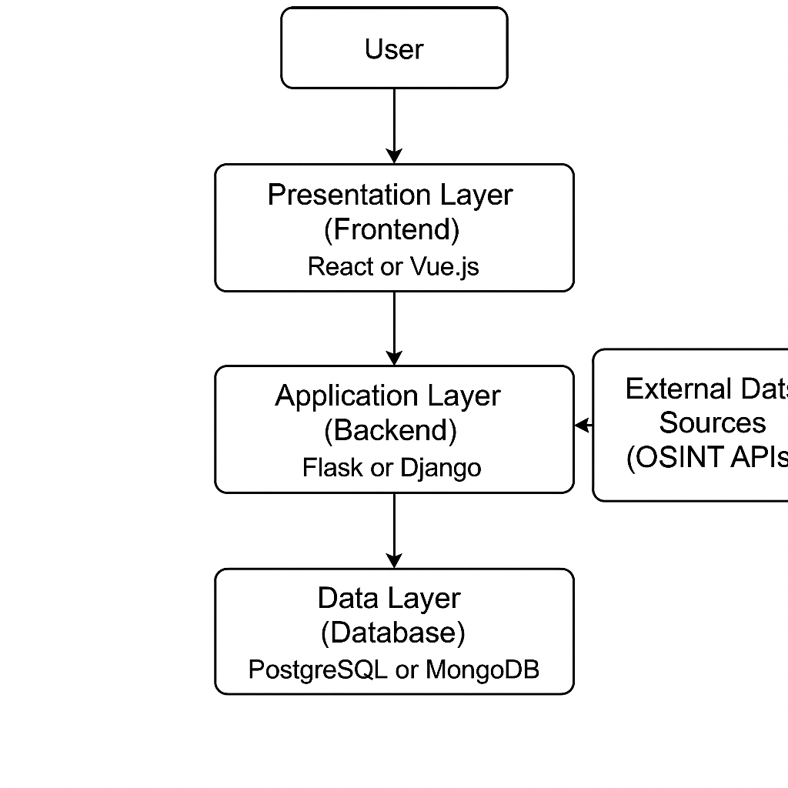
SYSTEM ARCHITECTURE

Slide 5
SYSTEM ARCHITECTURE
Presentation Layer (Frontend) Built using React framework. Provides the user interface (UI) with navigation, login screens, dashboard, and visualization of real-time threat data.
Application Layer (Backend) Developed using Flask (Python web framework). Handles API requests, business logic, data processing, and integration with external OSINT APIs.
Data Layer (Database) Stores structured information about assets, threats, vulnerabilities, and risk scores. Connected to the backend for data retrieval and updates. Used PostgreSQL as the database system.
External Data Sources (OSINT APIs) Third-party APIs like Shodan, Have I Been Pwned, and other open-source intelligence services. Provide real-time cybersecurity threat data to the backend server.
Git Repository Version control and submission of the web application code, database schemas, API scripts, and documentation.

Slide 6
TECHNOLOGIES USED
COMPONENT | TECHNOLOGY | PURPOSE
Frontend | React | Build the interactive user dashboard
Backend | Flask | API development, server-side processing
Database | PostgreSQL | Store assets, threats, vulnerabilities
OSINT APIs | Shodan, Have I Been Pwned | Fetch real-time cybersecurity threat information
Version Control | Git & GitHub | Code management, collaboration, and submission
Programming Language | Python, JavaScript | Backend (Python) and frontend (JavaScript)
Environment Setup | Virtual Environment (venv for Python) | Manage project dependencies

Slide 7
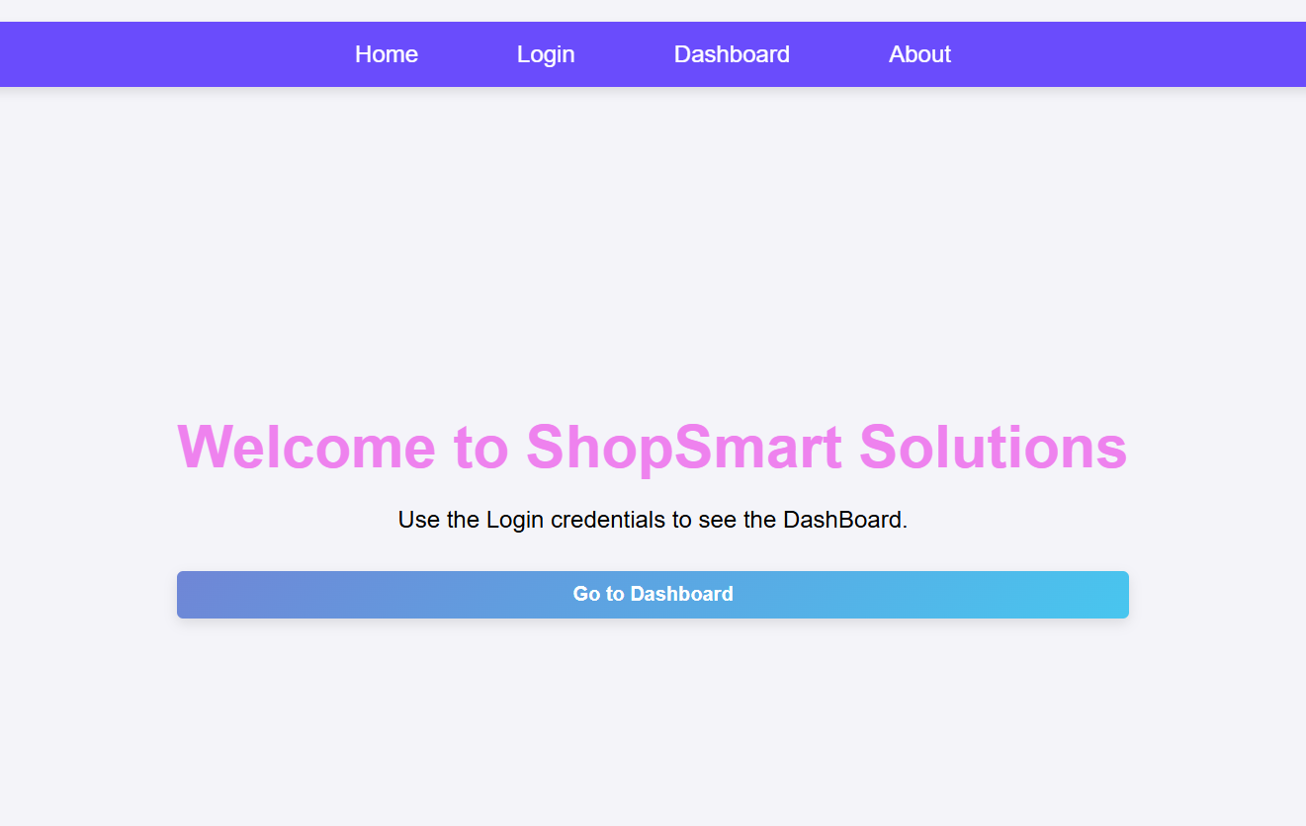
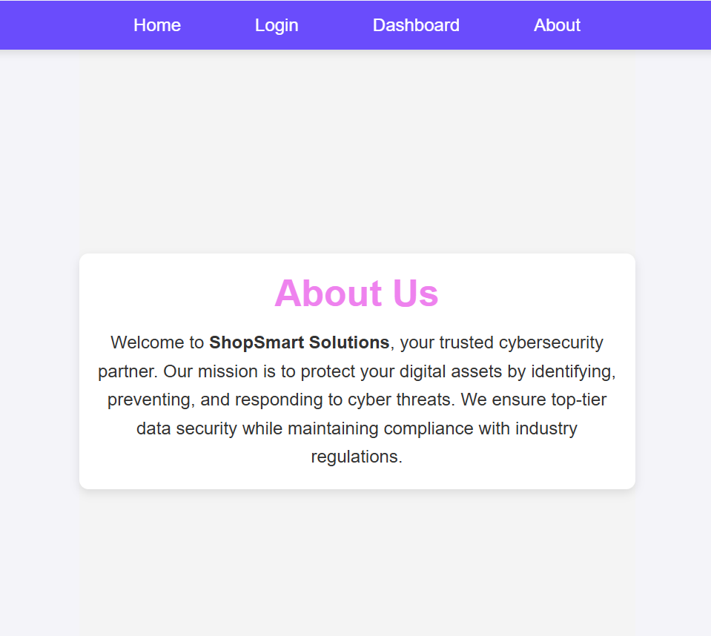
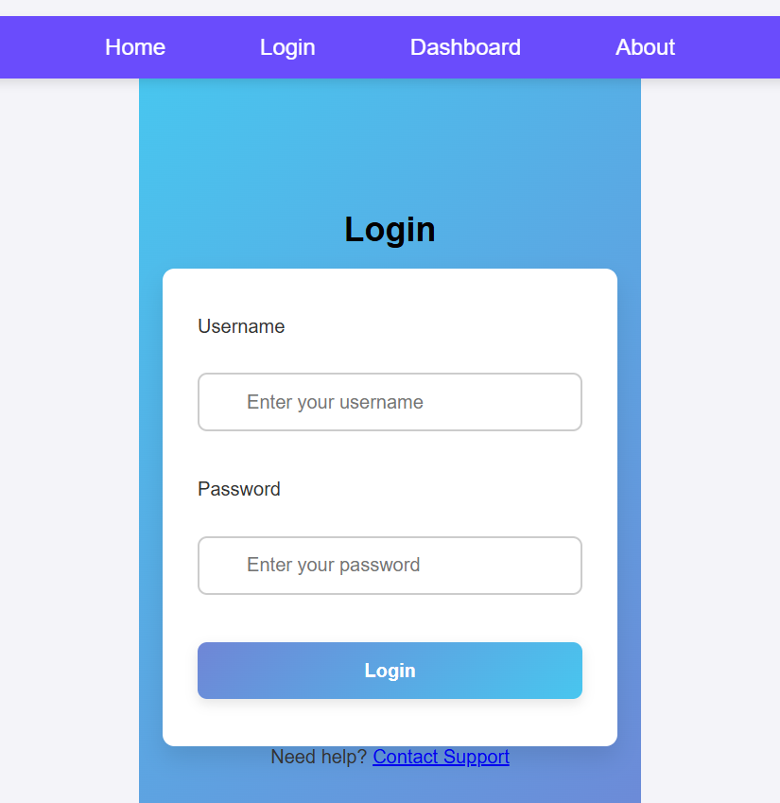
LIVE SYSTEM DEMONSTRATION

Slide 8
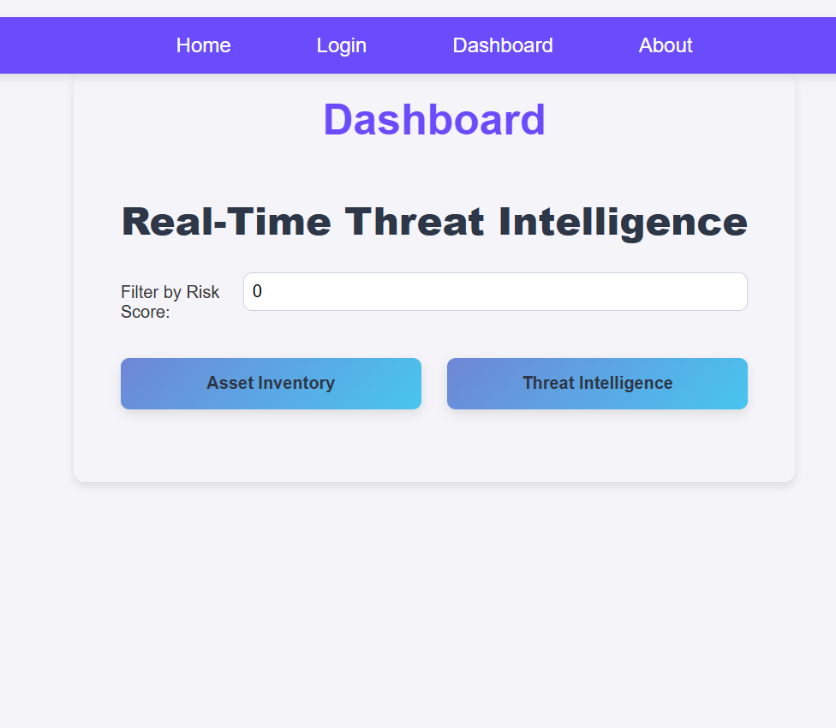
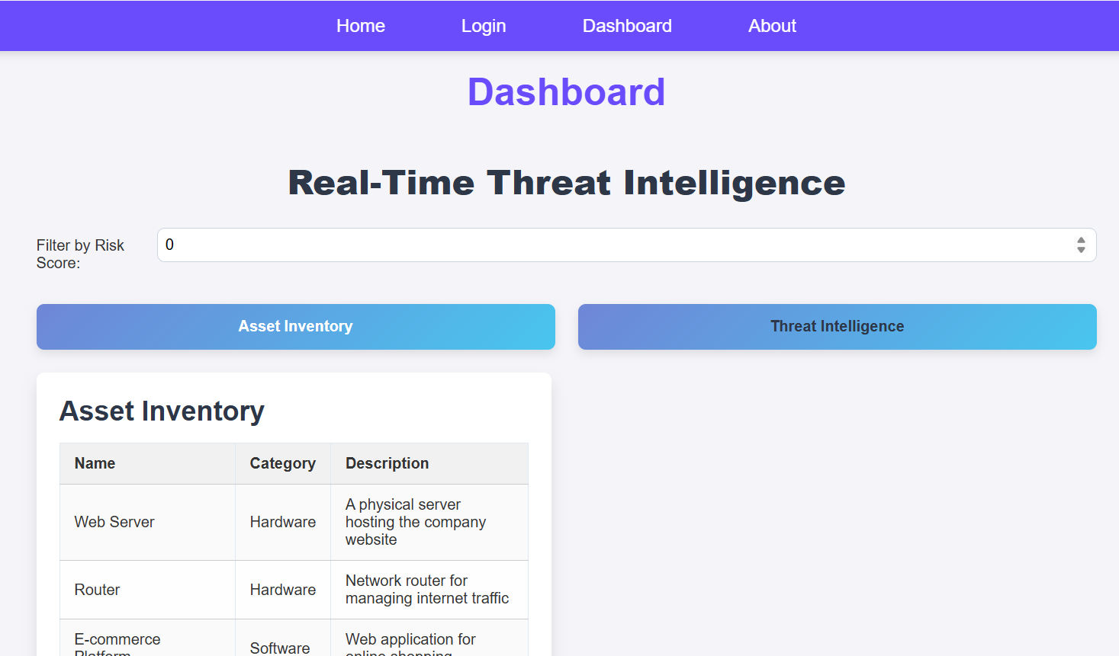
LIVE SYSTEM DEMONSTRATION

Slide 9
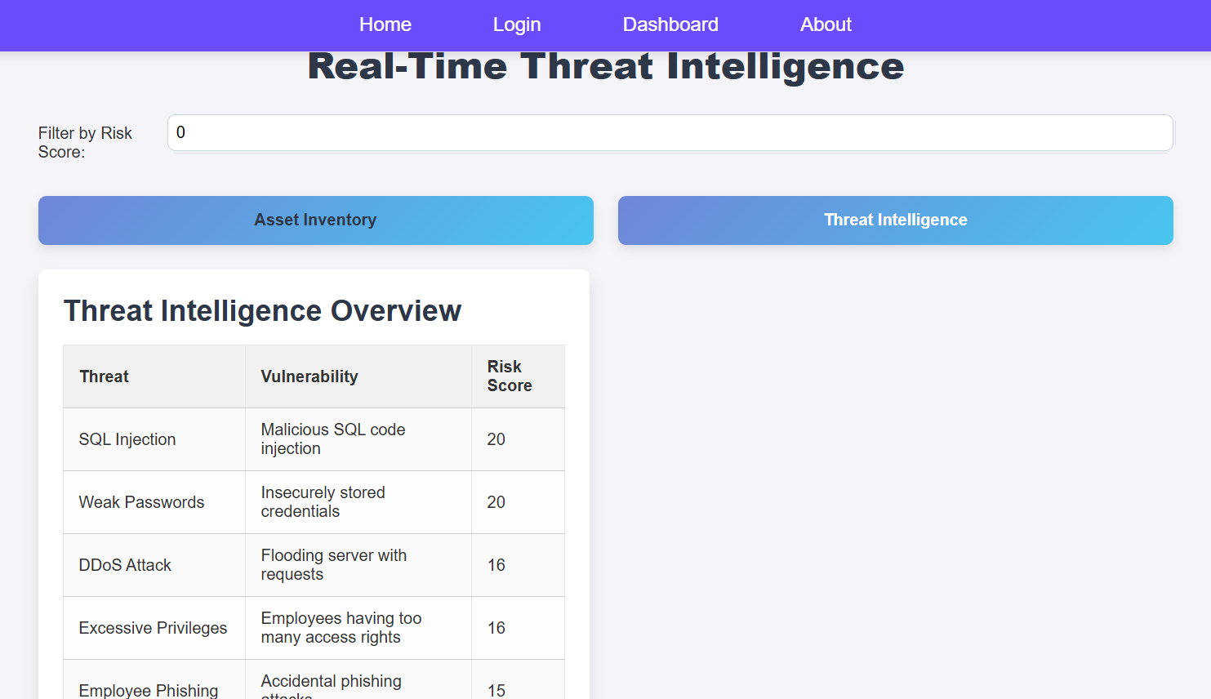
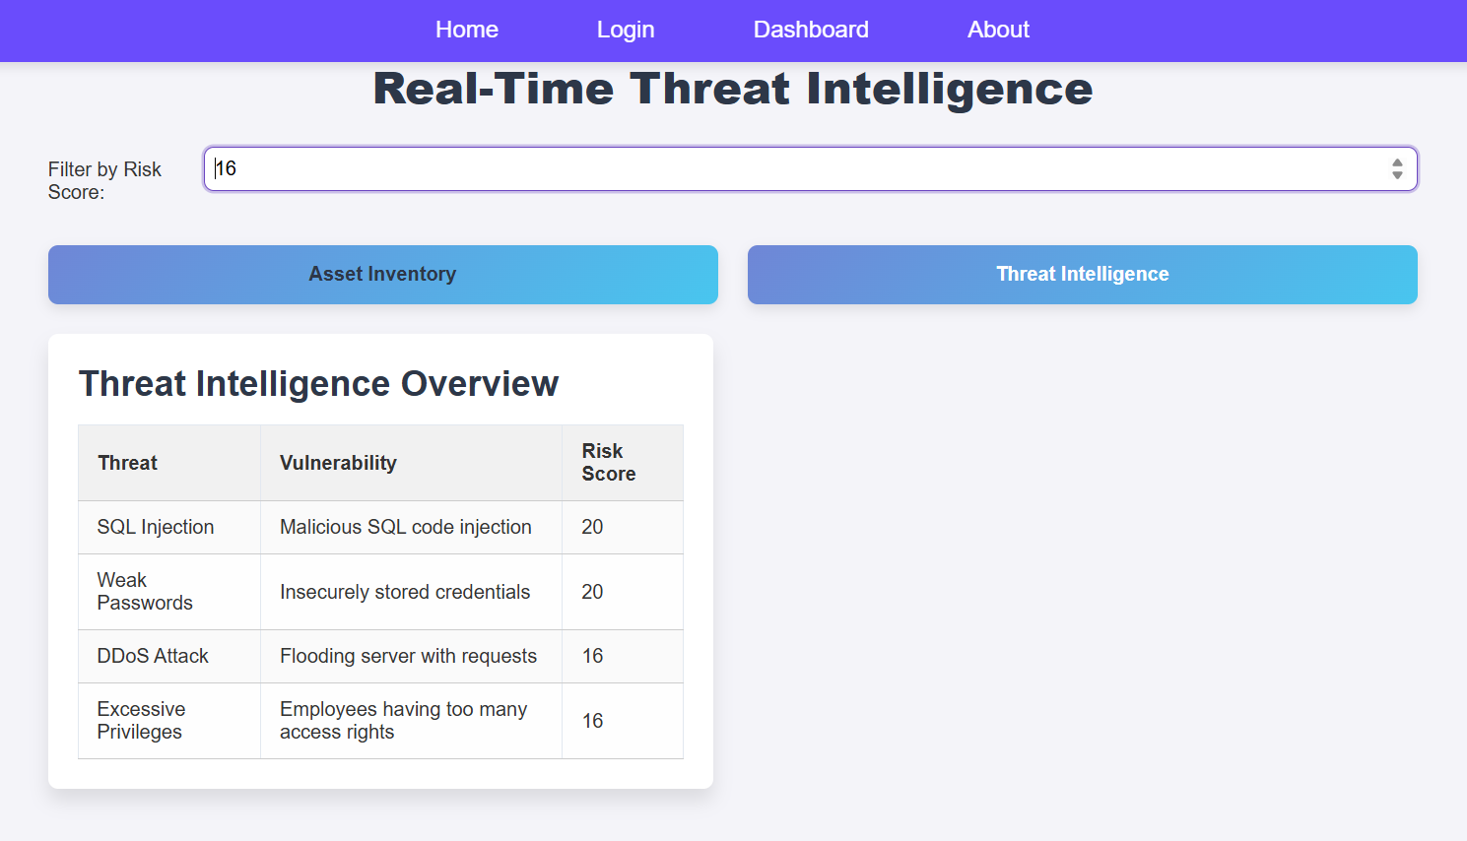
LIVE SYSTEM DEMONSTRATION

Slide 10
SECURITY FEATURES
Security Features Implemented
• Secrets Management:
o All API keys, database URIs, and tokens are loaded from a .env file using os.getenv().
o No sensitive information is hardcoded into the source code (e.g., api.py, osint_integration.py).
• Input Validation:
o Risk score filters on the React dashboard (Dashboard.js) are validated before queries are sent to the backend.
o Backend APIs (api.py) validate incoming data to prevent malformed or malicious requests.
• Alerting System:
o Automated email and webhook alerts triggered if a risk score exceeds the defined threshold (greater than 20).
o Alerts sent using the alerts.py script via SMTP with retry logic for reliability.

Slide 11
RISK MANAGEMENT
Risk Management Strategy
• Threat-Vulnerability-Asset (TVA) Mapping:
o Each threat collected from OSINT APIs is mapped to known organizational assets and associated vulnerabilities.
o Assets stored in PostgreSQL (assets table) are linked to threat intelligence feeds.
• AI-Enhanced Risk Scoring:
o GPT-4 is used via LLM_risk_analysis.py to evaluate the likelihood and impact of threats, generating a dynamic risk score.
TVA mappings and LLM output combined to prioritize threats automatically.
• Real-Time Monitoring & Alerts:
o Continuous background scripts (fetch_osint.py, risk_analysis.py) fetch new threats, compute risks, and update the dashboard live.
o If high-risk threats are detected, security teams are notified immediately.
• Proactive Defense (Planned Feature):
o blue_team_defense.py is prepared to automate blocking malicious IP addresses directly using iptables rules, reducing manual response times.

Slide 12
TESTING AND EVALUATION METRICS
Security Testing:
OWASP ZAP:
Detected missing Content-Security-Policy headers
Found cookies without Secure and HttpOnly flags
Identified unescaped inputs in React dashboard filters
Nmap:
Found SSH port (22) and MySQL port (3306) publicly accessible
Detected HTTP server version disclosure (Apache/2.4.41)
Burp Suite:
Discovered hardcoded admin credentials in Login.js
Found reflected XSS vulnerability in search functionality
Performance Testing:
Tool: Apache JMeter
Setup: 100 users, 10s ramp-up, ~1 min duration
Endpoints Tested: /, /dashboard/, /about/
* hypotheticals

Slide 13
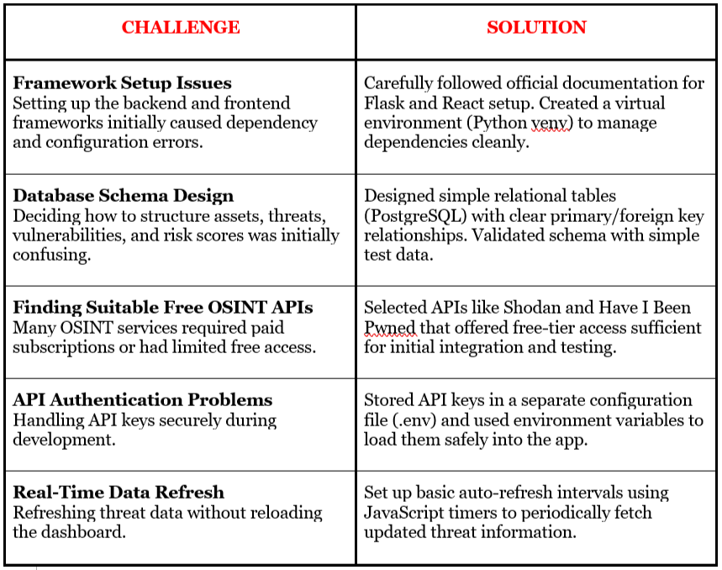
CHALLENGES AND SOLUTIONS

Slide 14
FUTURE IMPROVEMENTS
Add secure user login and registration using OAuth or JWT authentication.
Enhance the dashboard with graphical visualizations (using Chart.js or D3.js).
Integrate more OSINT APIs like VirusTotal, GreyNoise, and AbuseIPDB.
Set up real-time alerts via email or SMS using services like Twilio.
Improve database performance with NoSQL solutions for large-scale data (e.g., MongoDB Atlas).
Implement role-based access control (admin, analyst, viewer permissions).
Deploy the application to cloud platforms like AWS, Azure, or Heroku.
Establish CI/CD pipelines for automated testing and deployment.
Introduce threat prediction features using machine learning models.
Improve API security by encrypting API keys and adding request throttling.
Add data export features (download reports in CSV, PDF formats).
Create audit logs for tracking system access and actions for better security monitoring.
Fine-tune a proprietary LLM risk prediction model based on ShopSmart-specific threat history

