Slide 1

Facebook ıntroduces new bıddıng type
Average Bıddıng

Slide 2

Facebook recently introduced a new bidding type called "average bidding" as an alternative to the current bidding type called maximum bidding bombabomba.com has decided to test this new feature and wants to run an A / B test to see if averagebidding brings more conversions than maximumbidding.

Slide 3

customer journey
Website click
Search
Impression
Add to Chart
Purchase
View Content

Slide 4
A-Control group B- test group
A Group – Control Group
Facebook ad campaign with "maximumbidding" is posted on "ControlGroup"
B Group – Test Group
Facebook ad campaign with "average bidding" is posted on "Test Group"
The measure of success for Bombabomba.com is Purchase (Number of Purchases).
No NA value was observed in both groups.

Slide 5
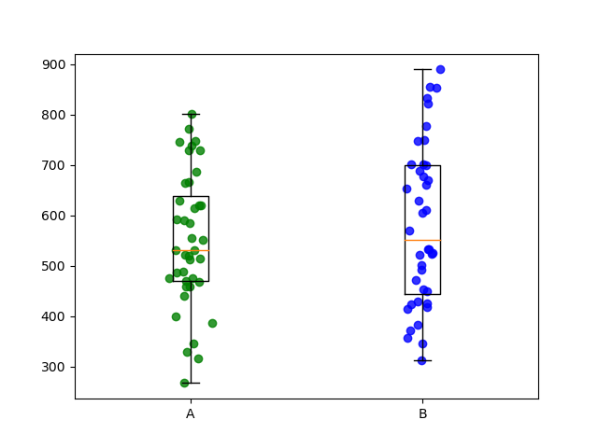
When we compare the test and control groups according to the 1-month data we have, the B group, that is the median of the test group, appears to be higher. The average bıddıngs looks better. But one month of data is insufficient to reach this conclusion. Here, if we use ab independent two sample tests, and our progress by establishing a hypothesis will make the results more realistic.

Slide 6
2 Independent Sample T Test normalıty assumptıon
H0: The population from which the sample comes is distributed normally.
H1: The population the sample comes from is not normally distributed.
from scipy.stats import shapiro
test statistics, pvalue = shapiro(control["Purchase"])
Control group p-value = 0.5891>0.05
from scipy.stats import shapiro
test statistics, pvalue = shapiro(test["Purchase"])
Test group p-value = 0.1541>0.05
The normal distribution hypothesis can’t be denied

Slide 7
2 Independent Sample T Test varıance homogeneıty
H0: Variances are homogeneous.
H1: Variances are not homogeneous.
from scipy import stats
stats.levene(control["Purchase"],test["Purchase"])
p-value =0.10828>0.05
The "variances are homogeneous" hypothesis can’t be rejected.

Slide 8
2 Independent Sample T Test
Assumptions provided we will run two samples T-test.
H0: The product purchase averages of the control group and the test group are equal.
H1: The product purchase averages of the control group and the test group are not equal.
test_istatistigi, pvalue = stats.ttest_ind(control["Purchase"],test["Purchase"], equal_var=True)
print('Test İstatistiği = %.4f, p-değeri = %.4f' % (test_istatistigi, pvalue))
p-value =0.3493>0.05
The product purchase averages of the control group and the test group are equal hypothesis cannot be denied.

Slide 9

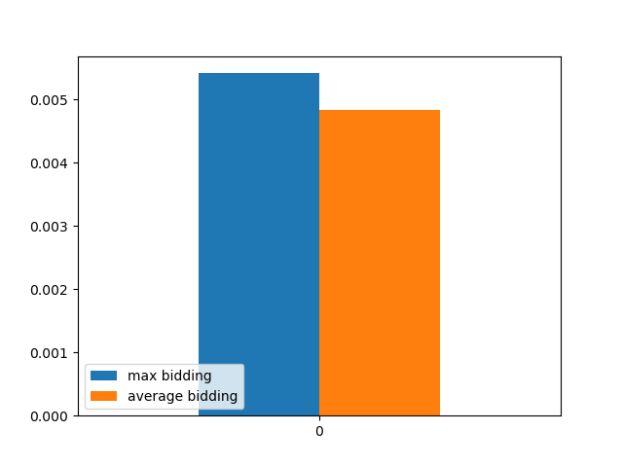
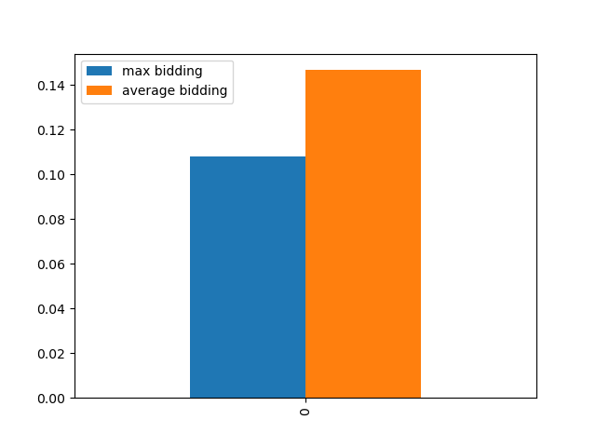
Let's examIne datas In a lIttle more detaIl together
purchase made for an impression
purchase made for an click
We can see that there is no significant difference between the two groups from the difference in outcomes.

Slide 10

suggestıons
There is no statistically significant difference between purchasing the control group and purchasing the test group. It has been proven with 95% confidence.
No difference between switching from the current system to the new system based on one month's data.
Therefore, the observation period can be extended.

