Slide 1
Project Website
by Andrejs Savkins 40012BDA

Slide 2
About project
Project - website where users can upload, save, discuss images and so on. Something like Pintester.

Slide 3
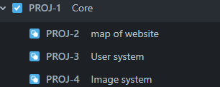
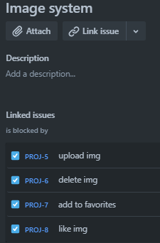
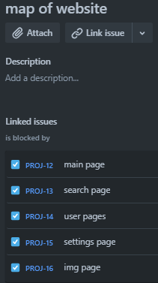
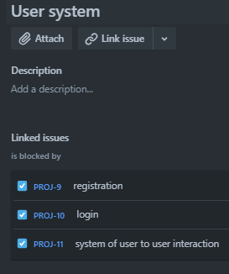
Structure
There I use Jira to show structure

Slide 4
What I going to use
Front-end - JavaScript
Back-end - C#
Jquery
Jira for development management
GitHub for store project

