Slide 1
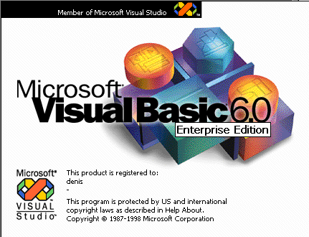
The VB Programming
Workshop
2k13
Chelmsford Makerspace
Learn how to make kool games.

Slide 2
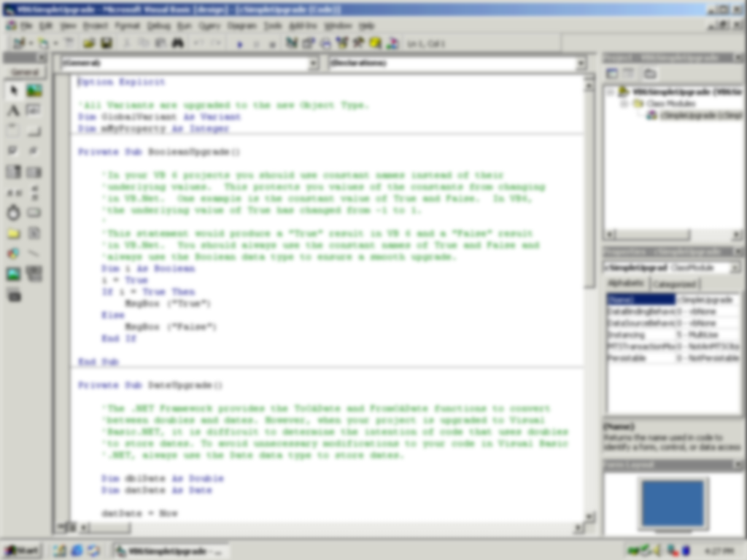
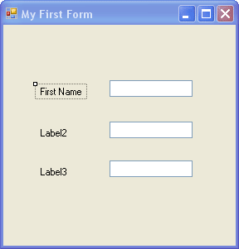
In VB you can…
Make forms that look pro.
Not use the old and obsolete syntax of many other languages. Use “Friend” instead of “Public”.
Write code quickly that can run without lots of installs.

Slide 3

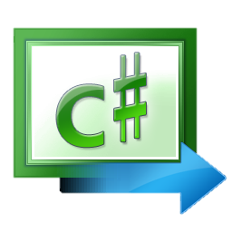
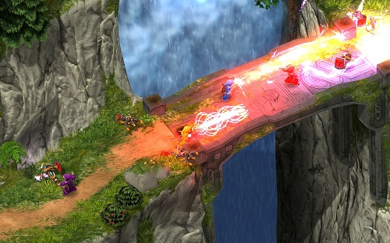
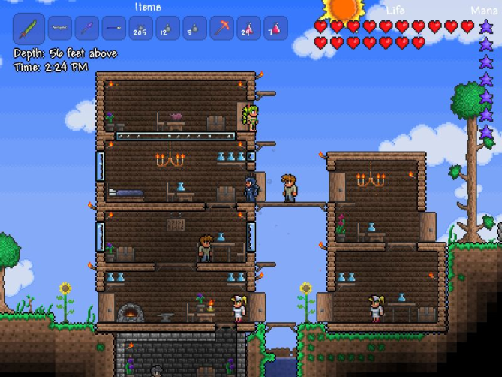
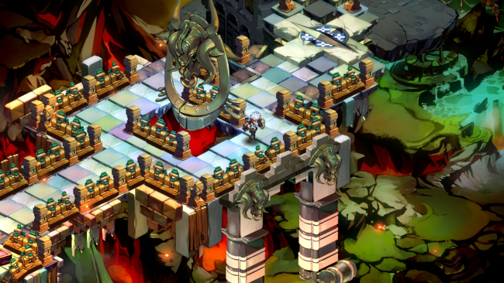
The Chelmsford Makerspace
Game Development Workshop
We aren’t actually going to use that language you just saw. That is Visual Basic, a terrible language you should learn to not use unless absolutely nessacery. C# is a much more traditional language but uses fairly new technology. Many games such as Bastion, Terraria and Magika have been made on it not including countless Xbox Marketplace games so its not only a great place to jump in but well supported too.

Slide 4
XNA and You

