Slide 1
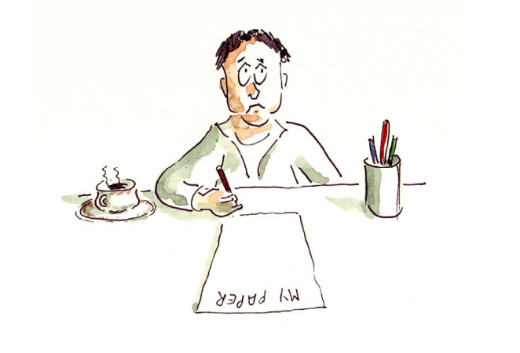
Reading makes a full man conference a ready man and writing an exact man --- Francis Bacon
Research&
Paper Writing
LWD
2025-3

Slide 2
What is a Scientific Paper?
Purpose:
Share your own original research work with other scientists or review the research conducted by others,
promoting the development of modern science.​
Characteristics:
Need to be highly readable, that is, clear, accurate, and concise.
Aim to inform, not impress.​
Audiences:
Referees (help the journal editor decide whether a paper is suitable for publication),
and journal readers (with different levels of knowledge about the topic).

Slide 3
Why paper?
motivations for writing a science paper.

Slide 4
Why Write and Publish a Paper?
two kinds of motivations,
altruism and self-interest,
Publication is usually the most straightforward way to make such a contribution.

Slide 5
How start?
The Literature Search
The goal of the search is to evaluate the state of our communal knowledge on a topic before embarking on a quest of adding to that knowledge.
Because science is about either confirming or refuting existing knowledge or developing new knowledge,
a thorough understanding of the current state of communal knowledge is essential.

Slide 6

Are your results new?
Literature studies are essential before you start the research program and writing.
There are hundreds of years of scientific research and millions of papers.
To publish a paper you must be at the research frontier.
You must know where the research frontier is.
You must continually check the most recent literature to make sure what others are doing.

Slide 7
Plan and Execute Research with Publication in Mind
document the work in sufficient detail so that
the reader can follow the reasoning presented and validate the conclusions drawn,
to defend the work against criticism

Slide 8
Why format? structure and organize?
Over the last 350 years, scientific journals have evolved a distinctive style, structure, and organization that make it easy for both the writer and the reader to get what they need from the paper: effective communication of scientific ideas
By following the standard structure and organization of a science research article, the author is constrained in many respects. But these constraints free the author and the reader to focus on the content, which often results in a better paper.

Slide 9
Outline
A good outline for the paper is a good plan for the research program.
An outline is a written plan of the organization of a paper, including the data on which it rests.
It can be relatively efficient to go through several (even many) cycles of an outline before beginning to write text.

Slide 10
The purpose of your paper is to convey the idea
. Here is a problem
. It’s an important problem
. It’s an unsolved problem
. Here is my idea
. My idea works (details, data)
. Here’s how my idea compares to other people’s
approaches

Slide 11
Basic parts of a paper
. Title
. Abstract
. Introduction
. Support (theoretical and experimental)
. Results and discussions
. Conclusions
. References-plagiarize, plagiarism, misconduct
. Acknowledgements
. Appendix

Slide 12
most papers use an “IMRaD” format:
Introduction
Method (experiment, theory, design, model)
Results
and Discussion
Conclusions
it makes it easier for the writer to organize the content of the paper, and it makes it easier for the reader to opportunistically find the information they seek. T

Slide 13
Introduction
the Introduction section should answer two questions: “
What?” and “So what?”
What is the paper about, and why should the reader care?

Slide 14
scope, novelty, and significance
Quality is implied and should be demonstrated, not explicitly claimed.

Slide 16
As Swales has described it, the research-article introduction moves through three phases:
Establish a territory (what is the field of the work, why is this field important, what has already been done?), •
Establish a niche (indicate a gap, raise a question, or challenge prior work in this territory),
and Occupy that niche (outline the purpose and announce the present research; optionally summarize the results).

Slide 17
three parts of the introduction uses
topic, problem, solution (for engineering);
or topic, observation/discovery, explanation (for science).
Some articles finish the introduction by presenting an outline of the article

Slide 18
Introduction
^{Style}
. Problem X is important
. A, B, and C have been done
. A, B, and C have their weakness (don’t over criticize)
. Our work D
. Features and advantages of D
. Results
. Organization of the paper
As you finish each section, go back to the introduction to revise corresponding contents.

Slide 19
Introduction – function
Introduce the subject: what is it about
Limit the research scope: where to start
Stating the general purpose: where to go
Explain the writing arrangement: how to go

Slide 20
Introduction – function
Introduce the subject: what is it about
Limit the research scope: where to start
Stating the general purpose: where to go
Explain the writing arrangement: how to go

Slide 21
Introduction – writing process
Start with the research background: literature review
Move towards the existing problem: new / unsolved
Focus on the present research: objectives, novel ideas, advanced methods, new materials, research scope

Slide 22
Textual development
Papers of theoretical nature:
textual description, logical development,
reasoning
Papers of experimental nature:
experiment process, technology, materials,
equipment, conditions, result analyses
Papers of combined nature:

Slide 23
Some common pitfalls in writing an introduction include
providing unnecessary background information (telling the reader what they already know or what they do not need to know),
exaggerating the importance of the work,
or failing to make clear what research questions this paper is trying to answer.

Slide 24
Method
describes how the results were generated. It should be sufficiently detailed so that an independent researcher working in the same field could reproduce the results sufficiently to allow validation of the conclusions.
A good method section should not only describe what was done and how it was done, but it should justify the experimental design as well. Of the many options available, why was this method chosen? Statistical considerations, such as sampling plans and analysis methods used, should be explained. If the raw results are not going to be presented, then a description of the data-reduction procedures is required. Also, consider how a figure or diagram might be used to illustrate or summarize the methods.

Slide 25
A common shortcoming of method sections in many papers today is the abandonment of the goal of reproducibility.
Other common pitfalls when writing the Method section: including results in the Method section, including extraneous details (unnecessary to enable reproducibility or judge validity), or treating the method as a chronological history of what happened.

Slide 26
Support (theoretical and experimental)
^{Purpose: Introduce your work}
^{Theoretical analysis}
The methods must be described in such a way that another researcher can repeat exactly what is done.
. Use references to describe standard or published
methods.
. Note any deviations that you have introduced in this
work.

Slide 27
Support (theoretical and experimental)
^{Experiments}
^{Style}
. Experimental design
Be sure that other researchers can repeat your
experiments according to your descriptions.
. Analysis of the results
. Comparisons
Put tedious details in Appendix.

Slide 28
Results and Discussion
Often, these results are presented in tables and/or graphs
An important goal when presenting results is to clearly designate those results that are new (never before published), while properly citing results that have been previously published

Slide 29
Results
Choosing only meaningful data: classifying and selecting
Short and clear: most important but shortest between experiment and discussion
Avoid redundancy in citing figures:
Poor: “It is clearly shown in Table 1 that the information desire grows with the development of industry.”
Improved: “The information desire grows with the development of industry (Table 1).”

Slide 30
Discussion
Analyze data: factual relation, generalization
Point out doubts: failures, points for attention
Expound the viewpoint: judgment, evaluation, analysis
Come to the conclusion: summary of end-result

Slide 31
The purpose of the Discussion section is to explain the results and show how they help to answer the research questions posed in the introduction.
This discussion generally passes through the stages of
summarizing the results, discussing whether results are expected or unexpected,
comparing these results to previous work,
interpreting and explaining the results (often by comparison to a theory or model), and hypothesizing about their generality.
The Discussion section inverts the format of the introduction, moving from the specific (the results generated in this work) to the general (how these results demonstrate a general principle that is more widely applicable).
Any problems or shortcomings encountered during the course of the work should also be discussed, especially if they might influence how results are to be interpreted.

Slide 32
Some common pitfalls when writing the results and discussion section are
a lack of organization,
presenting results that are never discussed, presenting discussion that does not relate to any of the results,
presenting results and discussion in chronological order rather than logical order,
ignoring results that do not support the conclusions,
or drawing conclusions from results without sound logical arguments to back them up

Slide 33
Results and Discussion
^{Results}
This section should simply state all results of the experiment.
Do not include information on what you believe should have happened or any analysis of the results.
The results section can include any graphs and data tables.

Slide 34
^{Results}
. Organize results neatly if graphs can be neatly
placed within the text, you may do so.
. If not, appendices should be used and referred to in
the Results section.
. Be sure to state what happened…not what was
supposed to happen.
. You should not draw any conclusions in the results
section.

Slide 35
Discussion
It is used to explain, interpret, and analyze your results. You should explain errors or problems with the experiment of data and can compare your results to previous research and theory.
. Don’t merely analyze the results, also discuss the
implications of those results.
. Pay attention to the errors that existed in the
experiment.
. Differs from the Results section in that you now
manipulate the data to defend your theories.

Slide 36
Conclusions
The Conclusions section provides a brief summary of the results and discussion, but it should be more than a summary.
After showing how each research question posed in the introduction has been addressed, the implications of the findings should be emphasized, explaining how the work is significant.
The goal here is to provide the most general claims that can be supported by the evidence.

Slide 37
This section should be reader-focused, avoiding a list of all the things that “I” or “we” have accomplished.
The Conclusions section should allow for opportunistic reading. When writing this section, imagine a reader who reads the introduction, skims through the figures, then jumps to the conclusion.
The conclusion should concisely provide the key message(s) the author wishes to convey.
It should not repeat the arguments made in the results and discussion, only the final and most general conclusions. While the results and discussion section is often quite long, the conclusion section is generally short.

Slide 38
The second goal of the conclusion is to provide a future perspective on the work. This could be recommendations to the audience or a roadmap for future work. A small amount of speculation can be appropriate here, so long as it is relevant and clearly labeled as speculative.
Some common pitfalls when writing the conclusion are
repeating the abstract, repeating background information from the introduction,
introducing new evidence or new arguments not found in the results and discussion,
repeating the arguments made in the results and discussion,
or failing to address all of the research questions set out in the introduction.

Slide 40
Abstract and Title
“That writer does the most who gives his reader the most information and takes from him the least time.”
-- Charles Caleb Colton
Nothing works better than a well-written title and abstract to make sure that the wrong reader does not waste time on the wrong paper, and that the right reader does not mistakenly skip over the right paper.
The purpose of a title and abstract is often described as “selling” the paper:
The true purpose of the title and abstract is to get the right people to read your paper
Thus, the purpose of the title and abstract is matchmaking:
matching a paper with the right readers, i.e., those who want and need the information
contained in the paper.

Slide 41
Abstract function
A condensed version of a research paper that highlights the major points covered and provides readers with a brief preview of the content and scope of the writing
For conf organizers to review before accepting the full paper
For conf participants to determine which session to attend
Expanding circulation especially electronically

Slide 42
Types of abstract
Descriptive:
information, purpose, methods, scope of paper, introduce the subject
Informative:
information, purpose, methods, scope of paper, results / findings, conclusions, recommendations

Slide 43
Features of effective abstract
Uses one or more well developed paragraphs: unified, coherent, concise, and self-contained
Uses a 3-part structure
Introduction / topic sentence
Body / supporting sentences
Conclusion / concluding sentence
Follow chronology of the thesis
Adds no new information
Uses passive voice

Slide 44
Order of the elements
1. Purpose and method of the study
2. Results
3. Conclusions and recommendations if any

Slide 45
Verb tense
Background information
Major activities
Methodology
Results
Conclusion
Present
Past or present perfect
Past
Past
Present

Slide 46
Common problems
Too detailed
Important information left out
Too long
Too short

Slide 47
Tips
Select important information from the headings and subheadings, table of contents, introduction and conclusion
Avoid direct copy of sentences
Avoid reference to other literatures
Avoid “I” or “we”
Use non-evaluating language to report rather than comment
Remember the word limit

Slide 48
The abstract should be a concise, stand-alone summary of the paper that covers the following topics:
Background/motivation/context, •
Aim/objective(s)/problem statement,
Approach/method(s)/procedure(s)/materials, •
Results, and •
Conclusion(s)/implications.

Slide 50
Structured Abstracts
Background: What issues led to this work? What is the environment that makes this work interesting or important?
Aim: What did you plan to achieve in this work? What gap is being filled?
Approach: How did you set about achieving your aims (e.g., experimental method, simulation approach, theoretical approach, combinations of these, etc.)? What did you actually do?
Results: What were the main results of the study (including numbers, if appropriate)?
Conclusions: What were your main conclusions? Why are the results important? Where will they lead?

Slide 51
EXAMPLES:
Background: Photoresist development rate can be defined microscopically (the development rate at a point) or macroscopically (the propagation rate of an average resist height). In the presence of stochastic noise, these two rates will be different.
Aim: In order to properly calibrate lithography simulators, the difference between these two definitions of development rate should be quantified.
Approach: Using theoretical derivations and a stochastic (Monte Carlo) resist simulator, the propagation rate of a resist surface is characterized in the presence of stochastic variation in the resist deprotection concentration and a nonlinear development rate response.
Results: The resulting propagation rate can be more than an order of magnitude higher than for the case of no stochastic noise. Correlation in the development rate creates an effective surface inhibition over a depth into the resist of several correlation lengths.
Conclusions: The differences between microscopic and macroscopic dissolution rate can have an important effect on how development rate models should be calibrated, depending on their use in continuum or stochastic lithography simulators.

Slide 52
Photoresist development rate can be defined microscopically (the development rate at a point) or macroscopically (the propagation rate of an average resist height). In the presence of stochastic noise, these two rates will be different. In order to properly calibrate lithography simulators, the difference between these two definitions of development rate should be quantified. Using theoretical derivations and a stochastic (Monte Carlo) resist simulator, the propagation rate of a resist surface is characterized in the presence of stochastic variation in the resist deprotection concentration and a nonlinear development rate response. The resulting propagation rate can be more than an order of magnitude higher than for the case of no stochastic noise. Correlation in the development rate creates an effective surface inhibition over a depth into the resist of several correlation lengths. These results show that the differences between microscopic and macroscopic dissolution rate can have an important effect on how development rate models should be calibrated, depending on their use in continuum or stochastic lithography simulators.

Slide 53
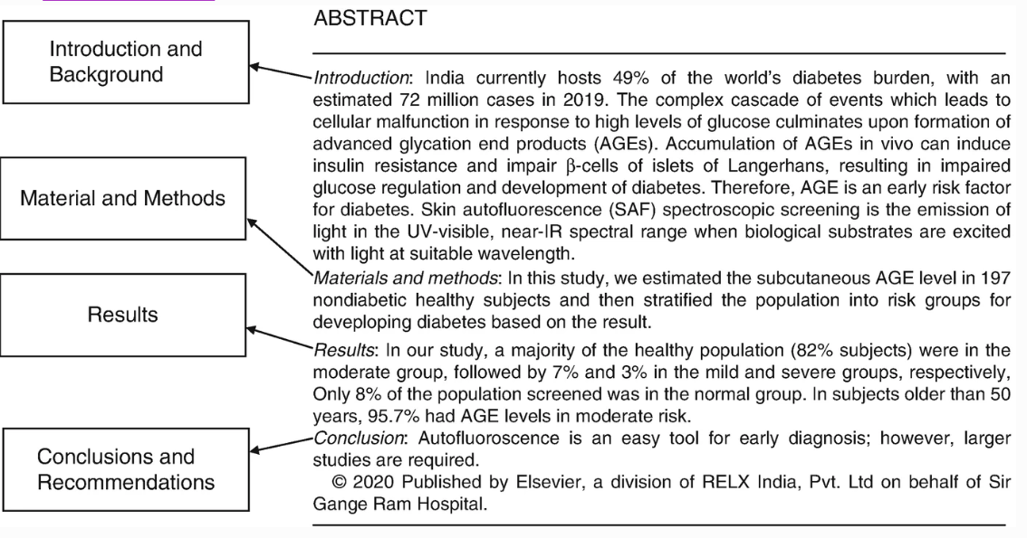

Slide 54
Additionally, the structured method of abstract writing also helps to avoid useless but all-too-common phrases like “in this paper” and “we report” or “will be discussed.” The abstract should talk about the work, not about the paper; phrases like “is discussed” turn your abstract into a table of contents rather than a summary of the paper. Do not use the first person (“I” or “we” or “the author”). Also, there is rarely a need to use phrases like “new” or “novel” in the abstract because only the novel results should be mentioned.

Slide 55
CHECK YOUR ABSTRACT
There is a three-part test that should be applied to your abstract when you are finished:
1. Is all of the information in the abstract consistent with what is written in the body of the paper?
2. Can all of the information found in the abstract also be found in the body of the paper?
3. Is the important information of the paper found in the abstract? Are any key words from the paper missing from the abstract?

Slide 56
The abstract must be self-contained, and it should generally not contain citations to other papers. If a citation is required (for example, if the paper is a response to a previous publication), then the full citation must be embedded in the abstract. Avoid abbreviations and acronyms in the abstract, but if you insist on including one, spell it out the first time it is used. Do not refer to figures or tables from the body of the paper, or use words or descriptions that will only make sense after the full paper has been read
keep the audience in mind
keep the audience in mind

Slide 57
Titles
working title
write the title last
In general, the title should reflect the aim and approach of the work. Depending on the audience (and the specificity of the journal), some of the background may have to be included. Rarely are results and conclusions even hinted at in the title.

Slide 58
Title
Function of the title:
generalize the text, attract the reader, facilitate the retrieval
Writing requirements of the title:
Be brief and concise (less than 15 words)
Be specific
Avoid questions
Be parallel

Slide 59
Sample titles
Poor: On the Addition to the Method of Microscopic Research by a New Way of Producing Color: – Contrast Between an Object and its Background or Between Definite Parts of the Object Itself
Improved: A New Way of Producing Color – Contrast in Microscopic Examination

Slide 60
Sample titles
Poor: Computer Retrieval
Improved: Computer Retrieval on Conference Information
Poor: The Design and Preparing of User Documents
Improved: The Design and Preparation of User Documents

Slide 61
Unlike the worlds of newspaper reporting and marketing press releases, the title of a scientific paper should describe the aim of the work, not the results. Thus, a good title might be
Impact of temperature and pressure on the compositional uniformity of sputter-deposited aluminum alloys
The following news-style title, on the other hand, is not appropriate:
Optimizing temperature and pressure improves sputter-deposited aluminum alloy films
Note that the good title is essentially a statement of the aim of the work. Often, it is important to mention the approach used as well, though an experimental approach is generally assumed if it is not mentioned. If the study had been based on simulation (or some other approach), however, this would generally be included in the title:
Impact of temperature and pressure on the simulated compositional uniformity of sputter-deposited aluminum alloys

Slide 62
A conflicting goal of the title is to be as short as possible (in 2011, titles in the Journal of Micro/Nanolithography, MEMS, and MOEMS ranged from 4 to 21 words in length, with an average length of 11.5). Specificity can often be improved through the use of more words, but a title that is too lengthy may not be read. Finding the best compromise between descriptiveness and brevity is where the art of authorship comes into play. Going back to our example, here is a title that sacrifices too much specificity to obtain brevity:
Impact of process parameters on the uniformity of aluminum alloys

Slide 63
A good test for your title is to answer these questions: Does the title of your manuscript, seen in isolation, give a full yet concise and specific indication of the work reported? Would someone interested in the exact topic of your paper, reading this title, be inclined to read the abstract? Avoid being overly clever with the title—a pun or a play on words may be great fun, but it is unlikely to help your article be found by a search engine (and can be easily misunderstood by an international audience). Titles should also be free of jargon unlikely to be understood by those not intimately familiar with the topic, and they should not contain acronyms. The overall goal should be a title that is clear and informative.

Slide 65
Author / Affiliation
Function:
bear responsibility, facilitate retrieval & correspondence, heighten celebrity
Eg:
Qiusheng YAN
Professor, Department of Foreign Languages, Tsinghua University
Beijing 100084, People’s Republic of China

Slide 66
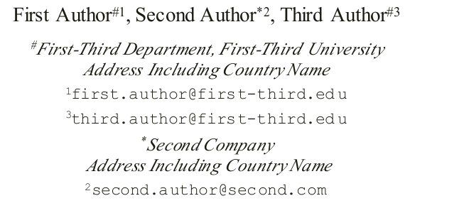

Slide 67
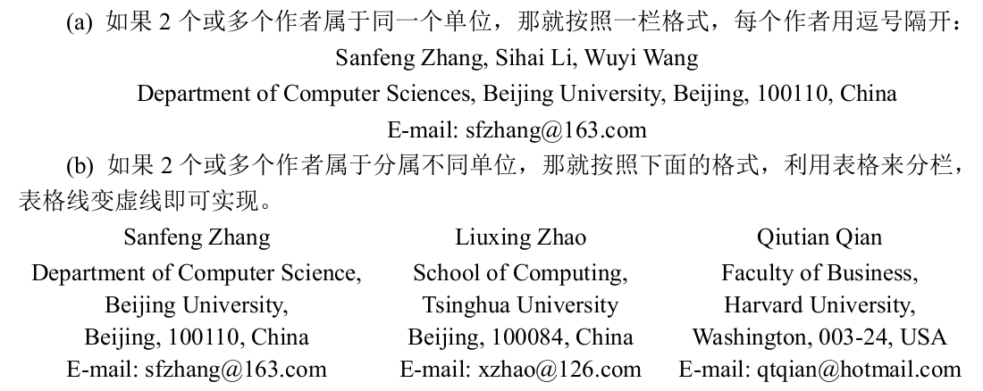

Slide 68
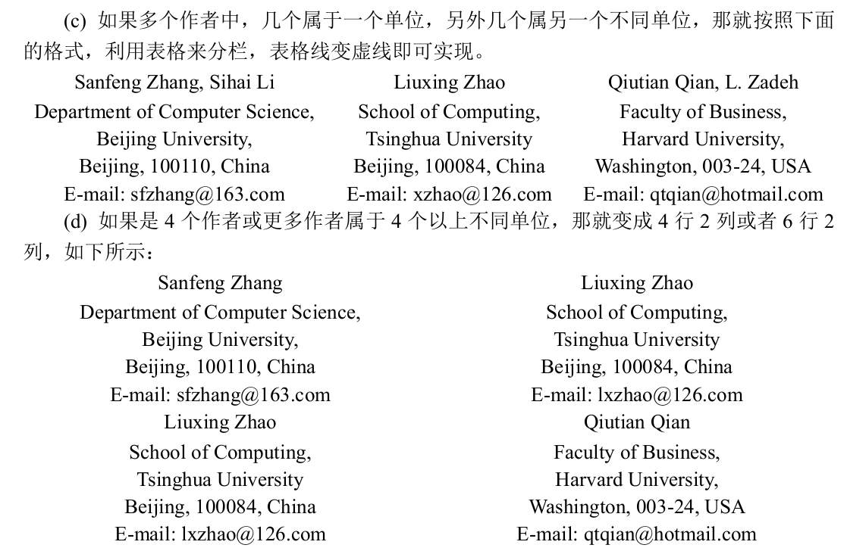

Slide 69
Keywords
Keywords (also called “subject terms”).
How you use search engine to locate relevant papers?
The most important keywords should be found in the title, and in the abstract several times.

Slide 70
Keywords
Function: retrieve; highlight the gist of paper
Requirements:
Use nouns, not verbs
Number of keywords: 4 to 6
Chosen from title and abstract
No capitalization, use comma or larger space, no full stop
Use standard abbreviation: ISO norm

Slide 72
Acknowledgment
感谢认真而又有实质性建议的匿名审稿人。
The authors sincerely thank the anonymous reviewers for their valuable comments that have led to the present improved version of the original manuscript.
感谢认真而又有实质性建议的朋友。
The authors also thank Prof. XYZ for his valuable comments and suggestions on the manuscript of the paper.
感谢有关科研基金。
This research was supported by the NSFC under grant 00111100.

Slide 73
Acknowledgment
To extend thanks an indebtedness to people who have helped during the research.
Supervisors, colleagues, peer students, funding or sponsoring associations, etc.
Requirements:
Be substantial and specific but brief
Avoid understatement or overstatement
Obtain permission

Slide 74
References
统一格式。
使用你打算投稿的机构规定的格式。
文献的多少要恰当：不要漏掉重要和必要的文献，又
不要罗列多余的、特别是你自己的但又毫不相关的文章。
文献中的每一篇文章都要引用到，否则就不要罗列。

Slide 75
References / Bibliography
Functions:
Show respect to previous works
Present scientific bases for the research
Avoid legal problem
Sample :
In text: (Smith, 1983: 123)
End of paper: Smith, L., 1983, Reading in English as an International Language, Oxford: Pergamon.

Slide 76
Appendix
附录通常可以放一些比较长的引理和定理的证明。
这样会方便读者顺利地阅读文章的全文，而只在有必要的时候才去检查这些证明。

Slide 77
Appendices
For any materials which are important but do not fit naturally in the text.
Materials included
Questionnaires used to obtain data
Sheets used in observation
Photocopied documents such as textbooks, exam papers and syllabuses
Other materials that are long and awkward if put in the text

Slide 78
Appendices – requirements
All materials in an appendix must have been referred to in the text
Each document should be included in a separate appendix which should be numbered and titled and begin on a new page

Slide 79
Misconceptions 1:
^{The more, the better}
Don’t provide too many “new” ideas in a paper. Try your best to focus on your core work.

Slide 80
Misconceptions 2:
^{The more complex, the better}
Try to make your paper easy to be understood.
Remember: You are showing your thoughts instead of confusing the readers.
Mathematical language is to help you clearly express your thoughts, not to show your depth.

Slide 81
Misconceptions 3:
^{The more selling, the better}
Don’t exaggerate too much on your work.
The reviews/readers will judge it.

Slide 82
Misconceptions 4:
The more authoritative, the better
Don’t refer too many own works while ignoring others.
Don’t behave as a big shot if you are not.

Slide 83
Tricks
. Read more, write more
. Use good papers as samples
to simulate but not to copy
. Use simple sentences
. Not to show your elegance
unless you are very famous
. Try to reduce syntax errors
Good works won’t be rejected for syntax, but at
least the paper should be readable.

Slide 84
Tricks
. Make your abbreviation easy to be pronounced
. Typeset according to the requirements of the target
. Revise, revise, and revise
. Improve from comments

Slide 85
Thank You !

