Slide 1

A First Book of ANSI C Fourth Edition
Chapter 1
Introduction to Computer Programming

Slide 2
A First Book of ANSI C Fourth Edition
Chapter 1
Introduction to Computer Programming

Slide 3
Objectives
History and Hardware
Programming Languages
Algorithms
The Software Development Process
Case Study: Design and Development
Common Programming Errors

Slide 4
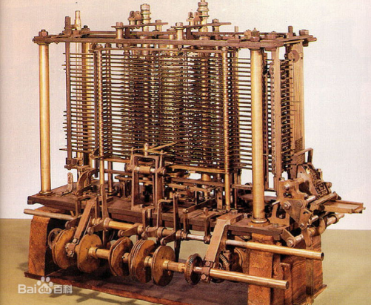
History and Hardware
Babbage’s analytical engine (1822)
Atanasoff-Berry Computer (ABC, 1937)
Human operator manipulated external wiring
Electrical Numerical Integrator and Computer (ENIAC, 1946)
Vacuum tubes
Mark I (1944)
Mechanical relay switches
Electronic Delayed Storage Automatic Computer (EDSAC, 1949)
Incorporated a form of memory

Slide 5
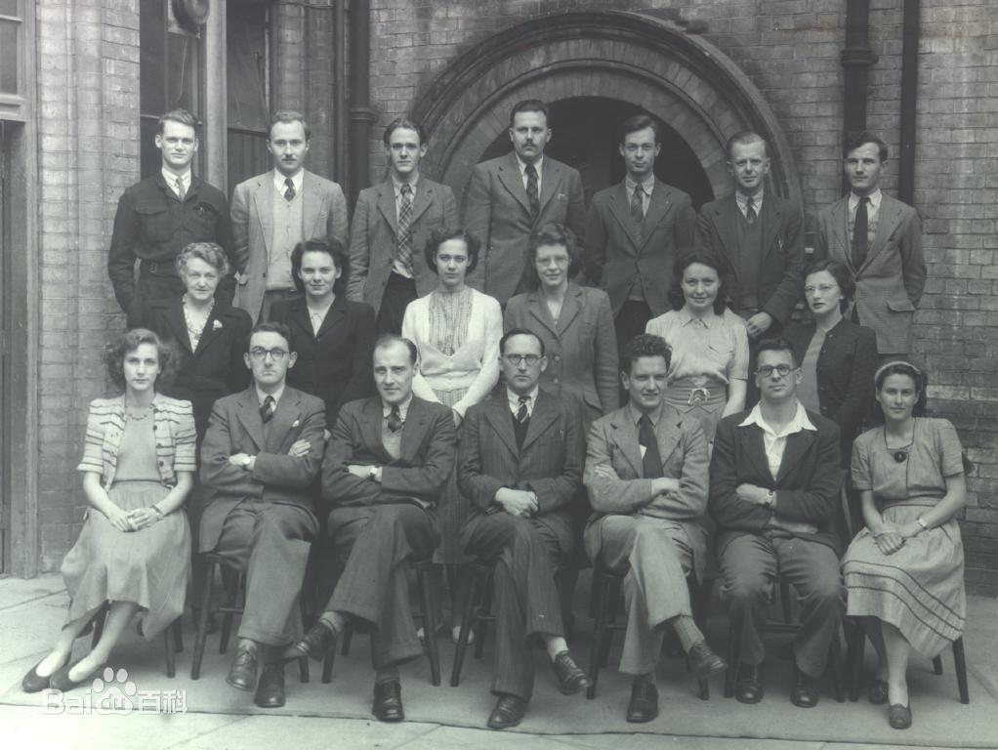
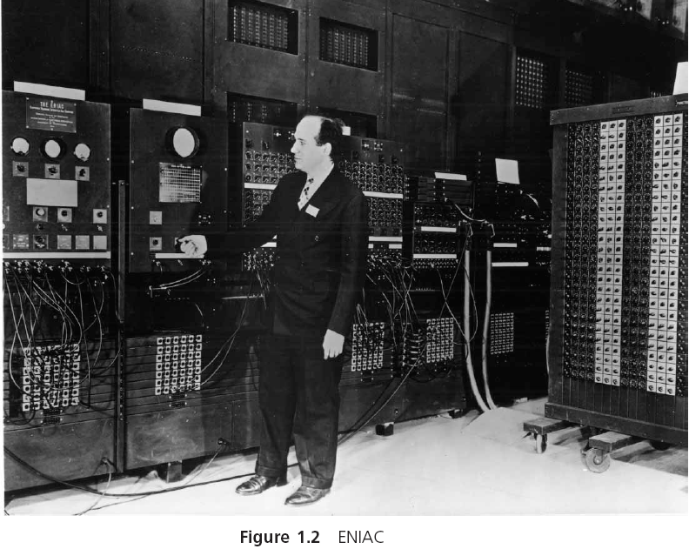
History and Hardware (continued)
Electronic Delayed Storage Automatic Computer (EDSAC, 1949)
Notes:
包括了18000个真空电子管，质量约为30 000千克。每秒能执行5000次加法或360次乘法

Slide 6
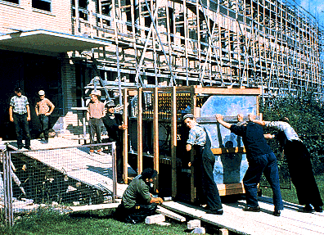
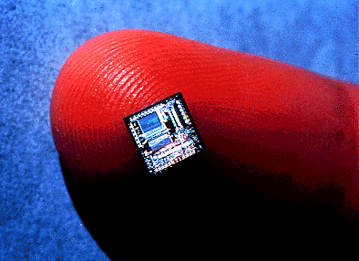
Hardware: The Size Does Matter

Slide 7
Computer Hardware
Computers are constructed from physical components referred to as hardware
Hardware facilitates the storage and processing of data under the direction of a stored program
Computer hardware does not store data using the same symbols that humans do

Slide 8
Bits and Bytes
The smallest and most basic data item in a computer is a bit
Open or closed switch
0 or 1
The grouping of 8 bits to form a larger unit is referred to as a byte
Can represent any one of 256 distinct patterns
The collections of patterns consisting of 0s and 1s used to represent letters, single digits, and other single characters are called character codes

Slide 9
Data Measurement Chart
1 Byte = 8 Bits
1 KB (Kilobyte) = 1024 Bytes
1 MB (Megabyte) = 1024 KB
1 GB (Gigabyte) = 1024 MB
1 TB (Terabyte) = 1024 GB
1 PB (Petabyte) = 1024 TB
1 EB (Exabyte) = 1024 PB
1 ZB (Zettabyte) = 1024 EB
1 YB (Yottabyte) = 1024 ZB
1 BB(Brontobyte ) = 1024 YB
1 NB(NonaByte ) = 1024 BB
1 DB(DoggaByte) = 1024 NB

Slide 10
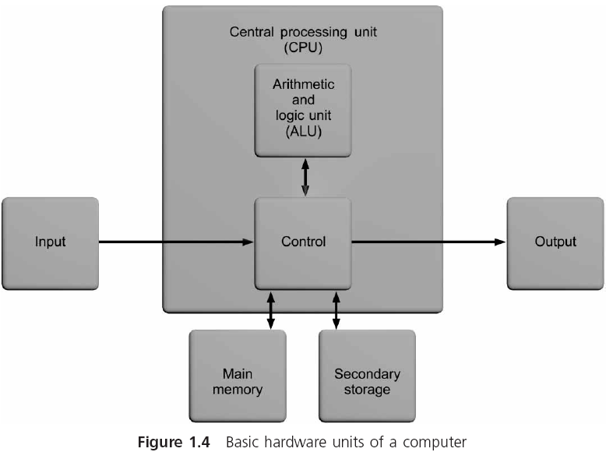
Components
冯·诺依曼结构也称普林斯顿结构，是一种将程序指令存储器和数据存储器合并在一起的存储器结构。

Slide 11
Main Memory Unit
Stores data and instructions as sequence of bytes
A program must reside in main memory if it is to operate on the computer
Combines 1 or more bytes into a single unit, referred to as a word
Constructed as random access memory, or RAM
Every section of memory can be accessed randomly as quickly as any other section
Volatile: data is lost when power is turned off
Size is usually specified in bytes (MB or GB)

Slide 12
Central Processing Unit (CPU)
Control unit: directs and monitors the overall operation of the computer
Keeps track of where the next instruction resides
Issues the signals needed to both read data from and write data to other units in the system
Executes all instructions
Arithmetic and Logic Unit (ALU): performs all of the computations, such as addition, subtraction, comparisons, and so on, that a computer provides
CPUs are constructed as a single microchip, which is referred to as a microprocessor

Slide 13
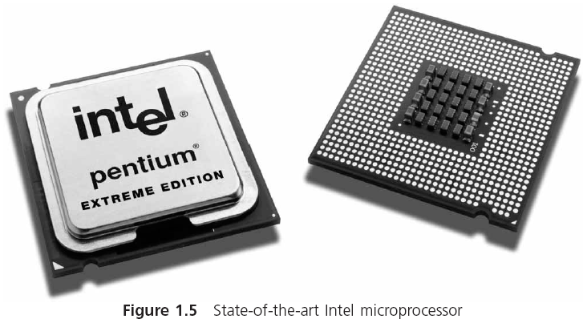
Microprocessor

Slide 14
Input/Output Unit
The input/output (I/O) unit provides access to the computer, allowing it to input and output data
It is the interface to which peripheral devices, such as keyboards, console screens, and printers, are attached

Slide 15
Secondary Storage
Used as permanent storage for programs and data
Magnetic tape, magnetic disks, and CD-ROMs
Direct access storage device (DASD): allows a computer to read or write any one file or program independent of its position on the storage medium
Magnetic hard disk consists of rigid platters that spin together on a common spindle
Initially, the most common magnetic disk storage device was the removable floppy disk

Slide 16
Programming Languages
Computer program: data and instructions used to operate a computer and produce a specific result
A program or set of programs is called software
Programming: writing instructions in a language that the computer can respond to and that other programmers can understand
Programming language: set of instructions that can be used to construct a program

Slide 17
Machine Language
Executable program: program that can operate a computer
Executable programs are written with binary numbers, which is a computer’s internal language (machine language)
An example of a simple machine language program containing two instructions is:
11000000000000000001000000000010
11110000000000000010000000000011
Opcode is short for operation code; tells the computer the operation to be performed

Slide 18
Assembly Language
Assembly language: uses the substitution of word-like symbols for the opcodes, and decimal numbers and labels for memory addresses
LOAD first
ADD second
MUL factor
STORE answer

Slide 19
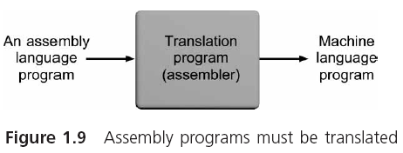
Assembly Language (continued)

Slide 20
Low- and High-Level Languages
Machine and assembly languages are low-level languages because they both use instructions that are directly tied to one type of computer
Programs written in a computer language are referred to as source programs and source code
When each statement in a high-level source program is translated individually and executed immediately upon translation, the programming language is called an interpreted language
Interpreter: program that translates each statement in a high-level source program and executes it immediately upon translation

Slide 21
Low- and High-Level Languages
Compiled language: the statements in a high-level source program are translated as a complete unit before any individual statement is executed
Compiler: translates a high-level source program as a complete unit before any statement is executed
The output produced by the compiler is called an object program (machine language version of the source code)
Linker: combines additional machine language code with the object program to create a final executable program

Slide 22
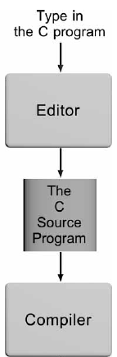
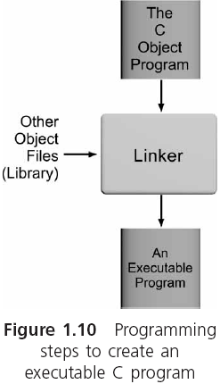
Low- and High-Level Languages
*.o
*.cpp
*.exe

Slide 23
Procedural and Object-Oriented Languages
Procedural language: instructions are used to create self-contained units, called procedures
Procedure: accepts data as input and transforms it in some manner to produce a specific result as output
Also called function or method
Procedures conforming to structure guidelines are known as structured procedures

Slide 24
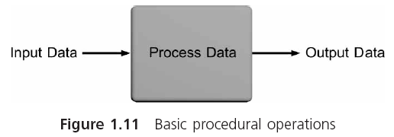
Procedural and Object-Oriented Languages
Structured language: high-level procedural language (e.g., C) that enforces structured procedures
Object-oriented languages: languages with object orientation such as C++, Java, Visual Basic, and C#

Slide 25
Application and System Software
Application software: programs written to perform particular tasks required by users
System software: collection of programs that must be readily available to any computer system to enable the computer to operate
The bootstrap loader is internally contained in ROM and is a permanent, automatically executed component of the computer’s system software

Slide 26
Application and System Software
Operating system: set of system programs used to operate and control a computer
Multiuser system: handles multiple users concurrently
Operating systems that permit each user to run multiple programs are referred to as both multiprogrammed and multitasking systems

Slide 27
The Development of C
Developed in the 1970s at AT&T Bell Laboratories by K. Thompson, D. Ritchie, and B. Kernighan
High-level structured language
Can also access the internal hardware of a computer
C permits a programmer to “see into” a computer’s memory and directly alter data stored in it
Standard maintained by the American National Standards Institute (ANSI)
In the 1980s, Bjarne Stroustrup (working at AT&T) developed C++
C with object-oriented capabilities

Slide 28
Algorithms
Algorithm: specific steps required to produce a desired result
Set n equal to 100
Set a equal to 1
Set b equal to 100
Calculate sum = n(a+ b)/2
Display the sum

Slide 29
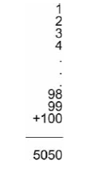
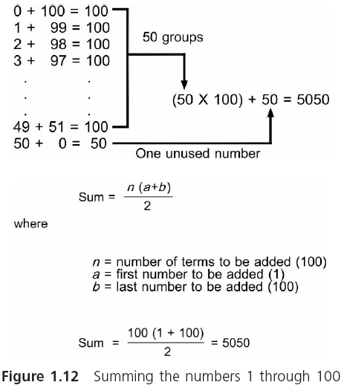
Algorithms

Slide 30
Algorithms
When English phrases are used to describe an algorithm, the description is called pseudocode
Input the three numbers into the computer
Calculate the average by adding the numbers and dividing the sum by three
Display the average

Slide 31
Algorithms (continued)
When mathematical equations are used to describe an algorithm, the description is called a formula
Flowchart: provides a pictorial representation of an algorithm using specifically defined shapes

Slide 32
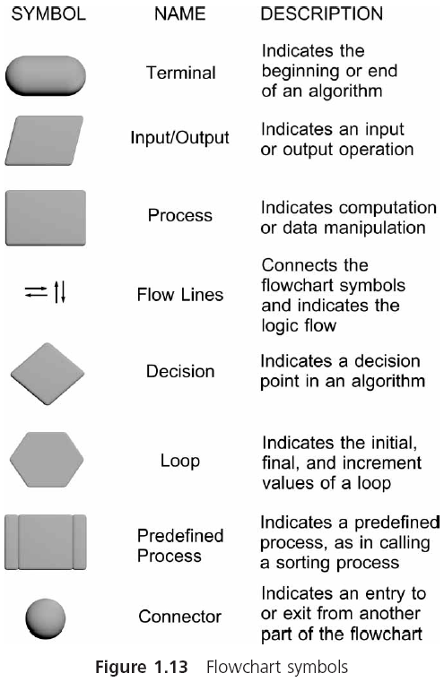

Slide 33
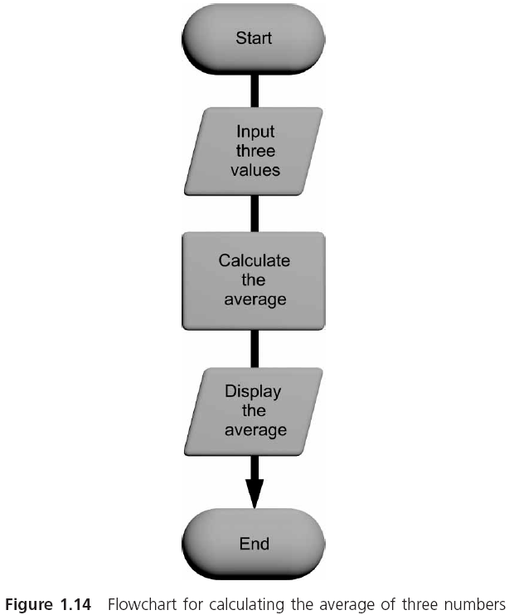
Algorithms

Slide 34

算法的特性
一个有效算法应该具有以下特点：
(1) 有穷性。一个算法应包含有限的操作步骤，而不能是无限的。
(2) 确定性。算法中的每一个步骤都应当是确定的，而不应当是含糊的、模棱两可的。

Slide 35
算法的特性
一个有效算法应该具有以下特点：
(3) 有零个或多个输入。所谓输入是指在执行算法时需要从外界取得必要的信息。
(4) 有一个或多个输出。算法的目的是为了求解，“解” 就是输出。
没有输出的算法是没有意义的。
(5) 有效性。算法中的每一个步骤都应当能有效地执行，并得到确定的结果。

Slide 36
算法的特性
对于一般最终用户来说:
他们并不需要在处理每一个问题时都要自己设计算法和编写程序
可以使用别人已设计好的现成算法和程序
只需根据已知算法的要求给予必要的输入，就能得到输出的结果
输入3个数
求3个数的最大数
3个数中最大数
黑箱子

Slide 37
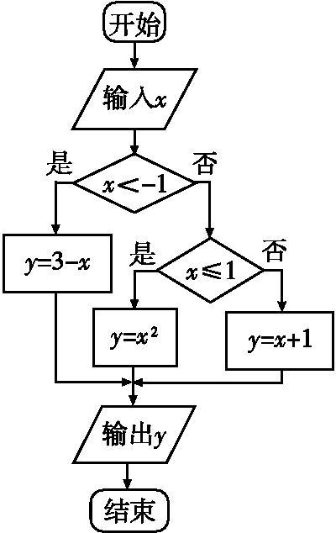
A First Book of ANSI C Fourth Edition
Chapter 2
Getting Started in C Programming

Slide 38

2.4.2用流程图表示算法
①
③
②
流程图是用一些图框来表示各种操作
用图形表示算法，直观形象，易于理解
③
③
位置不够
判断框
防止交叉
①
处理框
起止框
输入输出框
②
流程线
连接点
注释框

Slide 39
开始
1⇒t
算法用流程图表示。
求1×2×3×4×5
如果需要将最后结果输出:
2⇒i
t*i⇒t
i+1⇒i
N
i>5
Y
结束

Slide 40
开始
1⇒t
算法用流程图表示。
求1×2×3×4×5
如果需要将最后结果输出:
2⇒i
t*i⇒t
i+1⇒i
N
i>5
Y
结束
输出t

Slide 41
有50个学生，要求将成绩在80分以上的学生的学号和成绩输出。

Slide 42
如果包括输入数据部分
开始
开始
1⇒i
1⇒i
Y
g_{i}≧80
N
输入n_{i}、g_{i}
输出n_{i}、g_{i}
i+1⇒i
i+1⇒i
N
i>50
N
i>50
Y
Y
①
结束

Slide 43
如果包括输入数据部分
①
开始
1⇒i
1⇒i
Y
g_{i}≧80
N
输入n_{i}、g_{i}
输出n_{i}、g_{i}
i+1⇒i
i+1⇒i
N
i>50
N
i>50
Y
Y
①
结束

Slide 44
A First Book of ANSI C Fourth Edition
Chapter 2
Getting Started in C Programming

Slide 45
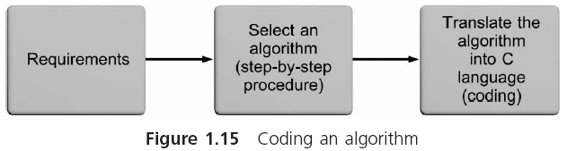
Algorithms
Converting an algorithm into a computer program, using a language such as C, is called coding the algorithm
The program instructions resulting from coding an algorithm are called program code, or simply code

Slide 46
The Software Development Process
Each field of study has a name for the systematic method used to design solutions to problems
In science: called the scientific method
In engineering: called the systems approach
The technique used by professional software developers for understanding the problem that is being solved and for creating an effective and appropriate software solution is called the software development process

Slide 47
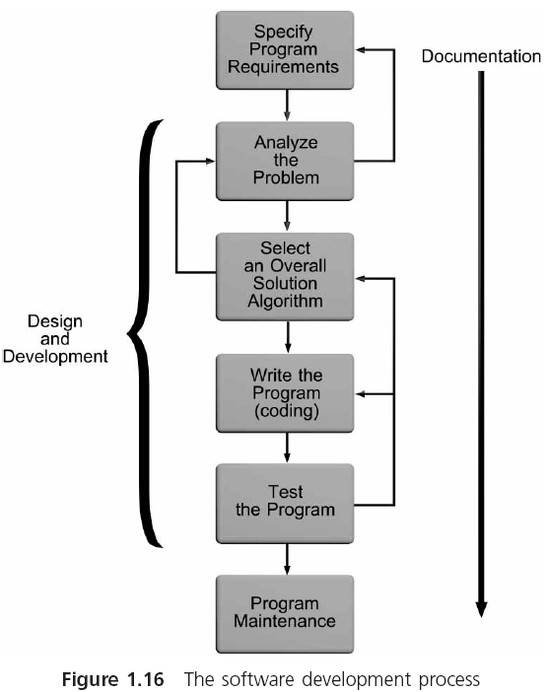
The Software Development Process

●

❍

Slide 48
Phase I: Specify the Program’s Requirements
Begins with a problem statement or a specific request for a program, which is called a program requirement
Suppose you receive an e-mail from your supervisor that says: We need a program to provide information about circles
This is not a clearly defined requirement
To clarify and define the problem statement, your first step would be to contact your supervisor to define exactly what information is to be produced (its outputs) and what data is to be provided (the inputs)

Slide 49
Phase II: Design and Development
Step 1: Analyze the problem. You must understand:
The outputs that must be produced
The input data required to create the desired outputs
The formulas relating the inputs to the outputs
Step 2: Select an overall solution algorithm

Slide 50
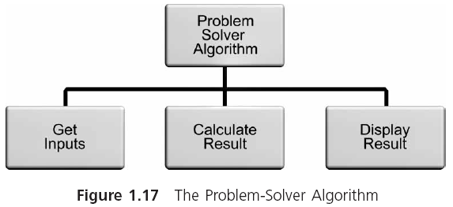
Phase II: Design and Development

Slide 51
Phase II: Design and Development
For larger programs you will have to refine the initial algorithm and organize it into smaller algorithms, with specifications for how these smaller algorithms will interface with each other
First-level structure diagram for an algorithm is the first attempt at a structure for a solution algorithm
Top-down algorithm development starts at the topmost level and proceeds to develop more and more detailed algorithms as it proceeds to the final set of algorithms

Slide 52
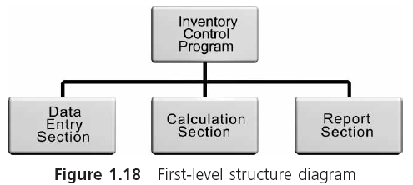
Phase II: Design and Development

Slide 53
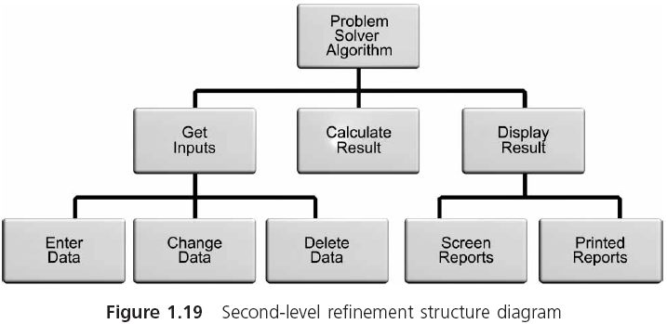
Phase II: Design and Development

Slide 54
Phase II: Design and Development
Step 3: Write the program (or code the algorithm)
Sequence structure defines the order in which instructions are executed by the program
Selection structure provides the capability to make a choice between different instructions, depending on the result of some condition
Repetition structure, also called looping or iteration, provides the ability for the same operation to be repeated based on the value of a condition
Invocation structure involves invoking specific sections of code as they are needed

Slide 55
Phase II: Design and Development
Step 4: Test and correct the program
A program error is called a bug
Testing attempts to ensure that a program works correctly and produces meaningful results
If you find an error, initiate debugging: locating, correcting, and verifying the correction
Develop a set of test data that determines whether the program gives correct answers
The tests should examine every possible situation under which a program will be used

Slide 56
Phase III: Documentation
Six documents for every problem solution:
The requirements statement
A description of the algorithms that were coded
Comments within the code itself
A description of modification and changes made over time
Sample test runs, which include the inputs used for each run and the output obtained from the run
A user’s manual, which is a detailed explanation of how to use the program

Slide 57
Phase IV: Maintenance
How easily a program can be maintained (corrected, modified, or enhanced) is related to the ease with which the program can be read and understood

Slide 58
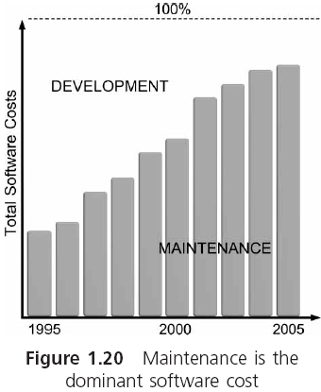
Phase IV: Maintenance (continued)

Slide 59
Backup
Making and keeping backup copies of your work when writing a program is critical
Not part of the formal software development process
Backup is unimportant if you don’t mind starting all over again
Many organizations keep at least one backup on site where it can be easily retrieved, and another backup copy either in a fireproof safe or at a remote location

Slide 60
Case Study: Design and Development
The circumference, C, of a circle is given by the formula C = 2π r, where π is the constant 3.1416, and r is the radius of the circle. Using this information, write a C program to calculate the circumference of a circle that has a 2-inch radius.
Step 1: Analyze the problem
Determine the desired outputs
Determine the input items
List the formulas relating the inputs to the outputs
Perform a hand calculation

Slide 61
Case Study: Design and Development
Step 2: Select an overall solution algorithm
Set the radius value to 2
Calculate the circumference, C, using the formula C = 2 π r
Display the calculated value for C
Step 3: Write the program (see next slide)
Step 4: Test and correct the program
The circumference of the circle is 12.566400
Because only one calculation is performed by the program, testing Program 1.1 really means verifying that the single output is correct

Slide 62
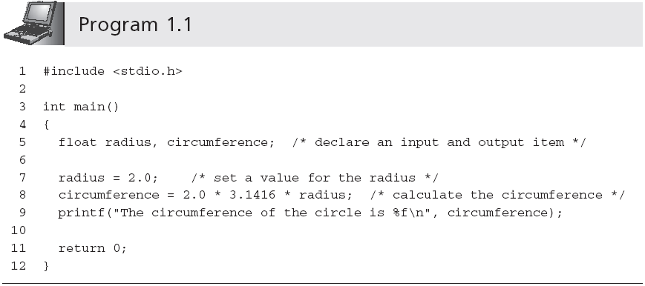
Case Study: Design and Development

Slide 63
Common Programming Errors
Rushing to write and execute a program without spending sufficient time learning about the problem or designing an appropriate algorithm
Forgetting to back up a program
Not understanding that computers respond only to explicitly defined algorithms

Slide 64
Summary
The first attempt at creating a self-operating computational machine was by Charles Babbage in 1822
The physical components used in constructing a computer are called hardware
The programs used to operate a computer are referred to as software
Programming languages come in a variety of forms and types
Compiler and interpreter languages are referred to as high-level languages

Slide 65
Summary (continued)
Algorithm: step-by-step sequence of instructions that must terminate and describes how to perform an operation to produce a desired output
The software development procedure consists of the following four phases:
Specification of the program’s requirements
Design and development
Documentation
Maintenance

Slide 66
Summary (continued)
Steps of the design and development phase are:
Analyze the problem
Select an overall solution algorithm
Write the program
Test and correct the program
Writing a program consists of translating the solution algorithm into a computer language
Fundamental programming control structures
Sequence, selection, iteration and invocation
You always need at least one backup of a program

