Slide 1
A First Book of ANSI C Fourth Edition
Chapter 2
Getting Started in C Programming

Slide 2
Objectives
Introduction to C Programming
Programming Style
Data Types
Arithmetic Operations

Slide 3
Objectives (continued)
Variables and Declarations
Case Study: Temperature Conversion
Common Programming and Compiler Errors

Slide 4
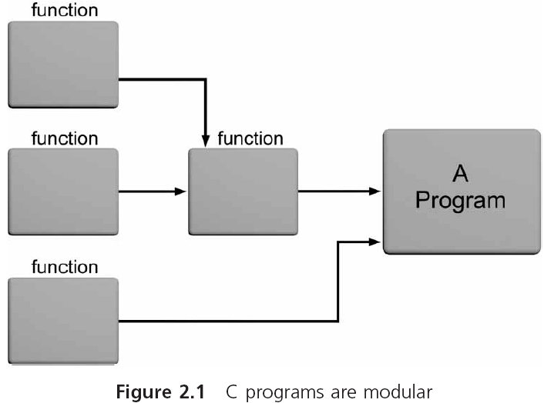
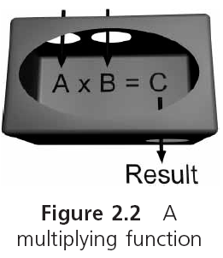
Introduction to C Programming
Notes:
图 2.2 外界与这个函数的接口是它接收的输入以及产生的输出。输入转换为输出的过程，被封装和隐藏在函数内部。

Slide 5
Introduction to C Programming (continued)
C provides a comprehensive set of functions
Stored in a set of files known as the standard library
The standard library consists of 15 header files (P488 Appendix C )
Notes:
Assert.h 断言库函数 assert宏用于为程序增加诊断功能
float.h
数学函数 math.h stdarg.h stdlib.h （动态存储分配函数）
ctype.h字符函数原型在ctype.h中
limits.h setjmp.h string.h (字符串函数) signal.h stdio.h（输入输出函数） time.h

Slide 6
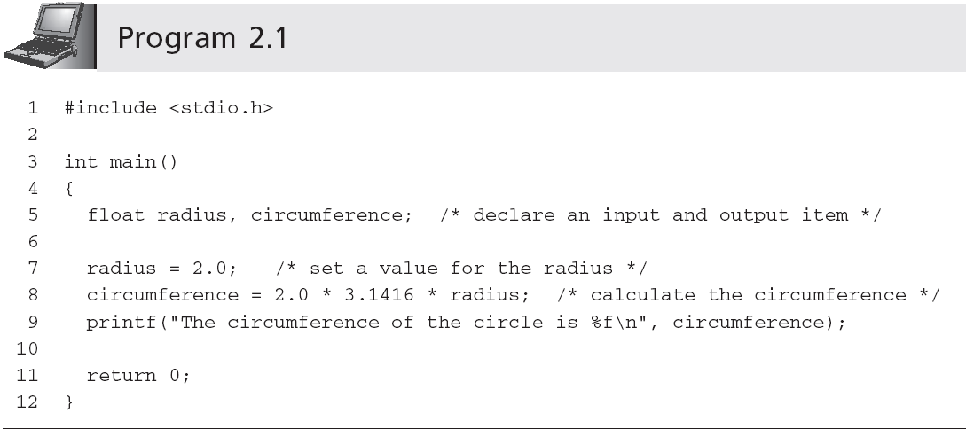
Introduction to C Programming (continued)
Identifiers

Slide 7
Identifiers
Identifiers in C consist of three types:
Reserved words
Standard identifiers
Programmer-created identifiers

Slide 8
Identifiers (continued)
Reserved word: word that is predefined by the programming language for a special purpose and can only be used in a specified manner for its intended purpose
Also referred to as keywords in C

Slide 9
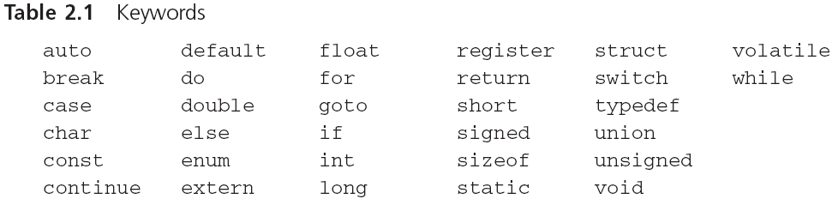
Identifiers (continued)

Slide 10
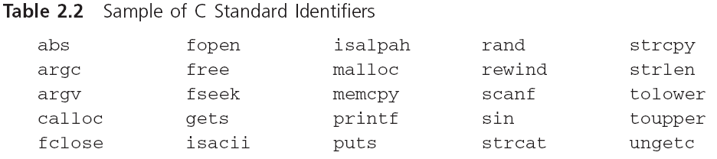
Identifiers (continued)
Standard identifiers: words predefined in C
Most of the standard identifiers are the names of functions that are provided in the C standard library
It is good programming practice to use standard identifiers only for their intended purpose

Slide 11
Identifiers (continued)
Programmer-created identifiers: selected by the programmer，Also called programmer-created names
Used for naming data and functions
Must conform to C’s identifier rules
Can be any combination of letters, digits, or underscores ( _ ) subject to the following rules:

Slide 12
Identifiers (continued)
Can be any combination of letters, digits, or underscores ( _ ) subject to the following rules:
First character must be a letter or underscore (_)
Only letters, digits, or underscores may follow the initial character
Blank spaces are not allowed
Cannot be a reserved word

Slide 13
Examples of invalid C programmer-created names:
4ab7
calculate total
while
All uppercase letters used to indicate a constant
A function name must be followed by parentheses
An identifier should be descriptive: degToRadians()
Bad identifier choices: easy, duh, justDoIt
C is a case-sensitive language
TOTAL, and total represent different identifiers
Notes:
Parentheses[pəˈrenθəsi:z]

Slide 14
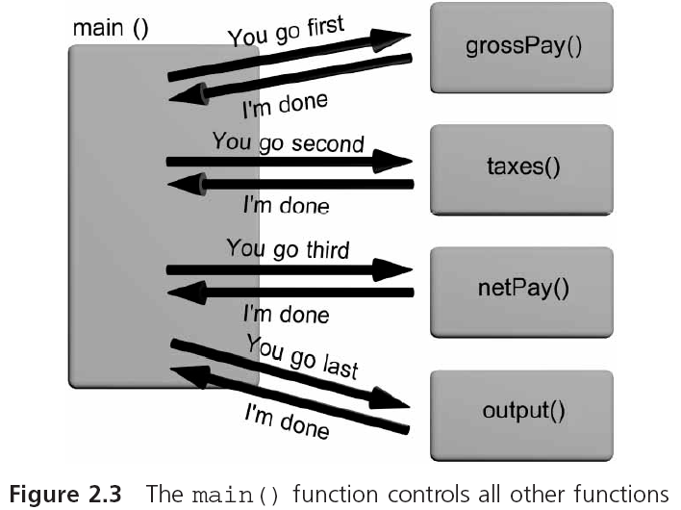
The main() Function
Sometimes main() referred to as a driver function
Notes:
Main（）函数提供函数以及每一条语句的有序定位和执行。它会通知其他函数将要操作的顺序。
每个函数总是返回到开始执行它的函数。Main函数也是这样，它把控制返回给有效地开始main()函数的操作系统。

Slide 15
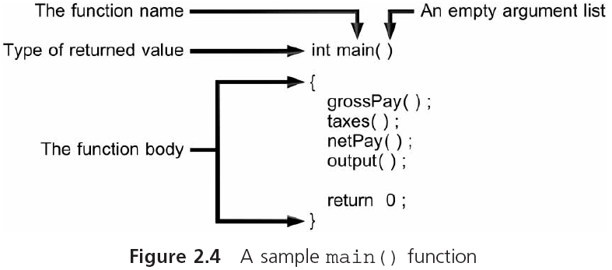
The main() Function (continued)
Function header line
Executable statements

Slide 16
The printf() Function
printf() formats data and sends it to the standard system display device (i.e., the monitor)
Inputting data or messages to a function is called passing data to the function
printf("Hello there world!");
Syntax: set of rules for formulating statements that are “grammatically correct” for the language
Messages are known as strings in C
A string of characters is surrounded by double quotes
printf("Hello there world!");
Notes:
C语言一个非常有用的函数printf（），正如其名字一样，用来打印格式化数据到系统显示设备上，也就是显示器的屏幕上。
Syntax【sintex】语法： quote【kwot】
printf()格式的数据并将其发送给显示设备(即标准系统。监控器)
输入数据或消息传递数据到一个函数里称为passing data to the function传递数据到函数
printf("Hello there world! ");
语法: 设定规则用来表达语句 也是“语法修正”的语言
消息被称为字符串
一串字符是双引号包围
printf("你好世界! ");

Slide 17
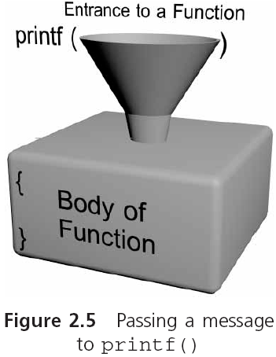
The printf() Function (continued)
Function arguments

Slide 18
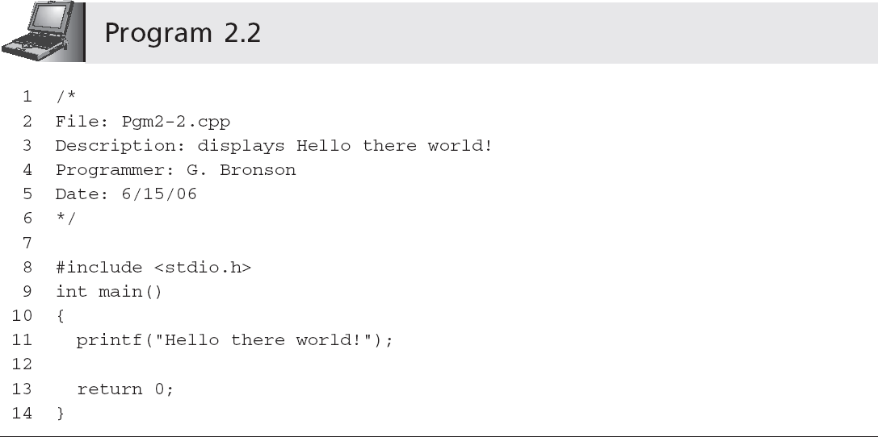
The printf() Function
Comment
Preprocessor command
Header file
Invoking or calling the printf() function
Notes:
开始于#，include，文件包含处理是指在一个源文件中，通过include命令将另一个源文件的内容全部包含在此文件中。在源文件编译时，连同被包含进来的文件一同编译，生成目标目标文件。 #include <stdio.h>没有用分号；结束。

Slide 19
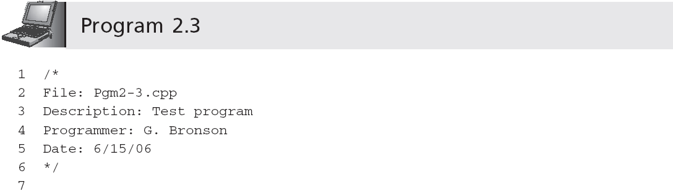
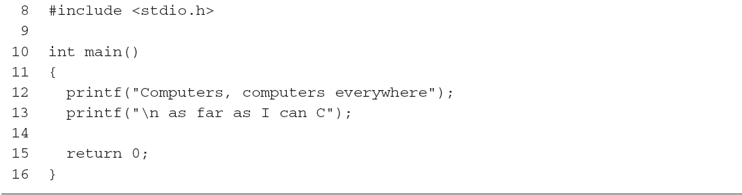
The printf() Function
Output is:
Computers, computers everywhere
as far as I can C
Newline escape sequence
Notes:
escape [ɪˈskeɪp] \n组合在一起代表的是下一行。必须放在printf函数的message的字符串里

Slide 20
Programming Style: Indentation
Except for strings, function names, and reserved words, C ignores all white space
White space: any combination of one or more blank spaces, tabs, or new lines
In standard form:
A function name is placed, with the parentheses, on a line by itself starting at the left-hand corner
The opening brace follows on the next line, under the first letter of the function name
The closing function brace is placed by itself at the start of the last line of the function
Notes:
可以把多条语句放在一行上，也可以一条语句跨越多行。

Slide 21
Programming Style: Indentation
Within the function itself, all program statements are indented two spaces
Indentation is another sign of good programming practice, especially if the same indentation is used for similar groups of statements
Don’t do this:
int
main
(
){printf
("Hello there world!"
);return 0;}

Slide 22
Programming Style: Comments
Comments help clarify what a program does, what a group of statements is meant to accomplish, etc.
The symbols /*, with no white space between them, designate the start of a comment; the symbols */ designate the end of a comment
/* this is a comment */
Comments can be placed anywhere within a program and have no effect on program execution
Under no circumstances may comments be nested
/* this comment is /* always */ invalid */
Notes:
clarify英 [ˈklærəfaɪ] 克拉若fai / 用英文表示slash *是asterisk 英 [ˈæstərɪsk] #是number sign designate [ˈdezɪgneɪt] 指明 dai, zi, ge nait
execution英 [ˌeksɪˈkju:ʃn]
Nested 嵌套

Slide 23
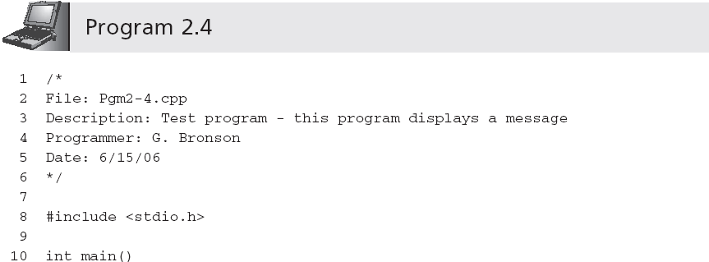
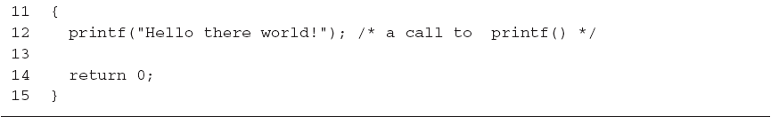
Programming Style: Comments

Slide 24
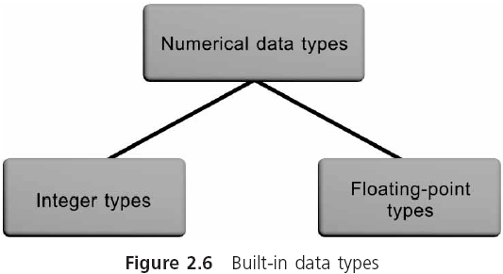
Data Types
Data type: a set of values and a set of operations that can be applied to these values
Built-in data type: is provided as an integral part of the language; also known as primitive type
Notes:
1、允许的数据的类型和为每种类型定义的适当的的运算。一组值和能够应用于这些值的一些操作，被定义为数据类型
内置数据类型，集成在编程语言里一起提供的数据类型。也称为基本类型

Slide 25
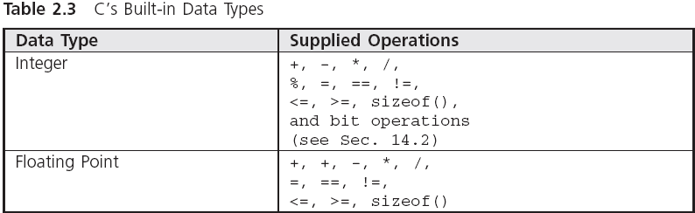
Data Types (continued)

Slide 26
Data Types (continued)
A literal is an acceptable value for a data type
Also called a literal value or constant
2, 3.6, −8.2, and "Hello World!" are literal values because they literally display their values
Notes:
Literal 文字是一种可接受的值的数据类型 literally 逐字地

Slide 27
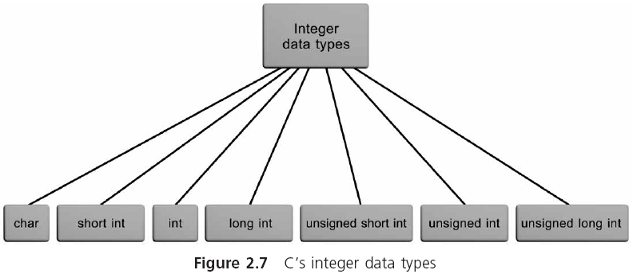
Integer Data Types

Slide 28
Integer Data Types (continued)
int: whole numbers (integers)
For example: 0, -10, 253, -26351
Not allowed: commas, decimal points, special symbols
char: stores individual characters (ASCII)
For example: 'A', '$', 'b', '!'
Notes:
整数可以有负号，但是不允许有逗号，小数点或专用符号。
comma英 [ˈkɒmə],
Commas ，decimal points, special symbols逗号、小数点、特殊符号

Slide 29
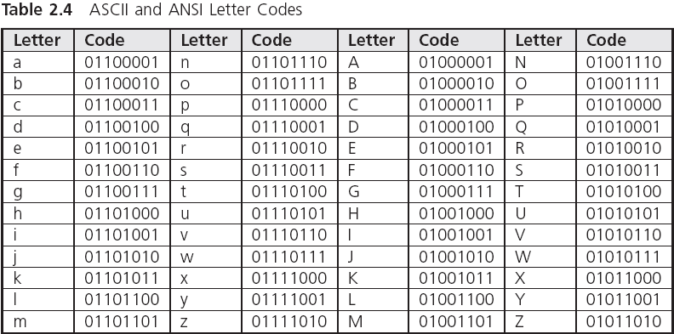
Integer Data Types (continued)
97
98
99
100
101
：
：
：
：
65
66
67
68
69
：
：
：
：
Notes:
ASCII :读音，Ass kee，American Standard Code for Information Interchange 美国标准信息交换码。
数字的ASCII码<大写字母<小写字母

Slide 30

字符型数据
1.字符与字符代码
大多数系统采用ASCII字符集
字母：A ~Z，a ~z
数字：0～9
专门符号：29个：! ” # & ‘ ( ) *等
空格符：空格、水平制表符、换行等
不能显示的字符：空(null)字符(以‘\0’表示)、警告(以‘\a’表示)、退格(以‘\b’表示)、回车(以‘\r’表示)等

Slide 31
字符型数据
字符’1’和整数1是不同的概念：
字符’1’只是代表一个形状为’1’的符号，在需要时按原样输出，在内存中以ASCII码形式存储，占1个字节
整数1是以整数存储方式(二进制补码方式)存储的，占2个或4个字节
0 0 1 1 0 0 0 1
0 0 0 0 0 0 0 0 | 0 0 0 0 0 0 0 1

Slide 32
字符型数据
2.字符变量
用类型符char定义字符变量
char c = ’?’;
系统把“?”的ASCII代码63赋给变量c
printf(”%d %c\n”,c,c);
输出结果是：
63 ?

Slide 33
给定一个大写字母，要求用小写字母输出。
解题思路：
关键是找到大、小写字母间的内在联系
同一个字母，用小写表示的字符的ASCII代码比用大写表示的字符的ASCII代码大32

Slide 34

#include <stdio.h>
int main ( )
{
char c1,c2;
c1=’A’;
c2=c1+32;
printf("%c\n",c2);
printf(”%d\n”,c2);
return 0;
}
将字符‘A’的ASCII代码65放到c1中
将65+32的结果放到c2中
用字符形式输出
用十进制形式输出

Slide 35
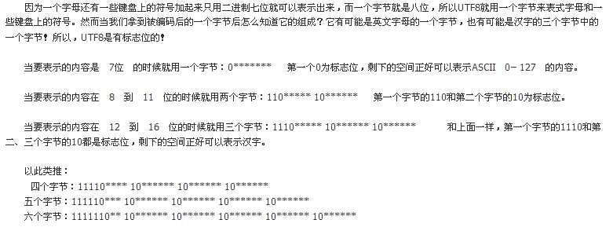
Integer Data Types (continued)
Notes:
ASCII :读音，Ass kee，American Standard Code for Information Interchange 美国标准信息交换码。
数字的ASCII码<大写字母<小写字母

Slide 36
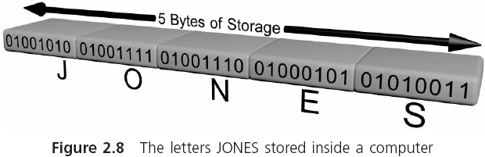
Integer Data Types (continued)

Slide 37
Escape sequence
Escape character ： The backslash character \ ，has a special meaning.
when the backslash is placed directly in front of a select group of characters , it tells the compiler to escape from the way these characters would normally be interpreted.
Escape sequence: The combination of a backslash and these specific characters is called an escape sequence.
Notes:
Escape使规避问题的

Slide 38
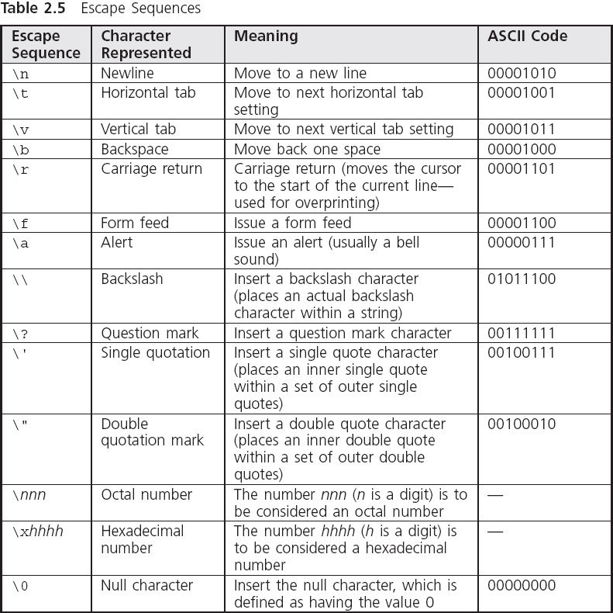
Integer Data Types (continued)
Notes:
很简单，只要在格式控制符里输入2个 %% 就可以了，例如：
#include <stdio.h>
int main()
{
int a=90;
printf("%d%%\n",a);
return 0;
}
这样就会在屏幕上得到 90%

Slide 39
Floating-Point Data Types
A floating-point value (real number) can be the number zero or any positive or negative number that contains a decimal point
For example: +10.625, 5., -6.2, 3251.92
Not allowed: commas, special symbols
float: single-precision number
double: double-precision number
Storage allocation for each data type depends on the compiler (use sizeof())
Notes:
Presicion 精度 [prɪ'sɪʒn]
单精度实数在内存中占32bit 有效数字为6~7位 双精度实数占内存单元为64bit 有效数字为15~16位

Slide 40
Floating-Point Data Types (continued)
float literal is indicated by appending an f or F
long double is created by appending an l or L
9.234 indicates a double literal
9.234f indicates a float literal
9.234L indicates a long double literal
Notes:
大写字母Captial letter 小写字母lower-case letter或者small letter

Slide 41

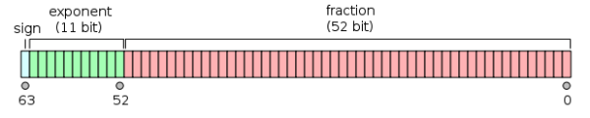
Exponential Notation
In numerical theory, the term precision typically refers to numerical accuracy
float
double
Notes:
numerical英 [nju:ˈmerɪkl] 数字的，数值的 accuracy英 [ˈækjərəsi] 艾克瑞sei
浮点数在计算机是按照指数形式存储的。系统把一个浮点型数据分成小数部分和指数部分。分别存放。小数部分占的位越多，数的有效数字愈多，精度也就越高。
指数部分占的位愈多，则表示的数值范围越大。
单精度（float）在计算机中存储占用4字节，32位，有效位数为7位（6位小数+小数点）。 双精度（double）在计算机中存储占用8字节，64位，有效位数为16位（15位小数+小数点）。
double 尾数部分52位，最小为2的-52次方，约为2.22乘以10的-16次方，所以精确到小数点后15位，有效位数为16位。
从运行结果可以看出，单精度浮点数小数部分只有前6位是准确的，后三位是不准确的。双精度小数部分9位都是准确的。

Slide 42
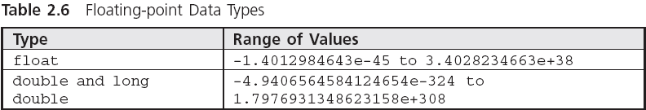
Floating-Point Data Types (continued)
Notes:
精度主要取决于尾数部分的位数，float为23位，最小为2的-23次方，约等于1.19乘以10的-7次方，所以float小数部分只能精确到后面6位，加上小数点算做一位，即有效数字为7位。

Slide 43
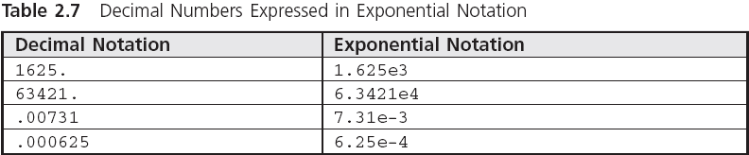
Exponential Notation (continued)
Notes:
7.31e-3 ， e就是10n次方

Slide 44
Arithmetic Operations
Arithmetic operators: operators used for arithmetic operations:
Addition +
Subtraction -
Multiplication *
Division /
Modulus Division %
Binary operators require two operands
An operand can be either a literal value or an identifier that has a value associated with it

Slide 45
Arithmetic Operations (continued)
A simple binary arithmetic expression consists of a binary arithmetic operator connecting two literal values in the form:
literalValue operator literalValue
3 + 7
12.62 - 9.8
.08 * 12.2
12.6 / 2.
Spaces around arithmetic operators are inserted for clarity and can be omitted without affecting the value of the expression

Slide 46
Displaying Numerical Values
Arguments are separated with commas
printf("The total of 6 and 15 is %d", 6 + 15);
First argument of printf() must be a string
A string that includes a conversion control sequence, such as %d, is termed a control string
Conversion control sequences are also called conversion specifications and format specifiers
printf() replaces a format specifier in its control string with the value of the next argument
In this case, 21
Notes:
% percent signs

Slide 47
用printf函数输出数据
1.printf函数的一般格式
printf（格式控制，输出表列）
例如：
printf(”i=%d,c=%c\n”,i,c);
格式声明

Slide 48
用printf函数输出数据
1.printf函数的一般格式
printf（格式控制，输出表列）
例如：
printf(”i=%d,c=%c\n”,i,c);
普通字符

Slide 49
3.4.3 用printf函数输出数据
1.printf函数的一般格式
printf（格式控制，输出表列）
例如：
printf(”i=%d,c=%c\n”,i,c);
可以是常量、变量或表达式

Slide 50
用printf函数输出数据
2. 常用格式字符
ｄ格式符。用来输出一个有符号的十进制整数
可以在格式声明中指定输出数据的域宽
printf(”%5d%5d\n”,12,-345);
%d输出int型数据
%ld输出long型数据

Slide 51
用printf函数输出数据
2. 常用格式字符
ｃ格式符。用来输出一个字符
char ch=’a’;
printf(”%c”,ch); 或
printf(”%5c”,ch);
输出字符：a

Slide 52
用printf函数输出数据
2. 常用格式字符
ｓ格式符。用来输出一个字符串
printf（”%s”,”CHINA”）; 
输出字符串：CHINA

Slide 53
用printf函数输出数据
2. 常用格式字符
f格式符。用来输出实数，以小数形式输出
①不指定数据宽度和小数位数，用%f
例3.6 用%f输出实数，只能得到６位小数。
double a=1.0;
printf(”%f\n”,a/3);

Slide 54
用printf函数输出数据
2. 常用格式字符
f格式符。用来输出实数，以小数形式输出
② 指定数据宽度和小数位数。用%m.nf
printf("%20.15f\n",1/3);
printf("%.0f\n”,10000/3.0);

Slide 55
用printf函数输出数据
2. 常用格式字符
f格式符。用来输出实数，以小数形式输出
② 指定数据宽度和小数位数。用%m.nf
float a;
a=10000/3.0;
printf("%f\n",a);

Slide 56
用printf函数输出数据
2. 常用格式字符
f格式符。用来输出实数，以小数形式输出
③ 输出的数据向左对齐，用%-m.nf

Slide 57
用printf函数输出数据
2. 常用格式字符
f格式符。用来输出实数，以小数形式输出
float型数据只能保证6位有效数字
double型数据能保证15位有效数字
计算机输出的数字不都是绝对精确有效的

Slide 58
用printf函数输出数据
2. 常用格式字符
e格式符。指定以指数形式输出实数
%e，VC++给出小数位数为６位
指数部分占5列
小数点前必须有而且只有1位非零数字
printf(”%e”,123.456);
输出：1.234560 e+002

Slide 59
3.4.3 用printf函数输出数据
2. 常用格式字符
e格式符。指定以指数形式输出实数
%m.ne
printf(”%13.2e”,123.456);
输出： 1.23e+002 (前面有4个空格)

Slide 60
Displaying Numerical Values (continued)
printf("The total of 6 and 15 is %d", 6 + 15);
The total of 6 and 15 is
21
printf ("The sum of %f and %f is %f", 12.2, 15.754, 12.2 + 15.754);
12.200000
and
The sum of
15.754000
is
27.954000

Slide 61
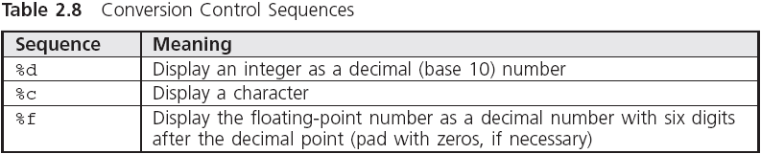
Displaying Numerical Values (continued)

Slide 62
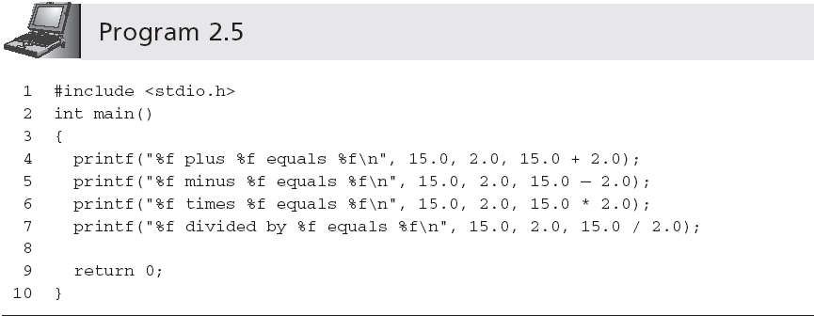
Displaying Numerical Values (continued)
15.000000 plus 2. 000000 equals 17. 000000
15.000000 minus 2. 000000 equals 13. 000000
15.000000 times 2. 000000 equals 30. 000000
15.000000 divided 2. 000000 equals 7. 500000

Slide 63
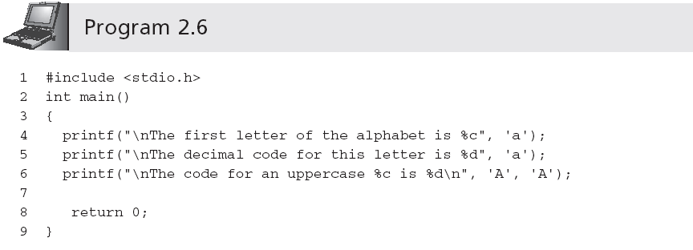
Displaying Numerical Values (continued)
The first letter of the alphabet is a
The decimal code for this letter is 97
The code for an uppercase A is 65

Slide 64
Displaying Numerical Values (continued)

Slide 65
Displaying Numerical Values (continued)

Slide 66
Expression Types
Expression: any combination of operators and operands that can be evaluated to yield a value
Integer expression: contains only integer operands; the result is an integer
Floating-point expression: contains only floating-point operands; the result is a double-precision
In a mixed-mode expression the data type of each operation is determined by the following rules:
If both operands are integers, result is an integer
If one operand is real, result is double-precision
Notes:
evaluate英 [ɪˈvæljueɪt] operand 操作数

Slide 67
Integer Division
15/2 = 7
Integers cannot contain a fractional part
Remainder is truncated
% is the modulus or remainder operator
9 % 4 is 1
17 % 3 is 2
14 % 2 is 0

Slide 68
Negation
A unary operator is one that operates on a single operand, e.g., negation (-)
The minus sign in front of a single numerical value negates (reverses the sign of) the number
Notes:
e.g. for example minus sign英 [ˈmainəs sain]

Slide 69
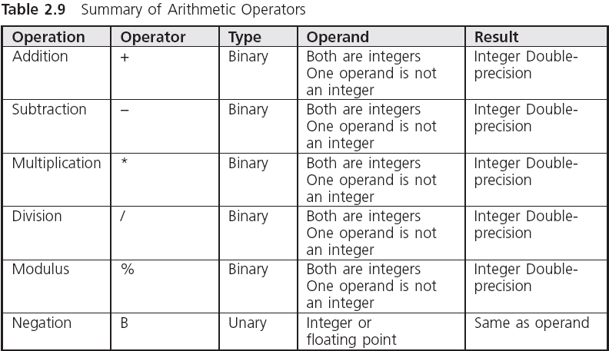
Negation (continued)

Slide 70
Operator Precedence and Associativity
Two binary arithmetic operator symbols must never be placed side by side
5 * % 6 is invalid
Parentheses may be used to form groupings
Expressions in parentheses are evaluated first
( 6 + 4 ) / ( 2 + 3 ) = 2
Notes:
precedence英 [ˈpresɪdəns]
parentheses英 [pəˈrenθəsi:z] p 额 ren 色 戏子

Slide 71
Parentheses may be enclosed by other parentheses
（2*（3+7））/5 = 4
Parentheses cannot be used to indicate multiplication，rather，the multiplication operator， * , must be used.
(3+4)(5+1) is invalid，
The correct expression is (3+4) * (5+1)

Slide 72
Operator Precedence and Associativity
Three levels of precedence:
All negations are done first
Multiplication, division, and modulus operations are computed next; expressions containing more than one of these operators are evaluated from left to right as each operator is encountered
Addition and subtraction are computed last; expressions containing more than one addition or subtraction are evaluated from left to right as each operator is encountered

Slide 73
Operator Precedence and Associativity
Example:
8 + 5 * 7 % 2 * 4 =
8 + 35 % 2 * 4 =
8 + 1 * 4 =
8 + 4 = 12

Slide 74
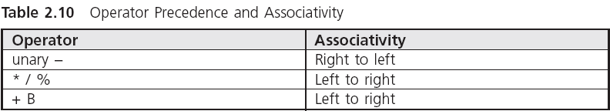
Operator Precedence and Associativity

Slide 75
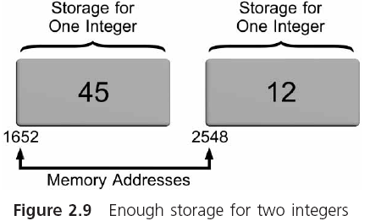
Variables and Declarations
Variables are names given by programmers to computer storage
Variable name usually limited to 255 characters
Variable names are case sensitive
Notes:
每组内存单元中的第一个地址是需要的，因为它提供了存储或取回的起始点。一旦这个起始点已知，则为每种值类型所保留的单元地址就能自动获得。

Slide 76
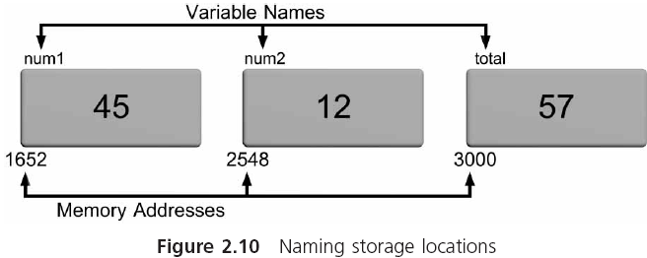
Variables and Declarations
num1 = 45;
num2 = 12;
total = num1 + num2;
Assignment statements
Variable：the value stored in the variable can change.
Notes:
变量的意思：因为存储在变量中的值能够改变或修改。

Slide 77
Declaration Statements
Naming and specifying the data type that can be stored in each variable is accomplished using declaration statements
datatype variableName;
int sum；
float firstNumber；

Slide 78
Declaration Statements
Declaration statements within a function appear immediately after the opening brace of a function
function name()
{
declaration statements;
other statements;
}
Definition statements define or tell the compiler how much memory is needed for data storage

Slide 79
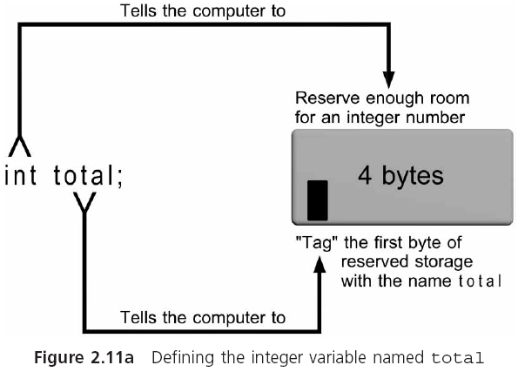
Declaration Statements (continued)

Slide 80
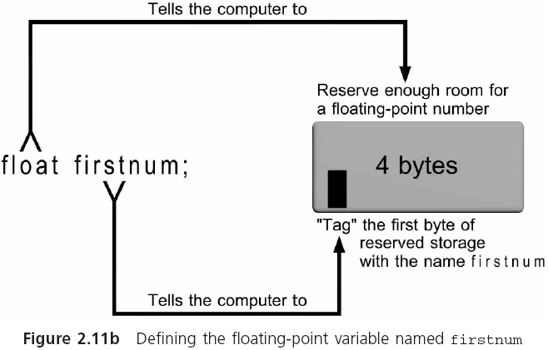
Declaration Statements (continued)

Slide 81
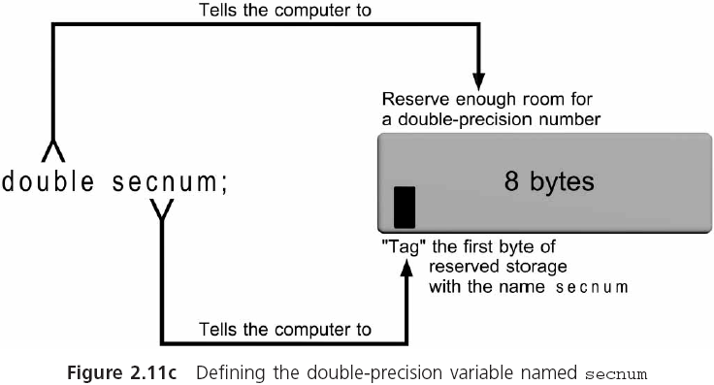
Declaration Statements (continued)

Slide 82
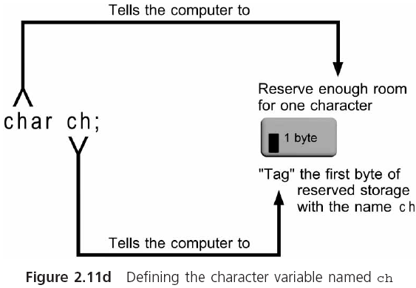
Declaration Statements (continued)

Slide 83
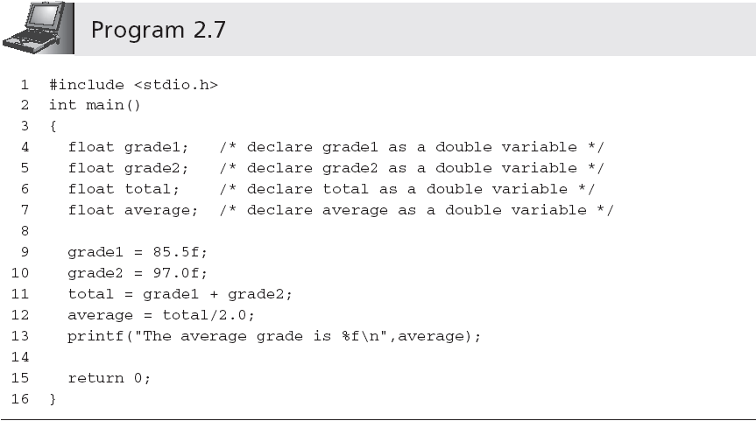
Declaration Statements
You can omit the f and let the compiler convert the double precision value into a float value when the assignment is made
Notes:
系统先把85.5作为双精度数，然后计算，得到的和也是一个双精度数，最后取其前7位赋给浮点型变量。
当变量average作为参数传递到Printf（）函数里，printf函数只是取的是存储在变量里的数值的拷贝。也就是函数调用的时候，遇到参数的变量名，它首先转向这个变量并取得这个变量所保存的值，把这个值传递给函数。Printf显示的是这个值。

Slide 84
Selecting Variable Names
Make variable names descriptive
Limit variable names to approximately 20 characters
Start the variable name with a letter, rather than an underscore (_)
In a variable name consisting of several words, capitalize the first letter of each word after the first
Notes:
approximately英 [əˈprɒksɪmətli]

Slide 85
Selecting Variable Names (continued)
Use variable names that indicate what the variable corresponds to, rather than how it is computed
Add qualifiers, such as Avg, Min, Max, and Sum to complete a variable’s name where appropriate
Use single-letter variable names, such as i, j, and k, for loop indexes
Notes:
Qualifier 限定语

Slide 86
Initialization
Declaration statements can be used to store an initial value into declared variables
int numOne = 15;
When a declaration statement provides an initial value, the variable is said to be initialized
Literals, expressions using only literals such as 87.0 + 12 − 2, and expressions using literals and previously initialized variables can all be used as initializers within a declaration statement

Slide 87
Case Study: Temperature Conversion
A friend of yours is going to Spain, where temperatures are reported using the Celsius temperature scale.
She has asked you to provide her with a list of temperatures in degrees Fahrenheit, and the equivalent temperature in degrees Celsius.
The formula relating the two temperatures is
Celsius = 5/9(Fahrenheit − 32).
Initially, you are to write and test a program that correctly converts the Fahrenheit temperature of 75 degrees into its Celsius equivalent.
Notes:
Celsius英 [ˈselsiəs] sale s yi a s

Slide 88
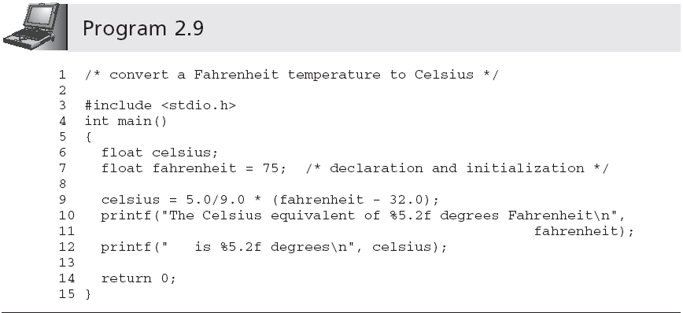
Case Study: Temperature Conversion (continued)

Slide 89
Common Programming Errors
Omitting the parentheses, (), after main
Omitting or incorrectly typing the opening brace, {, that signifies the start of a function body
Omitting or incorrectly typing the closing brace, }, that signifies the end of a function
Misspelling the name of a function; for example, typing print() instead of printf()
Forgetting to close a string passed to printf() with a double quote symbol
Notes:
parentheses英 [pəˈrenθəsi:z] signify[ˈsɪgnɪfaɪ]

Slide 90
Common Programming Errors (continued)
Omitting the semicolon( ；) at the end of each executable statement
Forgetting to include \n to indicate a new line
Forgetting to declare all the variables used in a program
Storing an incorrect data type in a declared variable
Notes:
semicolon英 [ˌsemiˈkəʊlən] 美 [ˈsemikoʊlən] n.分号

Slide 91
Common Programming Errors
Using a variable in an expression before a value has been assigned to the variable
Dividing integer values incorrectly
3.425+2/3 + 7.9； 2/3=0
Mixing data types in the same expression without clearly understanding the effect produced
Not including the correct conversion control sequence in printf() function calls for the data types of the remaining arguments

Slide 92
Common Programming Errors
Not closing the control string in printf() with a double quote symbol followed by a comma when additional arguments are passed to printf()
Forgetting to separate all arguments passed to printf() with commas

Slide 93
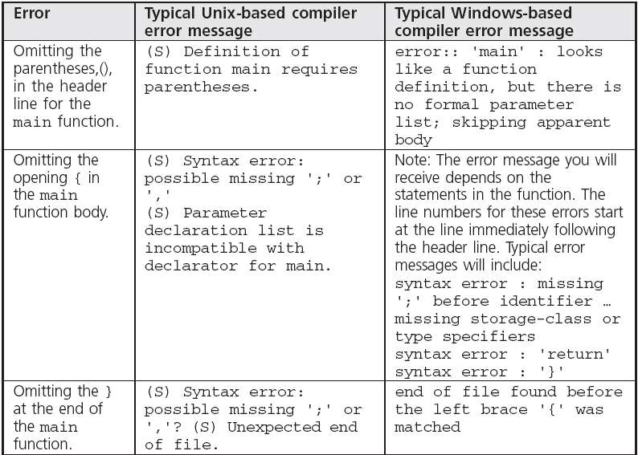
Common Compiler Errors

Slide 94
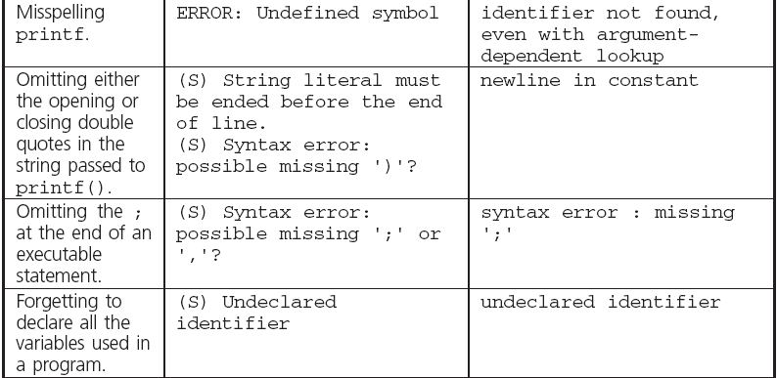
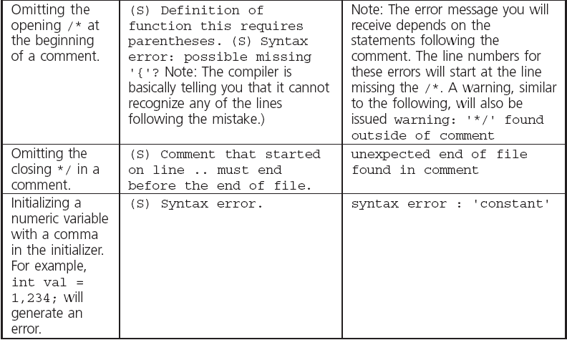
Common Compiler Errors (continued)

Slide 95
Summary
A C program consists of one or more functions
A function is a C language description of an algorithm
Many functions are supplied in a standard library of functions provided with each C compiler
Simple C programs consist of the single function named main()
An executable statement causes some specific action to be performed when the program is executed

Slide 96
Summary (continued)
All executable C statements must be terminated by a semicolon
The printf() function displays text or numerical results
The two basic numerical data types used almost exclusively in current C programs are integers and double-precision numbers
An expression is a sequence of one or more operands separated by operators

Slide 97
Summary (continued)
Expressions are evaluated according to the precedence and associativity of the operators used
printf() can display all of C’s data types
Every variable in a C program must be
Declared with a data type
Used after it is declared
Declaration statements inform the compiler of a function’s valid variable names

