Slide 1
A First Book of ANSI C Fourth Edition
Chapter 5
Repetition

Slide 2
Objectives
Basic Loop Structures
The while Statement
Computing Sums and Averages Using a while Loop
The for Statement

Slide 3
Objectives (continued)
Case Studies: Loop Programming Techniques
Nested Loops
The do-while Statement
Common Programming and Compiler Errors
Notes:
Nested 嵌套

Slide 4
Introduction
A section of code that is repeated is called a loop, because after the last statement in the code is executed, the program branches, or loops, back to the first statement and starts another repetition through the code
Each repetition is also called an iteration or pass through the loop
Notes:
一段重复的代码被称为循环，因为在执行代码中的最后一条语句,程序分支,或循环,回到第一个语句并开始另一个重复的代码
每个重复也被称为迭代或通过循环
Iteration 【,ɪtə‘reʃən 】迭代

Slide 5
Basic Loop Structures
Constructing a repeating section of code requires that four elements be present:
Repetition statement
while statement
for statement
do-while statement
Condition
A statement that initially sets the condition being tested
A statement within the repeating section of code that alters the condition so that it eventually becomes false
Notes:
——一个声明说明最初设置的测试条件
在重复部分的代码种一个声明可以改变条件，使这个条件最终变成了假的

Slide 6
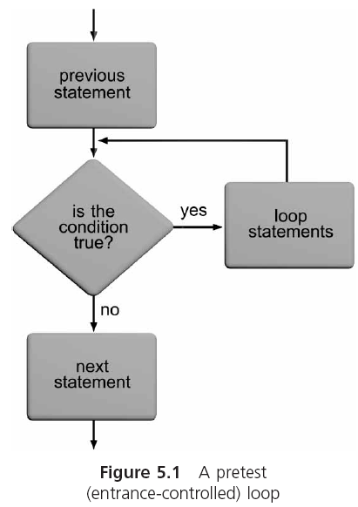
Pretest and Posttest Loops

Slide 7
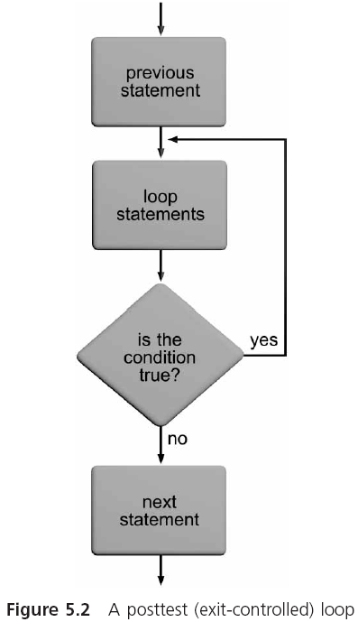
Pretest and Posttest Loops (continued)

Slide 8
Counter-Controlled and Condition-Controlled Loops
Counter-controlled loop: the condition is used to keep track of the number of repetitions
Also known as a fixed-count loop
Condition-controlled loop: the tested condition does not depend on a count being achieved, but rather on a specific value being encountered
Notes:
Counter-controlled计数控制循环: 条件是用来记录重复的数量
也称为固定计数循环 fixed-count循环
Condition-controlled 条件控制循环： 测试条件并不依赖于一个被取得计数, 而是直到遇到一个特定的值

Slide 9
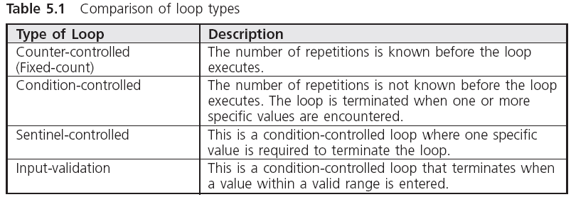
Basic Loop Structures
Notes:
sentinel['sɛntɪnl]守卫，放哨

Slide 10
The while Statement
The general form of the while statement is
while (expression)
statement;
The transfer of control back to the start of a while statement to reevaluate the expression is known as a program loop
The following is a valid but infinite loop:
while (count <= 10)
printf("%d ",count);
Notes:
传送控制回到while语句的开始，重新评估表达式，称为程序循环
下面例子是一个有效的，但是是一个无限循环

Slide 11
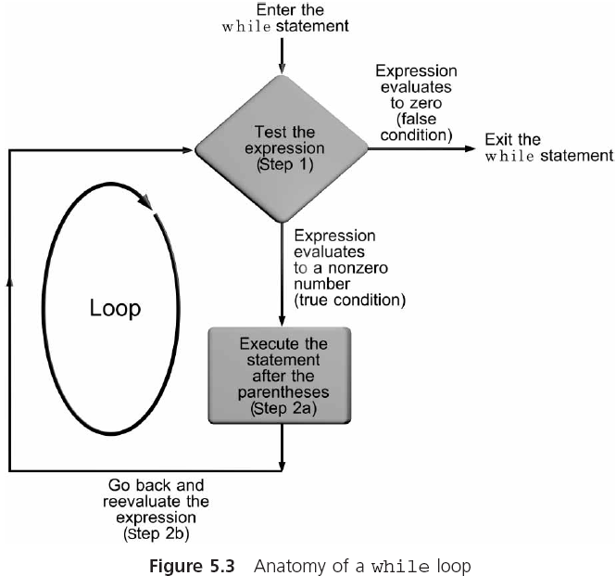
The while Statement (continued)

Slide 12
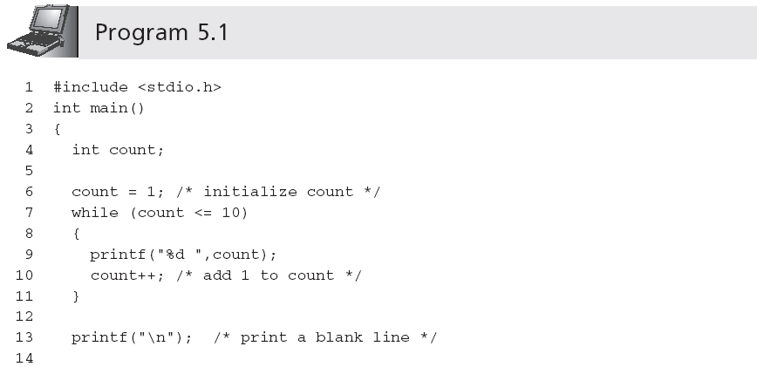
The while Statement
Change the value of count , so that finally exit the while statement
Output is:
1 2 3 4 5 6 7 8 9 10

Slide 13
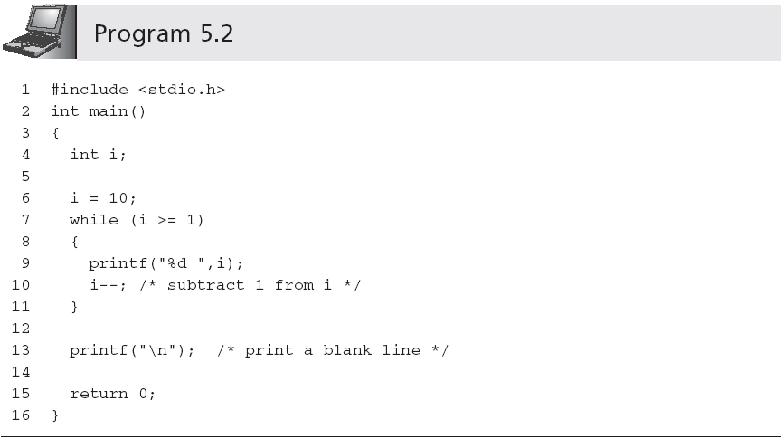
The while Statement
Output is:
10 9 8 7 6 5 4 3 2 1

Slide 14
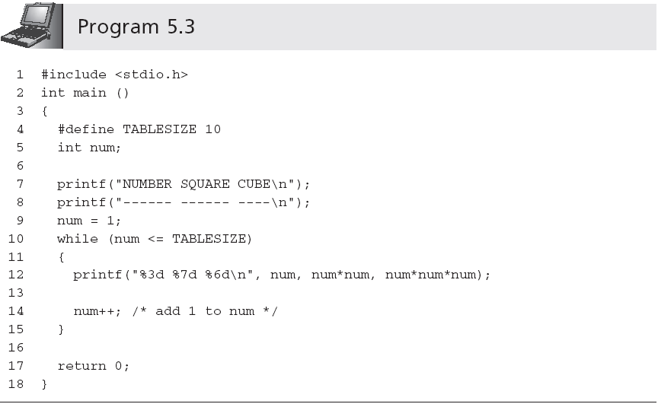
The while Statement
Output is:
NUMBER SQUARE CUBE
------ ------ ----
1 1 1
2 4 8
3 9 27
4 16 64
5 25 125
6 36 216
7 49 343
8 64 512
9 81 729
10 100 1000
The condition can be （num < 11）
Notes:
宏定义其作用域为宏定义命令起到源程序结束。如要终止其作用域可使用#undef命令。 原来以为什么是宏？无非就是定义一个替换的量，

Slide 15
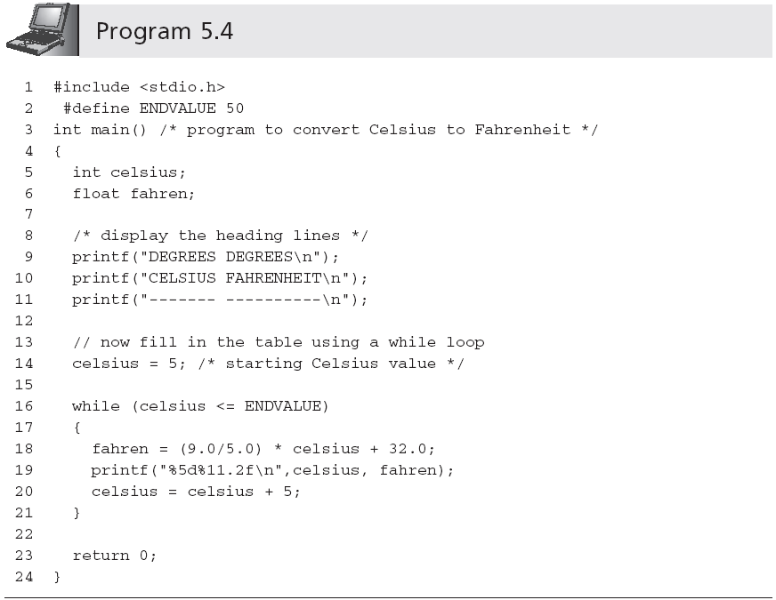
The while Statement
Condition-controlled loop
Output is:
DEGREES DEGREES
CELSIUS FAHRENHEIT
------- ----------
5 41.00
10 50.00
15 59.00
20 68.00
25 77.00
30 86.00
35 95.00
40 104.00
45 113.00
50 122.00

Slide 16
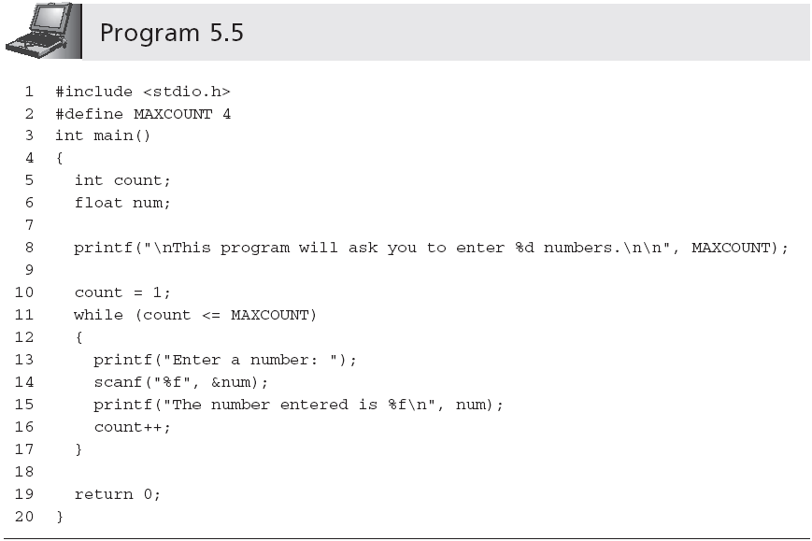
Computing Sums and Averages Using a while Loop

Slide 17
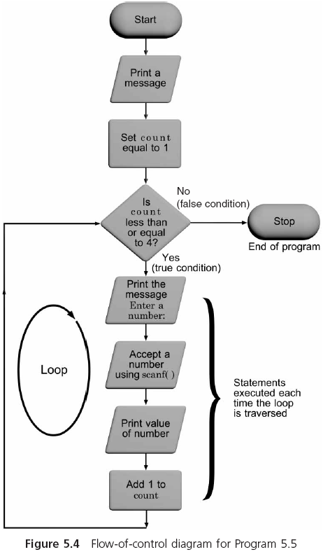
Computing Sums and Averages Using a while Loop

Slide 18
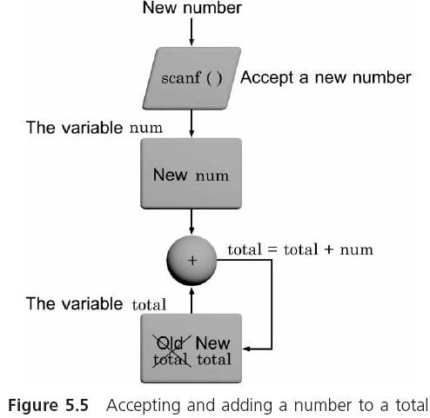
Computing Sums and Averages Using a while Loop

Slide 19
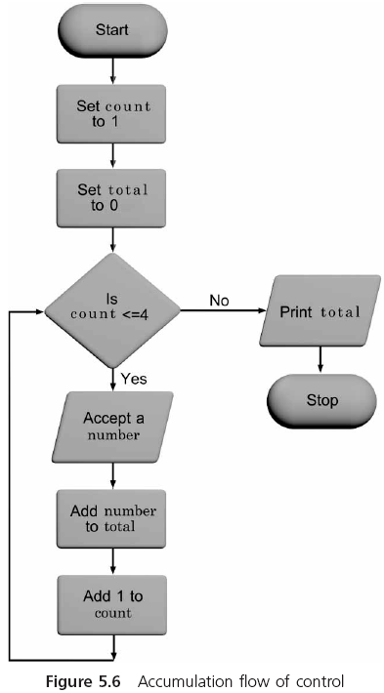
Computing Sums and Averages Using a while Loop

Slide 20
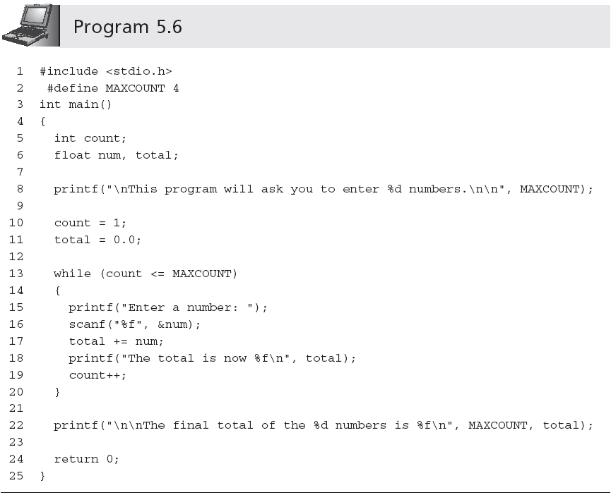
Computing Sums and Averages Using a while Loop
Ensures that any previous value present in the storage locations assigned to the variable total is overwritten and the total starts at a correct value
Accumulating statement
Notes:
Ensures…确保任何先前的值分配给变量中存储位置全覆盖，全是从一个正确的值

Slide 21
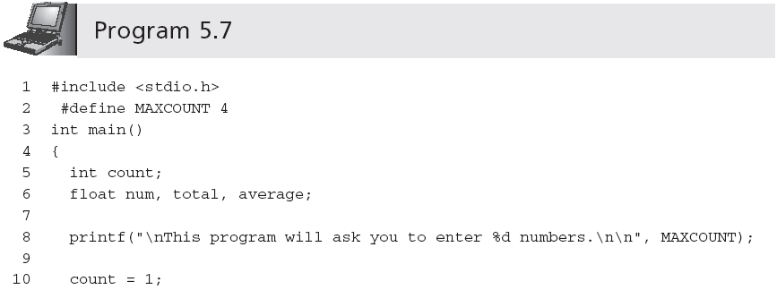
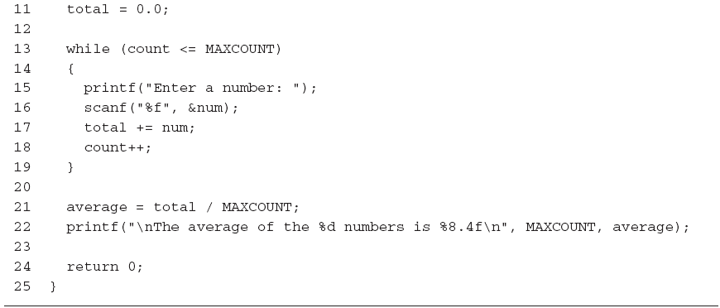
Computing Sums and Averages Using a while Loop
Calculating an average

Slide 22
Sentinels
A program, such as Program 5.7, can be made much more general by removing the restriction that exactly four numbers are to be entered
The user enters a value for how many numbers will be averaged
You can use a sentinel (a data value used to signal either the start or end of a data series)
The sentinel values must be selected so as not to conflict with legitimate data values
Notes:
在很多情况下，程序使用数据集，不希望像程序5.7那样被不停地打断输入数据。这种工作也很繁琐。例如我们输入一个大量的市场调研数据。像这种情况，一般采用第二种方式。这种方式，数据被不断地输入，直到最后，用户输入一个特殊数据值来作为信号结束数据的输入。 legitimate英 [lɪˈdʒɪtɪmət]
Sentinel 哨兵 程序,如5.7程序,可以更一般的限制, 到底是四个数字输入
用户输入的值，用来计算多少个数进行平均
您可以使用一个sentinel(一个用于一个数据系列的开始或结束的信号的数据值)
哨兵值必须选择不能与合法的数据值冲突的值

Slide 23
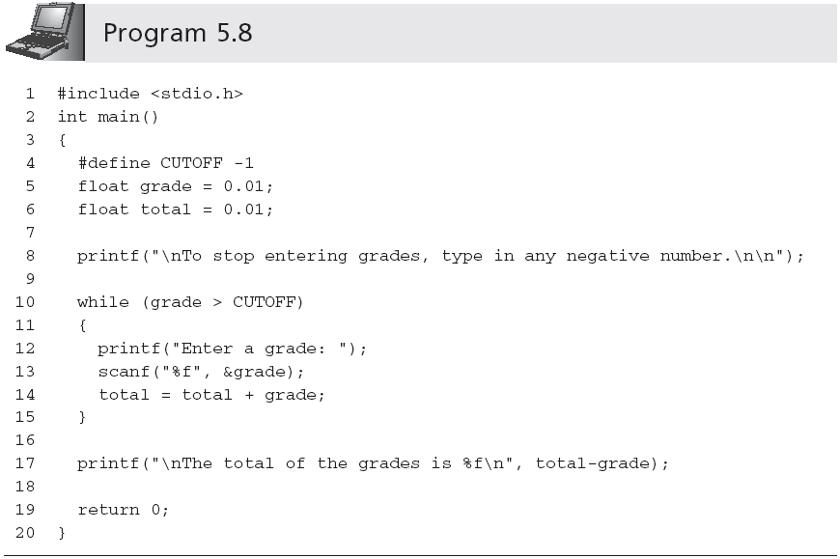
Sentinels (continued)
Enter a grade: 97
Enter a grade: 100
Enter a grade: 82
Enter a grade: -1
The total of the grade is 279.010000
Notes:
例如，我们写一个程序，一个好的sentinel值最好是0。一旦很多小于0的数输入，程序就会停止接受进一步的学分。这个程序会一直输入grade，直到一个负的grade输入，程序就会跳出while循环，计算出整个成绩。这里程序有个小错误，grade和total初始值不能是0.01； #define 定义尽量是local
变量，而不是全局变量。防止某个子程序更改。
之所以最后的语句中total – grade，是因为在while语句块中，scanf 先输入了grade =-1 ，然后total就加上了-1，然后再回到while条件里去判别grade >? -1。而此时grade 为-1，所以跳出while循环。

Slide 24
Sentinels (continued)
One useful sentinel in C is the named constant EOF (End Of File)
The actual value of EOF is compiler-dependent, but it is always assigned a code that is not used by any other character
EOF is defined in stdio.h
Notes:
因为在stdio.h 中EOF被定义为-1

Slide 25
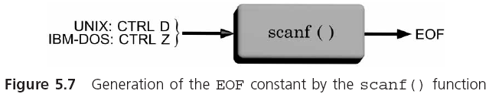
Sentinels (continued)
Notes:
不同的操作系统有自己的EOF代码。UNIX系统，CTRL+D同时输入时，就会产生EOF。而IBM的DOS系统，是ctrl+Z。当C程序探测到输入值是这个组合键后，它会自动转换成它自己系统的EOF code。
实际上EOF的定义是个常量，在stdio.h 编译源文件中，使用#define说明来定义EOF。 这个命名的EOF常量包括在库函数stdio.h文件里.

Slide 26
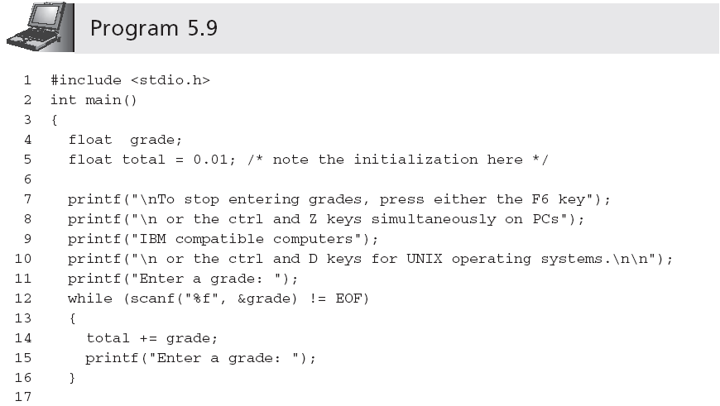
Sentinels (continued)
Notes:
在第一行#include <stdio.h>里声明了EOF常量。所以这个常量可以直接引用。
EOF符号常量是用来控制while循环的。
如果试图读取文件结束标志，使用scanf（）函数返回一个EOF值。从用户的角度来说，假定使用IBM计算机，同时按下ctrl+z，会产生EOF文件标记，被scanf（）转化成EOF常量。
例5.9 比5.8的好处在于the sentinel值没有被加到total变量里，因此它也就不需要随后被减去。这个好处从文件读数据是非常有用的。但是不便的地方就是需要用户输入一个不太熟悉的组合数据。
【scanf 函数返回值】 1.scanf()函数有返回值且为int型。 2.scanf()函数返回的值为：正确按指定格式输入变量的个数；也即能正确接收到值的变量个数。 3.当scanf函数的第一个变量格式不正确时返回值为0，即，当scanf函数的第n个变量格式不正确时，返回值为n-1；4.如果在scanf的时候在终端输入ctrl+d，或者直接输入异常时，scanf的返回值将是-1。
【EOF是什么】 EOF是end of file的缩写，表示"文字流"（stream）的结尾。这里的"文字流"，可以是文件（file），也可以是标准输入（stdin）。很自然地，我就以为，每个文件的结尾处，有一个叫做EOF的特殊字符，读取到这个字符，操作系统就认为文件结束了。但是，后来我发现，EOF不是特殊字符，而是一个定义在头文件stdio.h的常量，一般等于-1。 #define EOF (-1)
在Linux系统之中，EOF根本不是一个字符，而是当系统读取到文件结尾，所返回的一个信号值（也就是-1）。至于系统怎么知道文件的结尾，资料上说是通过比较文件的长度。 所以，处理文件可以写成下面这样： int c; while ((c = fgetc(fp)) != EOF) { do something } 但是，这样写也有问题。fgetc()读取文件的最后一个字符以后，C语言的feof()函数依然返回0，表明没有到达文件结尾；只有当fgetc()向后再读取一个字符（即越过最后一个字符），feof()才会返回一个非零值，表示到达文件结尾。所以，按照上面这样写法，如果一个文件含有n个字符，那么while循环的内部操作会运行n+1次。所以，最保险的写法是像下面这样：
int c = fgetc(fp); while (c != EOF) { do something; c = fgetc(fp); } if (feof(fp)) { printf("\n End of file reached."); } else { printf("\n Something went wrong."); } 除了表示文件结尾，EOF还可以表示标准输入的结尾。 int c; while ((c = getchar()) != EOF) { putchar(c); } 但是，标准输入与文件不一样，无法事先知道输入的长度，必须手动输入一个字符，表示到达EOF。 Linux中，在新的一行的开头，按下Ctrl-D，就代表EOF（如果在一行的中间按下Ctrl-D，则表示输出"标准输入"的缓存区，所以这时必须按两次Ctrl-D）；Windows中，Ctrl-Z表示EOF。（顺便提一句，Linux中按下Ctrl-Z，表示将该进程中断，在后台挂起，用fg命令可以重新切回到前台；按下Ctrl-C表示终止该进程。） 那么，如果真的想输入Ctrl-D怎么办？这时必须先按下Ctrl-V，然后就可以输入Ctrl-D，系统就不会认为这是EOF信号。Ctrl-V表示按"字面含义"解读下一个输入，要是想按"字面含义"输入Ctrl-V，连续输入两次就行了。

Slide 27
int scanf (char *format,[argument,...]);
scanf() returns the successful assignment of data items numbers, error returns EOF.
control string is composed of three types of characters:
Format specifier
Blank character (the blank character can be space, tab, newline, and so on,until the first non - blank character appears.)
Non Blank character
Format character | explain
%c | input a character
%d | input a digits
%s | input a string
%f | Input a real number

Slide 28
Scanf( ) 函数
Additional Format character | explain
l | input a long data （%lf)
Field | Specifies the width of the input data (%3d)
Blank | The blank character makes the scanf () function slightly out of one or more blank characters in the read operation
Non blank | A non blank character will make the scanf () function remove the same character as the non blank character when it reads.
Notes:
空白字符使scanf（）函数的点中的一个或多个读操作空白字符，空白字符可以是空间，制表符，换行符，所以直到第一个非空白字符出现。

Slide 29
The value returned by the scanf () function is the number of variables that can be correctly input in the specified format, that is, the number of variables that can receive the values correctly.
If you enter Ctrl + Z , or if you enter an exception directly, the return value of scanf will be - 1.
Notes:
If you enter Ctrl + D at the end of scanf, or if you enter an exception directly, the return value of scanf will be - 1.

Slide 30
scanf("%d%d", &a, &b)
four cases of return values
(1） If both a and b are successfully read in, the return value of scanf is 2
(2) If only a is successfully read in, the return value is 1
(3) If both a and b are not successfully read in, the return value is 0 (that is, when the scanf function encounters illegal input, the return value is 0).
(4） If you encounter end of file (EOF, Ctrl + Z input under the console), return EOF (stdio. h defined symbol constants: #define EOF-1)
Notes:
由此例可见因此可利用scanf函数的返回值判断数据是否正确读入。

Slide 31
The break and continue Statements
A break forces an immediate exit from while, switch, for, and do-while statements only
while(count <= 10)
{
printf("Enter a number: ");
scanf("%f", &num);
if (num > 76)
{
printf("You lose!");
break; /* break out of the loop */
}
else
printf("Keep on truckin!");
}
/* break jumps to here */
Notes:
Break跳出一层循环。参加testbreak.cpp

Slide 32
The break and continue Statements
The continue applies to loops only;
when a continue statement is encountered in a loop, the next iteration of the loop begins immediately
while (count < 30)
{
printf("Enter a grade: ");
scanf("%f", &grade);
if(grade < 0 || grade > 100)
continue;
total = total + grade;
count = count + 1;
}

Slide 33
The Null Statement
A semicolon with nothing preceding it is also a valid statement, called the null statement
;
Use the null statement where a statement is syntactically required, but no action is needed
Null statements typically are used either with while or for statements
Notes:
分号前还没有一个有效的声明中,称为空语句
使用空语句,语句语法要求,但没有行动是必要的 syntactically 句法地

Slide 34
The for Statement
The for statement combines all four elements required to easily produce a loop on the same line
for (initializing list; tested expression;
altering list)
statement;
This statement does not require that any of the items in parentheses be present or that they actually be used for initializing or altering the values in the expression statements
However, the two semicolons must be present
for ( ; count <= 20;) is valid
Omitting tested expression results in infinite loop

Slide 35
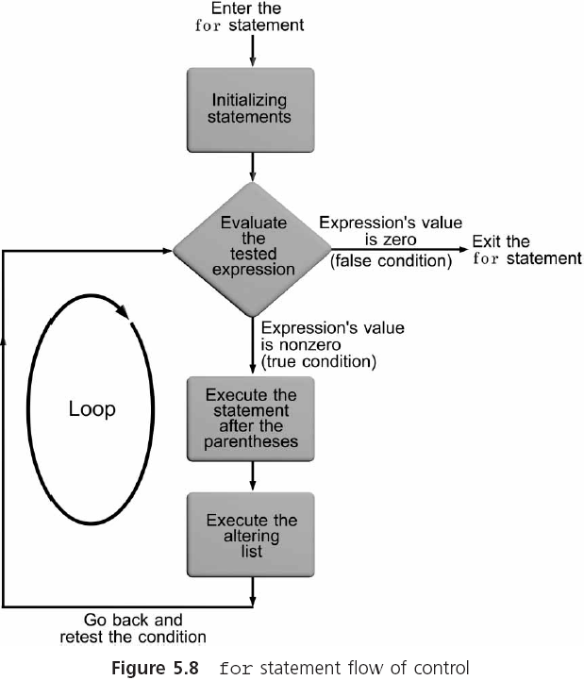
The for Statement

Slide 36
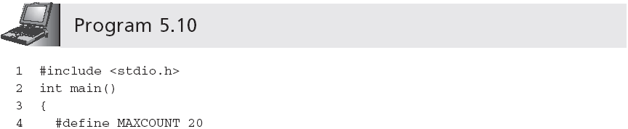
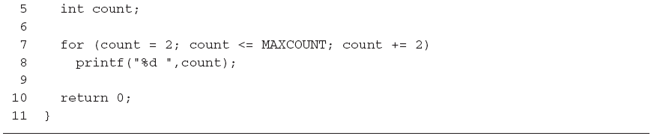
The for Statement (continued)
Output is:
2 4 6 8 10 12 14 16 18 20

Slide 37
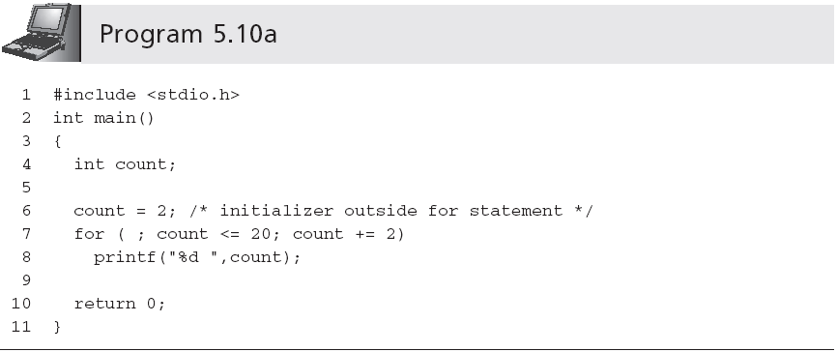
The for Statement (continued)

Slide 38
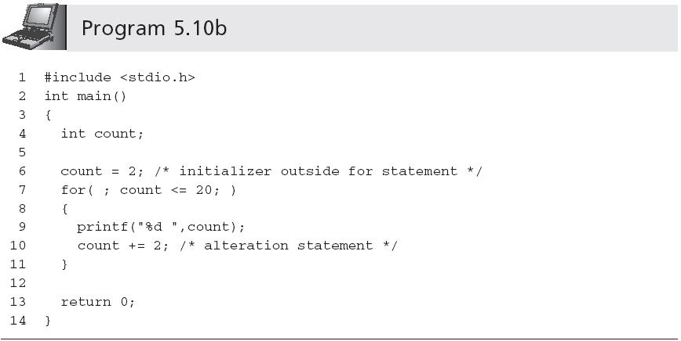
The for Statement (continued)

Slide 39
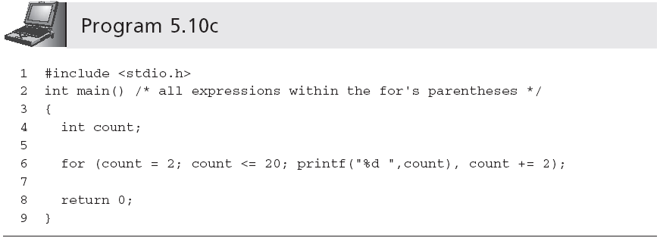
The for Statement (continued)
Comma-separated list
Here the Null statement satisfies the syntactical requirement that one statement follow the for’s parentheses

Slide 40
The for Statement (continued)
int a=2, b = 3;
int c = (a++, ++b, a+b);

Slide 41
The for Statement (continued)
int a=2, b = 3;
int c = (a++, ++b, ++a); or
int c = (a++, ++b, a++);

Slide 42
The for Statement (continued)
int a=0, b = 3;
int c = (a++)?(a++, ++b, ++a):(a++, ++b, a++);

Slide 43
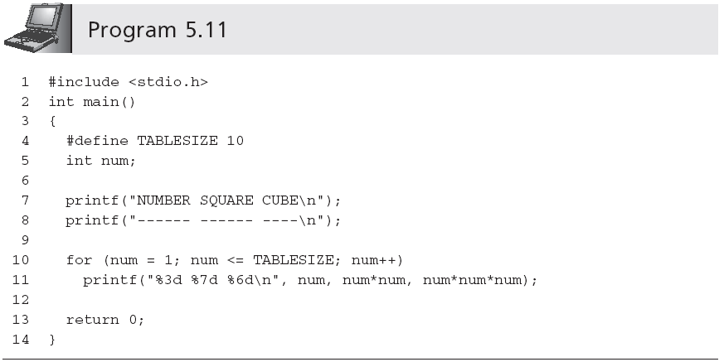
The for Statement (continued)
(compare with Program 5.3)

Slide 44
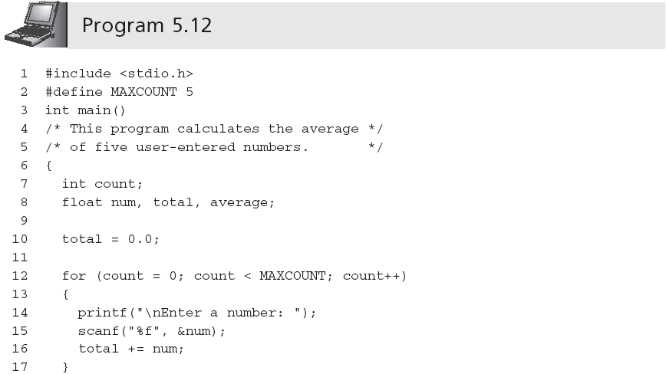
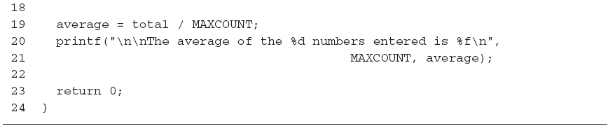
Computing Sums and Averages Using a for Loop
Notes:
用for循环求和和平均值

Slide 45
Case Studies: Loop Programming Techniques
Technique 1: Selection within a loop
Technique 2: Input data validation
Technique 3: Interactive loop control
Technique 4: Evaluating equations

Slide 46
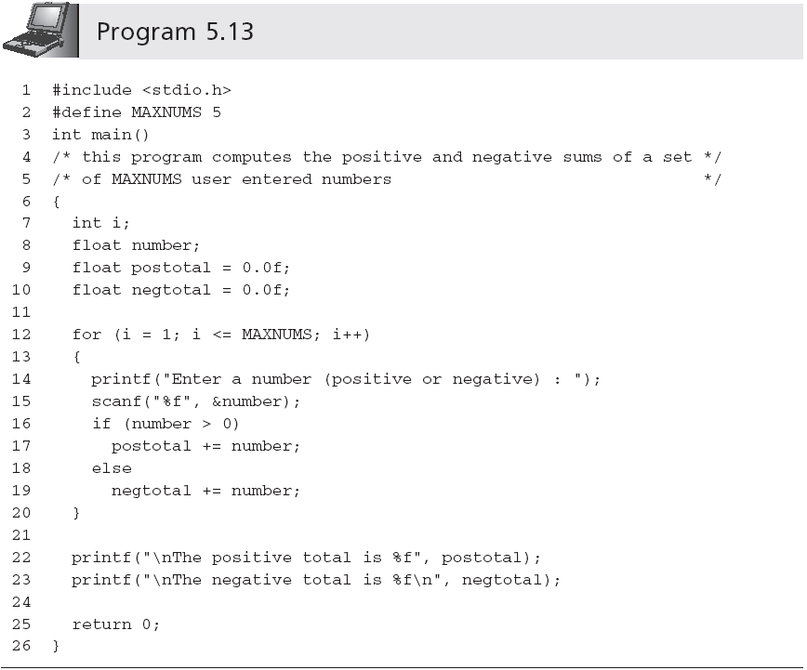
Technique 1: Selection within a Loop

Slide 47
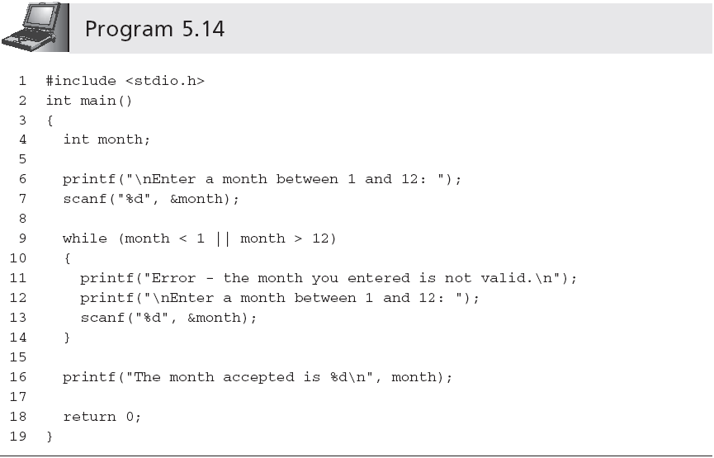
Technique 2: Input Data Validation
Same code used
in lines 6-7!
Notes:
重复代码的问题

Slide 48
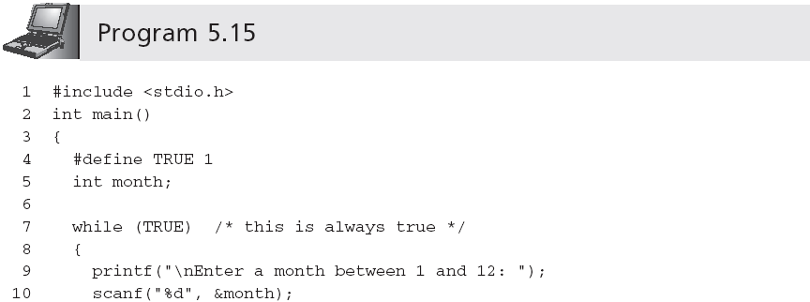
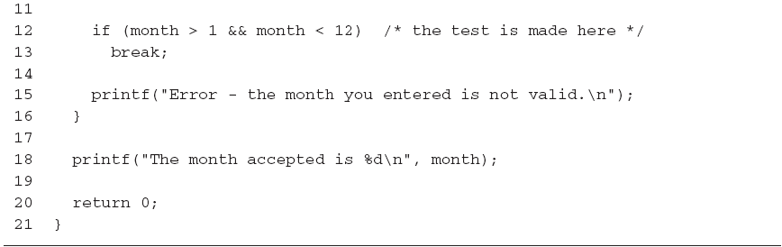
Technique 2: Input Data Validation
Notes:
若输入是有效值就跳出循环

Slide 49
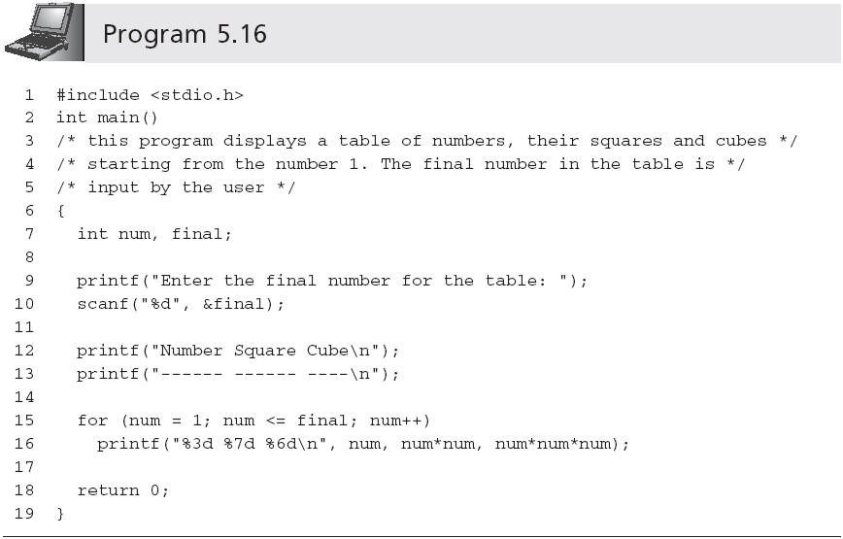
Technique 3: Interactive Loop Control
Notes:
控制循环变量的值，可以使用变量，可以用scanf函数获取实际的值，非常有用。

Slide 50
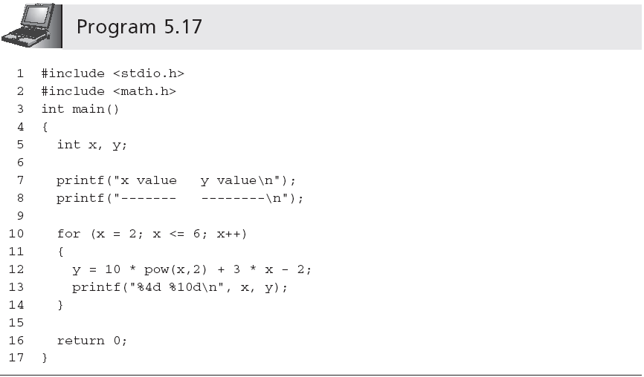
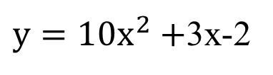
Technique 4: Evaluating Equations
Notes:
X既可以作为计数器变量，也可以是方程独立变量。
Pow返回值是double类型。但是表达式计算的结果是double型，赋给了一个int变量，自动隐式转换。

Slide 51
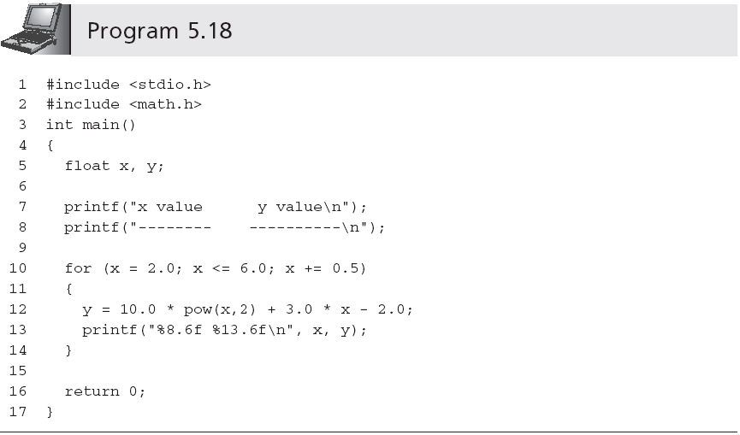
Technique 4: Evaluating Equations (continued)
Notes:
计数器变量并不一定是整型数，可以是小数。

Slide 52
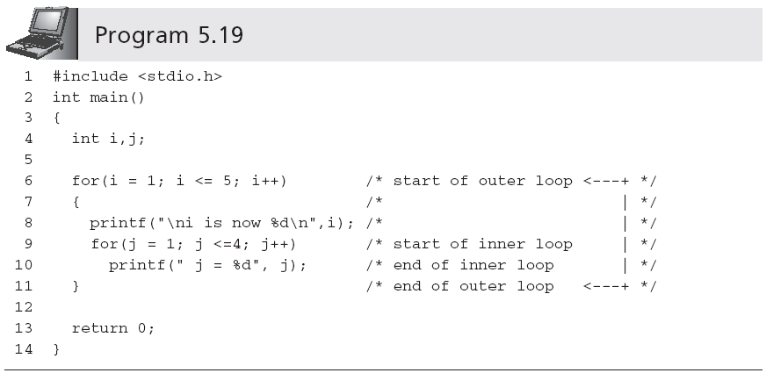
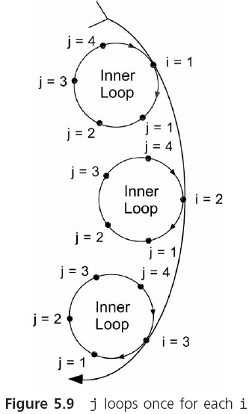
Nested Loops

Slide 53
Nested Loops (continued)
Sample run:
i is now 1
j = 1 j = 2 j = 3 j = 4
i is now 2
j = 1 j = 2 j = 3 j = 4
i is now 3
j = 1 j = 2 j = 3 j = 4
i is now 4
j = 1 j = 2 j = 3 j = 4
i is now 5
j = 1 j = 2 j = 3 j = 4

Slide 54
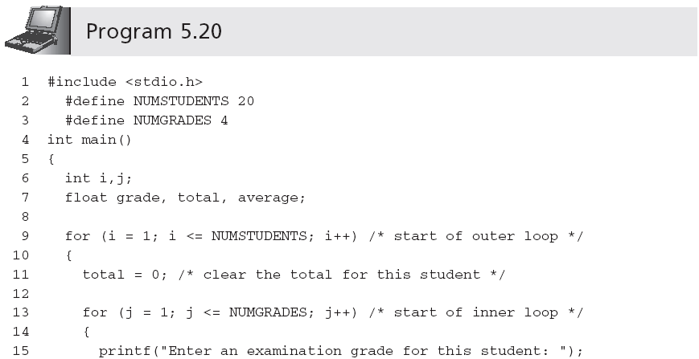
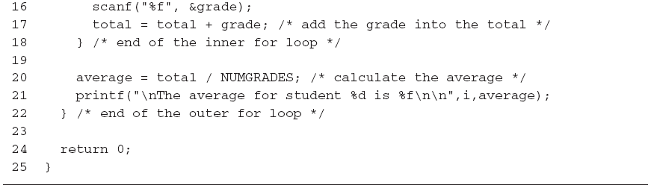
Nested Loops (continued)
Notes:
外层20，内层4个

Slide 55

求费波那西(Fibonacci)数列的前40个数。这个数列有如下特点：第1、2两个数为1、1。从第3个数开始，该数是其前面两个数之和。即:

Slide 56
这是一个有趣的古典数学问题：
有一对兔子，从出生后第3个月起每个月都生一对兔子。
小兔子长到第3个月后每个月又生一对兔子。
假设所有兔子都不死，问每个月的兔子总数为多少？

Slide 57
第几个月 | 小兔子对数 | 中兔子对数 | 老兔子对数 | 兔子总数
1 | 1 | 0 | 0 | 1
2 | 0 | 1 | 0 | 1
3 | 1 | 0 | 1 | 2
4 | 1 | 1 | 1 | 3
5 | 2 | 1 | 2 | 5
6 | 3 | 2 | 3 | 8
7 | 5 | 3 | 5 | 13
┇ | ┇ | ┇ | ┇ | ┇

Slide 58
f1=1,f2=1
输出f1,f2
For i=1 to 38
f3=f1+f2
输出f3
f1=f2
f2=f3

Slide 59
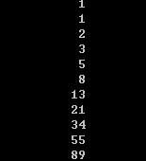
#include <stdio.h>
int main()
{ int f1=1,f2=1,f3; int i;
printf("%12d\n%12d\n",f1,f2);
for(i=1; i<=38; i++)
{ f3=f1+f2;
printf("%12d\n",f3);
f1=f2;
f2=f3;
}
return 0;
}
代码可改进
…

Slide 60
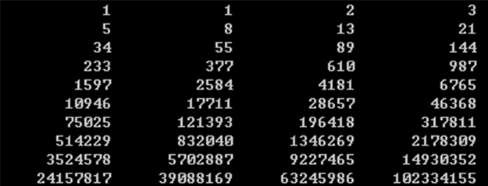
#include <stdio.h>
int main()
{ int f1=1,f2=1; int i;
for(i=1; i<=20; i++)
{ printf("%12d %12d ",f1,f2);
if(i%2==0) printf("\n");
f1=f1+f2;
f2=f2+f1;
}
return 0;
}

Slide 61
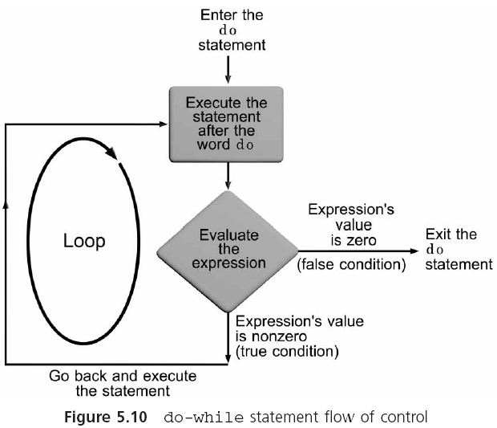
The do-while Statement
Notes:
有些时候在循环结尾的时候计算表达

Slide 62
The do-while Statement (continued)
The general form of the do statement is
do
statement;
while (expression);
do-while is a posttest loop
One type of application is ideally suited for a posttest loop:
Input data validation application

Slide 63
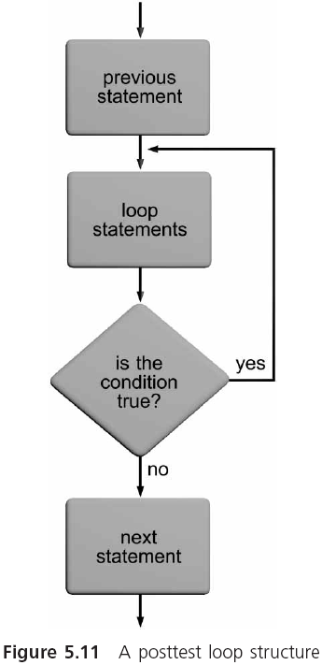
The do-while Statement (continued)
do
{
printf("\nEnter an ID number: ");
scanf("%f", &idNum);
} while (idNum < 1000 || idNum > 1999);

Slide 64
The do-while Statement (continued)
Use Sentinel and break statements to exit from the loop
#define SENTINEL 0.0
#define RATE 0.06
do
{
printf("\nEnter a price or -1 to terminate: ");
scanf("%f", &price);
if(price < SENTINEL)
break;
salestax = RATE * price；
} while (price >SENTINEL);

Slide 65
The difference of while loop and do…while loop
printf("Enter a grade:");
scanf("%f", &grade);
while(grade > SENTINEL)
{
total += grade;
printf("Enter a grade:");
scanf("%f",&grade);
}
printf("\total is %f\n", total);
do
{
printf("Enter a grade:");
scanf("%f",&grade);
total += grade;
}while(grade > SENTINEL);
printf("\nThe total is %f\n", total-grade);

Slide 66
Common Programming Errors
“Off by one” error, in which the loop executes either one too many or one too few times than intended
“Using the assignment operator, =, instead of the equality operator, ==, in the tested expression
for(i=1; i<11; i++) //execute 10 times not 11
Notes:
an accept amount

Slide 67
As with the if statement, repetition statements should not use the equality operator, ==, when testing single-precision or double-precision operands
fnum == 0.01 shoule be replaced by (fnum – 0.01) < 10e-6

Slide 68
Common Programming Errors
Placing a semicolon at the end of the for’s parentheses (creates a do-nothing loop)
Using commas to separate the items in a for statement instead of the required semicolons
Omitting the final semicolon from the do statement
for（count =1; count <=10; count ++）;
total = total + num;
Notes:
4、for语句后面放置一个分号。将产生一个什么都不做的循环。例如
for（count =1; count <=10; count ++）;
total = total + num;
5、用逗号而不是分号来分隔for 语句中的那些项。
7、省略了do while 循环语句中的最后的分号。

Slide 69
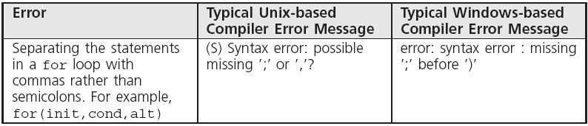
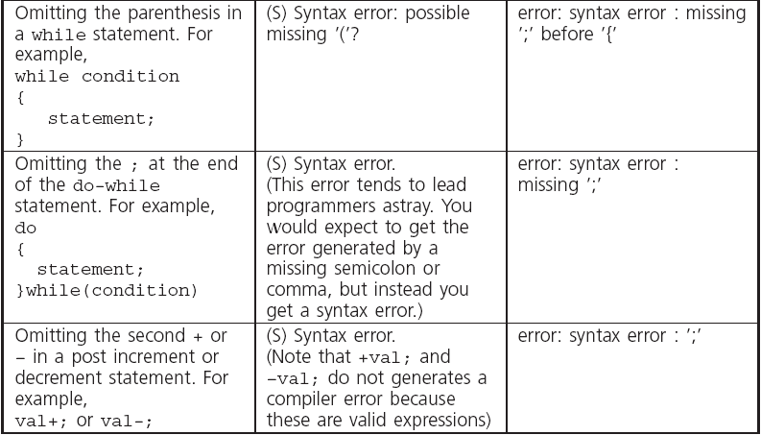
Common Compiler Errors

Slide 70
Summary
A section of repeating code is called a loop
The three C repetition statements are while, for and do-while
Loops are also classified as to the type of tested condition
The most commonly used syntax for a while loop is
while (expression)
{
statements;
}

Slide 71
Summary (continued)
A for statement performs the same functions as the while statement, but uses a different form
The for statement is extremely useful in creating counter-controlled loops
The do-while statement is used to create posttest loops because it checks its expression at the end of the loop

Slide 72
练习
（1）作业：用户输入一个无符号正整数，使用while 语句 或 for语句两种方法，计算该整数的阶乘，并打印阶乘值；
扩展练习，(a)进行防御性编程，防止阶乘溢出；
(b)嵌套循环，计算该阶乘的因子个数，并打印。
（2）对学过的内容进行练习，例如
(a)有m个学生，每个学生有n门课，计算每个学生学习平均成绩，成绩、m、n都可以通过scanf输入，printf输出平均成绩;
(b) 输入验证、利用输入控制循环...，等等；
(c) 思考题：输入10个各异的乱序数，求最大、最小，以及排序。整数数组int number [10]，对其中第五个整数的使用方法是number[4]，即number[4]作为一个变量使用，[]中下标从0~9。从循环与选择语句结合的粗暴求解开始

