Slide 1
A First Book of ANSI C Fourth Edition
Chapter 9
Character Strings

Slide 2
Objectives
String Fundamentals
Library Functions
Input Data Validation
Formatting Strings (Optional)
Case Study: Character and Word Counting
Common Programming and Compiler Errors

Slide 3
10.1 String Fundamentals
A string literal is any sequence of characters enclosed in double quotes
"Good Morning!"
Also called: string constant, string value, string
A string is stored as an array of characters terminated by an end-of-string symbolic constant named NULL ('\0')
NULL is useful for detecting the end of string

Slide 4
char codes[] = “sample”;
char codes[] = {'s', 'a', 'm', 'p', 'l', 'e'};

Slide 5
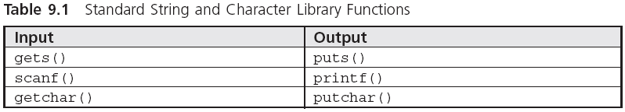
String Input and Output (continued)
require the header file stdio.h

Slide 6
String Input and Output
gets() accepts and stores the characters typed at the terminal into the character array
Pressing the Enter key generates a newline character, \n, which is interpreted by gets() as the end-of-character entry
All the characters encountered by gets(), except the newline character, are stored in the message array

Slide 7
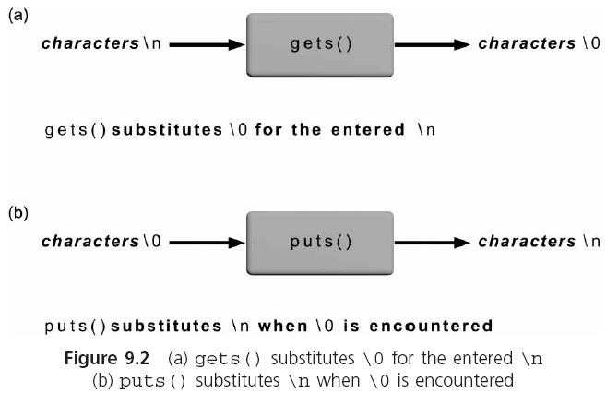
String Input and Output (continued)

Slide 8
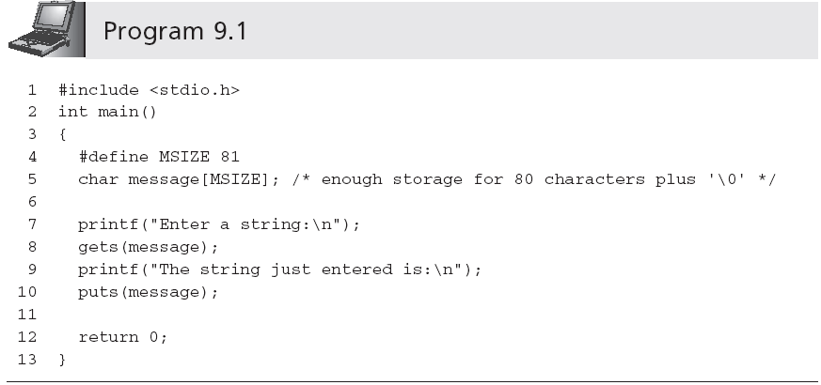
String Input and Output (continued)
Sample run:
Enter a string:
This is a test input of a string of characters.
The string just entered is:
This is a test input of a string of characters.

Slide 9
String Input and Output (continued)
A printf() function call can be used in place of a puts() function call
printf("%s\n", message); ≡ puts(message);
This correspondence between the output functions is not duplicated by the input functions scanf() and gets()
scanf() reads a set of characters up to either a blank space or a newline character
gets() stops accepting characters only when a newline is detected
Notes:
Message = &message[0]

Slide 10
scanf("%s", message);
//No & is required
message = &message[0]

Slide 11
int aray[10];
int *p1 = NULL,*p2 = NULL;
p1 = &aray[0];
p2 = aray;
问：p1?=p2

Slide 12
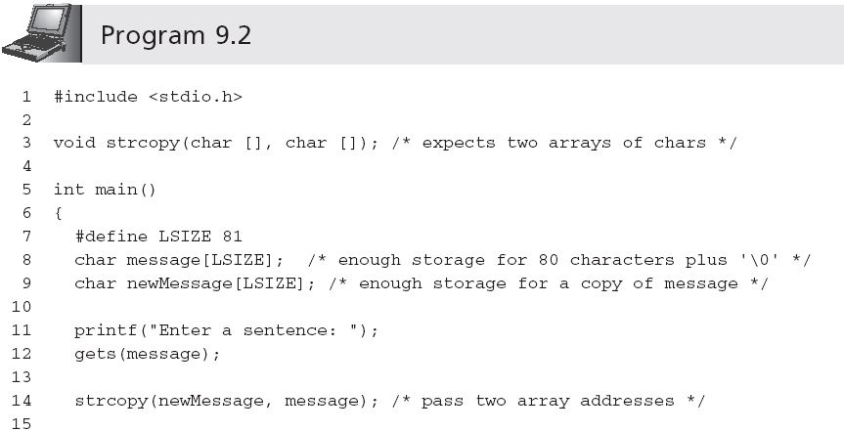
String Processing

Slide 13
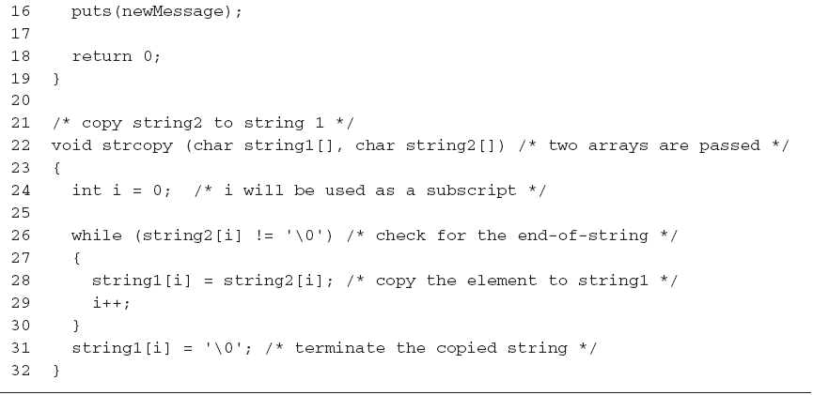
String Processing (continued)

Slide 14
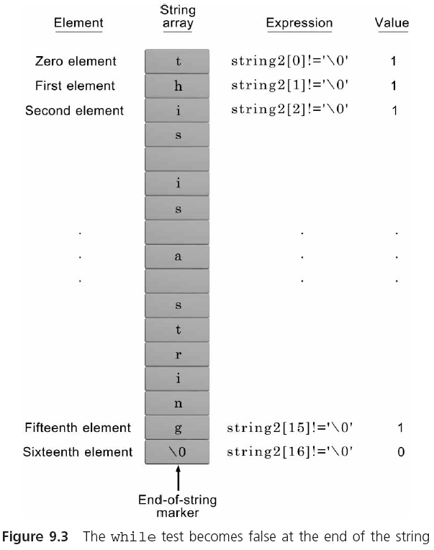
String Processing (continued)
NOTE: Because the expression string2[i] is only 0 at the end of a string and non-0 for every
other character, the expression while (string2[i] != '\0') can be replaced by the
simpler expression while (string2[i]).

Slide 15
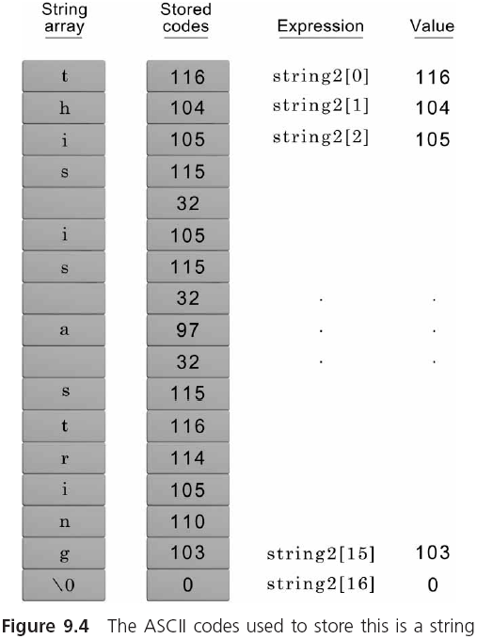
String Processing (continued)
While(string2[i])
{
}

Slide 16
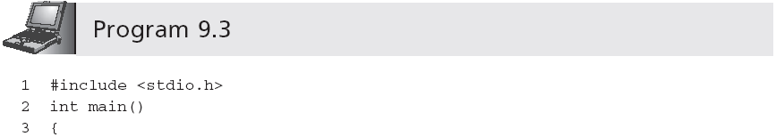
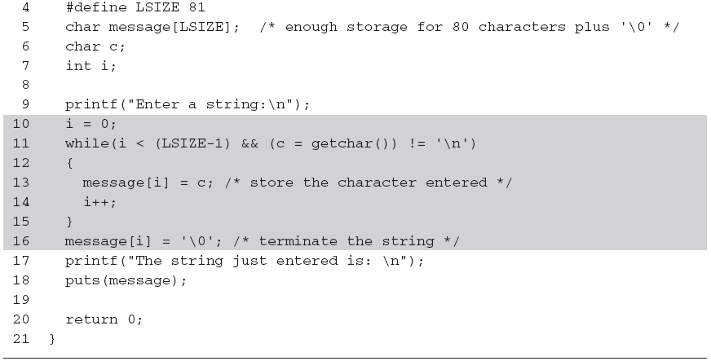
String Processing (continued)
Be careful: omitting the parentheses causes the entire expression to be equivalent to
c = (getchar() != '\n')

Slide 17
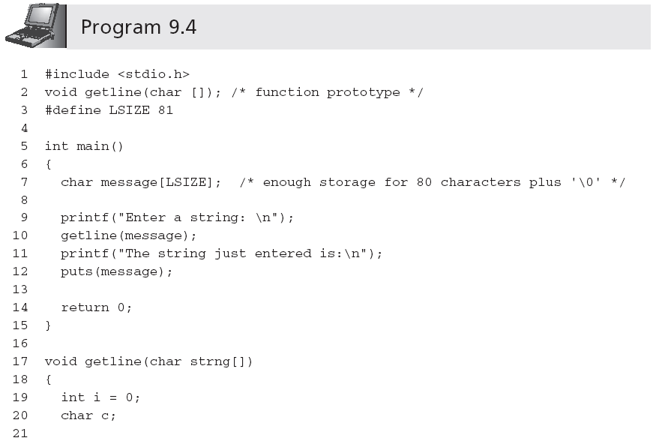
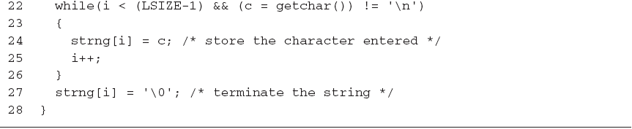
String Processing (continued)

Slide 18
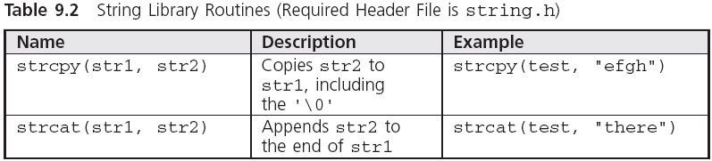
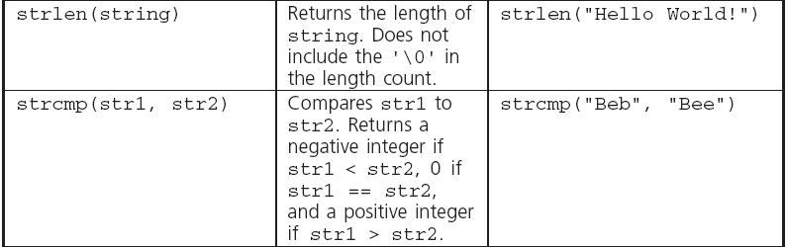
9.2 Library Functions
Note: Attempting to copy a larger string into a smaller string causes the copy to overflow the destination array beginning with the memory area immediately following the last array element.

Slide 19
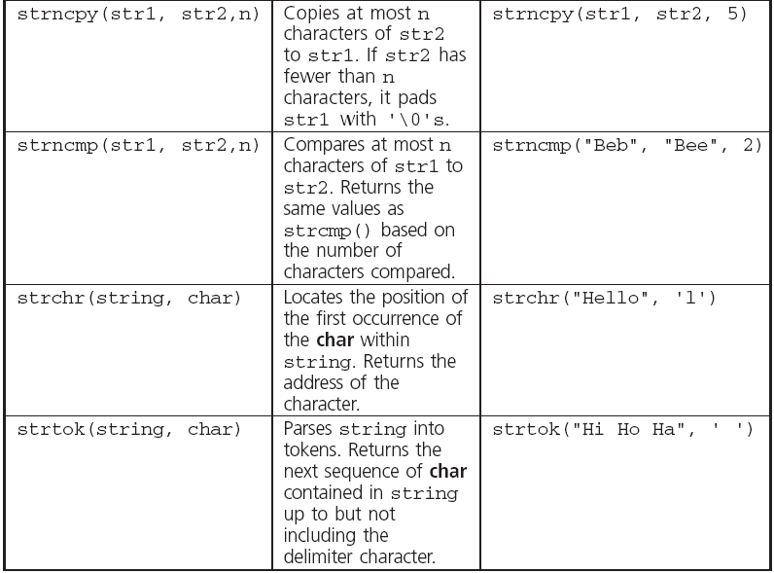
Library Functions (continued)

Slide 20
Library Functions (continued)
When comparing strings, their individual characters are evaluated in pairs; if a difference is found, the string with the first lower character is the smaller one
"Good Bye" is less than "Hello" because the first 'G' in Good Bye is less than the first 'H' in Hello
"Hello" is less than "Hello " because the '\0' terminating the first string is less than the ' ' in the second string
"123" is greater than "122" because '3' in 123 is greater than '2' in 122
"1237" is greater than "123" because '7' in 1237 is greater than '\0' in 123

Slide 21
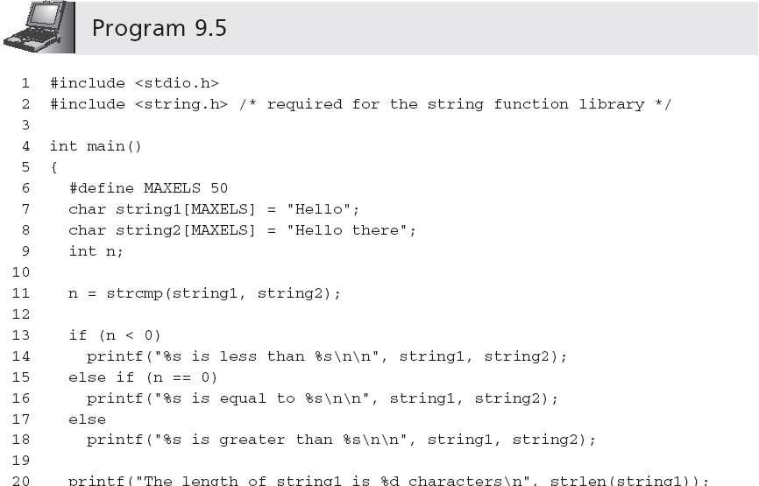
Library Functions (continued)

Slide 22
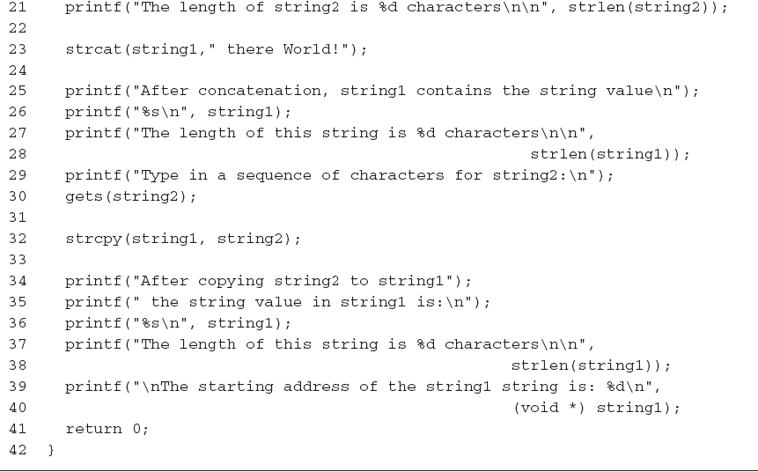
Library Functions (continued)
&string1[0]

Slide 23
Library Functions (continued)
Sample output:
Hello is less than Hello there
The length of string1 is 5 characters
The length of string2 is 11 characters
After concatenation, string1 contains the string value
Hello there World!
The length of this string is 18 characters
Type in a sequence of characters for string2:
It's a wonderful day
After copying string2 to string1, the string value in string1 is:
It's a wonderful day
The length of this string is 20 characters
The starting address of the string1 string is: 1244836

Slide 24
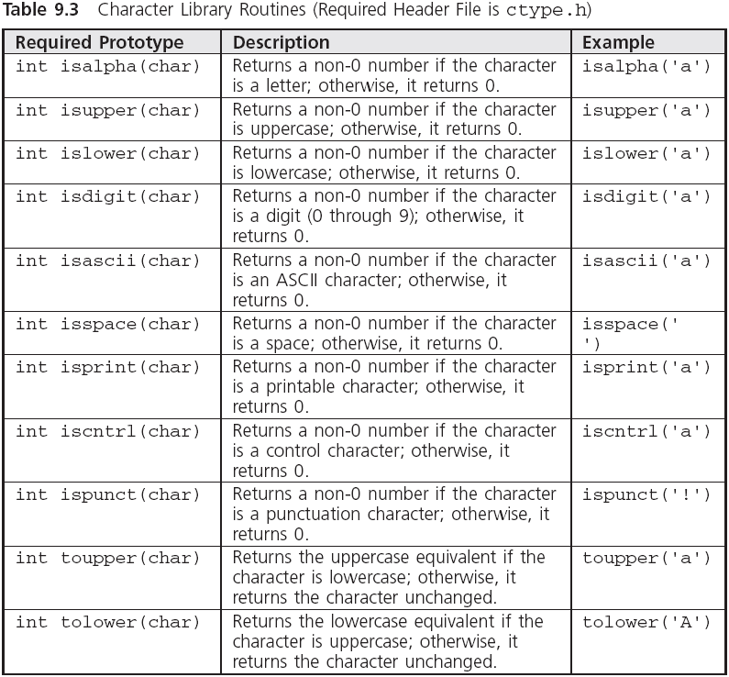
Character Routines

Slide 25
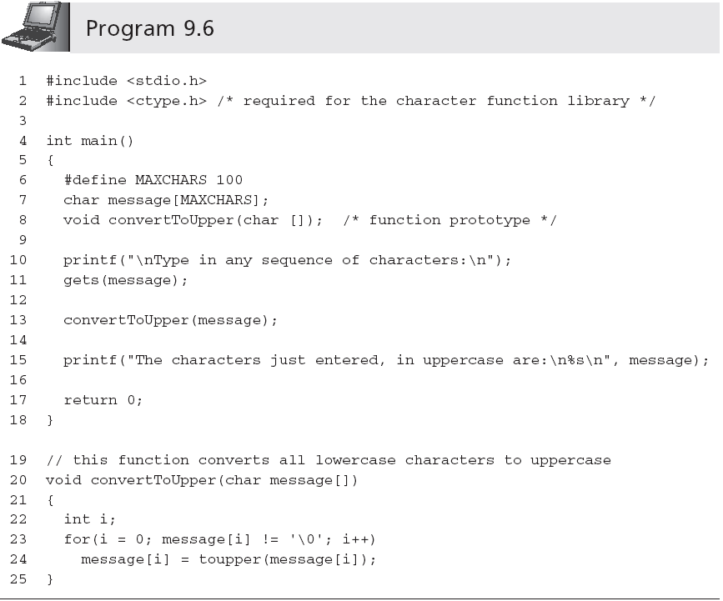
Character Routines (continued)

Slide 26
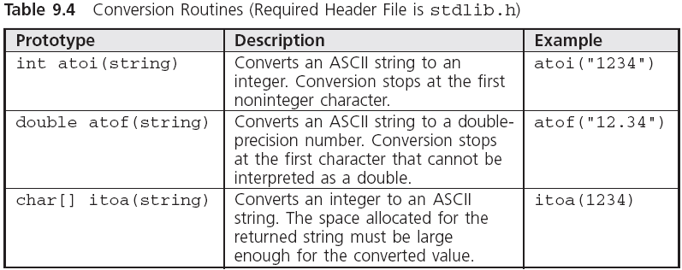
Conversion Routines

Slide 27
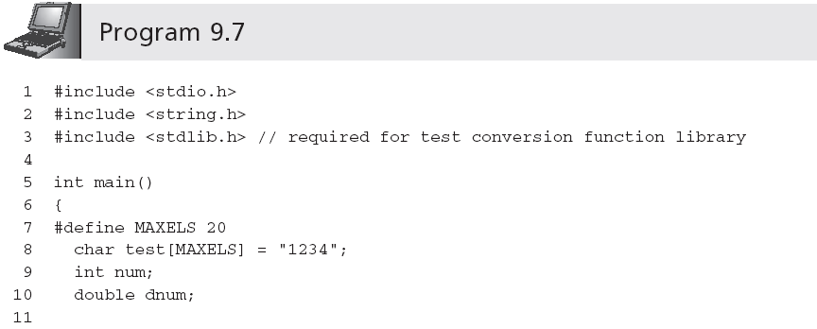
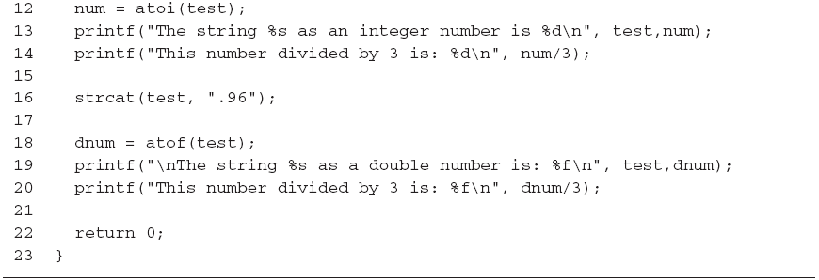
Conversion Routines (continued)

Slide 28
9.3 Input Data Validation
Successful programs always try to anticipate invalid data and isolate such data from being accepted and processed
First validate that the data is of the correct type; if not, request the user to re-enter the data
Explain why the entered data was invalid
One of the most common methods of validating input data is to accept all numbers as strings
Each character can then be checked to ensure that it complies with the data type being requested

Slide 29
Checking the following:
The string is not empty.
The presence of a valid sign symbol(+ or - )
If a sign symbol is present, at least one digit follows it.
All of the remaining characters are valid digits.
A valid digit is any character between 0 and 9,
while any character less than 0 or greater than 9 is not a digit.

Slide 30
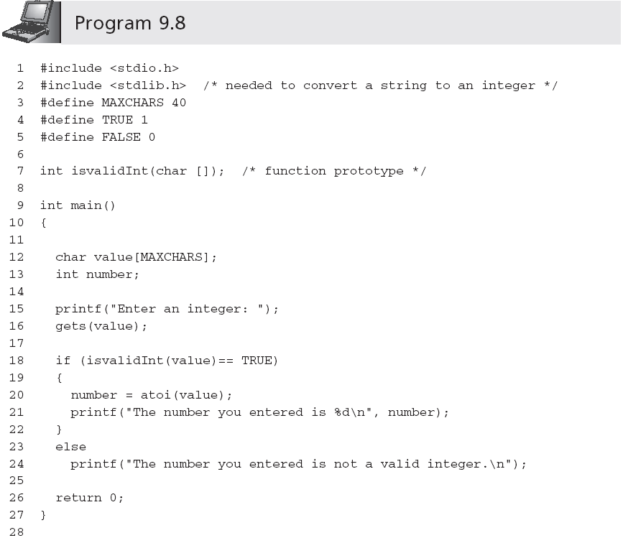

Slide 31
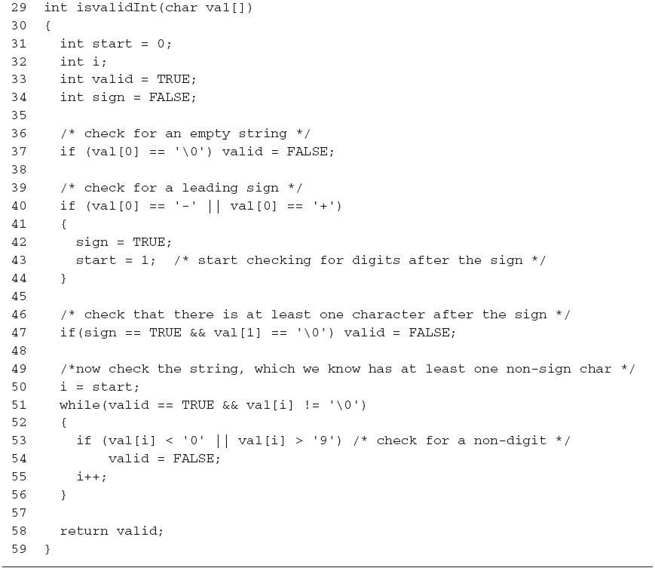
Input Data Validation (continued)

Slide 32
Input Data Validation (continued)
We can use isvalidInt() in a loop that continually requests an integer until a valid integer value is entered
Set an integer variable named isanInt to 0
do
Accept a string value
If the string value does not correspond to an integer
Display the error message "Invalid integer - Please re-enter: "
Send control back to expression being tested by the do-while statement
Set isanInt to 1 (this causes the loop to terminate)
while(isanInt is 0)
Return the integer corresponding to the entered string

Slide 33

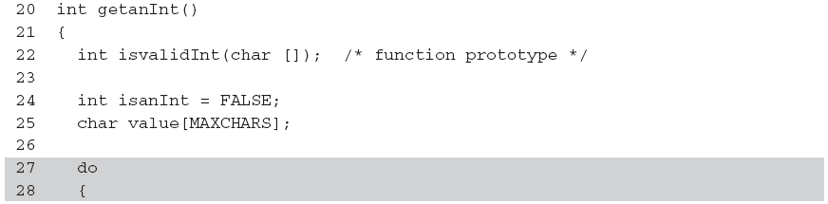
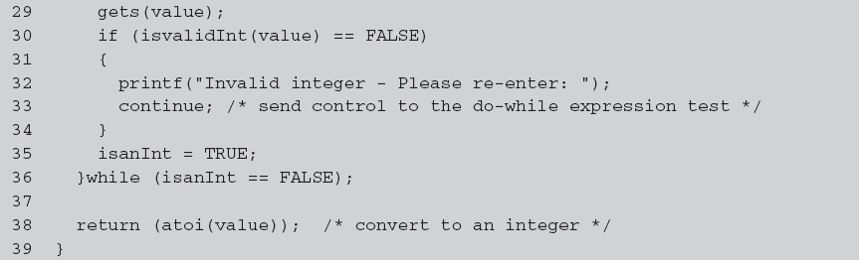
Input Data Validation (continued)
…

Slide 34
Creating a Personal Library
Programmers create their own libraries of functions
This permits the functions to be incorporated in any program without further expenditure of coding time
Each file in a library contains related functions
#include <C:\\mylibrary\\dataChecks.h>
#include "C:\\mylibrary\\dataChecks.h"
The #include statement for dataChecks.h must be placed after the #include statements for the stdio.h and stdlib.h header files (the functions in dataChecks.h require stdio.h and stdlib.h functions to correctly compile)

Slide 35
Make 概述
makefile定义整个工程的编译规则
一个工程中的源文件不计数，其按类型、功能、模块分别放在若干个目录中，makefile定义了一系列的规则来指定，哪些文件需要先编译，哪些文件需要后编译，哪些文件需要重新编译，甚至于进行更复杂的功能操作。
自动化编译
只需要一个make命令，整个工程完全自动编译 ；
make是一个命令工具，是一个解释makefile中指令的命令工具；一般来说，大多数的IDE都有这个命令，比如：Delphi的make，Visual C++的nmake，Linux下GNU的make。可见，makefile都成为了一种在工程方面的编译方法。

Slide 36
Makefile里主要有什么
显式规则、隐晦规则、变量定义、文件指示和注释。
1、显式规则。显式规则说明了，如何生成一个或多的的目标文件。这是由Makefile的书写者明显指出，要生成的文件，文件的依赖文件，生成的命令。
2、隐晦规则。由于我们的make有自动推导的功能，所以隐晦的规则可以让我们比较粗糙地简略地书写Makefile，这是由make所支持的。
3、变量的定义。在Makefile中我们要定义一系列的变量，变量一般都是字符串，这个有点你C语言中的宏，当Makefile被执行时，其中的变量都会被扩展到相应的引用位置上。
4、文件指示。其包括了三个部分，一个是在一个Makefile中引用另一个Makefile，就像C语言中的include一样；另一个是指根据某些情况指定Makefile中的有效部分，就像C语言中的预编译#if一样；还有就是定义一个多行的命令。有关这一部分的内容，我会在后续的部分中讲述。
5、注释。Makefile中只有行注释，和UNIX的Shell脚本一样，其注释是用“#”字符。如果你要在你的Makefile中使用“#”字符，可以用反斜框进行转义，如：“\#”。

Slide 37
关于程序的编译和链接
无论是C、C++，首先要把源文件编译成中间代码文件，在Windows下是 .obj 文件，UNIX下是 .o 文件，即目标文件，这个动作叫做编译（compile）。
然后再把大量的目标文件链接成执行文件，这个动作叫作链接（link）。
编译时，编译器检查语法，函数与变量的声明是否正确。对于声明，通常需要你告诉编译器头文件所在的位置（头文件中应该只是声明，而定义应该放在源文件中），只要所有的语法正确，编译器就可以编译出中间目标文件。一般来说，每个源文件可以生成一个中间目标文件（.o文件或是.obj文件）。

Slide 38
关于程序的编译和链接
链接时，主要是找到函数和全局变量的定义。
链接器并不管函数所在的源文件，只管函数的中间目标文件（Object File）。在大多数时候，由于源文件太多，编译生成的目标文件太多，而在链接时需要明显地指出中间目标文件名，这对于编译很不方便，所以，我们要给中间目标文件打个包，在Windows下这种包叫“库文件”（Library File)，也就是 .lib 文件，在UNIX下，是Archive File，也就是 .a 文件 或.so
下面是一个包含三个文件的工程

Slide 39
准备文件file1.c
##include <stdio.h>
#include "file2.h"
int main()
{
printf("print file1\n");
File2Print();
return 0;
}
返回
Notes:
讲一下GNU的历史，以及GPL协议

Slide 40
准备文件file2.c
##include "file2.h"
void File2Print()
{
printf("Print file2\n");
}
返回
Notes:
讲一下GNU的历史，以及GPL协议

Slide 41
准备文件file2.h
##ifndef FILE2_H_
#define FILE2_H_
#include<stdio.h>
void File2Print();
#endif
返回
Notes:
讲一下GNU的历史，以及GPL协议

Slide 42
Makefile里的主要规则
target ... : prerequisites ...
command
...
target是一个目标文件，可以是Object File，也可以是执行文件。还可以是一个标签(伪目标) 。
prerequisites是要生成那个target所需要的文件或是目标。
command也就是make需要执行的命令。(任意的Shell命令)
文件的依赖关系，也就是说，target……是需要生成的一个或多个文件，它们依赖于 prerequisites......中列出的文件，通过执行command来生成target.....。
一个规则可以有多个命令行，每一条命令占一行。 注意：每一个命令行必须以[Tab]字符开始，[Tab]字符告诉 make 此行是一个命令行。make按照命令完成相应的动作。这也是书写 Makefile 中容易产生，而且比较隐蔽的错误。
这就是Makefile的规则，也是Makefile中最核心的内容。
Notes:
讲一下GNU的历史，以及GPL协议

Slide 43
编写Makefile文件
helloworld:file1.o file2.o
gcc file1.o file2.o -o helloworld
file1.o:file1.c file2.h
gcc -c file1.c -o file1.o
file2.o:file2.c file2.h
gcc -c file2.c -o file2.o
clean:
rm -rf *.o helloworld

Slide 44
详细解读Makefile文件
helloworld : file1.o file2.o
gcc file1.o file2.o -o helloworld
helloworld依赖file1.o file2.o两个文件编译出helloworld可执行文件。-o表示指定 的目标文件名。
若file1.o和file2.o都存在，但是其中一个比helloworld新或helloworld不存在时，执行下面的gcc命令。
若file1.o和file2.o有任意一个不存在，假设是file1.o，会先找到file1.o的生成关系，生成file1.o后，再执行下面的gcc命令。
Notes:
讲一下GNU的历史，以及GPL协议

Slide 45
详细解读Makefile文件(续)
file1.o : file1.c file2.h
gcc -c file1.c -o file1.o
file1.o依赖file1.c 和file2.h这两个文件，编译出file1.o文件。
若依赖文件中有任意一个文件不存在或比file1.o新，都会重新执行下面的gcc命令。
-c表示gcc 只把给它的文件编译成.o文件，用源码文件的文件名命名但把其后缀由“.c” 变成“.o”。在这句中，可以省略-o file1.o，编译器默认生成file1.o文件，这就是-c的作用。
file2.o : file2.c file2.h gcc -c file2.c -o file2.o
这两句的功能同上。
返回
Notes:
讲一下GNU的历史，以及GPL协议

Slide 46
详细解读Makefile文件(续)
clean:
rm -rf *.o helloworld
#当用户输入make clean命令时，会执行rm指令，其功能是删除*.o 和helloworld文 件。
写好Makefile文件，在命令行中直接键入make命令，就会执行Makefile中的内容了
返回
Notes:
讲一下GNU的历史，以及GPL协议

Slide 47
10.4 Formatting Strings
Examples:
printf("|%25s|","Have a Happy Day");
| Have a Happy Day|
right justified, in a field of 25 characters.
printf("|%-25s|","Have a Happy Day");
|Have a Happy Day |
left justified, in a field of 25 characters.

Slide 48
The precision specifier
When the precision specifier used with string, the right of a decimal number determines the maximum number of characters that will be displayed.
printf("|%25.12s|","Have a Happy Day");
| Have a Happy|
12 characters to be right justified displayed in a field of 25 characters.
printf("|%.12s|","Have a Happy Day");
|Have a Happy|
The first 12 characters in this string to be displayed

Slide 49
In-Memory String Conversions
The sprintf() and sscanf() functions provide capabilities for writing and scanning strings to and from memory variables
sprintf(disStrn,"%d %d", num1, num2);
sscanf(data,"%c%lf %d",&dol,&price,&units);
"$23.45 10"
sscanf(date,"%d/%d/%d", &month, &day, &year);
"07/01/94“
sprintf: print to string
sscanf: scan from string

Slide 50
Format Strings
The control string containing the conversion control sequences need not be explicitly contained within the function
printf("$%5.2f %d",num1,num2);
Or,
char fmat[] = "$%5.2f %d";
printf(fmat,num1,num2);
Useful for listing format strings with other variable declarations at the beginning of a function
If you need to change a format, it is easy to find the desired control string without searching to locate the appropriate printf() or scanf() function calls

Slide 51
10.5 Case Study: Character and Word Counting
We construct two string-processing functions
Count the number of characters in a string
Count words in a sting
What constitutes a word?

Slide 52
Program Requirement: Character Counting
Pass a string to a function and have the function return the number of characters in the string
Any character in the string (blank, printable, or nonprintable character) is to be counted
The end-of-string NULL character is not to be included in the final count

Slide 53
Analyze the Problem
Determine the input data
Determine the required outputs
List the algorithm(s) relating the inputs to the outputs

Slide 54
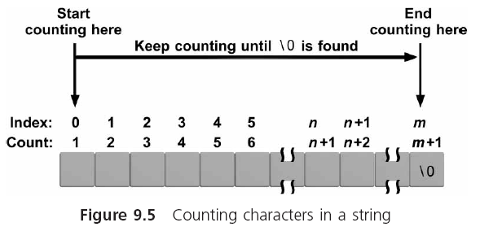
Analyze the Problem (continued)

Slide 55
Code the Function
int countchar(char list[])
{
int i, count = 0;
for(i = 0; list[i] != '\0'; i++)
count++;
return(count);
}

Slide 56
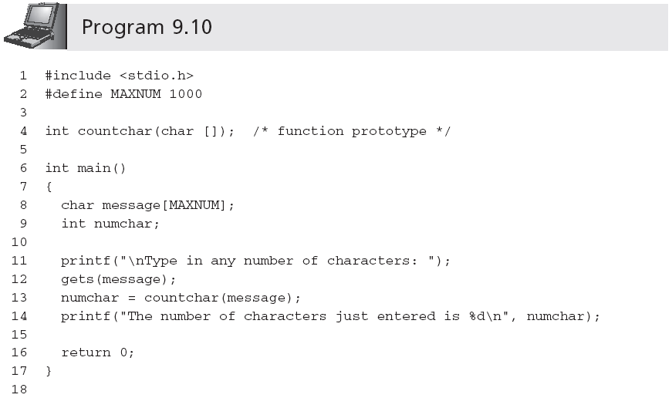
Test and Debug the Function
…

Slide 57
Requirement Specification: Word Counting
The last word does not have a trailing blank
More than one blank may be used between words
Leading blanks may be used before the first word
t
h
i
s
i
s
t
h
e
t
y
p
i
c
a
l
c
a
s
e
t
h
i
s
i
s
t
h
e
t
y
p
i
c
a
l
c
a
s
e

Slide 58
Algorithm
Set an integer variable named inaword to the symbolic constant NO
Set the word count to 0
For all the characters in the array
If the current character is a blank
set inaword to NO
Else if (inaword equals NO)
set inaword to the symbolic constant YES
increment the word count
EndIf
EndFor
Return the count
Criteria：the transition from a blank to a nonblank character
t
h
i
s
i
s
t
h
e
t
y
p
i
c
a
l
c
a
s
e

Slide 59
Code the Function
int countword(char list[])
#define YES 1
#define NO 0
{
int i, inaword, count = 0;
inaword = NO;
for(i = 0; list[i] != '\0'; i++)
{
if (list[i] == ' ')
inaword = NO;
else if (inaword == NO)
{
inaword = YES;
count++;
}
}
return(count);
}

Slide 60
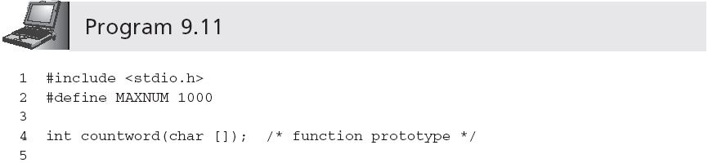
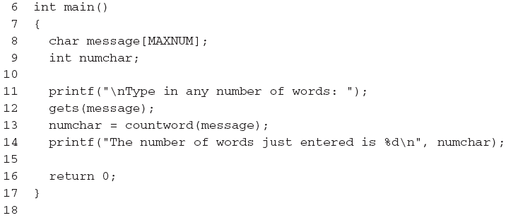
Test and Debug the Function
…

Slide 61
Test and Debug the Function (continued)
A sample run using Program 9.11 follows:
Type in any number of words: This is a test line with a bunch of words
The number of words just entered is 10
Further tests that should be performed are
Enter words with multiple spaces between them
Enter words with leading spaces before the first word
Enter words with trailing spaces after the last word
Enter a sentence that ends in a period or question mark

Slide 62
int ab[3][4]; ab地址为10020, int 四个字节大小
&ab[1][3]是多少？

Slide 63
int ab[3][4];
char *ptr = (char*)ab;
ptr += 20;
ptr对应哪个元素？

Slide 64
int ab[3][4]; int 四个字节大小
int *ptr = ab;
ptr += 10;
ptr是多少？

Slide 65
Common Programming Errors
Forgetting the terminating NULL character, '\0', when processing existing strings in a character-by-character manner
Forgetting to terminate a newly created character string with the NULL character
Forgetting that the newline character, '\n', is a valid data input character
Forgetting to include the string.h, ctype.h, and stdlib.h header files when using the string library, character library, and conversion library functions, respectively

Slide 66
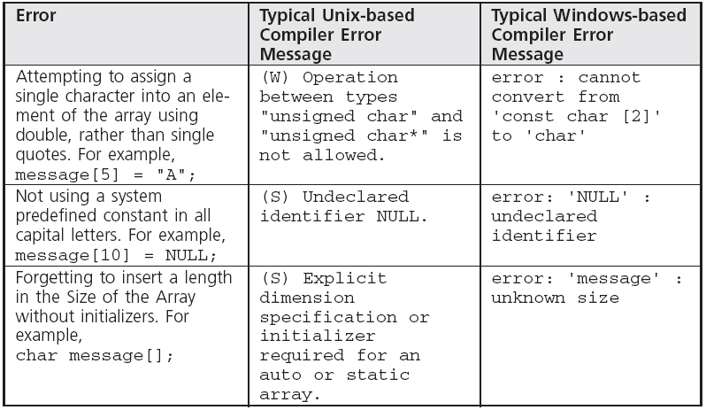
Common Compiler Errors

Slide 67
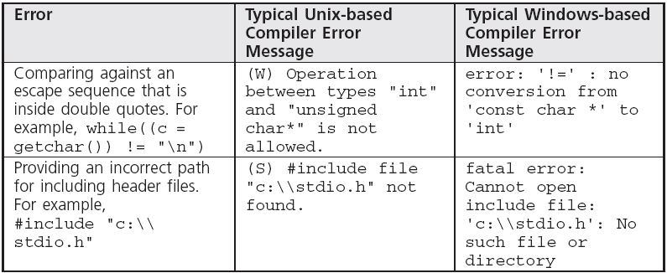
Common Compiler Errors (continued)

Slide 68
Summary
A string is an array of characters terminated by the NULL ('\0') character
Character arrays can be initialized using a string assignment of the form char arrayName[] = "text";
Strings can always be processed using standard array-processing techniques
The gets(), scanf(), and getchar() library functions can be used to input a string
The puts(), printf(), and putchar() functions can be used to display strings

Slide 69
Summary (continued)
Many standard library functions exist for processing strings as a complete unit
The standard C library also includes individual character-handling functions (ctype.h)
One of the major uses of strings is validating user input, which is an essential part of any program
The conversion routines atoi() and atof() are provided in the stdlib.h header file for converting strings to integer and double-precision numeric values

Slide 70
作业：
1. 从一个字符串中删除指定的字符（或字符串）
2. 输入C语言程序文本字符串，识别与提取其中的保留字、整数、浮点数，并打印输出。

Slide 71
bool deleteChar (char str[],char ch)
{
if(strlen(str)<1) return 0;
int a,b;
for(a=b=0;str[a]!=’\0’;a++)
if(str[a]!=ch)
str[b++]=str[a];
str[b]=’\0’;
return 1;
}

