Slide 1
A First Book of ANSI C Fourth Edition
Chapter 6
Modularity Using Functions: Part I

Slide 2
Objectives
Function and Parameter Declarations
Returning a Value
Case Study: Calculating Age Norms
Standard Library Functions
Common Programming and Compiler Errors

Slide 3
Function and Parameter Declarations
A function that is called into action by its reference in another function is a called function
A function that calls another function is referred to as the calling function

Slide 4
Function Prototypes
The declaration statement for a function is referred to as a function prototype
Declares the data type of the value that will be directly returned by the function
Declares the data type of the values that need to be transmitted to the called function when it is invoked
returnDataType functionName(argument data types);
Function prototypes allow the compiler to check for data type errors
If the function prototype does not agree with data types specified when the function is written, an error message (typically TYPE MISMATCH) will occur

Slide 5
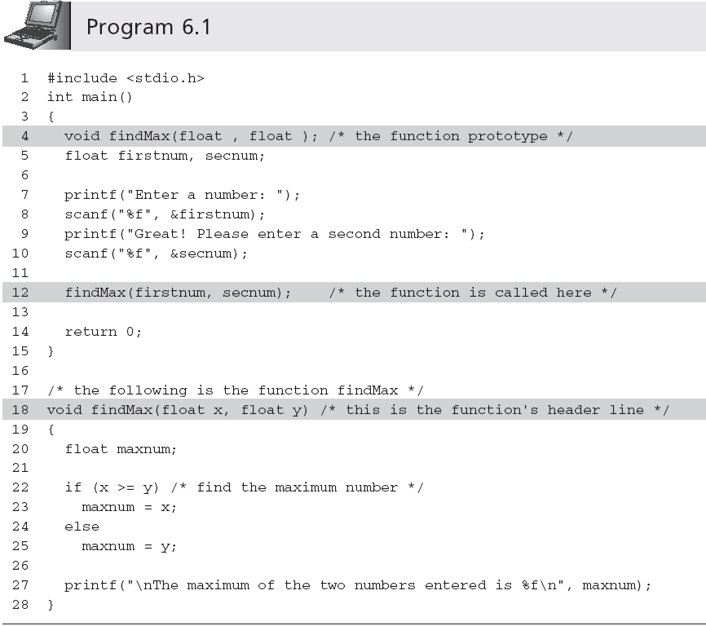
Function and Parameter Declarations (continued)

Slide 6
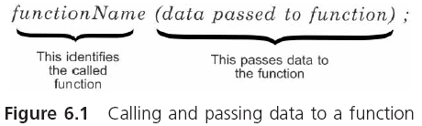
Function and Parameter Declarations (continued)

Slide 7
Calling a Function
Arguments: items enclosed in parentheses in a function call statement
Other terms used as synonyms for arguments are actual arguments and actual parameters
Pass by value: when a function receives copies of the values in each argument and must determine where to store them before it does anything else
Also referred to as call by value

Slide 8
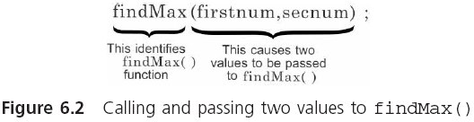
Calling a Function (continued)

Slide 9
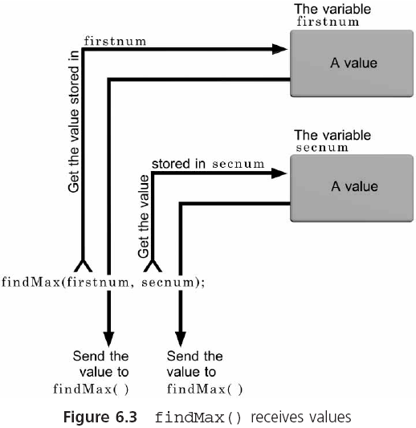
Calling a Function (continued)

Slide 10
Function Header Line
Function header: identifies the data type of the return value, provides the function with a name, and specifies the number, order, and type of values expected by the function
Function body: operates on the passed data and returns, at most, one value
The argument names in the header line are known as parameters or formal parameters and formal arguments

Slide 11
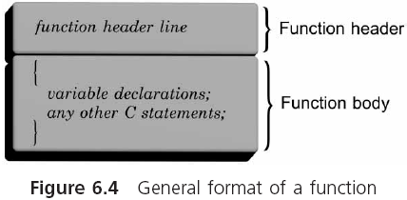
Function Header Line (continued)

Slide 12
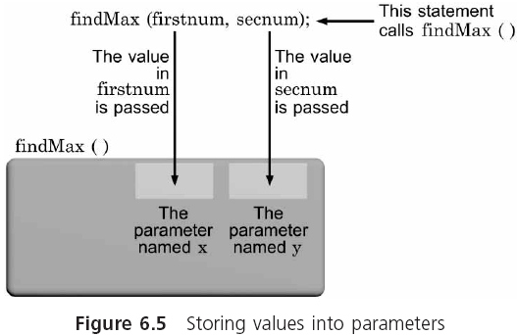
Function Header Line (continued)

Slide 13
Function Header Line (continued)
main() must adhere to the rules required for constructing all C functions
Some programmers prefer to put all called functions at the top of a program and make main() the last function listed
Each C function is a separate and independent entity with its own parameters and variables
Nested functions are not permitted
The function’s prototype, along with pre- and postconditions should provide all the information necessary to call the function successfully

Slide 14
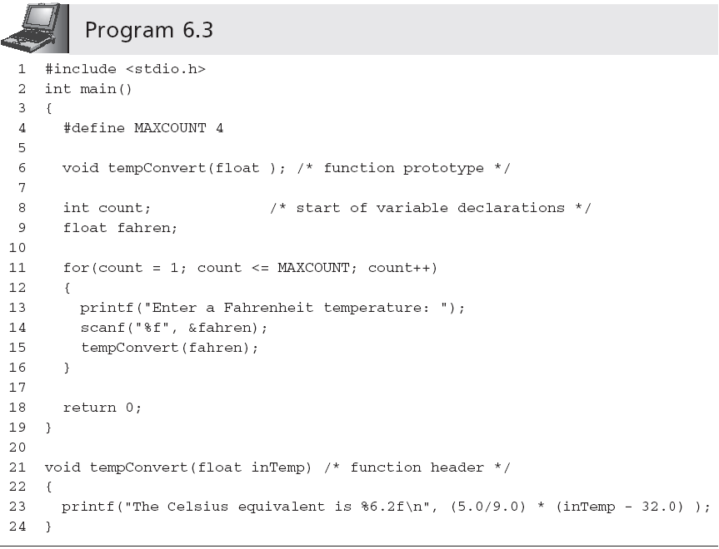
Function Header Line (continued)
Ends with a semicolon
Does not end with a semicolon

Slide 15
Placement of Statements
All preprocessor directives, variables, named constants, and functions, except main(), must be either declared or defined before they can be used
Basic (good) programming structure:
preprocessor directives
symbolic constants
function prototypes can be placed here
int main()
{
function prototypes can be placed here
variable declarations;
other executable statements;
return value;
}

Slide 16
Returning a Value
From its side of the return transaction, the called function must provide:
Data type of the returned value, which is specified in the function’s header line
Actual value being returned, which is specified by a return statement

Slide 17
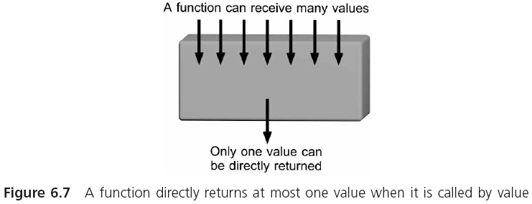
Returning a Value (continue)

Slide 18
Returning a Value (continue)
To return a value, use a return statement
return (expression); //or, return expression;
The expression is evaluated first; its value is then automatically converted to the return value’s data type as specified in the function’s header line before being sent back to the calling function
Failure to exactly match the return value with the function’s declared data type can lead to undesired results
Return value is converted to the data type declared in the function’s header line

Slide 19
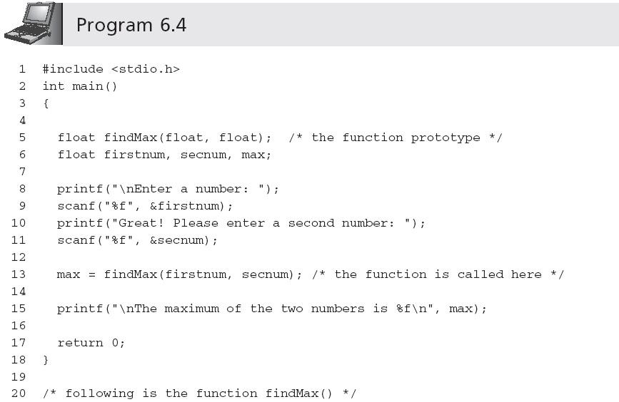
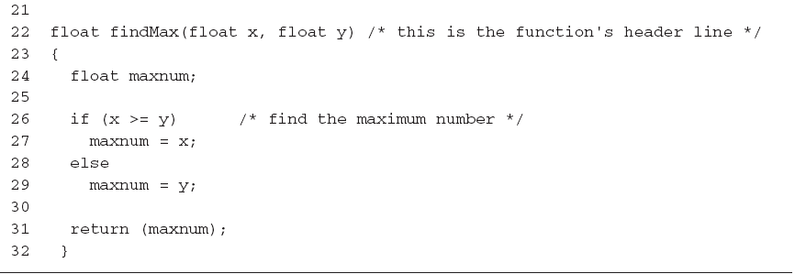
Returning a Value (continue)

Slide 20
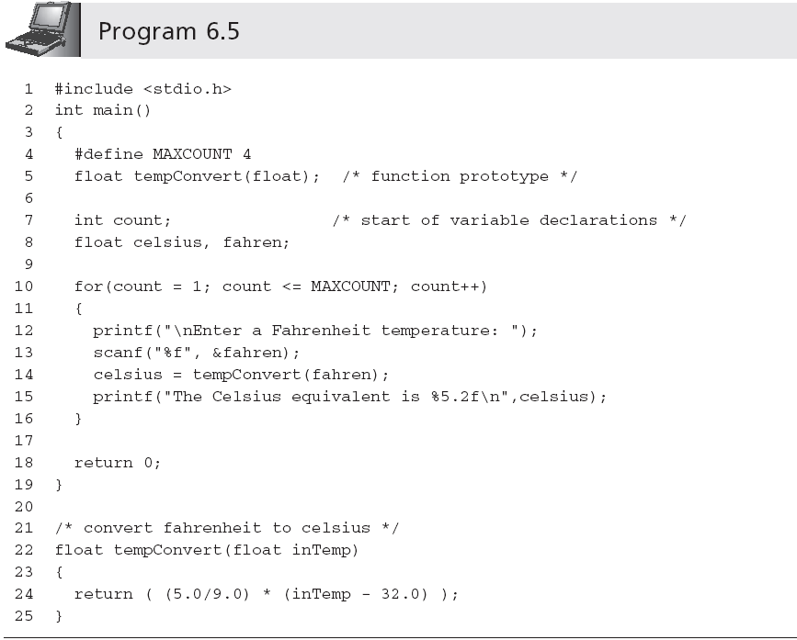
Returning a Value (continue)
printf("The Celsius equivalent is %5.2f\n", tempConvert(fahren));
Value is automatically converted from double to float (it may also generate a compiler warning message)

Slide 21
Function Stubs
A stub is the beginning of a final function, used as a placeholder until the final function is completed
float findMax(float x, float y)
{
printf("In findMax()\n");
printf("The value of x is %f\n", x);
printf("The value of x is %f\n ", y);
return 1.0;
}
A stub must compile and link with its calling module
Stub should display a message that it has been entered successfully and the value(s) of its received arguments

Slide 22
Functions with Empty Parameter Lists
The prototype for a function with empty parameter list requires either writing the keyword void or nothing between the parentheses following the function’s name
int display(void);
int display();
A function with an empty parameter list is called by its name with nothing written in the parentheses following the function’s name
display();

Slide 23
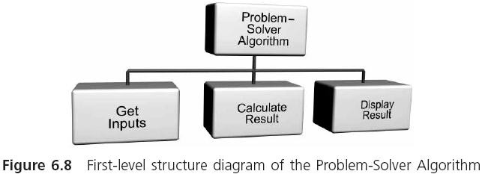
Case Study: Calculating Age Norms

Slide 24
Requirements Specification
A fairly common procedure in child development is to establish normal ranges for height and weight as they relate to a child’s age
These normal ranges are frequently referred to as age norms
In this case study, we develop a program for calculating both the expected height of a child between the ages of 6 and 11 and the deviation of this height norm to an actual child’s height

Slide 25
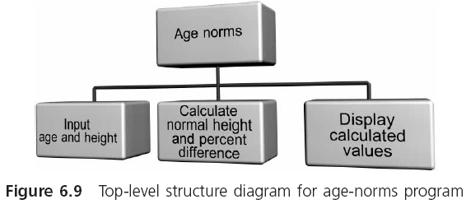
Requirements Specification (continued)

Slide 26
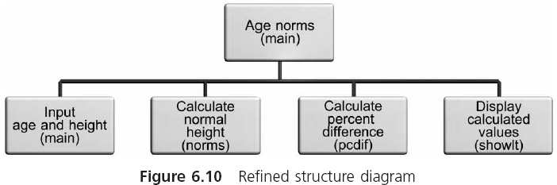
Requirements Specification (continued)

Slide 27
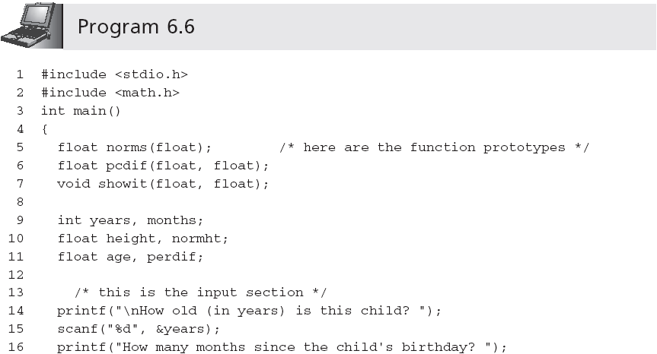
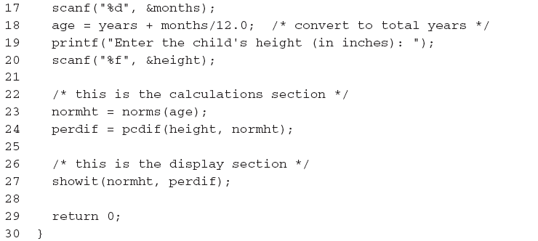
Requirements Specification (continued)

Slide 28
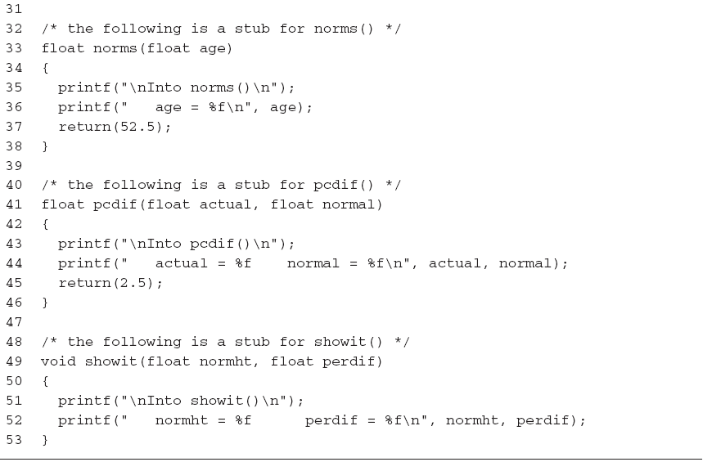
Requirements Specification (continued)

Slide 29
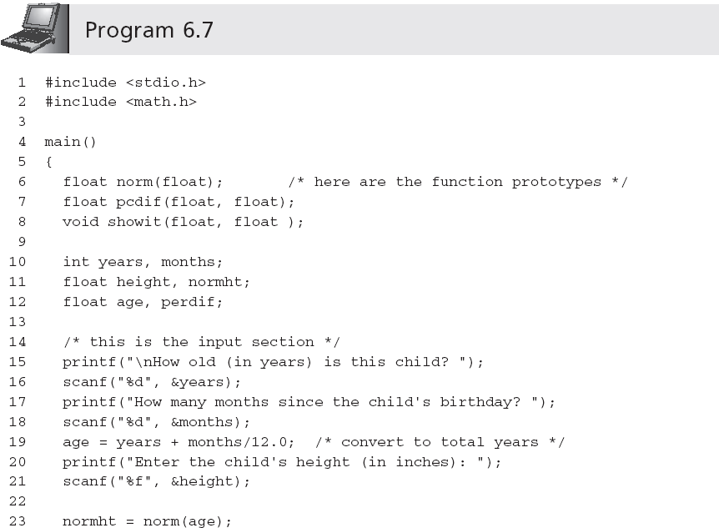
Requirements Specification (continued)

Slide 30
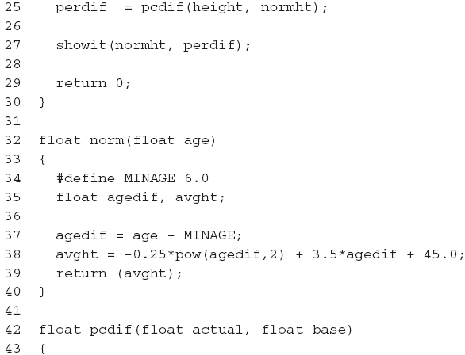
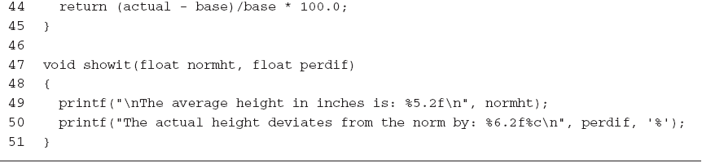
Requirements Specification (continued)

Slide 31

用户区
程序开始执行时给全局变量分配存储区，程序执行完毕就释放。在程序执行过程中占据固定的存储单元
程序区
静态存储区
动态存储区
全局变量全部存放在静态存储区中
①函数形式参数②函数中定义的没有用关键字static声明的变量③函数调用时的现场保护和返回地址等存放在动态存储区
函数调用开始时分配，函数结束时释放。在程序执行过程中，这种分配和释放是动态的
将数据存放在此区

Slide 32
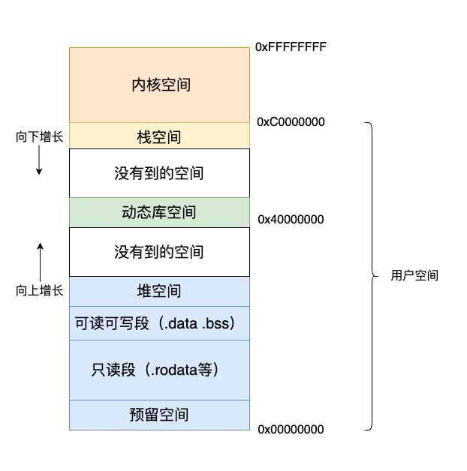


Slide 33
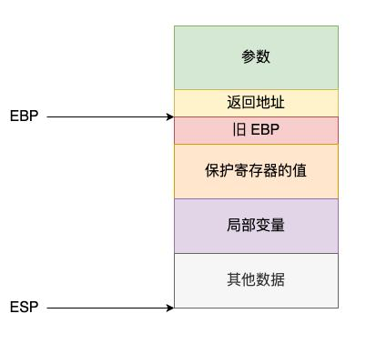
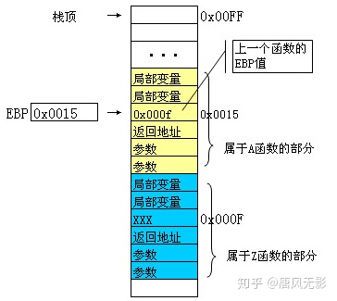

Slide 37
Standard Library Functions
The standard library consists of 15 header files
Before using these functions, you must know
The name of each available function
The arguments required by each function
The data type of the result (if any) returned by each function
A description of what each function does
How to include the library containing the desired function
#include <header-file-name>

Slide 38
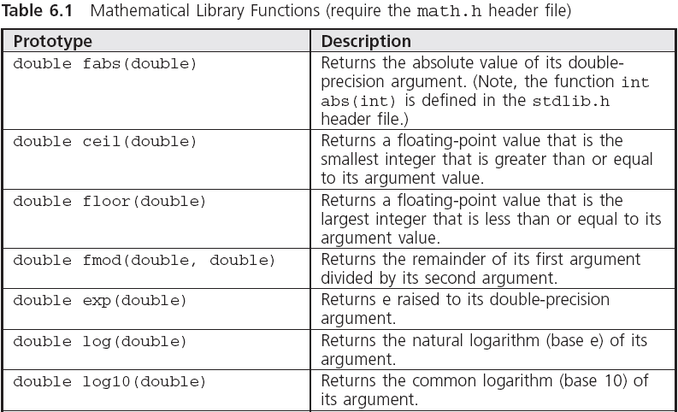
Mathematical Library Functions

Slide 39
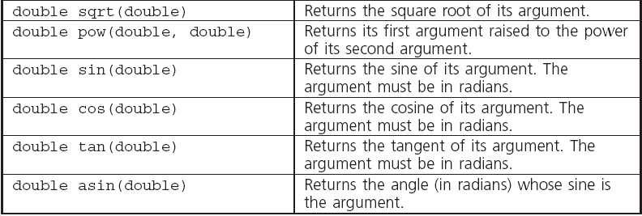
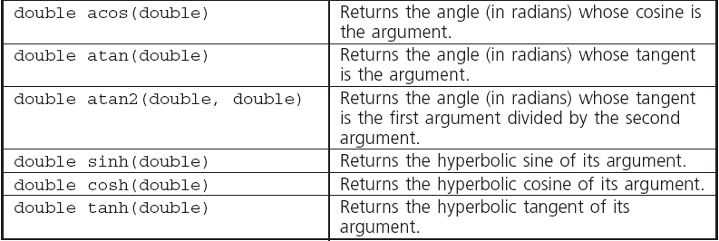
Mathematical Library Functions (continued)

Slide 40
The rand() and srand() Functions
Random numbers are a series of numbers whose order cannot be predicted
Pseudorandom numbers are not really random, but are sufficiently random for the task at hand
All C compilers provide two functions for creating random numbers: rand() and srand(), defined in the stdlib.h header file
rand() produces random numbers in the range 0 < rand() < RAND_MAX
srand() provides a starting “seed” value for rand()

Slide 41
线性模同余计算随机数序列
公式： y = (ax+b)%m
初始化：x=x0, 计算有y0=(ax0+b)%m
计算序列中第二项：令x1=y0, y1=(ax1+b)%m
计算序列中第三项：令x2=y1, y2=(ax2+b)%m
......
初始化的x0，就相当于于种子。

Slide 42
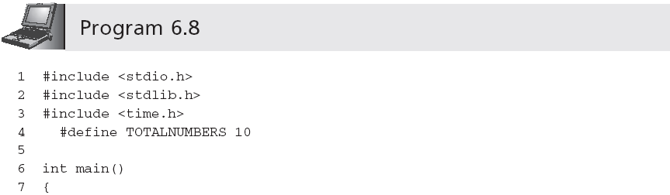
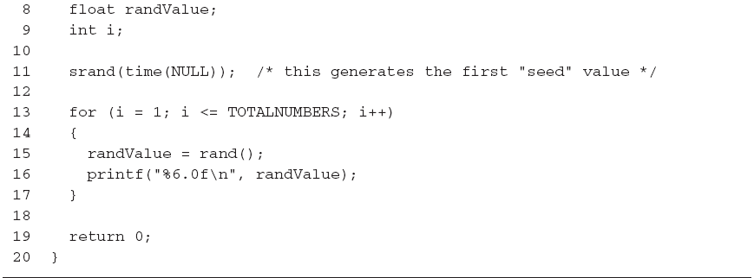
The rand() and srand() Functions (continued)

Slide 43
Scaling
The method for adjusting the random numbers produced by a random-number generator to reside within a specified range is called scaling
To scale a random number as an integer value between 1 and N:
1 + (int)rand() % N
To produce a random integer between the numbers a and b:
a + (int)(rand() % (b - a + 1))

Slide 44
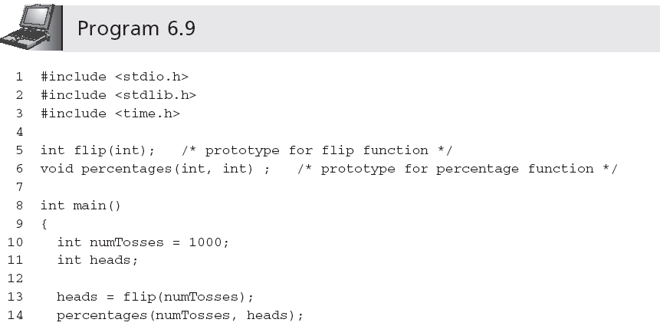

Coin Toss Simulation

Slide 45
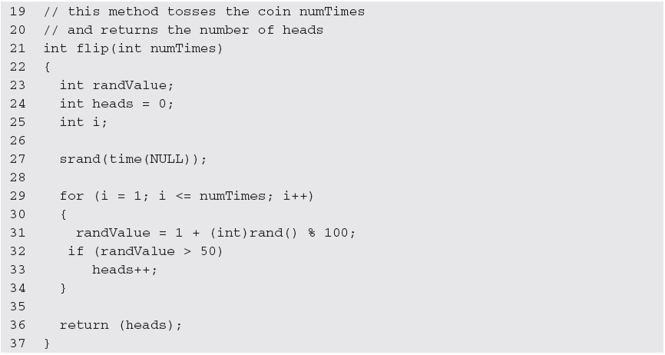
Coin Toss Simulation (continued)

Slide 46
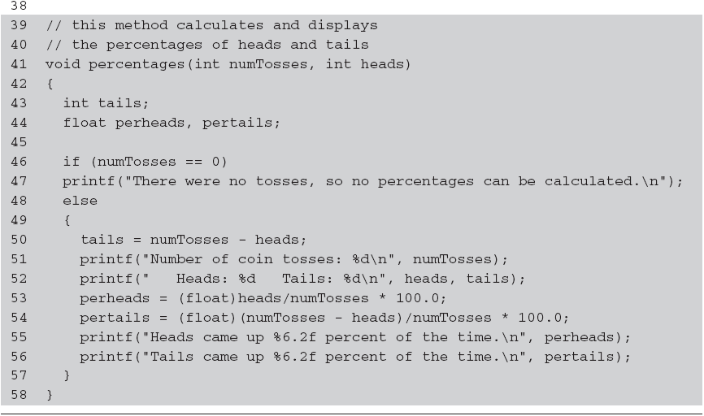
Coin Toss Simulation (continued)

Slide 47
Input/Output Library Functions
getchar() can be used for single character input
int getchar()
The reason for returning characters in integer format is to allow the End-Of-File (EOF) sentinel to be returned
putchar() expects a single character argument and displays the character passed to it on the terminal
For example, putchar('a')

Slide 48
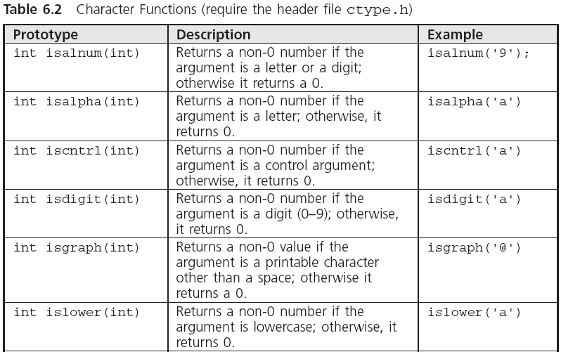
Character Processing Functions

Slide 49
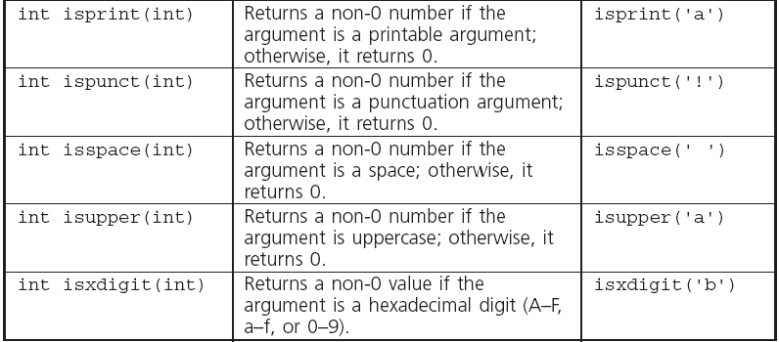
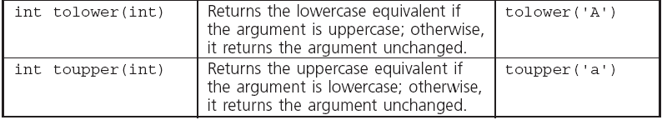
Character Processing Functions (continued)

Slide 50
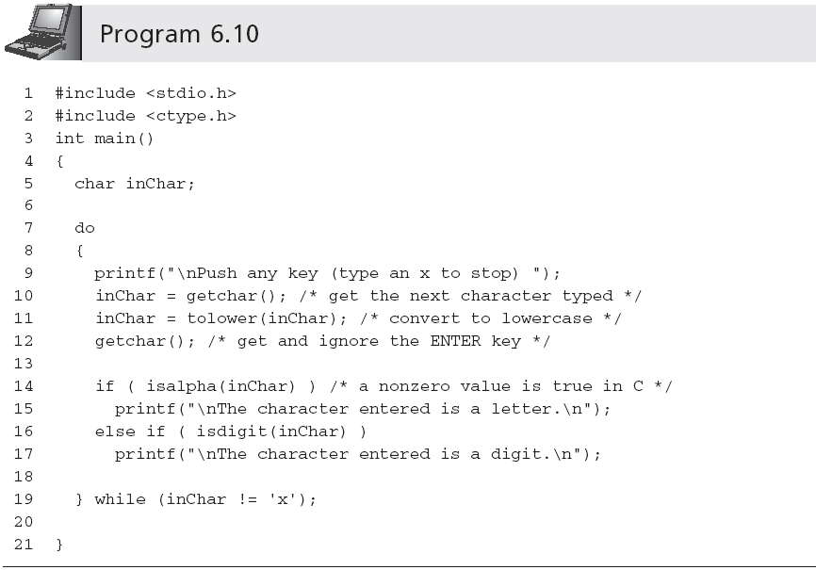
Character Processing Functions (continued)

Slide 51
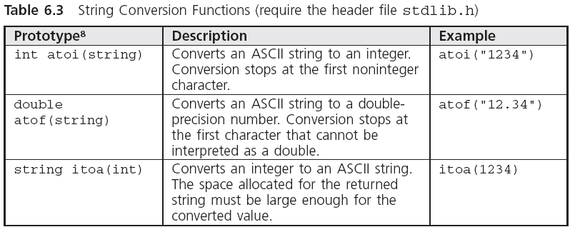
Conversion Functions

Slide 52
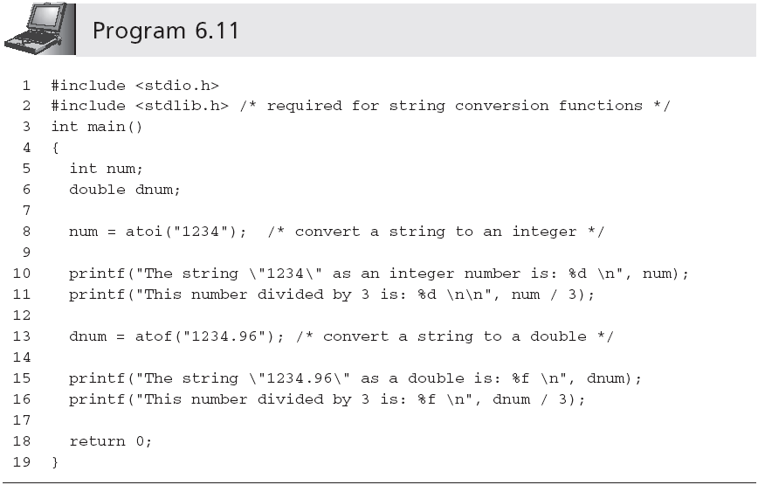
Conversion Functions (continued)

Slide 53
Recursion
Functions that call themselves are referred to as self-referential or recursive functions
When a function invokes itself, the process is called direct recursion
A function can invoke a second function, which in turn invokes the first function; this type of recursion is referred to as indirect or mutual recursion

Slide 54
Mathematical Recursion
The definition for n! can be summarized by the following statements:
0! = 1
1！=1*1=1*0！
2！=2*1=2*1！
3！=3*2*1=3*2!
n! = n * (n-1)! for n >= 1
This definition illustrates the general considerations that must be specified in constructing a recursive algorithm:
What is the first case or cases?
How is the n^{th} case related to the (n-1) case?

Slide 55
Mathematical Recursion (continued)
In pseudocode, the processing required is
If n = 0
factorial = 1
Else
Factorial = n * factorial(n - 1)
In C, this can be written as
int factorial(int n)
{
if (n == 0)
return (1);
else
return (n * factorial(n-1));
}

Slide 56
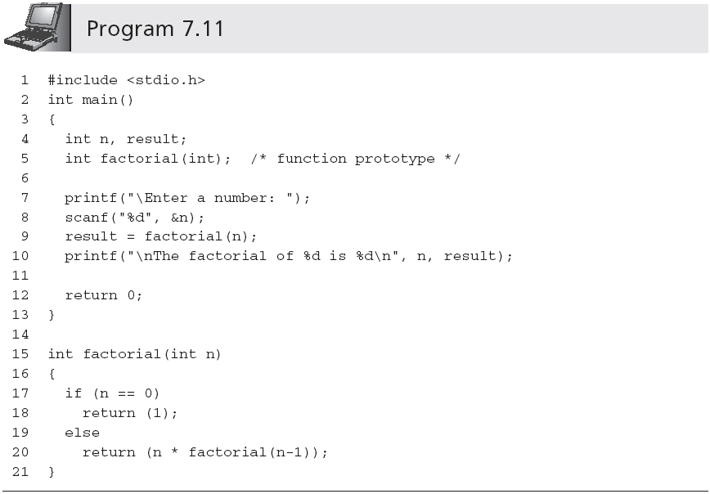
Mathematical Recursion (continued)

Slide 57
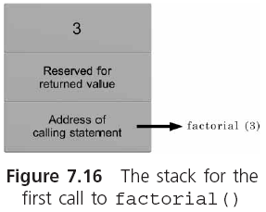
How the Computation is Performed

Slide 58
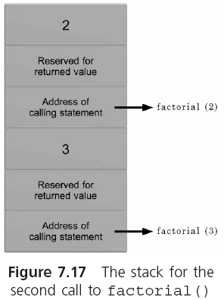
How the Computation is Performed (continued)

Slide 59
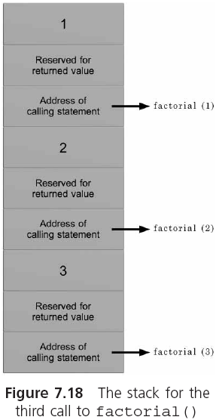
How the Computation is Performed (continued)

Slide 60
Recursion versus Iteration
The recursive method can be applied to any problem in which the solution is represented in terms of solutions to simpler versions of the same problem
Any recursive function can be written in a nonrecursive manner using an iterative solution
int factorial(int n)
{
int fact;
for(fact = 1; n > 0; n--)
fact = fact * n;
return (fact);
}

Slide 61
Hanoi（汉诺）塔问题。古代有一个梵塔，塔内有3个座A、B、C，开始时Ａ座上有64个盘子，盘子大小不等，大的在下，小的在上。有一个老和尚想把这64个盘子从Ａ座移到Ｃ座，但规定每次只允许移动一个盘，且在移动过程中在3个座上都始终保持大盘在下，小盘在上。在移动过程中可以利用B座。要求编程序输出移动一盘子的步骤。

Slide 62
A
B
C

Slide 63
解题思路：
要把64个盘子从A座移动到C座，需要移动大约2⁶⁴ 次盘子。一般人是不可能直接确定移动盘子的每一个具体步骤的
老和尚会这样想：假如有另外一个和尚能有办法将上面63个盘子从一个座移到另一座。那么，问题就解决了。此时老和尚只需这样做：

Slide 64
解题思路：
(1) 命令第2个和尚将63个盘子从A座移到B座
(2) 自己将1个盘子（最底下的、最大的盘子）从A座移到C座
(3) 再命令第2个和尚将63个盘子从B座移到C座

Slide 65
第1个和尚的做法
将63个从A到B
……
A
B
C

Slide 66
第1个和尚的做法
将63个从A到B
……
A
B
C

Slide 67
第1个和尚的做法
将1个从A到C
……
A
B
C

Slide 68
第1个和尚的做法
将1个从A到C
……
A
B
C

Slide 69
第1个和尚的做法
将63个从B到C
……
A
B
C

Slide 70
第1个和尚的做法
将63个从B到C
……
A
B
C

Slide 71
第2个和尚的做法
将62个从A到C
……
A
B
C

Slide 72
第2个和尚的做法
将62个从A到C
……
A
B
C

Slide 73
第2个和尚的做法
将1个从A到B
……
A
B
C

Slide 74
第2个和尚的做法
将1个从A到B
……
A
B
C

Slide 75
第2个和尚的做法
将62个从C到B
……
A
B
C

Slide 76
第2个和尚的做法
将62个从C到B
……
A
B
C

Slide 77
第3个和尚的做法
第4个和尚的做法
第5个和尚的做法
第6个和尚的做法
第7个和尚的做法
……
第63个和尚的做法
第64个和尚仅做：将1个从A移到C

Slide 78
将3个盘子从A移到C的全过程
将2个盘子从A移到B
A
B
C

Slide 79
将3个盘子从A移到C的全过程
将2个盘子从A移到B
A
B
C

Slide 80
将3个盘子从A移到C的全过程
将1个盘子从A移到C
A
B
C

Slide 81
将3个盘子从A移到C的全过程
将1个盘子从A移到C
A
B
C

Slide 82
将3个盘子从A移到C的全过程
将2个盘子从B移到C
A
B
C

Slide 83
将3个盘子从A移到C的全过程
将2个盘子从B移到C
A
B
C

Slide 84
将2个盘子从A移到B的过程
将1个盘子从A移到C
A
B
C

Slide 85
将2个盘子从A移到B的过程
将1个盘子从A移到C
A
B
C

Slide 86
将2个盘子从A移到B的过程
将1个盘子从A移到B
A
B
C

Slide 87
将2个盘子从A移到B的过程
将1个盘子从A移到B
A
B
C

Slide 88
将2个盘子从A移到B的过程
将1个盘子从C移到B
A
B
C

Slide 89
将2个盘子从A移到B的过程
将1个盘子从C移到B
A
B
C

Slide 90
将2个盘子从B移到C的过程
A
B
C

Slide 91
将2个盘子从B移到C的过程
A
B
C

Slide 92
将2个盘子从B移到C的过程
A
B
C

Slide 93
将2个盘子从B移到C的过程
A
B
C

Slide 94
解题思路：
(1) 命令第2个和尚将63个盘子从A座移到B座
(2) 自己将1个盘子（最底下的、最大的盘子）从A座移到C座
(3) 再命令第2个和尚将63个盘子从B座移到C座

Slide 95
可以将第(1)步和第(3)步表示为：
将“one”座上n-1个盘移到“two”座(借助“three”座)。
在第(1)步和第(3)步中，one 、two、three和A、B、C的对应关系不同。
对第(1)步，对应关系是one对应A，two对应B，three对应C。
对第(3)步，对应关系是one对应B，two对应C，three对应A。

Slide 96
把上面3个步骤分成两类操作：
(1) 将n-1个盘从一个座移到另一个座上（n＞1）。这就是大和尚让小和尚做的工作，它是一个递归的过程，即和尚将任务层层下放，直到第64个和尚为止。
(2) 将1个盘子从一个座上移到另一座上。这是大和尚自己做的工作。

Slide 97
编写程序。
用hanoi函数实现第1类操作（即模拟小和尚的任务）
用move函数实现第2类操作（模拟大和尚自己移盘）
函数调用hanoi(n,one,two.three)表示将n个盘子从“one”座移到“three”座的过程(借助“two”座)
函数调用move(x,y)表示将1个盘子从x 座移到y 座的过程。x和y是代表A、B、C座之一，根据每次不同情况分别取A、B、C代入

Slide 98
#include <stdio.h>
int main()
{ void hanoi(int n,char one,
char two,char three);
int m;
printf(“the number of diskes:");
scanf("%d",&m);
printf("move %d diskes:\n",m);
hanoi(m,'A','B','C');
}

Slide 99
void hanoi(int n,char one,char two,
char three)
{ void move(char x,char y);
if(n==1)
move(one,three);
else
{ hanoi(n-1,one,three,two);
move(one,three);
hanoi(n-1,two,one,three);
}
}

Slide 100

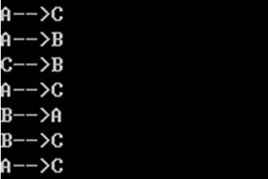
void move(char x,char y)
{
printf("%c-->%c\n",x,y);
}

Slide 101
Common Programming Errors
Passing incorrect data types
Omitting a called function’s prototype
Terminating a function’s header line with a semicolon
Forgetting to include a data type for each parameter listed in a function’s header line
Returning a different data type from a function than the data type specified in the function’s header line

Slide 102
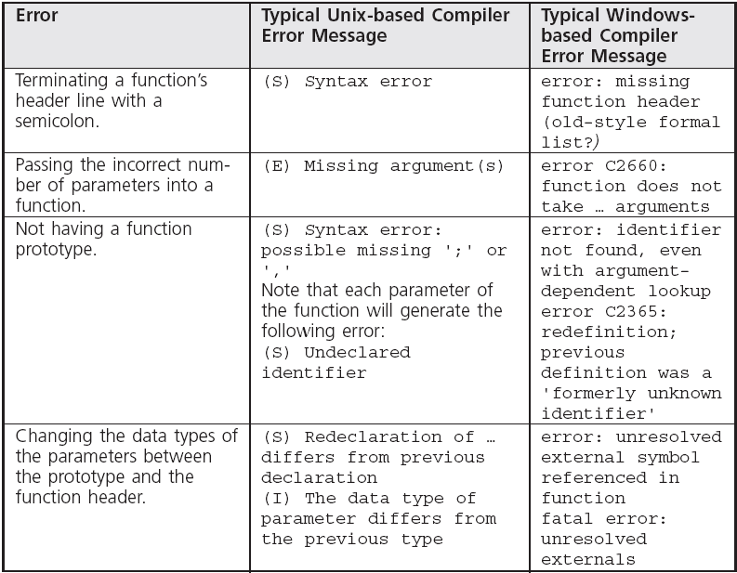
Common Compiler Errors

Slide 103
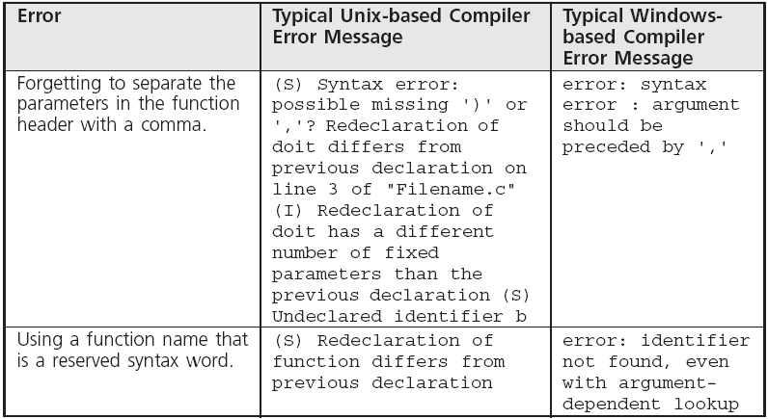
Common Compiler Errors (continued)

Slide 104
Summary
A function is called by giving its name and passing any data to it in the parentheses following the name
The first line of the function is called the function header
A function’s return type is the data type of the value returned by the function
Functions can directly return at most a single value to their calling functions

Slide 105
Summary (continued)
Functions can be declared to all calling functions with a function prototype
Arguments passed to a function provide a means of evaluating any valid C expression
A set of preprogrammed functions for mathematical calculations, character input and output, character processing, and numerical conversions are included in the standard library provided with each C compiler

Slide 106
练习
（1）用户输入一个正整数N，编写一个独立函数生成1~N之间的随机数（练习函数编写与调用的方法）。
扩展练习，(a)输入正整数M>>N，统计1~N之间任意一个随机数出现的频率，试验次数为M，验证它们是否相接近。即给定一个1<= i <= N, 在M次试验后，i出现频率是接近为1/N。
(b)将Main作为主控函数，初始化输入编写一个函数；随机数生成编写一个函数；频率统计编写一个函数；输出与资源清理编写一个函数(练习模块化编程)。
（2）将上次作业中阶乘求解算法，修改为递归实现。扩展练习：
(a)将求阶乘因子个数的算法编写为一个独立算法，并将该算法放到一个独立的文件中（也拥有独立的头文件）;
(b) 使用extern变量保存（a）中函数计算出的因子个数，共享到main函数中进行打印；
(c)增量阶乘计算，如7！=7*6*5！，可以使用static变量保存上次阶乘计算的相关数据与结果。

