Slide 1
Bioinformatics HW#2
Runan Yao
Partner: Harms, Alexander T

Slide 2
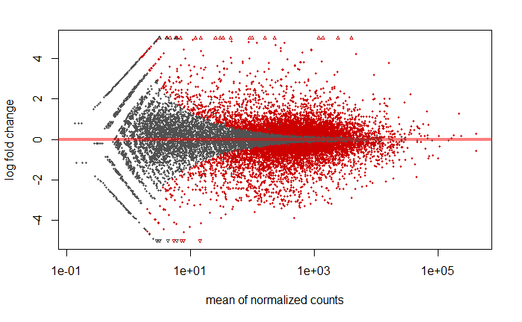
DESeq2 Result before lfcShrink

Slide 3
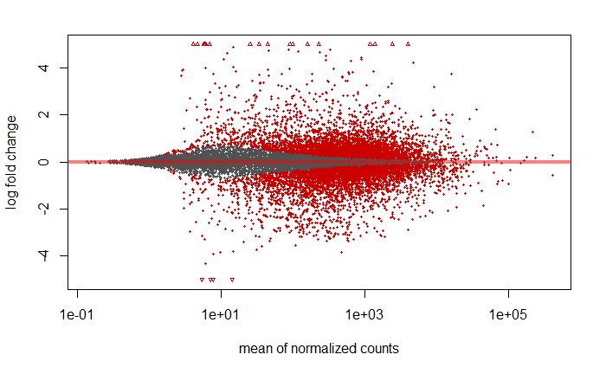
DESeq2 Result after lfcShrink

Slide 4
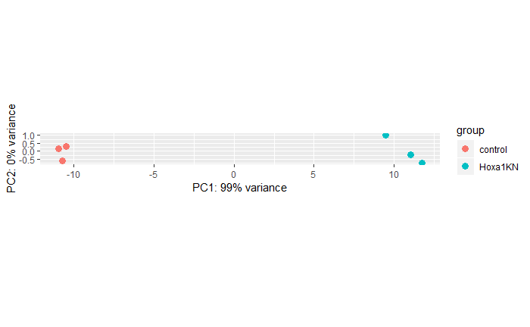
PCA before normalization

Slide 5
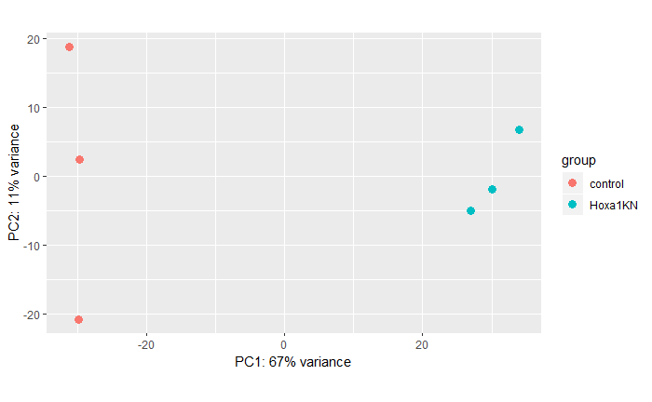
After normalization

Slide 6
Gene Function Analysis – Top Different Genes
Abs of LFC > 2
upgradeGenes <- res05incOrdered[res05incOrdered$log2FoldChange > 2, ]
downgradeGenes <- res05decsOrdered[res05decsOrdered$log2FoldChange < -2, ]
Increased (at least increased to twice) gene count: [1] 601
Decreased (at least reduced to half) gene count: [1] 553

Slide 7
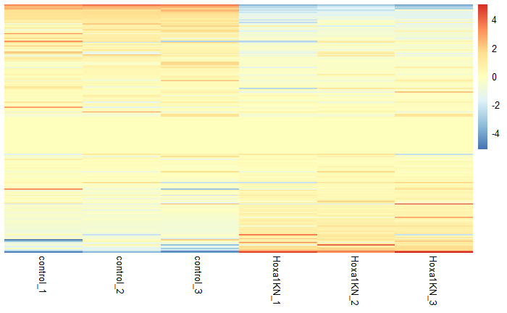
Some heatmap

Slide 8
Gene Function Analysis - Packages
https://david.ncifcrf.gov
Adv: web api
Disadv: do not have official R package ( have 3rd party )
http://genescf.kandurilab.org/
Adv: live databases (not one)
Dis adv: do not have any R package
http://geneontology.org/page/go-enrichment-analysis
Adv: official R package support
Dis adv: do not accept ensembl id

Slide 9
Convert Ensembl to GO
if(!file.exists('EG2GO.RDS')){
grch37 = useEnsembl(biomart="ensembl", dataset = "hsapiens_gene_ensembl")
head(listFilters(grch37))
EG2GO <- getBM(mart=grch37, attributes=c('ensembl_gene_id','go_id'))
saveRDS(EG2GO, file='EG2GO.RDS')
}else{
EG2GO <- readRDS('EG2GO.RDS')
} EG2GO <- EG2GO[EG2GO$go_id != '',]
s <- EG2GO$ensembl_gene_id %in% upGeneList
upGoId <- EG2GO %>%
filter(ensembl_gene_id %in% upGeneList) %>%
select(go_id)
upGoId <- unique(upGoId)

Slide 10
Online tools
http://geneontology.org/page/go-enrichment-analysis
http://www.pantherdb.org/
# Here we can go http://www.pantherdb.org/
# writeClipboard(rownames(upgradeGenes))
# writeClipboard(rownames(downGeneList))

Slide 11
Pantherdb
Pick the ‘up list’ genes
Functional classification viewed in gene list
Functional classification viewed in pie chart
Statistical overrepresentation test
Statistical enrichment test

Slide 12
Pantherdb
Functional classification viewed in gene list
Ontology:
Molecular Function
Biological Process
Cellular Component
Protein Class
Pathway
Pie chart – interactive
Bar chart – better reading
Gene list
Exportable data

Slide 13
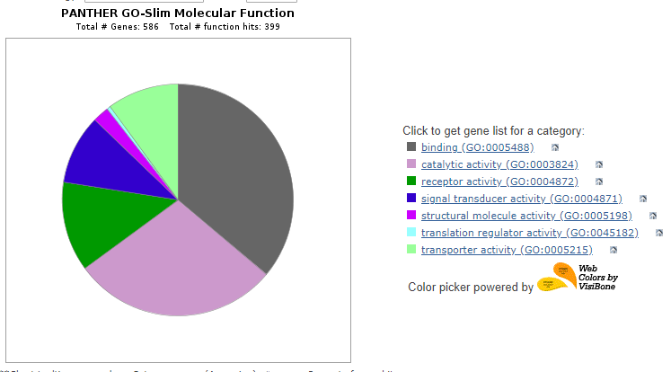
Pie chart

Slide 14
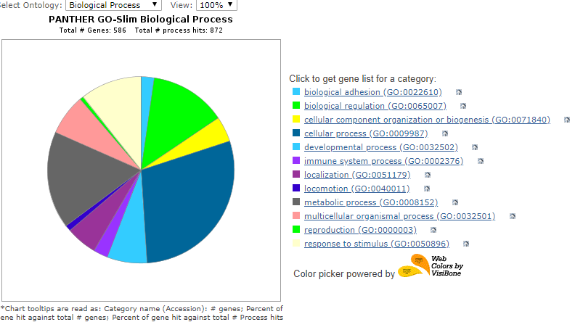
Pie chart

Slide 15
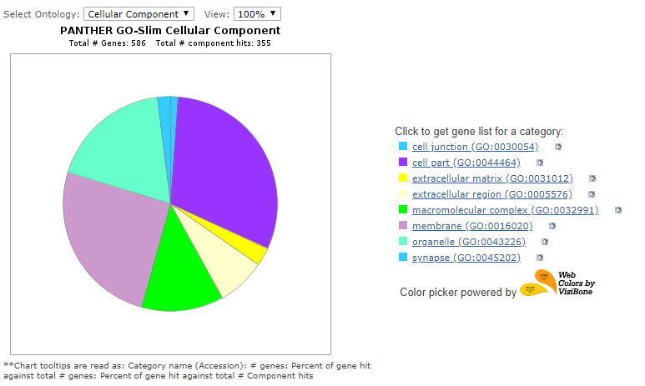
Pie chart

Slide 16
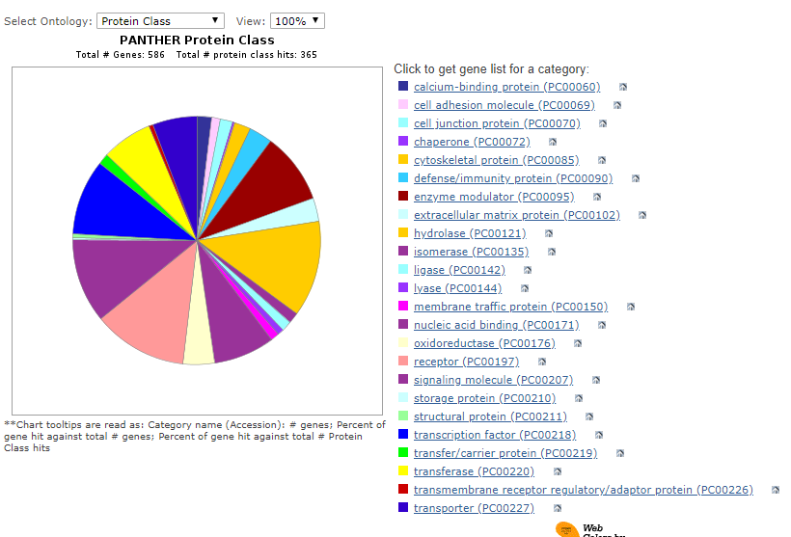
Pie chart

Slide 17
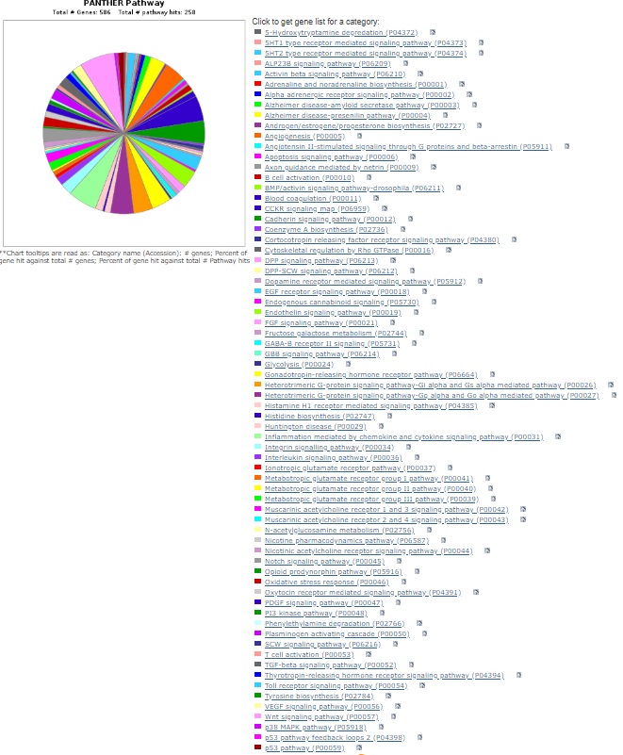
Pie chart

