Slide 1
Bioinformatics HW#3
Runan Yao
Partner: Harms, Alexander T

Slide 2
Gene Function Analysis - Packages
https://david.ncifcrf.gov
Adv: web api
Disadv: do not have official R package ( have 3rd party )
http://genescf.kandurilab.org/
Adv: live databases (not one)
Dis adv: do not have any R package
http://geneontology.org/page/go-enrichment-analysis
Adv: official R package support
Dis adv: do not accept ensembl id

Slide 3
Convert Ensembl to GO
if(!file.exists('EG2GO.RDS')){
grch37 = useEnsembl(biomart="ensembl", dataset = "hsapiens_gene_ensembl")
head(listFilters(grch37))
EG2GO <- getBM(mart=grch37, attributes=c('ensembl_gene_id','go_id'))
saveRDS(EG2GO, file='EG2GO.RDS')
}else{
EG2GO <- readRDS('EG2GO.RDS')
} EG2GO <- EG2GO[EG2GO$go_id != '',]
s <- EG2GO$ensembl_gene_id %in% upGeneList
upGoId <- EG2GO %>%
filter(ensembl_gene_id %in% upGeneList) %>%
select(go_id)
upGoId <- unique(upGoId)

Slide 4
Online tools
http://geneontology.org/page/go-enrichment-analysis
http://www.pantherdb.org/
# Here we can go http://www.pantherdb.org/
# writeClipboard(rownames(upgradeGenes))
# writeClipboard(rownames(downGeneList))

Slide 5
Up Gene List
Up:
110
rownames(upgradeGenes)[1:50]
[1] "ENSG00000109321" "ENSG00000125845" "ENSG00000072041" "ENSG00000110002" "ENSG00000104081" "ENSG00000153234" "ENSG00000130513" "ENSG00000128917"
[9] "ENSG00000151834" "ENSG00000108932" "ENSG00000149968" "ENSG00000159167" "ENSG00000169429" "ENSG00000124882" "ENSG00000042062" "ENSG00000197565"
[17] "ENSG00000114739" "ENSG00000168621" "ENSG00000164251" "ENSG00000102996" "ENSG00000101825" "ENSG00000183508" "ENSG00000104321" "ENSG00000150636"
[25] "ENSG00000171951" "ENSG00000196562" "ENSG00000161835" "ENSG00000101096" "ENSG00000116711" "ENSG00000105088" "ENSG00000196549" "ENSG00000057657"
[33] "ENSG00000091844" "ENSG00000166510" "ENSG00000041353" "ENSG00000118777" "ENSG00000164330" "ENSG00000123610" "ENSG00000185112" "ENSG00000152689"
[41] "ENSG00000154736" "ENSG00000002745" "ENSG00000186480" "ENSG00000115919" "ENSG00000164683" "ENSG00000157168" "ENSG00000095752" "ENSG00000066230"
[49] "ENSG00000157680" "ENSG00000198743"

Slide 6
Down Gene List
Down:
167
rownames(downgradeGenes)[1:50]
[1] "ENSG00000162520" "ENSG00000157456" "ENSG00000112984" "ENSG00000166851" "ENSG00000072571" "ENSG00000183287" "ENSG00000122966" "ENSG00000090889"
[9] "ENSG00000117399" "ENSG00000138180" "ENSG00000148773" "ENSG00000134690" "ENSG00000101057" "ENSG00000112742" "ENSG00000198901" "ENSG00000011426"
[17] "ENSG00000129195" "ENSG00000068489" "ENSG00000126787" "ENSG00000066279" "ENSG00000189056" "ENSG00000089685" "ENSG00000145386" "ENSG00000171241"
[25] "ENSG00000169679" "ENSG00000197594" "ENSG00000137812" "ENSG00000178999" "ENSG00000167900" "ENSG00000135069" "ENSG00000111206" "ENSG00000156970"
[33] "ENSG00000075218" "ENSG00000088325" "ENSG00000013293" "ENSG00000137804" "ENSG00000074410" "ENSG00000101447" "ENSG00000131747" "ENSG00000013297"
[41] "ENSG00000165072" "ENSG00000176890" "ENSG00000175063" "ENSG00000163431" "ENSG00000143228" "ENSG00000117724" "ENSG00000183856" "ENSG00000168078"
[49] "ENSG00000024526" "ENSG00000165480"

Slide 7
Pantherdb
Pick the ‘up list’ genes
Functional classification viewed in gene list
Functional classification viewed in pie chart
Statistical overrepresentation test
Statistical enrichment test

Slide 8
Pantherdb
Functional classification viewed in gene list
Ontology:
Molecular Function
Biological Process
Cellular Component
Protein Class
Pathway
Pie chart – interactive
Bar chart – better reading
Gene list
Exportable data

Slide 9
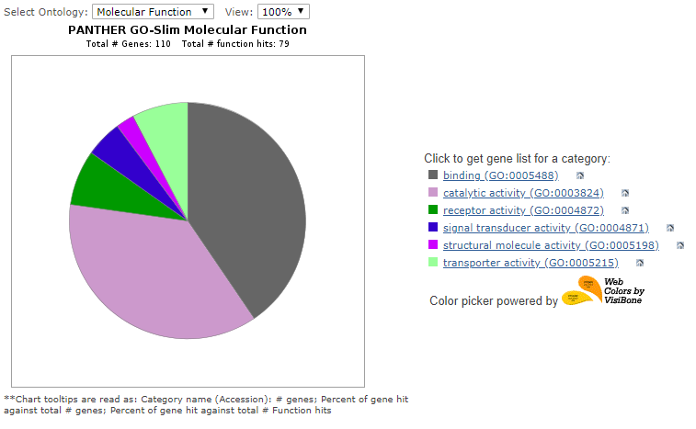
Up Molecular Function

Slide 10
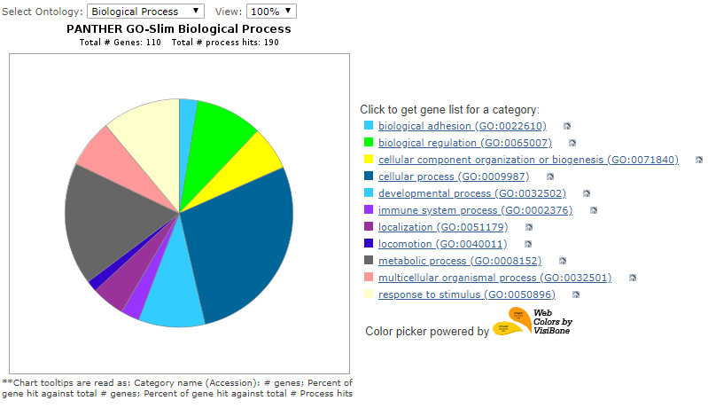
Up Biological Process

Slide 11
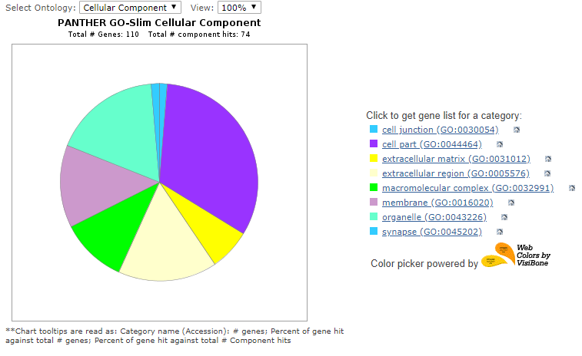
Up Cellular Component

Slide 12
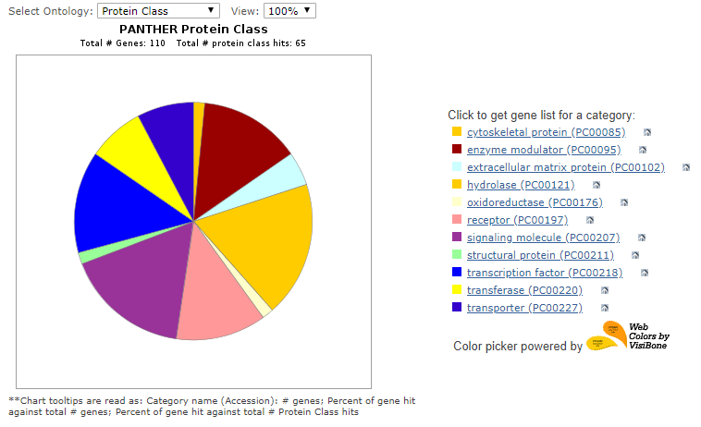
Up Protein Class

Slide 13
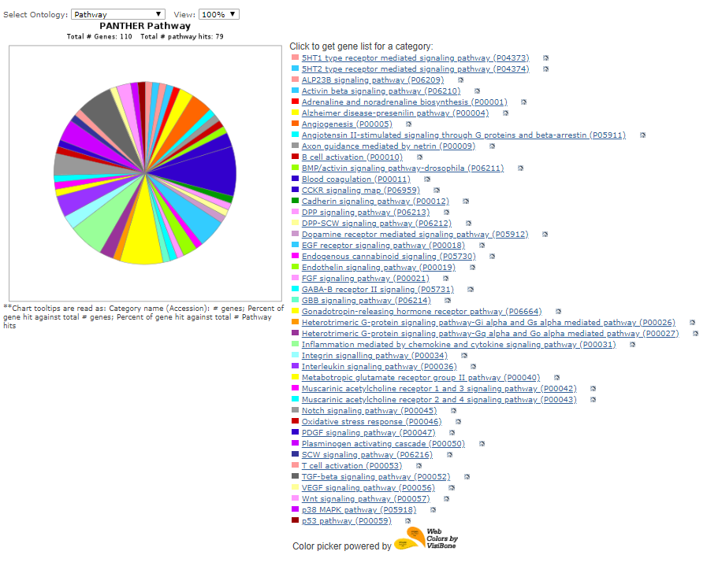
Up Pathway

Slide 14
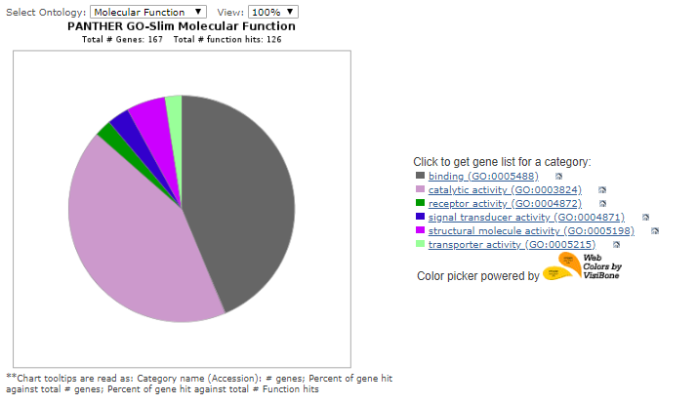
Down Molecular Function

Slide 15
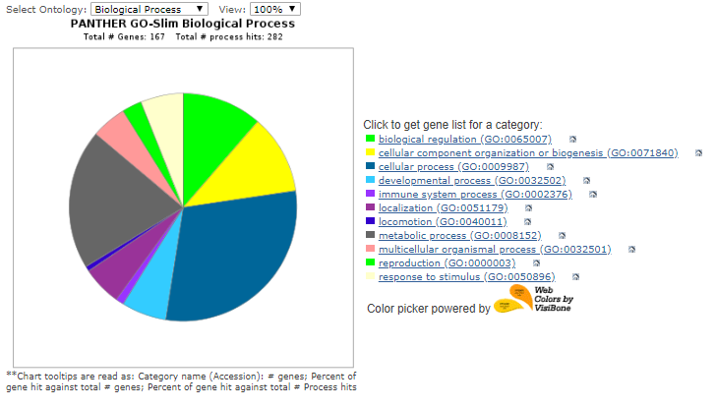
Down Biological Process

Slide 16
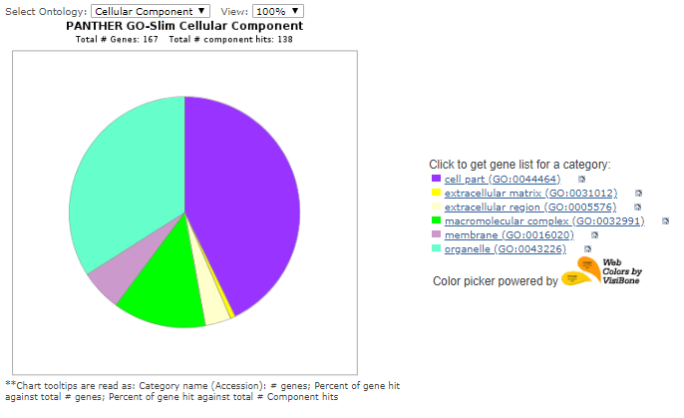
Down Cellular Component

Slide 17
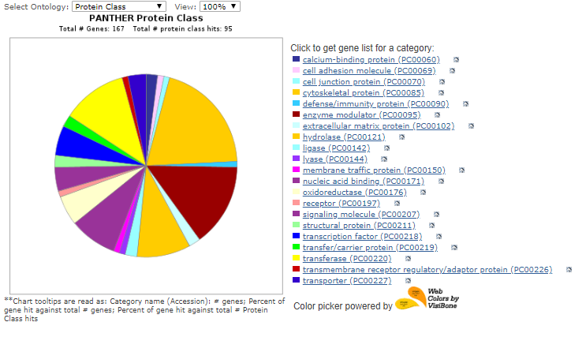
Down Protein Class

Slide 18
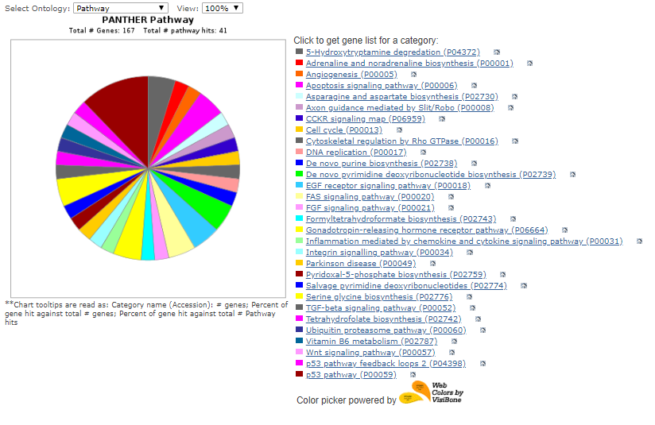
Down Pathway

