Slide 1

BIRD SOUND
CLASSIFICATION
using MFCC & SVM
Team Members: BEN FLIS ZIYA
THANHA NOORUDHEEN TT
ALEENA V J

Slide 2
PROBLEM STATEMENT
& MOTIVATION
🌿
🔊
⚙️
THE NEED
THE CHALLENGE
OUR APPROACH
Monitor biodiversity at scale using audio - non-invasive, continuous, and deployable anywhere.
Distinguish similar-sounding species like Cuckoo vs. Kingfisher from messy background noise.
Classical ML (SVM) over Deep Learning - resource-efficient, interpretable, runs on any device.

Slide 3
DATA SCIENCE
LIFE CYCLE
01
02
03
04
05
06
07
08
09
10
Definition
Collection
Preprocessing
EDA
Feature Eng.
Modeling
Evaluation
Interpretation
Deployment
Documentation

Slide 4
DATASET
OVERVIEW
347
5
140
Total
Samples
Bird
Classes
Features
per File
CLASS DISTRIBUTION
🔵 Bluejay
20%
🐦 Crow
22%
🐤 Cuckoo
18%
🟢 Kingfisher
22%
🔇 Noise
18%
Source: Xeno-Canto / Kaggle

Slide 5
FEATURE
ENGINEERING
MFCC
Simulates human hearing, captures timbre & pitch.
80
20 coeff × 4 stats
Spectral Centroid
Brightness : sharp chirp vs. dull call.
4
1 feat × 4 stats
Spectral Rolloff
Separates noise from tonal bird calls.
4
1 feat × 4 stats
Zero Crossing Rate
Detects percussive / noisy bursts.
4
1 feat × 4 stats
Chroma Features
Harmonic & melodic pitch content of call.
48
12 bins × 4 stats

Slide 6
MODEL
COMPARISON
★ WINNER
SVM
RF
KNN
RBF · C=10 · γ=scale
200 trees · seed=42
k=5 · Euclidean
81.4%
~78%
~72%
accuracy
accuracy
accuracy
F1: 0.80
F1: 0.77
F1: 0.70
Best performer, used for deployment
Provides feature importance insights
Simple, fast baseline classifier

Slide 7
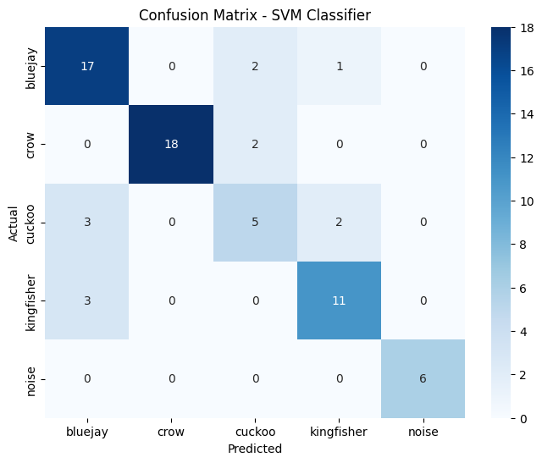
MODEL EVALUATION
CONFUSION MATRIX
📊
[ Paste Confusion Matrix
Heatmap Screenshot Here ]
KEY INSIGHTS
Noise
Highest accuracy : unique spectral signature
Crow
Strong recall : low-frequency raspy call
Bluejay
Slight confusion with Kingfisher
Cuckoo
Trickiest : varying pitch causes mix-ups
Kingfisher
Good recall : sharp whistle stands out

Slide 8
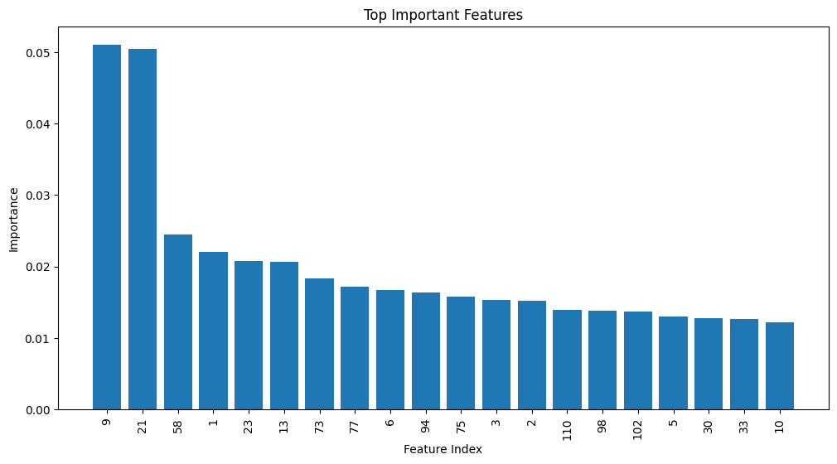
FEATURE IMPORTANCE
EXPLAINABILITY — RANDOM FOREST
📊
[ Paste Feature Importance
Bar Chart from Cell 17 ]
FEATURE INDEX MAP
0 – 79
MFCC stats
80 – 83
Spectral Centroid
84 – 87
Spectral Rolloff
88 – 91
Zero Crossing Rate
92 – 139
Chroma Features

Slide 9
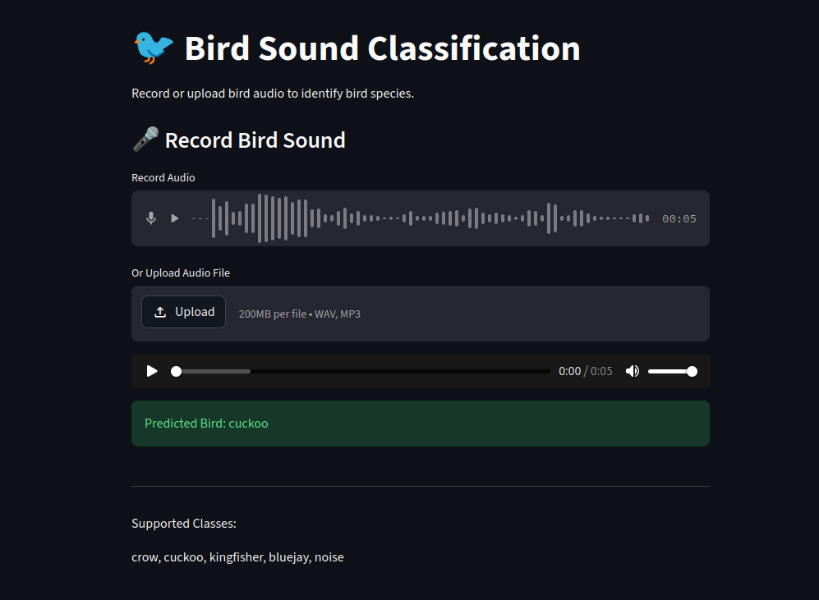
STREAMLIT
DEPLOYMENT
🖥️
[ Paste Streamlit
App Screenshot Here ]
Upload .wav or .mp3 directly
📁
🎙️
Record audio via microphone
🤖
Instant SVM prediction
📊
MFCC visual + confidence score
🌐
Live URL: https://bird-sound-classification-mqczgejumcx4e5u7sxb5jt.streamlit.app/
model/bird_svm_model.pkl · model/scaler.pkl · app.py

Slide 10
CONCLUSION
& FUTURE WORK
✅ MFCC + SVM achieved 81.4% accuracy, proving classical ML is highly effective for bio-acoustic classification with limited data.
⚠️ LIMITATIONS
🚀 FUTURE WORK
→ Small dataset, Cuckoo underrepresented.
→ CNN on mel-spectrograms for higher accuracy.
→ No real-time field recording pipeline yet.
→ Real-time Raspberry Pi mic pipeline.
→ Limited background noise diversity.
→ Federated community bird monitoring.
→ Expand to 20+ species from Xeno-Canto.

