Slide 1
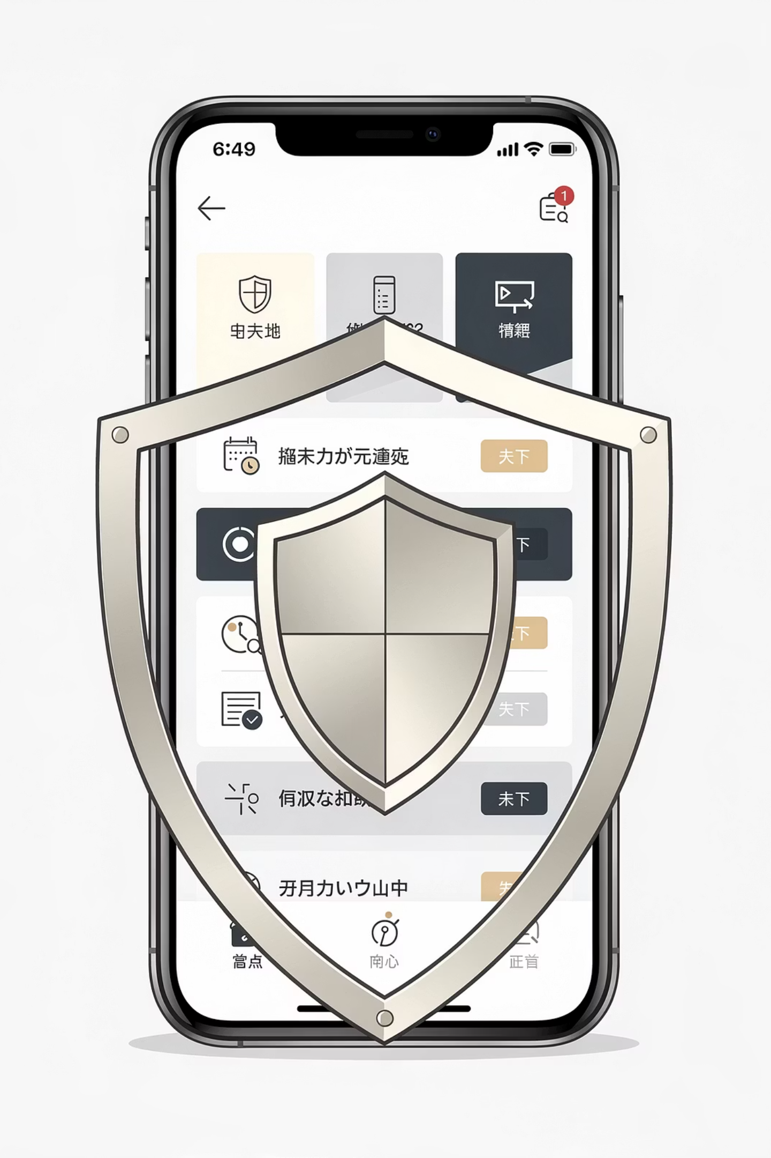
Hackathon Pitch
Promon Lens
Transforming mobile security conversations from abstract to actionable

Slide 2

Security is abstract. Value is hard to see.
In mobile security sales, the biggest barrier isn't the product—it's helping customers understand why they need it. When threats feel theoretical and protection seems invisible, closing deals becomes an uphill battle.

Slide 3


The Challenge We're Solving
Invisible Threats
Time Drain
Disconnected Tools
Customers struggle to identify which specific threats target their unique applications and business models
Sales Engineers spend valuable meeting time explaining basic security concepts rather than demonstrating concrete value
Promon Insight appears as an optional add-on instead of showcasing its power as a core security intelligence platform
The result? Conversations stall before they begin—or never start at all. Prospects remain unconvinced, and opportunities slip away.

Slide 4
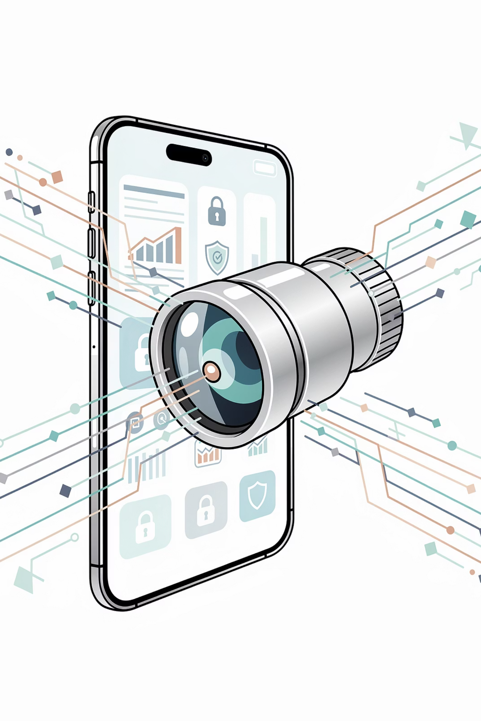
Solution: Promon Lens
01
02
Personalized Threat Analysis
Portfolio Mapping
Make mobile security tangible by demonstrating exactly how threats apply to each customer's specific application and industry
Clearly illustrate how Promon's comprehensive security portfolio directly mitigates the identified threats
03
Automated Briefings
Generate precise, to-the-point briefing documents automatically—no manual research required
Sales Enablement
Demand Generation
Connect Promon's portfolio to the customer's app before the meeting even starts, ensuring productive, value-focused conversations from minute one
Enable self-guided app analysis directly on the Promon website, letting prospects discover their vulnerabilities independently

Slide 5
Value & Business Impact
Customer Value
Promon Value
Clarity on Real Threats
Faster Value Conversations
Understand which threats actually matter for their specific application context
Skip the education phase and jump directly into meaningful discussions about protection and ROI
Clear Protection Path
Earlier Insight Positioning
See precisely how Promon's solutions mitigate their unique threat landscape
Establish Promon Insight as essential from day one rather than an afterthought
Real-Time Intelligence
Scalable Asset
Leverage Promon Insight to observe actual attacks and emerging trends in production environments
Create a repeatable, scalable resource for both pre-sales engagement and post-sales success
Data-Driven Decisions
Competitive Edge
Make informed, evidence-based security investments with confidence
Achieve stronger market differentiation through personalized, app-specific conversations from the very first interaction

Slide 6

Promon Lens
Turn security from abstract concepts into app-specific insight
By making threats visible and mitigation tangible, Promon Lens transforms how companies understand and invest in mobile security—creating faster sales cycles, stronger customer relationships, and measurable business impact.

