Slide 1
State
When A Class Is ambitious and wants to be many things
https://refactoring.guru/design-patterns/state

Slide 2
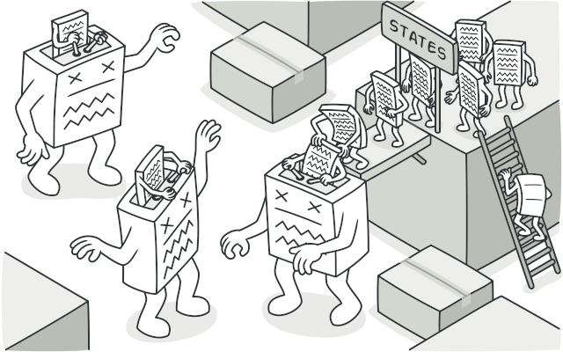
State
A quick recap: A state of an object is defined as the value and behaviours of the object at any given time during program execution.
A pattern implemented when an object wants to alter its behaviour. It might behave like a different class.
Depending on its internal state, an object may react differently to different scenarios.
The state pattern enables a modular way to add states and control transitions. We decouple the state from the object.

Slide 3
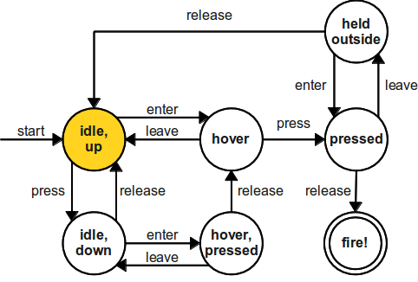
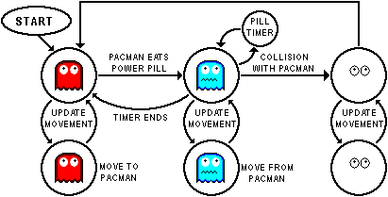
A Finite State Machine
A program can be divided into a finite number of states across which its execution is tracked.
Within a state, the program behaves differently
We can change the state of a program instantly.
Moving from one state to another state is bound by rules. These “Transitions” are also finite and predetermined.
The circles are our states
The arrows between them are transitions that encapsulate rules for state switching
If you are in the mood for some ‘light’ reading: https://en.wikipedia.org/wiki/Finite-state_machine

Slide 4
Apply this concept to objects
An object can be in multiple states. It’s behaviour is usually determined by its state:
Dog
Happy State: It wags its tail, sticks out its tongue and is playful
Scared State: Tail between its legs, tongue inside its mouth, whimpering
Aggressive State: Tail is not wagging, growling, tail is raised high, bared teeth
A UI Button:
Hover State: might change color
Pressed: Might change image and how its rendered
Idle: Render default image
Disabled: Button is not rendered

Slide 5
State – Naïve Implementation
import enum class ButtonEnum(enum.Enum): IDLE = 0, HOVER = 1, PRESSED = 2 DISABLEd = 3 class Button: def __init__(self, idle_img, hover_img, pressed_img, callback): self.btn_state = ButtonEnum.IDLE self.btn_on_click_callback = callback self.idle_img = idle_img self.hover_img = hover_img self.pressed_img = pressed_img def render(self): if self.btn_state == ButtonEnum.IDLE: print(f"Displaying {self.idle_img}") elif self.btn_state == ButtonEnum.HOVER: print(f"Displaying {self.hover_img}") elif self.btn_state == ButtonEnum.PRESSED: print(f"Displaying {self.pressed_img}") else: print("Button disabled") def on_button_press_callback(): pass def main(): idle_img = "btn_save_idle_sprite.png" hover_img = "btn_save_hover_sprite.png" pressed = "btn_save_pressed_sprite.png" button = Button(idle_img, hover_img, pressed, on_button_press_callback) button.render() button.btn_state = ButtonEnum.PRESSED button.render()
A ButtonEnum defines the different states a button can take.
A button stores its current state as an attribute
We use a series of if-else statements to change behaviour.
While this may be acceptable for simple scenarios, it isn’t maintainable in larger systems.

Slide 6
State – Naïve Implementation
import enum class ButtonEnum(enum.Enum): IDLE = 0, HOVER = 1, PRESSED = 2 DISABLEd = 3 class Button: def __init__(self, idle_img, hover_img, pressed_img, callback): self.btn_state = ButtonEnum.IDLE self.btn_on_click_callback = callback self.idle_img = idle_img self.hover_img = hover_img self.pressed_img = pressed_img def render(self): if self.btn_state == ButtonEnum.IDLE: print(f"Displaying {self.idle_img}") elif self.btn_state == ButtonEnum.HOVER: print(f"Displaying {self.hover_img}") elif self.btn_state == ButtonEnum.PRESSED: print(f"Displaying {self.pressed_img}") else: print("Button disabled") def on_button_press_callback(): pass def main(): idle_img = "btn_save_idle_sprite.png" hover_img = "btn_save_hover_sprite.png" pressed = "btn_save_pressed_sprite.png" button = Button(idle_img, hover_img, pressed, on_button_press_callback) button.render() button.btn_state = ButtonEnum.PRESSED button.render()
We want to be able to add and remove states without re-compiling the button class.
We want to be able to implement state-dependent behaviours easily as well.
In other words…
Making any changes to the states will affect the button class. Button is coupled to its state.
We want the button to be decoupled from its state.

Slide 7
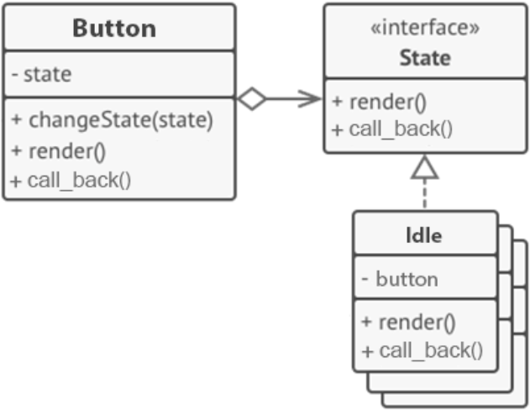
State Pattern
We separate the State out into its own hierarchy.
The Button should be dependent on a State interface, not the concrete states (Idle, Hover, Pressed, Disabled).
Now we can add and remove states easily.
The State Interface consists of all the state-defined behaviours in the Button class. This allows the Button class to communicate with it.
(In a way the Button wraps around its state)
Optionally, the state can keep a reference to the Button.
self.state.render()
print(f"Displaying {self.idle_img}")

Slide 8
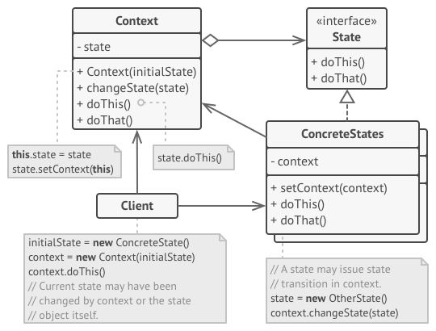
The generalized pattern
The object that has multiple States is called the Context
The context has a method to change its state.
The context delegates part or all of its behaviour to the State.
The concrete state may or may not have access to the context. If the state is responsible for changing the state of the context then this may be required.
The client instantiates the new state and assigns it to the context.

Slide 9
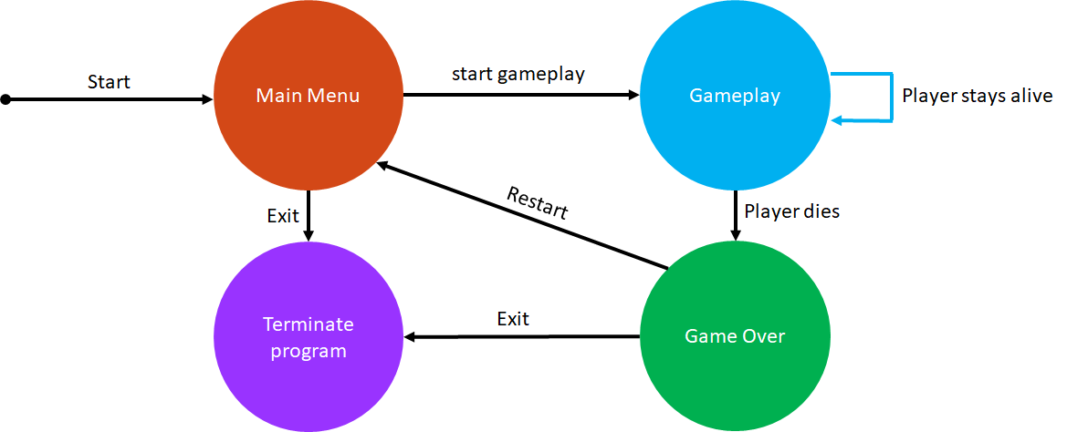
State example
We are working on a game where there are multiple game states controlled by a finite state machine (FSM)
Depending on user input, the FSM can change to one of the following states:
Main Menu
Gameplay
Game Over
The FSM’s representation of the game changes based on its state. The game starts off in the Main Menu state

Slide 10
State example
Different game events and transitions can occur depending on the state the game is in
Main Menu state
Transition to gameplay state
Exit program
Gameplay state
Keep playing the game
Character dies, go to the Game Over state
Game Over state
Return to main menu state
Exit program
Draw a UML diagram depicting how you would use the state pattern to solve this.

Slide 11
State transition diagram
Main Menu
Gameplay
Start
start gameplay
Player stays alive
Exit
Restart
Player dies
Terminate program
Game Over
Exit

Slide 12
State example
State
Let’s examine what happens in each state:
Game states generally contain Begin, Update, and End methods
Begin method – initialization executed once when entering the state
Update method – code executed every frame
End method – clean up executed once when exiting the state
Each type of state (Main Menu, Gameplay, Game Over) has different code in each of the methods
Begin
FSM calls state to begin
FSM calls state to update
Update
FSM calls state to end
End

Slide 13
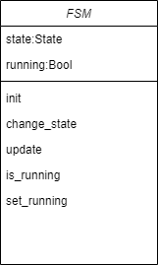
State example
1. Let’s start with modelling the FSM.
This is the context that will keep changing states
Properties
state
running
Methods
init()
change_state(state)
update()
is_running() -> Bool
set_running(running)
*BOLD items are pattern specific attributes

Slide 14
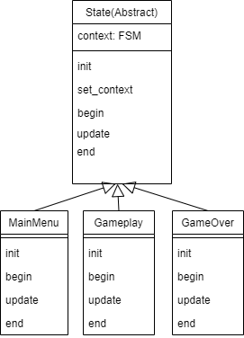
State example
State
Begin
Update
2. Model the States
1 abstract base class
3 sub class states: MainMenu, Gameplay, GameOver
Properties
context – reference back to FSM context
Methods
init()
set_context() – set reference back to context
begin()
update()
end()
End
*BOLD items are pattern specific attributes

Slide 15
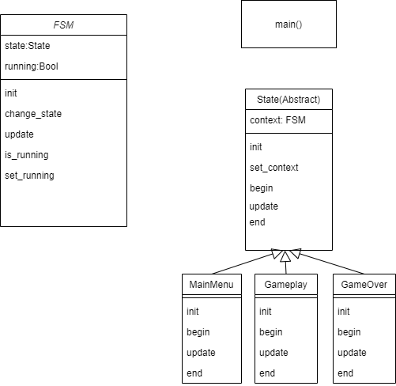
State example
Put it all together
main() is the client
Instantiate FSM and first state
Have a loop that will keep calling FSM update until FSM stops running

Slide 16

State example
Put it all together
main() is the client
Instantiate FSM and first state
Have a loop that will keep calling FSM update until FSM stops running
game_state_pattern.py

Slide 17
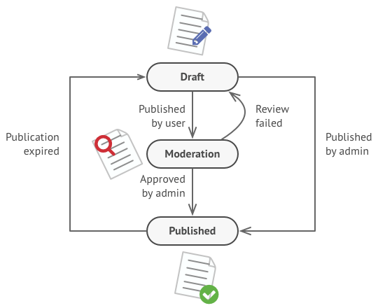
Another example – Document publishing
class DocumentState(enum.Enum): DRAFT = 0, MODERATION = 1, PUBLISHED = 2 class Document: def __init__(self, state): self.state = DocumentState.DRAFT # .. # .. def publish(self): if self.state == DocumentState.DRAFT: self.state = DocumentState.MODERATION print("Document is now waiting for approval") elif self.state == DocumentState.MODERATION: if current_user.role == "admin" and self.valid: self.state = DocumentState.PUBLISHED elif current_user.role == "admin" and not self.valid: self.state = DocumentState.DRAFT else: print("Only a admin can approve") else: print("Document already published.") # ... # ...

Slide 18
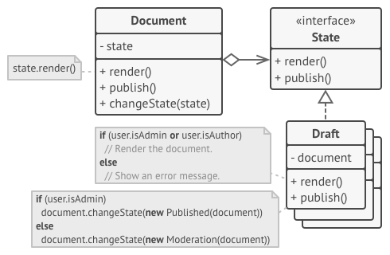
State Pattern
We separate the State out into its own hierarchy.
The Document should be dependent on a State interface, not the concrete states (Draft, Moderation and Published).
Now we can add and remove states easily.
The State Interface consists of all the state-defined behaviours in the Document class. This allows the document class to communicate with it.
(In a way the Document wraps around its state)
Optionally, the state can keep a reference to the Document.
document_state_pattern_example.py***

Slide 19

State: Why and When do we use it
Use this pattern when an object’s behaviour is heavily dependent on its states and the number of states can be large (or you may want to add more in the future)
Avoid massive if statement blocks to handle object behaviours based on state conditions.
You can create hierarchies of state classes if there are a lot of similar states that share code.
Implements the Single Responsibility Principle. Each state is self-contained.
Implements the Open/Closed Principle. We can add and remove states without modifying the context and multiple if-else statements.

Slide 20

State – Disadvantages
Can become hard to maintain if the object rarely changes state or only has a few states. Sometimes a simpler solution involving conditional statements works better.
State Transitions can be complex, especially if each state knows about its neighbouring states (that it transitions from/into). This can make the states highly coupled with each other.
There are a lot more classes and code to maintain.

Slide 21
How is State different from Strategy?
They solve different problems
Strategy
Choose an algorithm at run time
Algorithms don’t know about each other
Strategy usually does not have a reference to context
State
Change between states often based on some rules prescribed by a finite state machine.
States can know about each other
Can have a reference to context

Slide 22
Summary
When you need to switch behaviours at runtime (sounds a lot like State)
State
Allows a single object to have multiple behaviours.
These may be completely different behaviours as if the object belonged to another class.
The object is decoupled from its state.
Another way of phrasing this is that it let’s you swap algorithms at run-time.
Strategy

