Slide 1
Multiple Inheritance
COMP3522 Object Oriented Programming 2
Week 4

Slide 2
Recap
Ranges & Slicing
Iterators
Protocols
Sized
Container
Python Functions
Positional Arguments
Default Arguments
Named Arguments
Variable List Arguments
Unpacking
Variable Keyword Aguments

Slide 3
Unpacking

Slide 4
Unpacking
We’ve learned about unpacking using the * asterisk
There’s another form of unpacking that occurs implicitly without using the operator

Slide 5
Unpacking
Try this code:
>>> item1,item2 = (1, 2)
>>> print(item1)
>>> print(item2)

Slide 6
Unpacking
Try this code:
>>> item1,item2 = (1, 2)
>>> print(item1)
1
>>> print(item2)
2
Dynamically assigning each element of a sequence to a corresponding variable is known as unpacking.

Slide 7
Unpacking
Example of unpacking dictionary
default_character_data = {
'name' : "Untitled",
'level' : 4,
'max_level' : 10,
'weapon' : "Sword",
'Gender' : "Male"
}
for a_key, an_item in default_character_data.items():
print(f"{a_key} - {an_item}")

Slide 8
Unpacking
Example of unpacking dictionary
{'name' : "Untitled",
'level' : 4,
'max_level' : 10,
'weapon' : "Sword",
'Gender' : "Male“}
for a_key, an_item in default_character_data.items():
print(f"{a_key} - {an_item}")

Slide 9
Variable Keyword Arguments

Slide 10
Variable Keyword Arguments
Named Arguments are also known as Keyword Arguments.
Just like we can accept an arbitrary variable number of arguments using *args
*args is treated like a sequence type
We can accept an arbitrary variable number of keyword arguments using **kwargs
**kwargs is treated like a dictionary

Slide 11
Recall: Named Arguments
def my_func(a_list, a_num, a_string): print(a_list, a_num, a_string)
my_func(a_num=5, a_string='hello', a_list=['cat','dog'])
The position of parameters that are passed in doesn’t matter with named arguments. All that matters is explicitly assigning a value to a matching parameter name

Slide 12
Variable Keyword Arguments
def variable_keyword_args(**kwargs): for key, item in kwargs.items(): print(key, item) variable_keyword_args(port=21, host='localhost', debug=True)
Looks like we’re passing in named arguments
Also notice how this looks like a dictionary without the {}

Slide 13
Variable Keyword Arguments
def variable_keyword_args(**kwargs): for key, item in kwargs.items(): print(key, item) variable_keyword_args(port=21, host='localhost', debug=True)
There are keys

Slide 14
Variable Keyword Arguments
def variable_keyword_args(**kwargs): for key, item in kwargs.items(): print(key, item) variable_keyword_args(port=21, host='localhost', debug=True)
There are keys, and values

Slide 15
Variable Keyword Arguments
def variable_keyword_args(**kwargs): for key, item in kwargs.items(): print(key, item) variable_keyword_args(port=21, host='localhost', debug=True)
**kwargs interprets the key/value parameters passed in as a dictionary

Slide 16
Variable Keyword Arguments
def variable_keyword_args(**kwargs): for key, item in kwargs.items(): print(key, item) variable_keyword_args(port=21, host='localhost', debug=True)
kwargs is a dictionary, so in order to get the key/value pairs, we need to explicitly call the items method
Notice how we’re using unpacking to get the key/value pairs from the dictionary

Slide 17
Variable Keyword Arguments
def variable_keyword_args(**kwargs): for key, item in kwargs.items(): print(key, item) variable_keyword_args(port=21, host='localhost', debug=True)
Each key/value pair can be extracted using key, item variables
Note that key and item are NOT special names, they could be replaced by x, y and the code behaves the same
variable_keyword_arguments.py

Slide 18
Multiple Inheritance

Slide 19
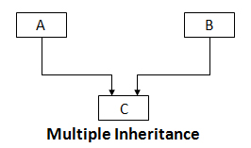

Multiple Inheritance
A VERY sensitive subject.
When one child class inherits from one or more base classes and is able to use functionality from all the base classes.
My Sagely Advice:
Avoid it if you can, there are alternatives and they are usually simpler to implement.
Many languages don’t support multiple Inheritance.
That being said, it is a feature and if it is needed, use it RESPONSIBLY. (Keep it simple and minimal)

Slide 20
Multiple Inheritance
class C(A, B):
# optional overridden functionality of A
# optional overridden functionality of B
# Implementation of C
pass
All the rules of inheritance apply here.
Multiple inheritance is usually the tool of choice to use when implementing multiple interfaces (Remember the Interface Segregation Principle?)

Slide 21
Rule of Thumb
As a rule of thumb, if you think you need multiple inheritance, you’re probably wrong, but if you know you need it, you’re probably right.
- Dusty Philips, Python3 Object-oriented Programming

Slide 22
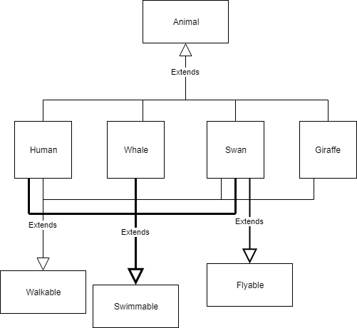





RECAP: Interface Segregation Principle
class Walkable(abc.ABC):
@abc.abstractmethod def walk(self): pass
class Swimmable(abc.ABC):
@abc.abstractmethod def swim(self): pass
class Human(Animal, Walkable, Swimmable):
def walk(self): # overridden walking code
def swim(self): # overridden swimming code
Instead of polluting the animal base class with additional functionality, we create separate interfaces (read: ABC) that handle different responsibilities.
This may seem difficult to maintain, but in fact it isn’t. This is only possible if the interfaces are well defined and have no overlap.

Slide 23
The Diamond Problem
A simple take at why multiple inheritance is problematic

Slide 24
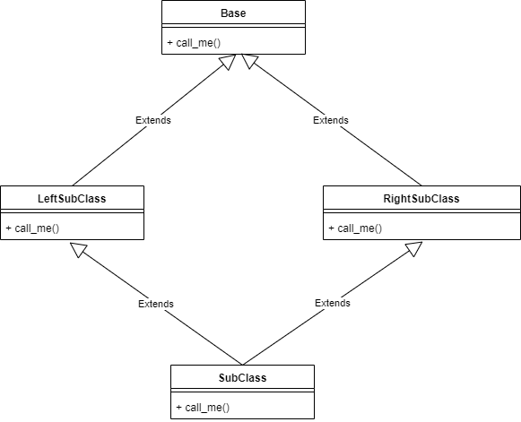
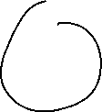

The Diamond Problem
At first glance this inheritance looks fine
Subclass inherits from 2 parents (LeftSubClass and RightSubClass). And Subclass also has a grandparent Base.
But if we look a little closer, some questions start to rise

Slide 25
The Diamond Problem
SubClass inherits from LeftSubClass, which means it also inherits from Base
SubClass inherits from RightSubClass, which means it also inherits from a second Base?
Does that mean SubClass has two instances of Base as grandparents?

Slide 26
The Diamond Problem
One of the trickiest aspects of Multiple Inheritance is to determine the order in which methods are executed
All of the classes have a call_me() function
If SubClass invokes call_me() on its parent, which call_me() function is called?
Is call_me() in LeftSubClass called?
Is call_me() in RightSubClass called?
Does it call both?
Is call_me() in grandparent Base called?

Slide 27
The Diamond Problem
If call_me method of a SubClass is invoked, in what order is the call_me methods of its super classes invoked?
Let’s take a look at some code!
multipleinheritance_diamond_problem.py
Notice in our code how it appears as though there are two Base grandparent classes if we call the parent’s call_me() method directly?
We still don’t know which parent’s call_me() function is called

Slide 28
The Diamond Problem
The super() keyword executes the methods in the parent class by first resolving the Method Resolution Order! (More on that in a bit)
multipleinheritance_diamond_solution.py

Slide 29
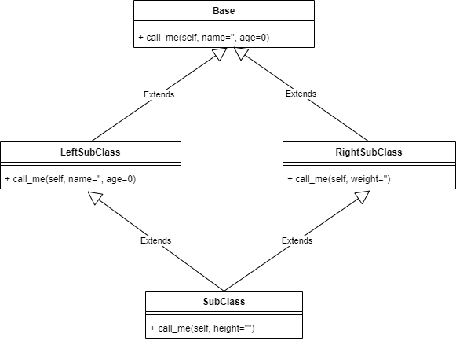
The Diamond Problem
Great we figured out how to get around the problem of which method is called first. But what if all the call_me() methods took different sets of arguments?

Slide 30
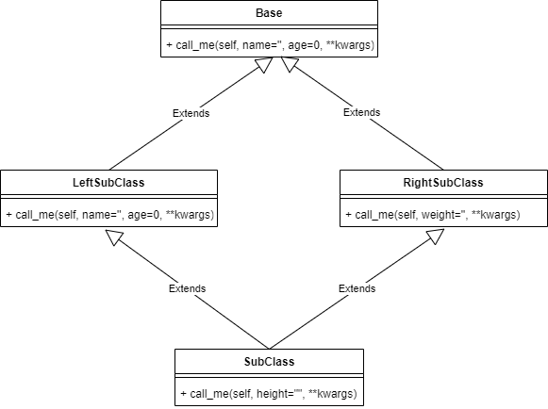
The Diamond Problem
The Answer: Variable Keyword Argument Lists! We use the power of method overloading in python to pass a dictionary of a number of different argument types.
multipleinheritance_super_different_arguments.py

Slide 31
Method Resolution Order
⛔Excluded from the Exam ⛔
A simple take at why multiple inheritance is problematic
Notes:
We’ve seen how multiple inheritance can cause issues. One of them is figuring out the order of method calls through the inheritance hierarchy. Method resolution order is a set of rules that helps us determine this order.

Slide 32
Method Resolution Order
⛔Excluded from the Exam ⛔
As we’ve seen in the previous example, finding which parent comes first in multiple inheritance is tricky.
Given a class C in a complicated multiple inheritance hierarchy, it’s difficult to determine the order that methods are overridden
Ie: to specify order of the ancestors of C
The list of ancestors of class C, including the class itself, ordered from nearest ancestor to furthest is called the class precedence list or the linearization of C
https://www.python.org/download/releases/2.3/mro/

Slide 33
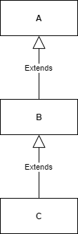
Method Resolution Order
⛔Excluded from the Exam ⛔
With single inheritance, if C is a subclass of B, and B is a subclass of A, then the linearization of class C is [C, B, A, object]
Linearizing single inheritance is easy. However with multiple inheritance, it gets more difficult
It’s more difficult to create a linearization that respects local precedence ordering and monotonicity (more on this soon!)
The Method Resolution Order (MRO) is the set of rules that we follow to construct this linearization
In Python, “MRO of C” and “linearization of class C” are synonymous
The MRO of C in this case is [C, B, A, object]
https://www.python.org/download/releases/2.3/mro/

Slide 34
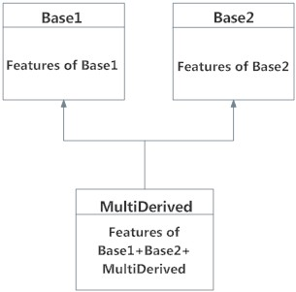
Method Resolution Order
⛔Excluded from the Exam ⛔
# Try this code:
class Base1:
pass
class Base2:
pass
class MultiDerived (Base1, Base2):
pass
print(MultiDerived.mro()) # or MultiDerived.__mro__
[<class '__main__.MultiDerived'>, <class '__main__.Base1'>, <class '__main__.Base2'>, <class 'object'>]

Slide 35
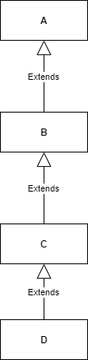
MRO: Rules
⛔Excluded from the Exam ⛔
MRO must respect monotonicity, and also provide local precedence ordering.
It ensures that a class always appears before its parents
Monotonicity:
If B Precedes A in the Linearization of C, then B HAS TO precede A in the Linearization of any child class of C.
Linearization(C) = [C, B, A, object] Linearization(D) = [D, C, B, A, object]

Slide 36
MRO: Rules
⛔Excluded from the Exam ⛔
Local Precedence ordering:
The order in a class that we’re inheriting from multiple parents
This means that a class C(B1, …, Bn) will have in its MRO, the base classes (B1, …, Bn) in the order that we specified
class F:
remember2buy = “Milk”
class E(F):
remember2buy = “Eggs”
class G(F,E):
pass
Local precedence of:
class F is the implicit (object)
class E is (F)
class G is (F, E) #we’ll see why this local precedence order is bad soon

Slide 37
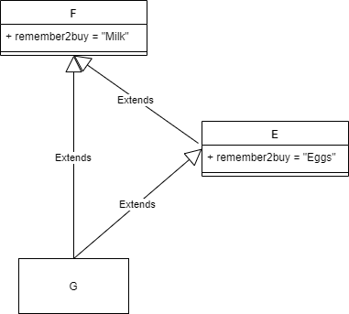
MRO: Rules
⛔Excluded from the Exam ⛔
Local Precedence ordering:
Let’s see how this looks visually
class F:
remember2buy = “Milk”
class E(F):
remember2buy = “Eggs”
class G(F,E):
pass

Slide 38
MRO: Rules
⛔Excluded from the Exam ⛔
As per the class G(F,E) declaration we evaluate in the following order:
G – Evaluate [G, F, E]
F – Evaluate [F, Object]
E – Evaluate [E, F], This causes F to be evaluated again! Not a valid inheritance hierarchy! Python3 will throw a:
Linear(G) = [G, F, Object, E, F]
TypeError: Cannot create a consistent method resolution order (MRO) for bases X, Y
class F:
remember2buy = “Milk”
class E(F):
remember2buy = “Eggs”
class G(F,E):
pass

Slide 39
MRO: Rules
⛔Excluded from the Exam ⛔
Linearization:
G = [G, F, Object, E, F] ← Fails monotonicity. F is a parent of E, it can not appear before E
class F:
remember2buy = “Milk”
class E(F):
remember2buy = “Eggs”
class G(F,E):
pass

Slide 40
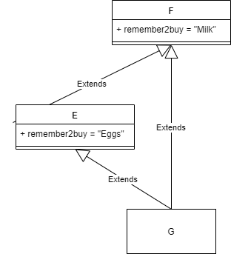
MRO: Rules - Solution
⛔Excluded from the Exam ⛔
We change the order in which class G inherits E and F. According to the new class G(E, F) declaration, we evaluate in the following order:
G – Evaluate [G, E, F]
E – Evaluate [E, F]
F – Evaluate [F, Object]
class F:
remember2buy = “Milk”
class E(F):
remember2buy = “Eggs”
class G(E,F):
pass

Slide 41
MRO: Rules - Solution
⛔Excluded from the Exam ⛔
Solution:
Linearization(G) = [G, E, F, object]
class F:
remember2buy = “Milk”
class E(F):
remember2buy = “Eggs”
class G(E, F):
pass

Slide 42
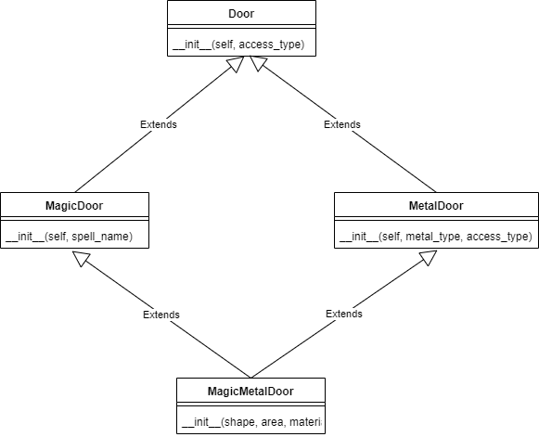
MRO: What would the MRO be?
⛔Excluded from the Exam ⛔
What would the MRO of MagicMetalDoor(MagicDoor, MetalDoor) Be?

Slide 43
MRO: What would the MRO be?
⛔Excluded from the Exam ⛔
What would the MRO of MagicMetalDoor(MagicDoor, MetalDoor) Be?
Linearization(MagicMetalDoor) = [MagicMetalDoor, MagicDoor, MetalDoor, Door, Object]

Slide 44
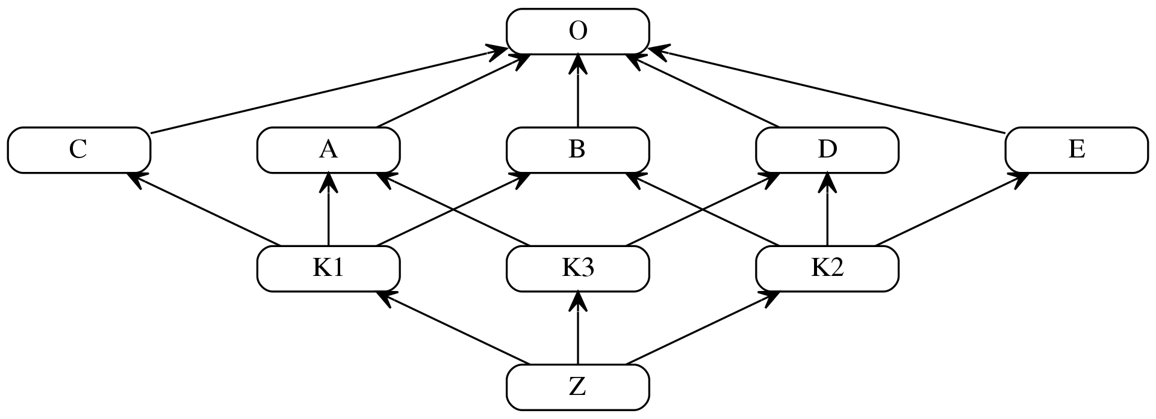
Try finding out the MRO of this MONSTER
⛔Excluded from the Exam ⛔
class O
class A extends O
class B extends O
class C extends O
class D extends O
class E extends O
class K1 extends A, B, C
class K2 extends D, B, E
class K3 extends D, A
class Z extends K1, K2, K3
https://en.wikipedia.org/wiki/C3_linearization

Slide 45
Try finding out the MRO of this MONSTER
⛔Excluded from the Exam ⛔
L(O) = [O]
L(A) = [A,O]
L(B) = [B,O]
L(C) = [C,O]
L(D) = [D,O]
L(E) = [E,O]
L(K1) = [K1, A, B, C, O]
L(K2) = [K2, D, B, E, O]
L(K3) = [K3, D, A, O]
class Z extends K1, K2, K3 #original python class code
L(Z) = [Z] + merge(L(K1), L(K2), L(K3), [K1, K2, K3])
What this is saying in regular English is “To find the linearization of Z, we must start with the list Z and merge it with the linearization of K1, K2, K3, along with the immediate parents K1, K2, K3”
https://en.wikipedia.org/wiki/C3_linearization

Slide 46
Try finding out the MRO of this MONSTER
⛔Excluded from the Exam ⛔
L(O) = [O]
L(A) = [A,O]
L(B) = [B,O]
L(C) = [C,O]
L(D) = [D,O]
L(E) = [E,O]
L(K1) = [K1, A, B, C, O]
L(K2) = [K2, D, B, E, O]
L(K3) = [K3, D, A, O]
L(Z) = [Z] + merge(L(K1), L(K2), L(K3), [K1, K2, K3])
L(Z) – this is our notation for indicating the Linearization of (Z)
[Z] – this is the list we’ll be adding to as we merge classes. Notice how we start with the class Z itself in the list
L(K1), L(K2), L(K3) – these are the linearizations of K1, K2, K3
[K1, K2, K3] – these are the immediate parents of Z
Notice how we must include the linearization of any parents along with the parents themselves
https://en.wikipedia.org/wiki/C3_linearization

Slide 47
Try finding out the MRO of this MONSTER
⛔Excluded from the Exam ⛔
L(O) = [O]
L(A) = [A,O]
L(B) = [B,O]
L(C) = [C,O]
L(D) = [D,O]
L(E) = [E,O]
L(K1) = [K1, A, B, C, O]
L(K2) = [K2, D, B, E, O]
L(K3) = [K3, D, A, O]
L(Z) = [Z] + merge(L(K1), L(K2), L(K3), [K1, K2, K3])
Step 1: Expand the linearization of the parents
Notice the reference of the previous linearizations on the left?
L(K1), L(K2), L(K3) are already done for us, so let’s put them in our equation
https://en.wikipedia.org/wiki/C3_linearization

Slide 48
Try finding out the MRO of this MONSTER
⛔Excluded from the Exam ⛔
L[Z] = [Z] + merge([K1, A, B, C, O], [K2, D, B, E, O], [K3, D, A, O], [K1, K2, K3])
Step 2: Begin merging
Before merging we need to follow an algorithm
There’s a concept of a head and tail in each class list
[K1, A, B, C, O]
Head
is the first element in the list: K1
Tail
is everything after the head: A,B,C,O
https://en.wikipedia.org/wiki/C3_linearization

Slide 49
Try finding out the MRO of this MONSTER
⛔Excluded from the Exam ⛔
L[Z] = [Z] + merge([K1, A, B, C, O], [K2, D, B, E, O], [K3, D, A, O], [K1, K2, K3])
Step 2: Begin merging
The algorithm is as follows:
Pick the head (K1) of the list, beginning with the first list ([K1, A, B, C, O])
If this head DOES NOT exist in the tail of any other list, add it to the linearization [Z] and remove it from all the other lists
If this head DOES exist in the tail of any other list, pick the head of the next list and repeat the previous check
If we go through all the lists and can’t find a head that doesn’t exist in a tail, MRO fails
https://en.wikipedia.org/wiki/C3_linearization

Slide 50
Try finding out the MRO of this MONSTER
⛔Excluded from the Exam ⛔
L[Z] = [Z] + merge([K1, A, B, C, O], [K2, D, B, E, O], [K3, D, A, O], [K1, K2, K3])
Step 2: Begin merging
Following the algorithm, we pick K1 as the head
K1 does not exist in any of the other lists’ tails, so we add it to the list [Z]
https://en.wikipedia.org/wiki/C3_linearization

Slide 51
Try finding out the MRO of this MONSTER
⛔Excluded from the Exam ⛔
L[Z] = [Z, K1] + merge([K1, A, B, C, O], [K2, D, B, E, O], [K3, D, A, O], [K1, K2, K3])
Step 2: Begin merging
Following the algorithm, we pick K1 as the head
K1 does not exist in any of the other lists’ tails, so we add it to the list [Z]
After adding K1 to [Z] we need to remove K1 from all the other lists
https://en.wikipedia.org/wiki/C3_linearization

Slide 52
Try finding out the MRO of this MONSTER
⛔Excluded from the Exam ⛔
L[Z] = [Z, K1] + merge([A, B, C, O], [K2, D, B, E, O], [K3, D, A, O], [K2, K3])
Repeat Step 2
Pick head from the first list in merge
We pick A
Does A exist in the tails of the other lists?
YES! It exists in the tail of [K3, D, A, O]
Skip to the next list
https://en.wikipedia.org/wiki/C3_linearization

Slide 53
Try finding out the MRO of this MONSTER
⛔Excluded from the Exam ⛔
L[Z] = [Z, K1] + merge([A, B, C, O], [K2, D, B, E, O], [K3, D, A, O], [K2, K3])
Repeat Step 2
Pick head from the next list in merge
We pick K2
Does K2 exist in the tails of the other lists?
NO! Add it to [Z, K1]
Remove all K2 in the other lists
https://en.wikipedia.org/wiki/C3_linearization

Slide 54
Try finding out the MRO of this MONSTER
⛔Excluded from the Exam ⛔
L[Z] = [Z, K1, K2] + merge([A, B, C, O], [D, B, E, O], [K3, D, A, O], [K3])
Repeat Step 2
Pick head from the next list in merge
We pick A
Does A exist in the tails of the other lists?
YES!
Skip to the next list
https://en.wikipedia.org/wiki/C3_linearization

Slide 55
Try finding out the MRO of this MONSTER
⛔Excluded from the Exam ⛔
L[Z] = [Z, K1, K2] + merge([A, B, C, O], [D, B, E, O], [K3, D, A, O], [K3])
Repeat Step 2
Pick head from the next list in merge
We pick D
Does D exist in the tails of the other lists?
YES!
Skip to the next list
https://en.wikipedia.org/wiki/C3_linearization

Slide 56
Try finding out the MRO of this MONSTER
⛔Excluded from the Exam ⛔
L[Z] = [Z, K1, K2] + merge([A, B, C, O], [D, B, E, O], [K3, D, A, O], [K3])
Repeat Step 2
Pick head from the next list in merge
We pick K3
Does K3 exist in the tails of the other lists?
NO! Add to [Z, K1, K2]
Remove all K3 in the other lists
https://en.wikipedia.org/wiki/C3_linearization

Slide 57
Try finding out the MRO of this MONSTER
⛔Excluded from the Exam ⛔
L[Z] = [Z, K1, K2, K3] + merge([A, B, C, O], [D, B, E, O], [D, A, O])
Keep repeating to get the following
= [Z, K1, K2, K3] + merge([A, B, C, O], [D, B, E, O], [D, A, O]) // fail A, select D
= [Z, K1, K2, K3, D] + merge([A, B, C, O], [B, E, O], [A, O]) // select A
= [Z, K1, K2, K3, D, A] + merge([B, C, O], [B, E, O], [O]) // select B
= [Z, K1, K2, K3, D, A, B] + merge([C, O], [E, O], [O]) // select C
= [Z, K1, K2, K3, D, A, B, C] + merge([O], [E, O], [O]) // fail O, select E
= [Z, K1, K2, K3, D, A, B, C, E] + merge([O], [O], [O]) // select O
= [Z, K1, K2, K3, D, A, B, C, E, O] // done
https://en.wikipedia.org/wiki/C3_linearization

Slide 58
Try finding out the MRO of this MONSTER
⛔Excluded from the Exam ⛔
L(O) = [O]
L(A) = [A,O]
L(B) = [B,O]
L(C) = [C,O]
L(D) = [D,O]
L(E) = [E,O]
L(K1) = [K1, A, B, C, O]
L(K2) = [K2, D, B, E, O]
L(K3) = [K3, D, A, O]
L[Z] = [Z, K1, K2, K3, D, A, B, C, E, O]
This final result may look strange because we might’ve expected
L[Z] = [Z, K1, K2, K3, A, B, C, D, E, O]
However the order of linearization completely depends on the inheritance order of the previous classes
Notice how K2, and K3 inherited D first then other classes? This is what caused the somewhat strange linearization
https://en.wikipedia.org/wiki/C3_linearization

Slide 59
Try finding out the MRO of this MONSTER
⛔Excluded from the Exam ⛔
L(O) = [O]
L(A) = [A,O]
L(B) = [B,O]
L(C) = [C,O]
L(D) = [D,O]
L(E) = [E,O]
L(K1) = [K1, A, B, C, O]
L(K2) = [K2, D, B, E, O]
L(K3) = [K3, D, A, O]
L[Z] = [Z, K1, K2, K3, D, A, B, C, E, O]
However, our linearization algorithm ensures monotonicity, and local precedence
Local precedence ordering
Class Z inherits from K1, K2, K3 before other classes
Monotonicity
The inheritance order of K1, K2, K3’s parents are maintained in the subclass Z
https://en.wikipedia.org/wiki/C3_linearization

Slide 60
Mix-Ins

Slide 61
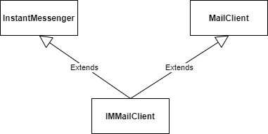
Mixins
Mixins are a special type of a SuperClass object which is not meant to be instantiated. Instead, it is meant to be Inherited.
These inherit and encapsulate behaviours and attributes from two completely different classes.
We then inherit from a mixin to create classes that can exhibit behaviours of both the base classes.

Slide 62
Mixins
class Mixin1: def sayHi(self): print('Hi’)
class Mixin2: def sayWorld(self): print('World’)
class MultiDerived (Mixin1, Mixin2): def __init__(self): self.sayHi() self.sayWorld() m = MultiDerived()
Output:
Hi
World

Slide 63
Mixin – Another Example
class LoggingMixin:
def log(self, message):
print(f"[LOG]: {message}")
class Database:
def save(self):
print("Saving to database...")
class User(Database, LoggingMixin):
def create_user(self, name):
self.log(f"Creating user: {name}")
self.save()
# Usage
u = User()
u.create_user("Alice")
Common Use Cases:
LoggingMixin – Adds logging capabilities.
TimestampMixin – Adds timestamps to objects.
AuthMixin – Adds authentication checks.

Slide 64
Benefits of Mixins
Code Reusability – Avoids code duplication.
Separation of Concerns – Keeps responsibilities modular.
Lightweight & Flexible – Allows functionality to be added without deep inheritance trees.

Slide 65
Interface Segregation Principle

Slide 66
Interface Segregation Principle
Multiple Inheritance is a great way to implement different Interfaces from parent Abstract Base Classes (ABC’s)
Some rules to guide you:
Make sure the interfaces don’t overlap
Avoid putting implementation in the ABC’s unless absolutely necessary. Emulate Java interfaces. Treat these as pure abstractions.
You can use mixins to encapsulate different interfaces to create a common base class to inherit from. For the purpose of this course this isn’t necessary or expected.
class Walkable(abc.ABC):
@abc.abstractmethod def walk(self): pass
class Swimmable(abc.ABC)
@abc.abstractmethod def swim(self): pass
class Human(Walkable, Swimmable):
def walk(self): # overridden walking code
def swim(self): # overridden swimming code

Slide 67
Multiple Inheritance Alternatives

Slide 68
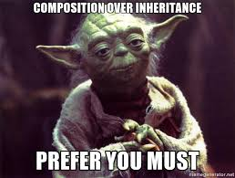





Alternatives?
Questions to ask yourself:
Do I need inheritance? Will this code be re-used a lot? If not, I can just define it separately in the child class.
Can I restructure my base classes?
Can I use composition instead?

