Slide 1
Adapter⁺ Design Pattern
Structural Design Pattern
⁺Also known as: Wrapper

Slide 2
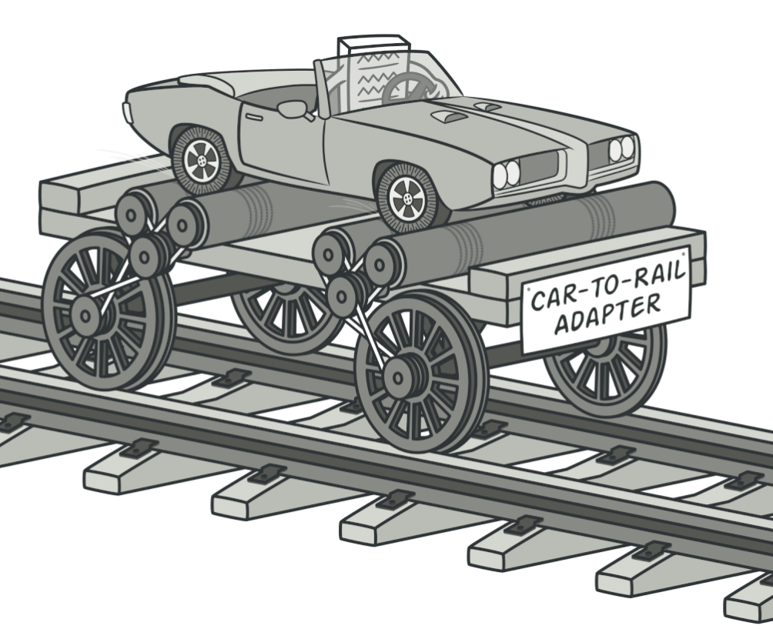
Intent
The Adapter pattern allows objects with incompatible interfaces to collaborate.
Converts the interface of a class into another interface clients expect
Lets classes work together that couldn’t otherwise due to incompatible interfaces
Wraps an existing class with a new interface

Slide 3
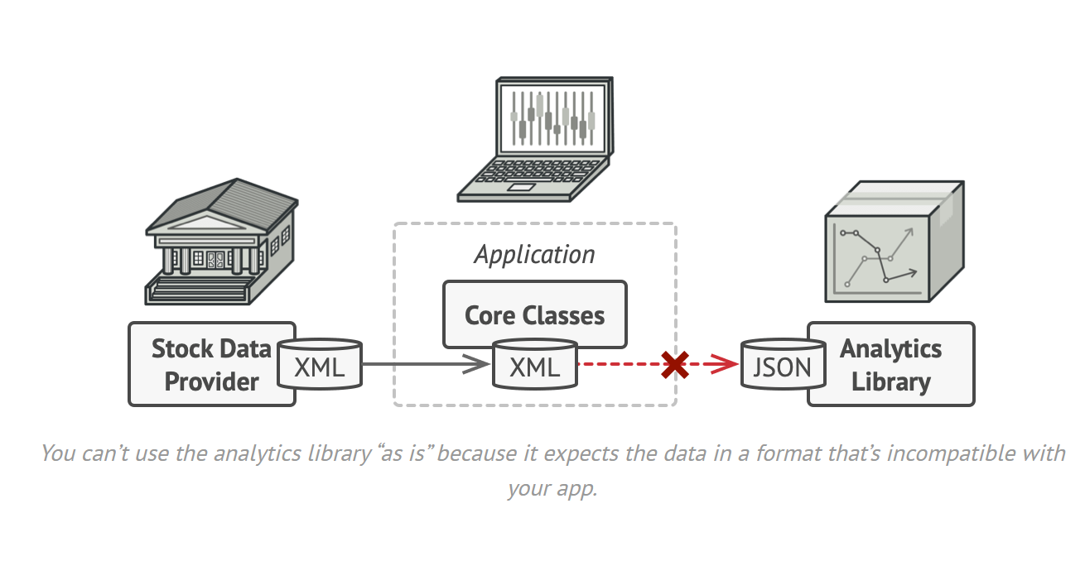
The Problem
Stock Market Monitoring App Example
App downloads stock data in XML format
Displays charts and diagrams
Want to integrate a 3rd-party analytics library
Problem: The library only works with JSON format

Slide 4
The Problem (cont’d)
Why Can’t We Just Change the Library?
Might break existing code that depends on it
May not have access to the library’s source code
Library might be used by other applications
We need a way to make incompatible interfaces work together!

Slide 5
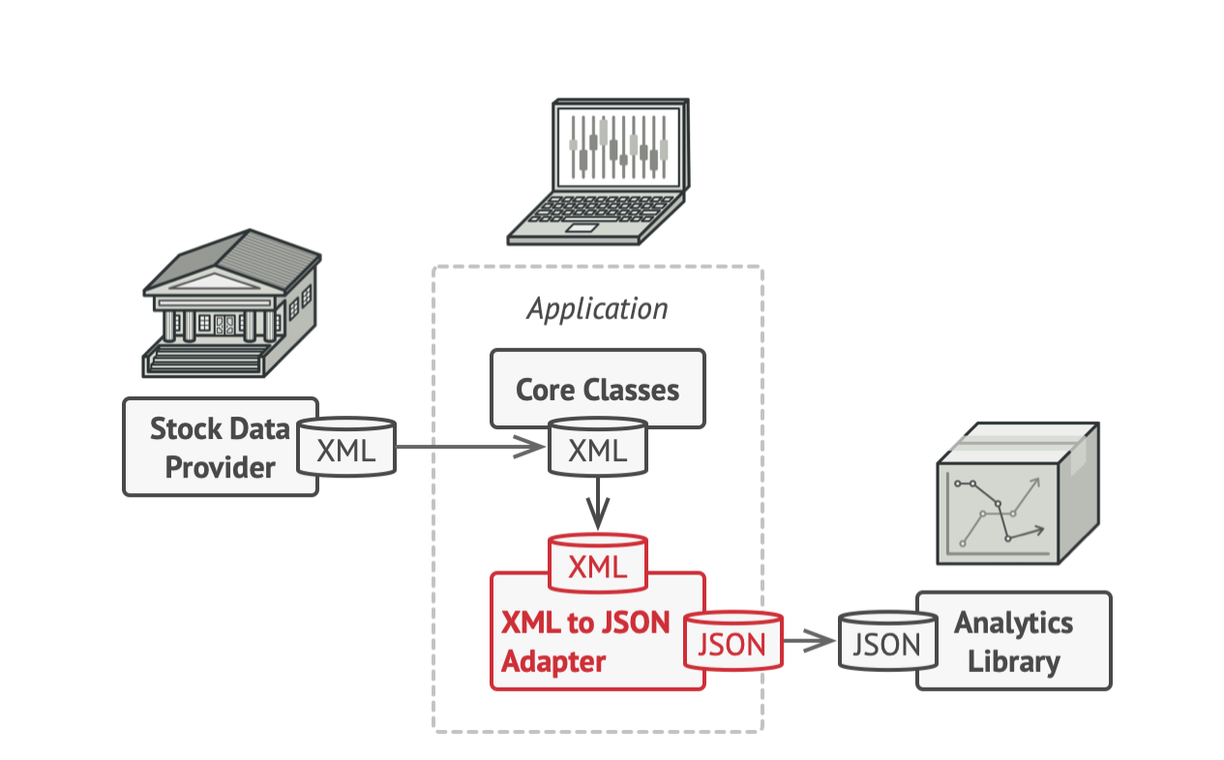
The Solution: Adapter Pattern
Create an adapter - a special object that converts the interface of one object so another object can understand it.
Key characteristics:
Wraps one of the objects
Hides the complexity of conversion
The wrapped object isn’t even aware of the adapter

Slide 6
How It Works
The adapter gets an interface compatible with one of the existing objects
The existing object can safely call the adapter’s methods
Upon receiving a call, the adapter passes the request to the second object in the format it expects
Sometimes you can create a two-way adapter
The adapter acts as a translator between incompatible formats!

Slide 7

Real-World Analogy
Power Plug Adapter
Traveling from US to Europe?
US plugs won’t fit European sockets
Different power plug standards
Solution: Power plug adapter
Has American-style socket
Has European-style plug

Slide 8
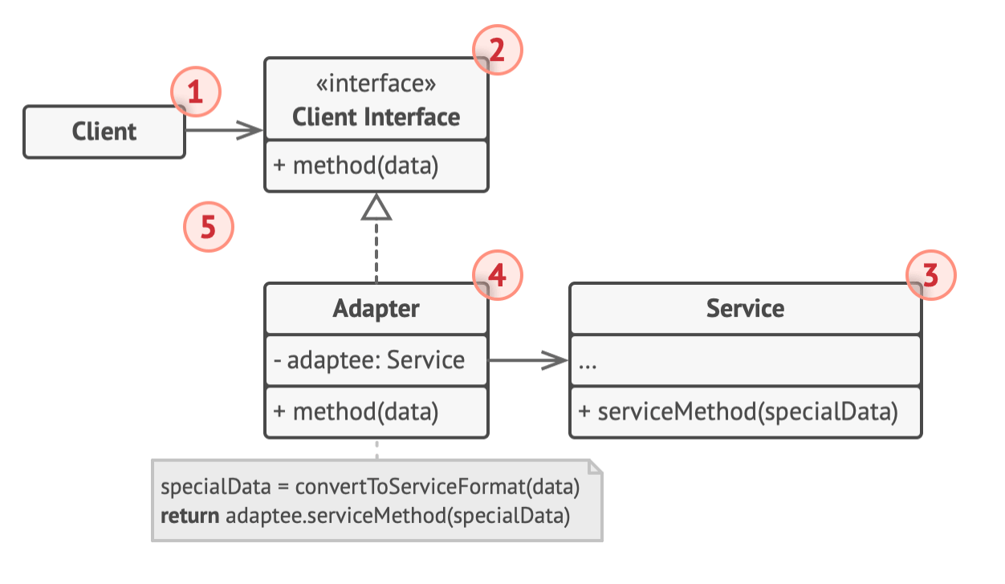
Structure: Object Adapter
Uses object composition principle
Components:
Client - contains existing business logic
Client Interface - protocol for collaboration
Service/Adaptee - useful class with incompatible interface
Adapter - works with both client and service

Slide 9
Object Adapter Structure
Key points:
Adapter implements the client interface
Adapter wraps the service object
Translates calls between client and service
Client doesn’t couple to concrete adapter class

Slide 10
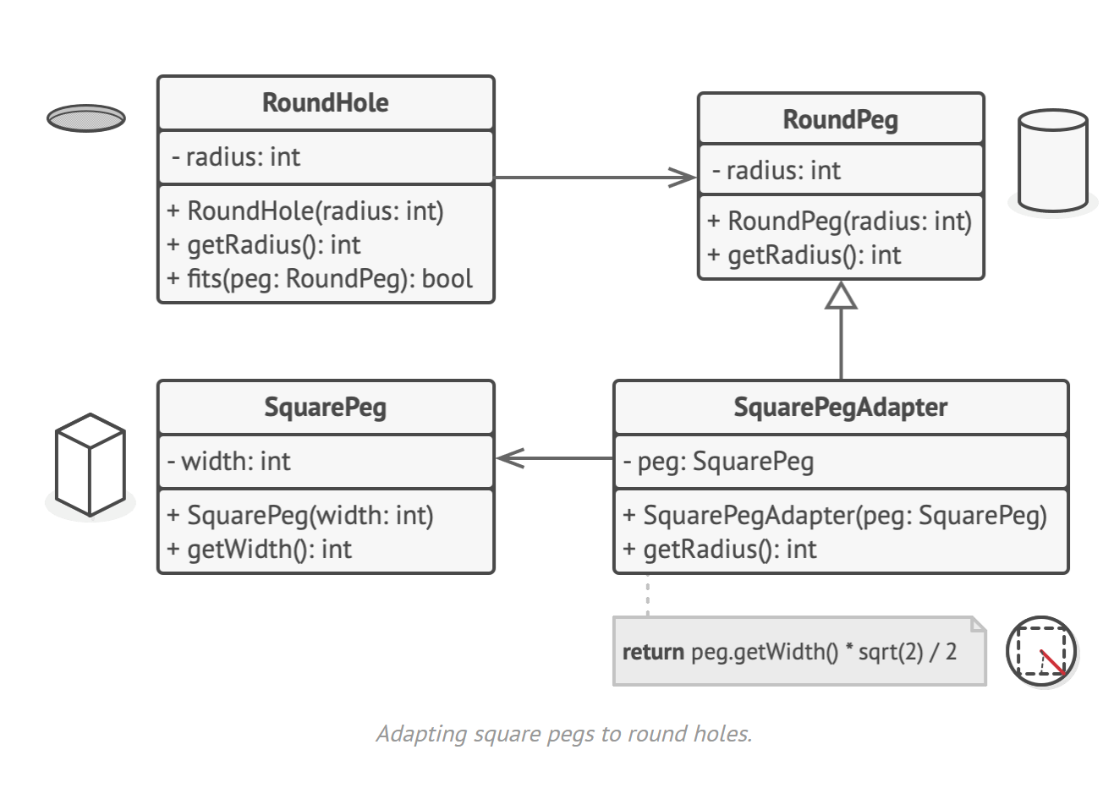

Classic Example: Square Pegs & Round Holes
The Setup
RoundHole accepts RoundPeg objects
SquarePeg has incompatible interface
Need to fit square pegs into round holes
“This square-peg teammate doesn’t fit our round-hole workflow… let’s write an adapter!”
1.square_in_holes.py

Slide 11
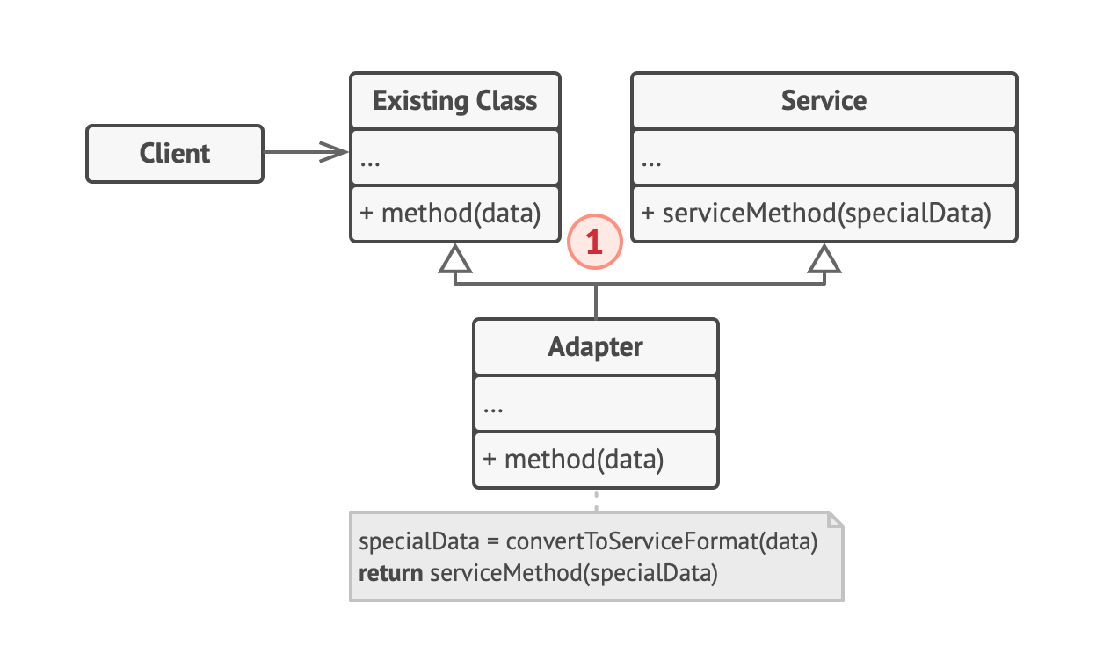
Structure: Class Adapter
Uses inheritance instead of composition
Requirements:
Language must support multiple inheritance (e.g., C++, Python)
Adapter inherits from both objects simultaneously
Difference:
No object wrapping needed
Adaptation happens in overridden methods
2.square_in_holes.py

Slide 12
When to Use the Adapter Pattern
Use Case #1
When you want to use an existing class, but its interface isn’t compatible with the rest of your code
Legacy classes
3rd-party libraries
Classes with unusual interfaces
The Adapter serves as a middle-layer translator

Slide 13
When to Use (cont’d)
Use Case #2
When you want to reuse several existing subclasses that lack common functionality that can’t be added to the superclass
Instead of duplicating code across subclasses:
Put missing functionality in an adapter class
Wrap objects with missing features
Gain features dynamically
Requirement: Target classes must have a common interface

Slide 14
Implementation Steps
Identify incompatible interfaces
Service class (can’t change)
Client classes (would benefit from service)
Declare the client interface
Define how clients communicate with service
Create the adapter class
Implement the client interface
Leave methods empty initially

Slide 15
Implementation Steps (cont’d)
Add a field for the service object
Initialize via constructor (common practice)
Or pass when calling methods
Implement all interface methods
Delegate real work to service object
Handle interface/data format conversion
Use adapter via client interface
Allows changing adapters without affecting client code

Slide 16

Adapter Advantages
Single Responsibility Principle: Separate interface/data conversion from business logic
Open/Closed Principle: Introduce new adapters without breaking existing code
Reuse existing classes without modification
Increases flexibility and reusability

Slide 17

Adapter Disadvantages
Increases overall code complexity
Need to introduce new interfaces and classes
Sometimes simpler to just change the service class directly
Additional layer of indirection

Slide 18
Relations with Other Patterns
Bridge vs Adapter
Bridge: Designed up-front for independent development
Adapter: Used with existing apps to make incompatible classes work
Decorator vs Adapter
Adapter: Provides completely different interface
Decorator: Interface stays same or gets extended
Decorator: Supports recursive composition

Slide 19
Relations with Other Patterns (cont’d)
Proxy vs Adapter
Adapter: Access via different interface
Proxy: Interface stays the same
Decorator: Access via enhanced interface
Facade vs Adapter
Facade: Defines new interface for existing objects
Adapter: Makes existing interface usable
Facade: Works with entire subsystem
Adapter: Usually wraps one object

Slide 20
Key Takeaways
Adapter makes incompatible interfaces work together
Two implementations: Object Adapter (composition) and Class Adapter (inheritance)
Acts as a translator/wrapper between client and service
Useful for legacy code and 3rd-party libraries
Increases flexibility but adds complexity

Slide 21
Questions?
Remember: The Adapter pattern is about making things work together that weren’t designed to work together.
Think of it as a translator or converter between incompatible interfaces.

Slide 22
Thank You!

