Slide 1
Creational Pattern:Builder Behavioral Pattern: Mediator and Dependency Injection
COMP3522 Object Oriented Programming 2
Week 12

Slide 2
Builder
When you want customization and complexity

Slide 3
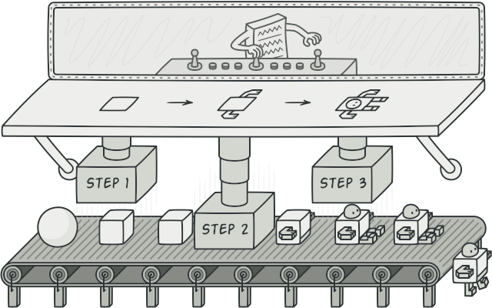
Builder
Often we need to initialize objects with a number of different parts, nested fields, optional attributes and behaviour.
This can cause either:
The initializer of an object to become bloated. Lots of parameters, most of which may not even be used often.
A complex inheritance hierarchy to model the optional features.
The Builder Pattern allows us to break this construction code into a separate class.
This separate class decouples independent blocks of construction code that can be mixed and matched.

Slide 4
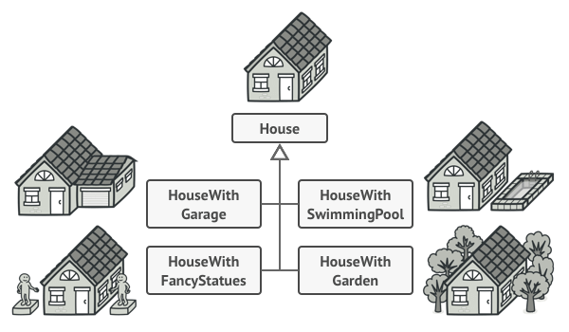
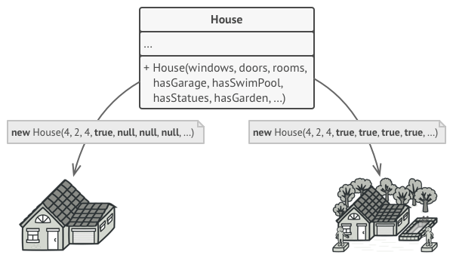
Builder
Say we were modeling and representing Houses.
Houses have a lot of components and optional parts.
Door, walls, roof, windows, etc.
We can use inheritance to model all these cases.
Or we can avoid inheritance, and have a single class with a lot of parameters in its constructor and unnecessary attributes to keep track of all the components. This leads to ugly initializer calls.

Slide 5
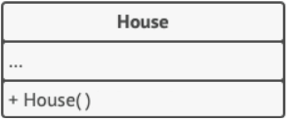
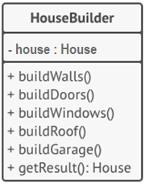
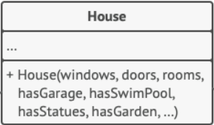
Builder
If the construction of an object is so complex, then why don’t we separate that out into its own class (HouseBuilder).
This would ensure the Single Responsibility Principle.
A class would be split into itself and its builder class with all of its construction code.
We can have a separate call for each different component that our object is aggregated/composed of.
Calling different combinations of these methods would lead to different types of homes.
New approach
1. House initializer has no parameters
Old approach
2. Construction logic separated into multiple methods

Slide 6
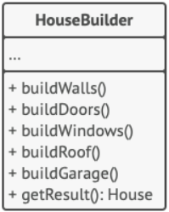
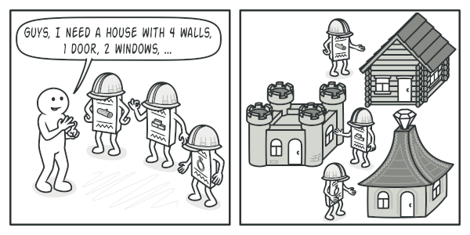
Builders and Variations
+ __init__(mat)
This is a really powerful pattern.
We can customize the Builder Class to take in its own parameters and options.
This can allow us to instantiate different Builder objects that execute the construction differently.
For example, we can have our builder class accept a parameter for the material we can build the house out of.
We can then make 3 builder objects:
builder_wood = HouseBuilder(mat=“Wood”) cabin = builder_wood.build_house()
builder_stone = HouseBuilder(mat=“Stone”) castle = builder_stone.build_house()
builder_paper = Housebuilder(mat=“Paper”) origami_house = builder_paper.build_house()

Slide 7

Builder and Director
class Director: def __init__(self, builder: Builder): self.builder = builder def build_townhouse(self) -> House: self.builder.build_walls() self.builder.build_roof() self.builder.build_garage() self.builder.build_swimming_pool() self.builder.build_second_story() self.builder.build_door() self.builder.build_windows() return self.builder.product def build_apartment(self) -> House: self.builder.build_walls() self.builder.build_door() self.builder.build_windows() return self.builder.product
We can optionally implement a manager class called a Director that can be responsible for different subroutines that call different methods in a builder class.
This Director class is optional and usually makes sense when working with complex objects that can be decoupled into different pieces/components that can be mixed and matched.
We can even inherit from a Builder class to create different variations of builders if the complexity demands it.

Slide 8
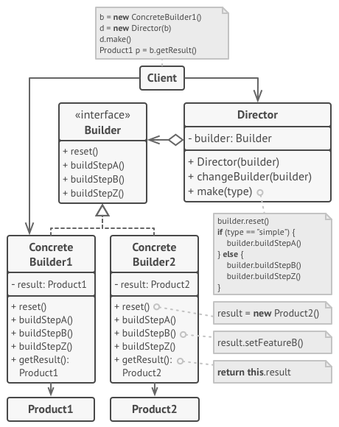
Builder Pattern: UML

Slide 9

Builder Pattern
Let’s look at some code:
bad_pizza.py
builder_sample_code.py

Slide 10
Mediator and Dependency Injection
COMP3522 Object Oriented Programming 2
Week 13

Slide 11

Last Class
Multiprocessing
Processes
CPU Bound Code
Multiprocessing module is similar to the threading module.
Lazy Initialization
Delay creation of an expensive resource until it is required.
Builder
Decouple an object from its creation code
Build an object in incremental steps.
Avoid complex constructor overloading
Set up creation subroutines in an optional Director class.

Slide 12
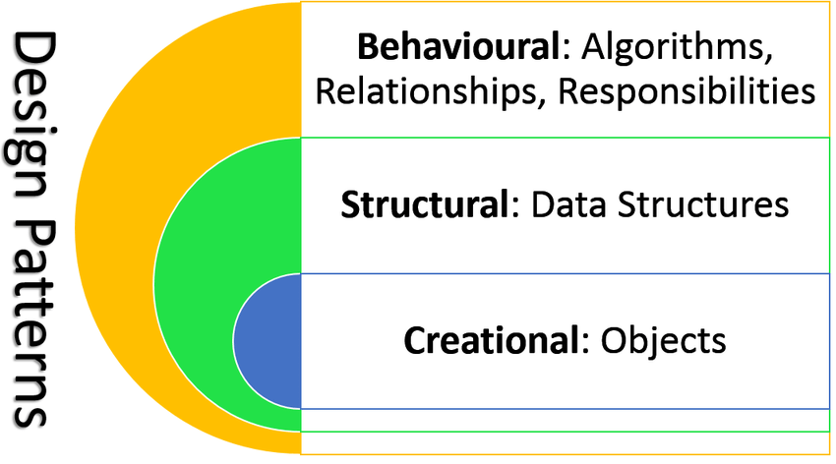
Categorizing Design Patterns
Behavioural (We are looking at these!)
Focused on communication and interaction between objects. How do we get objects talking to each other while minimizing coupling?
Structural How do classes and objects combine to form structures in our programs? Focus on architecting to allow for maximum flexibility and maintainability.
Creational All about class instantiation. Different strategies and techniques to instantiate an object, or group of objects

Slide 13
Mediator
The Middle PERSON that takes care of everything so you don’t have to.

Slide 14
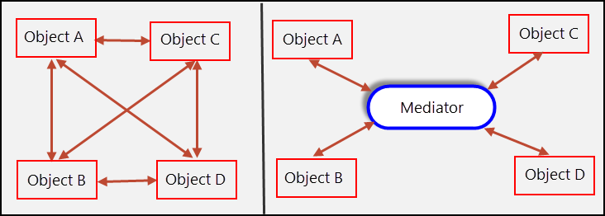
Mediator – The Problem.
Often our program can be broken down into modular subsystems.
These subsystems are often made up of certain objects (let’s call them components) that talk and are dependent on each other.
This communication between the components facilitates the intended behaviour of the system.
But what happens when this flow of communication becomes unregulated and difficult to follow/debug?
The system becomes highly coupled and difficult to maintain.

Slide 15
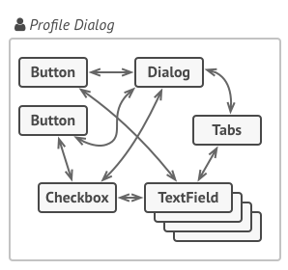
Mediator – An Example
We often see this in UI systems.
Within a certain context (a dialog box, or a screen for example) there are a number of different components that interact with each other.

Slide 16
Mediator – An Example Person finder
Enter name
Search options
Age
Height
Address
This is a search window to find people, with a number of filters represented as checkboxes. Selecting a checkbox may require that an additional text field be displayed.

Slide 17
Mediator – An Example Person finder
Jeff
Search options
Age
Height
Address
Entered name into search, but want to filter by age and height

Slide 18
Mediator – An Example Person finder
Jeff
Search options
Age
99
Selecting age checkbox opens textfield to enter age filter
Height
Address

Slide 19
Mediator – An Example Person finder
Jeff
Search options
Age
99
Height
2000
Selecting height checkbox opens textfield to enter height filter
Address

Slide 20
Mediator – An Example
In the previous slides we saw a search window with a number of filters represented as checkboxes. Selecting a checkbox may require that an additional text field be displayed.
Below is bad code, it makes it difficult to re-use the checkbox in any other screen. Breaks so many SOLID Principles.
Inheriting from the Checkbox class to satisfy this one screen would also be extremely unnecessary and not maintainable.
Age
99
class Checkbox: .. .. if self.selected: self.age_text_field.enabled = True .. ..

Slide 21
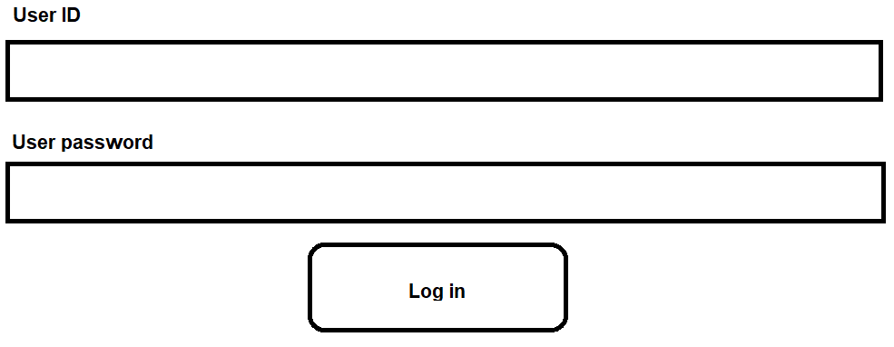
Mediator – An Example
Let’s examine how we may implement the following log in screen.
Notice there are many components:
TextLabels
Inputfields
User ID field
User password field
Screens
LogInButton
mediator_problem.py

Slide 22

Mediator – The solution
The Mediator pattern reduces the dependencies between a large number of components of a system.
It restricts communications between the different components by introducing a middleperson who ‘Mediates’ the communication between them.
This is very similar to the concept of Controller classes that you often come across in code.
The Mediator class/entity can be thought of as a formalized structured controller.
The components of a system are now unaware of each other and only depend on a Mediator.
This relationship is bidirectional.
https://www.123rf.com/photo_59304312_traffic-road-traffic-controller-control-transportation-on-street-cop-pointsman-vector-illustration.html

Slide 23
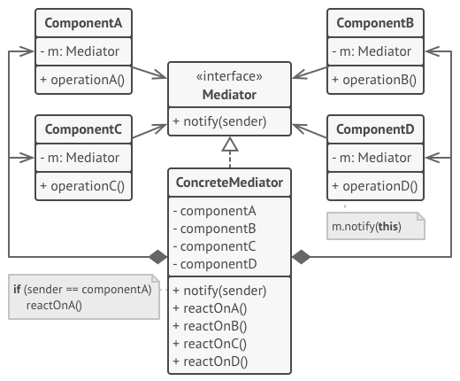
Mediator UML
All Mediators in a system can implement a common interface.
Each context or subsystem would have its own concrete mediator
By having a common mediator, we could re-use the components across contexts.
For example, a button can be used with a LogInMediator and a RegisterUserMediator.

Slide 24
Mediator
Let’s check out some code that simulates a Log In screen and implements the Mediator Pattern
mediator_sample_code.py

Slide 25

Some important tidbits.
Mediators don’t necessarily have to only be for UI systems
They can be used in other systems where we need objects or subsystems to talk to each other while being decoupled and unaware of each other.
Similar to the Observer Pattern, Mediators can cause different parts of a system to react to a component.
That being said, it is different from an Observer pattern.
Mediators facilitate bidirectional communication.
An Observer is more of a broadcast system that gets triggered when the state of the observed object changes.

Slide 26

Mediator: Why and When do we use it
A Mediator should be introduced when the communication patterns between different objects becomes chaotic and highly coupled.
Use this pattern when you want a component to be unaware of other components but still be able to communicate with them.
A Mediator may be the right choice if you are considering inheritance just to reuse some basic behaviour across contexts
Implements the Single Responsibility principle. The responsibility to facilitate communication between objects is extracted into one class.
Implements the Open/Closed Principle. We can introduce new mediators for new contexts without changing the components.

Slide 27

Mediator – Disadvantages
The Mediator itself becomes a complex object and an epicentre for coupling.
Check out God Objects, this is what is known as an Anti-Pattern.
a God object is an object that knows too much or does too much
https://en.wikipedia.org/wiki/God_object

Slide 28
Dependency Injection
When you want dependencies but you don’t want to hardcode the type of dependency

Slide 29
Dependency Injection
We are going to talk about some general design
Dependency Injection is a:
Concept
Technique
Framework
A phrase that you may hear often, especially when working with complex systems.
This sounds scary but once you understand the concept it feels obvious.
In fact. You have all written a fairly complex system that implements Dependency Injection already.

Slide 30
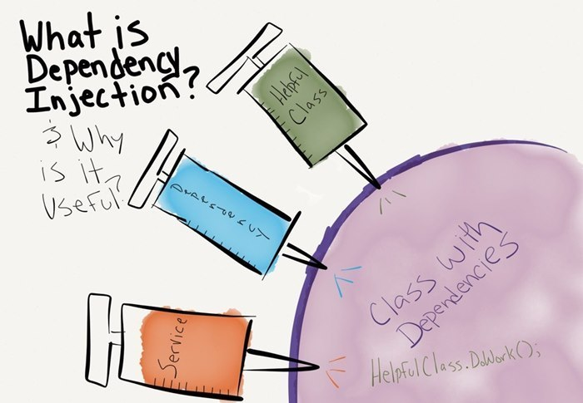
Dependency Injection – Concept
Class A is dependent on an entity B (a class, a system, an external package, etc.)
Our goal through many design patterns is to control and manage these dependencies.
How can we provide a dependency to a dependent class in a way that reduces coupling?
Dependency Injection is a concept and a set of software design principles that enable us to write code that can answer this question.

Slide 31
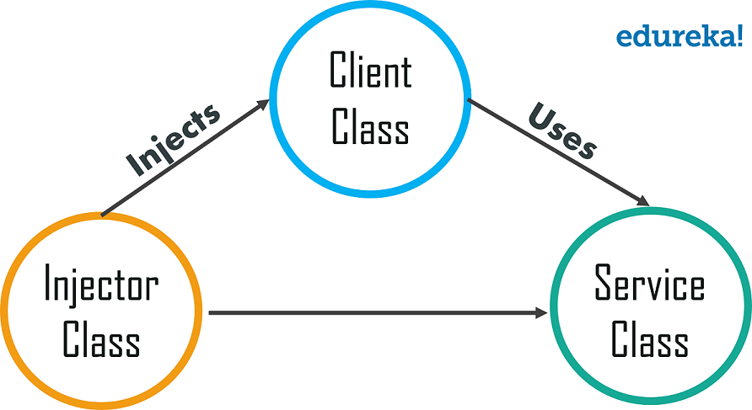
Dependency Injection
Dependency Injection involves having an external entity (the Injector) be responsible for creating (or retrieving) the right dependency for the use case and providing it to the client class.

Slide 32

Dependency Injection involves having an external entity (the Injector) be responsible for creating (or retrieving) the right dependency for the use case and providing it to the client class.
To decouple Class A from Class B and achieve dependency injection:
Class A should not explicitly refer to Class B.
Not mention its type (For languages with static typing)
Refer to an abstraction instead. Usually a common interface of some sort.
class ClassA: def __init__(self): self.class_b = ClassB()
class ClassB: pass

Slide 33
Dependency Injection involves having an external entity (the Injector) be responsible for creating (or retrieving) the right dependency for the use case and providing it to the client class.
To decouple Class A from Class B and achieve dependency injection:
Class A should not explicitly refer to Class B.
Not mention its type (For languages with static typing)
Refer to an abstraction instead. Usually a common interface of some sort.
class ClassA: def __init__(self): self.abstract_class_b = ClassB()
A little better…
class AbstractClassB(abc.ABC): pass
class ClassB(AbstractClassB): pass

Slide 34
Dependency Injection involves having an external entity (the Injector) be responsible for creating (or retrieving) the right dependency for the use case and providing it to the client class.
To decouple Class A from Class B and achieve dependency injection:
Class A should NOT be responsible for constructing or importing/retrieving the dependency
class ClassA: def __init__(self): self.abstract_class_b = ClassB()
class AbstractClassB(abc.ABC): pass
class ClassB(AbstractClassB): pass

Slide 35
Dependency Injection involves having an external entity (the Injector) be responsible for creating (or retrieving) the right dependency for the use case and providing it to the client class.
To decouple Class A from Class B and achieve dependency injection:
Class A should NOT be responsible for constructing or importing/retrieving the dependency
class ClassA: def __init__(self): self.abstract_class_b = None
A little better…
class AbstractClassB(abc.ABC): pass
class ClassB(AbstractClassB): pass

Slide 36
Dependency Injection involves having an external entity (the Injector) be responsible for creating (or retrieving) the right dependency for the use case and providing it to the client class.
To decouple Class A from Class B and achieve dependency injection:
Class B should be constructed (or imported/retrieved) by an external entity. (The Injector)
class ClassA: def __init__(self, class_b : AbstractClassB): self.abstract_class_b = class_b
BEST!
Uses
class AbstractClassB(abc.ABC): pass
Injects
def main(): abstract_class_b = ClassB() class_a = ClassA(abstract_class_b )
class ClassB(AbstractClassB): pass

Slide 37
RECAP: High Level & Low Level Modules
UI
Text File
read() write() search()
High Level Module
Low Level Module
Remember this slide from way back in Week 3 when we were talking about SOLID principles?
Let’s go back to this example. Here we can say that the UI is dependent on a Text File.

Slide 38
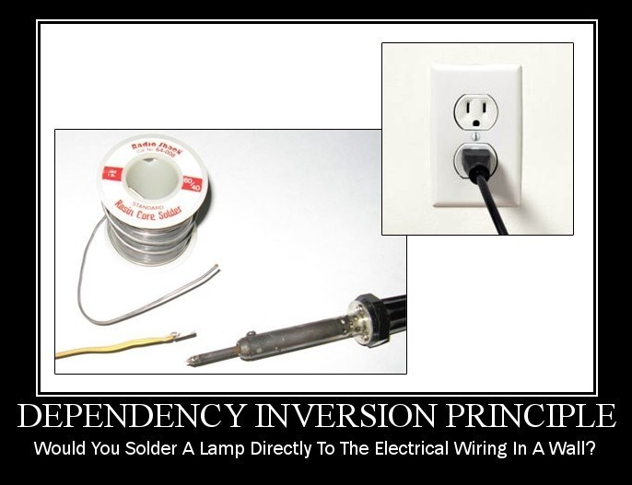
Dependency Inversion Principle Revisited
High-level modules should not depend on low-level modules. Both should depend on abstractions.
Abstractions should not depend on details. Details should depend on abstractions.
We call classes that implement details ‘Concrete Classes’. The Text File class is a concrete class.
Abstract classes declare an interface.
Concrete classes actually contain the code that implements the details of the interface.

Slide 39
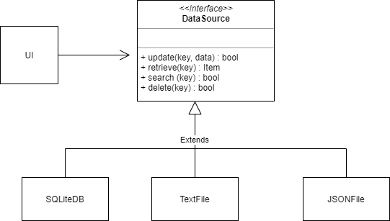
Dependency Inversion Principle Revisited
The UI class avoids direct references to the SQLiteDB, TextFile or JsonFile classes.
It is now dependent on a DataSource Abstraction.
So we met one of the requirements of Dependency Injection. In the UI class we no longer have a hardcoded reference to any of the 3 low level modules.
But if the UI class can’t instantiate an instance of the low level modules, then how does it have access to one?

Slide 40
Constructor Dependency Injection
We can do this via the initializer
By providing the UI class with a reference to a concrete DataSource the main method has injected the dependency.
The UI class was not responsible for importing the concrete class. It was done by an external entity.
This is an example of Constructor Dependency Injection.
class UI: def __init__(self, data_source: DataSource): self._data_source = data_source # data source injected .. .. def main(self): json_file = JSONFile("data.json") ui = UI(json_file)
no_dependency_injection.py
dependency_injection.py

Slide 41
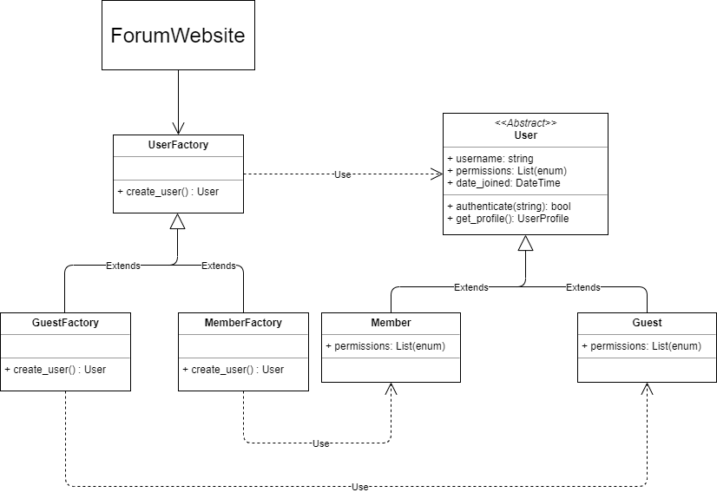
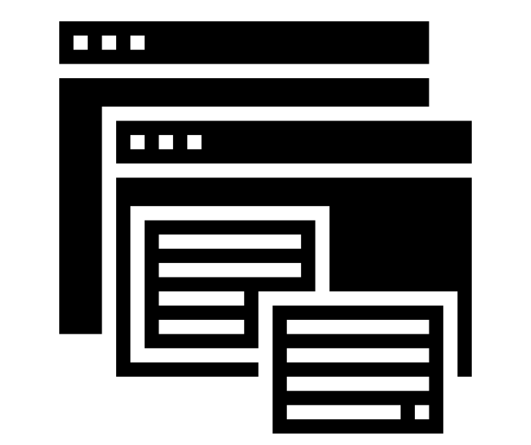
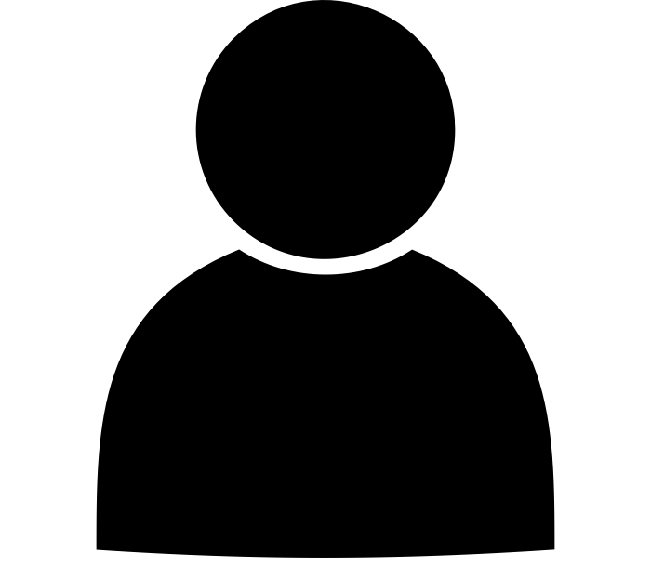
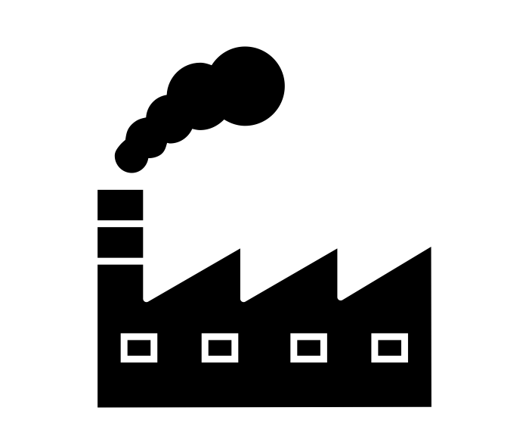
Factory Patterns as Dependency Injection
The Factory Pattern is a way of implementing Dependency Injection.
The client is dependent on a low level module. We implement the Dependency Inversion Principle by making the client depend on an abstract product Interface (User).
The client then needs a way of having access to the User, so we create Factory Classes.
The Factory classes “Inject” the client with the required dependency. The Factory class is the Injector.
In this example, the Forum Website is dependent on concrete users. The UserFactory injects the ForumWebsite with the right kind of user.
forum_user_factory.py

Slide 42
Builder Pattern: Why and When do we use it
When you want to get rid of ugly init methods in Python or the numerous constructors you may need in other languages
When a product is built out of many parts that can be mixed and matched. This allows you to build variations while (possibly) avoiding inheritance hierarchies
Single Responsibility Principle comes to life as we separate construction logic from the product logic. That is, we decouple complex construction logic from the product.

Slide 43
Builder Pattern – Disadvantages
Code complexity increases as we introduce more classes.
Does not work well for products that cannot be broken down into independent parts.

