Slide 1
Welcome!
COMP 3522 Object Oriented Programming 2
Week 2: Revisiting Object Oriented Programming
Slides by Jeffrey Yim

Slide 2
Agenda
Datetime
Essential Object Oriented Programming. (All about Classes & Objects)
The core tenets of Object Oriented Programming
Abstraction and Modularization
Polymorphism
Encapsulation
Inheritance

Slide 3
DATETIME

Slide 4
An interesting idea
Running programs while you’re at your computer is fine
But it’s also useful for programs to execute without our direct supervisions
We can use our computer’s clock to run code:
At some specified time and date
At regular intervals
We can also write programs that launch other programs on a schedule by using the subprocess and threading modules…

Slide 5
Let’s start with the time module
Your system’s clock is set to a specific date, time, and time zone
The time module gives us access to the current time
We will look at two functions:
time.time( )
time.sleep( )
Everything is predicated on the Unix epoch
https://docs.python.org/3.7/library/time.html

Slide 6
Unix epoch
Time reference used in programming
The unix epoch is the “point where time starts”
Everything begins on January 01 1970 at 00:00:00, Coordinated Universal Time (UTC)
We count the number of seconds since this time and call it seconds since the epoch

Slide 7
time.time( )
import time
time.time( )
It returns the number of seconds that have elapsed “since time began”
It’s a float (very precise!)
We can use this to profile* code!
* Profile: measure how long a piece of code takes to run

Slide 8
Example
import time
product = 1
start_time = time.time()
for i in range(1, 100000): #perform operation that takes a lot of time
product = product * i
end_time = time.time()
print('The result is %s digits long.' % (len(str(product))))
print('Took %s seconds to calculate.' % (end_time - start_time))

Slide 9
time.sleep(seconds)
We can pause our code for a specified number of seconds (can be a float for precision)
The time.sleep(seconds) function will block until at least the specified number of seconds has elapsed
* Block: will not return and release your program to execute other code

Slide 10
Example
import time
for _ in range(3):
print(‘Tick’)
time.sleep(1)
print(‘Tock’)
time.sleep(1)

Slide 11
The datetime module
The time module is good for getting a Unix epoch timestamp to work with
What if we want a date in a more convenient format?
Use the datetime module
Lets us manipulate dates and times
The datetime module contains a new datatype called datetime
a datetime represents a specific moment in time

Slide 12
datetime object
The datetime data type in the datetime module can be used to create datetime objects
A datetime object uses integers to store:
Year
Month
Day
Hour
Minute
Second

Slide 13
Converting time types
We can convert a Unix epoch timestamp to a datetime object using the datetime module’s fromtimestamp( ) function
The date and time of the datetime will be converted to the local time zone
import datetime
print(datetime.datetime.fromtimestamp(1000000)) #1970-01-12 05:46:40
import time
print(datetime.datetime.fromtimestamp(time.time())) #2020-01-12 16:25:04.843986 Whatever the time is at the moment you ran the code

Slide 14
Comparing times
datetime objects can be compared using the comparison operators
The later datetime object is the “greater” value
import datetime
halloween = datetime.datetime(2018, 10, 31) nyd = datetime.datetime(2019, 1, 1) oct_31 = datetime.datetime(2018, 10, 31) print(halloween == oct_31) #True print(halloween > nyd) #False print (nyd != oct_31) #True

Slide 15
Comparing times
HANDY TIP:
Change “import datetime” to “from datetime import datetime”
This imports just the datetime class from the datetime module.
This allows you to use the datetime class by calling “datetime” vs “datetime.datetime”
from datetime import datetime
halloween = datetime(2018, 10, 31) nyd = datetime(2019, 1, 1) oct_31 = datetime(2018, 10, 31) print(halloween == oct_31) #True print(halloween > nyd) #False print (nyd != oct_31) #True

Slide 16
Comparing times
ULTRA HANDY TIP:
Change “import datetime” to “from datetime import *”
This imports ALL CLASSES from the datetime module.
This allows you to use any class within the module by their class name class by calling “classname” vs “datetime.classname”
from datetime import *
halloween = datetime(2018, 10, 31) nyd = datetime(2019, 1, 1) oct_31 = datetime(2018, 10, 31) print(halloween == oct_31) #True print(halloween > nyd) #False print (nyd != oct_31) #True

Slide 17
The timedelta datatype
datetime represents a point in time
timedelta represents a duration of time
We can create a timedelta that stores:
Weeks
Days
Hours
Minutes
Seconds
Milliseconds
Microseconds

Slide 18
timedelta example
import datetime
halloween = datetime.datetime(2018, 10, 31) nyd = datetime.datetime(2019, 1, 1) delta = nyd - halloween print(delta) #62 days, 0:00:00
delta2 = datetime.timedelta(days = 5, minutes = 11, seconds = 7) print(delta2) #5 days, 0:11:07
https://docs.python.org/3.7/library/datetime.html#module-datetime

Slide 19
Hacking time
We can pause a program until a specific time or date:
import datetime import time
final_exam = datetime.datetime(2023, 4, 10, 9) while datetime.datetime.now() < final_exam: time.sleep(1)
https://docs.python.org/3.7/library/datetime.html#module-datetime
Notes:
datetime.datetime(year, month, day, hour)

Slide 20
CLASSES AND OBJECTS

Slide 21
What?
What is Object Oriented Programming?
What are Classes?
What are Objects?

Slide 22
Object Oriented Programming
A programming paradigm that architects code as a system of interacting objects.
Lab 1 was procedural programming.
In 2522 you learned that we write classes that represent real-life things:
Define attributes to store the state
Define behaviors (write methods) that act on the state
Instantiate the class and use it.

Slide 23
Why use classes and OOP?
Great modularization
Easy to understand
Easy to collaborate
Great for modeling real world problems
Encapsulates data and the methods that work on it
Adaptable and flexible use through design idioms and patterns
Compatible with modern software development approaches like Agile

Slide 24




Classes
A class is a blueprint, defining a Type. A class serves to create independent, distinct instances called objects in memory
A class defines all the attributes and methods that an instance of that class (called an object) will be composed of.

Slide 25
An Object Has A State
An object is an instance of a class with its own attributes (data).
An object has a state and behavior. It is an encapsulation of data and methods that act on that data (and other data that it may receive from the system).
The state of each object is the values of these variables at any given time
These variables are an object’s private property and last its lifetime
Mutating the state means we are changing the values in the instance variables

Slide 26
Let’s Create A Class

Slide 27
Methods vs Functions
Functionally speaking, they are the same.
Methods act on an object. Changing its state and working with its attributes
First parameter is ‘self’ . This is the object it is defined on and is passed automatically
Accessed through an object
def my_method(self, param1, param2):
#execute method code
Functions are not object dependent
Can be called without the assistance of objects
Doesn’t accept self as a parameter
def my_function(param1, param2):
#execute function code
But they both do something and should be atomic.

Slide 28

Special method #1: __init__(self)
__init__(self) method
Special built-in method called the initializer
First method inside the class definition
Executed once when a new object is instantiated
Note the 2 leading underscores and the 2 trailing underscores
Accepts one or more parameters:
self – every method call associated with a class automatically passes self, which is a reference to the instance itself.
data for the object’s state
Note that the variables defined in the __init__ method are prefaced with self

Slide 29
Instance Variables?
In Python we often call them data attributes!
We don’t define them at the top of the class, that’s a Java approach!
//Java instance variables
class Cat {
private int _age = 0 private int _name = “” private String _food_prefs = “”
public Cat(String name, int age, String favorite_food) { _age = age _name = name _food_prefs = favorite_food
}
}
//Python instance variables
class Cat: def __init__(self, name, age, favorite_food): self._age = age self._name = name self._food_prefs = favorite_food

Slide 30
Instance Variables?
Python:
Declare our variable and assign it a value inside the __init__(self) method
Any variable prefaced with self in the __init__(self) method is available to every method in the class
If it is not prefaced with self, it is just a local variable.
//Python instance variables
class Cat: def __init__(self, name, age, favorite_food): self._age = age self._name = name self._food_prefs = favorite_food
another_var = 10 #this is a local variable

Slide 31
Out first class!
class Cat: #notice the class keyword def __init__(self, name, age, favorite_food): self._age = age self._name = name self._food_prefs = favorite_food
tobias = Cat("Tobias", 3, ["Sushi", "Raw fish"]) #instantiate cat
Notice the self parameter. All class methods need a self parameter, but it’s not explicitly passed as a parameter when instantiating/calling methods
Notice we didn’t define _age, _name, _food_prefs class variables above the init
Declaring them inside the __init__ is our way of declaring the instance variables

Slide 32
What about visibility?
There are no access or visibility modifiers in Python
Everything in scope is always visible and transparent
Private
Package default
Protected
Everything is public always and forever.

Slide 33

And that works?
Yes!
Access modifiers are not Pythonic. Python provides unenforced guidelines and best practices and trusts you not to misuse this.
Python developers trust other programmers to stick to the rules and use good OOP approaches.

Slide 34

There Is A Standard!
Developers still need to communicate that it is not safe to access certain attributes in a class/object.
Single Underscore
class Cat:
def __init__(self, age):
self._age = age
A single underscore communicates to other developers that they should ideally not be touching this variable and modifying it is not recommended.

Slide 35
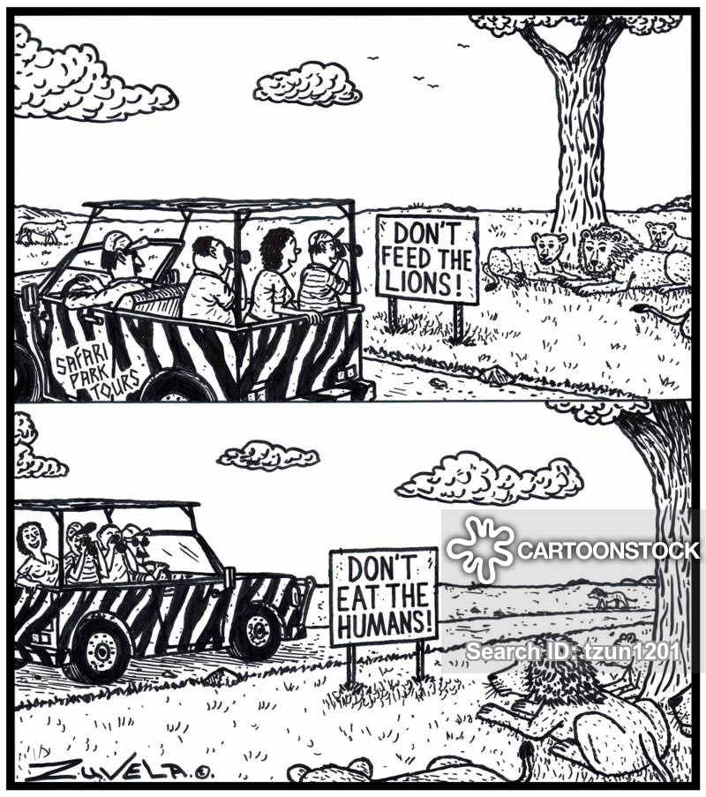
Double Underscores and Name Mangling
A variable name prefaced with double underscores (Dunder) is a way of saying “STAY AWAY”.
Python makes it difficult to access this variable through Name Mangling , that means you can only access it by prefacing it with the class names and some more underscores.
Since it’s a bother to access the variables developers are discouraged from detecting them and going near them.
class Cat:
def __init__(self, age):
self.__age = age
…
my_cat = Cat(10)
my_cat.age = 5 #doesn’t change cat __age
my_cat._Cat__age = 5 # Okay, but not good form

Slide 36
Special method #2: __repr__(self)
__repr__(self)
Is the same as Java’s toString
Should contain unambiguous information about the current state of the object
Is implicitly called when we pass an object to the print( ) function
This is really for developers’ eyes
Think of the information that should be in a log file
Method returns a string
“name: Tobias age: 3 food_prefs: ['Sushi', 'Raw fish'], num_lives: 9”
* Remember to say dunder for double under

Slide 37
Special method #3: __str__(self)
__str__(self)
Is also the same as Java’s toString
Should be the same as the repr, except perhaps a little prettier (not a single line)
Not required
If not provided, __repr__(self) will always be used
Method returns a string
“My name is Tobias and I'm 3 years old.
love eating ['Sushi', 'Raw fish']
I have 9 lives remaining”
* Remember to say dunder for double under

Slide 38
Instantiation
NameOfClass(__init__ arguments)
Invoking the constructor
Suppose we have a class called Die:
Instantiate a Die by typing Die()
This calls a special method called __new__(we never tamper with __new__ and we never call it directly)
__new__ allocates memory and invokes the object initializer
Die.__init__( ) is the initializer
__new__()
Memory allocation and object creation
__init__
Initialization

Slide 39
Accessors & Mutators
Accessors: Methods that return the value of an attribute Eg: def get_player_health(self):
Mutators: Methods that set the value of a data attribute Eg: def set_player_health(self, health_value):
Self parameter is the:
Only parameter for all accessors
First parameter for all mutators
Require docstring comments
Must not generate side effects
Accessors must not modify or print or send messages
Mutators may only modify a single value, and only if it remains logical

Slide 40
Properties vs Accessors / Mutators
A property is a way to encapsulate the getter (Accessor) and setter (Mutator) of an attribute.
Anyone interfacing the code with your library can still access the data attribute through a variable name.
The variable name automatically invokes the Accessor and Mutator.
Eg:
# set inside class definition temperature = property(get_temperature, set_temperature)
..
..
my_engine.temperature = 70 # this would invoke set_temperature(70)
property_example.py

Slide 41
Static (Class) Variables
Java instances share static variables
Are there statics in Python?
Yes!
Class variables are shared by all instances of a class
A class variable:
is declared inside the class but not inside a method
is accessible directly (remember no access variables!)
can be accessed using ClassName.class_variable

Slide 42
Class Methods
Class Methods are like Class Variables.
They belong to a class rather than the object.
They take cls as their first parameter instead of self
cls stands for the class itself.
Add @classmethod before method
Can modify and access class variables but not instance variables
While not quite like static functions, class methods can be accessed through the class name
@classmethod
def my_class_method(cls, arguments)

Slide 43
Class Methods
For example, say we had a temperature class that stored temperature as farenheit. We could write a class method that allows us to create objects using celcius
class Temperature:
def __init__(self, tempFarenheit):
self.temperature = tempFarenheit
@classmethod def from_celcius(cls, tempCelcius):
tempFarenheit = (tempCelcius * 9/5) + 32
return cls(tempFarenheit)
temp = Temperature.from_celcius(50)

Slide 44
Static Methods
The @staticmethod function decorator allows static functions to be defined.
Static functions belong to and can be accessed by the class and not the object.
Static functions do not require cls as its first parameter
In fact, static functions can’t access the class variables/object at all. They behave as independent functions within the scope of a class.
Eg:
@staticmethod
def convert_to_fahrenheit(tempCelcius):
farenheit = (tempCelcius * 9/5) + 32
return farenheit
Temperature.convert_to_fahrenheit(100)

Slide 45
Static Methods vs Class Methods
Hold on, Static Methods and Class methods seem pretty similar, what’s the difference?
Similarities:
Both are class level methods that are called on the class, NOT the instance
No need to instantiate an instance of the class before calling the method
class Temperature:
def __init__(self, tempFarenheit):
self.temperature = tempFarenheit
@classmethod def from_celcius(cls, tempCelcius):
# class method code
@staticmethod
def convert_to_fahrenheit(tempCelcius):
# static method code
# code is called on the class directly, not an instance
temp = Temperature.from_celcius(50) #call class method
Temperature.convert_to_fahrenheit(100) #call static method

Slide 46
Static Methods vs Class Methods
Hold on, Static Methods and Class methods seem pretty similar, what’s the difference?
Differences:
Static Methods – Purpose is to perform operation WITHOUT access to static class variables.
use @staticmethod decorator. Do NOT use cls as first parameter.
@staticmethod
def convert_to_fahrenheit(tempCelcius):
celcius = (tempCelcius * 9/5) + 32
return celcius
Class Methods – Purpose is to perform operation WITH access to static class
Use @classmethod decorator. Use cls as first parameter. cls parameter automatically passed in
@classmethod def from_celcius(cls, tempCelcius):
tempFarenheit = (tempCelcius * 9/5) + 32
return cls(tempFarenheit)

Slide 47
All the concepts together!
Let’s check out cat.py
Class declaration
Instance/class variables
Initializer (self)
Instantiation
Methods
Static, class methods (cls)
_ (‘private’ variables)
__ (dunder)

Slide 48
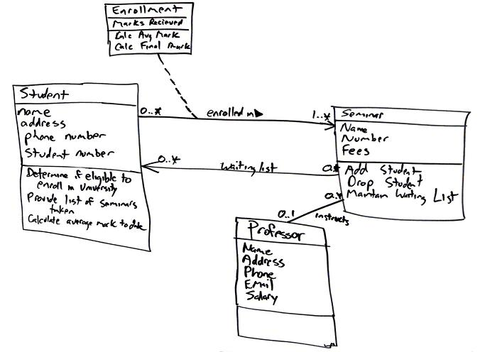
Designing classes (and functions, too!)
Design before you code!
Every class needs to be well-defined:
Represents a single clear concept
Maintain information by storing data in instance variables
Perform actions by executing code in their methods and modifying the state of the program
Don’t duplicate data
Don’t store more than we need
Minimize “moving parts”

Slide 49
Designing classes (and functions, too!)
Be thoughtful about identifiers:
Think of names as documentation
Invest time in finding the most appropriate names
Use similar names for similar things, and different names for different things
Make names pronounceable
The source code should tell its own story
Public names should be understandable without knowing the internals
Don’t joke with names

Slide 50
OOP = Collaboration and composition
Remember that objects are (usually) team players
When some other object already has the data and logic for performing a task, we delegate the work to it
We say that the objects collaborate
An object will often store its collaborators as its data attributes, because it refers to them frequently throughout its lifetime
An object is composed of collaborators that it trusts with some of its specific responsibilities

Slide 51
OOP PRINCIPLES

Slide 52
What Makes OOP
Object-oriented programming (OOP) is a programming paradigm that uses abstraction to create models based on the real world
OOP uses several techniques from previously established paradigms, including:
Modularity and abstraction
Encapsulation
Inheritance
Polymorphism.

Slide 53
Encapsulation (and information hiding)
Encapsulation:
Putting data with the functions that manage it
Wrapping them up in an impenetrable barrier of privacy (A class or a module)
Making state change is reliable and predictable
Information hiding:
Making a distinction between what is private (how a class’ behaviors are implemented) and what is public (what you need to know in order to use the class correctly)
Making the inner working inaccessible
Exposing only the things that absolutely MUST be exposed

Slide 54
An encapsulated object can be thought of as a black box
The inner working are hidden from the client object
The client object invokes the methods of the object, which manage the instance data
Another related term is Information Hiding

Slide 55
It’s All About The Interface
The methods and data of one object that are visible to other objects and parts of the system is known as the public interface of that object
Good OOP Design is centered around creating meaningful and maintainable interfaces.
Client
Object
or Function
Methods
Data
public methods
a.k.a The object’s interface

Slide 56
Public vs private
We like to expose a public interface
The interface is how we interact with an object
But some things should be private!
We say the implementation is private
An object’s data is conceptually private
How can we enforce privacy in Python?
Do not generate accessors and mutators for every instance variables
Only fields that are part of an object’s public description should have accessor methods, and possibly mutator methods

Slide 57
Encapsulation in Python
We can “enforce” privacy with some conventions. Recall the _ and __ conventions!
In Python, we can preface private function and instance variable identifiers with two underline characters, i.e., __count
A private method is only intended to be used by other methods in a class
It is not intended to be visible or accessible outside the class
A private variable is only intended to be used inside the class, or the class’ methods
It is not intended to be visible or modifiable from outside the class

Slide 58
Encapsulation in Python
class Visibility: def public_func(self): print('public') def __private_func(self): print("private") def other_func(self): self.public_func() self.__private_func() v = Visibility() v.public_func() # public v.other_func() # public private v.__private_func() # ERROR 'Visibility' object has no attribute '__private'

Slide 59

Abstraction is another hot OOP buzzword
How do we use abstraction?
Divide a problem into sub-problems
Divide a sub-problem into sub-sub-problems
Keep doing this until the individual problems are small enough to solve
Solve the small problems
Ignore the details of the solutions and treat each one as a single encapsulated building block (abstract the details away)
Notes:
Abstraction is a technique for separating the interface of a class from its implementation. It allows you to focus on what a class does, rather than how it does it. The idea is to hide the implementation details from the user, so that the user can interact with the class only through its interface.

Slide 60
Modularization
Abstraction uses modularization.
Modularization is the process of dividing something into well-defined parts.
Encapsulation is about Classes and Objects. Modularization is about the system and the bigger picture.
Each of these modules:
Is built separately
Encapsulates data with the methods that act on it. This could be functions and multiple classes.
Can be examined separately
Interacts in well-defined ways.
This is what building systems is all about! How do we decide when to split or maintain an ‘entity’?
Notes:
Modularization is a software design technique that involves dividing a large, complex program into smaller, more manageable modules. Each module is a self-contained unit that performs a specific task and has a well-defined interface through which it communicates with other modules. Modularization makes it easier to develop, test, and maintain large programs by allowing you to work on one module at a time.
In object-oriented programming, abstraction and modularization are often used together to create reusable and modular code. Abstraction helps to hide the implementation details of a module from other parts of the program, while modularization helps to organize the code into smaller, more manageable units.
If an Entity isn’t focused to be one thing and it', need to split into different entities.
Modular programming (also referred to as modular architecture) is a general programming concept. It involves separating a program's functions into independent pieces or building blocks, each containing all the parts needed to execute a single aspect of the functionality

Slide 61
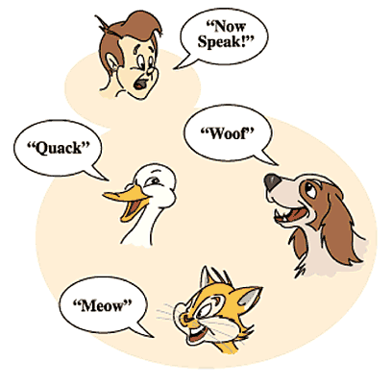
Polymorphism
Polymorphism is the ability of our system/object/functions/code to function differently and be context-aware
Context-Aware: When given the same interface, or command, your code behaves differently based on what kind of data and environment it’s working on.
Eg:
5 + 4 = 9
“5” + “4” = “54”
The + operator exhibits polymorphism.
Duck Typing is one way to exhibit polymorphism.

Slide 62
Inheritance and polymorphism
The kernel of OOP
The most important part of OOP
Polymorphism gives us absolute control over every source code dependency in the system
It creates a plugin architecture in which modules that contain high level policies are separate from modules which contain low-level details
This lets us use abstraction and modularization to make our code units independently flexible, maintainable, and growable!
We’ll see all this in action in the coming weeks. If this doesn’t make sense, don’t worry!
We’ll come back to this and have a discussion around it towards the end of the semester

Slide 63

Next class
Ranges & Slices
Scope (Python Fundamentals End)
Inheritance
Abstract Base Classes
UML
Lots of fun stuff!

